Slide 2
Application of laser sintering in dentistry
Assist prof.Ali Jameel

Slide 3
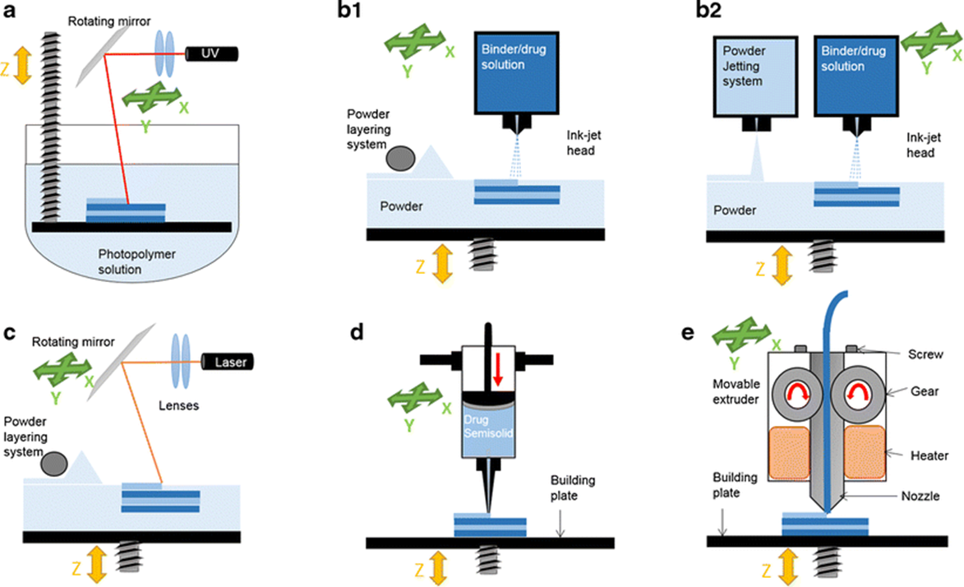
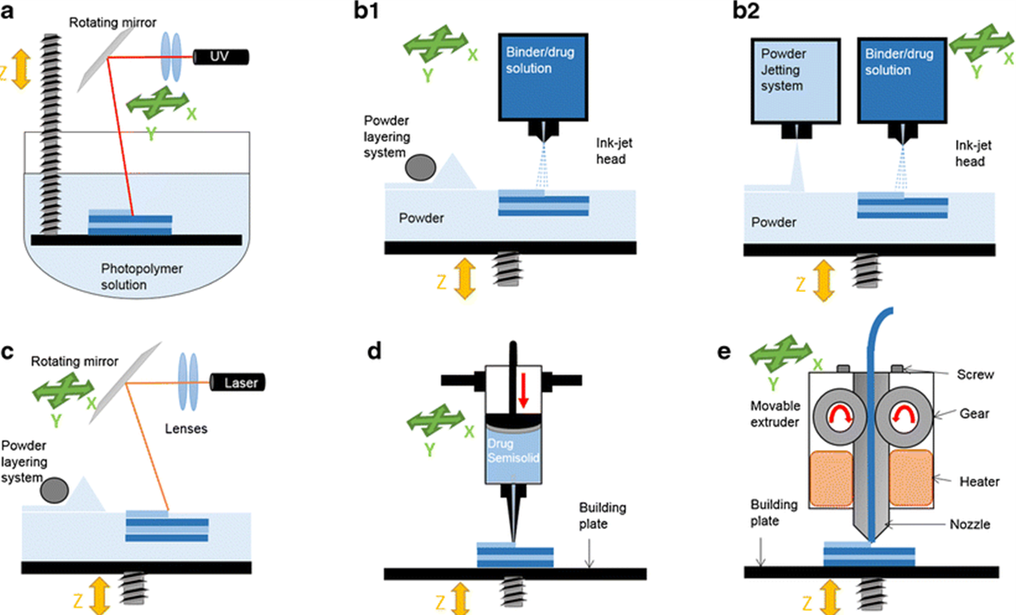
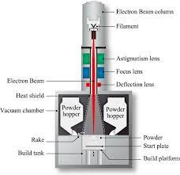
TYPES OF 3D PRINTING
Selective Laser Sintering (SLS)
Fused Deposition Modeling (FDM)
Digital Light Process (DLP)
Multi Jet Fusion (MJF)
Direct Metal Laser Sintering (DMLS)
Electron Beam Melting (EBM)

Slide 4
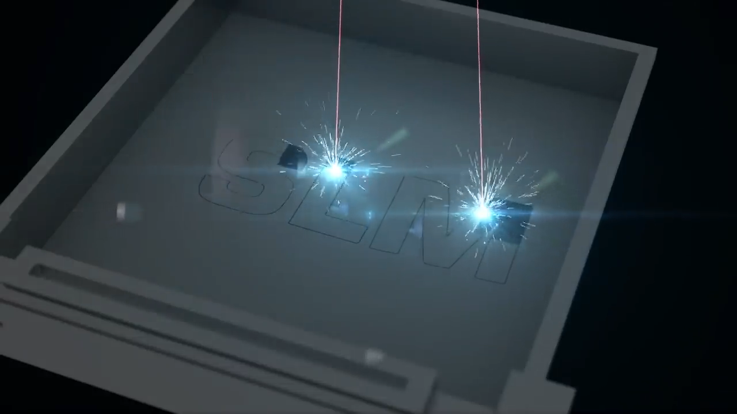
Definition
laser sintering (laser 3D printing)
Selective laser sintering (SLS) is an additive manufacturing method that use a laser as a power sources to sinter powdered material bed fusion process or a liquid polymers to build layer by layer parts under computer control to create three dimensional object.

Slide 5
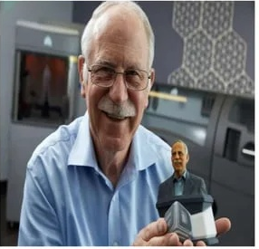
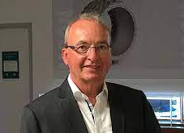
History
In 1984 Charles Hull an American Engineer developed the world‘s first working 3D printer
SLS its powder bed fusion technologies, started in 1995 at the Fraunhofer Institute ILT in Aachen, Germany, as a research project of Dr. Dieter Schwarze

Slide 6
Types of SLS 3D Printers
Selective Laser milting (SLM)
Additive layer manufacturing ( ALM)
Stereolithography (SLA)
The main differences between them are the type of laser, the size of the build volume, materials used and the complexity of the system.

Slide 7
Materials used
Metals like silver, steel, titanium
Resin like polymers ,polyamide (nylon),glass, filled polyamide, epoxy resins ,photopolymers, polycarbonate
Ceramics like hydroxyapatite
Organic materials such as cells, wood, and chocolate

Slide 8
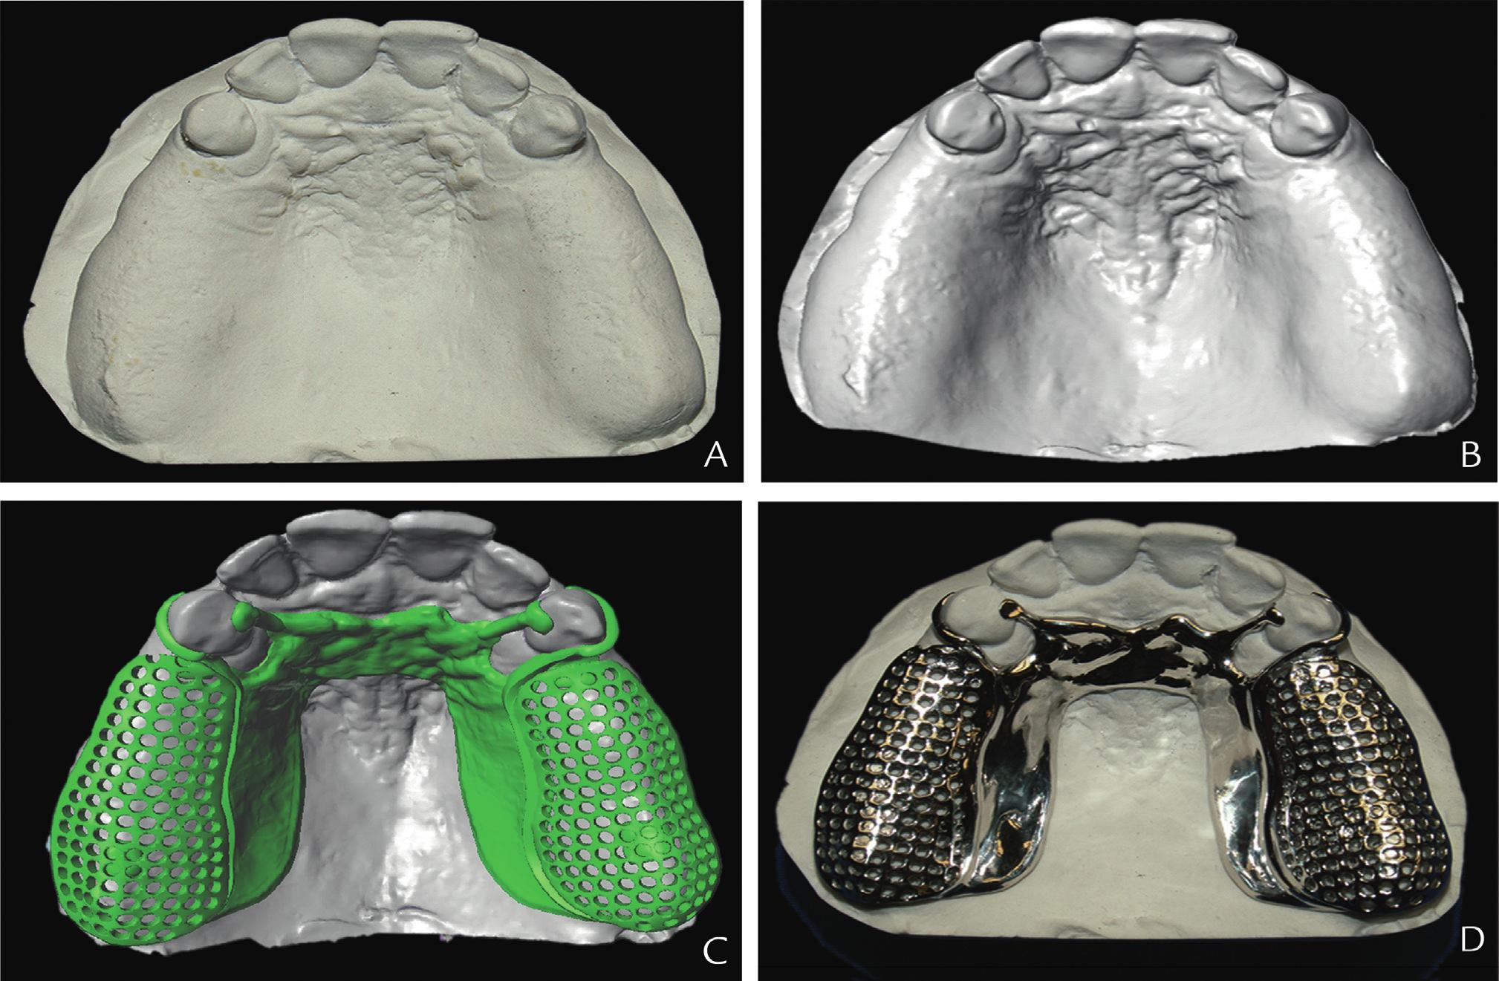
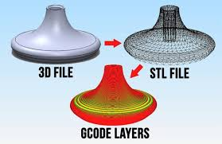
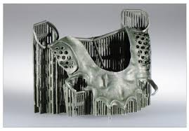
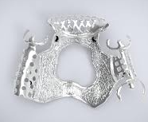
steps of 3d printing process
1
2
3
design
3D model is developed using CAD software
Slicing
CAD model broken into layers converted into an STL/AMF file
Printing
File transfer, positioning and printing of design layer by layer
4
Post-processing
Curing surface finishing etc…
5
Final product
Final product

