Slide 1
GPT chat lec Zainab a azeez

Slide 2
What is GPT chat

Slide 3
(Chat Generative Pre-trained Transformer) is an artificial intelligence chatbot that uses natural language processing that can respond to human input in a conversational manner

Slide 4
It had become the fastest-growing consumer software application in history.
Chatgpt is available for use online
Chatgpt was released as a freely available research preview,
Function is to mimic a human conversationalist, chatgpt is versatile. Among countless examples, it can write and debug computer programs; compose music, teleplays, fairy tales, and student essays; answer test questions

Slide 5
In dentistry

Slide 6
it is used in diagnoses and for assessing disease risk and scheduling appointments. It also has a role in scientific research. In the dental field, it has provided many benefits such as detecting dental and maxillofacial abnormalities on panoramic radiographs and identifying different dental restorations. Therefore, it helps in decreasing the workload.

Slide 7
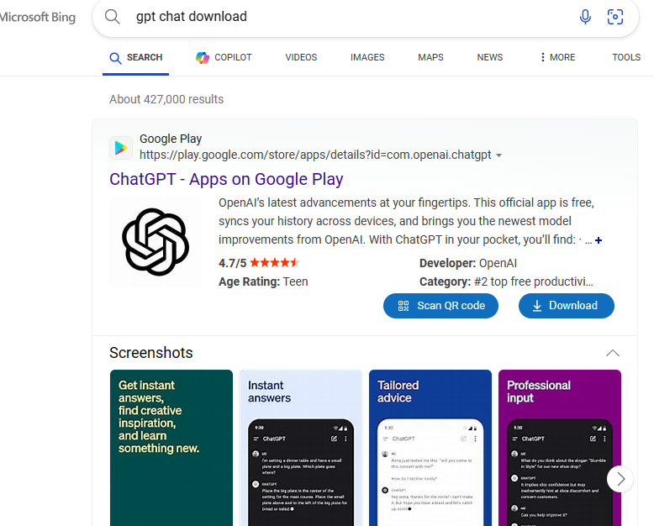

Slide 8
To get started with ChatGPT

Slide 9
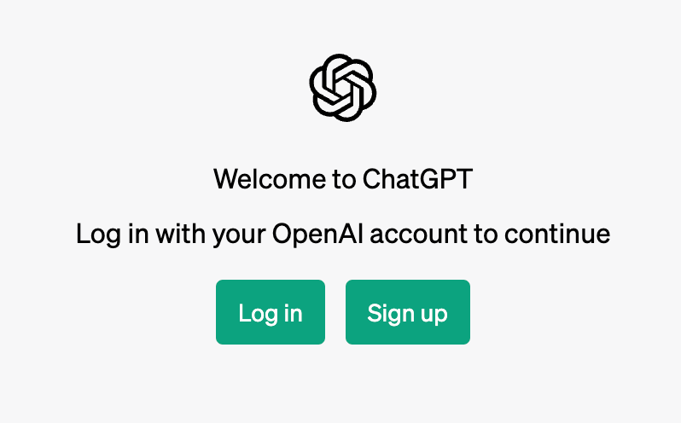
1. Opening a new OpenAI Account

Slide 10
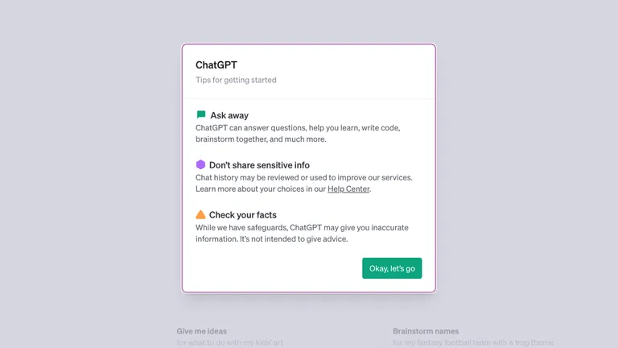
2. Read through the tips and disclaimers from ChatGPT

Slide 11
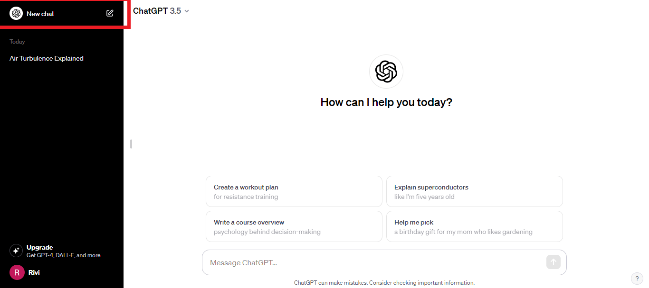
3. Get started with ChatGPT

Slide 12
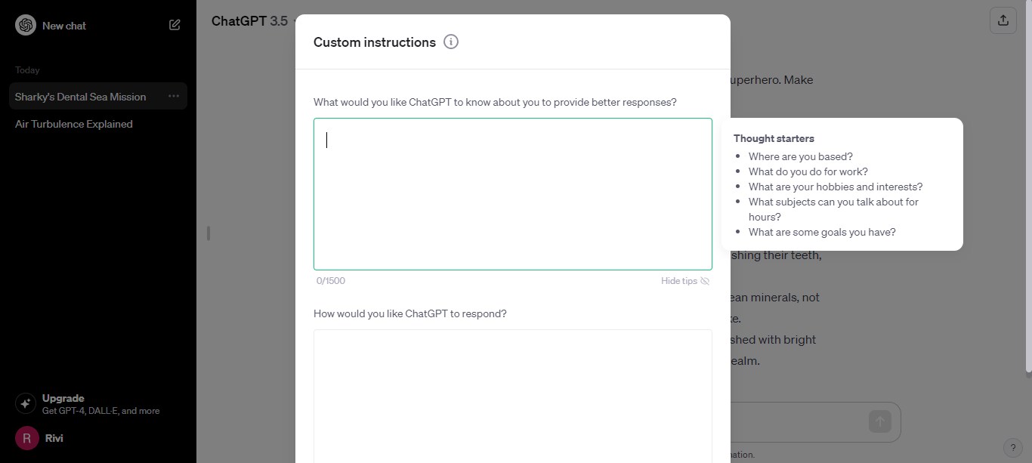

Slide 13
While ChatGPT’s ability to generate text and answer questions is impressive, not every response it gives may be accurate. It may take some trial and error to get the answer you are looking for
Provide enough context
Asking the AI to assume an identity or profession
Outline the output specifications
Provide additional reference material upfront
Provide examples that the AI can emulate

Slide 14
Note:
When using ChatGPT, think of it as conversing with another friend. Be very detailed when explaining what you want it to do for you.

Slide 15
limitation
ChatGPT does not write anything past 2021
It does not predict future events
It does not take a particular political stand
It does not search the Internet
It does not break copyright laws
It cannot help you hack into private data
It cannot help you create malicious programs

Slide 16
Conclusion
ChatGPT stands out as the innovation that broke the mold for the age of AI. Irrespective of your industry, you can employ this tool to improve your efficiency and speed in various ways. You only need an email account to get started. To avoid any delays that may occur during peak times

Slide 17
References
1. How does ChatGPT perform on the United States medical licensing examination? the implications of large language models for medical education and knowledge assessment. Gilson A, Safranek CW, Huang T, Socrates V, Chi L, Taylor RA, Chartash D. JMIR Med Educ. 2023;9:0. [PMC free article] [PubMed] [Google Scholar]
2. Can ChatGPT be used in oral and maxillofacial surgery? Balel Y. J Stomatol Oral Maxillofac Surg. 2023:101471. [PubMed] [Google Scholar]
3. Implications of large language models such as ChatGPT for dental medicine. Eggmann F, Weiger R, Zitzmann NU, Blatz MB. J Esthet Restor Dent. 2023:1–5. [PubMed] [Google Scholar]
4. Artificial intelligence systems assisting in the assessment of the course and retention of orthodontic treatment. Strunga M, Urban R, Surovková J, Thurzo A. Healthcare (Basel) 2023;11:683. [PMC free article] [PubMed] [Google Scholar]

