Slide 1
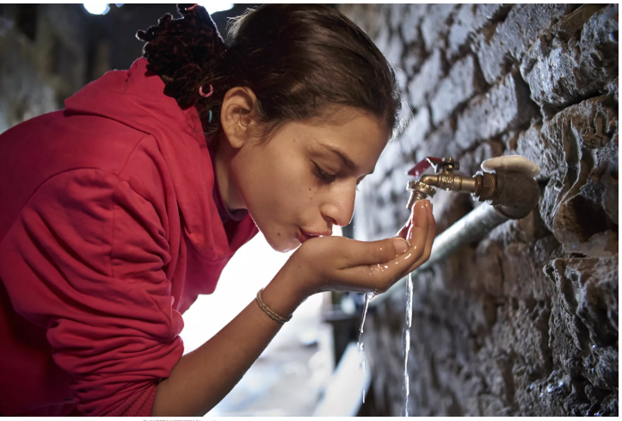
Sustainable approach for water desalination
Presenter: Dr. Safaa A. Ali Al-Obaid

Slide 2
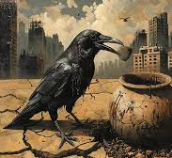
According to UN-Water, 2.3 billion people, or one in four of the world’s population, live in water-stressed countries.
By 2030, 700 million people could be displaced by intense water scarcity.
By 2040, roughly 1 in 4 children worldwide will be living in areas of extremely high-water stress
Notes:
craw

Slide 3
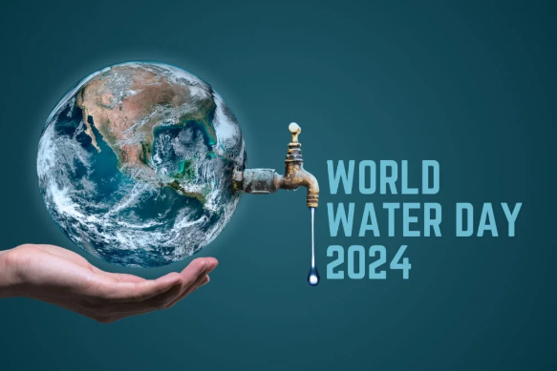
World Water Day is an annual United Nations observance day held on the 22nd of March that highlights the importance of fresh water.

Slide 4
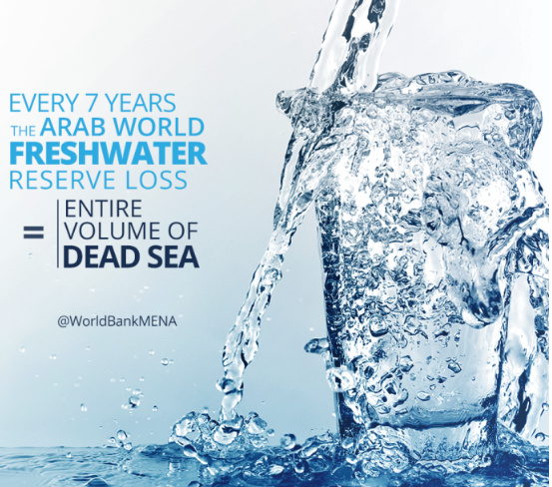
Water stress in the Middle East
Seven out of the 10 most water-stressed nations are in the Middle East and North Africa. In those countries, the average water stress level is 820 percent, which means that the annual water withdrawal is eight times higher than the water supply from renewable resources.
The Middle East has a predominantly dry and arid climate with low rainfall and high temperatures. To provide their residents with enough water, several countries in the region, particularly in the Gulf, rely on desalination, a process that removes salt from seawater.

Slide 5
Did you know noticed that some lake vanished recently?
Disappearing lakes
Rising temperatures, an increased demand for water and the construction of dams have led to several lakes shrinking across the Middle East. Two notable disappearing lakes are Lake Urmia in Iran and Lake Sawa in Iraq.

Slide 6
Lake Sawa, Iraq
Lake Sawa has now completely dried up after consecutive years of severe drought. Rising temperatures and a drastic decrease in the water levels of the Tigris and Euphrates rivers have caused extreme droughts across the county of 43 million people.
The timelapse video below shows how much the lake has evaporated since 2011.
Lake Urmia, Iran
Lake Urmia was once the largest lake in the Middle East and the sixth-largest saltwater lake on Earth. It is located in northwestern Iran and has now all but dried up to become a salt plain.
The timelapse video below shows how much the lake has evaporated since the 1980s.

Slide 7
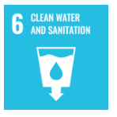
Demonstrating our commitment to the Sustainable Development Goals
Renewable energy comes from sources that the earth can naturally replenish, such as crops and biomatter. Sustainable energy comes from sources that don't need to be replenished because they can never be depleted, such as sunlight and wind energy.

Slide 8
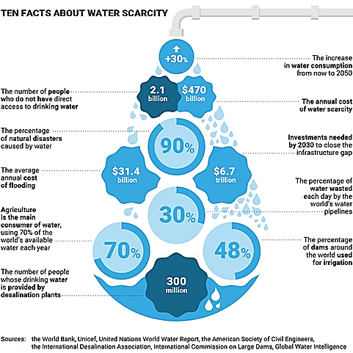

Slide 9
`
How important is desalination?
Desalination is an industrial process that transforms salt water from seas and oceans into drinking water. Desalination plants are used by 300 million people in 150 countries. Most of the world’s plants are in countries located in the Gulf, where treated water supplies 90% of the amount used for domestic purposes.

Slide 10
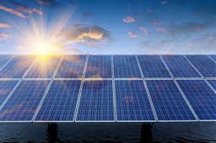
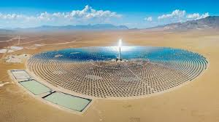
What is renewable energy?
Energy derived from natural sources that are replenished at a higher rate than they are consumed.
SOLAR ENERGY
Solar energy is the most abundant of all energy resources and can even be harnessed in cloudy weather. The rate at which solar energy is intercepted by the Earth is about 10,000 times greater than the rate at which humankind consumes energy.

Slide 11
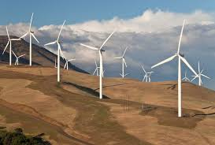
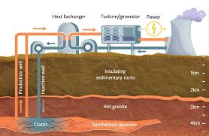
WIND ENERGY
Wind energy harnesses the kinetic energy of moving air by using large wind turbines located on land (onshore) or in sea- or freshwater (offshore).
GEOTHERMAL ENERGY
Geothermal energy utilizes the accessible thermal energy from the Earth’s interior. Heat is extracted from geothermal reservoirs using wells or other means.

Slide 12
HYDROPOWER
Hydropower harnesses the energy of water moving from higher to lower elevations. It can be generated from reservoirs and rivers. Reservoir hydropower plants rely on stored water in a reservoir, while run-of-river hydropower plants harness energy from the available flow of the river.
Hydropower currently is the largest source of renewable energy in the electricity sector.
OCEAN ENERGY
Ocean energy derives from technologies that use the kinetic and thermal energy of seawater - waves or currents for instance - to produce electricity or heat.

Slide 13
BIOENERGY
Bioenergy is produced from a variety of organic materials, called biomass, such as wood, charcoal, dung and other manures for heat and power production, and agricultural crops for liquid biofuels.

Slide 14
Microbial desalination cell (MDC)
Microbial Desalination Cell (MDC) is a novel technology able to produce sustainable drinking water by using the energy provided from the metabolism of electroactive bacteria when organic matter is degraded

Slide 16
Electrolysis sea water `

Slide 17
https://www.aljazeera.com/news/2023/3/22/world-water-day-mapping-water-stress-across-the-middle-east

