Slide 1
Multiple Scrolosis
اعداد : م.م مياسة عبد الله

Slide 2
Multiple sclerosis (MS)
is a condition that can affect the brain and spinal cord, causing a wide range of potential symptoms, including problems with vision, arm or leg movement, sensation or balance.

Slide 3
Multiple sclerosis (MS)
It's a lifelong condition that can sometimes cause serious disability, although it can occasionally be mild.
In many cases, it's possible to treat symptoms. Average life expectancy is slightly reduced for people with MS.

Slide 4
Multiple sclerosis (MS)
It's most commonly diagnosed in people in their although it can develop at any age. It's about 2 to 3 times more common in women than men.
MS is one of the most common causes of disability in younger adults.

Slide 5
Symptoms of multiple sclerosis
The symptoms of MS vary widely from person to person and can affect any part of the body.
The main symptoms include:
fatigue
difficulty walking
vision problems, such as blurred vision
problems controlling the bladder
numbness or tingling in different parts of the body
muscle stiffness and spasms
problems with balance and co-ordination
problems with thinking, learning and planning

Slide 8
What causes multiple sclerosis?
MS is an autoimmune condition. This is when something goes wrong with the immune system and it mistakenly attacks a healthy part of the body – in this case, the brain or spinal cord of the nervous system.

Slide 9
In MS, the immune system attacks the layer that surrounds and protects the nerves called the myelin sheath.
This damages and scars the sheath, and potentially the underlying nerves, meaning that messages travelling along the nerves become slowed or disrupted.

Slide 10
Exactly what causes the immune system to act in this way is unclear, but most experts think a combination of genetic and environmental factors is involved.

Slide 11
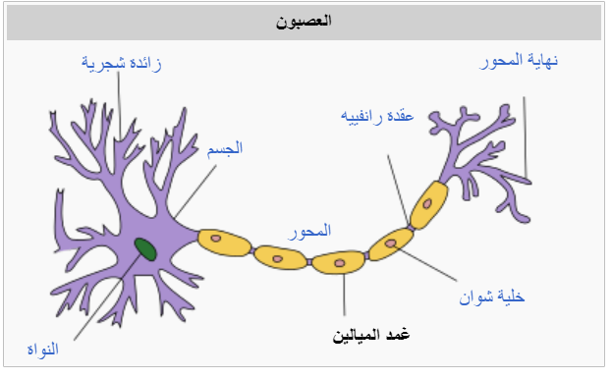
Myelin
is an insulating layer, or sheath that forms around nerves, including those in the brain and spinal cord. It is made up of protein and fatty substances.
This myelin sheath allows electrical impulses to
transmit quickly and efficiently along the nerve cells. If myelin is damaged, these impulses slow down.

Slide 12
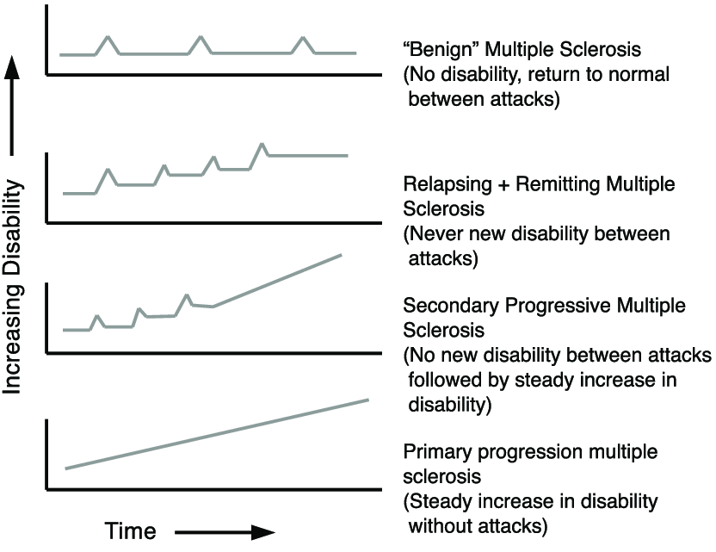
Type of multiple sclerosis
Diagram representing the different types of multiple sclerosis.

Slide 13
Diagnosis of multiple sclerosis
Blood tests, to help rule out other diseases with symptoms like MS. Tests to check for specific biomarkers associated with MS are currently under development and may also aid in diagnosing the disease.
Spinal tap (lumbar puncture), in which a small sample of cerebrospinal fluid is removed from your spinal canal for laboratory analysis. This sample can show abnormalities in antibodies that are associated with MS. A spinal tap can also help rule out infections and other conditions with symptoms like MS. A new antibody test (for kappa free light chains) may be faster and less expensive than previous spinal fluid tests for multiple sclerosis.

Slide 14
MRI, which can reveal areas of MS (lesions) on your brain, cervical and thoracic spinal cord. You may receive an intravenous injection of a contrast material to highlight lesions that indicate your disease is in an active phase.

Slide 15
Evoked potential tests that record the electrical signals produced by your nervous system in response to stimuli may be done. An evoked potential test may use visual stimuli or electrical stimuli. In these tests, you watch a moving visual pattern, as short electrical impulses are applied to nerves in your legs or arms. Electrodes measure how quickly the information travels down your nerve pathways.

Slide 16
In most people with relapsing-remitting MS, the diagnosis is straightforward and based on a pattern of symptoms consistent with the disease and confirmed by brain imaging scans, such as an MRI.
Diagnosing MS can be more difficult in people with unusual symptoms or progressive disease. In these cases, further testing with spinal fluid analysis, evoked potentials and additional imaging ma

Slide 17
Treatments for MS attacks
Corticosteroids, such as oral prednisone and intravenous methylprednisolone, are prescribed to reduce nerve inflammation. Side effects may include insomnia, increased blood pressure, increased blood glucose levels, mood swings and fluid retention.

Slide 18
Plasma exchange (plasmapheresis). The liquid portion of part of your blood (plasma) is removed and separated from your blood cells. The blood cells are then mixed with a protein solution (albumin) and put back into your body. Plasma exchange may be used if your symptoms are new, severe and haven't responded to steroids.

Slide 19
Interferon beta medications: These drugs used to be the most prescribed medications to treat MS. They work by interfering with diseases that attack the body and may decrease inflammation and increase nerve growth. They are injected under the skin or into muscle and can reduce the frequency and severity of relapses.

Slide 20
Physical therapy: A trained health care professional can teach you exercises that help you stay active. You might also learn how to use a cane, walker, or other assistive device to get around more easily.

Slide 21
Lifestyle Changes
Medications aren’t the only answer. Taking good care of yourself will help you live better with MS. Every day, make sure you:
Get plenty of rest: Keep a regular sleep schedule and make sure your bedroom is cool, dark, and screen-free.

Slide 22
Eat healthy food: There is no “MS diet.” Choose foods low in saturated fats and high in fiber. The U.S. Department of Agriculture’s MyPlate website is a good starting point.
Get some exercise: Even a walk around the block can help. Exercise builds bones and strengthens muscles. It keeps depression at bay and helps you sleep better.

Slide 23
Manage your stress: It may make your symptoms worse. Whether you meditate, read, journal, or chat with friends, find something that helps you control the ups and downs.
Stay cool: A rise in body temperature can make your symptoms worse. Stay in the AC if you can. Wear loose, breathable clothes outside.

Slide 24
Thank you for listening

