Slide 1
Rampant Caries
Lec. Juman Dhia Al-khayoun
Pedodontic and preventive Dentistry

Slide 2
Definition of Rampant Caries
Rampant caries has been defined by Massler as a "suddenly appearing, widespread, rapidly burrowing type of caries, resulting in early involvement of the pulp and affecting those teeth usually regarded as immune to ordinary decay”.
In epidemiologic studies, rampant caries is defined as a decayed, missed and filled teeth (DMFT) value of 5 or more, and labial caries is regarded as a specific entity.

Slide 3
Etiology of Rampant Caries
Four things are required for caries formation:
Bacteria
time
Tooth Surfaces
Fermentable Carbohydrates

Slide 4
There is no evidence that the mechanism of the decay process is different in rampant caries or that it occurs only in teeth that are malformed or inferior in composition.
On the contrary, rampant caries can occur suddenly in teeth that were previously sound for many years. The sudden onset of the disease suggests that an imbalance of the oral environment has occurred, and some factors in the caries process seem to accelerate it, so that it becomes uncontrollable; it is then referred to as rampant caries (Dean et al. ,2016).

Slide 5
Emotional disturbances
There is considerable evidence that emotional disturbances may be a causative factor in some cases of rampant caries.
Repressed emotions and fears, dissatisfaction with achievement, a traumatic school experience, and continuous general tension and anxiety have been observed in children and adults with rampant caries.
An emotional disturbance may initiate an unusual craving for sweets or the habit of snacking, which in turn might influence the incidence of dental caries.

Slide 6
Clinical appearance of Rampant Caries
The pattern of rampant caries in the primary dentition is usually related to the order of tooth eruption with the exception of the mandibular primary incisor. The mandibular incisors are probably more resistant to caries because of their close proximity to the secretions of the submandibular salivary glands as well as the cleansing action of the tongue during the process of suckling the bottle.
The initial lesion usually appears on the labial surface of the maxillary incisors, close to the gingival margins, as a whitish area of decalcification or pitting of the enamel surface shortly after eruption.

Slide 7
Clinical appearance of Rampant Caries
These lesions soon become pigmented to a light yellow and at the same time, extend laterally to the proximal surfaces and downward to the incisal edge.
Less commonly, the decalcification may present initially on the palatal surfaces, or even at the incisal edge in some cases.
At a more advanced stage, the carious process will often extend around the circumference of the tooth, leading to pathologic fracture of the crown on minimal trauma.
Other teeth, namely the first primary molars, the second primary molars, and the canines, will gradually become involved.

Slide 8
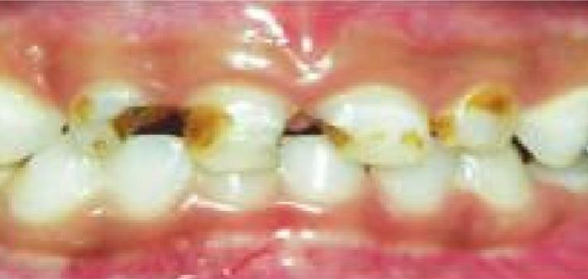
Clinical appearance of Rampant Caries
Nursing bottle caries is a form of rampant dental caries in the primary dentition of infants and children. In most cases, the problem is found in an infant who frequently falls asleep with a baby bottle filled with milk or sugar containing substances like vitamin C syrup, sweetened fruit juice, or even carbonated drinks.
The condition can also be associated with breastfed infants who have prolonged feeding habits or with children whose pacifiers are frequently dipped in honey, sugar, or syrup.
The decrease in salivary flow rate during sleep, as well as the pooling of sweet fluids around the teeth, results in a highly cariogenic environment.

Slide 9
Clinical appearance of Rampant Caries
Rampant caries may also occur in the permanent dentition of teenagers, because of their frequent intake of cariogenic snacks and sweet drinks between meals. Typical rampant caries in adolescents is characterized by buccal and lingual caries of premolars and molars and proximal and labial caries in the mandibular incisors.
A specific form of rampant caries may occur in children and adolescents who have a greatly reduced salivary flow as a result of radiotherapy for the treatment of cancer of the head and neck region or as a result of the surgical removal of neoplasm in the oral cavity, this is called radiation caries

Slide 10
Classification of rampant caries
Rampant caries is classified according to Garg and Garg, (2010) of following three types:
1- Early childhood caries is a term used to describe dental caries present in the primary dentition of young children.
2- Bottle caries or nursing caries are names used to describe a particular form of rampant caries in the primary dentition of infants and young children. The clinical pattern is characteristic, with the four maxillary deciduous incisors most severely affected.
3- Xerostomia induced rampant caries (radiation rampant caries) are commonly observed that after radiotherapy of malignant areas of or near the salivary glands. Because of radiotherapy salivary flow is very much reduced. This results in rampant caries even in those teeth which were free from caries before radiotherapy.

Slide 11
Classification of Early Childhood Caries
Classification of ECC by Wayne (1999)
1- Type I-------------- Mild-to-moderate
Clinical features
Existence of isolated carious lesion involving molars and incisors
Number of carious teeth increase as cariogenic challenge persists
Cause is usually a combination of cariogenic semi-solid food and lack of oral hygiene
Seen in 2–5 years old

Slide 12
Classification of Early Childhood Caries
2- Type II---------- Moderate-to-severe
Clinical features
Labiolingual carious lesion affecting maxillary incisors
Mandibular incisors are not affected
Use of feeding bottle or at will breastfeeding or a combination of both with or without poor oral hygiene
Seen soon after eruption of teeth
3- Type III------- Severe
Clinical features
Carious lesions affecting all the teeth including lower incisors
Cause is cariogenic food and poor oral hygiene
Condition is rampant

Slide 13
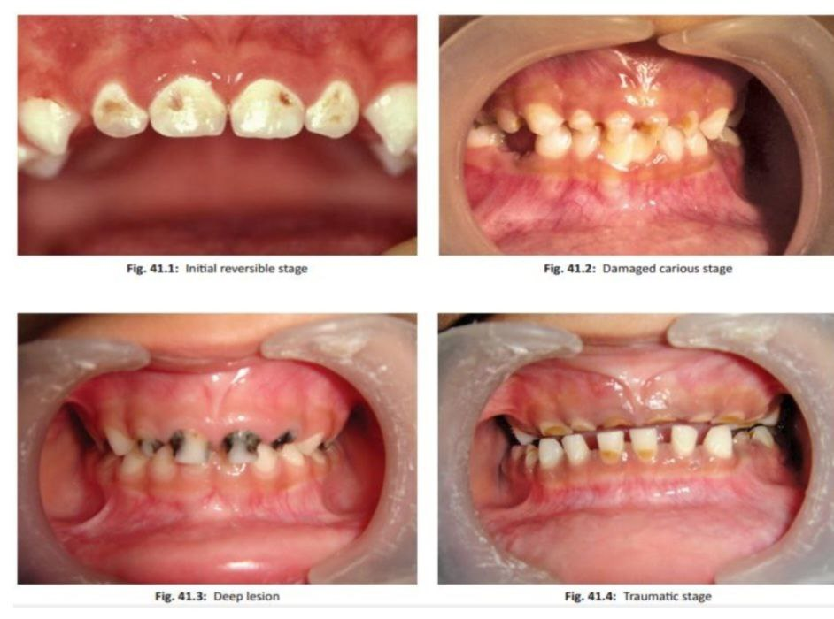
Stages in development of Nursing Bottle Caries

Slide 14
Classification of rampant caries
Rampant caries in adult ( adolescent rampant caries):
Adult severe caries cases as patients aged 16 years or older with multiple open coronal carious cavities (at least 8), including caries of an anterior tooth (mandibular or maxillary incisor, or canine).
When found in adults, it is often associated with conditions that cause salivary gland hypofunction, e.g. irradiation of salivary glands, use of antisialogogic drugs, as well as substance abuse, Psychogenic disorders, such as late-life depression, and autoimmune diseases, and it is one of the oral manifestations of HIV/AIDS.

Slide 15
Consequences of rampant caries
Caries can lead to pain, inability to chew, and reduced ability to chew and eat. In the case of pulpal involvement, the abscess developed can potentially damage permanent teeth and incur enamel opacities, hypoplasia, or incomplete development.
Premature loss of deciduous teeth can lead to reduced dental arch, tooth displacement, tilting, and rotations. Early loss of teeth results in difficulty in phonetics, affecting normal language.
ECC is associated with a higher risk of new carious lesions in both the primary and permanent dentitions. Early onset of caries is associated with future caries development.
Hospitalizations and emergency room visits are required to manage pain and spreading of infections due to caries.

Slide 16
THANK YOU

