Slide 2
Nitrous Oxide Sedation in Dentistry done by Lecturer Noor Ahmed

Slide 4
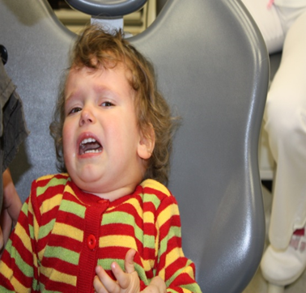

Slide 6
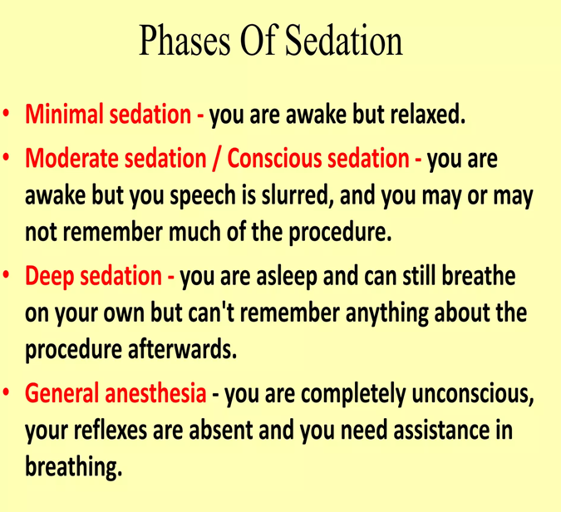

Slide 8
Inhalation Sedation

Slide 12
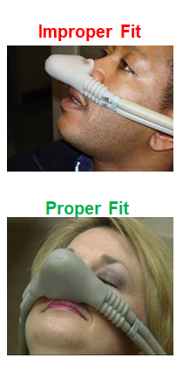
Exposure Controls
Proper work practices, training, patient and equipment management are part of administrative controls and contribute to controlling N₂O exposure to you
Inspect delivery system prior to N₂O administration
Check connections, breathing bags, hoses and clamps.
Do not fill breathing bag to capacity
Over inflation can cause excessive leakage from the mask
The bag should collapse and expand as the patient breathes
Flush the system of N₂O after the procedure by administering O₂ to the patient for five minutes before disconnecting the gas delivery system

Slide 13
ANATOMIC & PHYSIOLOGICAL DIFFERENCES IN CHILDREN
Difference in BASAL METABOLIC RATE. Greater in children, which ultimately affects not only the drug response, but also important physiologic parameters.
Difference in RESPIRATORY RATE. Because oxygen demand is greater, but the alveolar system is less mature, the respiratory rate is far higher in children than adults. So, it must be considered when giving drugs that depress the respiratory system.

Slide 14
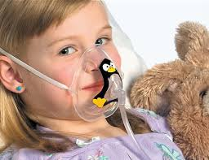
AIRWAY MANAGEMENT is different because of anatomic variations. The narrow nasal passages, glottis, hypertrophic tonsils & enlarged tongue produce a much greater risk of airway obstruction.
The airway of all patients should be examined prior to sedation. Patients with tonsillar tissue that occupies more than 50% of pharyngeal space are at an increased risk of respiratory obstruction.

Slide 15
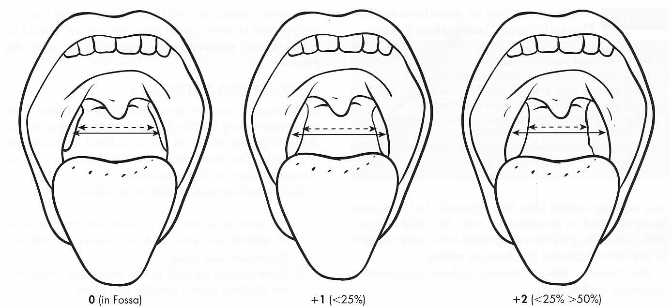
Standardized system for evaluation of tonsillar size
Classification of tonsil size should be completed for all patients prior to sedation. Patients classified as +3 or greater (having more than 50% of the pharyngeal area occupied by tonsils) are at increased risk of developing airway obstruction.

Slide 16
Children demonstrate a reduced tolerance to respiratory obstruction.
Thus, sudden APNOEA is a great concern in pediatric age group. Because thorax is smaller, with less expansion capability & children have less functional reserve. So, are prone to rapid obstruction or respiratory depression.
For this reason children with sleep apnea are not good candidates for conscious sedation.

Slide 17
Relative Contraindications
bronchitis, emphysema
Otitis Media
Severe emotional disturbances
Claustrophobia or irrational fear of “gas”
Maxillofacial deformities or nasal obstructions
Pregnant patients-especially in first trimester

Slide 18
Remember!
Nitrous oxide is not a substitute for traditional behavior management techniques
It should be considered an adjunct to aid in the management of the mild to moderately anxious patient who is capable of cooperating in the dental chair

