Slide 2
Neuronal cell death in the central nervous system has always been a challenging process to decipher. In normal physiological conditions, neuronal cell death is restricted in the adult brain, even in aged individuals. However, in the pathological conditions of various neurodegenerative diseases, cell death and shrinkage in a specific region of the brain represent a fundamental pathological feature across different neurodegenerative diseases

Slide 3
Neuronal cell death used to be an enigmatic area of study. After decades of the molecular dissection of the mechanism, it is now acknowledged that, in most cases, neuronal cell death is the outcome after a neuron activates well-orchestrated programs in order to terminate its existence, a process that can be triggered by internal or external signals throughout the cell’s lifetime. During the development of the human central nervous system (CNS), neurogenesis is often accompanied by massive neuronal loss, a necessary part of constructing a functionally adequate command center [1]. In spite of occasional or arranged death events, extensive neuronal loss rarely occurs in mature CNSs [2]. During the aging process, neuronal loss is still limited, albeit in certain brain regions, observable differences of neuron numbers between young and old individuals may exist [3,4,5,6]. However, in many neurodegenerative diseases, a significant increase in neuronal loss occurs compared to age-matched controls, which also correlates with longitudinal examinations of disease progression

Slide 4
Characteristics of neurodegenerative diseases are often linked to pathological protein formation and, in many cases, high-order aggregate formation [15,16,17]. These factors often place stress onto neurons and render subsequent cytotoxic events, which include an increased number of reactive oxygen species (ROS), excitotoxicity, synaptic dysfunction, impaired protein degradation systems, endoplasmic reticulum (ER) stress, DNA damage, mitochondrial dysfunction, inflammation and cell cycle re-entry [18]. These are all major neuronal challenges and their mishandling eventually causes neurons to die. However, the underlying signaling mechanisms of how these factors induce the initiation of cell death remain elusive.

Slide 5
Types of Cell Death
In neurodegenerative diseases, apoptosis and necrosis are believed to be the two major death pathways for neurons [19,20]. The fundamental differences between apoptosis and necrosis lie in the disparity of cell morphology and whether the cellular contents leak out during the process [20,21].

Slide 7
1. Apoptosis
Apoptosis is a type of programmed cell death (PCD). The cytomorphological features of an apoptotic cell include shrinkage, chromosome condensation and DNA fragmentation [22,23,24]. During this process, apoptotic bodies eventually form in many cases and cellular contents generally do not leak out, which is believed to minimize the eliciting of immunological responses [25]. Fragmented DNA can indicate the possible existence of apoptosis, which can occur late-phase and can be detected by terminal deoxynucleotidyl transferase dUTP nick end labeling (TUNEL) assays, either in vivo or in situ

Slide 8
2.Necrosis
Necrosis, which is an alternative mechanism of cell death, is signified by the swelling of a cell; thus, the integrity of the cell membrane is lost and the intracellular contents leak out. DNA breakage is also involved in the degradation process; however, necrosis does not involve chromosome condensation [21,36]. Therefore, the pathological features of necrosis can be differentiated from those of apoptosis [37]. The necrosis death pathway has also emerged as a type of active PCD. Among these pathways, the best-characterized one is termed “necroptosis” [38,39].

Slide 9
In the past, necrotic cell death has been considered an event without genetic determinants since it is not programmed. However, the discovery that the tumor necrosis factor (TNF) can induce necrosis suggests otherwise. Indeed, the activation of specific death receptors or Toll-like receptors lead to the initiation of necroptosis [39]. The activation of death receptors, such as TNF alpha receptor 1, lead to the recruitment of a series of proteins, including the cellular inhibitors of apoptosis 1 and 2 (c-IAP1/2) and RIP1, namely RIPK1, which forms protein complex 1. Subsequently, RIP1 is translocated into the cytosol and interacts with RIP3 in the necrosome, which indicates the initiation of necroptosis [7,40]. RIP3 can phosphorylate the mixed lineage kinase-like pseudokinase (MLKL), the executor of the pathway that translocates to the cell membrane and leads to membrane rupture [41,42]. Therefore, detecting the protein interactions or protein levels of the RIP1-RIP3-MLKL axis is useful for identifying the existence of necroptosis [7].

Slide 10
3. Neuronal Cell Death in the Adult Human Brain
Unlike many somatic cells, mature neurons in the adult human brain are resilient to various stresses and pro-apoptotic stimuli, such as the deprivation of neurotrophic factors. Therefore, the majority of mature neurons in the CNS are capable of enduring and functioning well throughout an individual’s lifespan [12]. Intriguingly, a study has shown that cerebellar progenitor cells in mice that were transplanted into rats survived throughout the rats’ lives, which are much longer than the lives of mice [49]. This seems to suggest that there is no internal clock that defines how long a neuron will continue living. Nonetheless, this notion should not be viewed as mature neurons somehow being able to evade cell death pathways

Slide 11
, because a limited loss of neurons still proceeds during aging and several canonical apoptotic molecules are involved in the pathogenesis of neurodegenerative diseases. It should be noted that it is not easy to observe neuron death directly from clinical samples, as dead neurons are often eliminated within a couple of days. The caveat of linking PCD with physiological and neurodegenerative conditions will remain until scientists can determine specific markers for observation [19,50].

Slide 12
3.1. Neuronal Cell Death in Physiological Conditions
Neurogenesis in an adult CNS is often accompanied by neuronal cell death as an extension of the neurogenesis’s development [51]. Lifelong neurogenesis processes have been observed in many regions of the brain. Recently, it was found that hippocampal neurogenesis is continuous without significant concessions, even during the aging process [3,52]. In the amygdala, neuron numbers continue to increase in adults, which is possibly due to both the local maturing of immature neurons and the migration of immature neurons to this region [53]. During this process, immature neurons follow environmental cues and migrate to the target site, forming connections with the pre-existing mature neurons. Failed neurons often undergo apoptosis and are eliminated by microglia [51,54].

Slide 13
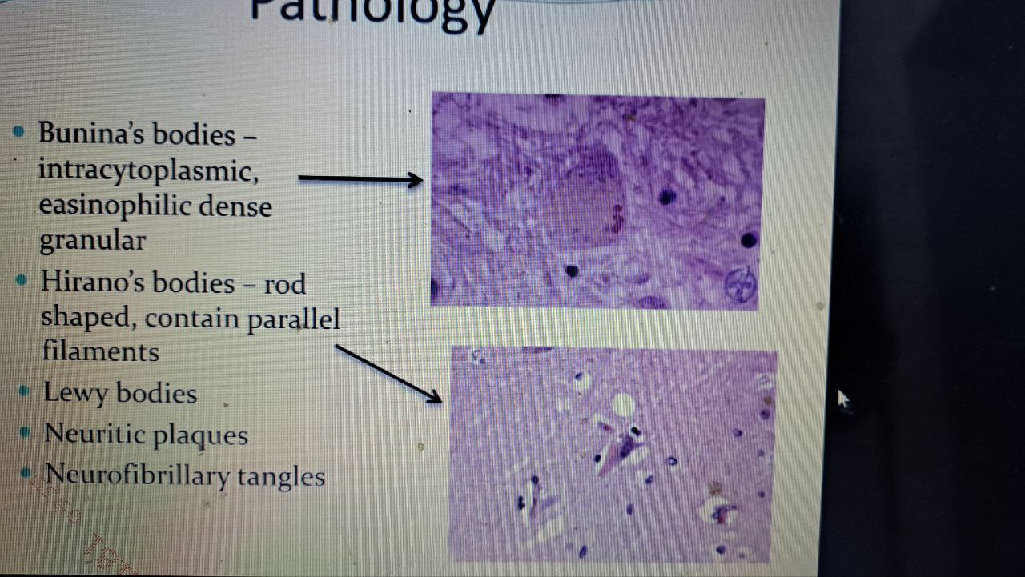

Slide 14
microenvironment and systemic signals, to establish new functional states that modify neurologic diseases.
Transcriptional profiling has revealed several different microglia populations/states with distinct functional properties.
Understanding the molecular mechanisms that govern microglia adaptation and plasticity may lead to the development of targeted therapies for a broad range of neurologic disorders.
Originally hypothesized to function solely as immunologic responders within the central nervous system (CNS), emerging evidence has revealed that microglia have more complex roles in normal brain development and in the context of disease. In health, microglia influence neural progenitor fate decisions, astrocyte activation, neuronal homeostasis, and synaptogenesis. In the setting of brain disease, including autism, brain tumors, and neurodegenerative disorders, microglia undergo substantial morphological, molecular, and functional changes, which establish new biological states relevant to disease pathogenesis and progression. In this review, we discuss the function of microglia in health and disease and outline a conceptual framework for elucidating their specific contributions to nervous system pathobiology.

Slide 15
3.2. Neuronal Cell Death in Neurodegenerative Diseases
Neuronal cell death is one of the major pathological hallmarks of neurodegenerative diseases. Several primary regions of the brain suffer neuronal loss, while as diseases progress, these regions can be expanded in some conditions. It should be noted that a local volume change may not be associated with a change in neuron number, as other factors, such as reduced innervations of neurons, could also contribute to this change without exacerbating cell death. Therefore, to definitively describe whether a brain region shrinkage is associated with cell death is to adopt a standard way to measure the neuron number, such as counting the NeuN-stained soma in brain’s sections [68].

Slide 16
3.2.1. Alzheimer’s Disease
Memory loss, the most prominent clinical symptom in Alzheimer’s patients, is correlated with neuronal loss in the hippocampal region. The endurance of neuronal loss is correlated with the progression of the disease [69,70,71,72]. Notably, detectable neuronal loss in multiple regions, which precedes even the clinical symptoms of AD, occurs in entorhinal cortex layer II, the nucleus basalis of Meynert and the locus coeruleus [69]. As the disease advances, the frontal cortex and other cortical/subcortical regions also experience neuronal losses that sometimes can be very severe [71,72]. The death pathways involved may be apoptosis or necroptosis. Regarding apoptosis, it has been suggested that initiator or executor caspases are activated in the disease [73,74,75,76,77]. In addition, it has been reported that the levels of extrinsic apoptotic pathway protein Fas and its ligands are elevated in AD brains [78]. However, in some reports, apoptotic morphology was not observed in any sections of the brain [66,79];

Slide 17
.2.2. Parkinson’s Disease
The most prominent pathological features of Parkinson’s disease (PD) are diminished SN, which is part of the output component of the basal ganglia, the severe loss of dopamine (DA)-producing nigral neurons and the associated decreased striatal DA levels. A clinical study found that on average, at least 50% of nigral neurons were lost before the neurologist could make a positive diagnosis of a patient with PD [110]. It is also noteworthy that at this point, the measured DA levels in the caudate nucleus, which is the input nucleus that receives signals from the SN, are decreased by 70–80% [111]. The insufficient input of DA results in a down-regulation of excitatory signals and up-regulation of inhibitory signals in the circuitry of the motor loops controlling body movement, which leads to body movement

Slide 18
.2.3. Huntington’s Disease
Huntington’s disease (HD) is characterized by the loss of corpus striatum GABAergic medium spiny neurons and cholinergic neurons. Opposing the neuronal loss of the SN in PD, the loss of striatum neurons in HD causes an up-regulation of excitatory signal output through the motor circuitry and the patient shows symptoms of ataxia. It should be noted that neuronal loss is not restricted at the corpus striatum in HD brains because significant neuronal losses have been found across the whole cerebral cortex [131]. In contrast to the complex genetic backgrounds of AD and PD, HD is an uncomplicated autosomal dominant disease that is caused by the pathogenic huntingtin gene, which bears an aberrant stretch of glutamine residues (encoded by >39 CAG/CTG repeats) at its N-terminus [132].

Slide 19
3.2.4. Amyotrophic Lateral Sclerosis
Amyotrophic lateral sclerosis (ALS) mainly affects the upper and lower motor neurons that are responsible for controlling voluntary muscles. ALS patients exhibit complex extremity symptoms as well as cranial nerve symptoms. Postmortem brains have shown that corticospinal fibers and partial upper motor neurons are lost and the neurons of the anterior horn of the spinal cord are depleted [11,141]. The pathological hallmark of ALS is its cytoplasmic inclusion, which is mainly composed of TAR DNA-binding protein 43 (TDP-43). Other proteins, including the ones involved in nucleocytoplasmic transport, can also be found within the inclusion [142]. The correlation between TDP-43 inclusion and neuronal loss is relatively high [11,141]. TDP-43 inclusion is also a major pathological hallmark of frontal-temporal dementia, AD and Lewy-body dementia [143,144]. Occasionally, the inclusions are found to be TDP-43-negative; in these cases, fused in sarcoma-containing inclusions are often found [141,145].

