Slide 1

Personalized Learning: Enhancing Student Motivation and Performance
Personalized learning is a student-centered approach that tailors instruction to individual needs, abilities, and interests. This innovative educational strategy aims to increase student motivation, engagement, and academic performance by providing customized learning experiences.
In this presentation, we'll explore the key principles, benefits, and strategies of personalized learning, as well as its impact on student motivation and academic success.
By Maysaa Rashid Abdul-majeed & Ruwayda Ahmed Hassan

Slide 2

Key Principles of Personalized Learning
Individualized Instruction
Learning Pathways
Competency-Based Assessment
Tailors teaching to match each student's unique needs, abilities, and learning preferences.
Offers multiple routes to mastery, allowing students to choose paths that resonate with them.
Focuses on mastery of skills and knowledge rather than standardized testing.

Slide 3


Benefits of Personalized Learning
Time-Saving
Increased Engagement
Reduces time needed to understand new subjects.
Relevant content leads to higher interaction.
Better Retention
Improved Results
Experience-based content improves long-term memory.
Yields better learning outcomes overall.

Slide 4





Personalized Learning Strategies
Assessments and Individualized Feedback
Identify strengths, weaknesses, and progress. Provide tailored guidance.
Customized Learning Plans
Create plans catering to individual strengths, learning styles, and improvement areas.
Progress Tracking
Continuously monitor and adjust learning plans based on student performance.
Teacher-Student Relationships
Teachers become mentors, guiding students through their academic journey.

Slide 5
Enhancing Motivation Through Personalized Learning
Intrinsic Motivation
Active Participation
Motivation Techniques
Personalized learning increases intrinsic motivation by tailoring instruction to individual characteristics. It focuses on learner readiness, strengths, needs, and interests.
Learners actively participate in setting goals, planning learning paths, tracking progress, and demonstrating their learning. This involvement fosters a sense of ownership and motivation.
Personalized learning allows for various motivation techniques, including self-motivation strategies, positive thinking, success mindset, and resilience strategies.

Slide 6




Impact on Academic Performance
1
Improved Learning Results
2
Increased Engagement
3
Enhanced Knowledge Retention
4
Personalized Instruction
Research on personalized learning strategies has demonstrated their positive impact on academic performance. Studies involving universities have highlighted the importance of customized and individualized learning modules that meet the needs of each student.

Slide 7
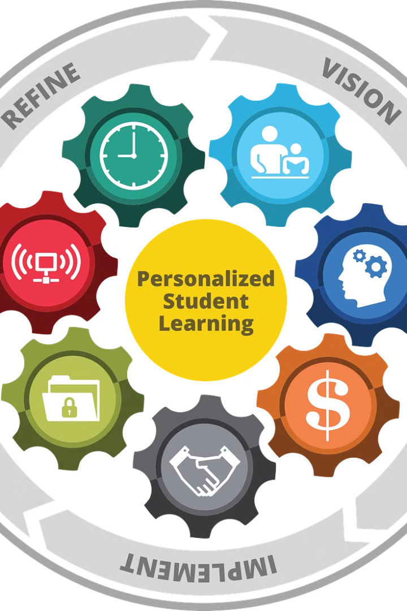
Implementation Challenges and Solutions
Teacher Training
Curriculum Design
Provide comprehensive training on personalized learning principles and techniques.
Align curriculum with personalized learning principles for effective implementation.
Technology Integration
Data Analysis
Incorporate adaptive learning tools and platforms to support personalization.
Utilize data analytics to track progress and refine personalized learning strategies.

Slide 8

Conclusion: The Future of Personalized Learning
Personalized learning provides a powerful framework for implementing motivational strategies in education. By tailoring instruction to individual learner characteristics, it maximizes engagement and motivation, leading to improved academic performance.
As technology advances and our understanding of learning processes deepens, personalized learning will continue to evolve. The integration of adaptive learning and individual learning paths will further enhance the educational experience, creating highly engaging and motivating learning environments for all students.

