Slide 1
Personalized Learning Instruction in EFL Classroom
Instr. Ienas Talib Naseef

Slide 2
Personalized learning
It is increasingly recognized as a promising strategy to boost student academic growth by meeting the individual needs of students

Slide 3
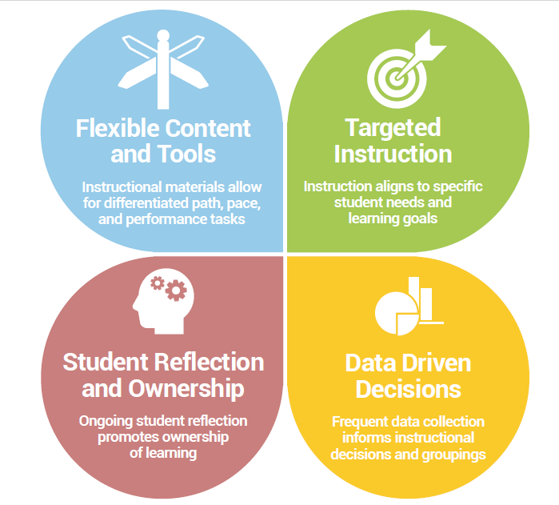
THE CORE FOUR ELEMENTS OF PERSONALIZED LEARNING IN THE CLASSROOM
Flexible Content and Tools
Targeted Instruction
Student Reflection and Ownership
Data-Driven Decisions

Slide 4
Flexible Content and Tools
Instructional materials allow for differentiated path, pace, and performance tasks
Teachers understand how to use foundational, adaptive, and highly customizable content and tools in order to differentiate the path, pace, and/
or performance tasks of learning.

Slide 5
Where digital content and tools are used, they do not replace the teacher; rather, they work alongside the teacher to better support students’ needs by providing remediation, practice, extension, and/or a variety of ways to demonstrate knowledge authentically.

Slide 6
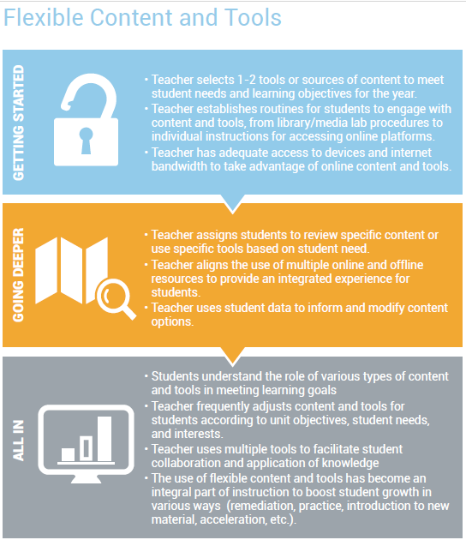

Slide 7
2. Targeted Instruction
Instruction is aligned to specific student needs and learning goals
Using data, teachers identify specific student needs and provide instruction to meet those needs. Teachers employ small groups, 1-1, strategy groups, or other targeted instruction to create a learning environment where all individual needs can be met.

Slide 8
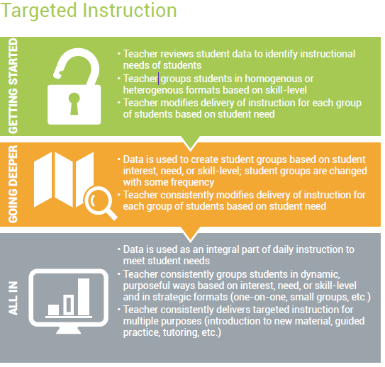

Slide 9
Student Reflection and Ownership
Ongoing student reflection promotes ownership of learning
Students have frequent opportunities to reflect on what they are learning and their success in learning. Students make goals to improve their learning outcomes and have opportunities to make authentic choices for their learning. Students have authentic choice and ownership over their learning.

Slide 10
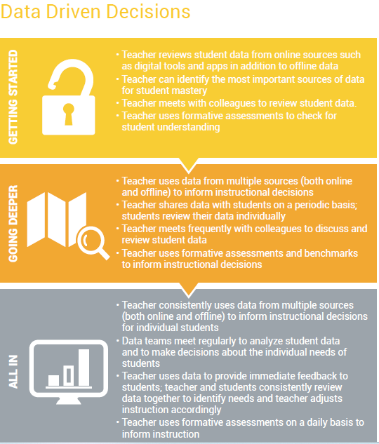

Slide 11
Data-Driven Decisions
Frequent data collection informs instructional decisions and groupings
Teachers use data to inform instructional decisions in their classrooms. Students are provided with opportunities to review their own data and make learning decisions based on that data.

Slide 12
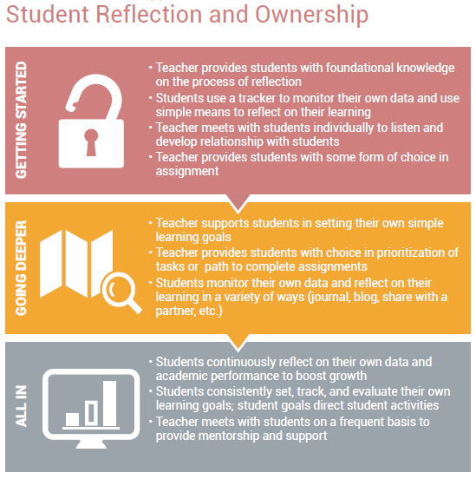

Slide 13
Conclusion Shifting to personalized learning is not a simple task. Significant effort will be necessary to create a vision, develop instructional models, acquire digital tools, and train teachers and students. The Core Four is designed to provide educators with a guide for their personalized learning implementation. The elements of the Core Four should be viewed as spectrums that can be started immediately in small ways, building on what you’re already doing in your schools and classrooms. To master these elements alone or in conjunction requires a significant dedication of time and resources.

