Slide 1
Autonomous Learning and its Role in Developing Personal and Productivity Skills
By:
Dr. Hind Salim Kashkool

Slide 2
What is learner autonomy?
Learner autonomy is a concept that describes the ability of learners to take control of their own learning journey. The theory is that by giving learners the freedom to take responsibility for their learning including what they learn and how they learn .

Slide 3
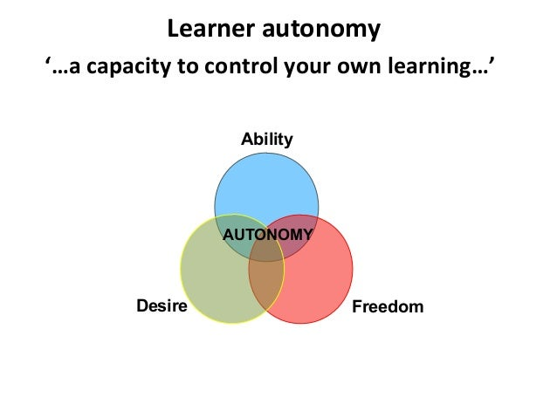

Slide 4
Key elements of learner autonomy
For learners to be fully autonomous, they need to be equipped with a range of skills to help them take responsibility for their learning.
Learners can identify and set their own learning goals
Learners plan and perform their learning activities
Learners are able to reflect on their learning and evaluate their progress
Learners understand the purpose of learning
Learners understand their own learning processes
Learners can apply a range of learning strategies in different contexts

Slide 5

The Concept of Autonomy

Slide 6
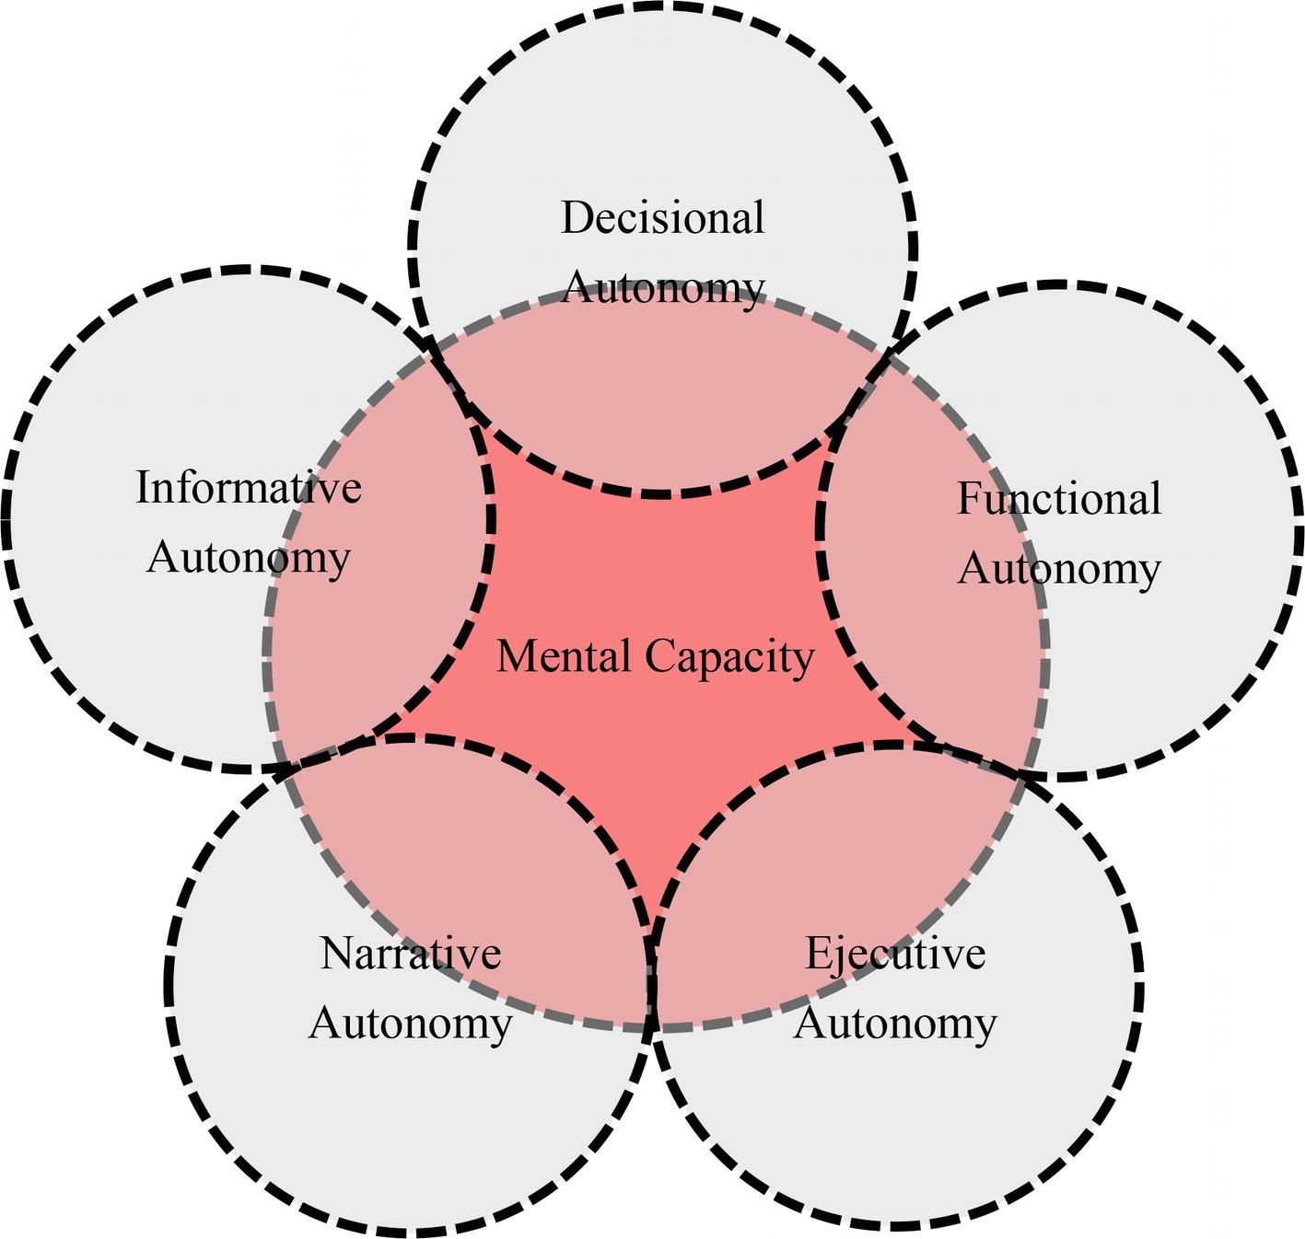

Slide 7
Characteristics of Autonomous Learner
They are responsible for their own learning.
Determine the organization of their learning ( what and how to learn).
Are able to learn from others.
Are able to integrate the new knowledge with what they already know.

Slide 8
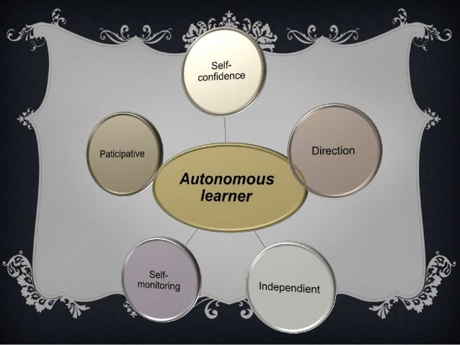

Slide 9
Autonomy
and
Communication

Slide 10
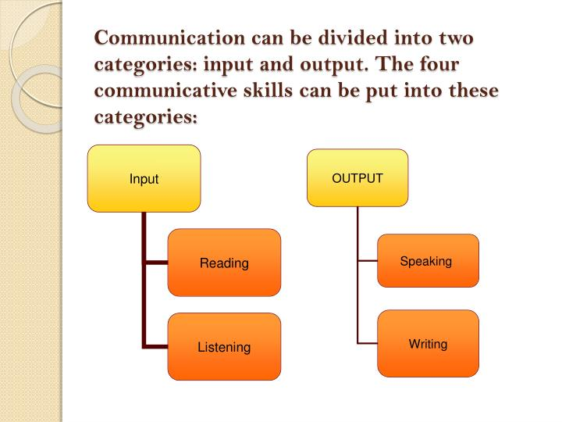

Slide 11
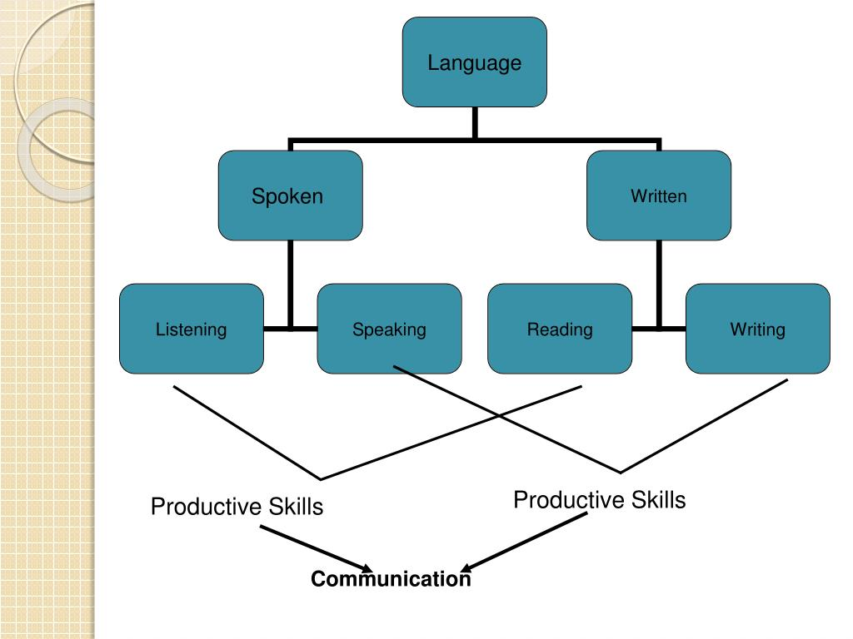

Slide 12
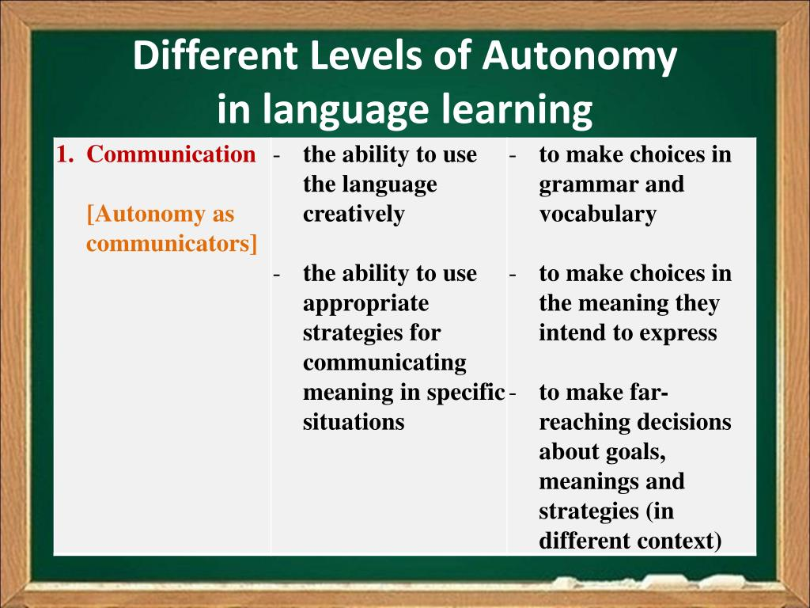

Slide 13
What are Productivity Skills
Productivity skills are a set of complementary competencies that help individuals effectively and efficiently manage their time, prioritize tasks, and accomplish goals. These skills are critical in today’s fast-paced world, where efficiency and effectiveness are valued in all areas of life. Whether in the workplace, in school, or in personal life, possessing strong productivity skills can significantly increase one’s chances of success and satisfaction.

Slide 14
Understanding Productivity Skills
Productivity skills are the abilities and techniques that individuals use to maximize their output while minimizing their input. These skills are vital in helping people achieve their goals by enabling them to manage their time and resources effectively. Productivity skills include the ability to manage time, and set achievable goals. They also involve the ability to focus, eliminate distractions, and work efficiently.

Slide 15
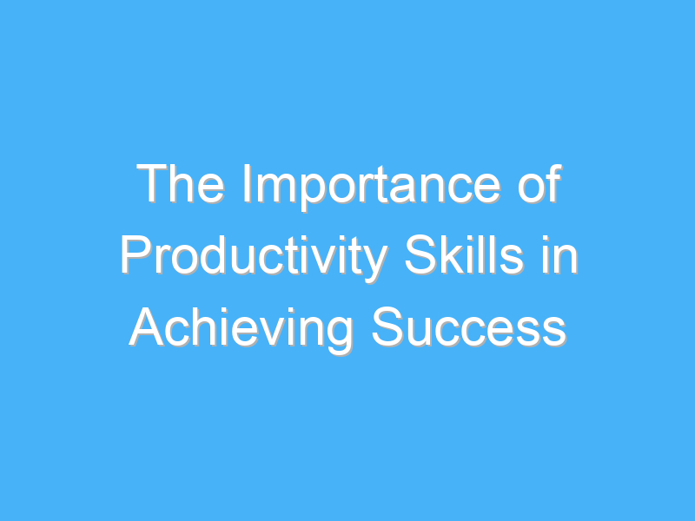

Slide 16
Prioritization
Prioritization is a vital productivity skill that involves identifying the most critical tasks and completing them first. This skill helps individuals to manage their time efficiently and ensures that they achieve their goals. Prioritization involves evaluating tasks based on their urgency, importance, and impact, and then allocating resources accordingly.

Slide 17
Time Management
Time management is another essential productivity skill that involves the ability to manage time effectively. This skill helps individuals to allocate their time to activities that are most important to them. Time management also involves setting realistic deadlines, avoiding procrastination, and minimizing interruptions.

Slide 18
Goal Setting
Goal setting is a crucial productivity skill that involves setting clear, achievable goals. This skill helps individuals to focus on what they want to achieve and enables them to measure their progress. Goal setting also involves breaking down larger goals into smaller, more manageable tasks.

Slide 19
Focus
Focus is a critical productivity skill that involves the ability to concentrate on tasks without getting distracted. This skill helps individuals to work efficiently and complete tasks quickly. Focus involves eliminating distractions, managing interruptions, and maintaining concentration.

Slide 20
Efficiency
Efficiency is another essential productivity skill that involves the ability to complete tasks quickly and with minimal waste. This skill helps individuals to maximize their output while minimizing their input. Efficiency involves using resources effectively, eliminating unnecessary steps, and streamlining processes.

Slide 21
How can one develop or improve productivity skills?
Productivity skills can be developed and improved through various techniques, such as :
Setting realistic goals and deadlines.
Breaking tasks into smaller manageable chunks.
Eliminating or delegating non-essential tasks.
Developing effective communication skills.
Practicing self discipline and time management strategies.

Slide 22


Slide 23
Productivity skills
Are essential in achieving success as they enable individuals to manage their time and resources effectively, set clear achievable goals, maintain focus, and work efficiently. Contrary to popular misconceptions.

Slide 24
productivity skills
Can be learned and developed with practice and determination, and they offer several benefits such as increased efficiency, improved time management, enhanced focus, goal achievement, and better work-life balance.

Slide 25


