Slide 1




Integrating Technology for Personalized Learning in EFL Content
Prof. DR. Baan Jafar Sadiq
Assist. Instr. Hiba Ahmed Kareem

Slide 2

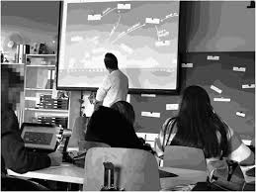
Personalized learning refers to tailoring education to the individual learning needs, interests, and abilities of students.
- In English as a Foreign Language (EFL), Personalized learning means adapting the teaching methods, materials, and assessment strategies to ensure that each learner has the opportunity to progress at their own pace and in a way that works best for them, all while focusing on acquiring the English language skills.
Introduction to Personalized Learning

Slide 3
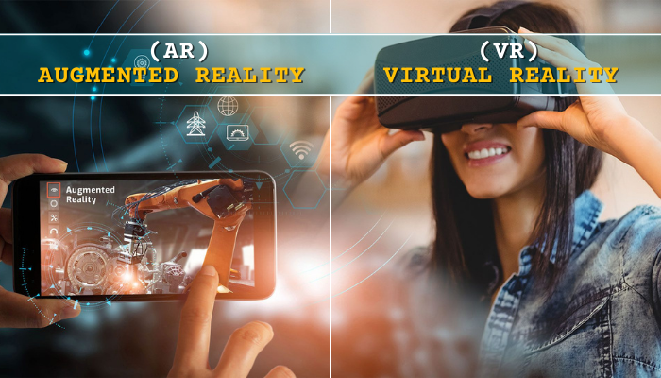

The Role of Technology in Personalized Learning
Content
1.Adaptive Learning Platforms
2. Digital Content & Resources
3. Gamification & Game-Based Learning
4. Collaboration Tools & Social Learning
5. Artificial Intelligence (AI) & Virtual Assistant (VA)
6. VR/AR for Immersive Learning istants
7. Assistive Technology

Slide 4
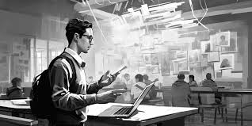



1.Role of the EFL Teachers -Identify Individual Needs -Adapt Teaching Strategies -Provide Personalized Feedback -Foster a Positive Learning Environment. 3. Role of the Textbook -Structured Learning Path -Variety of Exercises -Flexibility -Incorporate Real-World Context | 2.Role of the EFL Students -Self-Directed Learning -Reflective Practice -Engagement: -Use of Technology 4. Role of the Classroom -Flexible Space -Technology Integration -Collaboration -Real-World Practice

Slide 5
- Adaptive Learning Platforms
(e.g., Duolingo, Rosetta Stone)
- Language Learning Apps
(e.g., Babbel, Memrise)
- Online Grammar and Vocabulary Tools
(e.g., Grammarly, Quizlet)
- Speech Recognition Technology
(e.g., Google Speech, Pronunciation Power)
Types of Applications for Personalized EFL Learning Content

Slide 6
1. Flexibility: Learners can progress at their own pace.
2. Access to a Range of Resources: Multimedia content, interactive activities.
3. Real-Time Feedback: Instant corrections and improvements.
4. Engagement: Gamification and interactive elements increase motivation.
Benefits of Using Technology for Personalized EFL Learning Content

Slide 7
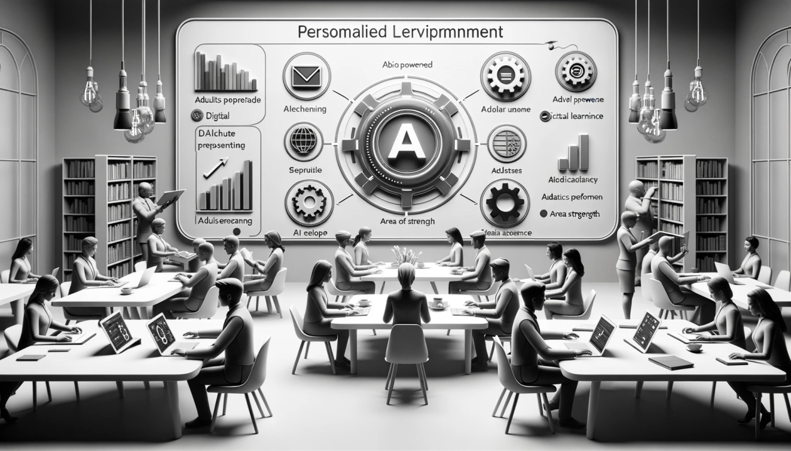
- Access to Devices: Ensuring all students have access to necessary technology.
- Teacher Training: Providing professional development for teachers to effectively use technology.
- Student Motivation: Overcoming engagement issues with digital learning.
- Technical Issues: Addressing potential connectivity or platform-related problems.
Challenges in Integrating Technology Content

Slide 8
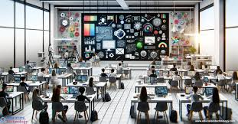
Best Practices for Integrating Technology in EFL Classrooms Content
- Blended Learning: Combining face-to-face teaching with online learning.
- Flipped Classroom: Students engage with content online before class and apply learning in class.
- Gamification: Using game-like elements (leaderboards, points) to increase motivation.

Slide 9
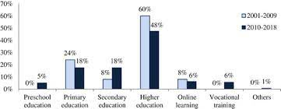

Slide 10
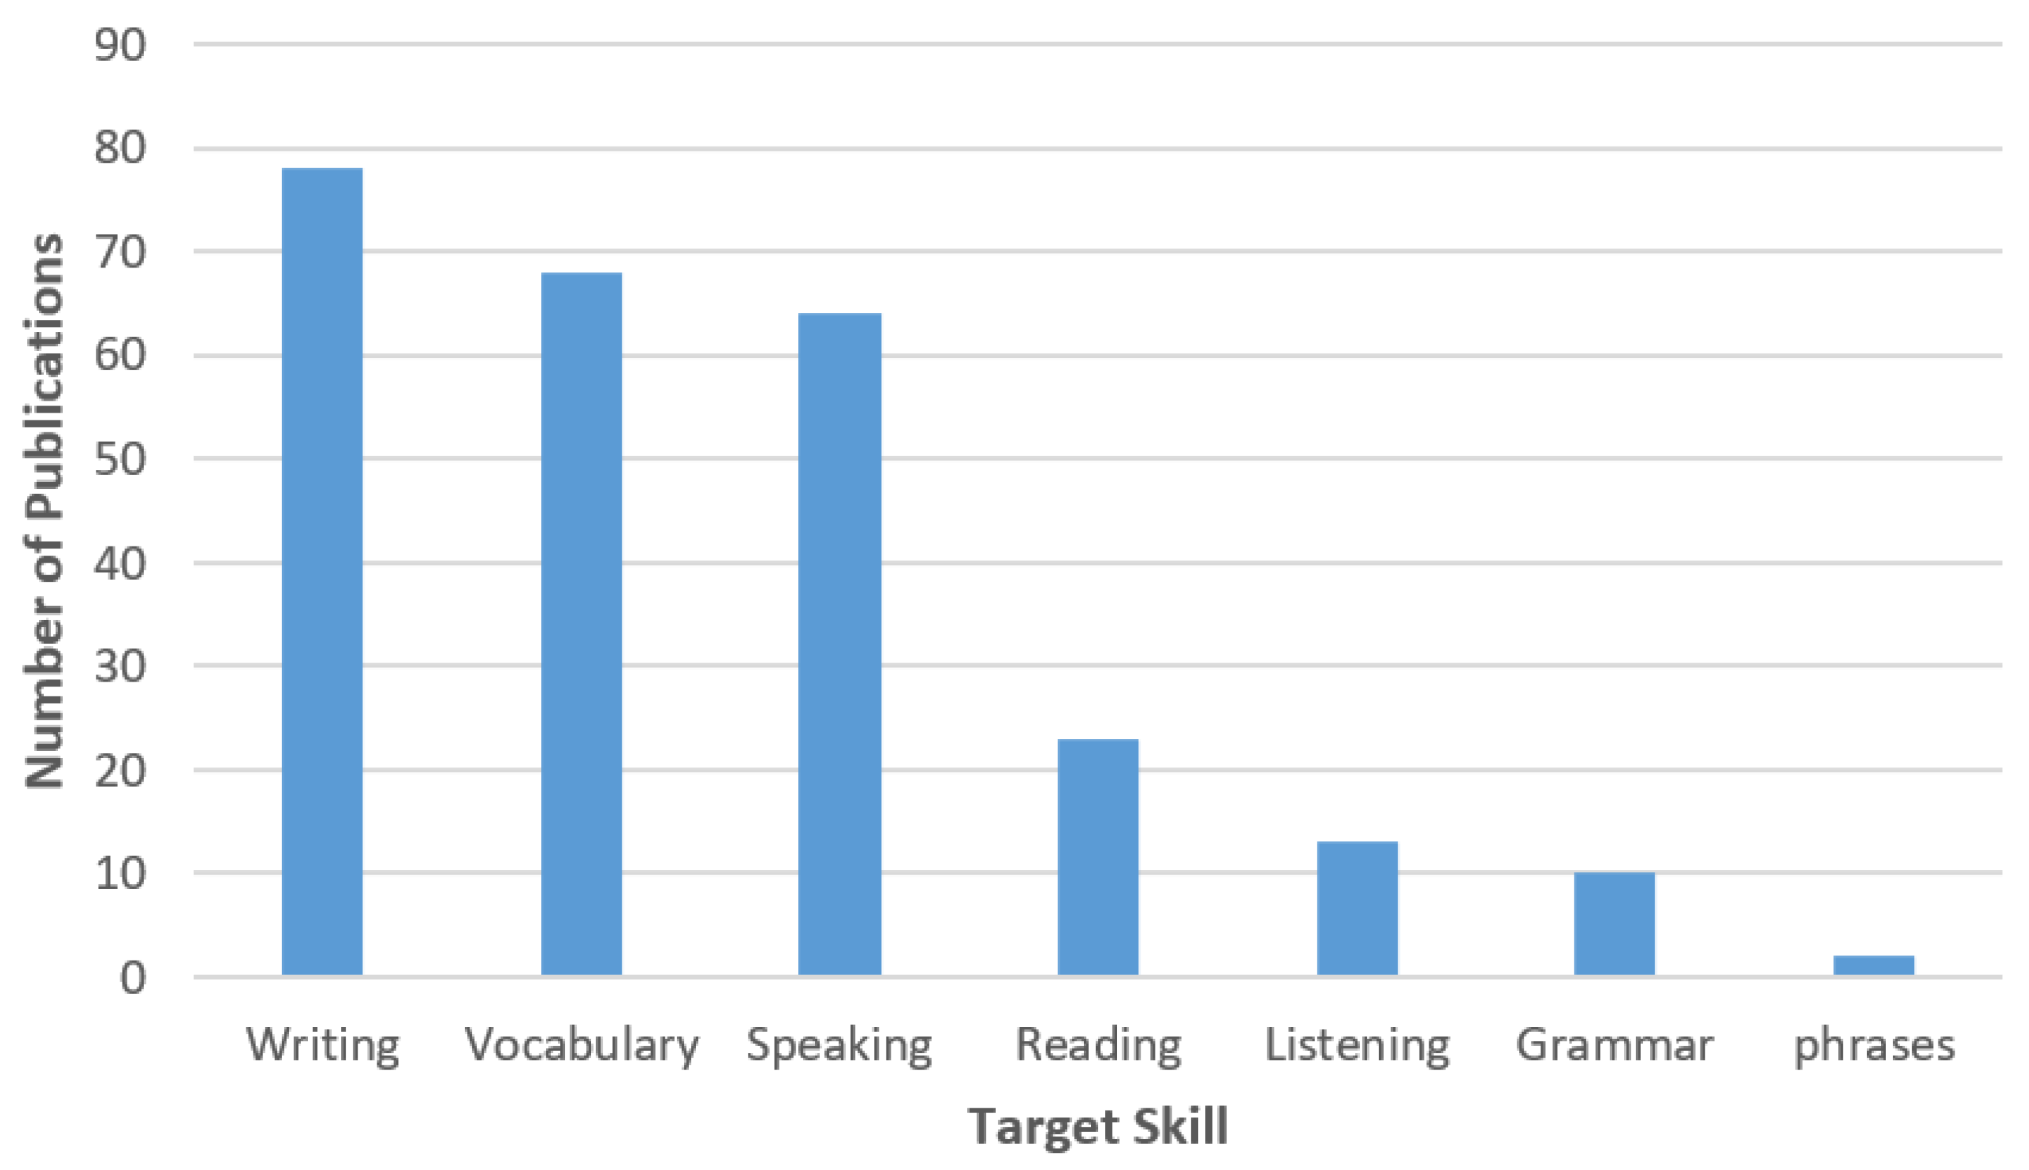

Slide 11

Conclusion and Future Directions Content
- Technology offers significant potential for personalizing EFL instruction and improving student outcomes.
- Continuous advancements in AI and machine learning can further personalize language learning.
- Teachers should keep exploring innovative technologies to meet evolving student needs.

Slide 12



