Slide 1
Management of Dentin hypersensitivity
Done By
Assist. lec Shatha A. Abbas

Slide 2
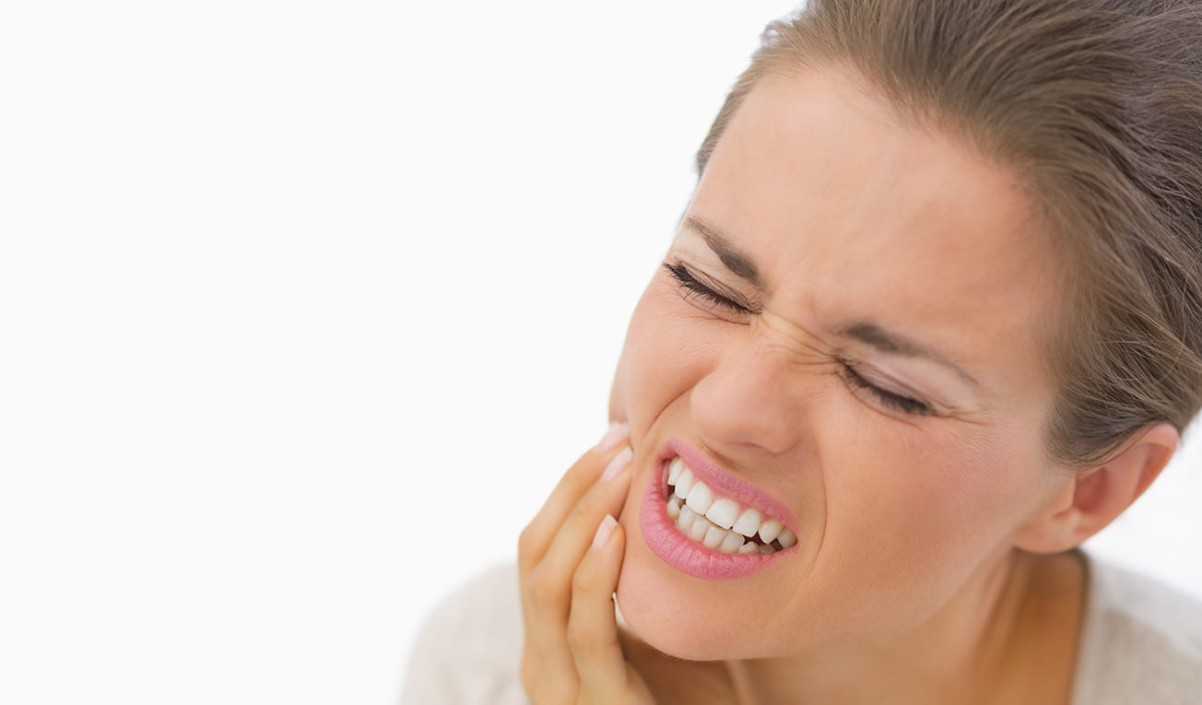
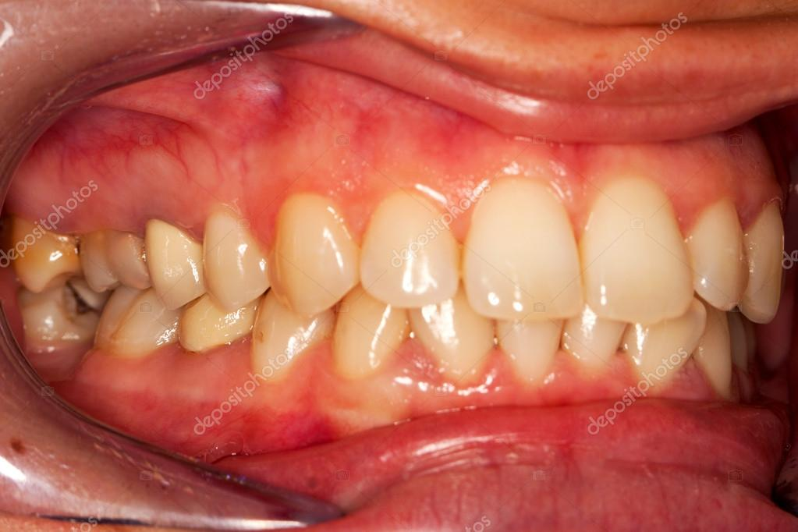
Introduction
Dentin hypersensitivity is defined as a sharp short pain arising from exposed dentin in response to stimuli typically thermal, evaporative, tactile, osmotic or chemical and which cannot be ascribed to any other form of dental defect or pathology. It is more prevalent in the patient with the age range of 30-40 and more prevalent in female individuals
Canine & premolars
Buccal surfaces

Slide 3
Etiology
Usually occurred due to dentin exposure caused by
Enamel loss
Gingival recession

Slide 4
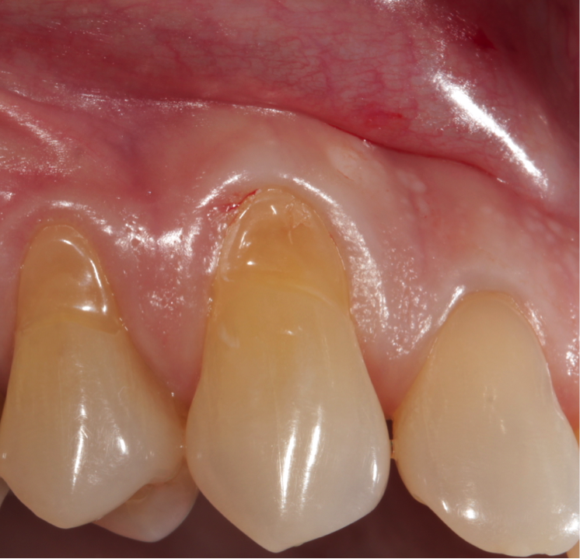
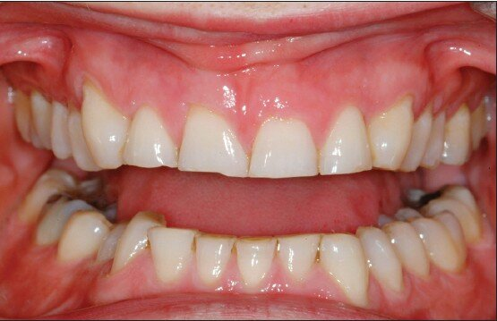
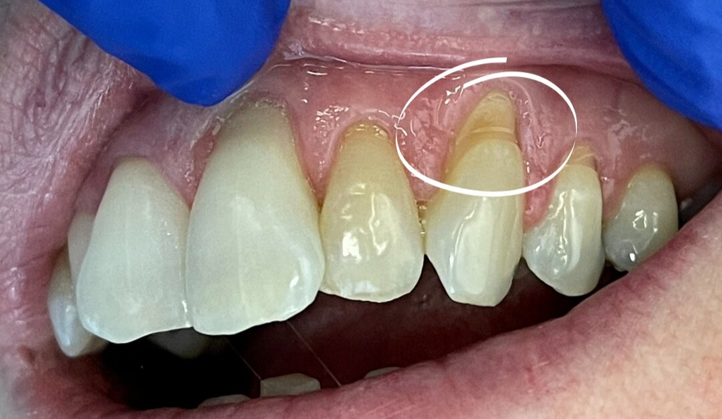
Enamel loss
Abrasion
Erosion
Attrition
Abfraction

Slide 5
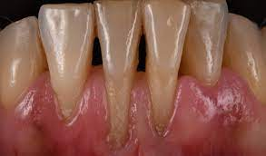
Gingival Recession
Predisposing factors
Alveolar bone
Tooth anatomy and position
Oral hygiene
Gingival diseases
Trauma
Other factors

Slide 7
The “hypersensitive” dentin has more widely open tubules and thin/under calcified smear layer as compared with “non-sensitive” dentine. The wider tubules increase the fluid movement and thus the pain response

Slide 8
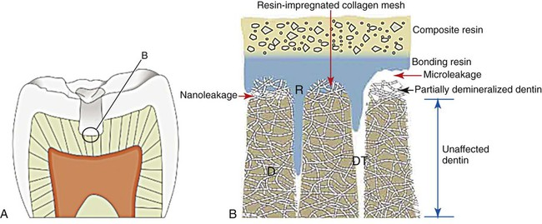
Differential Diagnosis
Leakage of dental adhesive

Slide 9
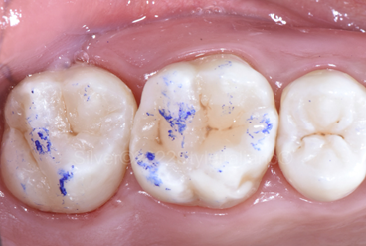
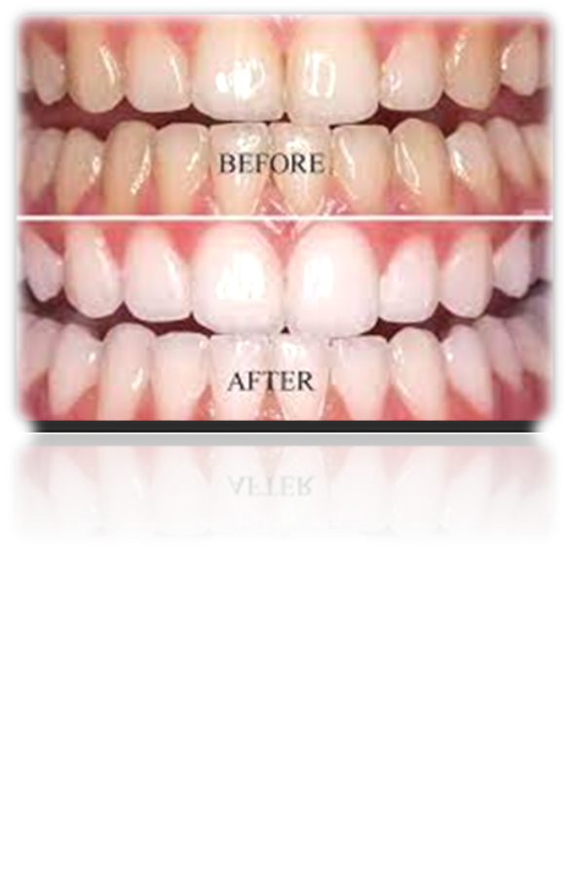
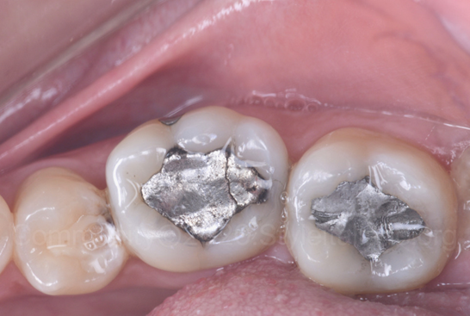
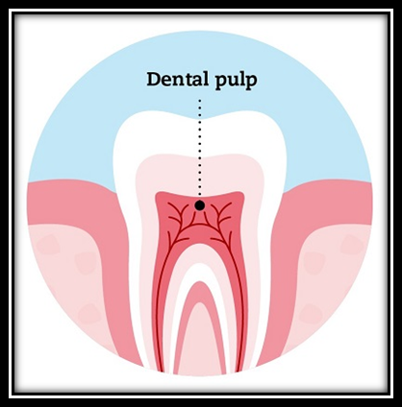
Differential Diagnosis

Slide 10
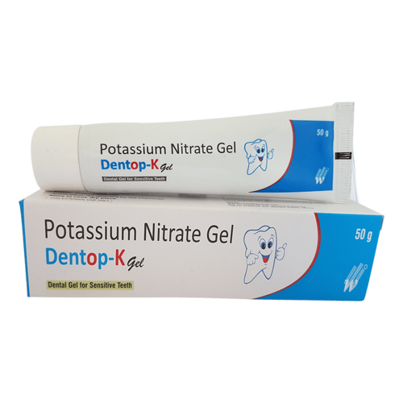
Management of Dentin Hypersensitivity
Desensitizing the nerve
Occlusion of Dentinal tubule
Potassium salt: potassium nitrate, citrate, chloride.
A) Formation of smear layer
B) Topical agents
C) Restorations
D) Laser

Slide 11
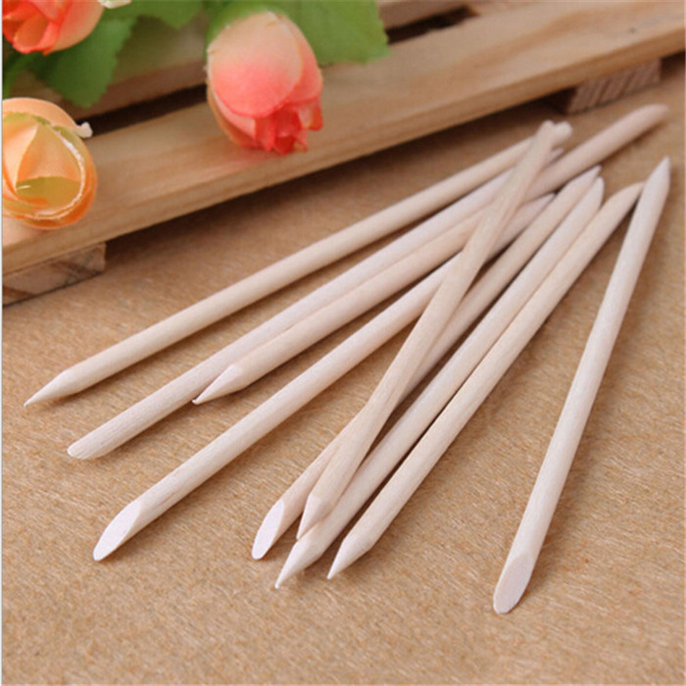
Occlusion of Dentinal tubule
A) Formation of smear layer
Isolation
Burnishing of dentin with an orange wood stick

Slide 12
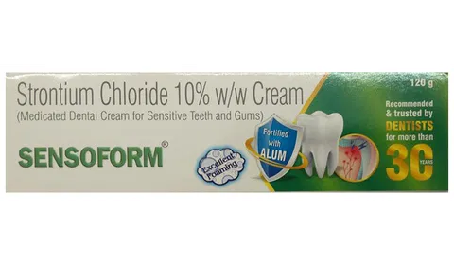
B) Topical agents
strontium Chloride
SrCl2 was the first tubule blocking agent to be introduced into toothpastes
a)nerve depolarization
b)because it is chemically similar to calcium it can replace lost calcium in hydroxyapatite lattice
c)deposit a layer of fine particles which can occlude the tubules

Slide 13
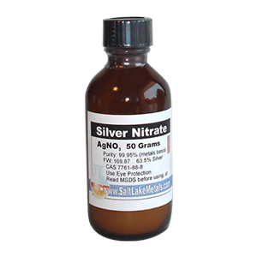
Silver Nitrate
It reduces fluid movement by precipitating protein or silver chloride within the dentinal tubules.
But it stains dentin and is also damaging to the pulp and gingiva.
Not used anymore

Slide 14
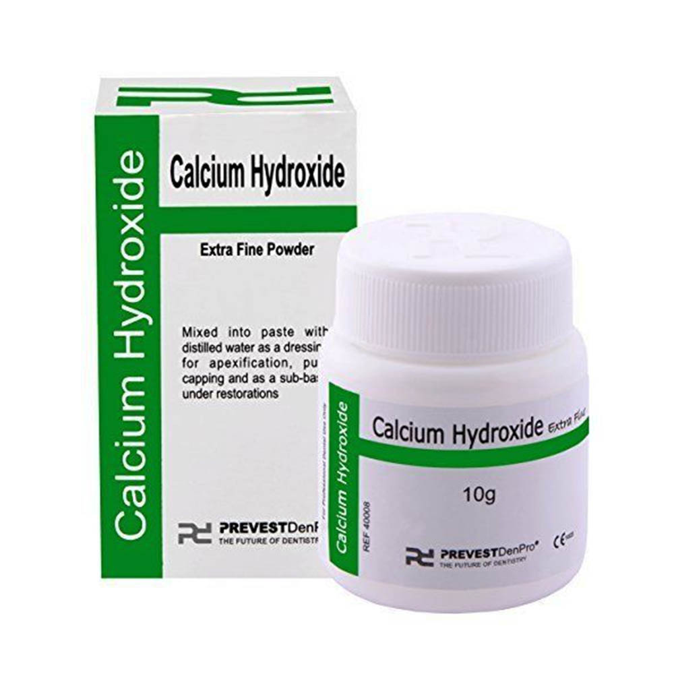
Calcium Hydroxide
Mixed with distilled water to form a thick paste
Applied for a few minutes on exposed dentin
Increases remineralization
Temporary relief

Slide 15
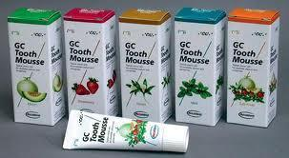
Calcium Phosphate Pastes
Blocks tubules & reduces permeability by 85%
Can also be used to remineralize incipient enamel caries

Slide 16
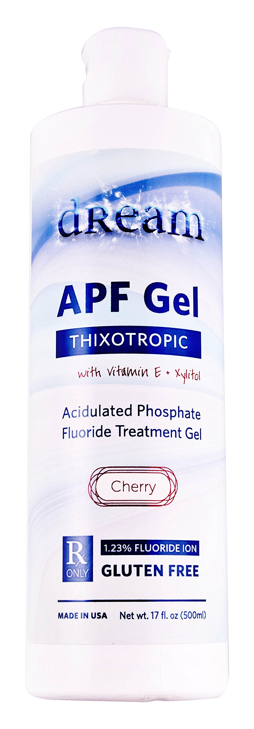
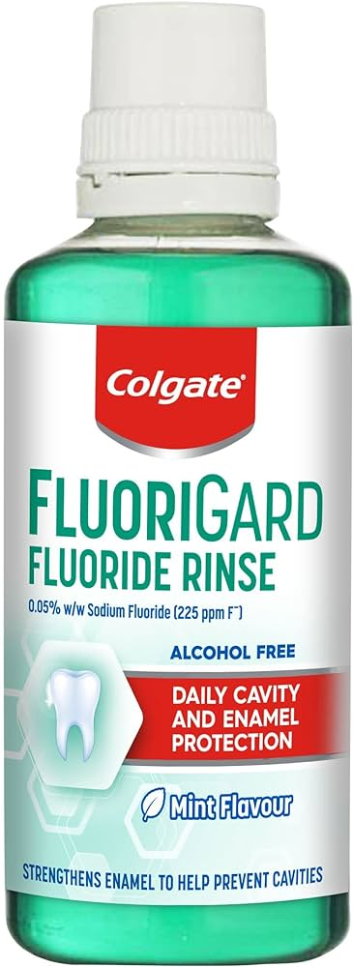
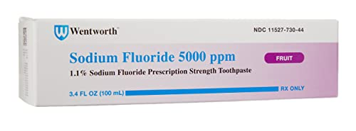
Fluoride
Act by forming fluoroapatite within tubules which blocks fluid movement within dentin.
Gel-kam Dentin Block: Consists of 0.9% sodium fluoride,0.4% stannous fluoride & 0.14% hydrogen fluoride that can be applied in a tray.

Slide 17
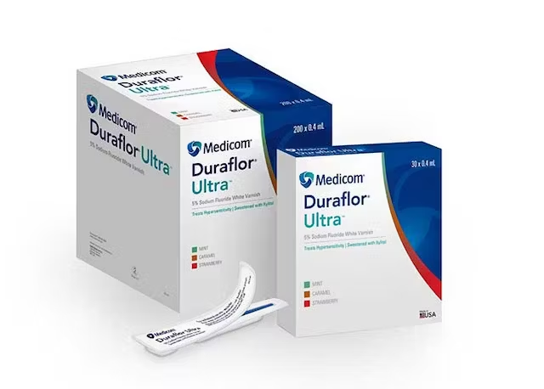
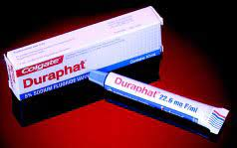
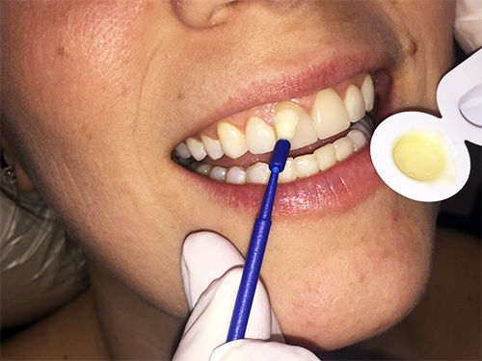
Varnishes
Forms a barrier over exposed dentin & reduces the permeability
Temporary relief

Slide 18
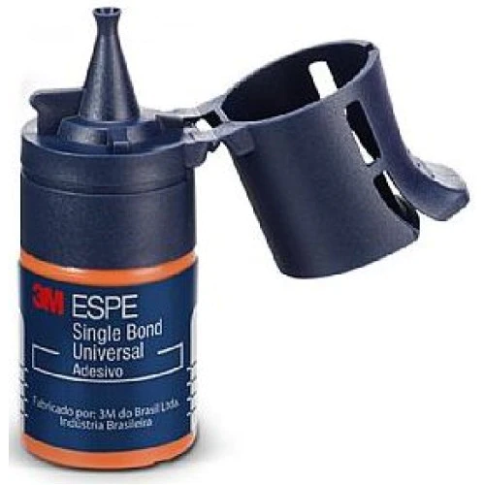
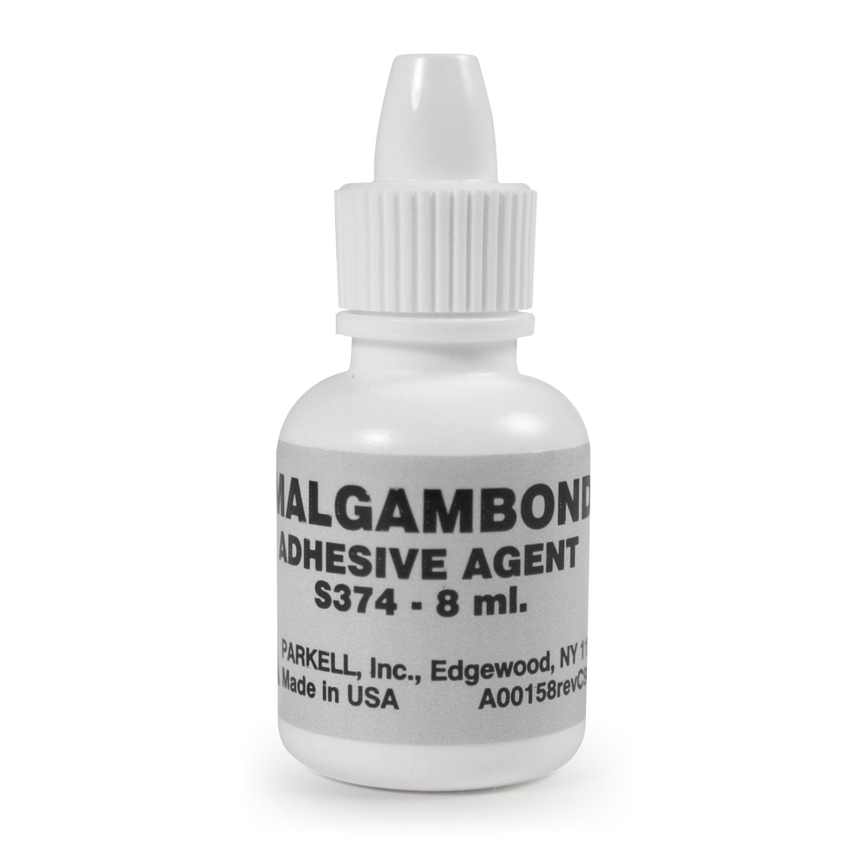
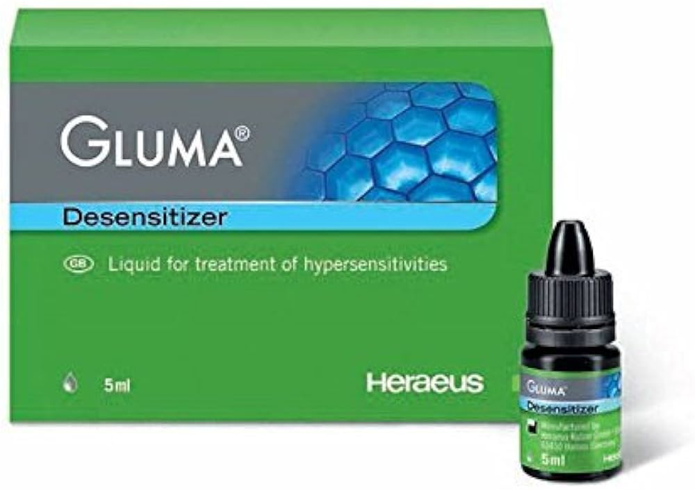
Dentin Adhesives
Micromechanical bonding through formation of an inter diffusion hybrid
Gluma Desensitizer: 5% gluteraldehyde and 35%HEMA in water
• Control DH & decrease post operative sensitvity in restorative procedures
• No mixing & no curing.
No repetitive steps.
• No drip formula, so it stays where you place it, minimising contact with soft tissues.

Slide 19
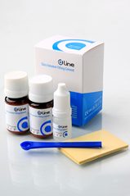
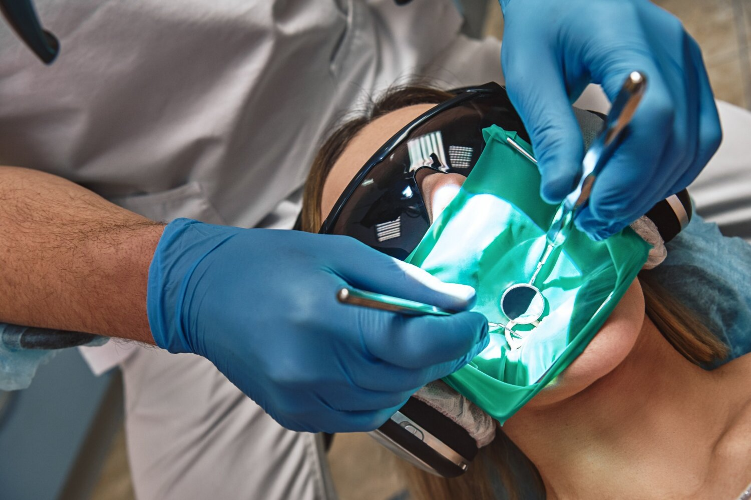
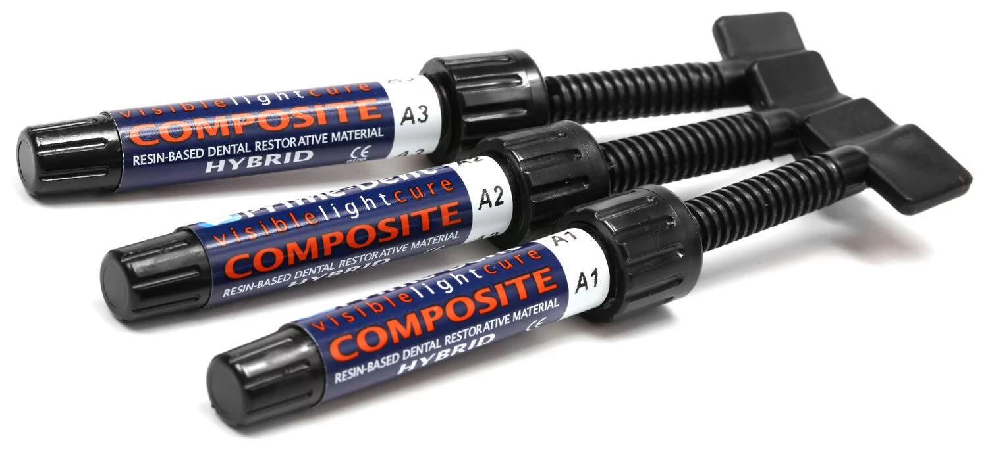
C)Restorations :
• Glass Ionomer Cement or a Composite Resin Restoration is used
• Long lasting relief

Slide 20
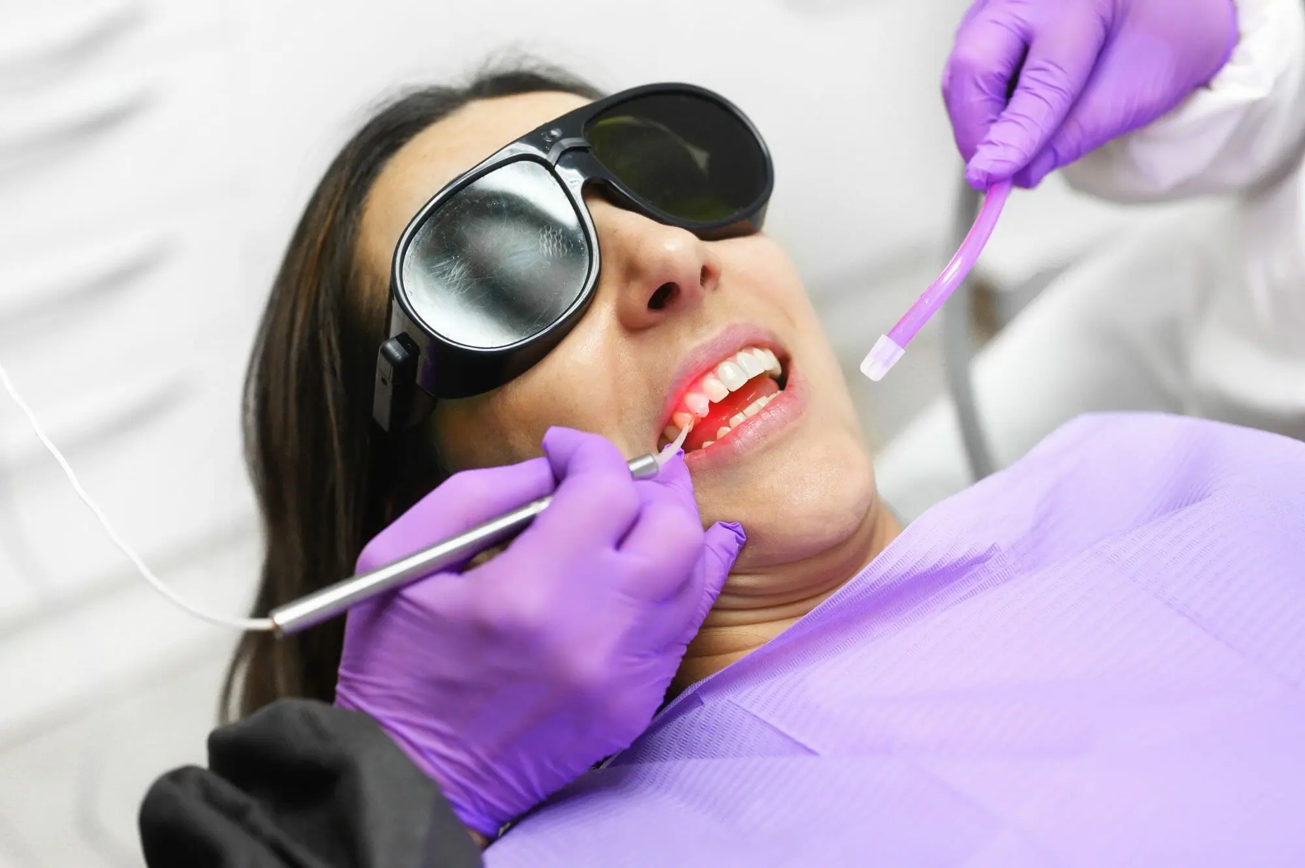
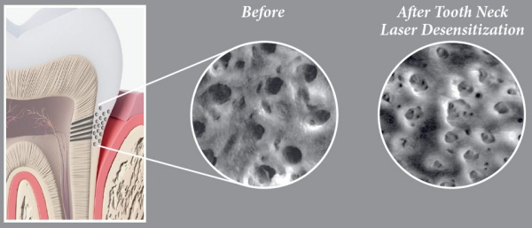
D) Lasers :
Coagulation & precipitaion of plasma proteins in the dentinal fluid without altering the surface of dentin.
ADVANTAGES : analgesic, bio-stimulant, anti-inflammatory effects, painless, safe, fast, conservative treatment, and it is well accepted by the patients

Slide 21
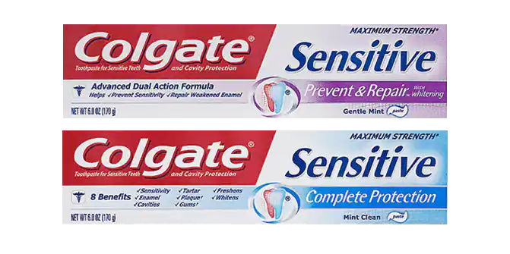
Other Technologies
A) Pro-argin Technology
“Saliva based composition”
1. Arginine (an aminoacid which is positively charged at physiological pH)
2. Bicarbonate (pH buffer)
3. Calcium carbonate (source of calcium) • Commercially available as ProClude (instant relief which lasts upto 28days)
COLGATE has combined ARGININE , CALCIUM CARBONATE & FLUORIDE and this has been clinically proven to provide lasting relief

Slide 22
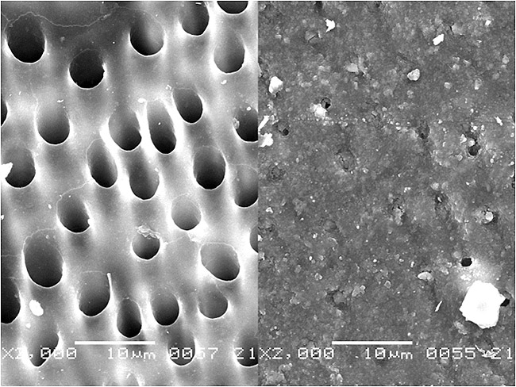
B) Novamin
• Bioactive glass ceramic material that provides calcium and phosphate
• Calcium sodium phosphosilicate reacts when exposed to aqueous medium to release calcium & phosphate ions which form hydroxy-carbonate apatite

Slide 23
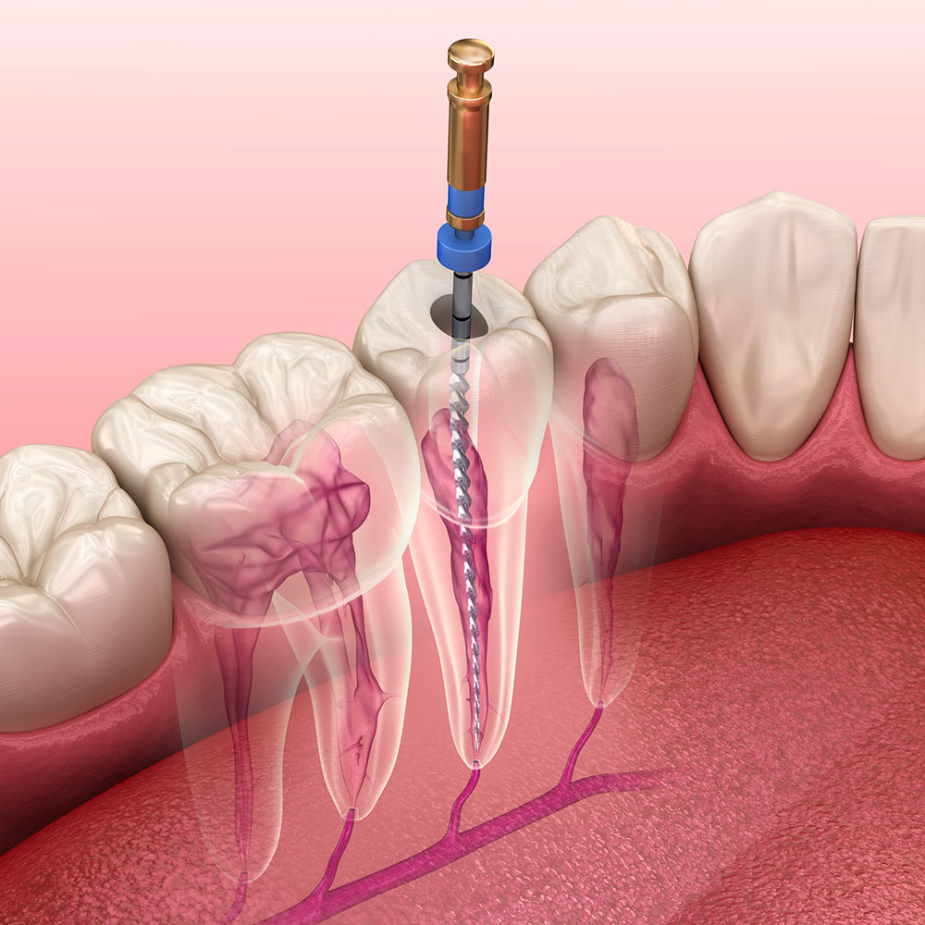
Considering Root Canal Treatment when all previous treatments are not effective

Slide 24
Conclusion
Dentin hypersensitivity can be detected after removing all the other factors which can possibly cause the pain. The treatment of dental hypersensitivity should be on a regular basis and initiate with at-home therapy and then continue with complementary therapies. It is recommended that follow-up visits should be organized for all the patients after undergoing periodic treatments.

Slide 25
THANK YOU

