Slide 1
Homeless at home: Sam Shepard’s Buried Child As a Study Case
By
Asst. Inst. Alaa’ Ali Mahmood

Slide 2


Slide 3
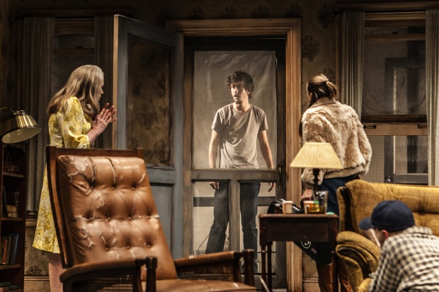

Slide 4
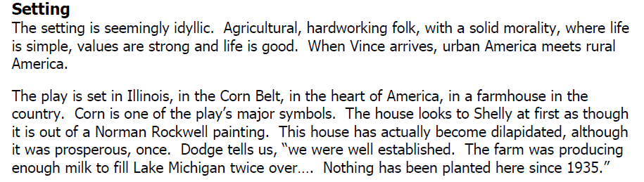

Slide 5
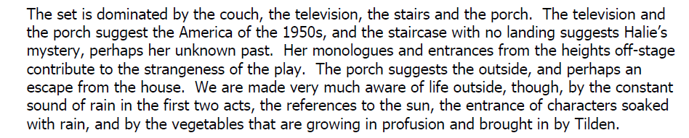

Slide 6
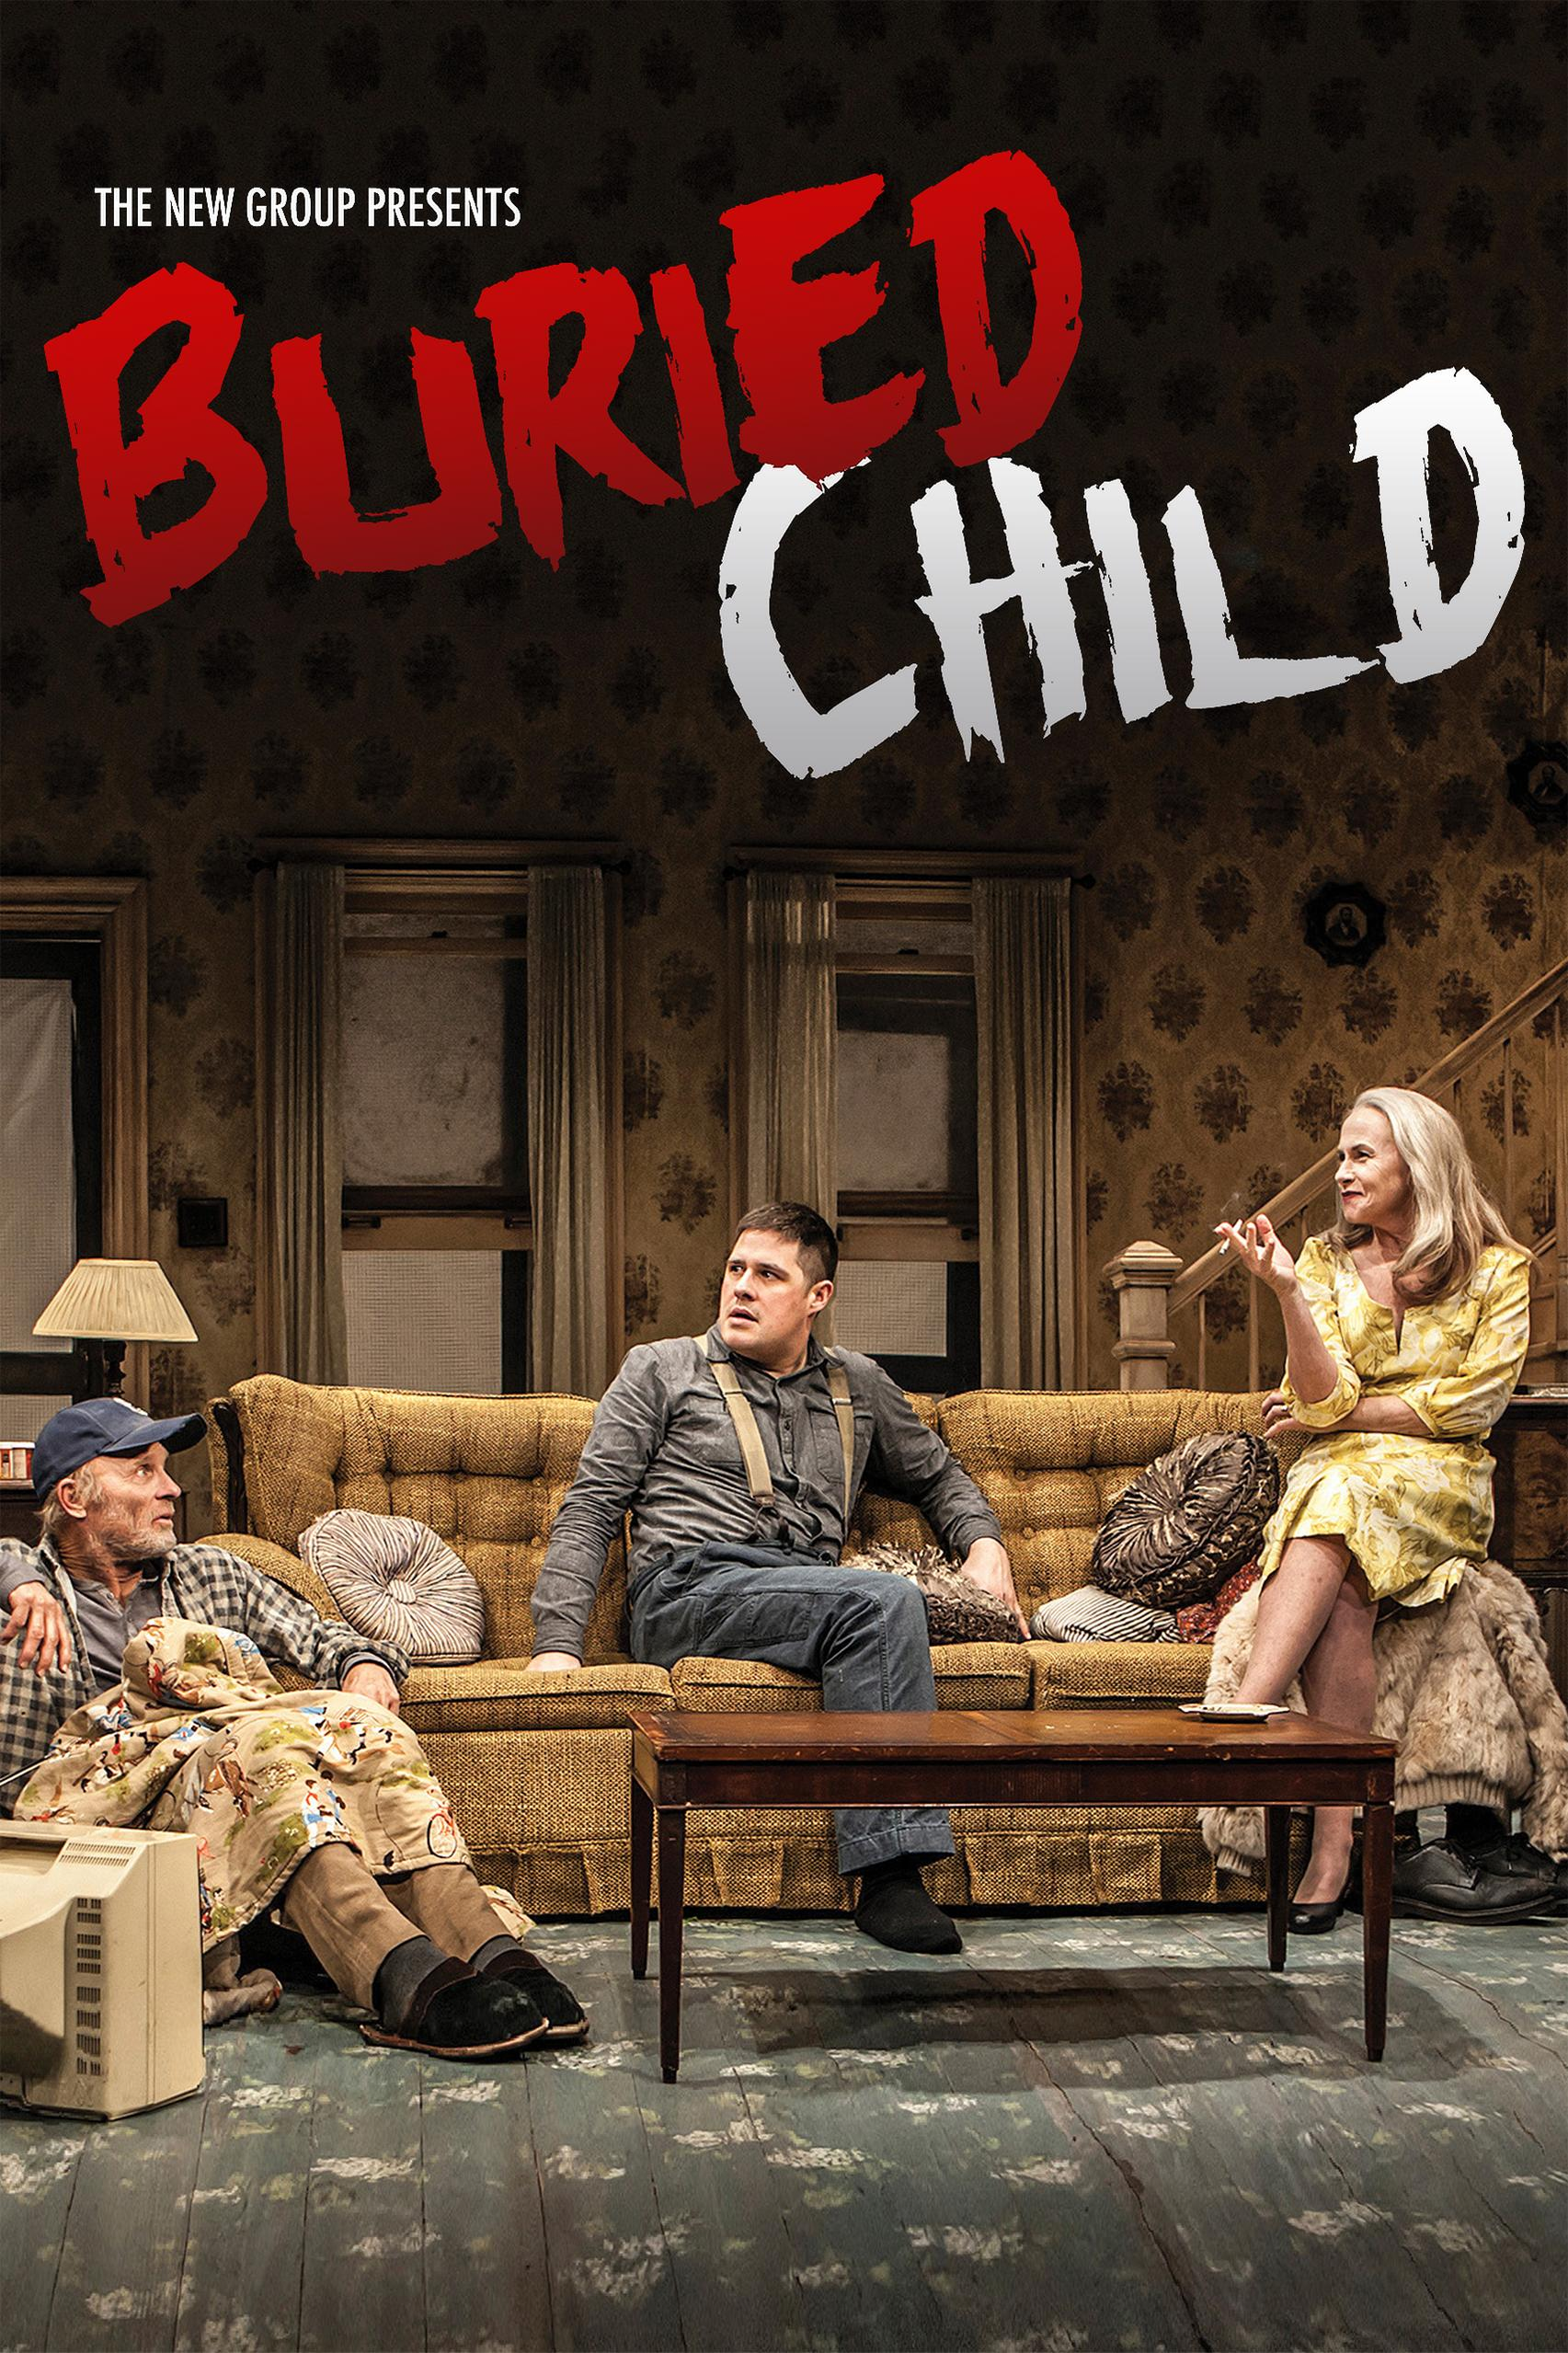

Slide 7
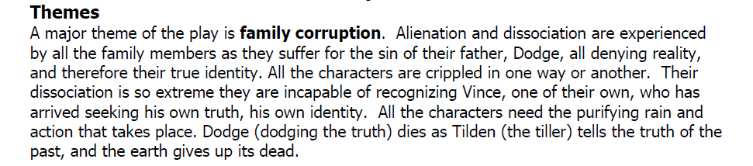

Slide 8
Identity :
1. The quest for identity is encompassed by the grandson of Dodge, Vince. He has gone through an identity crisis at home. Vince has left his home six years ago and has created a new identity for himself in New York. Before returning to home, he has premonition that he may not be recognized by his family. He says Shelly that, “I just don't want to have them think that I've suddenly arrived out of the middle of nowhere completely deranged.” (Sam Shepard Seven Plays 85). As he enters the house, he is not recognized by anyone, even refused by Dodge and Tilden to have any flesh and blood relation. In Act Two, he is desperately endeavouring to create his identity but gets humiliated as Dodge rejects to recognise him:

Slide 9
VINCE: Grandpa, where did Halie go? Maybe we should call her.
DODGE: What are you talking about? Do you know what you're talking about? Are you just talking for the sake of talking? Lubricating the gums?
VINCE: I'm trying to figure out what’s going on here!
DODGE: Is that it?
VINCE: Yes. I mean I expected everything to be different.
DODGE: Who are you to expect anything? Who are you supposed to be?
VINCE: I’m Vince! Your Grandson!
DODGE: Vince. My Grandson.
VINCE: Tilden's son.
DODGE: Tilden's son, Vince.
VINCE: You haven't seen me for a long time.
DODGE: When was the last time?
VINCE: I don't remember.
DODGE: You don't remember?
VINCE: No.
DODGE: You don't remember. How am I supposed to remember if you don't remember? (Sam Shepard Seven Plays 89)

Slide 10
2. At Home, Lost Identity
At home, instead of gaining an identity, Vince lost his identity that he has gained for himself in the New York. He was firmly bent on to regain his lost identity. To meet his quest for identity he needs to prove his origins but was denied of having any bond of flesh and blood between his father, Tilden and grandfather, Dodge. After complete denial of any relationships, he became baffled and in frustration he cries, “How could they not recognize me! How in the hell could they not recognise me! I’m their son”. (Sam Shepard Seven Plays 97)

Slide 11
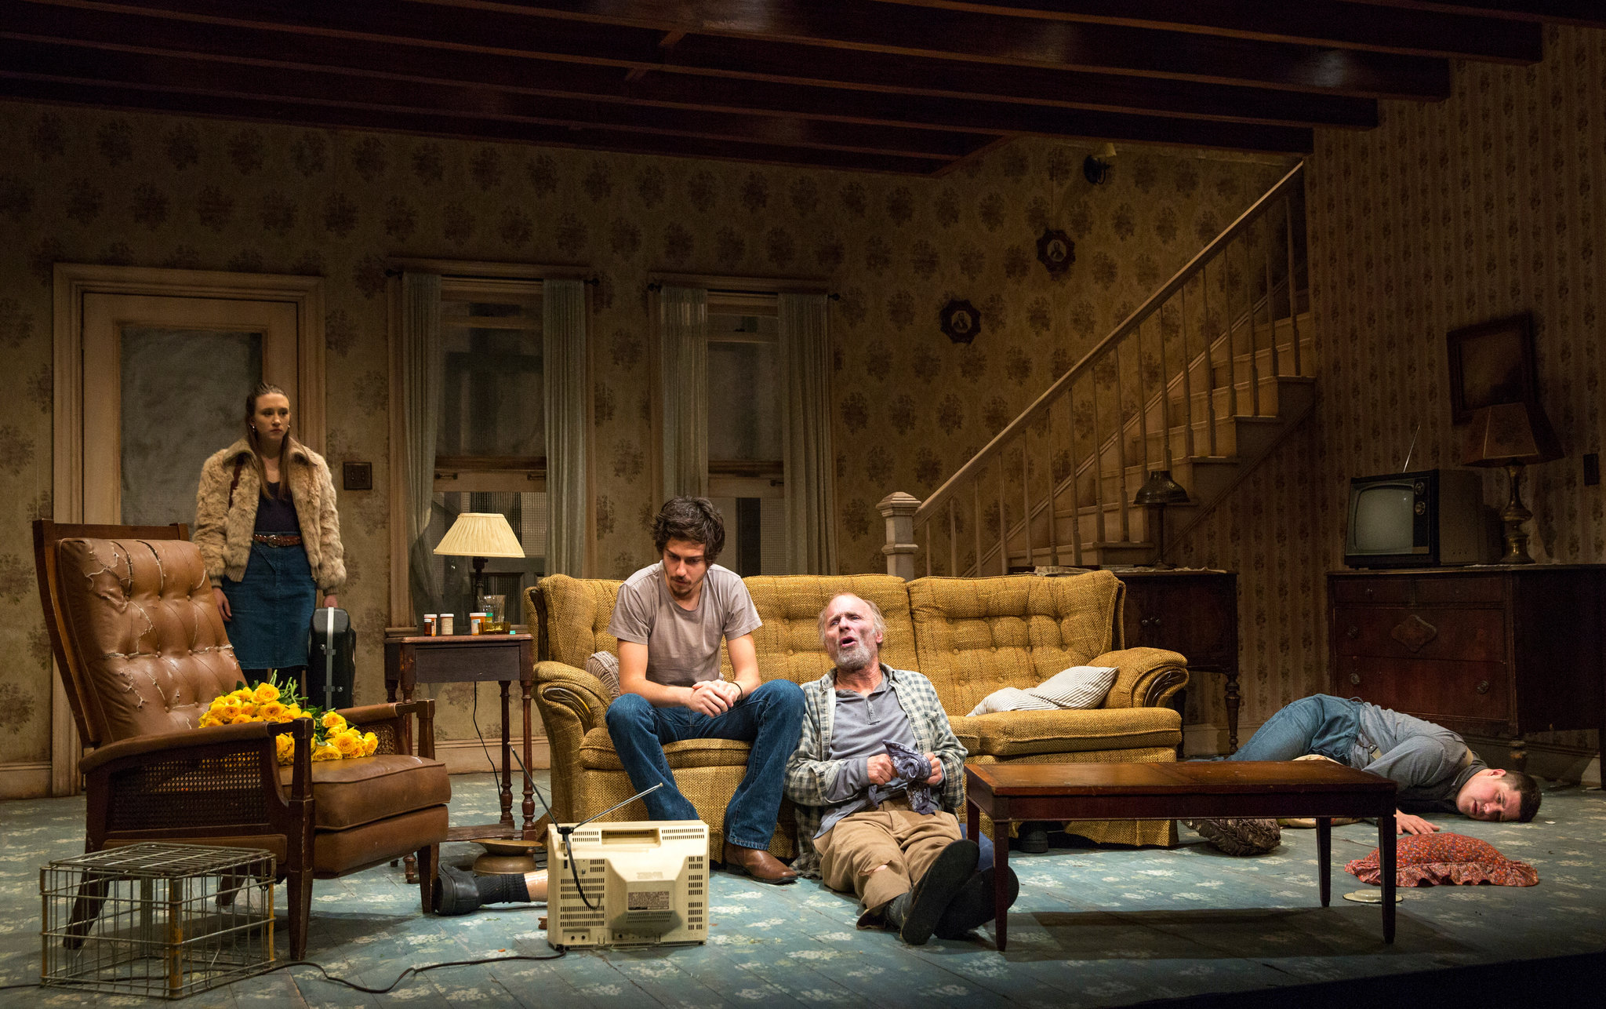

Slide 12
The House
In this play the house symbolize the sins that adhere to the family. The sin of incest and murder which can not be forgotten by all the member of the family. This house fells like trap for everyone, even for the innocent like Vince, Shelly, and father Dewis, there have no idea of what happen in the family but once they are involved, they can not turn away or escape from the house.

Slide 13


