Slide 1
The Significance of Place in Selected Poems by Seamus Heaney

Slide 2
Seamus Heaney (1939 –2013)
An Irish poet, translator, and lecturer.
In search of intellectual life, Heaney traveled abroad, leaving his land and family behind.
Heaney stresses such ideas as belonging, home, family, etc. in his poetry. Home, for him, means Ireland.

Slide 3
Domestic life home/family Ireland
The domestic scene is a metaphor for Ireland. Historically, the Irish people cherished home, family, and children the most.
So, the poet sees Ireland as a house whose people, food, music, religion are part and partial of his being.
In some of his poems, Ireland is depicted as a kitchen that gathers the poet with his family. For example, in “Clearances”, the poet says:

Slide 4
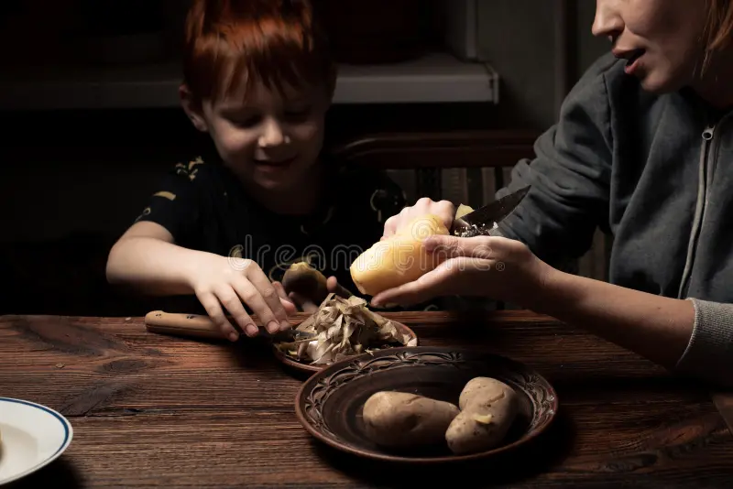
When all the others were away at Mass
I was all hers as we peeled potatoes.
It is a joyful and warmth scene. It is something typically Irish (the love between mother and son, and the word “potato” which reminds the reader with the potato famine in 1840.
Peeling has a significant meaning. When you are peeling something you come to its heart. It is like the act of digging the earth. Metaphorically, it means diving into the history of his land.

Slide 5
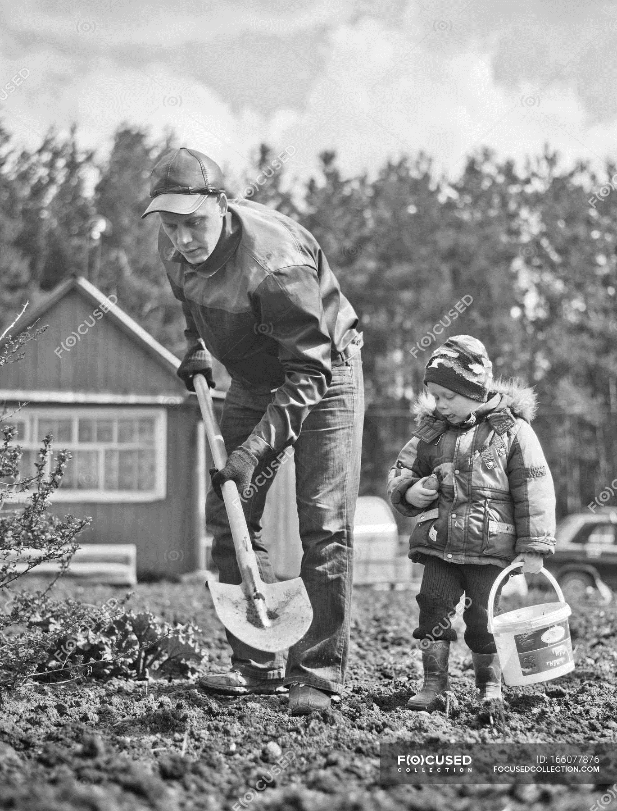
Under my window, a clean rasping sound
When the spade sinks into gravelly ground:
My father, digging. I look down
…
Bends low, comes up twenty years away
Stooping in rhythm through potato drills
Where he was digging.
This poem reflects his strong connection to his birthplace and his family.
His father’s digging into the ground to bring potatoes out, which is their source of living, is identified with the act of digging into the world to find the sense of intimacy, stability and belonging.
The poem becomes a house of being on which the poet is dwelling, and the linguistic signs invite the reader to contemplate on the beauty of the poet’s home. Therefore, language becomes the home of the poet and his readers as well.

Slide 6
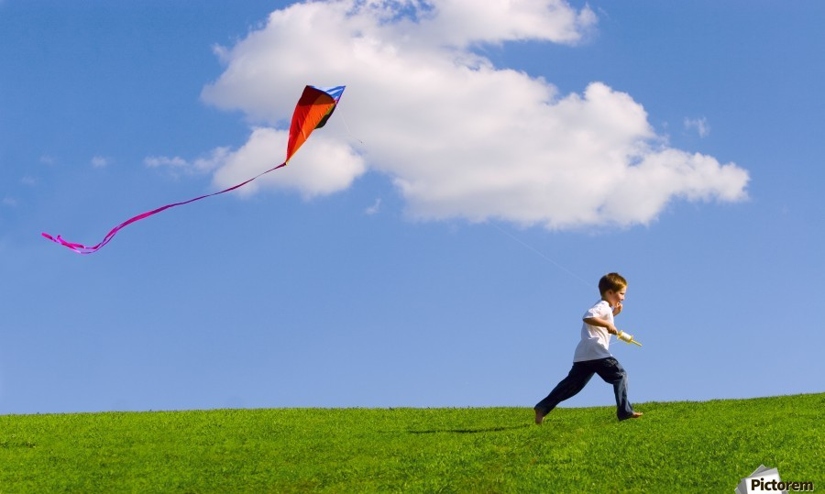
In “Gravities”, Heaney concentrates on the link between the poet and his homeland by using the images of kite and pigeon:
High-riding kites appear to range quite freely
Though reined by strings, strict and invisible.
The pigeon that deserts you suddenly
Is heading home, instinctively, faithful
The strings of the kite metaphorically represent the invisible link between the poet and Ireland. They also represent the unconscious force that attracts him back to his homeland. The speaker declares that going home when one needs to feel safety is the right choice because home matches the sense of belonging, a place of shelter, a place that he is familiar with, a place that provides comfort, security, and protection.
Symbolically, this home stands for the gravity of Ireland to its citizens, especially when the poet talks about the pigeon that leaves its place and fly a distance, but suddenly has the desire to return home. This means that there is an unconscious force that pulls the poet back to his homeland. That is why the poem is called “Gravities”

Slide 7
To conclude, Heaney, in his poetry, is seen inseparable from his family, roots, and land. His sense of belonging springs from his admiration and gratitude towards his ancestry. This sense also comes from the poet’s desire to motivate the young generation to establish a strong relation to their homeland.
I had my existence. I was there.
Me in the place, and the place in me
Seamus Heaney

