Slide 1
Heterotopia and the Domestic Space: A Reading of Somerset Maugham’s “The Three Fat Women of Antibes”
Asst. Prof. Dr. Maha Qahtan Sulaiman

Slide 2

Heterotopia and the Domestic Space

Slide 3
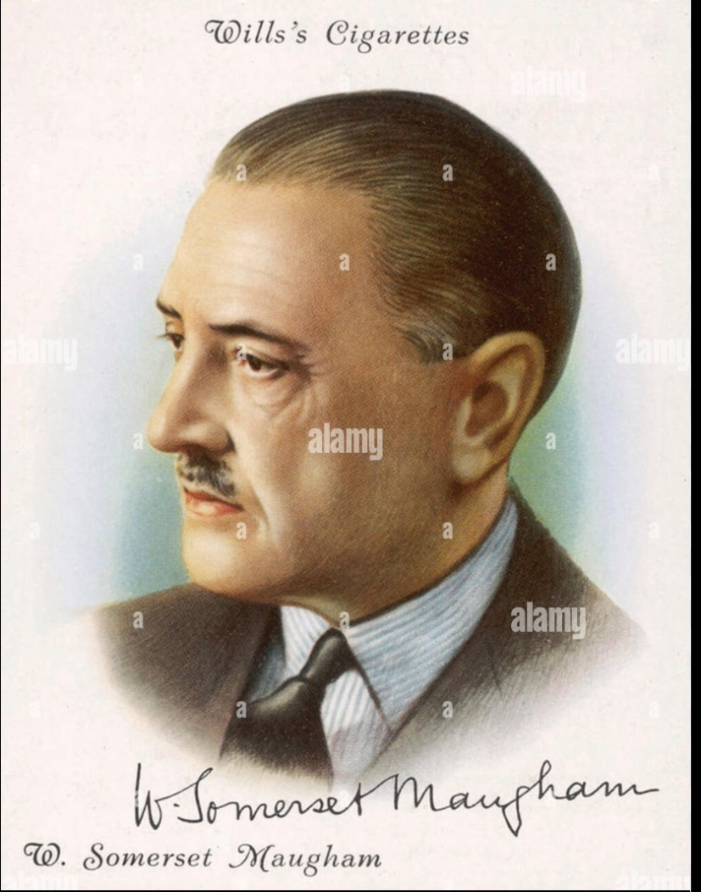
Somerset Maugham

Slide 4
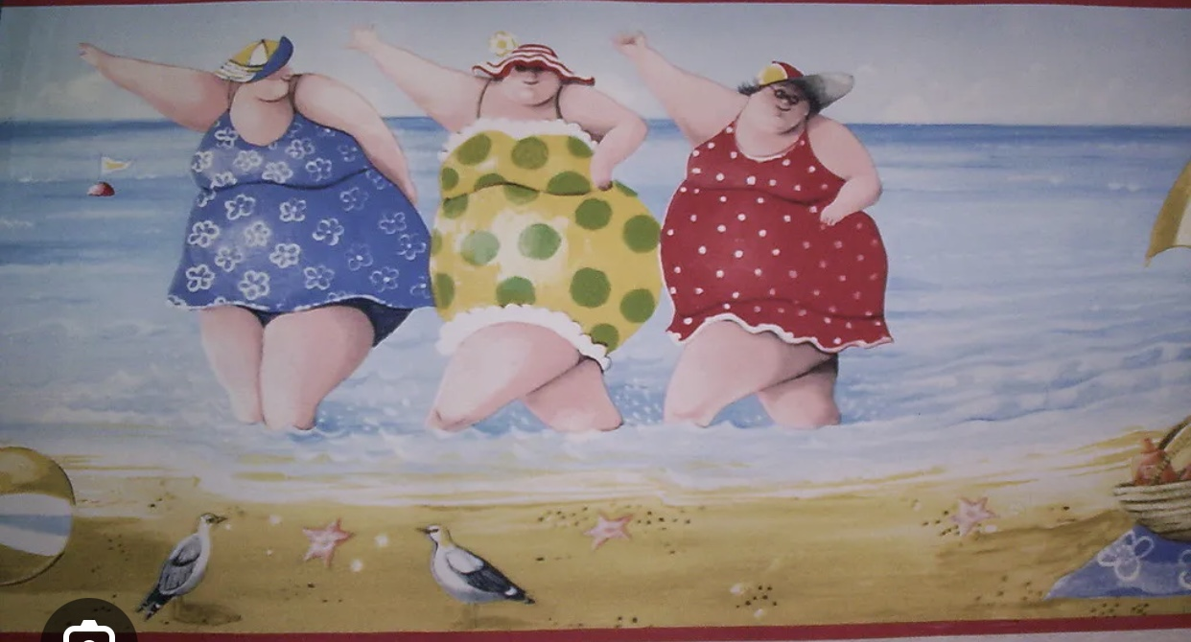
One was called Mrs. Richman and she was a widow. The second was called Mrs. Sutcliffe; she was American and she had divorced two husbands. The third was called Miss Hickson and she was a spinster.

Slide 5
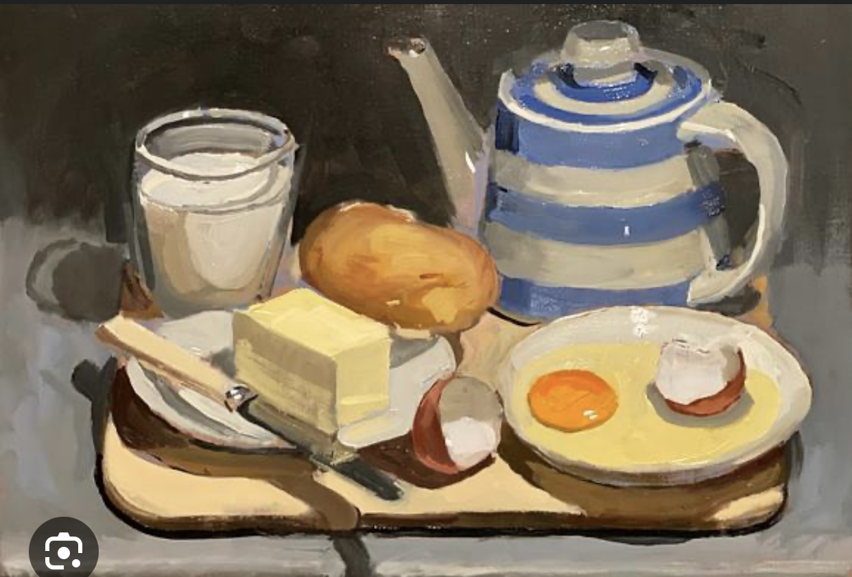
“But if I’m never to eat a thing I like, life isn’t worth living.”

Slide 6

Thank You

