Slide 1


The home through a human perspective
(A historical review with Philosophical thoughts)
Amna Bassim Mohammed Salih
Lecturer at the department of architecture - college of Engineering- University of Baghdad
Prof . Dr: Ghada AL-Silk
Professor at the department of architecture - the college of Engineering- University of Baghdad

Slide 2
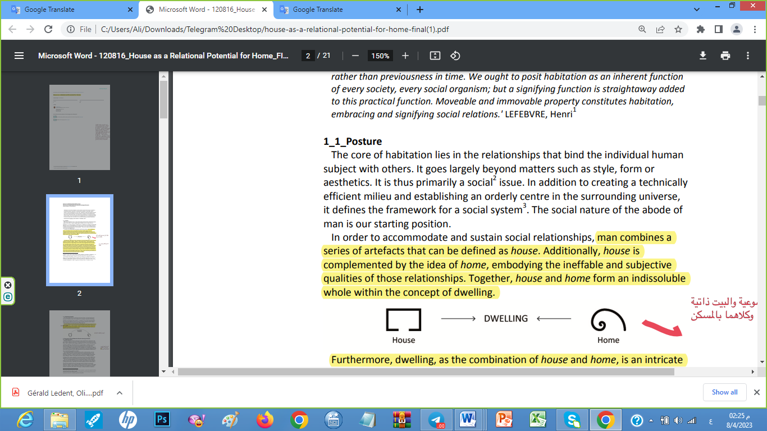
What is the house, home and dwelling?
House , dwelling, and home

Slide 3
The human and home
Philosophical perspective
Bollonow,1961
Bachelard, 1964
Heidegger,1971
Schulz,1985
Analysis
supporting knowledge

Slide 4
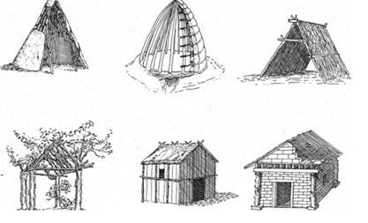
Bollonow,1961
Where is my home??
The primitive huts

Slide 5
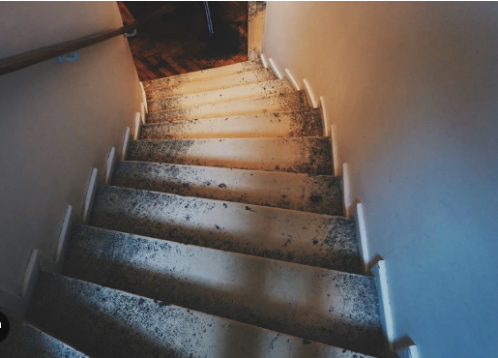
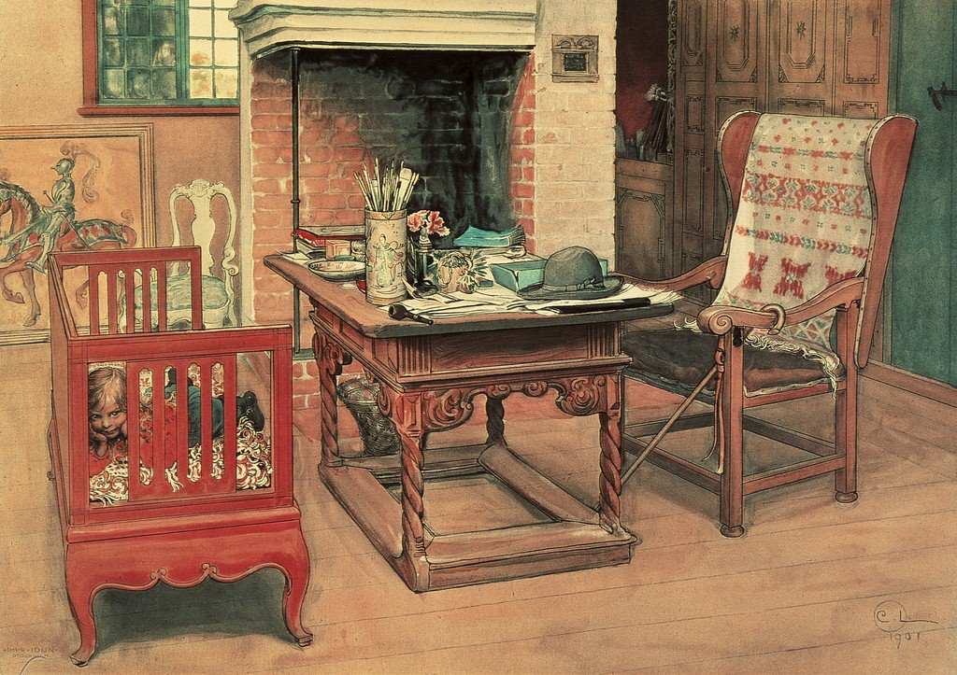
Bachelard, 1964
The Cellar-the attic
Home of things

Slide 6
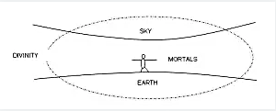
Heidegger,1971
"building, dwelling, thinking
“Dasein” in a formal way as “being-in-the world
To be a human being means to be on the earth as a mortal. It means to dwell
dwelling is the manner in which human beings are on earth.
we build and have built because we dwell.
fourfold, that is, the earth, the sky, the divinities and fellow human beings.

Slide 7
The idea of home is closely related to our existence on earth (Heidegger, 1971). In fact, Heidegger describes the concept of dwelling as ‘’the way in which you are and I am, the manner in which we humans are on earth’’ (1971:145). Then, we are dwellers in our nature, and that is the reason we build and create homes; to dwell. So we might understand the home as essential to our very being. (Dalia Al-Tarazi,2021)

Slide 8
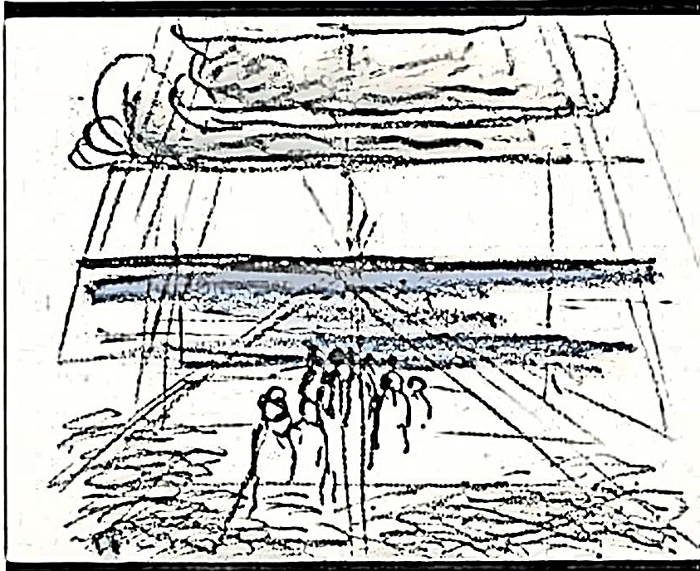
Schulz,1985
Norberg-Schulz’ (1979) concept of dwelling outlines that Man dwells when he can orientate himself within and identify himself with an environment, or, in short, when he experiences the environment as meaningful.

Slide 9
Intangible sides of place
The place\ Socially
home
The place\ physically

Slide 10
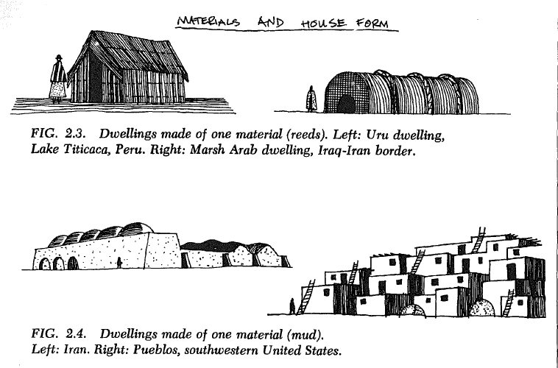
Rapport ,1968 … Anthropological perspective

Slide 11
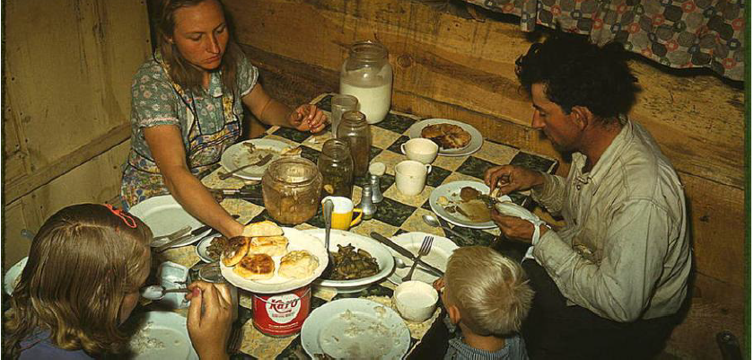

Slide 12
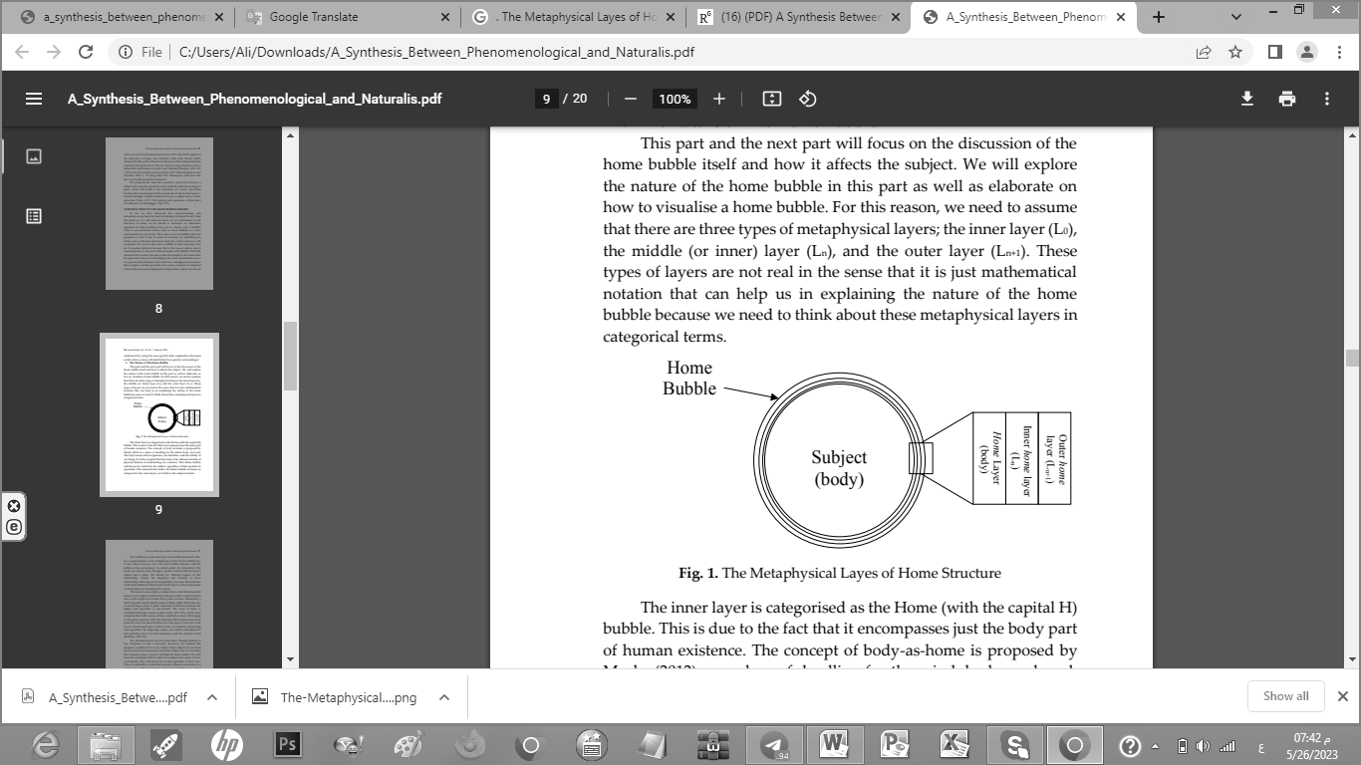
Humanities perspective as Supportive knowledge

Slide 13
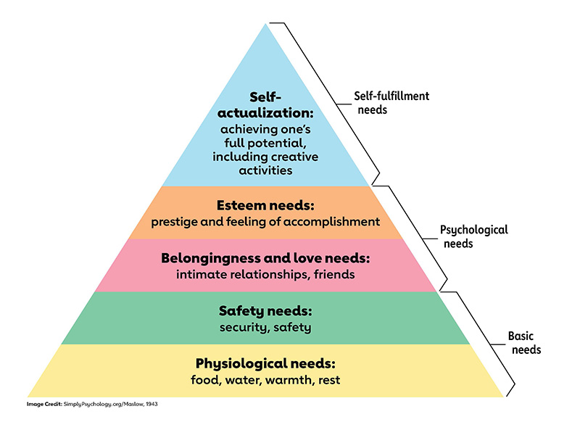
Human needs and home
home
house
Dwelling- shelter

Slide 14
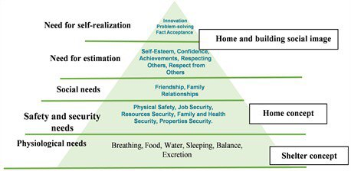

Slide 15
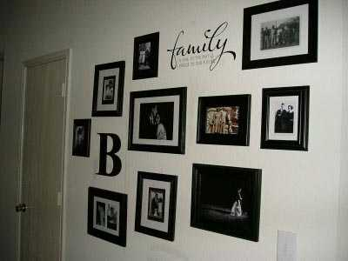
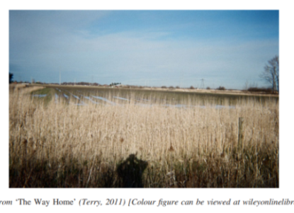
Through the time…

Slide 16
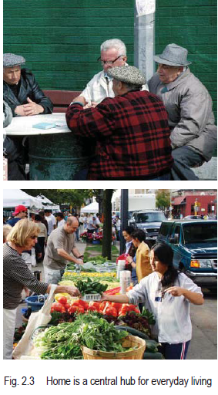

Slide 17
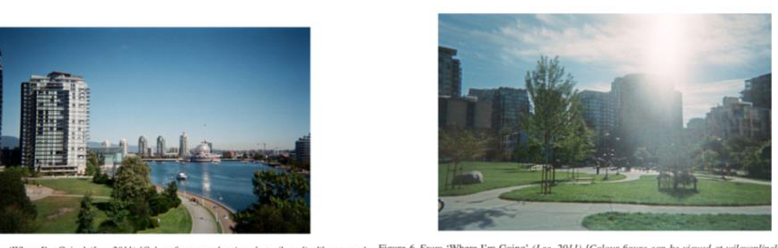
The future dreams as home…

Slide 18
The conclusion
The place\ Socially
Time and memories
The place\ physically
thoughts and values

Slide 19
Thank you …

