Slide 1

Battered Women Behind Closed Doors
By
Nadia Hikmet Faris

Slide 2



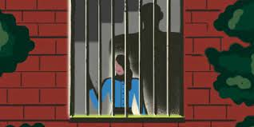
Three Main Theories From Psychology
Battered Women Syndrome
1
Cycle of Violence
2
Learned Helplessness
3

Slide 3



Questions
What are the reasons behind some women's decision to remain in abusive relationships?
Can helplessness be learned?
What are the strategies and interventions that can be implemented to break the cycle of violence?

Slide 4

Exploring the Complexities of Battering
A detailed overview of the concepts
BWS
Acceptance
COV
Interpreting
Analyzing
LH
The Process

Slide 5



Gain
Understand
Realise
Can Literature Find the Answers???
Provide

Slide 6

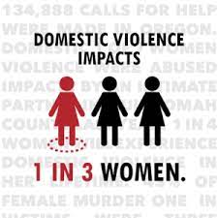
Lenore Walker first coined the term in the 1979
Characterized by: a. Anxiety b. Depression c. Feelings of helplessness and hopelessness d. Post-traumatic stress disorder (PTSD)
Factors contributing to a woman being 'battered': a. Isolation b. Parental restriction c. Lack of support d. Low self-esteem
01
Battered Women Syndrome

Slide 7
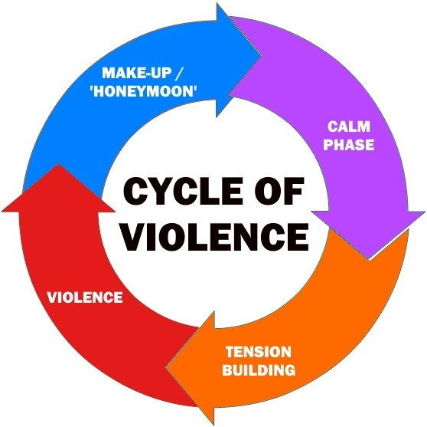
What is the Cycle of Violence?
        The Tension Building Phase
        The Acute Battering Phase
        The Reconciliation Phase
2
The Cycle of Violence

Slide 8
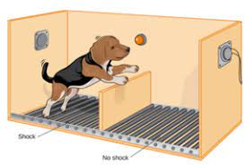

-What is Learned Helplessness?
-The Experiment
-Symptoms of Learned Helplessness
-Causes of Learned Helplessness
-Effects of Learned Helplessness
Martin Seligman
3
Learned Helplessness

Slide 9

-powerlessness
-hopelessness
-depression
-lack of motivation
-despair
Symptoms & Effects

Slide 10
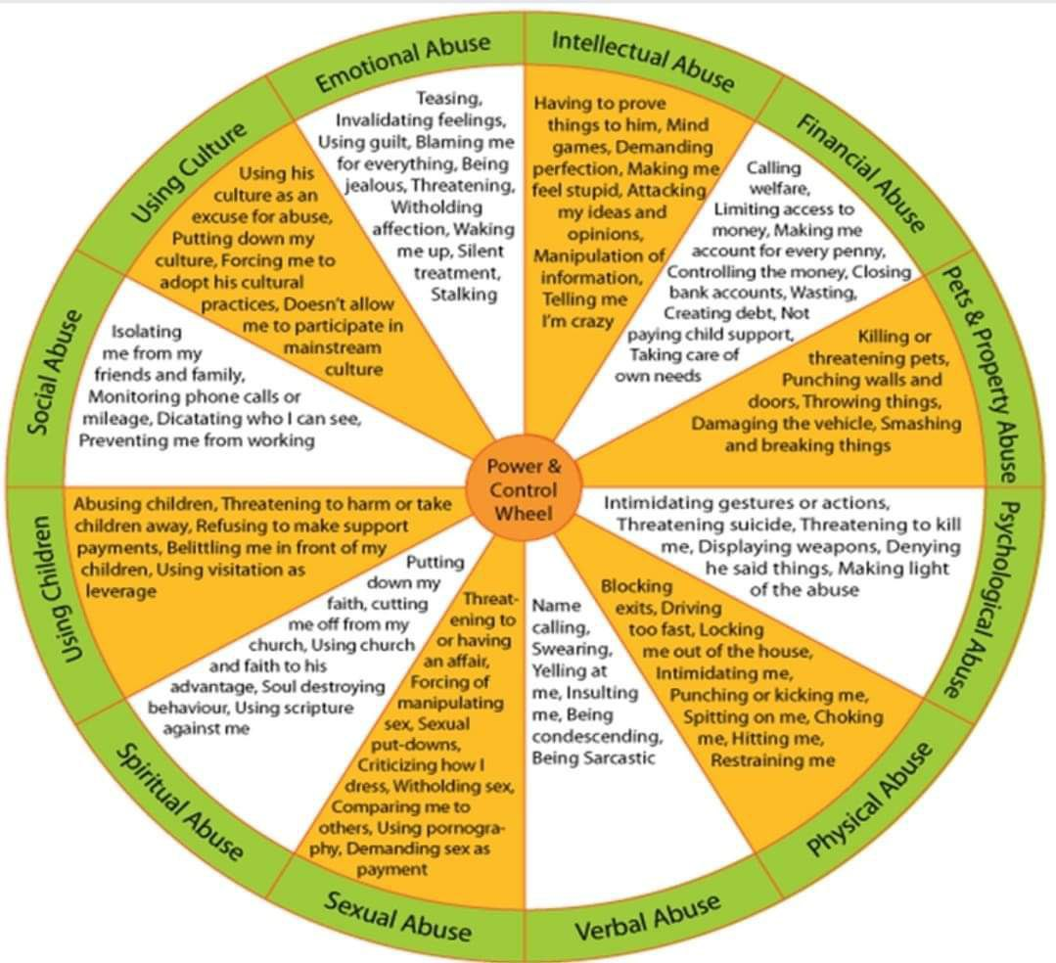
-Verbal Abuse
-Physical Abuse
-Spiritual Abuse
- Social Abuse
-Psychological Abuse
-Sexual Abuse
-Emotional Abuse
-Financial Abuse
-Using Children
-Using Culture
Causes

Slide 11



What's
The reasons behind abusive behaviors??

Slide 12


?
Psychological Issues
Behind Closed Doors
personality disorders
Extreme Narcıssısm

Slide 13

Results
Resilience
GOAL!
For the problems of the study
The root causes
Empowerment
Symptoms
Community engagement

Slide 14
Thank you for listening !
@
Nadia.hikmet@gmail.com

