Slide 1
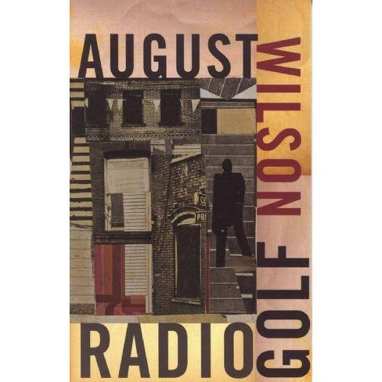
August Wilson’s Last Vision of African Americans’ Home in Radio Golf
Prof. Marwa G. Mohammed, PhD
College of Education for Women
University of Baghdad

Slide 2
Pittsburgh Cycle
Over the course of his playwriting career, August Wilson wrote his own cycle of ten plays collectively called the “American Century Cycle,” or the “Pittsburgh Cycle.” Wilson sets each of his ten plays in a different 20th-Century decade, offering insight into the complexities of the African American experience through changing social and historical landscapes over the course of 100 years. The plays in Wilson’s cycle, except Ma Rainey’s Black Bottom, are set in the Hill District of Pittsburgh, Pennsylvania—the area of Pittsburgh where Wilson grew up.

Slide 3
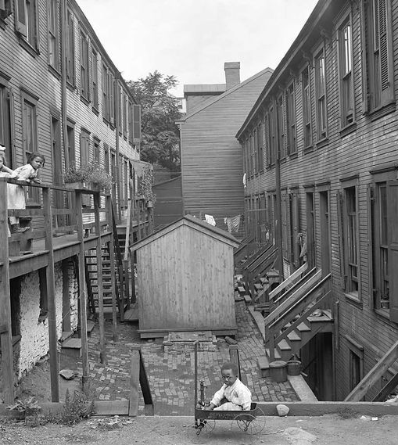
Hill District of Pittsburgh
Radio Golf, like most of Wilson’s plays, takes place in the Hill District of Pittsburgh, Pennsylvania. Of the plays in his American Century Cycle. The Hill District acts as a character in its own right, growing, changing, and responding to the social and political issues facing its community throughout the cycle. Located northeast of downtown Pittsburgh, the Hill District’s history is as vast and diverse as its inhabitants over the years. It has gone by many names, being known at some points as “Little Haiti,” “Little Harlem,” and “the crossroads of the world.” By the 1930s, the Hill District was a predominantly Black neighborhood with a culture and social scene all its own. Even as poverty continued to plague the area, the Hill District became a flourishing epicenter of arts and kinship. As the documentary Wylie Avenue Days says, “from the 1930s to the 1950s, the Hill District emerged as one of the most prosperous and influential Black communities in America.” Indeed, the Hill District earned a reputation for its thriving jazz scene, boasting famous jazz artists.

Slide 4
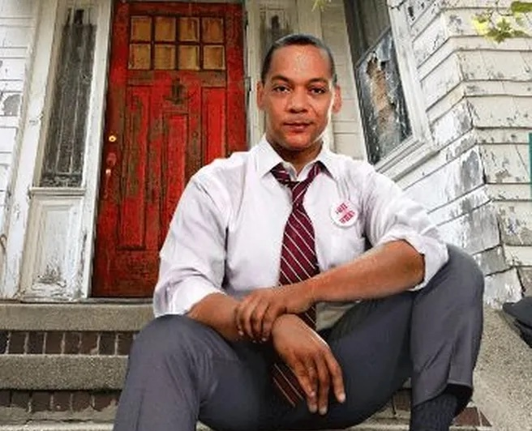
Harmond Wilks
The tale centers on the wholly plausible Harmond Wilks , a charming property developer who has high hopes that his revitalization will pave the way for him to become the city’s first Black mayor.

Slide 5
History vs. Mythology
Asked about the foundations of African American culture in a 1991 interview, Wilson replied, “The one thing which we did not have as Black Americans —we didn’t have a mythology. We had no origin myths.” The Wilson cycle is permeated by the tropes of mythology. August Wilson had no analogous body of mythology upon which to draw in writing his cycle, and so he created one himself.
Radio Golf occupies a unique position within this framework. In many ways, it dramatizes the central conflict between history and mythology. Harmond Wilks is a man of history, a man of destiny. The path before him is clear, and he knows what he must do in order to walk it. But into his life comes Elder Joseph Barlow, a mythological archetype in the vein of Solly Two Kings or Aunt Ester. He represents the tradition of mythology and folklore for which Harmond has never previously had time. As the successive revelations of the plot unfold, Harmond learns that he is not just a product of history; Wilson’s mythology runs in Harmond’s blood, and he cannot turn his back on it. August Wilson gave the African American community, and all Americans, a great gift in his cycle. He created the cycle for all of us, and he showed us in Radio Golf that we need both history and mythology to move forward into the future.

Slide 6
“You might be wearing a suit, but how many lives were sacrificed, how much blood was shed for you to get here?”

Slide 7
“If you don’t know where you are, you probably don’t know who you are”
Radio Golf forces Harmond to understand his place in the world, literally moving him from the office space that represents both his future (it is a campaign office) and the neighborhood’s future (it is a construction office established for the renewal of the Hill District) to the protest at Old Joe’s house, which represents his personal history and the neighborhood’s past.

Slide 8
THANK YOU

