Slide 1



Optimality Theoretic Pragmatics
Asst. Prof. Ramia Fu’ad Abdulazeez (Ph.D.)

Slide 2
What is OT?
OT is a constraint-based concept whereby linguistic generalizations are analyzed by means of constraints only, neither rules nor transformations.
The gist of this theory reads as follows: any language consists of a set of competing surface forms out of which one, and only one, is optimal. It becomes optimal when it least violates that language's highly-ranked constraints.

Slide 3
OT Basic Components
OT has four basic components:
Generator (henceforth, GEN).
Constraint (henceforth, CON).
Evaluator (henceforth, EVAL).
Candidates (henceforth, CAN).

Slide 4
Definitions
GEN: Given an input representation, GEN provides a set of potential output forms.
EVAL: Given the candidate set created by GEN, EVAL chooses the most optimal or harmonic output for the given input representation.
CON: A language-specific ranking of a universal set of CON is used by EVAL in determining the optimal output form.

Slide 5
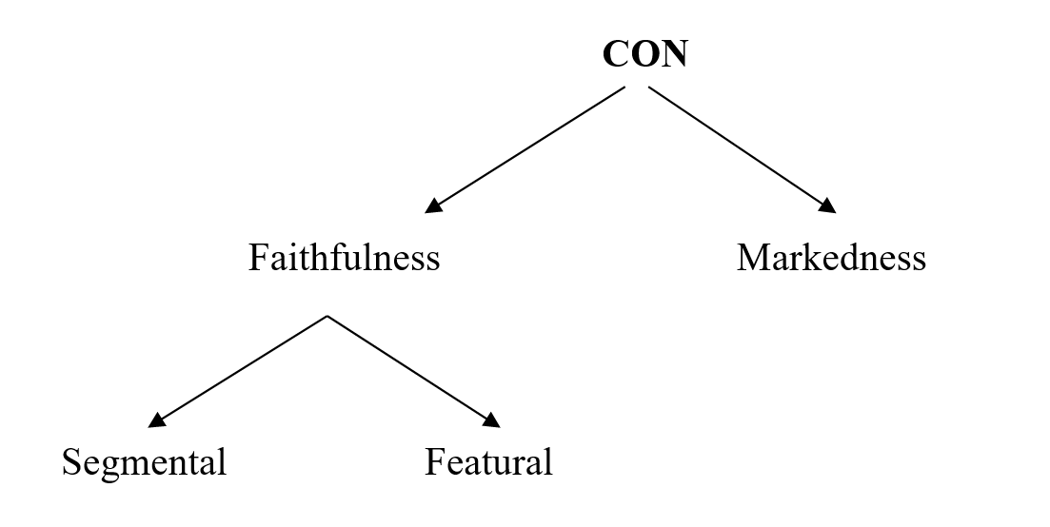
Constraints?
A CON is a criteria-provider: it provides the necessary criteria required to choose among the possible candidates one optimal output. They are universal, violable, and rankable. They are of two types:

Slide 6
OT Pragmatics
It is an application of the integrated approach to the domain of Gricean pragmatics. This has to do with the normative character that is attributed to the Gricean setting. Speakers, as Grice puts it, must
make their contribution such as is required, at the stage at which it occurs, by the accepted purpose or direction of the talk exchange in which (they) are engaged.

Slide 7
However?
There is a philosophical gap between Gricean pragmatics as a normative theory and OT as a scientific, explanatory theory of natural language. Thus, the naturalistic stance taken by OT pragmatics is one characteristic that brings it close to Relevance Theory, whose basic principle is: "every utterance conveys the information that it is relevant enough for it to be worth the addressee's effort to process it"

Slide 8
Whom to focus on? Speaker or Hearer?
In an answer to this question, another approach emerges: Neo-Gricean systems which posit two opposing optimization principles focusing n both:
the Q- and the I-principle by two simultaneous optimization directions (the speaker and the hearer direction) and so obtain a bidirectional OT pragmatics.
The first is oriented to the interests of the hearer and looks for optimal interpretations; the second is oriented to the. interests of the speaker and looks for expressive optimization.

Slide 9
Pragmatic Constraints? A definition of what is marked in interpretation.
FAITH: What is marked according to FAITH are any deviations from what is overtly given in the utterance.
2. PLAUSIBLE: An interpretation is bad if there is a more plausible
interpretation that is otherwise equally good.
3. NEW: Old referents are preferred over connected referents which are preferred over new referents.

Slide 10
Last Pragmatic Constraint
4. RELEVEANCE: prefers interpretations which help to achieve current goals of the conversation, or which settle the questions that have been activated. Accordingly, what is unmarked here makes sense to the goals of the conversation. Any deviations or digressions to address a new topic are special.

Slide 11
Applications of OT Pragmatics ?
Mono-directional OT:
Strategic Maneuvering: selecting modes of strategic maneuvering.
Critical Pragmatics: Selecting the optimal reproduction strategy.

Slide 12
Bidirectional OT:
pragmatics for propositional attitudes.
Disambiguation.
Discourse particles and presupposition.
Scalar implicatures and exhaustification.
Lexical pragmatics.

Slide 13
THANKS FOR THE ATTENTIVE LISTENING

