Slide 1
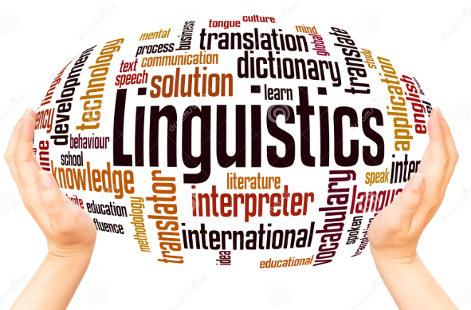
Interdisciplinarity in Translation: Broadening the Horizons
Asst. Prof. Dr. Khalida H. Tisgam

Slide 2
What do translation studies, linguistics, psychology, neuroscience, cognitive science, reading and writing research and language technology have in common?

Slide 3
Translation: the state of the art
Translation is a specific manifestation of linguistic behavior, or, as Coffin (1982) has put it: “Translation: An Exceptional Form of Language Use.”
Today the word translation is used in varied senses by sociologists, culture critics, philosophers, and linguists who often speak about translation in connection with globalisation and resistance.

Slide 4
As studies in semiotics suggest that borders tend to be more multiple and permeable than traditionally conceived, translation scholars therefore attempted to erase the borders between disciplines and rethink translation as an ongoing process of every communication.

Slide 6
Interdisciplinarity
Interdisciplinarity has played a significant role in establishing close relations with different disciplines. The greatest development is the “emergence of new perspectives, each seeking to establish a new ‘paradigm’ in translation studies” (Munday, 2012, p. 26).
The diversity and multiplicity of interdisciplinary approaches has set the scene for the central role of translators as “agents who work in the space of the relations between languages and cultures” (Pym, 1998, p. 57).

Slide 7
Interdisciplinarity has established close relations between translation studies and different disciplines such as philosophy, linguistics, anthropology, cultural studies, history, sociology, computer science, psychology and pragmatics.

Slide 9
Translation scholars are heavily drawn on the very broad domain of linguistics as they both concerned with the major function of transferring meaning and enhancing communication and interaction.

Slide 11
The publication of Mona Baker’s seminal article in 1993 has put corpus-based translation studies on centre stage.
Corpora of translated texts have been employed by translation researchers to systematically describe the translated product at different points in the translation process (e.g., prior to and following the (self-) revision stage).

Slide 12
Corpus linguistics in Translation
It provides a method for description of language use in translation.
It enables translation scholars to uncover the nature of translated text as a mediated communicative event.
It analyzes the translated and non translated texts.
It tells the similarities and differences of translated and non translated texts.
It reveals the effect of the original language on the target language.

Slide 13
the use of corpora is not limited to identifying, quantifing and analyzing keywords.
It also reveals collocational co-occurences.
Shed light يلقي الضوء
Shed tears يذرف الدموع
Shed blood يريق الدماء
Shed pounds ينقص وزنه
Shed skin ينزع جلده (الأفعى)

Slide 14
Conclusion
The interaction between translation studies and other disciplines is fruitful on theoretical, methodological as well as practical levels.
By borrowing ideas and concepts from other disciplines, translation scholars were able to gain great insights into additional translational phenomena, and the field experienced another boom.
Only through Interdisciplinary we can move beyond the confines of the original-translation binary and conceive Translation Studies as an ever-widening and inclusive space that thrives on dialogues and border crossings.

