Slide 1
Ecostylistics and Text Analysis
By
Asst. Prof. Eman Adil Jaafar
Department of English -College of Education for Women
University of Baghdad
Symposium
Interdisciplinary Innovation in Linguistic Studies
October 24.2023

Slide 2
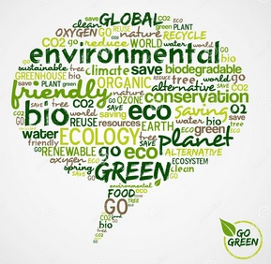
Ecostylistics focuses on the stylistic analysis of environmental topics in various texts genres (both literary and non-literary) by using a variety of linguistic frameworks and approaches (Virdis, 2022).te analysis and assessment of ecological language patterns in texts increase awareness of the global ecological problems.
https://images.app.goo.gl/646KyLFWJX8z3vzV7

Slide 3
Ecostylistics )Green stylistics)
According to The Oxford English Dictionary, the prefix eco- has two meanings: First, environment means the surroundings that people live in. Second, ecology means the relationship between different organisms and their environment. Ecostylistics designates a new approach that overlaps with both ecolinguistics and ecocriticism.
Ecostylistics concentrates on two perspectives. First, the relation between the style of a text, physical environment, and linguistic representation. Second, the evaluation and investigation of ecological linguistic patterns in text, thereby contributing to the global environmental awareness (Zurru, 2017).

Slide 4
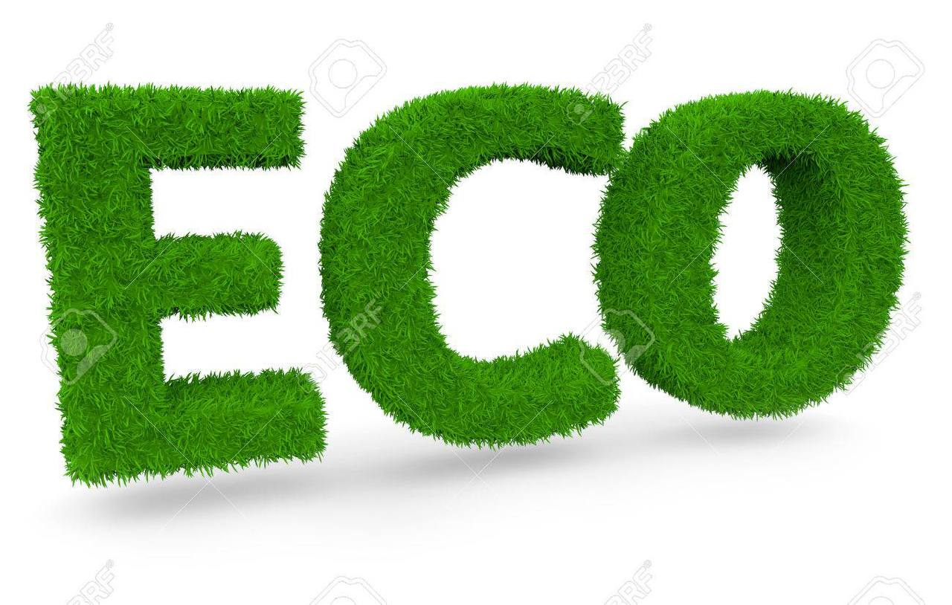
Eco-words
The interconnectedness between human existence and the physical environment is becoming more apparent with the emergence of eco-words in the English language. Eco-words are related to the environment which presents the place of plants, animals, and organisms. (Zurru, 2017).

Slide 5
Possible Research Questions
What are the ecostylistic features in a selected text?
2. What are the main language patterns that reveal authorial style in portraying the role of eco elements?
3. What are the main non-human environmental participants that affect humans and how this influence is portrayed by the authors?

Slide 6
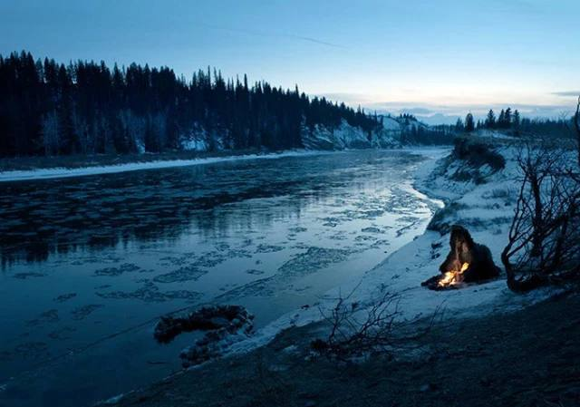
The Significance of Ecostylistic approach
The approach highlights the language patterns that are used to describe nature and environmental elements.
In particular, the focus is on the conflict or the relationship between human and non-human participants, and how humans can confront environmental issues.

Slide 7
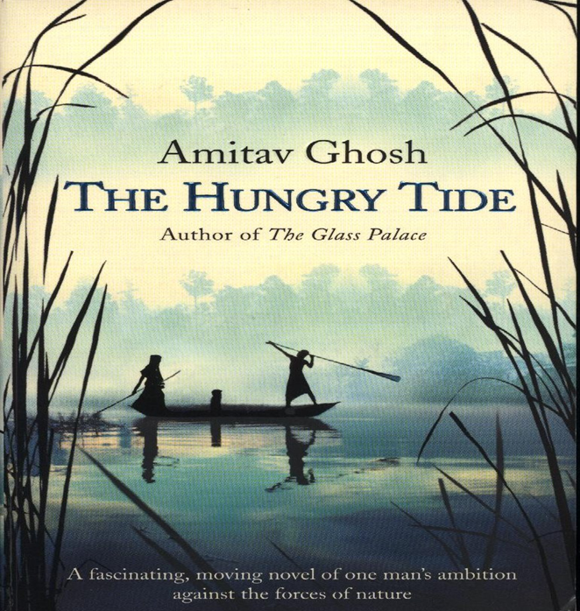
Example
The theoretical and methodological frameworks of ecostylistics are applied to the analysis of The Hungry Tide (THT) novel by Amitav Ghosh (2005). The next section will therefore focus on the ecostylistic analysis of two extracts from to investigate the relation construed between humans and physical landscape, notably rivers and tides, and the linguistic choices at work by adopting a functional approach to the analysis of Process Type and Agency in the case study.
Halliday’s Systemic Functional
Grammar (SFG; Halliday &
Matthiessen 2014[1985]).

Slide 8
Analysis and Discussion/ The Hungry Tide
The title of the novel gives rise to an unusual collocation, since the premodifier ‘hungry’ is usually employed in relation to animate entities, e.g. people. This constitutes an instance of deviation in stylistic terms and is, consequently, foregrounded (Douthwaite, 2000, p. 179).

Slide 9
Example (1)
“The tide country digested the great galleon within a few years” (Ghosh, 2005, p. 186).
In Example (1) above, “The tide country” is therefore the Actor in the transitive model and the Agent in the ergative model, whereas “the great galleon” is the Goal in the transitive model. Example (1) is thus a first indication of how physical landscape is assigned Agency through specific linguistic choices in THT.

Slide 10
Example 2 The Matla took pity on this matal.
In [2] the nominal group “The Matla”( Matla River, West Bengal, India)
is the Senser in the emotive Mental Process “take pity on” (Halliday & Matthiessen 2014[1985]: 249), whenever a non-conscious entity is linguistically made into a Senser, that entity is constructed metaphorically, hence personified. The Matla personified at the linguistic level, but it is also made into a character at the narrative level(Zurru, 2017, p. 210).

Slide 11
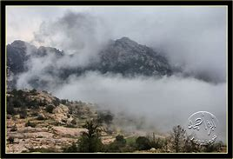
Thus, the linguistic selections so far guide readers towards adopting an unusual mental set in which the Matla is to be seen principally as a personified character rather than as an inanimate entity forming part of the setting of the story. Ghosh stresses the non-human participant by embedding the environment with clear agency. The narrator depicts nature as a human participant to deliver a message that nature is very important like humans.

Slide 12
Conclusion
In order to attract the reader’s attention and create defamiliarization in a text, the author gives authority to non-humans ( nature). Ghosh focuses on the interaction between people and the natural world. The rivers of the Tide country actively affect human behaviors. Ghosh utilizes nature elements in comparison to helpless humans who have no chance against it. The writer conveys an important idea that the agency is not limited to human beings. The writer transforms readers’ perceptions by shifting his attention from individual actors and entities to the relationships between them. He allows the reader to explore how non-human participants play a fundamental, active, and purposeful role in the making of the human world.

Slide 13
References
Zurru, E. (2017). The agency of the hungry tide. In J. Douthwaite, D. F. Virdis & E. Zurru. (Eds.), The stylistics of the landscape, the landscape of stylistics (pp. 191-223). John Benjamins. http://benjamins.com.
Virdis, D. F. (2022). Ecological stylistics: Ecostylistic approaches to discourses of nature, the environment and sustainability. Springer Publishing.
Ghosh, A. (2005). The hungry tide. Houghton Mifflin Company.
Goatly, A. (2021). Thematic adverbial adjuncts of place and direction and their relationship to conceptual metaphor. In A. E. Housmanʹs A Shropshire Lad. In D. F. Virdis, E. Zurru & E. Lahey (Eds), Language in place: Stylistic perspectives on landscape, place and environment (pp. 17-44). Van Haren Publishing.
Google Image (n.d.). Google Image Result for https://thumbs.dreamstime.com/z/go-green-eco-words-cloud-social-media-bubble-24393524.jpg. https://images.app.goo.gl/646KyLFWJX8z3vzV7

