Slide 1
Navigating Social Context: Pragmatics and Sociolinguistics in Harmony
Assistant Instructor Israa Amer Mahmood Assistant Instructor Hiba Kareem Neamah
Symposium
Interdisciplinary Innovation in Linguistic Studies
October 24.2023

Slide 2
Introduction
Linguistics is a dynamic field, and its intersections with other disciplines are becoming increasingly vital. This presentation explores the synergy between two key linguistic branches: Pragmatics and Sociolinguistics.

Slide 3
Understanding Pragmatics
Pragmatics studies language in use, focusing on the way context shapes meaning.
Pragmatic analysis delves into implicatures, speech acts, and conversational principles.
Pragmatics is the study of how context influences meaning in communication. It focuses on the implied meanings, intentions, and assumptions behind linguistic expressions. By integrating pragmatics into sociolinguistics, researchers can analyze how language choices and social factors interact to shape communication patterns within different communities. This interdisciplinary approach provides valuable insights into how individuals navigate language use and negotiate meaning in real-world interactions.

Slide 4
Unveiling Sociolinguistics
Sociolinguistics investigates the relationship between language and society.
It emphasizes how language varies in different social contexts.
Sociolinguistics is a field that examines the relationship between language and society. By studying language variation and change in social contexts, researchers gain a deeper understanding of how language reflects and shapes social identities, power dynamics, and cultural norms. When combined with pragmatics, sociolinguistics offers a comprehensive perspective on how language functions in society, providing valuable insights into communication dynamics across different communities.

Slide 5
The Intersection
Pragmatics and Sociolinguistics converge in analyzing language within its social context.
Understanding how language is used in specific communities and situations is central to both fields.

Slide 6
Benefits of Synergy
Enhanced interpretation: A combination of pragmatic and sociolinguistic insights allows for a richer understanding of language use.
Societal implications: This synergy aids in addressing societal issues like linguistic discrimination, politeness, and identity construction.
The relationship between pragmatics and sociolinguistics is symbiotic, as each field contributes to a deeper understanding of language and its sociocultural context. Pragmatics focuses on the meaning and interpretation of language in social interactions, while sociolinguistics examines how language varies and changes in different social groups. By studying the interplay between these two fields, linguists can uncover valuable insights about language use, social norms, and identity construction.

Slide 7
Possible Case Studies:
Application in politics: Analyzing political discourse from a pragmatic and sociolinguistic perspective can reveal hidden agendas and persuasive strategies.
Social media communication: Understanding the pragmatics of online interactions in sociolinguistic terms can provide insights into evolving communication norms.

Slide 8
Sample Case Study:
Pragmatic Markers in New Zealand Workplace Interaction
According to Janet Holmes (2018 ) “Sociolinguists describe the linguistic resources available in speech communities, and provide a systematic account of how social variables influence linguistic choices from among those resources. Pragmatics explains how individuals use linguistic resources to produce and interpret meaning in interaction, and sometimes to change relationships. Certain aspects of each discipline are generally recognized as distinct, but there are also areas of overlap.”
She used workplace discourse to explore the constraints of egalitarianism and gender in New Zealand society, she has illustrated the advantage of drawing on both disciplines, and has demonstrated how macro-level (societal) and meso-level (eg. workplace teams, communities of practice) sociolinguistic norms may act as sociopragmatic constraints or as a focus for contestation in interaction at the micro-level in face-to-face workplace interaction.

Slide 9
Her research study explores the impact of societal norms related to gender and egalitarianism,(the belief in equality and fairness, particularly in terms of social, political, and economic rights), on workplace discourse in New Zealand.
- The study draws on two disciplines, namely sociolinguistics and sociology, to gain a comprehensive understanding of the issue.
- The research focuses on two levels of analysis: macro-level (societal) and meso-level (workplace teams and communities of practice) to examine how sociolinguistic norms operate as constraints or points of contention in face-to-face workplace interactions.
- The study suggests that societal norms related to gender and egalitarianism can impact workplace interactions, and these norms can be either constraining or contested in face-to-face interactions.
- the researcher uses the term "sociopragmatic constraints" refers to the limitations or restrictions imposed by societal norms on language use in social interactions.
- The study suggests that these constraints can be challenged or contested in workplace interactions, particularly at the micro-level, where individuals negotiate meaning and social norms in their interactions.
- The study highlights the importance of examining workplace discourse from multiple levels of analysis to gain a comprehensive understanding of the issue and its impact on workplace interactions.
Notes:
Sociolinguistics vs pragmatics Where does the boundary lie?
Janet Holmes | Part of
Pragmatics and its Interfaces Edited by Cornelia Ilie and Neal R. Norrick 2018

Slide 10
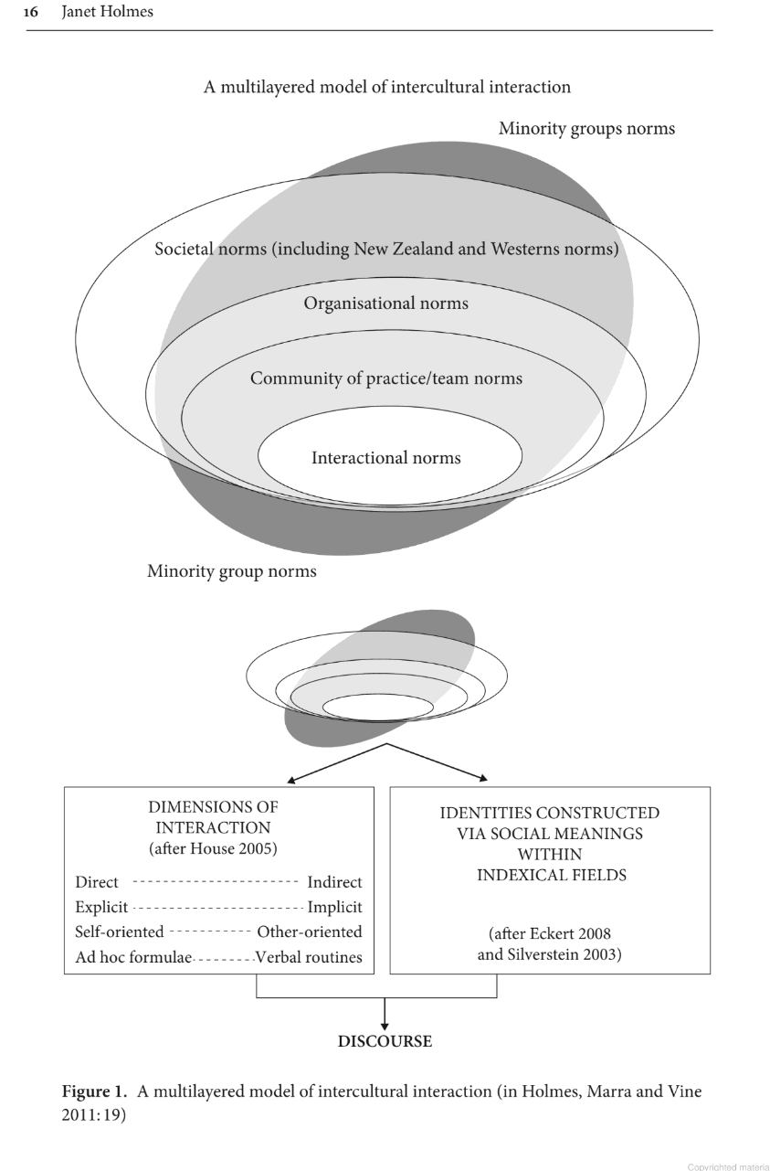

Slide 11
Janet Holmes (2018 ) refers to the fact that there is limited research on men's linguistic behavior in female-dominated professions compared to the extensive research on women in male-stereotyped roles. However, Holmes refers to a previous research that suggests that men in such professions often feel pressured to emphasize their masculinity when working in female stereotypical professions. Contrary to this, Holmes's work suggests that there isn’t much macho behavior in female occupational contexts. As McDowell (2015, p. 379) points out
"(the language used is the language of being a nurse regardless of the gender of the person in that work role".

Slide 12
Conclusion
In conclusion, the study of the dynamic relationship between pragmatics and sociolinguistics is crucial for understanding how language is shaped by sociocultural contexts and influences social norms and identity construction.

Slide 13
Bibliography
Blommaert, J. (2011). Pragmatics and discourse. In R. Mesthrie (Ed.), The Cambridge Handbook of Sociolinguistics (Cambridge Handbooks in Language and Linguistics, pp. 122-137). Cambridge: Cambridge University Press. doi:10.1017/CBO9780511997068.012
Pragmatics and Its Interfaces. (2018). Netherlands: John Benjamins Publishing Company.
Levinson, S. C. (1983). Pragmatics. Cambridge: Cambridge University Press.
Wardhaugh, R. (1986). An introduction to sociolinguistics. Blackwell.

Slide 14
“Because language and society are so closely linked, it is possible, in some cases, to encourage social change by directing attention towards linguistic reflections of aspects of society that one would like to see altered.”
― Peter Trudgill, Sociolinguistics: An Introduction to Language and Society

