Slide 1
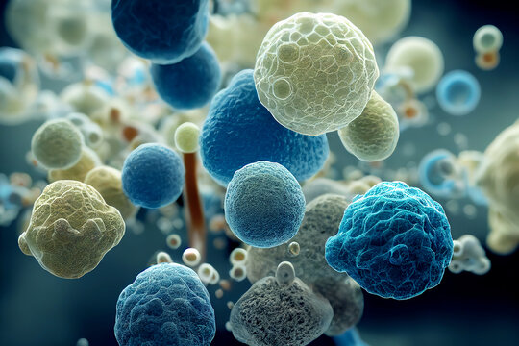
Diagnostic Methods used for Identification of Positive and Negative Bacteria
م.د. انســـام خالد محمد
م. مريم حمدي عبد الكريم

Slide 3
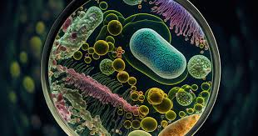

Slide 4
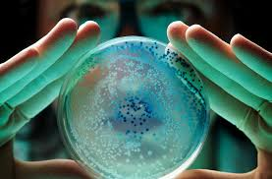

Slide 5
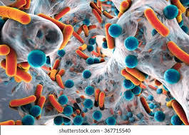

Slide 7
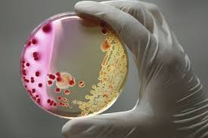

Slide 12
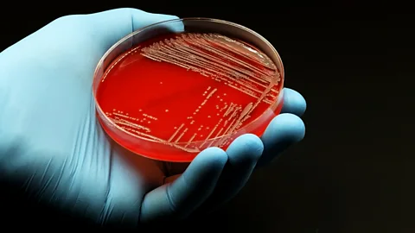

Slide 28
RT-PCR

Slide 34
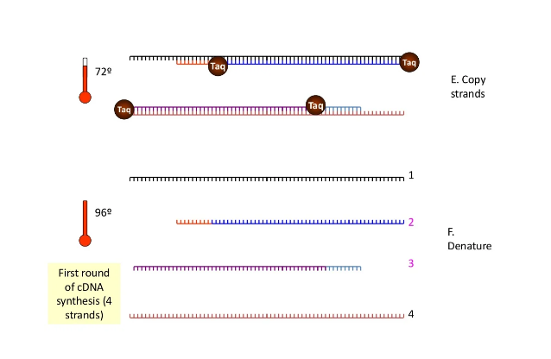

Slide 35
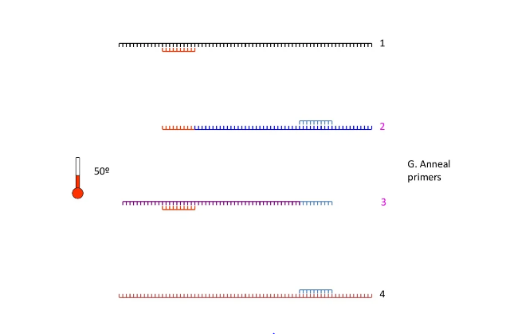

Slide 36
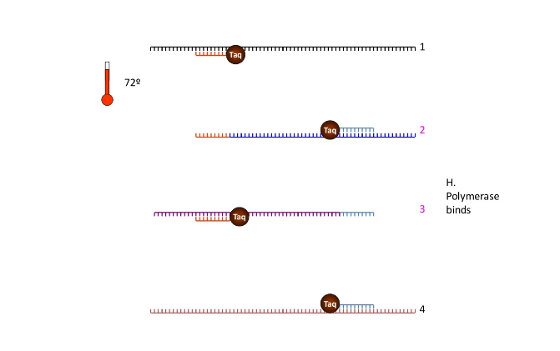

Slide 43
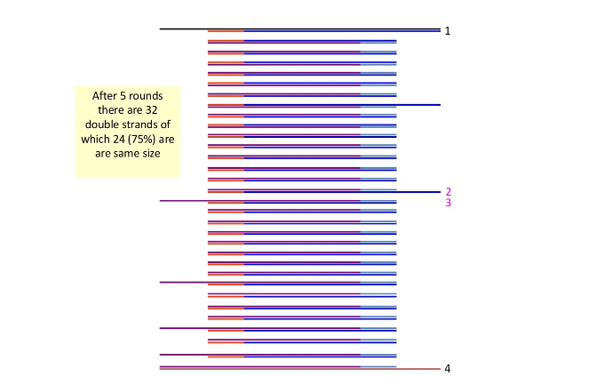

Slide 44
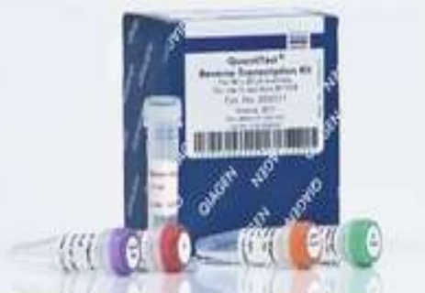

Slide 55
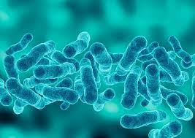

Slide 56
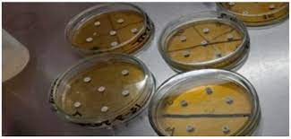

Slide 57
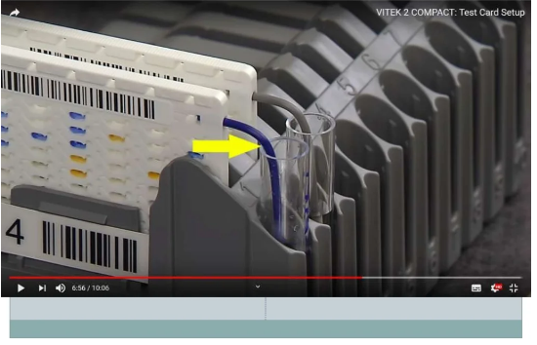

Slide 59
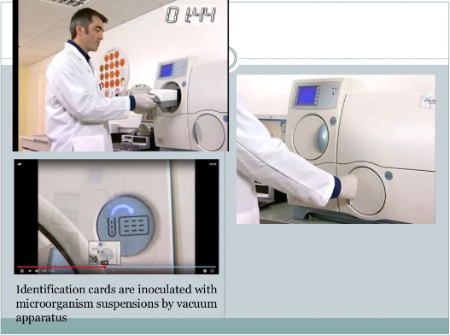

Slide 61
DIAGNOSTIC METHODS USED FOR IDENTIFICATION OF POSITIVE AND NEGATIVE BACTERIA
Q1- Both microfeatures and macrofeatures of the culture medium are useful at the identification of bacteria
Q2- MacConkey agar is a selective medium for G-ve bacteria
Q3- The most effective way for diagnosis of G+ve from G-ve bacteria is using VITEK2
Q4- Media are more effective for diagnosis of bacteria than biochemical tests
Q5- Conventional PCR is more efficient than RT-PCR in identifying bacteria

