Slide 1
Traditional and modern immunological methods in diagnosing some pathogens
Presented by
Dr .Ikram Abbas Aboud Al-Samarraae
Prof. Dr. Haider Mohammed Ali Sadiq
Al-Rubaie
Lecturer Dr. Roua Jassim Mohammed
Baghdad university\veterinary medicine

Slide 2
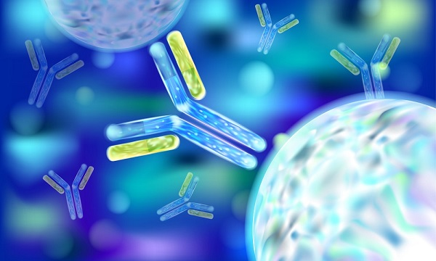
Introduction
Immunoassays to aid in the diagnosis of disease caused by infectious microorganisms, immunoassays have been developed. These biochemical and serological techniques are based on the detection and quantitation of antibodies generated against an infectious agent, a microbe, or non-microbial antigen.
Serology is the branch of immunology that studies the antigen — antibody reaction in vitro.

Slide 3
Training bag guide
The Subject: Traditional and Modern immunological methods in diagnosing some pathogens.
The general objective of the training package:
To provide trainees with knowledge of traditional and modern immunological tests.
Detailed objectives: At the end of the program, the trainee is expected to be able to :
The trainee will acquire knowledge about the types of immunological tests, both traditional and modern.
.The trainee should understand how these tests work.
The trainee learns how to apply it to diagnose pathogenic germs
The duration of the program : 3 days
Number of hours: 1 hour per day

Slide 4
There are many types of immunological tests
1
2
3
Agglutination
Hemagglutination
Precipitation
4
5
6
Enzyme Linked Immunosorbent Assay (ELISA)
Radioimmunoassay (RAST)
Immunofluorescence
7
Complement fixation

Slide 5
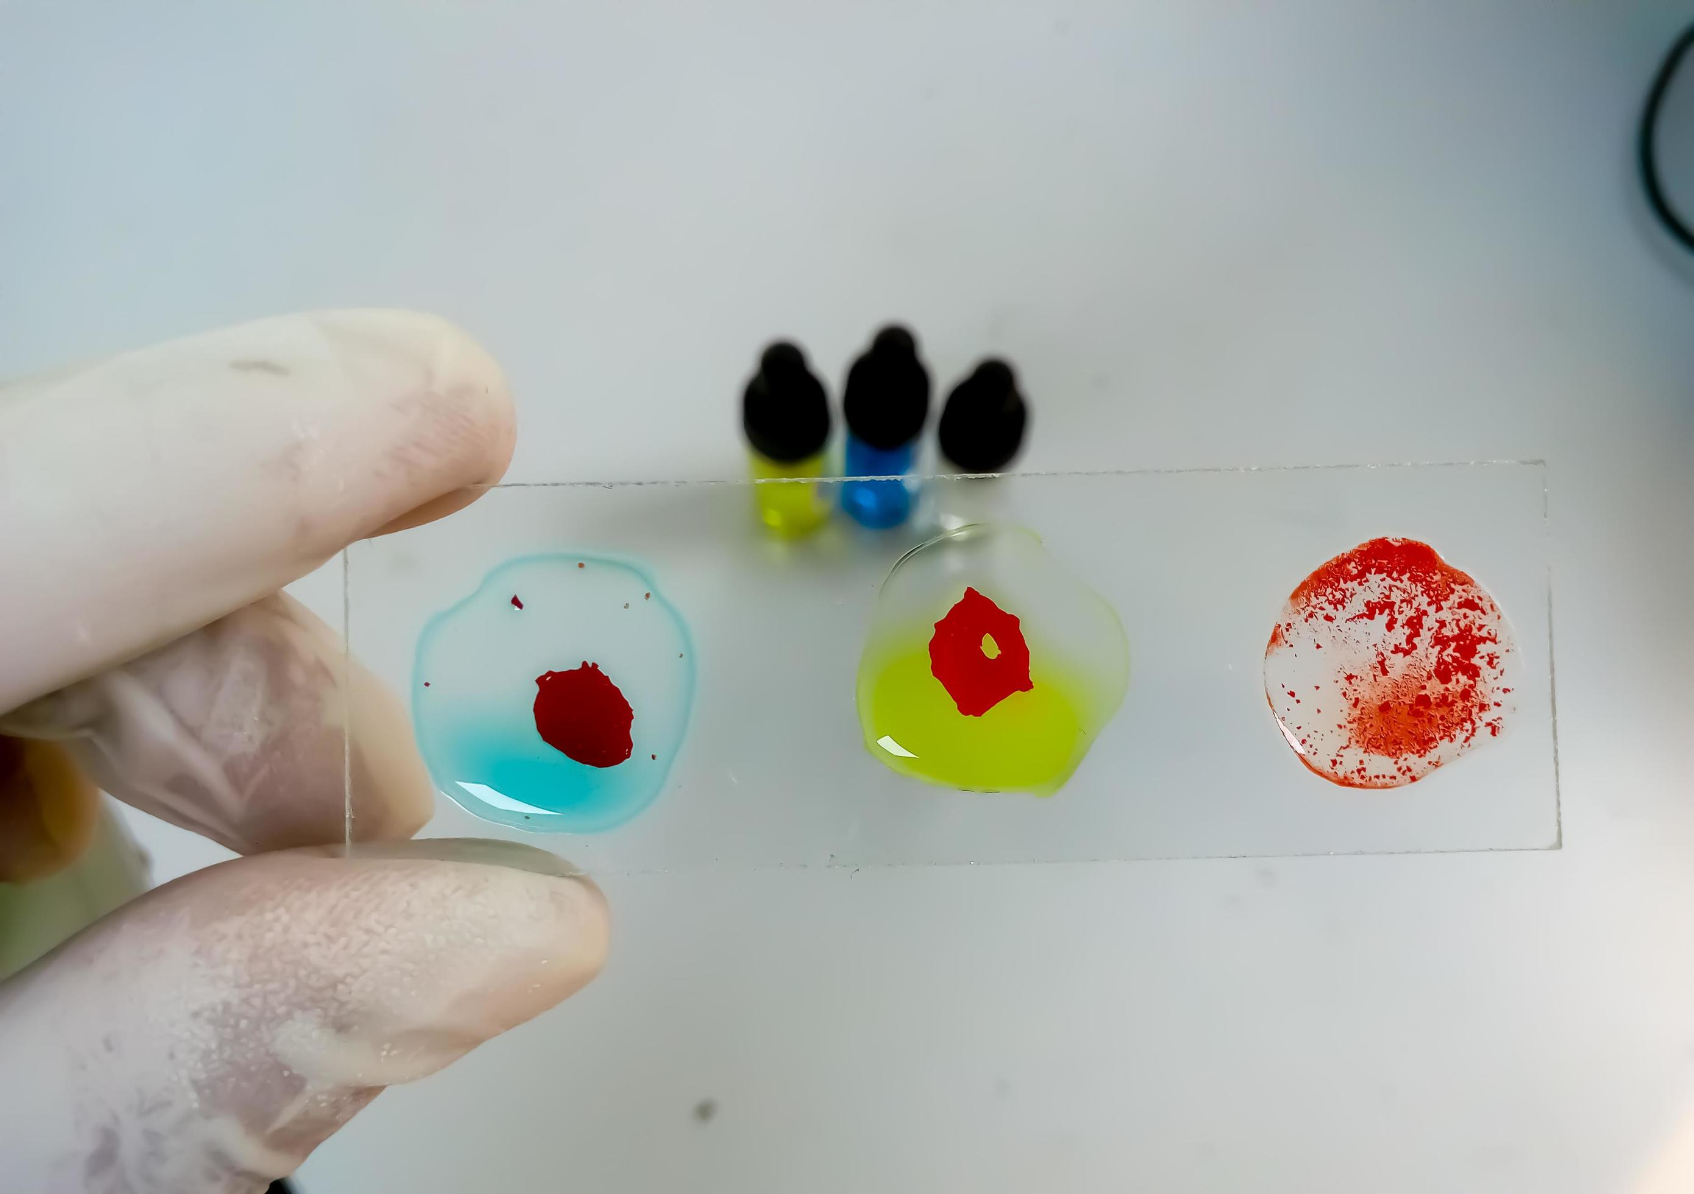
Agglutination:
In this test the antigen is particulate (visible, big and insoluble) (e.g. bacteria and red blood cells) or an inert particle (latex beads) coated with antigen.
• Antibody is divalent and cross links the multivalent antigen to form a lattice network or clumps (agglutination).
• This reaction can be performed in a tube or on a glass slide e.g. ABO blood grouping.

Slide 6
2. Hemagglutination Test : It is a type of agglutination test performed on RBCs. It has two types:
Passive: the antigen here is not the RBC. The RBC absorbs it and expresses it on the surface.
• It will form clumps when mixed with antibodies.
• i.e. red cells are passive carriers
Active: the antigen is the RBC itself.
• Viruses can clump red blood cells from one species or another (active Hemagglutination)
• This can be inhibited by specific anti-viral antibodies.
• Another example is the test used in ABO grouping.

Slide 8
3-Precipitation test :
In this test, the antigen is in soluble form (solution). Antibody cross -links antigen molecules to form aggregates (precipitates) in the zone of equivalence: optimal proportion of antigen and antibody. Precipitation test can be performed in solution or in semi-solid medium (agar).

Slide 9
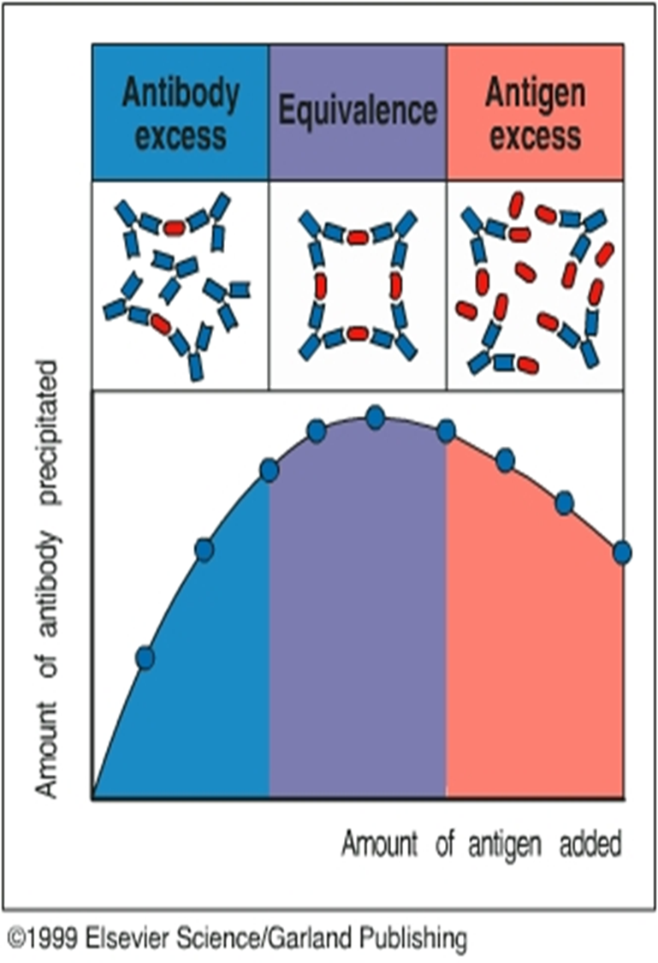
Time: 2 minute
Activity\ What is the Zone of Equivalence in precipitation tests?
Zone of Equivalence For antibody-antigen reaction to form a precipitate that we can see, the amount of antigen and antibody should be the same (optimum concentration). This happens in the zone of equivalence.

Slide 10
This can be made by 2 methods:
2-Double immunodiffusion
Here, we have a plate with 2 holes. We add the antigen in one of them, and the serum in the other, and we allow them to diffuse and form precipitation lines at the points of optimal concentrations.
RESULT:
Precipitation line identical, partial or non –identical
1.SINGLE RADIAL IMMUNODIFFUSION
• We use a plate with a known amount of antigen
• The plate is special in that it has a hole for insertion of serum.
• Then we add serum into the hole.
RESULT:
• forming a small precipitation ring.

Slide 11
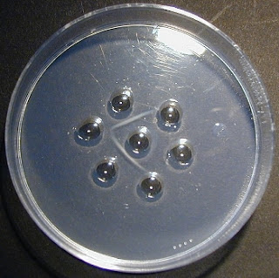
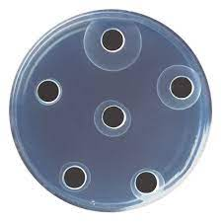

Slide 12
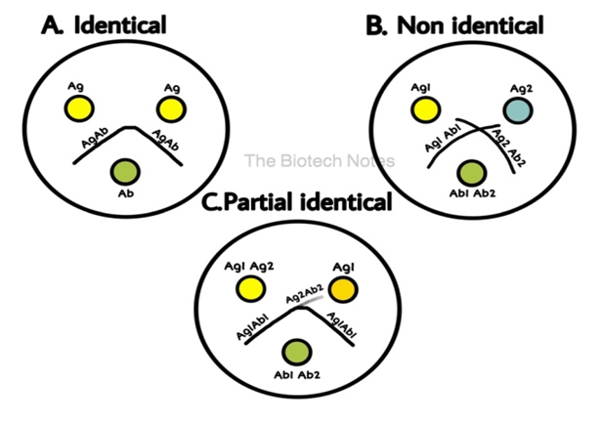
Double immunodiffusion

Slide 13
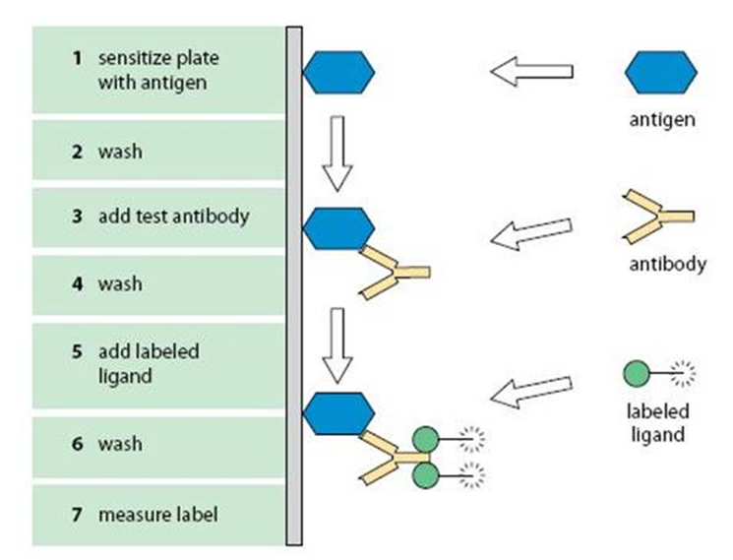
4-Radioimmunoassay (RAST):
measure specific IGE Labeled anti-IgE helps us to measure the amount of reaction.

Slide 14
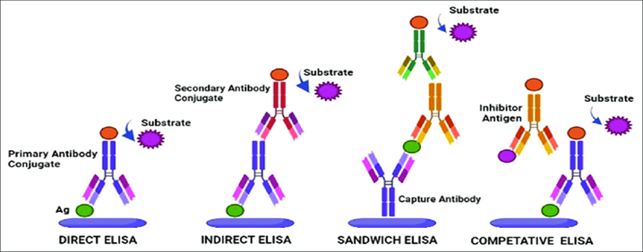
5-Enzyme Linked Immunosorbent Assay (ELISA)
This method is used for measuring either antigen or antibody in patient serum.
Types of ELISA

Slide 15
6-Immunofluorescence:
Fluorescent dyes e.g. fluorescein and rhodamine can be covalently attached to antibody molecules and made visible by ultraviolet (UV) light in a fluorescent microscope. Such labeled antibody can be used to identify antigens on surface of microorganisms ( e.g. treponemes), in histological section or in other specimens.It can be:
A known labeled antibody interacts directly with an unknown antigen.
Immunofluorescence involves a two-stage process:
Patient’s serum is added, incubated and the preparation is washed.
Antibody of interest if present will remain attached and can be detected by addition of fluorescent dye labeled antibody under UV light
Antigen is attached to a slide.
Direct
Indirec

Slide 16
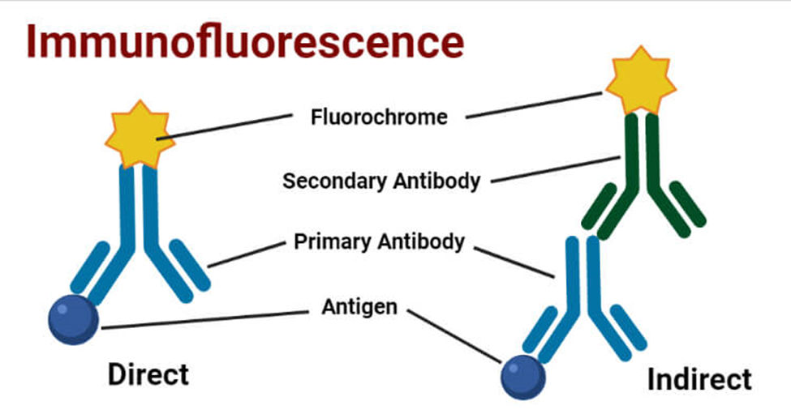

Slide 17
Complement fixation:
Based on the principle that antigen and antibody reaction activates complement
Antigen and antibody, one known and the other unknown are mixed.
A measured amount of complement is added
If antigen-antibody reaction has occurred it will combine “fix” complement.
An indicator system consisting of “sensitized” red blood cells (red blood cells plus anti-red blood cell antibody) is added.
If the complement was fixed because of antigen antibody reaction red cells will not be hemolyzed i.e. the test is positive.
• If the antigen antibody reaction did not occur in the first step complement will not
be fixed and will be available to lyse RBCs – a negative test.

Slide 19
