Slide 1
طرق زراعة وتنمية البكتريا Cultivation of Bacteria & Culture Methods
م سفانة عبد الستار ياسين
م مريم حمدي عبد الكريم
م م جوان ياسين بير رضا
فرع الاحياء المجهرية

Slide 2
العوامل المؤثرة على النمو البكتيري
م مريم حمدي عبد الكريم
فرع الاحياء المجهرية

Slide 3
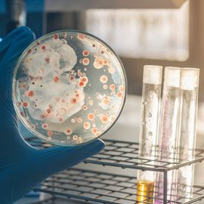
factors that affect bacterial growth

Slide 4
The four main factors that affect bacterial growth are:
Warm
Moisture
PH levels
Oxygen levels.

Slide 5
Temperature. Bacterial growth is greatly influenced by the temperature of the environment. ...
Moisture. Bacteria need consistent water supply to multiply and grow. ...
Oxygen Levels. ...
pH Levels.

Slide 6
The most important element for bacterial growth is water. The rate of metabolic and physiological activities of bacteria is determined by the amount of water available in the culture media. Water dissolves sugar, salts, and other chemicals, making them accessible to bacteria.

Slide 7
Growth factors:
Growth factors are organic compounds such as amino acids , purines , pyrimidines , and vitamins that a cell must have for growth but cannot synthesize itself. Organisms having complex nutritional requirements and needing many growth factors are said to be fastidious .

Slide 8
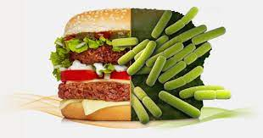
The most important factors that affect microbial growth in foods can be summarized in the following categories: factors related to the food itself:

Slide 9
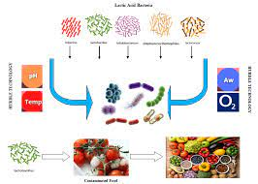
the “intrinsic factors,” which include nutrient content, water activity, pH value, redox potential, and the presence of antimicrobial substances and mechanical barriers ...

Slide 10
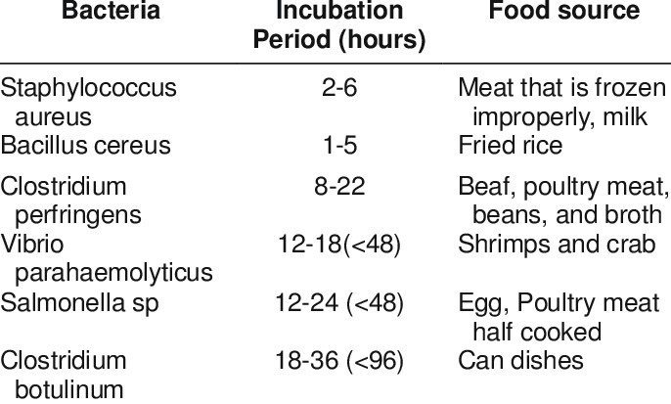

Slide 11
FATTOM is an acronym used to describe the conditions necessary for bacterial growth: Food, acidity, time, temperature, oxygen, and moisture.
Foods provide a perfect environment for bacterial growth, due to their provision of nutrients, energy, and other components needed by the bacteria.

Slide 12
Moisture – Bacteria need moisture in order to grow.
Food – Food provides energy and nutrients for bacteria to grow.
Time – If provided with the optimum conditions for growth, bacteria can multiply to millions over a small period of time via binary fission .
Bacteria are among the fastest reproducing organisms in the world, doubling every 4 to 20 minutes.

Slide 13
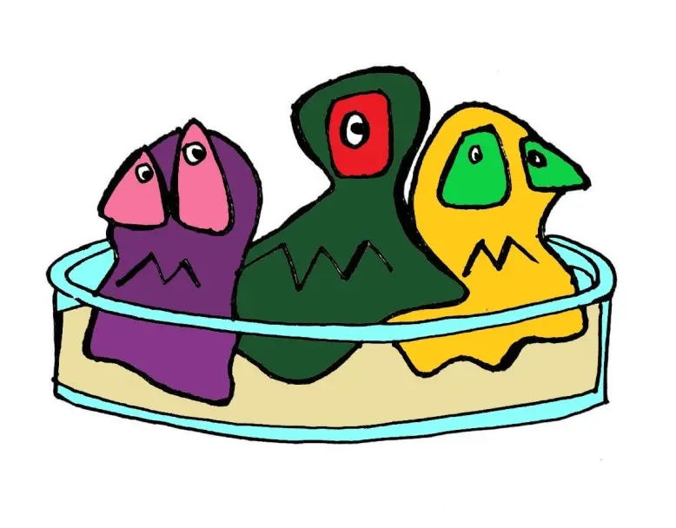
Common problems with bacterial culture

Slide 14
Common problems with bacterial culture
Contamination – Contamination of bacterial cultures can be very problematic, particularly if it goes undetected. At best, it can mean the need to re-isolate a pure culture, but at worst could lead to illness and very costly remedial work if it were to occur in a food or production setting. Culture contamination can come from many sources, right from the original sample itself through the process of culturing and even storage. Good aseptic technique can help to avoid contamination of bacterial cultures.

Slide 15
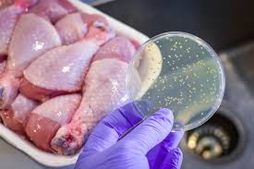
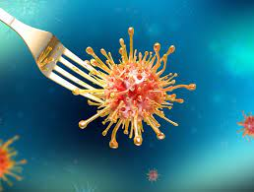
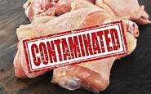

Slide 16
Overgrowth of some species – Some bacterial species grow easily and vigorously. When attempting to isolate a species from a mixed sample, these vigorous species may overgrow and mask the presence of slower-growing target species. Using selective media and optimal growth conditions for your target species (if known) can help to mitigate this. Try to culture the sample as soon as possible after it has been taken to ensure it is as representative as possible.

Slide 17
Antibiotic treatment prior to sampling –
In a diagnostic setting, it is important to know if antibiotic treatment has been administered prior to sampling. If this is the case, failure to culture a particular species may not indicate that it was not the cause of the infection.

Slide 18
Incorrect growth conditions – The use of inappropriate or suboptimal growth conditions may impede or completely prevent the growth of your target strain. Be sure to double check growth requirements or if using antibiotic selection ensure the correct antibiotic has been chosen for the resistance gene present.

Slide 19
Non-culturable and slow-growing organisms – Some bacterial species, even now, cannot be grown in the lab. Others, such as mycobacteria, are very slow growing and can take months to culture successfully, which is particularly problematic when trying to diagnose infections.

