Slide 1


Challenges associated with screening for cervical carcinoma

Slide 2



Slide 3
Objective
To determine the limitations and barriers related to application of cervical cancer screening using the Pap smear test in women

Slide 4
Cervical cancer is a leading cause of mortality among women.
In 2020, an estimated 604 000 women were diagnosed with cervical cancer worldwide and about 342 000 women died from the disease.

Slide 5
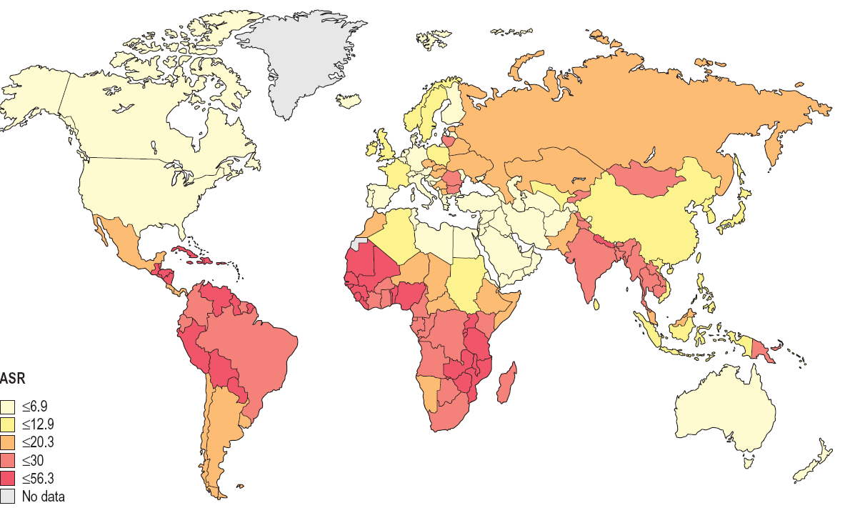
World age-standardized incidence rates (ASR) of cervical cancer 2008. Rates per 100 000 women per year.

Slide 6
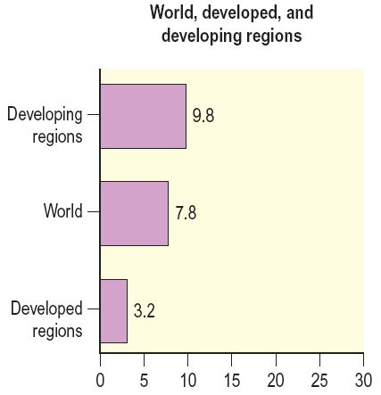
Age-standardized cervical cancer mortality rate per 100 000 women (all ages) per year

Slide 7
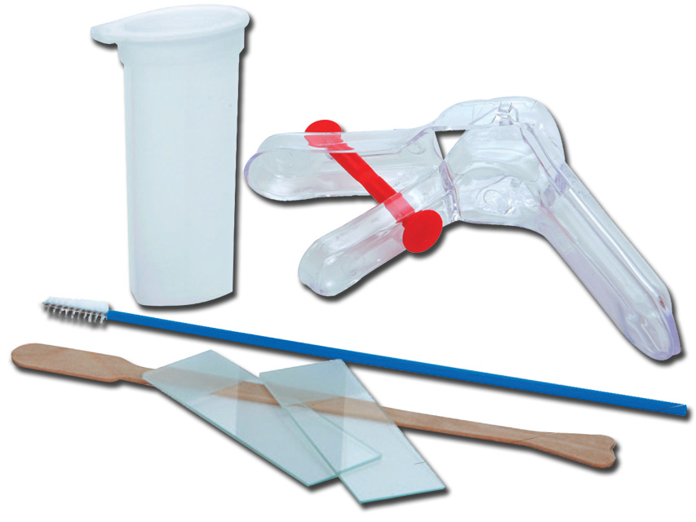
Pap test
It is a test that’s used as a primary form of cervical cancer Screening.
Found widespread use with significant decline in the incidence of cervical cancer.
Advantage
Cost little.
Easy to perform
Interpreted accurately.

Slide 8
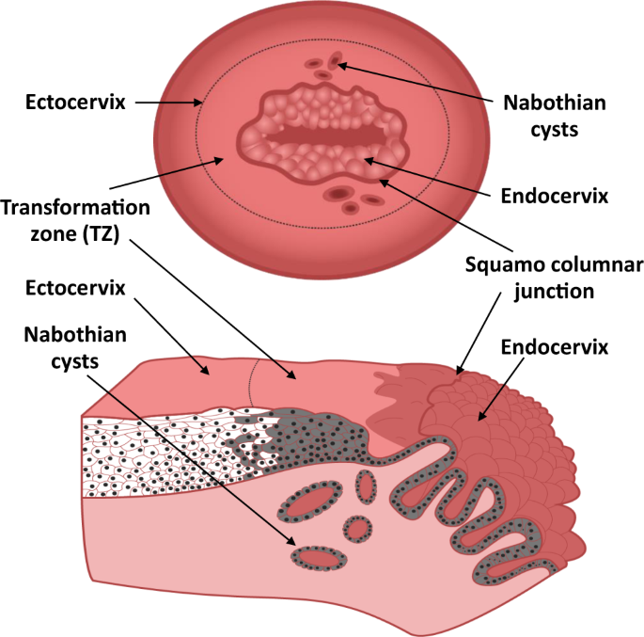

Slide 9
Who are the candidate?
According to the recent guideline of the American Cancer Society’s:
Age 25‒65 : Pap test every 3 years.
Age 65 and older: No screening if a series of prior tests were normal.
What is the aim?

Slide 10
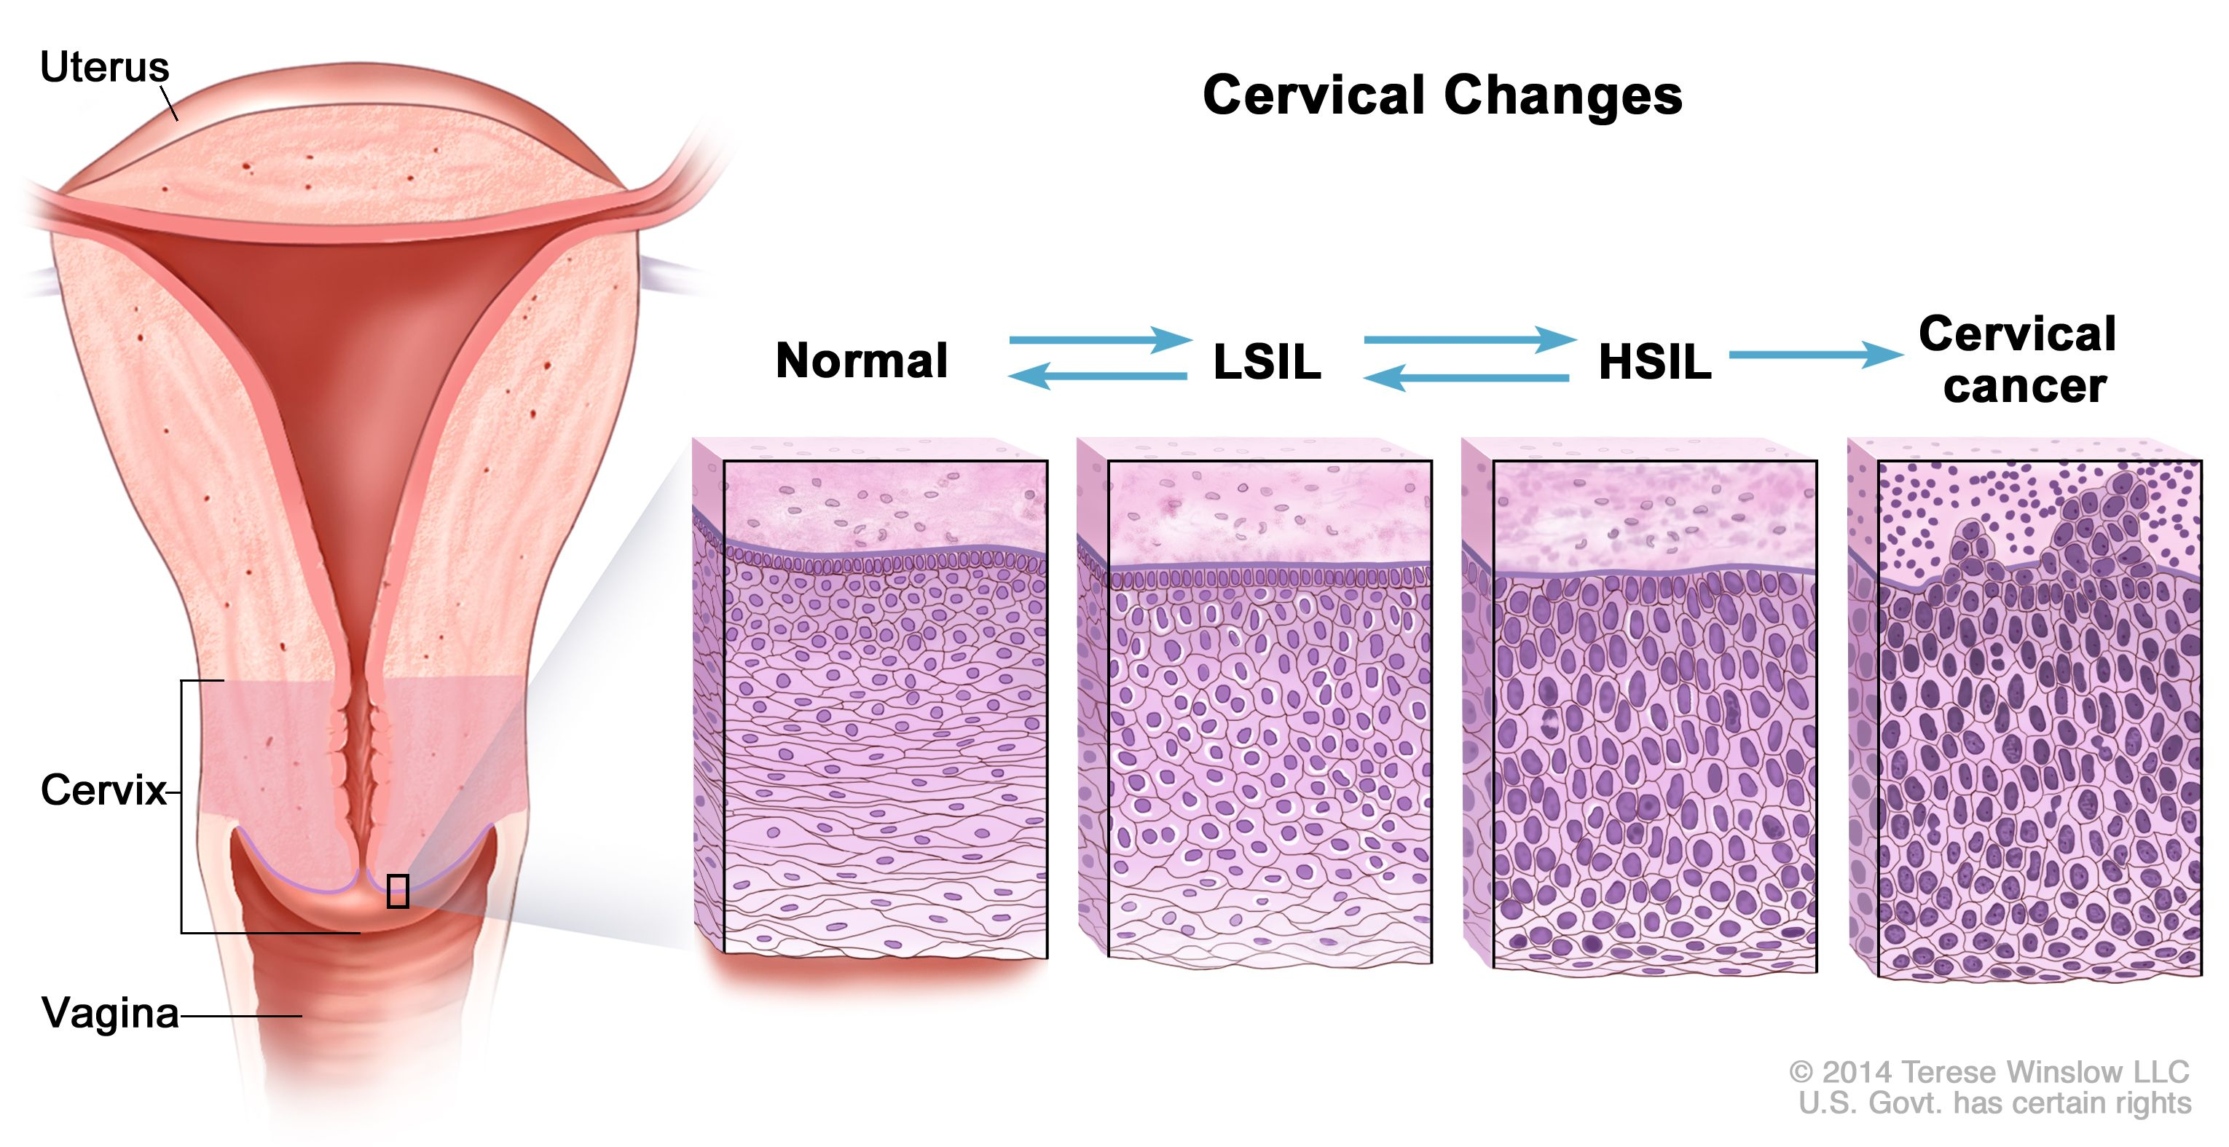

Slide 11
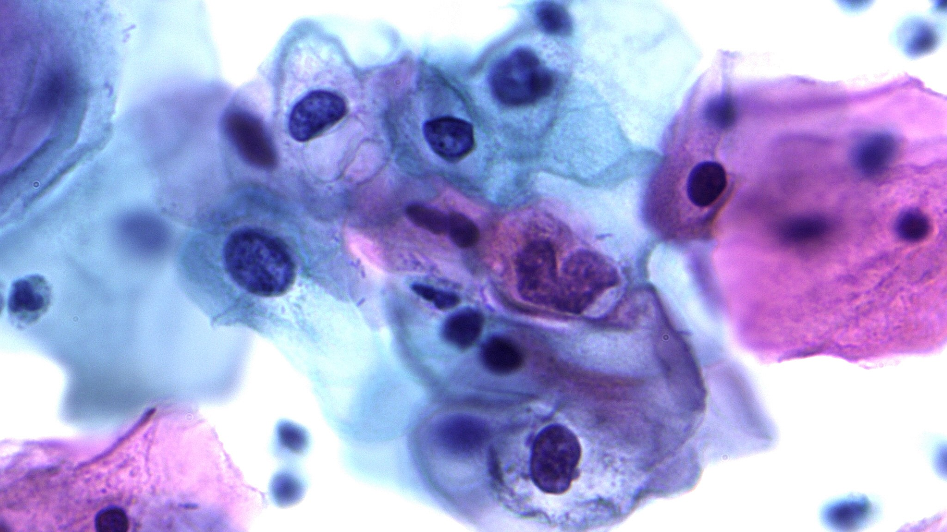
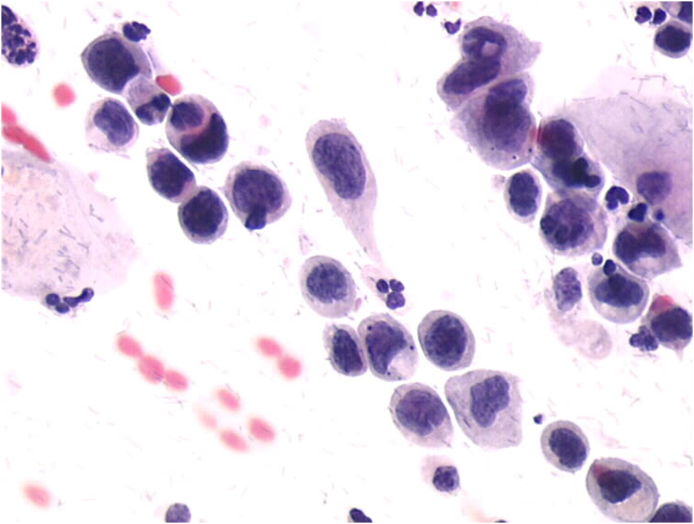
LSIL Vs HSIL

Slide 12
History
George Nicholas Papanicolaou (1883-1962).
He is best known for creating the Papanicolaou test.
He collaborated with Dr Herbert Traut (gynecological pathologist), publishing their book in 1943 “Diagnosis of Uterine Cancer by the Vaginal Smear”
The use of the Pap test as a national screening programs can be dated back to the 1960s and 1970s.

Slide 13
Obstacles
The World Health Organization emphasizes, is due to:
Limitations of the Pap smear test.
Existing organizational mechanisms of the healthcare systems and cultural and community aspects.

Slide 14
1-Limitations of the pap as a screening programs
Errors and Failures in the Program
- Low sensitivity: where the false-negatives 3% -13%, so they may miss some precancers and have to be repeated frequently.
- Inadequate collection of material to be examined.
- Errors of interpretation in the cytopathology laboratory.
- Absence of adequate follow-up.
- Failures in the treatment of precursor lesions.
It becomes fundamental to keep the multidisciplinary teams who work with prevention stimulated and up to date, aware of the importance of each stage and its role in achieving the final result, which is to avoid death by cervical cancer.

Slide 15
- Achieving the ideal coverage: For a prevention program to diminish cervical cancer mortality it must achieve a coverage estimated at around 80% of the women.
The community must be mobilized and informed in order to make the women realize the causes and consequences of cervical cancer and so submit to the tests.
Lack of knowledge becomes one of the main allies of the inefficiency of screening programs.
Strategies must be established to encourage regular participation of women in the program and the return of women with abnormal results (29% do not return).

Slide 16
2- Socioeconomic and Cultural Problems
Sociocultural and behavioral factors can also be a negative influence in the running of programs and should be detected and minimized.
-Level of education of the community.
A recent statistics registered in developing countries shows that there is a high percentage of women in rural communities refusing cervical cancer screenings using the Pap test.
Not to accept the test were an absence of symptoms and the belief that the test was unnecessary.
Decisive influence of the woman’s partner, contributing to diminishing women’s adhesion to the screening programs.

Slide 17
-Political limitations, in developing countries the priority for contagious diseases such as TB or AIDS, vaccination, or the fight against hunger and poor nutrition and thus oppose the prevention of cervical cancer.
-Religious aspects

Slide 18
Other factors
The women felt embarrassed being examined by a doctor of the male sex.
Aversion to pelvic examination .
Lacking trust in the healthcare personnel.
Believe that the test would be painful.
Long wait times.

Slide 19
Procedures essential to the success of Pap test
The basic integrated actions include:
(1) Care with collection.
(2) Processing of the smears.
(3) Screening and interpretation of the specimens
(4) Follow-up of the patients.

Slide 20

1. Care with collection.
The majority of false-negatives arise from problems with collection of specimens.
The smears must be well identified.
Slim, Uniform, without contaminants
There should be a minimum of blood, mucus, or other obscuring material.
Contain samples from the transformation zone.
Adequately and rapidly fix.
Thus this stage should be systemized and there should be training and recycling of the personnel responsible for taking the samples.

Slide 21
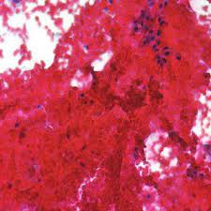
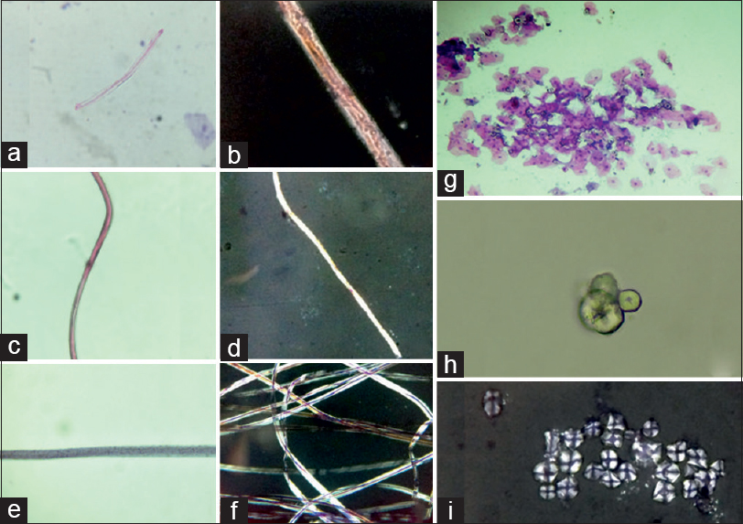
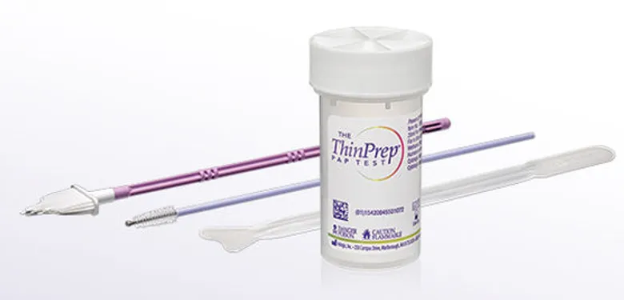

Slide 22
2-Processing the smears
Prevention programs cover a large number of tests, so laboratories should have:
Guidance regarding the systemizing of the processing.
Guidance for recording of a large volume of specimens.

Slide 23
3-Screening and interpretation of the specimens
The screening should be done in as little time as possible, by trained and qualified personnel.
Care should also be taken with refresher courses and recycling.
The report on the tests should be systemized and use a unique nomenclature, of which all involved in the preparation and interpretation of the results should be fully aware.
DYSPLASIA=CIN=SIL

Slide 24
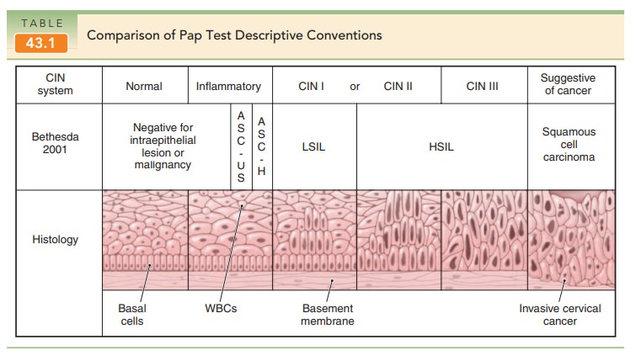

Slide 25
4-Follow-up of patients
Developing a mechanisms for finding and managing patients who did not return after the initial test and who show alterations.
Treatment of lesions in a pre-invasive stage is fundamental.
Outpatient treatment centers for the more simple cases, and others for more complex cases, should be integrated into a service network for the program.

Slide 26


