Slide 1
TEXAS A&M UNIVERSITY

Slide 2
TEXAS A&M RING

Slide 3
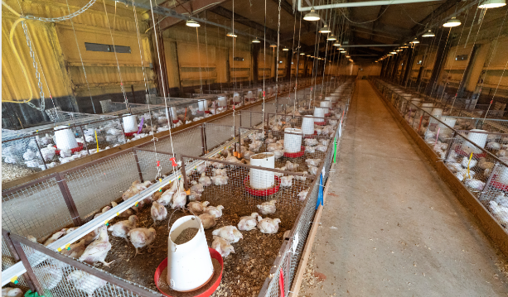
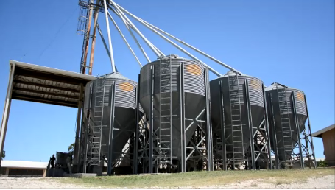

Slide 4
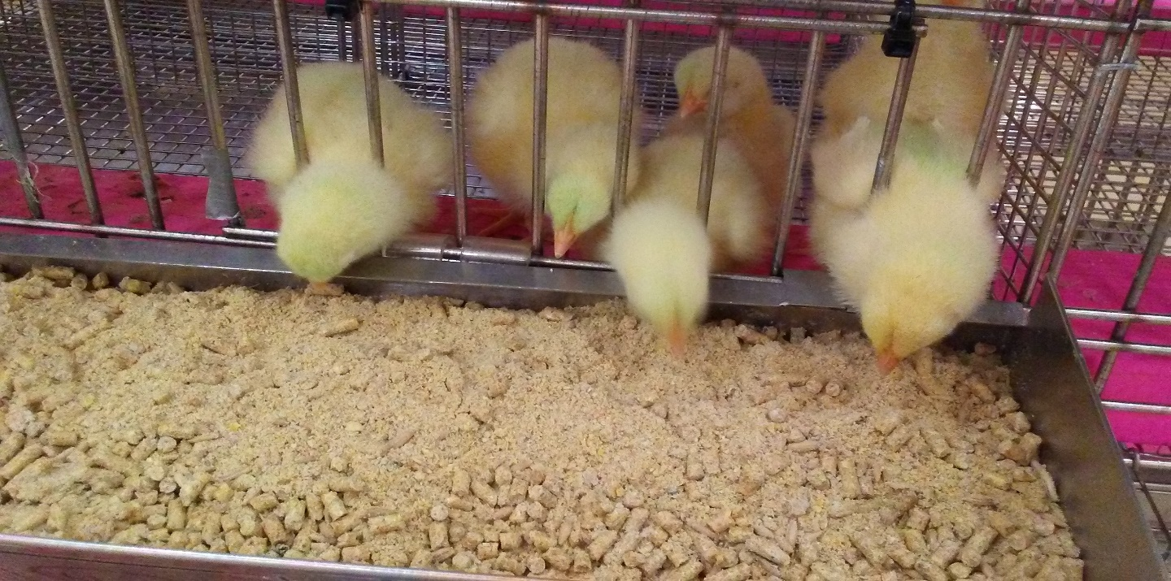
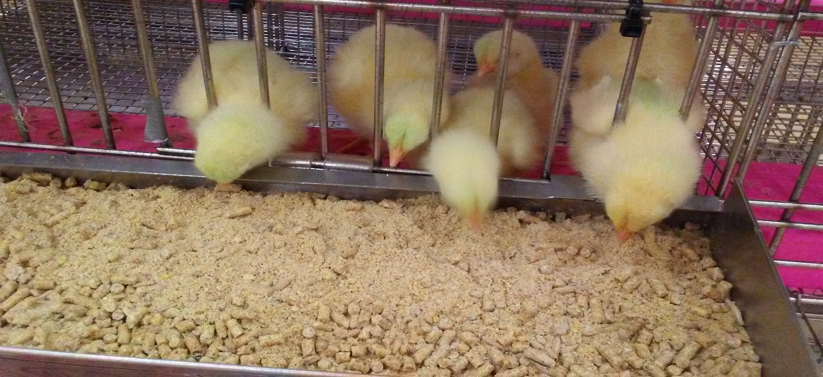

Slide 5
THE EVALUATION OF VARIOUS ANTIBIOTIC ALTERNATIVES FOR OPTIMUM POULTRY PERFORMANCE UNDER PATHOGEN CHALLENGE
A Dissertation by Yansoon AL-Jumaa
August 9, 2022

Slide 6
Introduction
From 1961 to 2019, annual poultry production improved from 9 to 132 million tons.
Poultry industry is estimated to grow of 2–3% annually between 2015 and 2030, which is the highest growth rate in the livestock sector.
Many antibiotics have been used as growth promoters to improve growth, reduce morbidity and mortality occurring because of clinical and subclinical diseases.
Veterinary Feed Directive; Implemented January 1, 2017, Medicines deemed “important for human medicine” and used by both humans and animals will require a written VFD from a veterinarian in order to be used on livestock for treatment, control, or prevention of illness only.
In the countries that stopped using antibiotic growth promoters in poultry industry, the rate of necrotic enteritis associated with Clostridium perfringens has been increased.
https://www.thepoultrysite.com/articles/feeder-colour-preference-of-broilers-and-its-effects-on-performance
Notes:
Probably need a citation for at least the last bullet: In the countries that stopped using antibiotic growth promoters in intense poultry industry, the rate of necrotic enteritis associated with Clostridium perfringens has been increased
.

Slide 7
Antibiotic Alternatives
Therefore, the quest for antibiotic alternative products to improve poultry productivity and maintain chickens’ health by preventing or controlling diseases has increased.
Probiotics, prebiotics, their mixtures (synbiotics), and postbiotics are some of the several types of antibiotic alternatives which have been recommended in poultry production.
https://www.mdpi.com/topics/Probiotics_Prebiotics_Postbiotics_Health

Slide 8
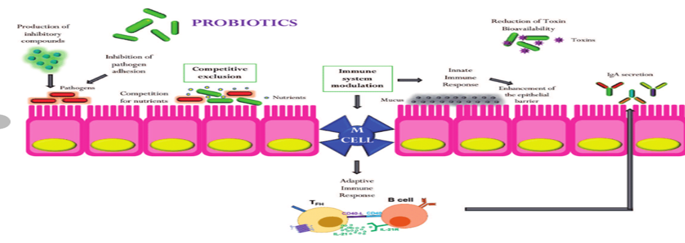
Probiotics
Probiotics are defined as mono or mixed cultures of live organisms which should be administered in sufficient amounts to lead to hosts health beneﬁt.
Saccharomyces cerevisiae.
Bacillus ; Bacillus amyloliquefaciens, Bacillus pumilus, and Bacillus licheniformis.
Lactobacillus.
https://www.researchgate.net/figure/Mechanism-of-action-of-probiotics_fig1_335774500

Slide 9
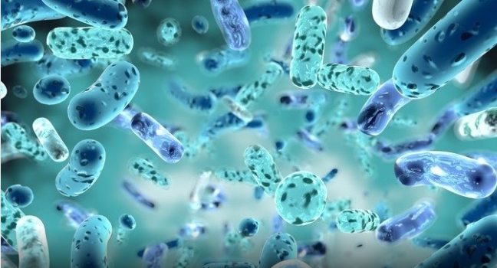
Bacillus
Bacillus species are rod-shaped bacteria, aerobic or electively anaerobic.
They are Gram-positive bacteria, but some species could turn to Gram-negative in aged culture.
They are endospore forming. The spores are resistant to cold, heat, desiccation, disinfectants, and radiation.
The numerous species of Bacillus demonstrate many physiologic capabilities which allow them to survive in a natural environment
https://www.nutraingredients-asia.com/Article/2022/05/04/probiotic-bacillus-clausii-insignificant-in-alleviating-childhood-diarrhoea-rct

Slide 10
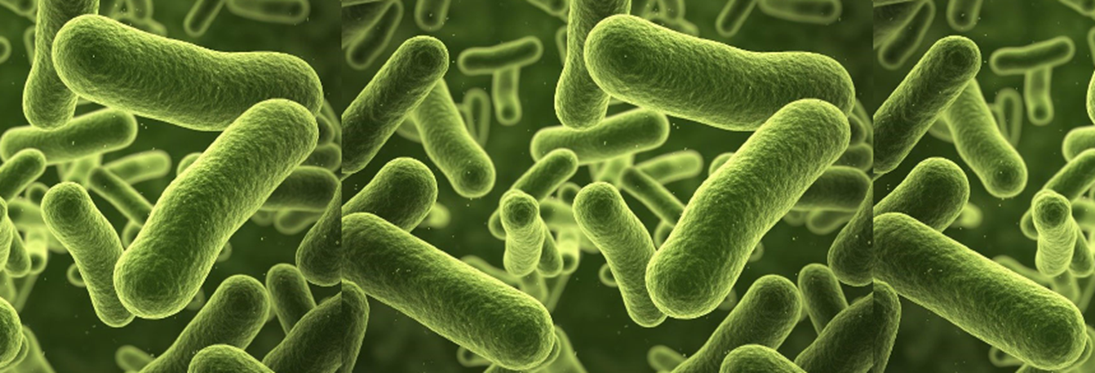
Bacillus amyloliquefaciens
Bacillus amyloliquefaciens is a species of Bacillus bacteria that synthesizes a natural antibiotic protein
Barnase (Bacterial RiboNucleASE) which inhibits pathogen growth.
This “Barnase” could be antiviral, immune-suppressing, and anti-inflammatory.
They are also reported to produce various enzymes including α-amylase, protease, lipase, cellulase, xylanase, pectinase, aminotransferase, peroxidase, and laccase.
http://www.hexonlab.com/bio-products-pharma-food/probiotics/bacillus-amyloliquefaciens/

Slide 11
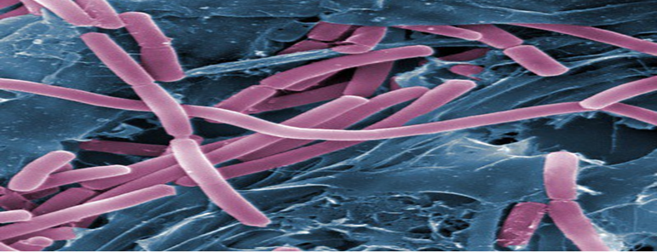
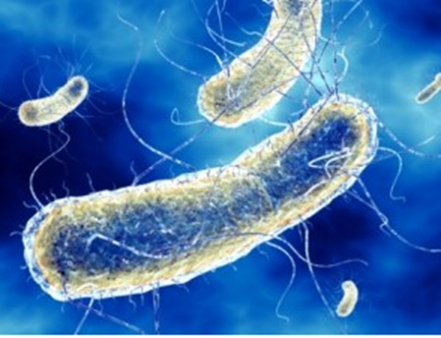
Bacillus pumilus
Bacillus pumilus
Secrete antimicrobial substances.
Secret protease enzymes.
http://blog.coralwonders.com/en/bacterias-en-el-acuario-marino/bacillus-pumilus-bacteria/#iLightbox[postimages]/0
Bacillus licheniformis
Induce Macrophages Extracellular Traps (METs) which are fundamental in the elimination of microbial pathogens.
https://nootriment.com/bacillus-licheniformis

Slide 12
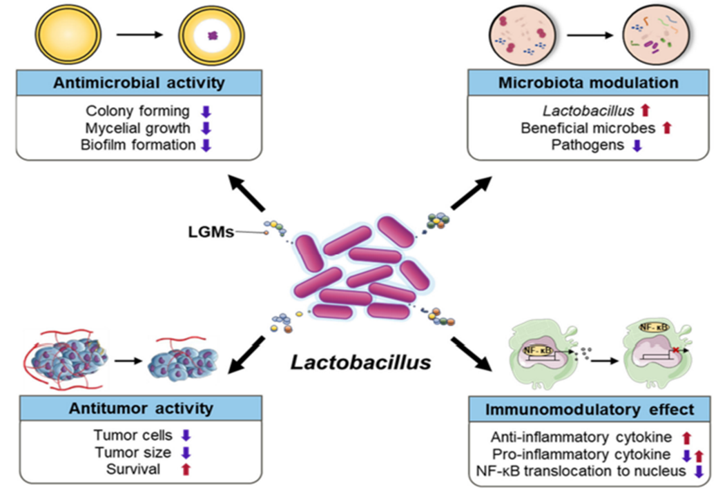
Lactobacilli
Lactobacilli species are microaerophilic gram-positive bacteria which found in milk, fruits, and soil. Lactobacilli could support intestinal health of chicken by balancing intestinal microflora.
Produce antimicrobial peptides known as bacteriocins, which prevent the proliferation of selected pathogens.
Effective in preventing the enteropathogen-mediated infection by competing for nutrients and binding sites
Jeong et al., 2022. The Lactobacillus as a Probiotic: Focusing on Liver Diseases
Notes:
LGMs indicate Lactobacillus generated molecules.
Nuclear factor kappa B (NF-κB) is an ancient protein transcription factor (Salminen et al., 2008) and considered a regulator of innate immunity (Baltimore, 2009). The NF-κB signaling pathway links pathogenic signals and cellular danger signals thus organizing cellular resistance to invading pathogens.

Slide 13
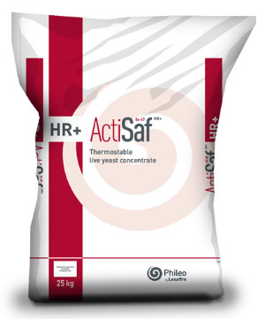
Saccharomyces cerevisiae
Saccharomyces cerevisiae yeast are unicellular fungi that multiply by budding or fission.
They are a source of various nutrients and metabolites:
Vitamins and Amino Acids;
Vitamin C, Vitamin B2, Vitamin B3 and Vitamin B12
Various enzymes;
amylase, glucanase, lipase, mannanase, and protease
Mannoproteins and β-glucans:
Act as prebiotics and pathogen inhibitors
https://www.dreamstime.com/saccharomyces-cerevisiae-yeast-d-illustration-microscopic-fungi-baker-s-brewer-used-as-probiotics-to-restore-normal-flora-image126324877
Actisaf® from Phileo, which used in this project as an example for yeast probiotic.
https://phileo-lesaffre.com/en/actisaf/

Slide 14
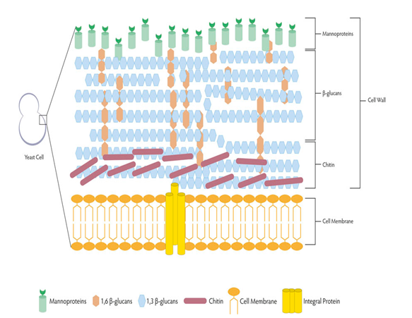
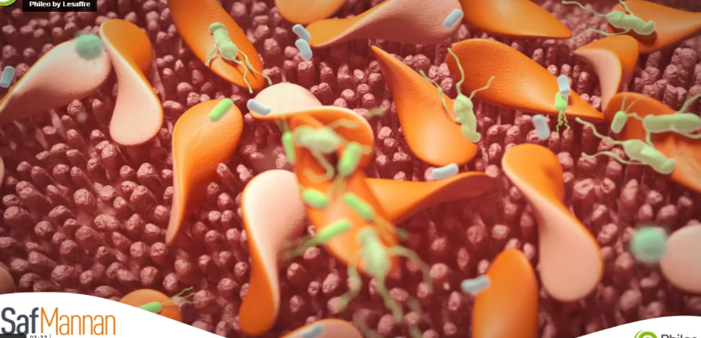
Prebiotics
Yeast Cell Wall
They are defined as a non-digestible food ingredients that improve host health beneficially by stimulating the growth and/or activity of one or a limited number of selected beneficial bacteria in the intestine.
Multiple kinds of oligosaccharides and non-starch oligosaccharide are counted as prebiotics such as; mannanoligosaccharide and β-glucan.
Yeast Cell Wall, like Safmannan®, which is used in this project, is an example for prebiotic products that marketed for use in poultry feed.
When yeast cell wall prebiotics are added to feeds, they have been shown to give an improvement to the feed conversion ratio of poultry.
https://www.mazzoleni.com/en/news/yeast-cell-wall-benefits-all
https://phileo-lesaffre.com/en/safmannan

Slide 15
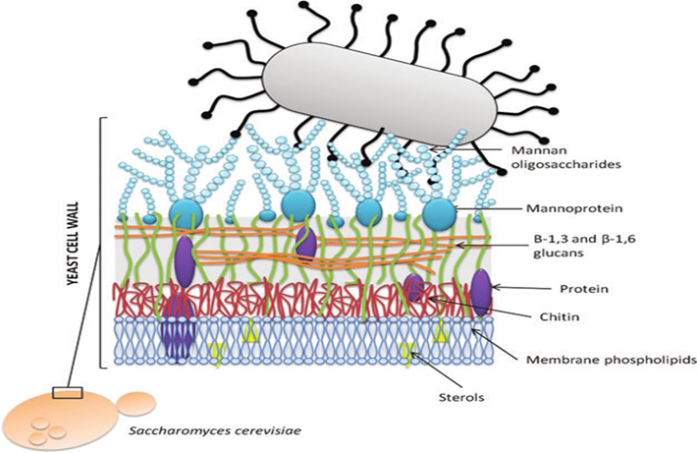
Functionality of Yeast Cell Wall as Prebiotic
The usefulness of how the YCW approach to binding to the pathogens like Salmonella can be seen in the figure.
The Saccharomyces cerevisiae binds to the type 1 fimbriae, like the type on Salmonella enterica, using the mannoproteins that are attached along the outer portion of the YCW.
This form of agglutination denying the pathogen the ability to bond to the gastrointestinal tract, or the ability to multiply, and thus allows for the removal of the pathogen from the bird. (Santovito et al., 2018).
https://www.mazzoleni.com/en/news/yeast-cell-wall-benefits-all

Slide 16
Yeast Cell Wall Purification
https://link.springer.com/article/10.1007/s11947-018-2156-8

Slide 17
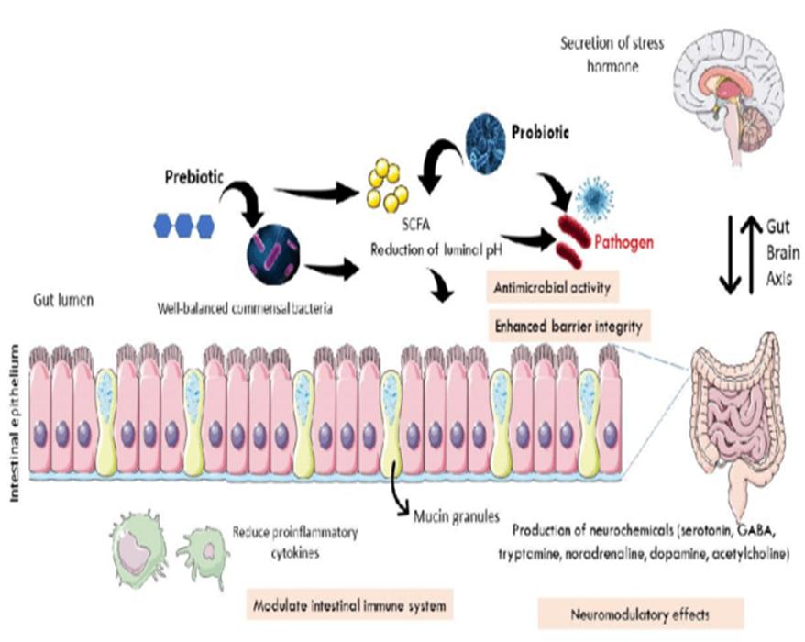
Yeast Cell Wall Prebiotic - Probiotic Combination
A Synbiotic
The concept of using yeast cell wall (YCW) in conjunction with a probiotic has been tested with promising results.
The combination could be used in broiler production as feed additive to enhance the performance.
Combination of Safmannan® and probiotic products were used in this project.
https://www.researchgate.net/figure/Mechanisms-of-prebiotic-and-probiotic-action-in-modulating-bidirectional-gut-brain-axis_fig1_354264549

Slide 18
Postbiotics
Are defined by the International Scientific Association of Probiotics and Prebiotics (ISAPP) as a “preparation of inanimate microorganisms and/or their components that confers a health benefit on the host”.
The effective postbiotics should contain inactivated microbial cells or cell components.
https://www.laurelacupuncturesd.com/blog/pre-pro-and-post-biotics-a-recipe-for-a-healthy-gut

Slide 19
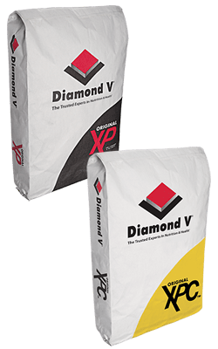
Postbiotic use in Poultry Production
Adding postbiotic products to broiler diets could enhance the performance of chickens.
Postbiotics could improve intestinal morphology by increasing villi height.
Postbiotic could be produced from Saccharomyces cerevisiae as a yeast cell wall culture.
Postbiotic XPC® and XPC-Ultra® which are used in this project.
https://diamondv.com/products/xp-xpc-products/

Slide 20
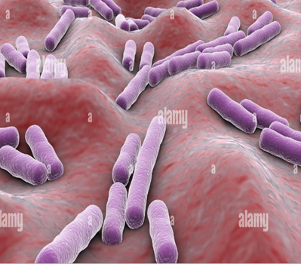
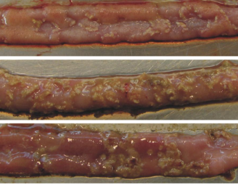
Pathogen Challenge - Clostridium perfringens
Clostridium perfringens is an anaerobic Gram-positive rod-shaped, spore forming bacteria that is encapsulated and non-motile.
It causes enteric disorder in animals and humans.
It causes losses in poultry production.
Infection with Clostridium perfringens could cause clinical necrotic enteritis or subclinical necrotic enteritis.
The clinical necrotic enteritis is characterized by diarrhea, anorexia, ruffled feathers, depression and sudden death.
The subclinical type of necrotic enteritis is characterized by reduction in production, or shallow diarrhea, and low mortality.
https://www.alamy.com/microscopic-view-of-clostridium-perfringens-bacteria-inside-human-body-image431667337.html
https://www.mdpi.com/2072-6651/2/7/1913/htm

Slide 21
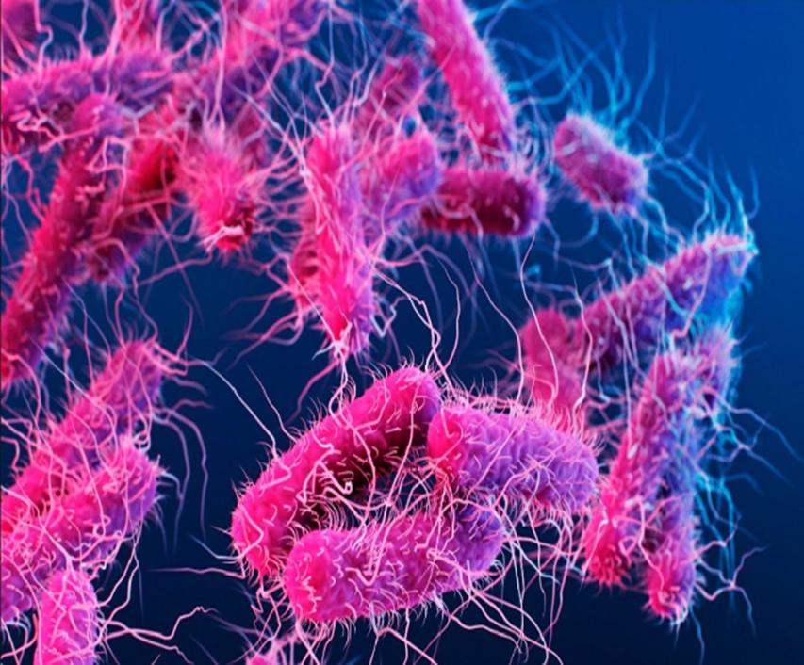
Pathogen Challenge - Salmonella Typhimurium
Salmonella is a non-spore forming, gram-negative bacillus, motile, aerobic to facultative anaerobic bacterium.
It is a typical zoonotic disease, causing losses due to mortality, inhibition of growth rate and reduced egg production.
https://www.india.com/health/what-is-salmonella-typhimurium-the-bacterial-infection-
affecting-kids-in-europe-is-your-kid-at-risk-expert-explains-5393245/

Slide 22
OBJECTIVES
Evaluation of the effect of Phileo® Safmannan and Diamond V® yeast culture on the performance of broiler chickens when challenged with Clostridium perfringens OR Salmonella Typhymurium.
Evaluation of Envera® and Safmannan® probiotic on starter broiler performance in birds subjected to bursa vaccine and Clostridium perfringens challenge.
Evaluation of Phileo-LFA® Safmannan® prebiotic and Bacillus probiotic on full term broiler performance.
Evaluation of Phileo-LFA® Safmannan prebiotic and Bacillus probiotic in birds subjected to bursa vaccine and Clostridium perfringens challenge.

Slide 23
Experiment 1 Materials and Methods
All methods were approved by the TAMU institution animal care and use committee and the Animal Care and Use Committee at the Southern Plains Agriculture Research Center.
A 10-day trial with 240 Ross 308 newly hatched broiler chicks.
Origin: Sanderson Farms
Two stainless steel Battery Brooder Units (48 pens; 5 birds per pen) at United States Department of Agriculture (USDA ARS) in College Station, Texas.

Slide 24
Experimental Design
Treatment Products¹ | Concentration ppm | Challenge² | Antibiotic Alternative
XPC-Ultra® | 625 | + | Postbiotic
XPC® | 1250 | + | Postbiotic
Safmannan® | 125 | + | Prebiotic
Safmannan® | 250 | + | Prebiotic
Challenged Chicks | - | + | None
None-Challenged Chicks | - | - | None
¹Safmannan® is obtained from primary culture and the purification of selected Saccharomyces cerevisiae proprietary strain sold by Phileo®. XPC® is a yeast culture Saccharomyces cerevisiae yeast grown on a media of processed grain by-products, roughage products, cane molasses, malt and corn syrup sold by Diamond V®. XPC-Ultra® is a concentrated version of XPC®. ²Salmonella Typhimuriumat challenge at day 3 by oral gavage for each bird using 0.5 ml of Salmonella typhimurium broth dilution 1x10⁷

Slide 25
Experiment Time-Line
Date | Phase
Day 0 | Bird placement, birds weight and feed weight.
Day 3 | Gavage with Salmonella Typhimurium¹
Day 10 | 1. Take the weight of feed and birds. 2. Collect ceca for Salmonella enumeration. 3. Collect ceca content samples for Semi-Quantitative Roka Salmonella - detection.
¹Salmonella Typhimurium challenge by oral gavage for each bird using 0.5 ml of Salmonella typhimurium broth dilution 1x10⁷

Slide 26
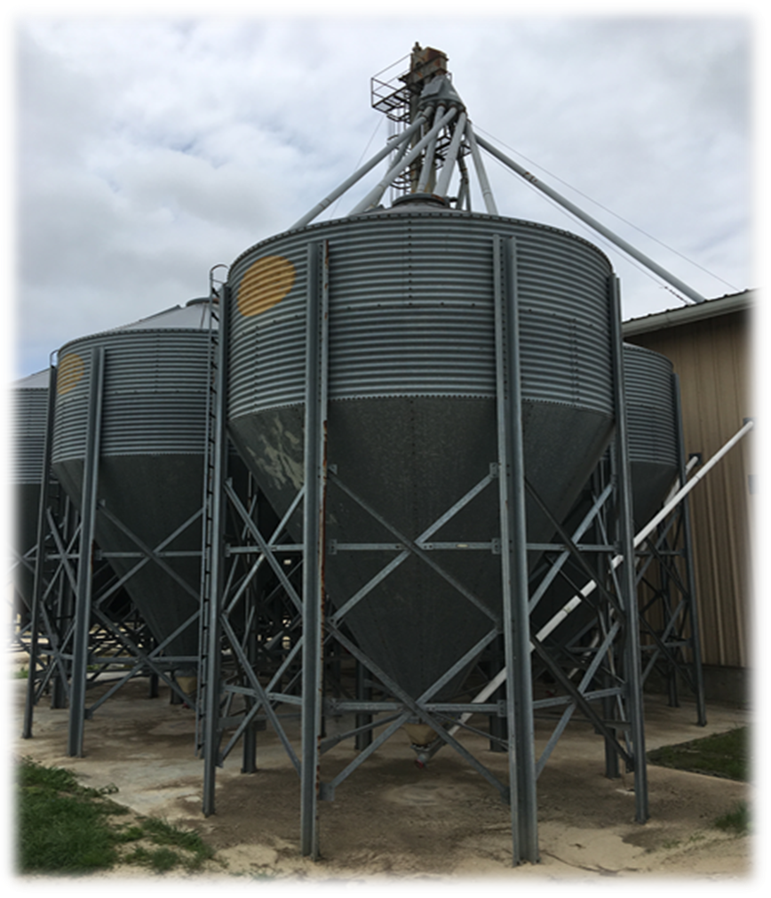
Experimental Diet
Corn-soy industry type basal broiler starter diet.
Diet divided into 5 equally-sized portions
Diets were fed as crumbles.

Slide 27
Basal Diet Composition
Ingredient | Percentage
Corn | 62.24
Dehulled Soybean Meal | 31.71
DL-Methionine | 0.27
Lysine HCL | 0.18
L-Threonine 98% | 0.03
Soybean oil | 1.99
Limestone | 1.31
Biofos TM | 1.55
Salts | 0.41
Trace Mineral¹ | 0.05
Vitamins² | 0.25
Calculated Nutrient Content | Percentage
Protein | 22.00
ME (Kcal/Kg) | 3050
Crude Fat | 3.77
Crude Fiber | 2.14
AV phosphate | 0.45
Calcium | 0.90
Methionine | 0.60
Met+Cys Lysine Threonine | 0.96 1.30 0.85
Arginine | 1.45
Tryptophan | 0.26

Slide 28
Data Collection
Performance data:
On the 10th day, weigh birds and feed, and count mortality.
Salmonella Typhimurium count on plates:
All 5 birds were taken for Salmonella plating numeration.
0.5 gm of ceca content/bird
PBS for dilutions
XLT4 agar for plating
Numeration after 24 hours of incubation
Two birds for ceca swabs for Roka Bioscience analysis
The swabs were preserved in peptone water.

Slide 29
Statistical Analysis
One Way ANOVA test, using the GLM procedure in SPSSTM (IBM, Armonk, NY, USA).
Means were separated using Duncan’s multiple range tests.
https://elkaconsult.com/data-analysis

Slide 30
Results: Day 10 Production Performance
Treatment | Final Body Weight (g) | Weight Gain (g) | Feed to Body Weight | Feed to Gain
Cultured Yeast Cell Wall Products (postbiotic)
XPC-Ultra® 625 | 257± 19 | 212± 19 | 1.16± 0.03 ^{ab} | 0.95± 0.03
XPC® 1250 | 262± 14 | 216± 13 | 1. 15± 0.02 ª | 0.95± 0.01
Yeast Cell Wall Products (prebiotic)
Safmannan® 125 | 248± 30 | 203± 30 | 1.19± 0.04 ^{b} | 0.96± 0.04
Safmannan® 250 | 256± 15 | 211± 15 | 1.18± 0.05 ^{ab} | 0.97± 0.04
Control Groups (no antibiotic alternative)
Challenged | 267± 13 | 222± 15 | 1.16± 0.04 ^{ab} | 0.97± 0.03
None-Challenged | 261± 9 | 215± 8 | 1.16± 0.02 ^{ab} | 0.96± 0.02
^{a,b} Means ±Standard Deviation within a column with no common superscript differ based on Duncan’s multiple range test. For this experiment there was no difference between the challenged and unchallenged birds nor was there a difference between the yeast culture postbiotics or yeast cell wall prebiotics. ANOVA and Duncan’s mean separations are therefore shown based on a one-way ANOVA.
Notes:
Add mortality to the table

Slide 31
Day 10 Productivity Index - With & Without Mortality in Safmmanan125 Group
Treatment | PI With Mortality | PI Without Mortality
Cultured Yeast Cell Wall Products (postbiotic)
XPC-Ultra® 625 | 223 ± 17 ^{ab} | 223 ± 17
XPC® 1250 | 229 ± 15 ª | 229 ± 15
Yeast Cell Wall Products (prebiotic)
Safmannan® 125 | 199 ± 42 ^{b} | 210 ± 31
Safmannan® 250 | 217 ± 18 ^{ab} | 217 ± 18
Control Groups (no antibiotic alternative)
Challenged | 231 ± 17ª | 231 ± 17
None-Challenged | 225 ± 10 ª | 225 ± 10
^{a,b} Means ±Standard Deviation within a column with no common superscript differ based on Duncan’s multiple range test. For this experiment there was no difference between the challenged and unchallenged birds nor was there a difference between the yeast culture postbiotics or yeast cell wall prebiotics. ANOVA and Duncan’s mean separations are therefore shown based on a one-way ANOVA.
Notes:
PI (Productivity Index) = (VB*AW)/ (FC*AA)
VB= (Final number of birds/Initial number of birds)*100
AW= Birds average weight
FC=Total consumption of feed/ total weight gain
AA=Age of Animal

Slide 32
Day 10 Salmonella Typhimurium Numeration by Plating & ROKA¹
Treatment | Count in plates (CFU log10)/ gm | ROKA¹ count (CFU log 10)/ml
Cultured Yeast Cell Wall Products (postbiotic)
XPC-Ultra® 625 | 6.01 ± 1.16 ^{c} | 4.93 ± 0.60 ^{b}
XPC® 1250 | 5.67 ± 1.13 ^{c} | 4.77 ± 0.55 ^{b}
Yeast Cell Wall Products (prebiotic)
Safmannan® 125 | 5.07 ± 1.83 ^{b} | 4.87 ± 0.57 ^{b}
Safmannan® 250 | 6.04 ± 1.05 ^{c} | 5. 02 ± 0.22 ^{b}
Control Groups (no antibiotic alternative)
Challenged | 5.77 ± 1.39 ^{c} | 5.01 ± 0.31 ^{b}
None-Challenged | 0.17 ± 1.10 ª | 3.75 ± 2.13 ª
¹Roka assay target ribosomal RNA (rRNA) to detect pathogen in the sample.
^{a,b,c} Means ±Standard Deviation within a column with no common superscript differ based on Duncan’s multiple range test. For this experiment there was no difference between the challenged and unchallenged birds nor was there a difference between the yeast culture postbiotics or yeast cell wall prebiotics. ANOVA and Duncan’s mean separations are therefore shown based on a one-way ANOVA.

Slide 33
Conclusion
In conclusion, adding YCW prebiotic or YCW cultured postbiotic products to the starter diet of broiler chicken didn’t enhance total body weight or daily gaining weight during the first 10 days of bird’s life while challenging with Salmonella Typhimurium.
The YCW cultured postbiotic XPC® 1250 product enhanced feed to body weight ratio compared to the YCW prebiotic Safmannan® 125 treatment.
Safmannan® fed at 125 ppm showed significant decrease in Salmonella Typhimurium count on the plates compared to XPC® 1250 group.

Slide 34
Experiment 2 Materials and Methods
All methods were approved by the TAMU institution animal care and use committee and the Animal Care and Use Committee at the Southern Plains Agriculture Research Center.
A 21-day trial with 200 Ross 308 newly hatched broiler chicks.
Origin: Sanderson Farms
Two stainless steel Battery Brooder Units (48 pens; 4 birds per pen) at United States Department of Agriculture (USDA ARS) in College Station, Texas.

Slide 35
Experimental Design
Treatment Products¹ | Concentration (ppm) | Challenge² | Antibiotic Alternative
XPC-Ultra® | 625 | + | Postbiotic
XPC® | 1250 | + | Postbiotic
Safmannan® | 250 | + | Prebiotic
Safmannan® | 500 | + | Prebiotic
Challenged Chicks | 0 | + | None
None-Challenged Chicks | 0 | - | None
¹Safmannan® is obtained from primary culture and the purification of selected Saccharomyces cerevisiae proprietary strain sold by Phileo®. XPC® is a yeast culture Saccharomyces cerevisiae yeast grown on a media of processed grain by-products, roughage products, cane molasses, malt and corn syrup sold by Diamond V®. XPC-Ultra® is a concentrated version of XPC®.
²Challenge with Clostridium perfringens occurred on day 16 and 17 of the experiment. 3 ml oral gavage 10⁷ CFU/ml per each challenged bird for all birds in challenged groups.

Slide 36
Experiment Time Line
Date | Phase
0 | Birds Placement, weight birds and feed
10 | IBD Vaccination, weight birds and feed
16 | Clostridium perfringens challenge¹, weight birds and feed
17 | Clostridium perfringens challenge
21 | Experiment termination, weight birds and feed
¹Challenge with Clostridium perfringens occurred on day 16 and 17 of the experiment. 3 ml oral gavage 10⁷ CFU/ml per each challenged bird for all birds in challenged groups.

Slide 37
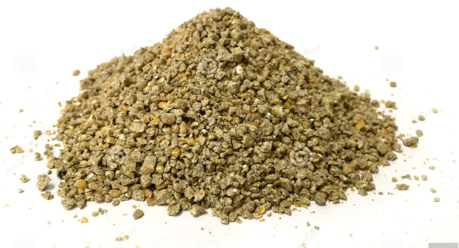
Diet
Corn-soy industry type basal broiler starter diet.
Diet divided into 5 equally-sized portions
Diets were fed as crumbles.
https://www.dreamstime.com/poultry-crumble-pellet-feed-white-background-small-chicken-broiler-breeder-pullet-animal-image179594335

Slide 38
Basal Diet Composition
Ingredient | Percentage
Corn | 58.43
Soybean Meal | 34.49
DL-Methionine | 0.23
Lysine HCL | 0.18
AV Blend 8500 | 2.76
Limestone | 1.56
BioFos 16/21P | 1.54
Salts | 0.51
Vitamins Premix¹ | 0.25
Trace minerals Premix² | 0.05
Calculated Nutrient Content | Percentage
Protein | 22
ME (Kcal/Kg) | 3050
Crude Fat | 5.32
Crude Fiber | 2.63
AV phosphate | 0.45
Calcium | 0.95
AV Methionine | 0.53
AV Met+Cys AV Lysine Sodium | 0.82 0.19 0.22
Potassium | 0.86
Chloride | 0.39

Slide 39
Data Collection
Performance data:
On the day10, 16, 21, weigh birds and feed, and count mortality.

Slide 40
Statistical Analysis
One Way ANOVA test, using the GLM procedure in SPSSTM (IBM, Armonk, NY, USA).
Means were separated using Duncan’s multiple range tests.
https://www.analyticssteps.com/blogs/how-do-exploratory-data-analysis-building-machine-learning-models

Slide 41
Results Day 10 Production Performance
Treatment | Body Weight (g) | Weight Gain (g) | Cumulative Feed to Body Weight | Phase Feed to Gain | PI¹ | Phase Mortality%
Cultured Yeast Cell Wall (Postbiotic)
XPC-Ultra® 625 | 262±21 | 223±21 | 1.00±0.02 | 1.18±0.04 | 247±26 | 0
XPC® 1250 | 270±9 | 231±9 | 1.00±0.00 | 1.17±0.02 | 257±13 | 0
Yeast Cell Wall Products (Prebiotics)
Safmannan® 250 | 264±11 | 225±10 | 0.98±0.02 | 1.15±0.02 | 255±13 | 0
Safmannan® 500 | 261±21 | 222±21 | 1.00±0.02 | 1.18±0.03 | 246±28 | 0
Control Groups (No Antibiotic Alternatives)
Challenged Chicks | 256±15 | 217±15 | 0.98±0.01 | 1.16±0.02 | 246±16 | 0
None-Challenged Chicks | 265±9 | 226±9 | 0.99±0.02 | 1.16±0.02 | 254±10 | 0
+ Standard Deviation
¹PI = Productivity Index

Slide 42
Day 16 Production Performance
Treatment | Body Weight (g) | Phase Weight Gain (g) | Cumulative Feed to Body Weight | Phase Feed to Gain | Cumulative Feed to Gain | PI ¹ | Phase Mortality % | Cumulative Mortality%
Cultured Yeast Cell Wall (Postbiotic)
XPC-Ultra® 625 | 566±45 | 282±25 | 1.139±0.015^{c} | 1.27±0.02^{c} | 1.23±0.02^{c} | 295±29 | 0 | 0
XPC® 1250 | 566±18 | 296±9 | 1.133±0.012^{c} | 1.25±0.02^{bc} | 1.22±0.02^{bc} | 310±13 | 0 | 0
Yeast Cell Wall Products (Prebiotics)
Safmannan® 250 | 546±2 | 282±14 | 1.129±0.011^{bc} | 1.27±0.02^{c} | 1.22±0.01^{bc} | 300±13 | 0 | 0
Safmannan® 500 | 545±42 | 284±21 | 1.136±0.011^{c} | 1.26±0.02^{bc} | 1.23±0.02^{c} | 297±26 | 0 | 0
Control Groups (No Antibiotic Additives)
Challenged Chicks | 548±31 | 292±23 | 1.110±0.014ª | 1.22±0.03ª | 1.20±0.02^{ab} | 306±21 | 0 | 0
None-Challenged Chicks | 548±17 | 283±14 | 1.117±0.021^{ab} | 1.24±0.03^{ab} | 1.20±0.02^{ab} | 303±10 | 0 | 0
^{a-c} Means within a row with no common superscript differ significantly (P<0.05)
+ Standard Deviation
¹PI= Productivity Index

Slide 43
Day 21 Productivity Performance
Treatment | Body Weight (g) | Phase Weight Gain (g) | Cumulative Feed to Body Weight | Phase Feed to Gain | Cumulative Feed to Gain | PI ¹ | Phase Mortality% | Cumulative Mortality%
Cultured Yeast Cell Wall (Postbiotic)
XPC-Ultra® 625 | 860±59 | 316±39 | 1.255±0.019^{b} | 1.48±0.11 | 1.317±0.02^{b} | 316±33 | 0 | 0
XPC® 1250 | 874±23 | 309±25 | 1.246±0.021^{b} | 1.46±0.08 | 1.304±0.02^{b} | 335±13 | 0 | 0
Yeast Cell Wall Products (Prebiotics)
Safmannan® 250 | 858±25 | 312±20 | 1.240±0.020^{b} | 1.44±0.06 | 1.299±0.02^{b} | 320±28 | 3±9 | 3±9
Safmannan® 500 | 876±55 | 332±21 | 1.237±0.021^{ab} | 1.41±0.07 | 1.297±0.02^{ab} | 318±54 | 6±12 | 6±12
Control Groups (No Antibiotic Additives)
Challenged Chicks | 857±34 | 309±42 | 1.236±0.024^{ab} | 1.48±0.13 | 1.273±0.19ª | 331±18 | 0 | 0
None-Challenged Chicks | 879±35 | 331±15 | 1.216±0.012ª | 1.38±0.01 | 1.297±0.03^{ab} | 345±10 | 3±9 | 3±9
^{a,b} Means within a row with no common superscript differ significantly (P<0.05)
+ Standard Deviation
¹PI= Productivity Index

Slide 44
Conclusion
Although all treatment groups showed higher final body weight compared to the challenged group ,there were no significant differences between the groups caused by of adding yeast cell wall postbiotic or prebiotic to broiler feed while challenging with Clostridium perfringens.

Slide 45
Experiment 3 Materials and Methods
All methods were approved by the TAMU institution animal care and use committee and the Animal Care and Use Committee at the Southern Plains Agriculture Research Center.
A 21-day trial with 288 Ross 308 newly hatched broiler chicks.
Origin: Sanderson Farms
Two stainless steel Battery Brooder Units (48 pens; 6 birds per pen) at United States Department of Agriculture (USDA ARS) in College Station, Texas.

Slide 46
Experimental Design
Treatment Products¹ | Concentration (ppm) | Challenge² | Antibiotic Alternative
Microsaf® | 500 | + | Probiotic
Envera Goplus® | 500 | + | Probiotic
Envera Goplus® + Safmannan® | 500 + 125 | + | Probiotic + Prebiotic
Safmannan® | 250 | + | Prebiotic
Challenged Chicks | 0 | + | None
None-Challenged Chicks | 0 | - | None
¹Safmannan® is obtained from primary culture and the purification of selected Saccharomyces cerevisiae proprietary strain sold by Phileo®. Microsaf® is a probiotic obtained from Phileo®, contains Bacillus amyloliquefaciens, Bacillus pumilus, and Bacillus licheniformis. Envera Goplus® is Lactobacillus probiotic from Animal Care Envera.
²Challenge with Clostridium perfringens occurred on day 16 and 17 of the experiment. 3 ml oral gavage 10⁷ CFU/ml per each challenged bird for all birds in challenged groups.

Slide 47
Experiment Time Line
Date | Phase
0 | Bird placement.
10 | 1 Bird removed from each pen. IBD Vaccination. Birds and feed weight.
16 | 1 Bird removed from each pen. Clostridium perfringens Challenge¹.
17 | Clostridium perfringens Challenge¹. Birds and feed weight.
21 | Experiment termination. Birds and feed weight.
¹Challenge with Clostridium perfringens occurred on day 16 and 17 of the experiment. 3 ml oral gavage 10⁷ CFU/ml per each challenged bird for all birds in challenged groups.

Slide 48
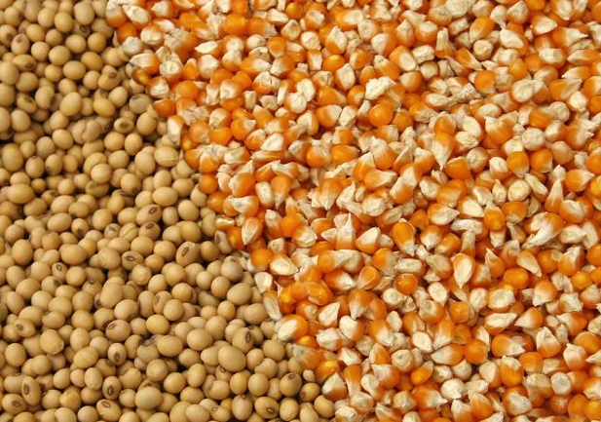
Diet
Corn-soy industry type basal broiler starter diet.
Diet divided into 5 equally-sized portions
Diets were fed as crumbles.
https://www.asian-agribiz.com/2022/06/02/practical-alternatives-to-corn-and-soybean-meal-in-southeast-asia/

Slide 49
Basal Diet Composition
Ingredient | Percentage
Corn | 58.43
Soybean Meal | 34.49
DL-Methionine | 0.23
Lysine HCL | 0.18
AV Blend | 2.76
Limestone | 1.56
BIOFOS | 1.54
Salts | 0.51
Vitamins Premix¹ | 0.25
Trace minerals Premix² | 0.05
Calculated Nutrient Content | Percentage
Protein | 22
ME (Kcal/Kg) | 3050
Crude Fat | 5.32
Crude Fiber | 2.63
AV phosphate | 0.45
Calcium | 0.95
AV Methionine | 0.53
AV Met+Cys AV Lysine Sodium | 0.83 1.19 0.22
Potassium | 0.86
Chloride | 0.39

Slide 50
Data Collection
Performance data:
On the day10, 16, 21, weigh birds and feed, and count mortality.

Slide 51
Statistical Analysis
One Way ANOVA test, using the GLM procedure in SPSSTM (IBM, Armonk, NY, USA).
Means were separated using Duncan’s multiple range tests.
https://fcpaprofessor.com/wp-content/uploads/2016/04/Statistical-Analysis.jpg

Slide 52
Results Day 10 Performance
Treatment | Body Weight (g) | Phase Weight Gain (g) | Cumulative Feed to Body Weight | Phase Feed to Gain | PI ¹ | Phase Mortality%
Probiotic Products Group
Microsaf® 500 | 260.5 ± 4.1 | 222.8 ± 3.9 | 1.01 ± 0.01 ^{ab} | 1.18 ± 0.01 ^{ab} | 221 ± 5 ª | 0
Envera Goplus® 500 | 258.3 ± 3.3 | 220.5 ± 3.4 | 1.00 ± 0.01 ª | 1.18 ±0.01 ^{ab} | 220 ± 3 ^{ab} | 0
Probiotic and Prebiotic Mix Group
Envera goplus® 500+ Safmannan® 125 | 247.6 ± 4.5 | 210.3 ± 4.3 | 1.01 ± 0.01 ^{ab} | 1.20 ±0.01 ^{b} | 208 ± 4 ^{b} | 0
Prebiotic Group
Safmannan® 250 | 258.0 ± 4.6 | 220.5 ± 4.5 | 1.02 ± 0.01 ^{b} | 1.19 ±0.02 ^{b} | 217 ± 6 ^{ab} | 0
Control Group (No Antibiotic Alternative Additives)
None-Challenged Chicks | 260±2.6 | 223.6 ± 2.6 | 1.00 ± 0.004 ª | 1.16 ± 0.005 ª | 225 ± 3 ª | 0
^{a,b} Means within a row with no common superscript differ significantly (P<0.05)
+ Standard Deviation
¹PI= Productivity Index

Slide 53
Day 16 Performance
Treatment | Body Weight (g) | Phase Weight Gain (g) | Cumulative Feed to Body Weight | Phase Feed to Gain | Cumulative Feed to Gain | PI ¹ | Phase Mortality% | Cumulative Mortality%
Probiotic Products Group
Microsaf® 500 | 544.7 ± 7.3 | 279.3 ± 4.5 | 1.25 ± 0.01 | 1.32 ± 0.02 | 1.25 ± 0.01 | 273 ± 4 | 0 | 0
Envera Goplus® 500 | 546.7 ± 6.8 | 283.1 ± 5.5 | 1.25 ± 0.01 | 1.32 ± 0.01 | 1.25 ± 0.01 | 274 ± 4 | 0 | 0
Probiotic and Prebiotic Mix Group
Envera goplus® 500+ Safmannan® 125 | 531.9 ± 7.7 | 278.6 ± 3.8 | 1.25 ± 0.01 | 1.30 ± 0.01 | 1.25 ± 0.01 | 267 ± 4 | 0 | 0
Prebiotic Group
Safmannan® 250 | 547.1 ± 8.4 | 283.5 ± 4.4 | 1.25 ± 0.01 | 1.30 ± 0.01 | 1.25 ± 0.01 | 274 ± 5 | 0 | 0
Control Group (No Antibiotic Alternative Additives)
None-Challenged Chicks | 545.6 ± 6.6 | 280.1 ± 3.7 | 1.25 ± 0.004 | 1.32 ± 0.01 | 1.24 ± 0.04 | 275 ± 4 | 0 | 0
+ Standard Deviation
¹PI= Productivity Index

Slide 54
Day 21 Performance
Treatment | Body Weight (g) | Phase Weight Gain (g) | Cumulative Feed to Body Weight | Phase Feed to Gain | Cumulative Feed to Gain | PI ¹ | Phase Mortality% | Cumulative Mortality %
Probiotic Products Group
Microsaf® 500 | 842±12 | 293±10 | 1.56 ± 0.02 | 1.58 ± 0.05 ^{b} | 1.34 ± 0.01 ^{b} | 275 ± 15 | 13 ± 7 | 8 ± 5
Envera Goplus® 500 | 849±16 | 299±11 | 1.55± 0.01 | 1.55 ± 0.05 ^{ab} | 1.33 ± 0.01 ^{ab} | 285 ± 9 | 9 ± 5 | 6 ± 3
Probiotic and Prebiotic Mix Group
Envera goplus® 500+ Safmannan® 125 | 830±18 | 291±12 | 1.51 ± 0.02 | 1.48 ± 0.03 ^{ab} | 1.31 ± 0.01 ^{ab} | 301 ± 7 | 0 | 0
Prebiotic Group
Safmannan® 250 | 853.0±18 | 303±16 | 1.51 ± 0.02 | 1.47 ± 0.05^{ab} | 1.31 ± 0.01 ^{ab} | 304 ± 10 | 3.3 | 2.2
Control Groups (No Antibiotic Alternative Additives)
Challenged Chicks | 828±21 | 288±10 | 1.53 ± 0.02 | 1.48 ± 0.02 ^{ab} | 1.32 ± 0.01 ^{ab} | 300 ± 8 | 0 | 0
None-Challenged Chicks | 871±12 | 313±6 | 1.51 ± 0.01 | 1.45 ± 0.02ª | 1.30 ± 0.01 ª | 319 ± 5 | 0 | 0
^{a,b} Means within a row with no common superscript differ significantly (P<0.05)
+ Standard Deviation
¹PI= Productivity Index

Slide 55
Conclusion
Adding Microsaf®, Envera Goplus®, Safmannan®, Envera®+Safmannan® combination enhanced body weight of broilers after challenging with Clostridium perfringens compared to challenged control group.

Slide 56
Experiment 4 Material and Methods
The study was approved by the Texas A&M institutional Animal Care.
Birds were housed at Texas A&M University Poultry Research Center.
Day-Old (960) Cobb-700 male broiler chicks.
60 (3’ x 6’) floor pens (16 birds per pen, 5 blocks and 2 replicates per block) in TAMU poultry farm building.

Slide 57
Experimental Design
Treatment Products¹ | Concentration (ppm) | Antibiotic Alternative
Safmannan® | 250 | Prebiotic
Actisaf® | 250 | Probiotic
Envera Goplus® | 2X10⁶ (500 ppm) | Probiotic
Safmannan® + Envera Goplus® | 125 + 2X10⁵ (500ppm) | Prebiotic + Probiotic
XPC® | 1250 | Postbiotic
Control | 0 | Non
¹Safmannan® is obtained from primary culture and the purification of selected Saccharomyces cerevisiae proprietary strain sold by Phileo®. Actisaf® is a highly concentrated micro granule form of proprietary Saccharomyces cerevisiae live yeast from Phileo®. Envera Goplus® is Lactobacillus probiotic from Animal Care Envera. XPC® is a yeast culture Saccharomyces cerevisiae yeast grown on a media of processed grain by-products, roughage products, cane molasses, malt and corn syrup sold by Diamond V.

Slide 58
Experimental Time Line
Day | Testing
1 | -Bird placement -Birds weight and feed weight
14 | -10 feces samples/pen pooled for dry matter (not cecal droppings)
21 | -2 birds per pen mid gut (ilium) sample for histopathology - Birds weight and feed weight
28 | -5 feces samples/pen pooled for dry matter (not cecal droppings)
35 | - Birds and feed weight
41 | -5 feces samples/pen pooled for dry matter (not cecal droppings)
42 | -Study termination, birds weight and feed weight

Slide 59
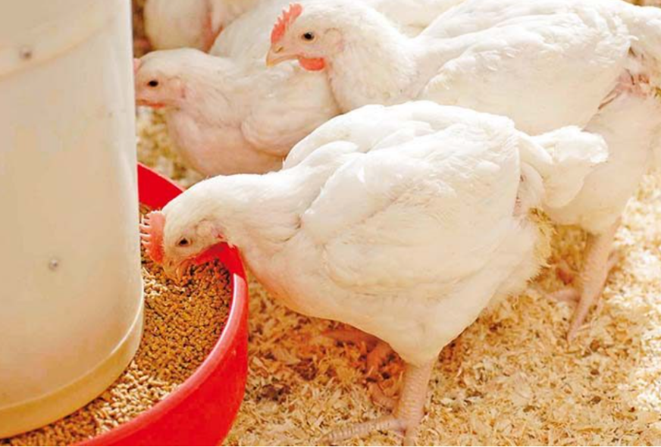
Diet
A basal corn-soy diet was formulated for each of the.
3 feeding phases (starter, grower & finisher), subdivided to create 6 different experimental groups.
5% DDG’s (starter), 8% DDG’s (grower) and 10% DDG’s (finisher).
https://agricsite.com/types-of-broiler-feed/

Slide 60
Basal Diet Composition (Starter)
Ingredient | Percentage
Corn | 50.10
Soybean Meal | 26.82
DDGs | 5.00
DL-Methionine | 0.31
Lysine HCL | 0.33
L-Threonine 98% | 0.10
Fat Blended | 0.84
Limestone | 1.35
BIOFOS | 1.57
Salts | 0.28
Vitamins Premix¹ | 0.25
Trace minerals Premix² | 0.05
Calculated Nutrient Content | Percentage
Protein | 22.00
ME (Kcal/Kg) | 2970
Crude Fat | 3.73
Crude Fiber | 2.69
AV phosphate | 0.45
Calcium | 0.90
AV Methionine | 0.61
AV Met+Cys AV Lysine Sodium | 0.90 1.20 0.16
Potassium | 0.90
Chloride | 0.29

Slide 61
Basal Diet Composition (Grower)
Ingredient | Percentage
Corn | 60.34
Soybean Meal | 24.78
DDGs | 8.00
DL-Methionine | 0.45
Lysine HCL | 0.49
L-Threonine 98% | 0.68
Fat Blended | 2.61
Limestone | 1.46
BIOFOS | 1.36
Salts | 1.29
Vitamins Premix¹ | 0.25
Trace minerals Premix² | 0.05
Calculated Nutrient Content | Percentage
Protein | 20.50
ME (Kcal/Kg) | 3100
Crude Fat | 5.02
Crude Fiber | 2.48
AV phosphate | 0.40
Calcium | 0.90
AV Methionine | 0.53
AV Met+Cys AV Lysine Sodium | 0.81 1.07 0.16
Potassium | 0.84
Chloride | 0.28

Slide 62
Basal Diet Composition (Finisher)
Ingredient | Percentage
Corn | 67.14
Soybean Meal | 16.94
DDGs | 10.00
DL-Methionine | 4.38
Lysine HCL | 0.29
Fat Blend | 2.33
Limestone | 1.37
BioFOS | 1.17
Salts | 0.10
Sodium Bicarb | 0.25
Vitamins Premix¹ | 0.25
Trace minerals Premix² | 0.05
Calculated Nutrient Content | Percentage
Protein | 17.50
ME (Kcal/Kg) | 3150
Crude Fat | 5.00
Crude Fiber | 2.42
AV phosphate | 0.38
Calcium | 0.80
AV Methionine | 0.38
AV Met+Cys AV Lysine Sodium | 0.62 0.90 0.16
Potassium | 0.70
Chloride | 0.17

Slide 63
Data Collection
Performance data;
On the day 0. 21, 35, 42 weigh birds and feed, and count mortality.
Fecal Dry Matter Calculation;
10 feces samples per pen pooled for dry matter (not cecal droppings) at day 14, 28, 41.
Histology Samples;
Day-21 of the trial 2 birds per pen.
Notes:
A 3 cm ilium section was taken from each bird. The ileum was defined as that portion of the small intestine extending 20 mm from the vitelline diverticulum to a point 20 mm proximal to the ileo-caecal junction. Intestinal samples were fixed in formalin for further analysis.

Slide 64
Statistical Analysis
One Way ANOVA test, using the GLM procedure in SPSSTM (IBM, Armonk, NY, USA).
Means were separated using Duncan’s multiple range tests.

Slide 65
Results: Growth and Performance at day 21 of the experiment
Treatment | Body Weight (g) | Phase Weight Gain (g) | Cumulative Feed to Body Weight | Phase Feed to Gain | PI ¹ |  | Phase Mortality%
Probiotic Products Group
Actisaf® 250 | 792 ± 22 | 755 ± 22 | 1.38 ± 0.02 | 1.45 ± 0.03 | 252 ± 18 |  | 3.1 ± 5.3
Envera Goplus® 500 | 792 ± 37 | 755 ± 37 | 1.41 ± 0.06 | 1.48 ± 0.07 | 253 ± 20 |  | 1.3 ± 2.6
Probiotic and Prebiotic Mix Group
Envera Goplus® 500+ Safmannan® 125 | 792 ± 51 | 755 ± 501 | 1.39 ± 0.13 | 1.46 ± 0.15 | 247 ± 40 |  | 5.6 ± 8.0
Prebiotic Group
Safmannan® 250 | 780 ± 39 | 742 ± 39 | 1.41 ± 0.02 | 1.48 ± 0.02 | 237 ± 21 |  | 5.6 ± 5.5
Postbiotic Group
XPC® 1250 | 790 ± 45 | 753 ± 45 | 1.41 ± 0.06 | 1.49 ± 0.07 | 234 ± 41 |  | 8.8 ± 9.9
Control Group (No Antibiotic Alternative Additive)
Control Group | 800 ± 35 | 763 ± 35 | 1.41 ± 0.03 | 1.49 ± 0.03 |  | 250 ± 17 | 2.5 ± 4.4
+ Standard deviation
¹ PI = Productivity Index

Slide 66
Growth and Performance at day 35 of the experiment
Treatment | Body Weight (g) | Phase Weight Gain (g) | Cumulative Feed to Body Weight | Phase Feed to Gain | Cumulative Feed to Gain | PI ¹ | Phase Mortality% | Cumulative Mortality%
Probiotic Products Group
Actisaf® 250 | 1938 ± 83 | 1146 ± 70 | 1.66 ± 0.03 ª | 1.87 ± 0.06ª | 1.69 ± 0.04 ª | 316 ± 32 | 0.6 ± 2.0 | 3.8 ± 5.3
Envera Goplus® 500 | 1908 ± 117 | 1115 ± 102 | 1.68 ± 0.07 ^{ab} | 1.90 ± 0.10ª | 1.72 ± 0.07 ^{ab} | 312 ± 25 | 0.6 ± 2.0 | 1.9 ± 3.0
Probiotic and Prebiotic Mix Group
Envera Goplus® 500+ Safmannan® 125 | 1946 ± 79 | 1154 ± 55 | 1.66 ± 0.07 ª | 1.87 ± 0.06ª | 1.70 ± 0.07 ª | 309 ± 34 | 0.0 ± 0.0 | 5.6 ± 8.0
Prebiotic Group
Safmannan® 250 | 1887 ± 79 | 1106 ± 61 | 1.69 ± 0.04 ^{ab} | 1.93 ± 0.08^{ab} | 1.73 ± 0.04 ^{ab} | 292 ± 29 | 0.7 ± 2.1 | 6.3 ± 5.9
Postbiotic Group
XPC® 1250 | 1893 ± 87 | 1103 ± 46 | 1.69 ± 0.02 ^{ab} | 1.94 ± 0.04^{ab} | 1.73 ± 0.03 ^{ab} | 266 ± 42 | 0.0 ± 0.0 | 8.8 ± 9.9
Control Group (No Antibiotic Alternative Additive)
Control Group | 1900 ± 107 | 1101 ± 80 | 1.73 ± 0.04 ^{b} | 1.98 ± 0.06^{b} | 1.76 ± 0.04 ^{b} | 297 ± 27 | 1.3 ± 2.8 | 3.8 ± 6.0
^{a,b} Means within a row with no common superscript differ significantly (P<0.05)
+ Standard Deviation
¹PI= Productivity Index
Notes:
All groups contain Live Microorganisms (Actisaf, Envera, envera+Safmannan) enhanced phase feed to gain ratio compared to control group.

Slide 67
Growth and Performance at day 42 of the experiment
Treatment | Body Weight (g) | Phase Weight Gain (g) | Cumulative Feed to Body Weight | Phase Feed to Gain | Cumulative Feed to Gain | PI ¹ | Phase Mortality% | Cumulative Mortality%
Probiotic Products Group
Actisaf® 250 | 2584 ± 127 | 646 ± 96 | 1.76 ± 0.03 | 2.12 ± 0.15 | 1.79 ± 0.04 | 330 ± 38 | 0.8 ± 2.6 | 4.4 ± 6.6
Envera Goplus® 500 | 2501 ± 144 | 594 ± 68 | 1.78 ± 0.06 | 2.17 ± 0.15 | 1.81 ± 0.06 | 321 ± 25 | 0.7 ± 2.3 | 2.5 ± 3.2
Probiotic and Prebiotic Mix Group
Envera Goplus® 500+ Safmannan® 125 | 2575±130 | 629 ± 64 | 1.78± 0.04 | 2.18 ± 0.09 | 1.81 ±0.04 | 319 ± 36 | 0.8 ± 2.6 | 6.3 ± 8.8
Prebiotic Group
Safmannan® 250 | 2491 ± 150 | 605 ± 102 | 1.80 ± 0.04 | 2.22 ± 0.28 | 1.84 ± 0.05 | 304 ± 40 | 0.0 ± 0.0 | 6.3 ± 5.9
Postbiotic Group
XPC® 1250 | 2522 ± 152 | 629 ± 107 | 1.80 ±0.05 | 2.22 ± 0.26 | 1.84 ± 0.05 | 299 ± 43 | 0.0 ± 0.0 | 8.8 ± 9.9
Control Group (No Antibiotic Alternative Additive)
Control Group | 2559 ± 220 | 659 ± 156 | 1.81 ± 0.06 | 2.13 ± 0.25 | 1.84 ± 0.06 | 318 ± 31 | 0.0 ± 0.0 | 3.8 ± 6.0
+ Standard deviation
¹ PI = Productivity Index

Slide 68
Fecal Dry Matter Percentage
Treatment | Day 14 | Day 28 | Day 41
Probiotic Products Group
Actisaf® 250 | 23.63 ± 5.47 | 19.54 ± 1.35 | 18.61 ± 2.20
Envera Goplus® 500 | 21.85 ± 1.49 | 18.77 ± 1.91 | 18.64 ± 1.59
Probiotic and Prebiotic Mix Group
Envera Goplus® 500+ Safmannan® 125 | 21.97 ± 2.09 | 18.44 ± 1.90 | 19.56 ± 1.39
Prebiotic Group
Safmannan® 250 | 22.25 ± 2.44 | 19.35 ± 1.16 | 18.73 ± 0.78
Postbiotic Group
XPC® 1250 | 24.83 ± 5.75 | 19.48 ± 1.28 | 18.57 ± 1.85
Control Group (No Antibiotic Alternative Additive)
Control Group | 23.31 ± 2.37 | 20.78 ± 5.48 | 17.84 ± 2.26
+ Standard deviation

Slide 69
Histology at day 21 of the experiment
Treatment | Villi Height (µm) | Crypt Depth (µm) | V: C
Probiotic Products Group
Actisaf® 250 | 1263 ± 195 | 190 ± 109 | 7.49 ± 2.15
Envera Goplus® 500 | 1203 ± 135 | 174 ± 27 | 7.07 ± 1.22
Probiotic and Prebiotic Mix Group
Envera Goplus® 500+ Safmannan® 125 | 1176 ± 196 | 178 ± 32 | 6.79 ± 1.56
Prebiotic Group
Safmannan® 250 | 1238 ± 115 | 182 ± 34 | 7.02 ± 1.37
Postbiotic Group
XPC® 1250 | 1256 ± 207 | 166 ± 21 | 7.73 ± 1.90
Control Group (No Antibiotic Alternative Additive)
Control Group | 1215 ± 168 | 179 ± 33 | 7.01 ± 1.67
+ Standard deviation

Slide 70
Conclusion
All additive groups showed improved cumulative feed to body weight ratio compared to the control group at day 42 of the experiment.
Groups contains live microorganisms like Actisaf®, Envera®, and the combination of Envera®+Safmannan® , showed significant enhancement in phase feed to gain compared to control group at day 35, and the same groups showed increased PI compared to control group at day 42.

Slide 71
Experiment 5 Materials and Methods
All methods were approved by the TAMU institution animal care and use committee and the Animal Care and Use Committee at the Southern Plains Agriculture Research Center.
A 21-day trial with 288 Cobb-500 newly hatched broiler chicks.
Origin: Sanderson Farms
Two stainless steel Battery Brooder Units (48 pens; 6 birds per pen) at United States Department of Agriculture (USDA ARS) in College Station, Texas.

Slide 72
Experimental Design
Treatment Products¹ | Safmannan® Concentration (ppm) | FB (10^{x}) | Clostridium Perfringens Challenge²
FB4 + Safmannan® 125 | 125 | 10⁴ | +
FB4 + Safmannan® 250 | 250 | 10⁴ | +
FB5 + Safmannan® 125 | 125 | 10⁵ | +
FB5 + Safmannan® 250 | 250 | 10⁵ | +
FB6 + Safmannan® 125 | 125 | 10⁶ | +
FB6 + Safmannan® 250 | 250 | 10⁶ | +
Challenged Control | 0 | 0 | +
None-Challenged control | 0 | 0 | -
¹Safmannan® is obtained from primary culture and the purification of selected Saccharomyces cerevisiae proprietary strain sold by Phileo®. FB is A Bacillus probiotic from Phileo®.
²Challenge with Clostridium perfringens occurred on day 16 and 17 of the experiment. 3 ml oral gavage 10⁷ CFU/ml per each challenged bird for all birds in challenged groups.

Slide 73
Experimental Time Line
Date | Phase
0 | Birds Placements Birds and Feed Weight
10 | IBD Vaccination Birds and Feed Weight
14 | Diet Change Birds and Feed Weight
16 | Clostridium perfringens Challenge¹ Birds and Feed Weight
17 | Clostridium perfringens Challenge¹
21 | Experiment Termination Birds and Feed Weight
¹Challenge with Clostridium perfringens occurred on day 16 and 17 of the experiment. 3 ml oral gavage 10⁷ CFU/ml per each challenged bird for all birds in challenged groups.

Slide 74
Diet
Two Diets D1 & D2
D1, corn-soy based diet
Day 0-13 of the Experiment
D2, wheat middling and distiller’s dried grains (DDG’s)
Day 14-21 of the experiment
Both diet divided into 7 equally-sized portions
Diets were fed as crumbles

Slide 75
Basal Diet Composition, Diet 1
Ingredient | Percentage
Corn | 58.43
Soybean Meal | 34.49
DL-Methionine | 0.23
Lysine HCL | 0.18
AV Blended | 2.76
Limestone | 1.56
BIOFOS | 1.54
Salts | 0.51
Vitamins Premix¹ | 0.25
Trace minerals Premix² | 0.05
Calculated Nutrient Content | Percentage
Protein | 22.00
ME (Kcal/Kg) | 3050
Crude Fat | 5.32
Crude Fiber | 2.63
AV phosphate | 0.45
Calcium | 0.95
AV Methionine | 0.53
AV Met+Cys AV Lysine Sodium | 0.83 1.19 0.22
Potassium | 0.86
Chloride | 0.39

Slide 76
Basal Diet Composition, Diet 2
Ingredient | Percentage
Corn | 28.53
DDGs | 6.41
Wheat | 35.00
Soybean | 22.97
DL-Methionine | 0.26
Lysine HCL | 0.31
L-Threonine 98% | 0.07
Soybean Oil | 3.20
Limestone | 1.29
BIOFOS | 1.38
Salts | 0.29
Vitamins Premix¹ | 0.25
Trace minerals Premix² | 0.05
Calculated Nutrient Content (%)
Protein | 19.00
ME (Kcal/Kg) | 3086
Crude Fat | 5.36
Crude Fiber | 2.88
AV phosphate | 0.42
Calcium | 0.84
AV Methionine | 0.47
AV Met+Cys AV Lysine Sodium | 0.68 0.99 0.16
Potassium | 0.84
Chloride | 0.29

Slide 77
Data Collection
Performance Data
Birds weight and feed weight and mortality at day 10, 14, 16, 21.

Slide 78
Statistical Analysis
One Way ANOVA test, using the GLM procedure in SPSSTM (IBM, Armonk, NY, USA).
Means were separated using Duncan’s multiple range tests.
https://online.york.ac.uk/the-use-of-statistics-in-data-science/

Slide 79
Results DAY 10, 14, 16, and 21 Body Weight Results (g)
Treatment | Day 0-10 | Day 10-14 | Day 14-16 | Day 16-21
FB4 + Safmannan® 125 | 264 ± 9 | 468 ± 16 | 584 ± 23 | 910 ± 38^{ab}
FB4 + Safmannan® 250 | 256 ± 11 | 460 ± 16 | 581 ± 21 | 879 ± 62^{b}
FB5 + Safmannan® 125 | 257 ± 17 | 465 ± 24 | 591 ± 27 | 909 ± 53^{ab}
FB5 + Safmannan® 250 | 269 ± 13 | 469 ± 22 | 595 ± 32 | 931 ± 96^{ab}
FB6 + Safmannan® 125 | 265 ± 30 | 480 ± 35 | 603 ± 30 | 946 ± 48^{ab}
FB6 + Safmannan® 250 | 261 ± 12 | 466 ± 18 | 590 ± 23 | 943 ± 48^{ab}
Challenged Control | 263 ± 8 | 466 ± 21 | 590 ± 23 | 906 ± 59^{ab}
None-Challenged Control | 273 ± 21 | 485 ± 23 | 614 ± 27 | 961 ± 32ª
^{a,b} Means within a row with no common superscript differ significantly (P≤0.05)
+ Standard deviation

Slide 80
DAY 10, 14, 16, and 21 Phase Weight Gain Results (g)
Treatment | Day 0-10 | Day 10-14 | Day 14-16 | Day 16-21
FB4 + Safmannan® 125 | 219 ± 10 | 198 ± 10 | 116 ± 9 ^{b} | 314 ±17^{b}
FB4 + Safmannan® 250 | 211 ± 12 | 196 ± 9 | 121 ± 7 ^{ab} | 284 ± 54^{b}
FB5 + Safmannan® 125 | 212 ± 17 | 199 ± 11 | 126 ± 7 ^{ab} | 302 ± 51^{ab}
FB5 + Safmannan® 250 | 224 ± 13 | 198 ± 6 | 125 ± 11 ^{ab} | 326 ± 67^{ab}
FB6 + Safmannan® 125 | 220 ± 30 | 207 ± 6 | 123 ± 5 ^{ab} | 331 ± 36 ^{ab}
FB6 + Safmannan® 250 | 216 ± 13 | 198 ± 7 | 124 ± 6 ^{ab} | 345 ± 29 ª
Challenged Control | 218 ± 8 | 201 ± 10 | 124 ± 5 ^{ab} | 312 ± 49^{ab}
None-Challenge Control | 228 ± 21 | 208 ± 10 | 129 ± 6 ª | 341 ± 24^{ab}
^{a,b} Means within a row with no common superscript differ significantly (P≤0.05)
+ Standard deviation

Slide 81
DAY 10, 14, 16, and 21 Phase Feed to Weight Ratio Results
Treatment | Day 0-10 | Day 10-14 | Day 14-16 | Day 16-21
FB4 + Safmannan® 125 | 1.18 ± 0.2 | 1.20 ± 0.04 ^{b} | 1.43 ± 0.06 ^{b} | 1.73. ± 0.10
FB4 + Safmannan® 250 | 1.19 ± 0.4 | 1.21 ± 0.03 ^{b} | 1.39 ± 0.04 ^{ab} | 1.82 ± 0.26
FB5 + Safmannan® 125 | 1.19 ± 0.3 | 1.21 ± 0.03 ^{b} | 1.37 ± 0.08 ª | 1.74 ± 0.27
FB5 + Safmannan® 260 | 1.17 ± 0.01 | 1.21 ± 0.03 ^{b} | 1.38 ± 0.05 ^{ab} | 1.78 ± 0.25
FB6 + Safmannan® 125 | 1.19 ± 0.06 | 1.19 ± 0.04 ^{ab} | 1.39 ± 0.03 ^{ab} | 1.71 ± 0.18
FB5 + Safmannan® 250 | 1.19 ± 0.03 | 1.20 ± 0.04 ^{ab} | 1.35 ± 0.04 ª | 1.63 ± 0.11
Challenged Control | 1.15 ± 0.02 | 1.16 ± 0.03 ª | 1.37 ± 0.04 ª | 1.77 ± 0.21
None-Challenged Control | 1.17 ± 0.03 | 1.18 ± 0.03 ^{ab} | 1.36 ± 0.05 ª | 1.63 ± 0.12
^{a,b} Means within a row with no common superscript differ significantly (P≤0.05)
+ Standard deviation

Slide 82
DAY 10, 14, 16, and 21 Cumulative Feed Gain Ratio Results
Treatment | Day 0-10 | Day 10-14 | Day 14-16 | Day 16-21
FB4 + Safmannan® 125 | 118 ± 0.02 | 1.19 ± 0.01 ^{b} | 1.24 ± 0.01 ^{c} | 1.38 ± 0.02 ^{ab}
FB4 + Safmannan® 250 | 1.19 ± 0.04 | 1.20 ± 0.01 ^{b} | 1.24 ± 0.02 ^{c} | 1.40 ± 0.06 ^{b}
FB5 + Safmannan® 125 | 1.19 ± 0.03 | 1.20 ± 0.03 ^{b} | 1.23 ± 0.04 ^{bc} | 1.38 ± 0.07 ^{ab}
FB5 + Safmannan® 250 | 1.17 ± 0.01 | 1.19 ± 0.01 ^{b} | 1.23 ± 0.01 ^{bc} | 1.37 ± 0.02 ^{ab}
FB6 + Safmannan® 125 | 1.19 ± 0.06 | 1.19 ± 0.2 ^{b} | 1.23 ± 0.02 ^{bc} | 1.37 ± 0.04 ^{ab}
FB6 + Safmannan® 250 | 1.19 ± 0.3 | 1.20 ± 0.02 ^{b} | 1.23 ± 0.02 ^{bc} | 1.35 ± 0.03 ^{ab}
Challenged Control | 1.15 ± 0.02 | 1.15 ± 0.01 ª | 1.20 ± 0.02 ª | 1.36 ± 0.03 ^{ab}
None-Challenged Control | 117 ± 0.03 | 1.17 ± 0.01 ª | 1.21 ± 0.02 ^{ab} | 1.34 ± 0.04 ª
^{a,b} Means within a row with no common superscript differ significantly (P≤0.05)
+ Standard deviation

Slide 83
DAY 10, 14, 16, and 21 Cumulative Feed to Body Weight Ratio Results
Treatment | Day 0-10 | Day 10-14 | Day 14-16 | Day 16-21
FB4 + Safmannan® 125 | 0.978 ± 0.01 ^{b} | 1.17 ± 0.02 | 1.22 ± 0.02 | 1.57 ± 0.04
FB4 + Safmannan® 250 | 0.982 ± 0.03 ^{b} | 1.16 ± 0.04 | 1.20 ± 0.04 | 1.57 ± 0.07
FB5 + Safmannan® 125 | 0.980 ± 0.03 ^{b} | 1.17 ± 0.03 | 1.21 ± 0.04 | 1.55 ± 0.09
FB5 + Safmannan® 250 | 0.975 ± 0.01 ^{ab} | 1.18 ± 0.03 | 1.22 ± 0.03 | 1.58 ± 0.03
FB6 + Safmannan® 125 | 0.982 ± 0.03 ^{b} | 1.17 ± 0.02 | 1.21 ±0.01 | 1.56 ± 0.04
FB6 + Safmannan® 250 | 0.987 ± 0.02 ^{b} | 1.17 ± 0.02 | 1.21 ± 0.02 | 1.54 ± 0.04
Challenged Control | 0.950 ± 0.02 ª | 1.15 ± 0.02 | 1.19 ± 0.01 | 1.57 ± 0.05
None-Challenged Control | 0.972 ± 0.02 ^{ab} | 1.16 ± 0.02 | 1.20 ± 0.02 | 1.53 ± 0.05
^{a,b} Means within a row with no common superscript differ significantly (P≤0.05)
+ Standard deviation

Slide 84
DAY 10, 14, 16, and 21 PI¹ Results
Treatment | Day 0-10 | Day 10-14 | Day 14-16 | Day 16-21
FB4 + Safmannan® 125 | 223 ± 11 | 281 ± 10 ^{ab} | 295 ± 13 ^{bc} | 305 ± 26 ^{ab}
FB4 + Safmannan® 250 | 209 ± 24 | 266 ± 23 ^{b} | 284 ± 22 ^{c} | 292 ± 43 ^{b}
FB5 + Safmannan® 125 | 217 ± 14 | 278 ± 10 ^{ab} | 299 ± 10 ^{abc} | 315 ± 28 ^{ab}
FB5 + Safmannan® 250 | 230 ± 13 | 282 ± 14 ^{ab} | 303 ± 17 ^{abc} | 297 ± 45 ^{ab}
FB6 + Safmannan® 125 | 255 ± 36 | 289 ± 25 ª | 307 ± 23 ^{abc} | 318 ± 35 ^{ab}
FB6 + Safmannan® 250 | 219 ± 14 | 279 ± 11 ^{ab} | 301 ± 13 ^{abc} | 324 ± 37 ^{ab}
Challenged Control | 229 ± 8 | 289 ± 13 ª | 308 ± 12 ^{ab} | 309 ± 33 ^{ab}
None-Challenged Control | 235 ± 23 | 297 ± 14 ª | 318 ± 14 ª | 342 ± 16 ª
^{a,b,c} Means within a row with no common superscript differ significantly (P≤0.05)
+ Standard deviation
¹ PI= Productivitu Index

Slide 85
DAY 10, 14, 16, and 21 Phase Mortality Percentage Results
Treatment | Day 0-10 | Day 10-14 | Day 14-16 | Day 16-21
FB4 + Safmannan® 125 | 0 ± 0 | 0 ± 0 | 0 ± 0 | 4.2 ± 10.2 ^{ab}
FB4 + Safmannan® 250 | 3.8 ± 6.8 | 0 ± 0 | 0 ± 0 | 0.0 ± 0.0 ª
FB5 + Safmannan® 125 | 0 ± 0 | 0 ± 0 | 0 ± 0 | 0.0 ± 0.0 ª
FB5 + Safmannan® 250 | 0 ± 0 | 0 ± 0 | 0 ± 0 | 12.5 ± 13.7 ^{b}
FB6 + Safmannan® 125 | 0 ± 0 | 0 ± 0 | 0 ± 0 | 5.0 ± 11.2 ^{ab}
FB6 + Safmannan® 250 | 0 ± 0 | 0 ± 0 | 0 ± 0 | 4.2 ± 10.2 ^{ab}
Challenged Control | 0 ± 0 | 0 ± 0 | 0 ± 0 | 4.2 ± 10.2 ^{ab}
None-Challenged Control | 0 ± 0 | 0 ± 0 | 0 ± 0 | 0.0 ± 0.0 ª
^{a,b} Means within a row with no common superscript differ significantly (P≤0.05)
+ Standard deviation

Slide 86
DAY 10, 14, 16, and 21 Cumulative Mortality Percentage Results
Treatment | Day 0-10 | Day 10-14 | Day 14-16 | Day 16-21
FB4 + Safmannan® 125 | 0.0 ± 0.0 | 0.0 ± 0.0 | 0.0 ± 0.0 | 2.8 ± 6.8
FB4 + Safmannan® 250 | 2.8 ± 6.8 | 2.8 ± 6.8 | 2.8 ± 6.8 | 2.8 ± 6.8
FB5 + Safmannan® 125 | 0.0 ± 0.0 | 0.0 ± 0.0 | 0.0 ± 0.0 | 0.0 ± 0.0
FB5 + Safmannan® 250 | 0.0 ± 0.0 | 0.0 ± 0.0 | 0.0 ± 0.0 | 8.3 ± 9.1
FB6 + Safmannan® 125 | 0.0 ± 0.0 | 0.0 ± 0.0 | 0.0 ± 0.0 | 3.3 ± 7.5
FB6 + Safmannan® 250 | 0.0 ± 0.0 | 0.0 ± 0.0 | 0.0 ± 0.0 | 2.8 ± 6.8
Challenged Control | 0.0 ± 0.0 | 0.0 ± 0.0 | 0.0 ± 0.0 | 2.8 ± 6.8
None-Challenged Control | 0.0 ± 0.0 | 0.0 ± 0.0 | 0.0 ± 0.0 | 0.0 ± 0.0
+ Standard deviation

Slide 87
Conclusion
All treatment groups showed enhancement in performance except FB4 + Safmannan® 250.
Increased final body weight in all treatment groups compared to Challenged control group.

Slide 88
Overall Dissertation Conclusion
Adding antibiotic alternatives enhanced performance while challenging with Clostridium perfringens in starter chicks or without challenging with Clostridium perfringens in full term chickens, but not significantly.
Antibiotic alternatives showed better effects on broiler performance in the later rearing phases of the chickens.

Slide 89
REFRENCES
Anderson, C.J. and Kendal M.M. (2017). Salmonella enterica Serovar Typhimurium Strategies for Host Adaptation. Frontiers in Microbiology. 12:1-16.
Craven, S. E., N. J. Stern, E. Line, J. S. Bailey, N. A. Cox, and P. Fedorka-Cray. (2000). Determination of the incidence of salmonella spp., campylobacter jejuni, and clostridium perfringens in wild birds near broiler chicken houses by sampling intestinal droppings. Avian Dis. 44:715-720.
Craven, S. E., N. J. Stern, J. S. Bailey, and N. A. Cox. (2001). Incidence of clostridium perfringens in broiler chickens and their environment during production and processing. Avian Dis. 45:887-896.
Danladi, Y., Loh, T.C., Foo, H.L., Henny Akit, H.A., Tamrin, N.A.M., Azizi, M.N. (2022). Effects of Postbiotics and Paraprobiotics as Replacements for Antibiotics on Growth Performance, Carcass Characteristics, Small Intestine Histomorphology, Immune Status and Hepatic Growth Gene Expression in Broiler Chickens. Animals. 12:917-935.
Dar, M.A., Ahmad, S.M., Bhat, S.A., Ahmed, R., Urwat, U., Mumtaz, P.T., Bhat, S.A., Dar, T.A., Shah, R.A., and Ganai, N.A. (2017). Salmonella typhimurium in poultry: a review. World's Poultry Science Journal. 73(2):345-354.
Freedman, J. C., J. R.Theoret, J. A. Wisniewski, F. A. Uzal, J. I. Rood, and B. A. Mcclane. (2015). Clostridium perfringens type a–e toxin plasmids. Res. Microbiol. 166:264-279.
Romo-Barrera, M.C., Castrillón-Rivera, L.E., Palma-Ramos, A., Castañeda-Sánchez, J.I., and Luna-Herrera, J. (2021). Bacillus licheniformis and Bacillus subtilis, Probiotics That Induce the Formation of Macrophage Extracellular Traps. Microorganisms 9:1-12.
FAO. (2015). Livestock production.
FAO. (2021). Gateway to Poultry Production and Products.
FAW/WHO. (2001). Report of a Joint FDA/WHO Expert Consultation on Evaluation of Health and Nutritional Properties of Probiotics in Food Encluding Powder Milk with Live Lactic Acid Bacteria.

Slide 90
References
Gadde, U., Kim, W. H., Oh, S. T., and Lillehoj, H. S. (2017). Alternatives to antibiotics for maximizing growth performance and feed efficiency in poultry: A review. Anim. Health Res. Rev. 18:1-20.
Hasan, F., Khan S., Shah A., and Abdul Hameed. (2009). Production of Antibacterial Compounds by Free and Immobilized Bacillus pumilus SAF1. Pakistan journal botany. 41(3): 1499-1510.
Humam, A. M., Loh, T.C., Foo, H.L., Samsudin, A.A., Mustapha, N.M., Zulkifli, I., and Izuddin, W.I. (2019). Effects of Feeding Different Postbiotics Produced by Lactobacillus plantarum on Growth Performance, Carcass Yield, Intestinal Morphology, Gut Microbiota Composition, Immune Status, and Growth Gene Expression in Broilers under Heat Stress. Animals. 9:644-663.
Khelfa, D.E., Abd El-Ghani, W.A., and Salem, H.M. (2012). Recent Status of Clostridial enteritis affecting early weaned rabbit in Egypt. Life Sci. J. 9:227-2279.
Ngalimat, M.S., Yahaya,R.S.R., Baharudin, M.M.A., Yaminudin,S.M., Karim, M., Ahmad, S.A., and Sabri, S. (2021). A Review on the Biotechnological Applications of the Operational Group Bacillus amyloliquefaciens. Microorganism. 9:1-18.
Petit, L., M. Gibert, and M. R. Popoff. (1999). Clostridium perfringens: Toxinotype and genotype. Trends Microbiol. 7: 104-110.
Rebollada-Merino, A., Ugarte-Ruiz, M., Hernández, M., Miguela-Villoldo, P., Abad, D., Rodríguez-Lázaro, D., de Juan, L., Domínguez, L., and Rodríguez-Bertos, A. (2020). Reduction of Salmonella Typhimurium Cecal Colonisation and Improvement of Intestinal Health in Broilers Supplemented with Fermented Defatted ‘Alperujo’, an Olive Oil By-Product. Animals. 10:1-16.
Risdian, C., Mozef, T., and Wink, J. (2019). Biosynthesis of Polyketides in Streptomyces. Microorganisms. 7:1-18.
Trunbull, P.C.B. (1996). Bacillus. Medical microbiology. 4th edition.
Salminen, S., Collado, M.C., Endo, A., Hill, C., Lebeer, S., Quigley, E.M.M., Sanders, M.E., Shamir, R., Swann, J.R., Szajewska, H. and Vinderola, G. (2021). The International Scientific Association of Probiotics and Prebiotics (ISAPP) consensus statement on the definition and scope of postbiotics. GASTROENTEROLOGY AND HEPATOLOGY. 18: 649-667.

Slide 91
References
Songer, J. G. (1996). Clostridial enteric diseases of domestic animals. Clin. Microbiol. Rev. 9:216-234.
Underwood, W.J., Blauwiekel, R., Delano, M.L., Gillesby, R., Mischler, S.A., Schoell, A. (2015). Laboratory Animal Medicine (Third Edition): Biology and Diseases of Ruminants (Sheep, Goats, and Cattle). 623-695.
Van Immerseel, F., J. I. Rood, R. J. Moore, and R. W. Titball. (2009). Rethinking our understanding of the pathogenesis of necrotic enteritis in chickens. Trends Microbiol. 17:32-36.
https://www.123rf.com/photo_43136855_broiler-cartoon-illustration.html
https://medcraveonline.com/MOJT/MOJT-05-00151.pdf

Slide 93
Thank you

