Slide 1
برعاية السيد عميد كلية الهندسة الخوارزمي الأستاذ الدكتور ودود طاهر محمد المحترم يقيم قسم الهندسة الكيميائية الاحيائية ورشة العمل الموسومة
Genetic Cloning
المحاضر
م.د. دعاء خالد

Slide 2
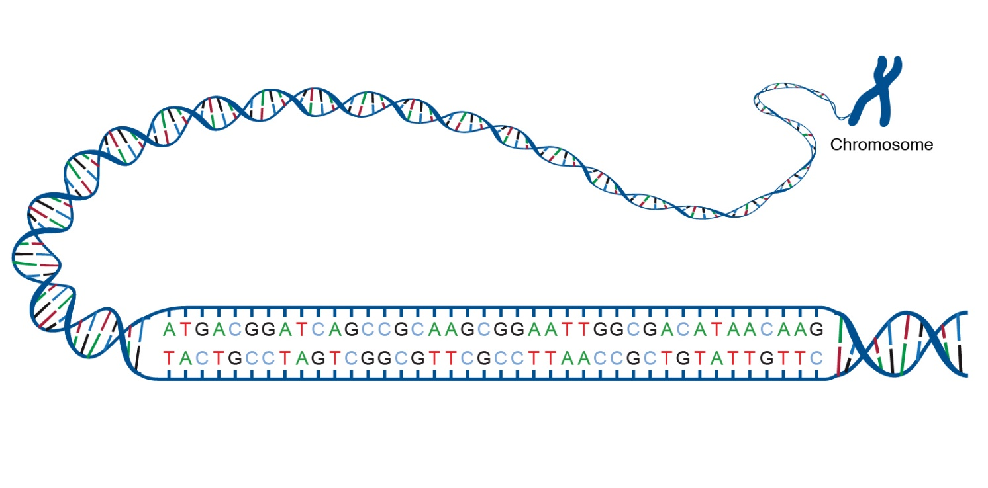
Genetic Material
Genetic material refers to the molecules responsible for carrying and transmitting genetic information. It contains the instructions needed for the growth, development, functioning, and reproduction of all living organisms.
It is known as DNA (deoxyribonucleic acid) or RNA (ribonucleic acid).
A gene is the basic physical and functional unit of heredity. Genes are made up of DNA. Some genes act as instructions to make molecules called proteins. However, many genes do not code for proteins. ‏

Slide 3
Genetic Cloning
Genetic Cloning is the process of creating a genetically identical copy of an organism, a gene, or a cell. This means the DNA sequence of the copied entity is identical to the original one.

Slide 4
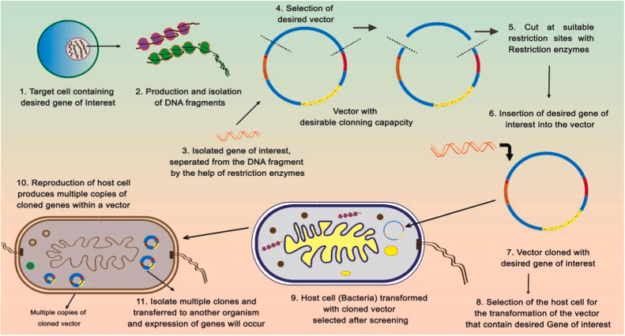
Genetic Cloning Steps

Slide 5
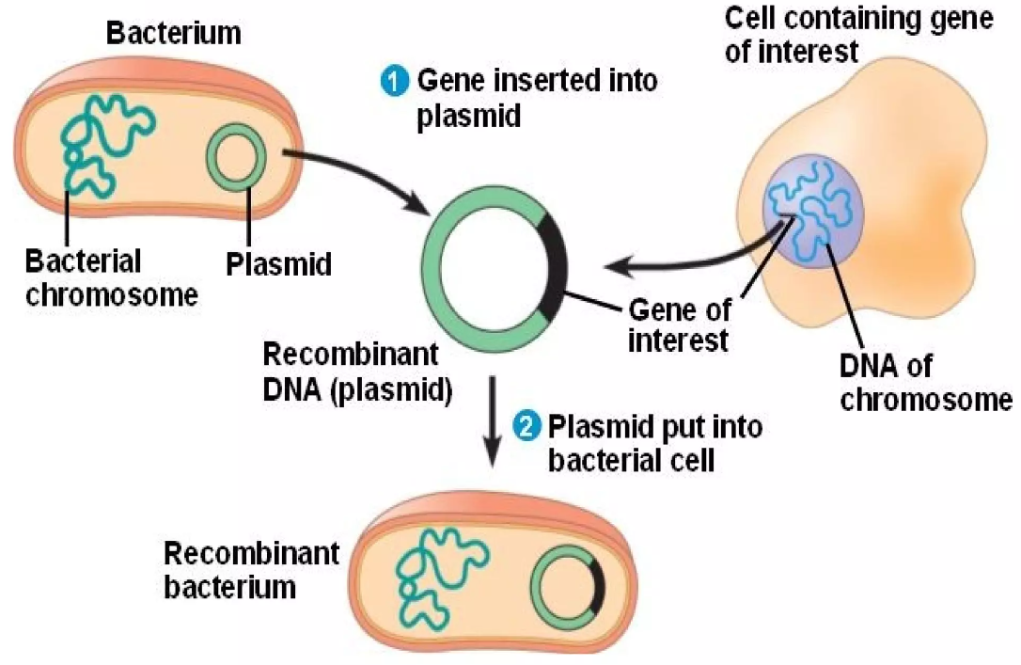
Genetic Cloning Steps

Slide 6
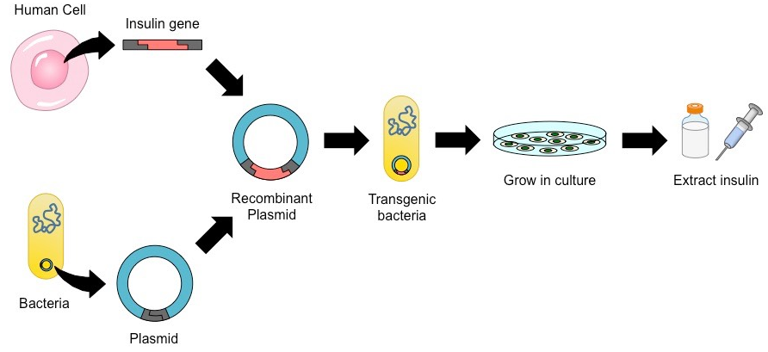
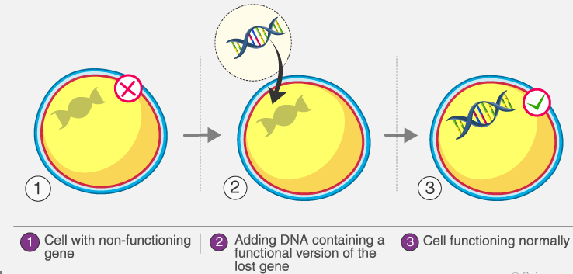
Genetic Cloning/ Medical Applications
Medical Applications
a. Production of Therapeutic Proteins
b. Gene Therapy
c. Vaccine Development:

Slide 7
Genetic Cloning/ Environmental Applications
Bioremediation
Genetic engineering can be used to create microorganisms that can break down or detoxify pollutants in industrial waste. These genetically modified microorganisms can be used to clean up contaminated soil and water.
GEMs, or genetically engineered microorganisms, are gaining popularity in the area of bioremediation as a result of recent technical developments. GEMs are sought because of their genetic material, which may be altered to include desired genes.
GEMs for environmental cleanup: Gene cloning allows the modification of microorganisms to target specific pollutants in contaminated environments. For example, bacteria can be engineered to break down oil spills, heavy metals, or other harmful chemicals.

Slide 8
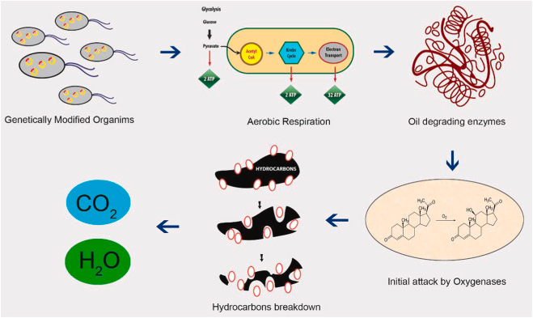
Genetic Cloning/ Environmental Applications

Slide 9
Genetic Cloning/Industrial Applications
Industrial fermentation: Genetic engineering can be used to create microorganisms that can ferment sugars into various products such as organic acids, amino acids, and vitamins. These products can be used in various industrial applications such as food and beverage production, pharmaceuticals, and cosmetics.

Slide 10
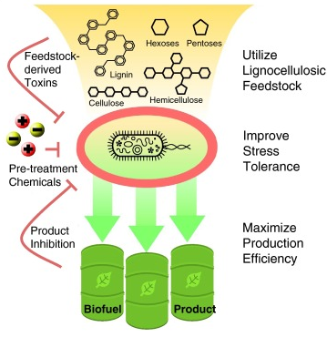
Genetic Cloning/Industrial Applications
Biofuel production: Creating microorganisms for sustainable fuel generation: Genetically modified microbes can be created to produce biofuels like ethanol or biodiesel from renewable sources, such as plant waste or cellulose. This provides a more sustainable alternative to traditional fossil fuels.

Slide 11
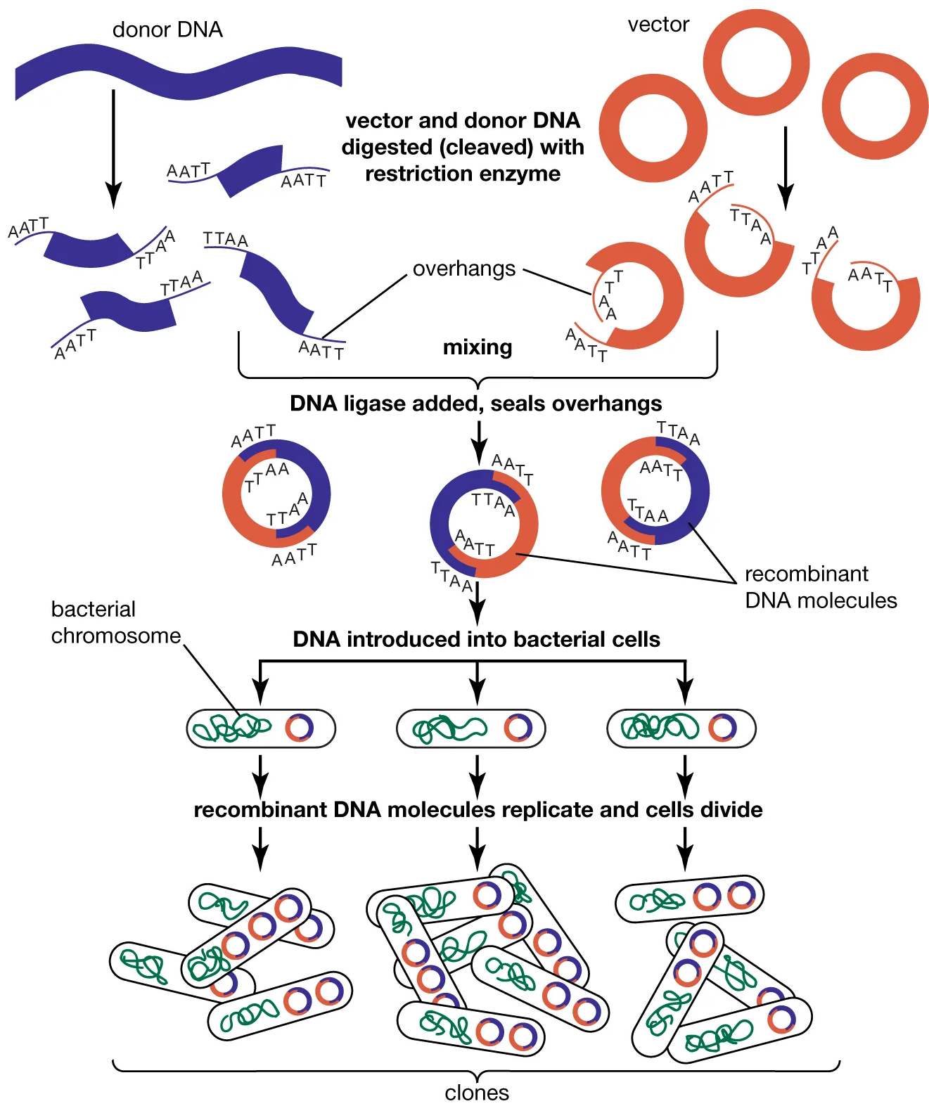
Genetic Cloning/Industrial Applications
Enzyme production: Genetic engineering can be used to produce enzymes that are used in various industrial processes such as food processing, textile manufacturing, and paper production. These enzymes can be optimized for specific industrial applications, making them more efficient and cost-effective.

Slide 12
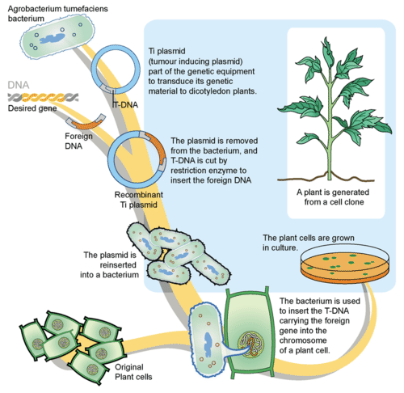
Genetic Cloning/Agriculture Applications
Agricultural biotechnology: Genetic engineering can be used to create crops that are resistant to pests and diseases, have improved yields, and can grow in harsh environmental conditions. These genetically modified crops can help meet the growing demand for food and can be used to produce biofuels and other industrial products.

Slide 13
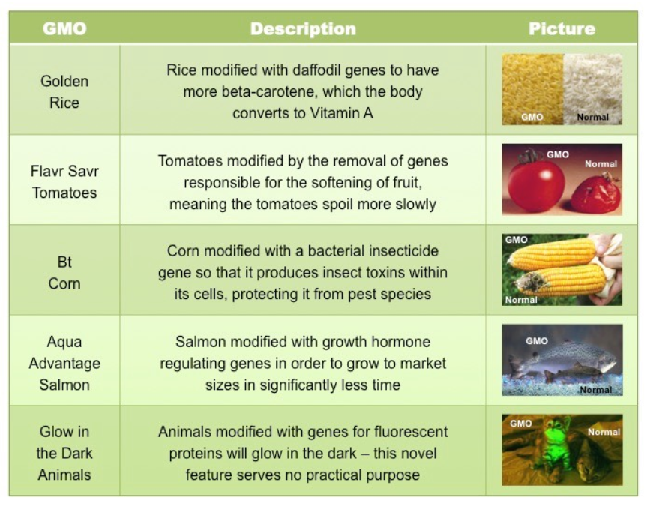
Genetically Modified Food (GMF)

Slide 15
