Slide 1
Polymeric injectable fillers

Slide 2
Polymeric injectable fillers
Injectable fillers have become a vital part of cosmetology. A wide variety of injectable fillers are developed for either correction of facial wrinkles and folds or facial contouring. As the most popular filler products, polymeric injectable fillers represent a class of the most common implantable medical devices.

Slide 3
History
In the late 1800s, shortly after the invention of the syringe, chemical agents were used for facial augmentation. Unfortunately,
history has taught us that new technologies must be used with care, because complications can occur, sometimes many years after initial treatment. Since the launch of the first commercial filler that was made of collagen around 1980, more and more injectable fillers have emerged. In 2018, around 2.3 million polymeric injectable filler products were used in United States.

Slide 4
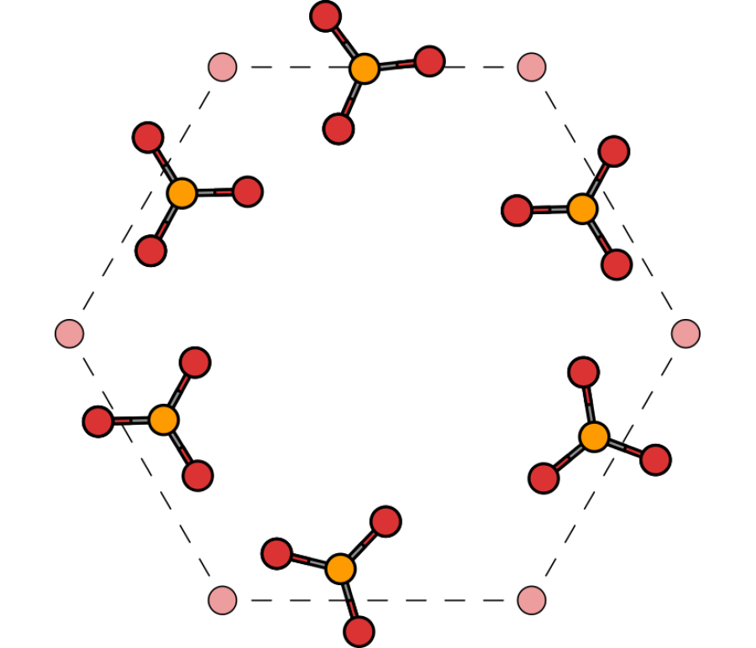
The material used
implantable biomaterials have been developed. such as hydroxyapatite. polymers such as hyaluronic acid and autologous tissue derivatives
In the past several decades, injectable fillers have been paid more and more attention due to their unique features including easy-to-operate and minimally invasive procedures.

Slide 5
Classification
The injectable fillers have been classified as temporary or permanent according to the resorbability of the filler. Injectable fillers may also be classified as inert or fibrogenic based on the mechanism of action. fillers prepared by the same raw material may be classified into different categories if the fillers were prepared by different methods, such as crosslinking and surface treatment. polymeric injectable fillers classified as the following four categories:
Type A
Type B
Type C
Type D

Slide 6
Type A
The fillers are made of same or similar components of extracellular matrices (ECMs) in human body. As a result, type A fillers are easy to be resorbed if they were not chemical modified or crosslinked. They may temporarily occupy the body volume and cause limited local host tissue response (limited fibrogenic). Examples of type A fillers include sodium hyaluronate acid (HA), collagen, and acellular matrices (ACMs).

Slide 7
Type B
The fillers are composed of bioresorbable materials which usually have a longer resorption time in vivo than those in type A. As foreign materials to the body, type B fillers may temporarily occupy the body volume, and cause some host tissue response and form fibrosis. Such fibrosis will still exist after the complete degradation of the type B filler. the most widely used type B fillers are resorbable polyesters, such as PLA and poly(ε-caprolactone) (PCL). In addition, fillers containing hydroxyapatite can be classified as type B as well.23 For example, Radiesse24 which is comprised hydroxyapatite and cellulose was approved by FDA in June 2015.

Slide 8
Type C
The fillers are made of non-bioresobable synthetic polymers, which are intended to have permanent and irreversible occupation of the body volume, and cause some host tissue response and form fibrosis. Examples of type C fillers poly(acrylic acid) (PAA) and poly(vinyl alcohol) (PVA). Because type C fillers will not degrade, their augmentation effect is permanent and irreversible. Such effect has always been a safety concern after injection. Safety is the top priority of implantable materials.

Slide 9
Type D
Permanent augmentation effect can be achieved with the newly formed collagen, ECMs, or even regenerated tissue .TBD

Slide 10
Representative Type A Fillers Hyaluronate-Based Filler Products
Injectable filler based on hyaluronic acid (HA) has the largest number of products and is the most extensively used product at present. In 2018, around 80% of the injectable fillers in United States are hyaluronate-based products. HA is extracted from the rooster crest (animal-derived) or prepared by microbial fermentation, while the latter is more popular processing method. Chemicals such as 1,4-butanediol diglycidyl ether (BDDE) and divinyl sulfone (DVS) can crosslink HA to form hydrogel with three-dimensional (3D) network. 26 The non-crosslinked or low-degree crosslinked HA-based filler has relative short resorption time and limited augmentation effect. As a result, non-crosslinked or low-degree crosslinked HAs are only used to correct small wrinkles. Some non-crosslinked or low-degree crosslinked HA-based fillers are used to improve the tone and elasticity of skin after superficial injection, which is an approved indication in Europe but not in United States or China. Generally, supplements of vitamins and amino acids to HAs can supply nutritional ingredients to further enhance the above effect.

Slide 11
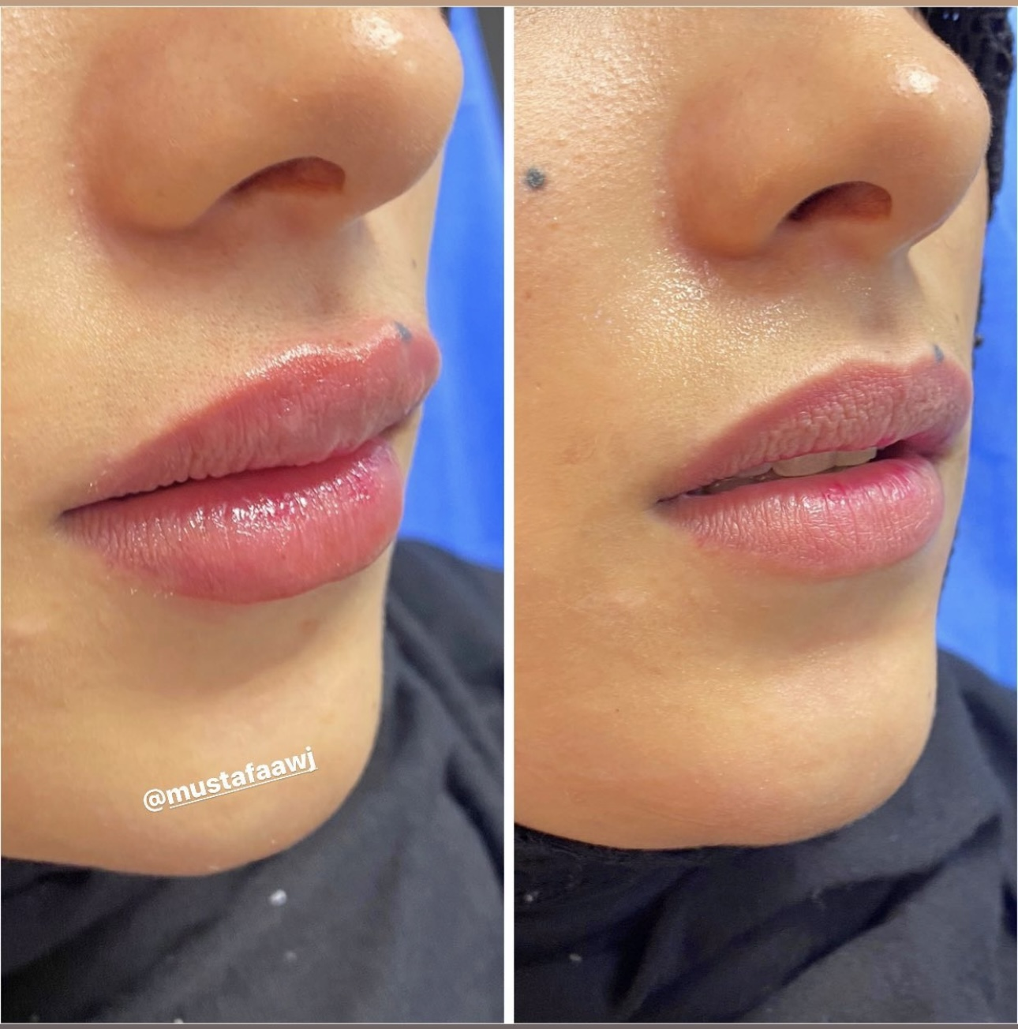
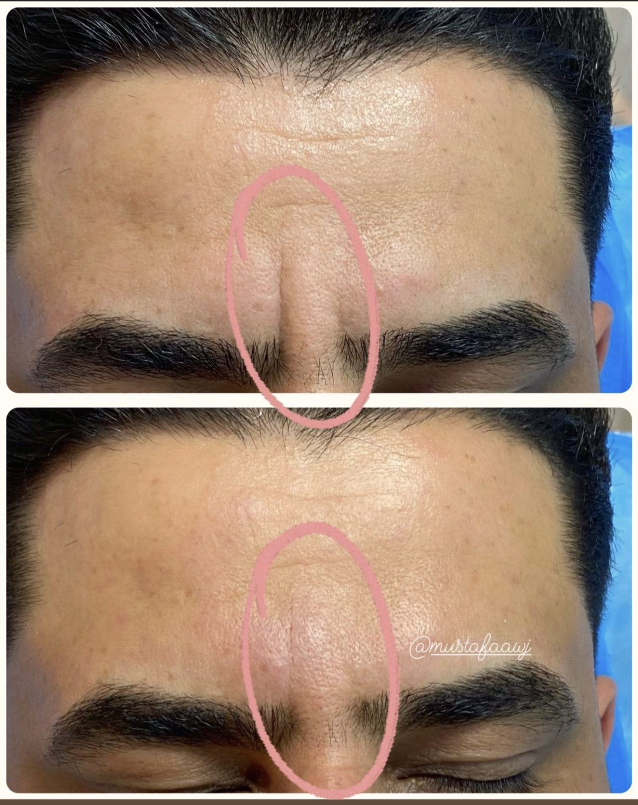

Slide 12
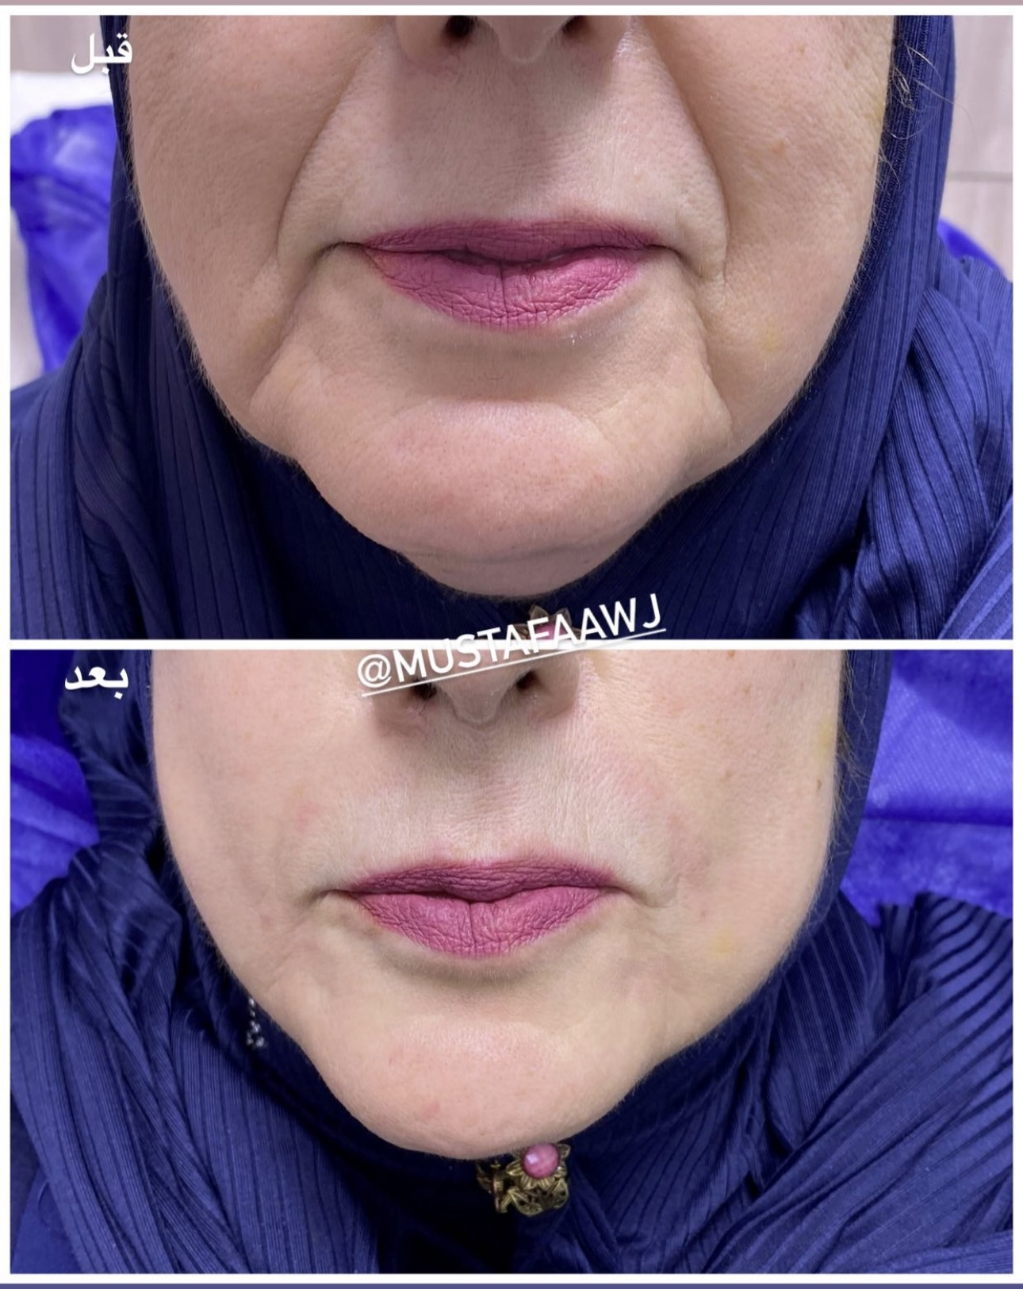
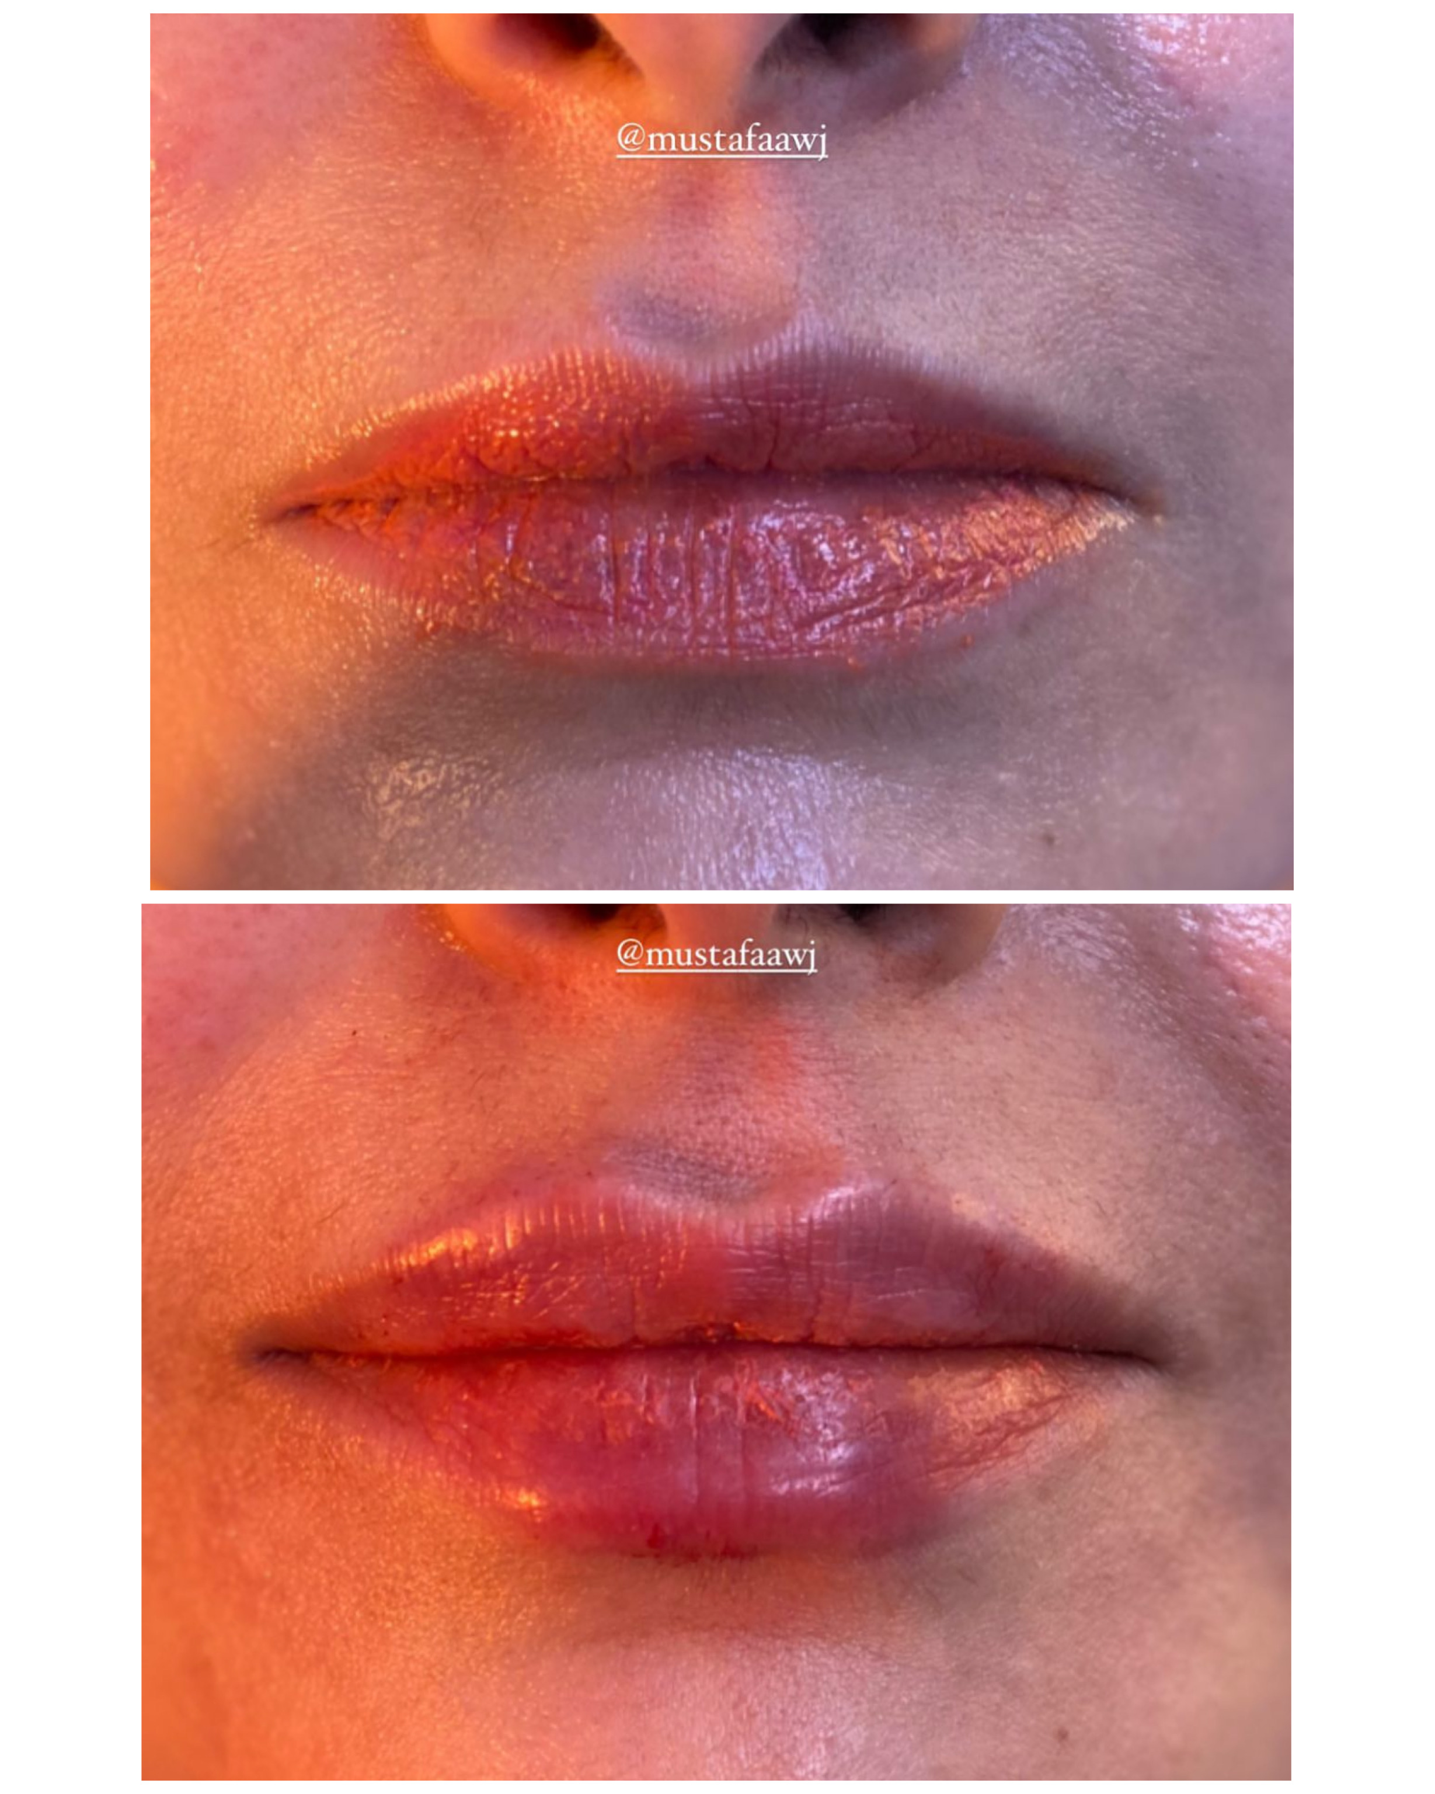

Slide 13
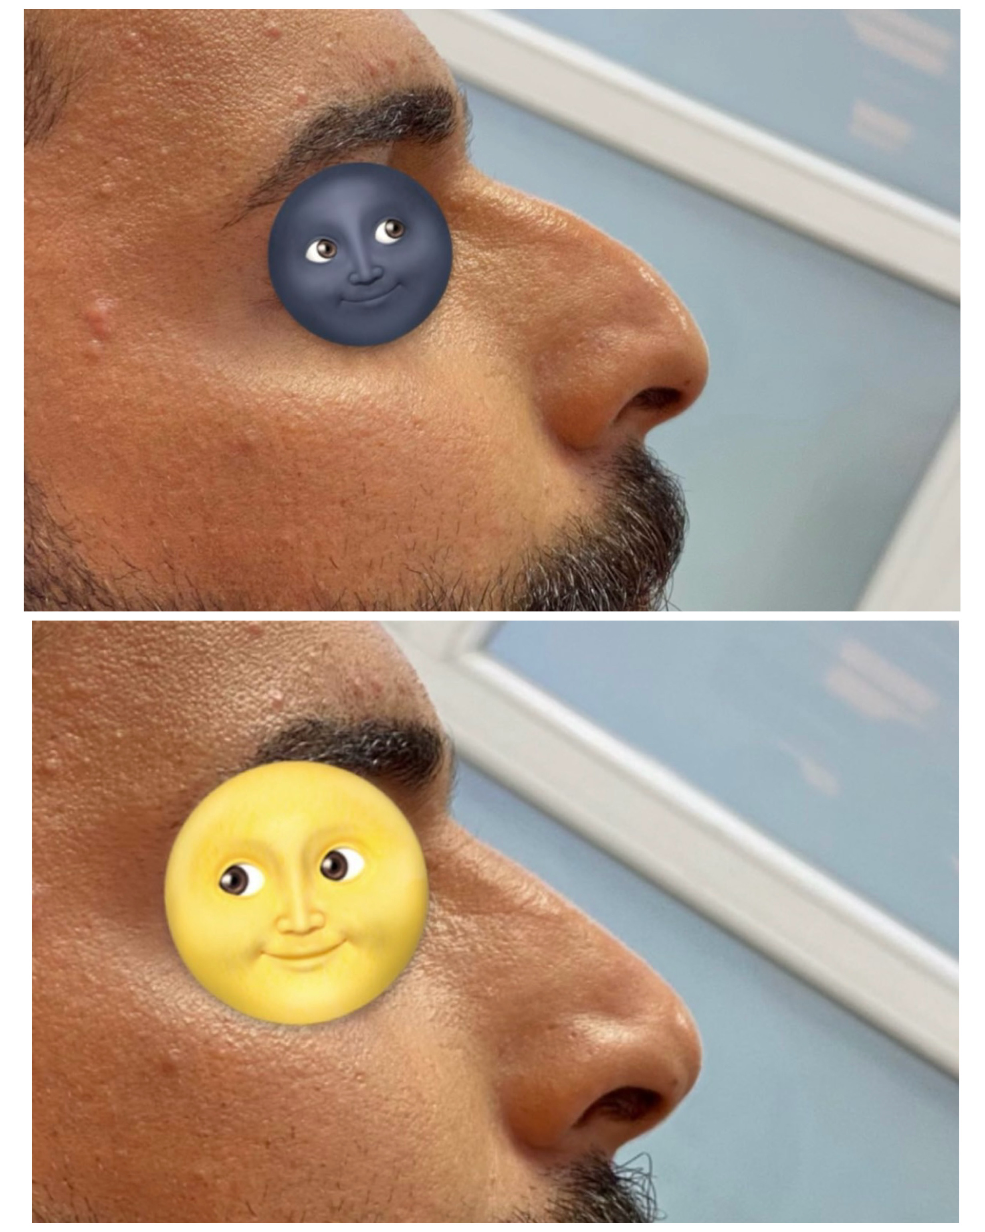
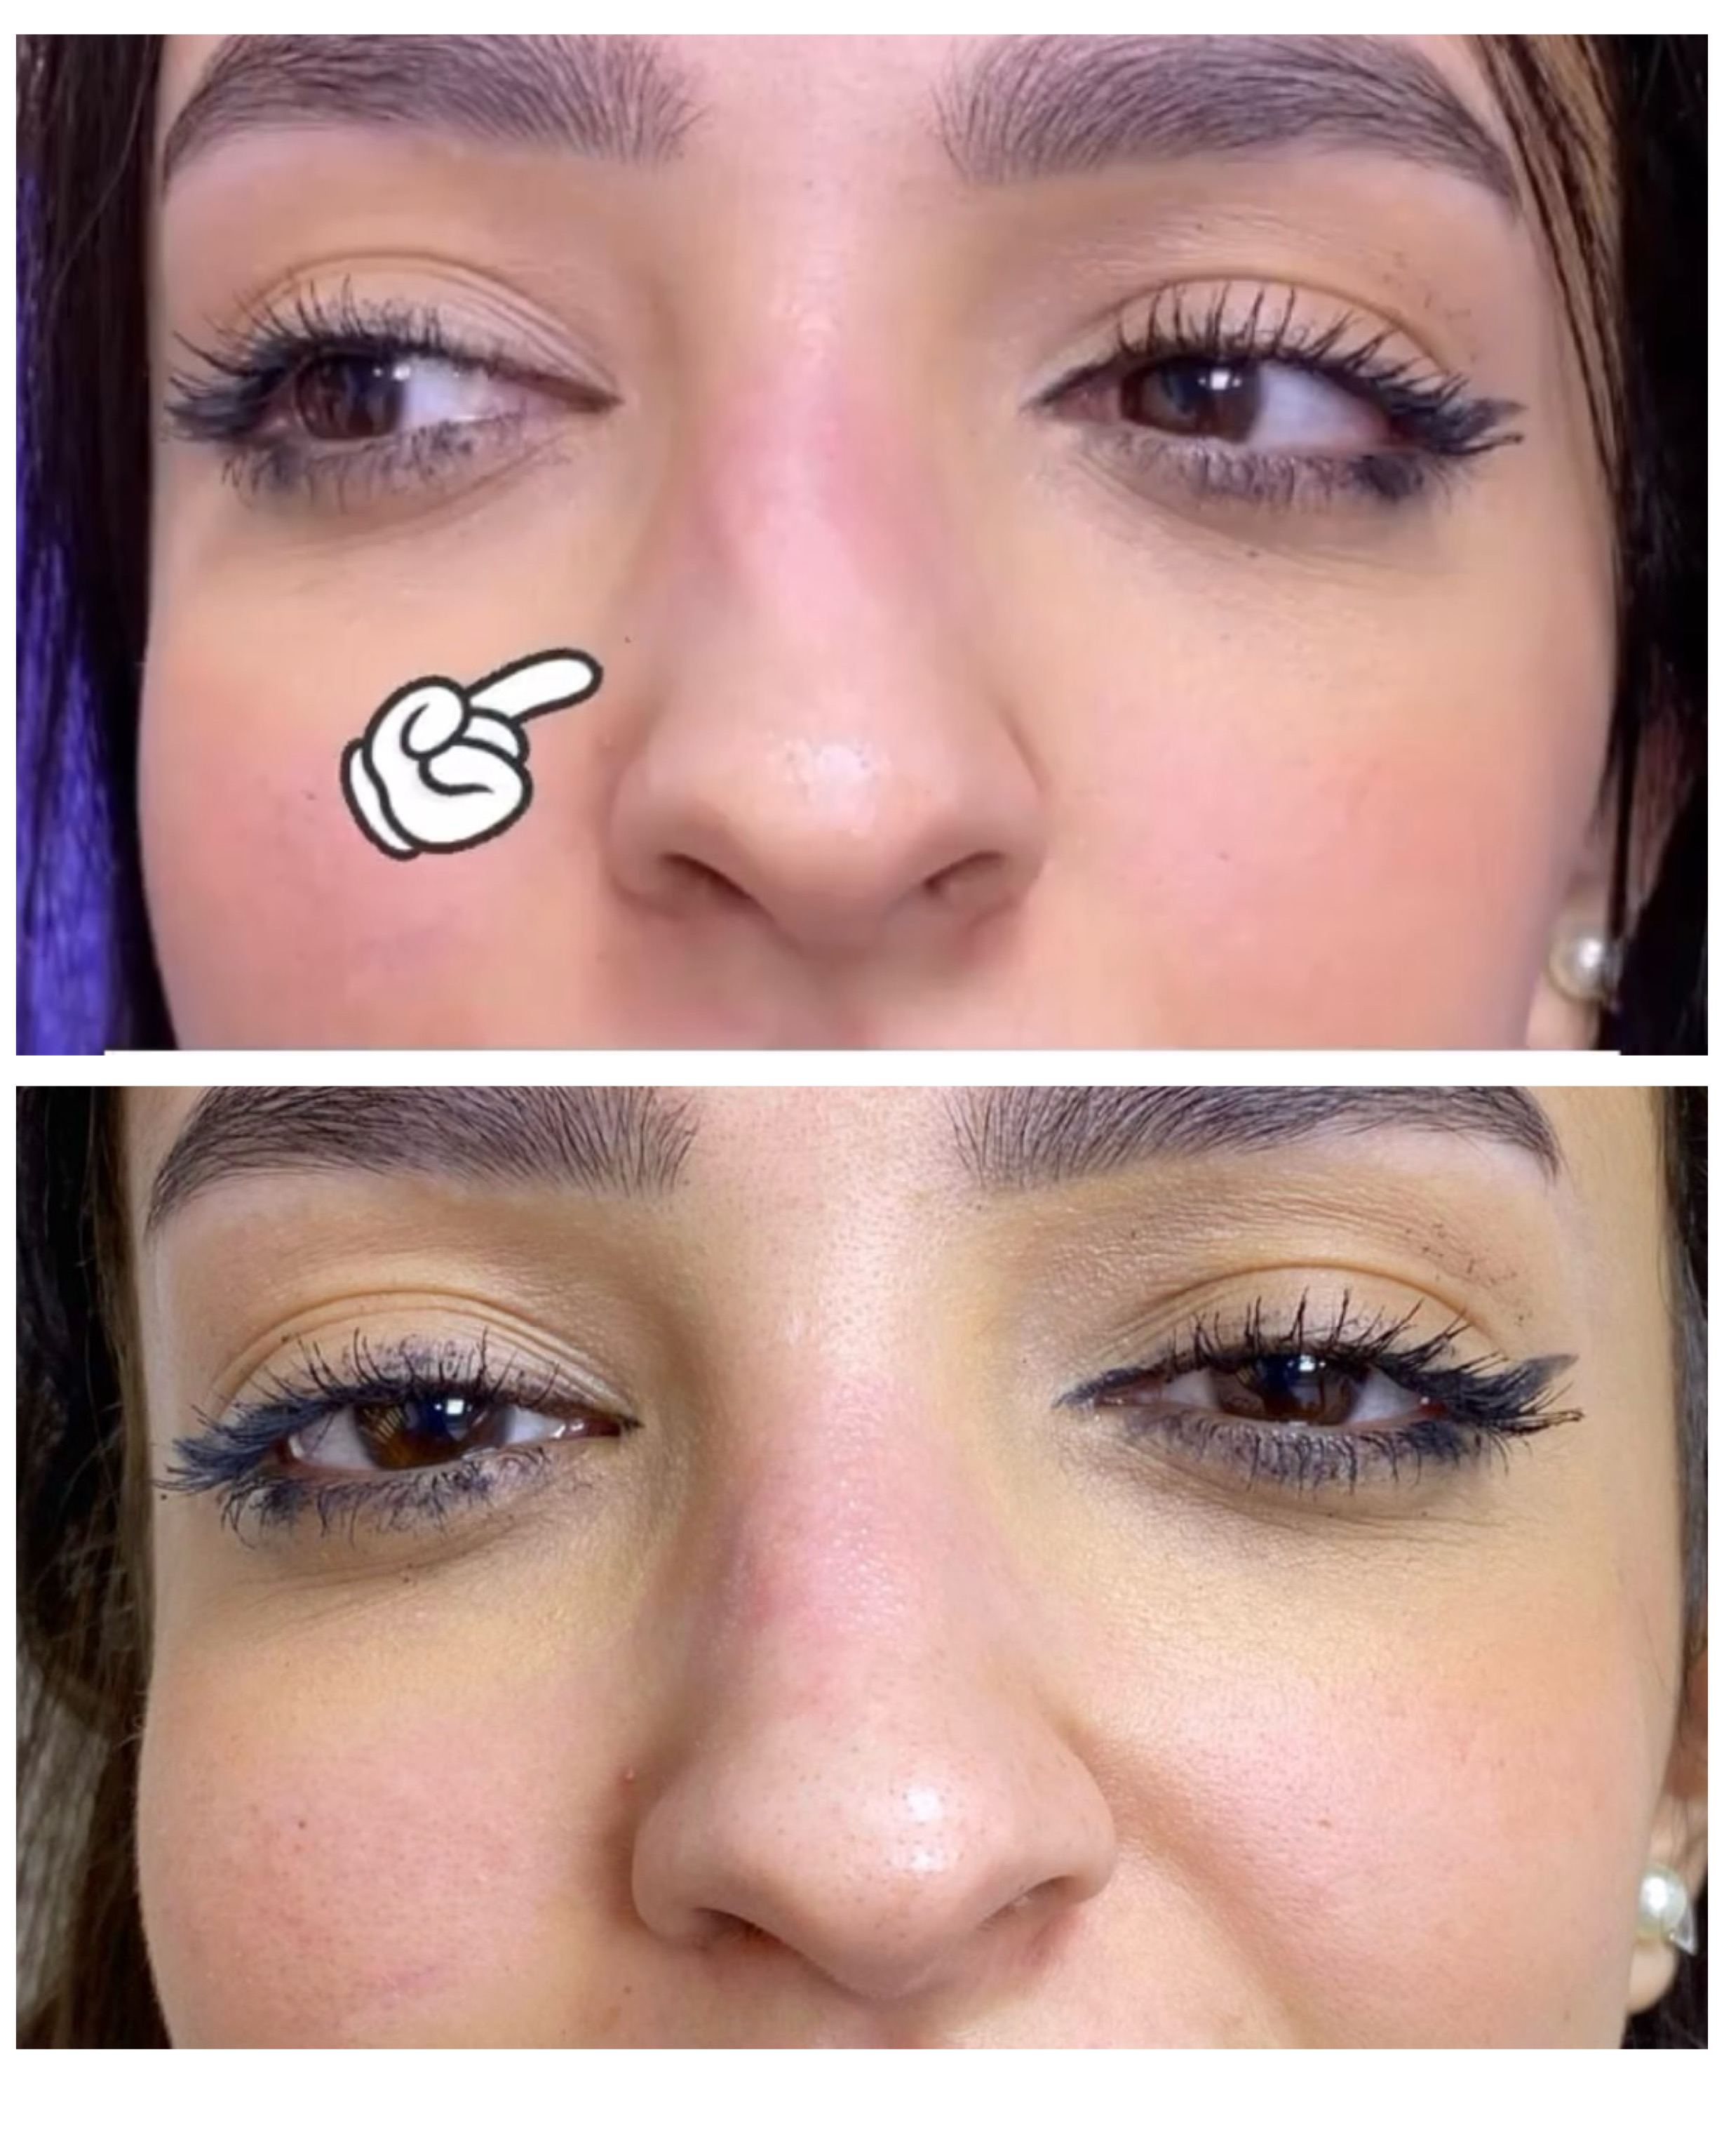

Slide 15
Presented by: Mustafa Awj
Thanks

