Slide 1


AL-Khwarizmi College of
Engineering
University of Baghdad
Department of Information and Communications Engineering
Artificial Intelligence Applications
Dr.Omar Adel Al-Jubouri
30 April 2024

Slide 2

Artificial Intelligence?

Slide 3
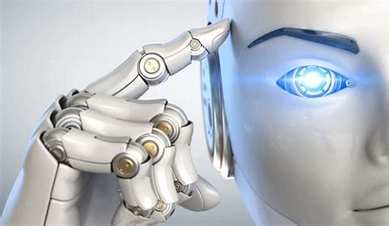
How Did Artificial Intelligence Appear And How Does It Work?
By Algorithms
ANN , SVM ,RF

Slide 4
Artificial Intelligence specializations
Speech Recognition
Natural Language Processing
Computer Vision
Face Recognition
Image Processing
Robotics
Pattern Recognition
Machine learning
Neural Network
Deep Learning

Slide 5
What Is Your Job In Artificial Intelligence?
Data Scientist
Machine Learning Engineer
Machine Learning Architect
Developer

Slide 6

Learning plan to understand AI Algorithms
Math @ Statistics
Algebra
Calculus
statistics

Slide 7

Machine Learning Programing Phase
Mathlap
Python

Slide 8

What programing can do?
Cleaning Data
Removing Data
Adding Data
Changing from Data type to another Data Type

Slide 9
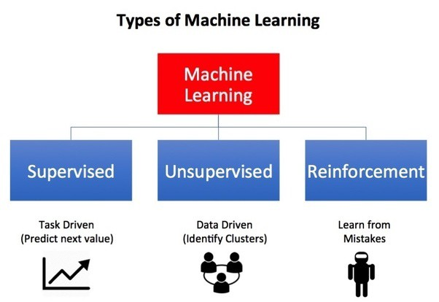
Types of Learning In AI

Slide 10
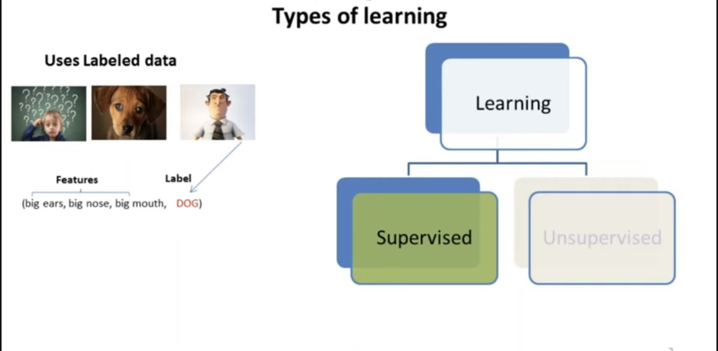

Slide 11
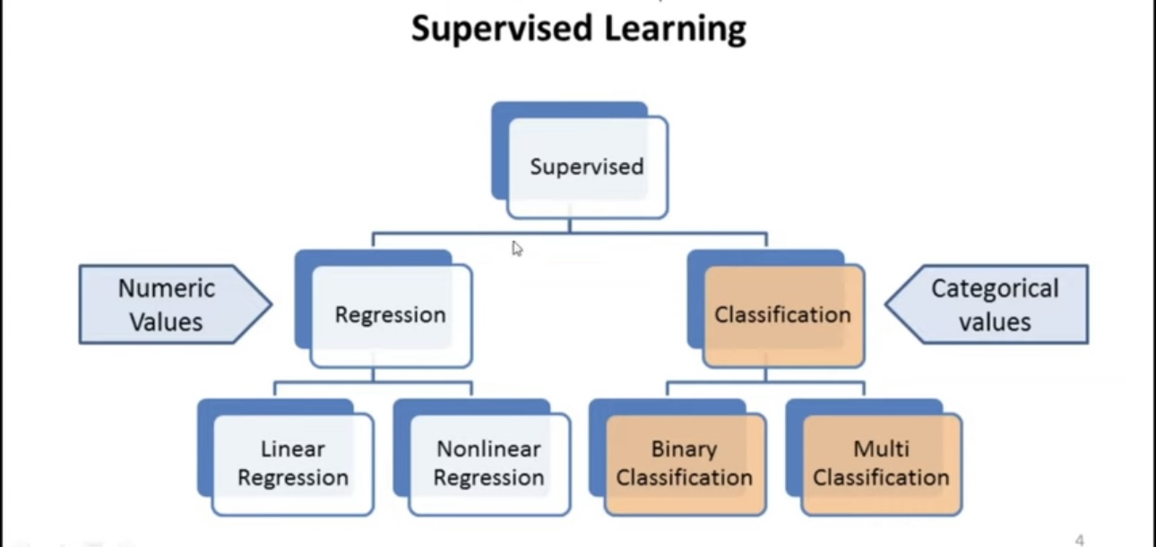

Slide 12
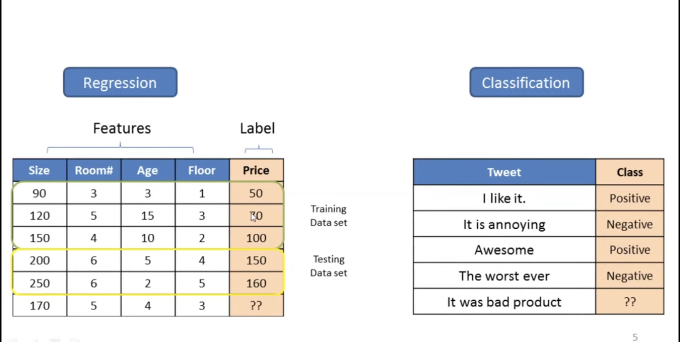

Slide 13
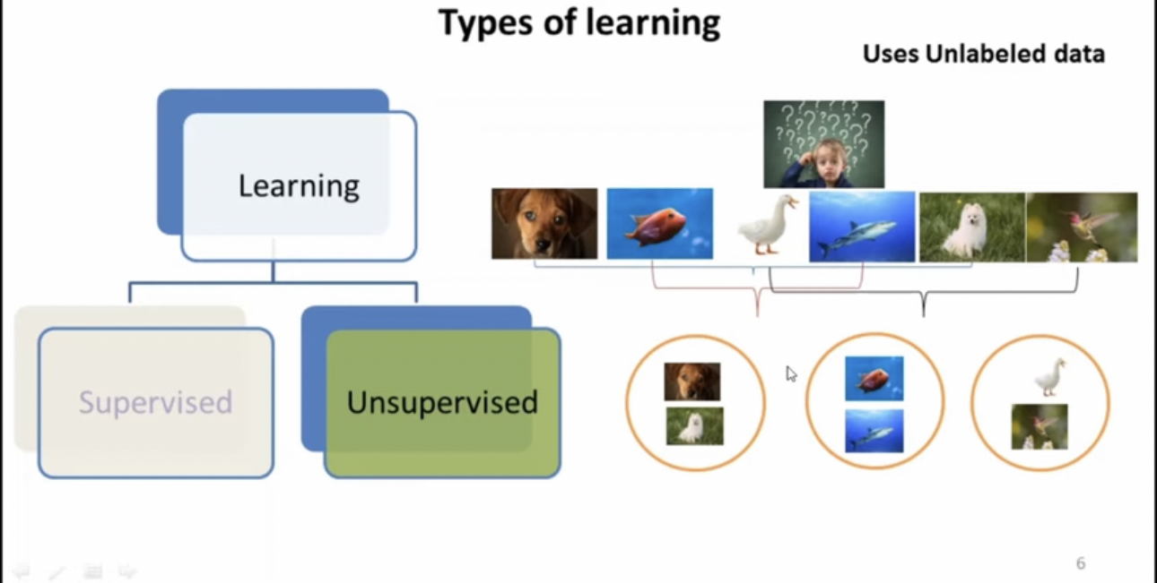

Slide 14
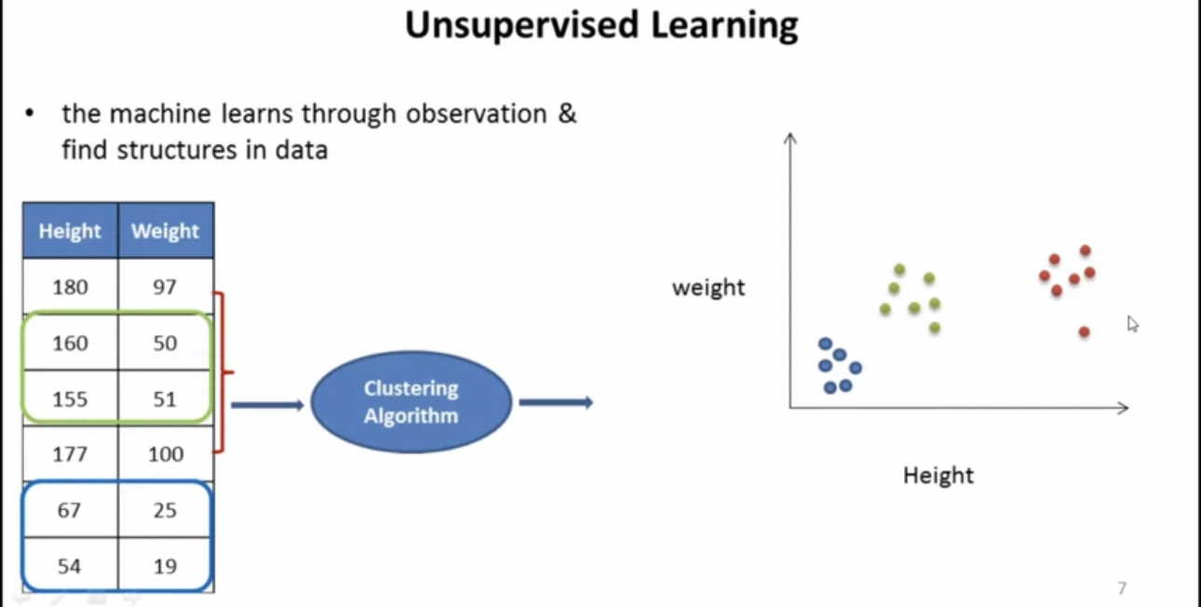

Slide 15
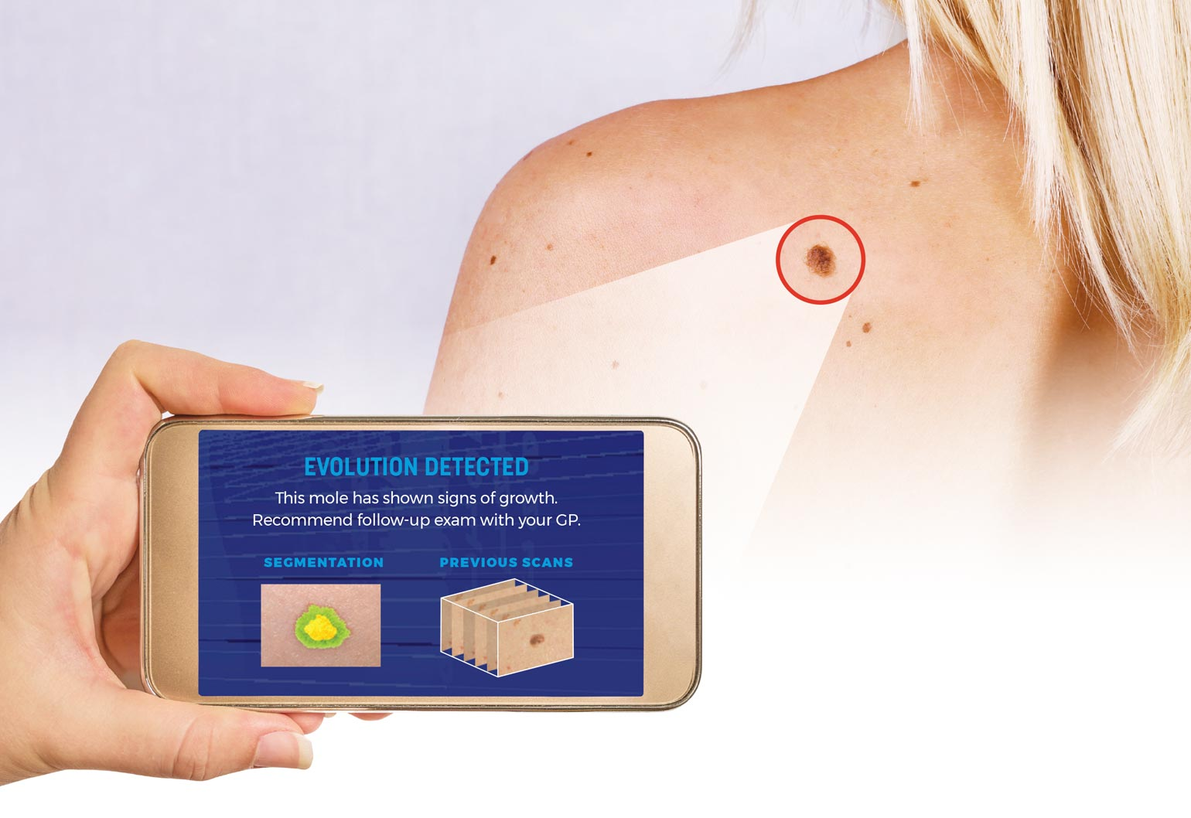
AI In Diagnosis And Treatment

Slide 16
Outline
Theoretical backgrounds
  Research Objectives
  Research Questions
  Problem Statement
  Research Significance
  Research Scope
  Literature Map
  Methodology
  Findings
  Research Contribution
  Conclusion

Slide 17
Theoretical backgrounds
The health care system exploits the Internet to simplify the digital medical images and information exchange between health institutions to provide e-health services to patients.
Internet facilitates the communication of huge numbers of people and the transmission of enormous data, which poses a challenge to information security, resources and to ensure the network authenticity against various attacks.
Medical image security is essential and compulsory due to the digital technologies rapid development including Internet technologies and image processing tools.
The powerful image processing tools and advanced software make it easy to manipulate, alter and distribute data. Therefore, it becomes mandatory to enhance content security during data use and transmission.

Slide 18
Skin Cancer Image

Slide 19
  Research Objectives
1-To extract the significant features for skin cancer in medical dermoscopy images.
2-To develop a hybrid detection model for skin cancer in medical dermoscopy images.
3-To develop an embedding technique based on chaotic map for embedding watermark in the region of non interest in the medical dermoscopy images.
4-To evaluate the performance of the proposed watermarking technique and the detection model.

Slide 20
  Research Questions
1- How to extract significant features of skin cancer in medical images that would be effective in identifying the skin cancer from non-skin cancer regions?
2-What are the good detection techniques for skin cancer in digital images?
3-How to develop a hybrid skin cancer watermarking?
4-How to evaluate the performance of the watermarking and the detection model?
5-How would the proposed watermarking technique and the detection model perform compared with other techniques?

Slide 21
  Problem Statement
Medical image watermarking is a proper method to enhance medical data security and authentication, which is crucial and used for further diagnosis and treatment. Most watermarking techniques alter, and may distort the host image in order to insert authentication information.
In several applications, image fidelity loss is not forbidden as long as original and modified images are perceptually equivalent except in medical, military, and legal applications, where the need for authentication is often essential .
Many techniques and approaches have been developed for watermarking. Least significant bit (LSB) and spread spectrum are some of the spatial domain techniques. Discrete Fourier Transform (DFT), Discrete Cosine Transform (DCT), and Discrete Wavelet Transform (DWT) are commonly used in frequency (transform) domain. They are more secure but cause information loss due to rounding (when the inverse transform is applied). Therefore, it is preferred to select the adequate and secure watermarking technique that can attain good balancing between imperceptibility and embedding capacity.

Slide 22
Luckily, chaos algorithms have proved their high performance. They have several serious properties, such as the sensitivity to initial conditions and system parameters.
To maintain medical image quality like skin cancer image, watermark embedding process should avert the regions of interest (ROI) that identified by the segmentation process due to include these regions the sensitive information. Image segmentation should be done in a proper manner to gain some disease characteristics or following lesion, followed by feature extraction to identify the ROI that may be a tumor, lesion, abnormality etc.
This research aims to reveal the potentials of digital watermarking in medical data management issues and proposes a novel method to enforce integrity, authenticity and confidentiality of the medical information, by proposing a robust watermark based on chaotic embedding and hybrid detection model for skin cancer.

Slide 23
Research Significance
Medical information is significant and valuable due to its role in clinical diagnosis, treatment, education, research and other applications, for various organizations.
Digital watermarking methods have the potential to become a good solution to provide alternative and complementary method for a large number of issues related to medical information communication, distribution and management.
Research Scope
This research proposes a hybrid skin cancer watermark based on chaotic embedding and hybrid detection model.
The hybrid detection model utilizes voting technique based on three classifiers including neural network, support vector machines and K nearest neighbor based on RGB color spaces standard skin cancer features related to color, shape and texture.

Slide 24
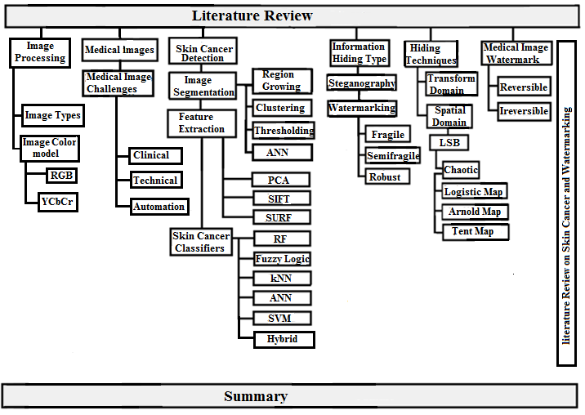
  Literature Map

Slide 25
  Research Methodology
Phase 1.
Preprocessing
Phase 2.
Image Segmentation
Phase 4.
Detection Model
Phase 3.
Feature Extraction
Phase 5.
Watermark Model
Phase 6.
Performance Evaluation

Slide 26
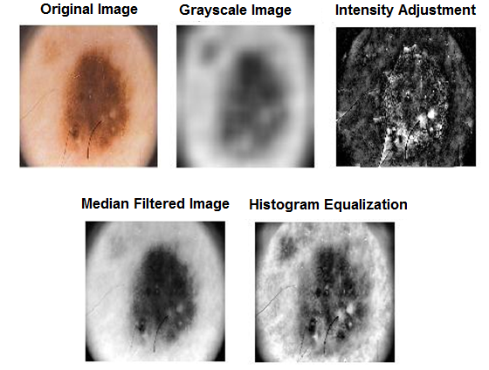
Findings
1.Preprocessing

Slide 27
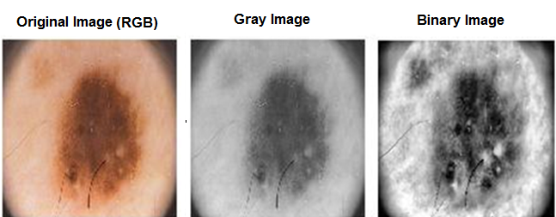
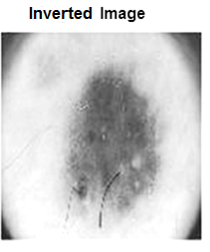
2. Segmentation
Grayscale image
Thresholding: conversion of a gray-scale image to a binary image

Slide 28
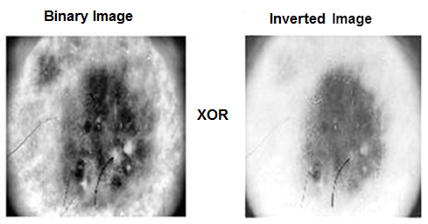
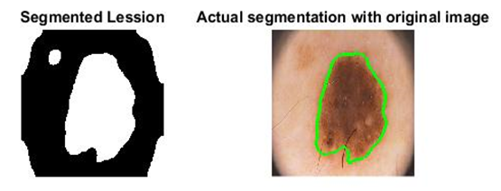
XOR original image and Inverted image

Slide 29
3- Feature Extraction: The detection model utilized the extracted features by the Principle Components Analysis according to ABCD rule to assess visual features in the dermoscopic images and to identify the skin cancer. Consequently, 21 features were extracted for classification purposes.
4. Classification : Dermoscopic image dataset (PH2) was used for testing purpose, which includes 200 different images. Two different sizes of this data were used. Dataset 1 includes 120 images for training with 80 images for testing whereas, Dataset 2 employs 160 images for training with 40 images for testing.
60% for training and for 40%testing
Classifier | Accuracy | Sensitivity | Specificity
SVM | 86.25 % | 93.75 % | 100 %
KNN | 75 % | 56.25 % | 79.6 %
ANN | 85 % | 78.1 % | 100 %
Voting | 87.45 % | 81.25 % | 87.5 %

Slide 30
80% for training and for 20%testing
Classifier | Accuracy | Sensitivity | Specificity
SVM | 94.4 % | 100 % | 100 %
KNN | 77.7 % | 66.6 % | 83.3 %
ANN | 88.8 % | 100 % | 100 %
Voting | 95.64 % | 100 % | 83.3%
90% for training and for 10%testing
Dataset | Classifier | Accuracy | Sensitivity | Specificity
Third dataset (Training 90 % Testing 10%) | SVM | 84% | 95 % | 95 %
 | kNN | 82.5 % | 88.6 % | 90 %
 | ANN | 83.5% | 93% | 98 %
 | VOTING | 86 % | 100% | 90%

Slide 31
Comparison with Other Research Using Same Dataset
Author | Dataset | Classifier | Accuracy | Specificity | Sensitivity
Chakravorty et al., 2016 | 117 images | SVM | 74% | 66 % | 80%
 |  | kNN | 72% | 64% | 78%
 | 52 images | SVM | 81% | 87% | 62%
 |  | kNN | 82% | 90% | 63%
The Proposed Methods | First dataset 200 images (120 training 80 testing) | SVM | 86.25 % | 93.75 % | 100 %
 |  | KNN | 75 % | 56.25 % | 79.6 %
 |  | VOTING | 87.45 % | 81.25 % | 87.5 %
 | Second dataset 200 images (160 training 40 testing) | SVM | 94.4 % | 100 % | 100 %
 |  | KNN | 77.7 % | 66.6 % | 83.3 %
 |  | VOTING | 95.64 % | 100 % | 83.3%
 | Third dataset 200 images (180 training 20 testing) | SVM | 84% | 95 % | 95 %
 |  | KNN | 82.5 % | 88.6 % | 90 %
 |  | VOTING | 84% | 95 % | 95 %

Slide 32
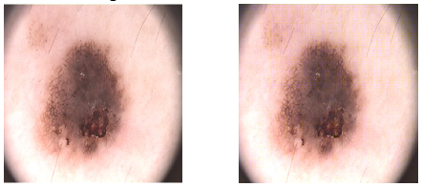
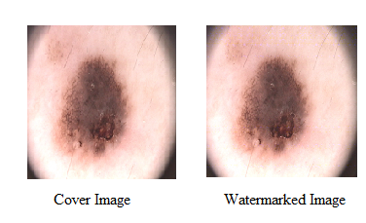
5. Watermarking :
Robust Watermarking using DWT
B. Robust Watermarking using DCT

Slide 33
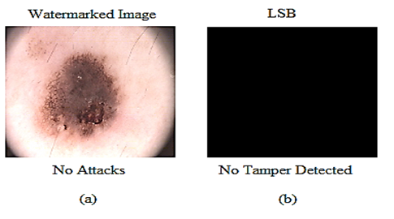
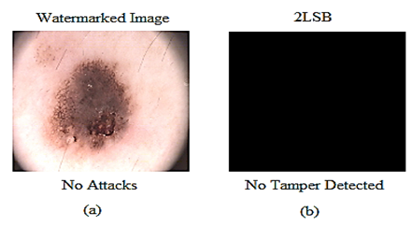
C. Fragile Watermarking USING LSB
D. Fragile Watermarking using 2LSB

Slide 34
Performance Evaluation for Robust watermark using DWT and DCT
DCT | DWT |  | Attacks
1 | 1 | NC | No attacks
100 | 100 | BCR (%)
0.79 | 0.99 | NC | AWGN
89.40 | 99.61 | BCR (%)
0.93 | 0.99 | NC | Salt & Pepper Noise
96.53 | 99.32 | BCR (%)
0.69 | 0.93 | NC | Speckle Noise
83.03 | 96.46 | BCR (%)
0.90 | 0.98 | NC | Blurring
95.31 | 99 | BCR (%)
1 | 0.99 | NC | Cropping
100 | 99.56 | BCR (%)
0.94 | 0.99 | NC | Intensity adjustment
96.68 | 99.56 | BCR (%)
1 | 1 | NC | Gamma Correction
100 | 100 | BCR (%)
1 | 1 | NC | Histogram Equalization
100 | 100 | BCR (%)
0.65 | 0.83 | NC | JPEG Compression
75.17 | 91.31 | BCR (%)

Slide 35
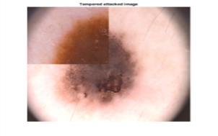

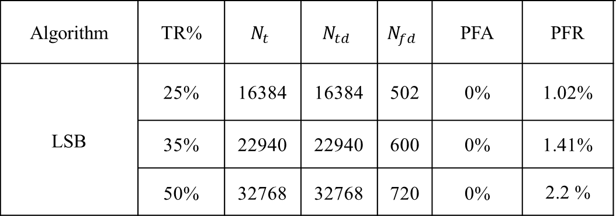
Fragile using LSB
Tamper watermark LSB
25%
35%
50%
Performance Measure for Fragile using LSB
TR |  | Tampered Watermarked Image |  |  |  |  | LSB
Algorithm | TR% | $$N_{t}$$ | $$N_{td}$$ | $$N_{fd}$$ | PFA | PFR
LSB | 25% | 16384 | 16384 | 502 | 0% | 1.02%
 | 35% | 22940 | 22940 | 600 | 0% | 1.41%
 | 50% | 32768 | 32768 | 720 | 0% | 2.2 %

Slide 36


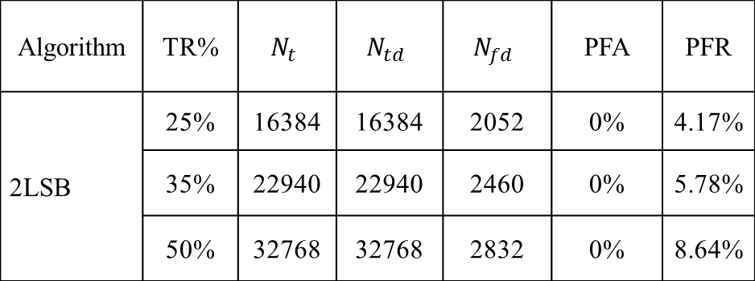
Fragile Watermark Using 2LSB
25%
35%
50%
Tamper watermark 2LSB
Performance Measure of Fragile Watermark Using 2LSB
Algorithm | TR% | $$N_{t}$$ | $$N_{td}$$ | $$N_{fd}$$ | PFA | PFR
2LSB | 25% | 16384 | 16384 | 2052 | 0% | 4.17%
 | 35% | 22940 | 22940 | 2460 | 0% | 5.78%
 | 50% | 32768 | 32768 | 2832 | 0% | 8.64%

Slide 37
Research Contributions
Medical image watermarking needs more care than other images watermarking, where the quality is highly recommended and the distortion is unacceptable. The research contributes to these issues by introducing of a practical method to enforce integrity, authenticity and confidentiality of the medical information, by proposing a hybrid watermark.
The hybrid watermark is embedded in different domains based on chaotic embedding and hybrid detection model for skin cancer. This research is among the first researches that utilizes voting detection model for skin cancer medical images.
The hybrid watermark is used for both storing patient information and for protecting information authenticity. This will help health organizations to deal with medical information effectively, especially during storage and transportation. Several sub contributions are achieved related to providing and addressing different challenges related to medical images, skin cancer detection in image processing, and information hiding challenges.

Slide 38
Conclusion
This research aims to reveal the potentials of digital watermarking in medical data management issues and proposes a novel method to enforce integrity, authenticity and confidentiality of the medical information.
Dermoscopic image dataset (PH2) was used for testing purpose, Dermoscopic image dataset (PH2) was used for testing purpose, which includes 200 different images. Two different sizes of this data were used.
The hybrid watermark includes Robust watermark for storing the patient information in the frequency domain using Discreet Wavelet Transform and Fragile watermark for authentication and embedding in the spatial domain at the Least Significant Bits of the image.
The hybrid detection model utilizes the voting technique .The voting technique revealed high performance and have achieved 87.54% accuracy with 81.25% sensitivity and 87.5% specificity for Dataset 1 while 95.64% accuracy with 100% sensitivity and 83.3% specificity have achieved with Dataset 2. These results are better than any single classifier in the detection model.

Slide 39

Thank You For Listening

