Slide 1


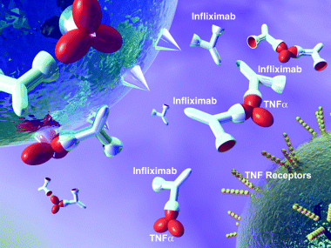
جامعة بغداد-كلية الصيدلة
وحدة الشؤون العلمية
Loss of response to Anti-TNFα medications
الصيدلاني احمد كاظم عبد
طالب الدكتوراه في فرع الصيدلة السريرية
الثلاثاء 9-1-2024
الساعة العاشرة صباحا
قاعة البيروني – فرع الصيدلة السريرية

Slide 2
Loss of response to anti-TNFα medications
PhD student
Ahmad Kadhum Al-Jalehawi

Slide 3
Inflammatory bowel disease IBD
Inflammatory bowel disease (IBD), which includes Crohn disease and ulcerative colitis, is a relapsing and remitting condition characterized by chronic inflammation at various sites in the gastrointestinal tract, which results in diarrhea and abdominal pain.
About 10% of colitis cases are not initially distinguishable and are termed unclassified; if a surgical pathologic specimen cannot be classified, it is termed indeterminate colitis.

Slide 4
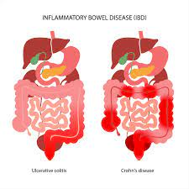
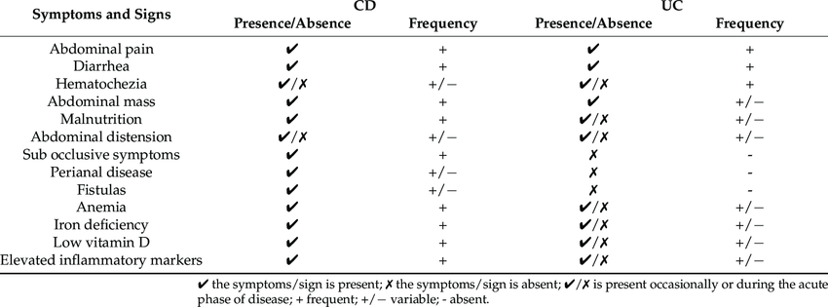
Signs and symptoms

Slide 5
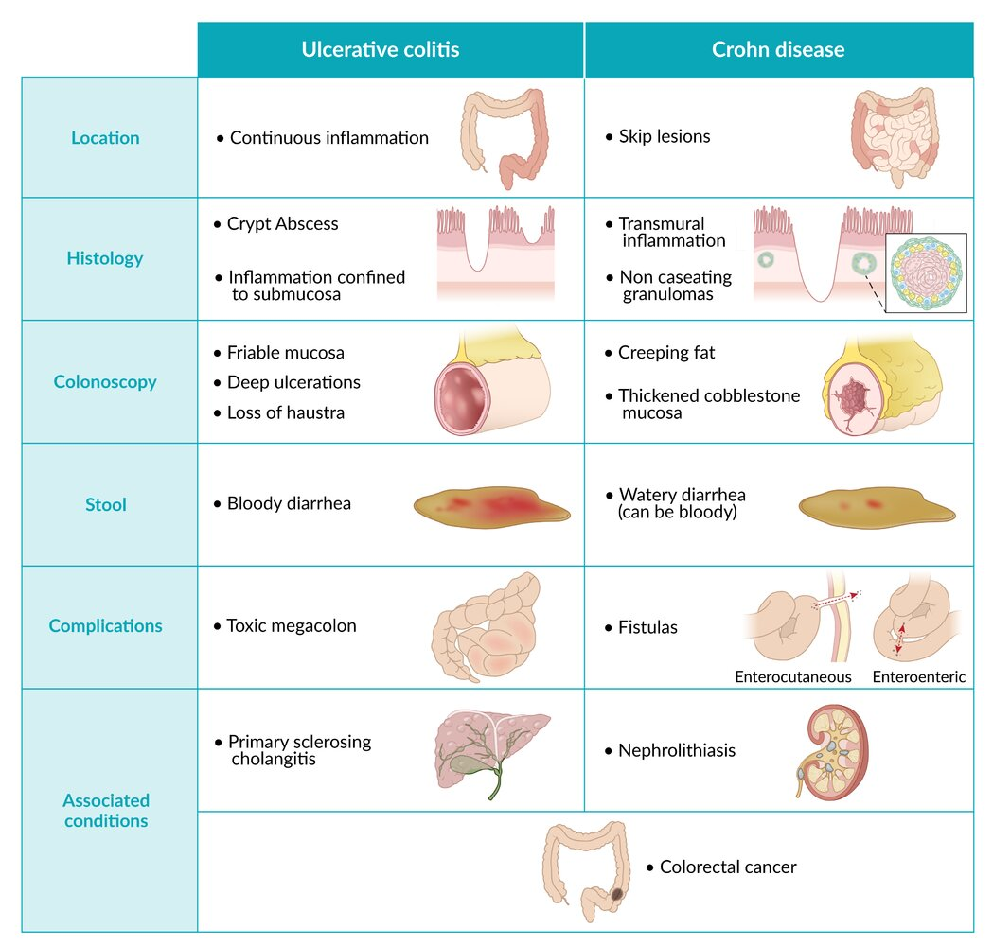

Slide 6

Etiology
Inflammation results from a cell-mediated immune response in the gastrointestinal mucosa.
The precise etiology of inflammatory bowel disease is unknown, but evidence suggests that the normal intestinal flora inappropriately triggers an immune reaction in patients with a multifactorial genetic predisposition (perhaps involving abnormal epithelial barriers and mucosal immune defenses).
No specific environmental, dietary, or infectious causes have been identified.

Slide 7
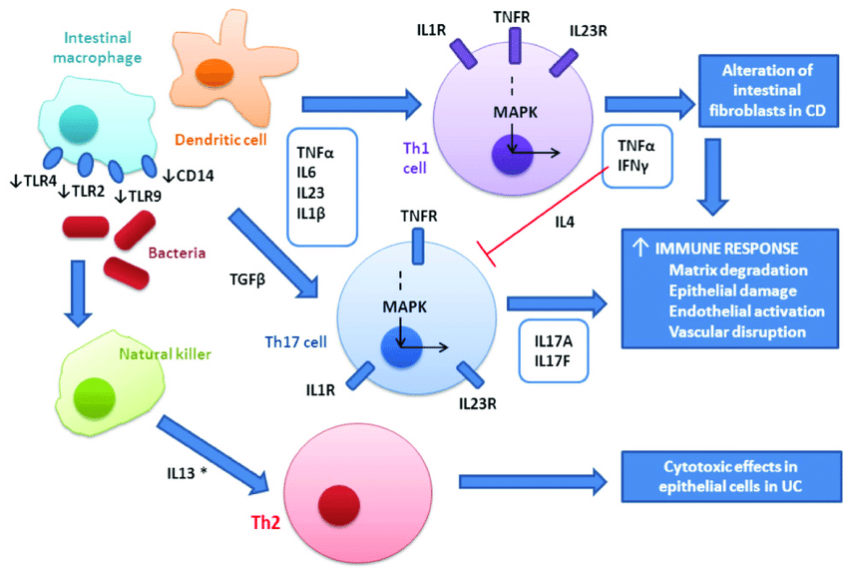
The immune reaction involves the release of inflammatory mediators, including cytokines, interleukins, and tumor necrosis factor.

Slide 8





Epidemiology
@ all ages but peak 14-24 years
equally affected
First-degree relatives
X 4- to 20-fold increased risk
common among people of Northern European
X 2 to 4 Ashkenazi Jewish
Notes:
Inflammatory bowel disease (IBD) affects people of all ages but usually begins before age 30, with peak incidence from 14 to 24.
IBD is most common among people of Northern European and Anglo-Saxon origin
It is 2 to 4 times more common among people of Ashkenazi Jewish ancestry
the incidence is increasing among Black and Latin American people living in North America.
Both sexes are equally affected.
First-degree relatives of patients with IBD have a 4- to 20-fold increased risk;
Familial tendency is much higher in Crohn disease than in ulcerative colitis. Several gene mutations conferring a higher risk of Crohn disease (and some possibly related to ulcerative colitis) have been identified.

Slide 9
Cigarette smoking seems to contribute to development or exacerbation of Crohn disease but decreases risk of ulcerative colitis.
Appendectomy done to treat appendicitis also appears to lower the risk of ulcerative colitis.
Nonsteroidal anti-inflammatory drugs (NSAIDs) may exacerbate IBD. Oral contraceptives may increase the risk of Crohn disease. Some data suggest that perinatal illness and the use of antibiotics in childhood may be associated with an increased risk of IBD.
For unclear reasons, people who have a higher socioeconomic status may have an increased risk of Crohn disease.

Slide 10
Extraintestinal Manifestations of IBD
usually parallel
arthritis,
clearly associated with IBD but appear independently of IBD activity
ankylosing spondylitis,
consequences of disrupted bowel physiology
B12
episcleritis,
aphthous stomatitis,
erythema nodosum
sacroiliitis,
uveitis,
pyoderma gangrenosum
Malabsorption
minerals,
anemia,
hypocalcemia, hypomagnesemia,
clotting disorders,
bone demineralization.
Extraintestinal manifestations of inflammatory bowel disease are categorized in 3 ways:

Slide 11
Biologics – Anti-TNF alpha inhibitors
Infliximab (CD &UC)
5 mg/kg IV at 0, 2, and 6 weeks, THEN q8Weeks thereafter
Moderate-to-severe (NYHA class III or IV) heart failure: Not to exceed 5 mg/kg/dose
Adalimumab (CD & UC)
Induction: 160 mg SC either as 4 injections of 40 mg on day 1 or as 2 injections of 40 mg daily on 2 consecutive days, then 80 mg SC 2 weeks later (day 15)
Maintenance (beginning Week 4 [Day 29]): 40 mg SC q2wk
Certolizumab (CD)
Initial: 400 mg SC (2 injections of 200 mg), repeat at 2 and 4 weeks
Maintenance: 400 mg SC q4Weeks

Slide 12
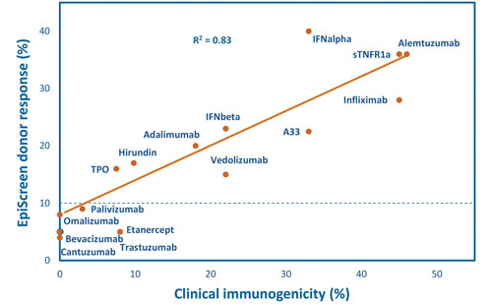
Figure 2. Mean frequency of anti-drug antibodies observed clinically (source PubMed) correlates with observed immunogenicity (% donor response) in ex vivo EpiScreen T-cell assays.

Slide 13
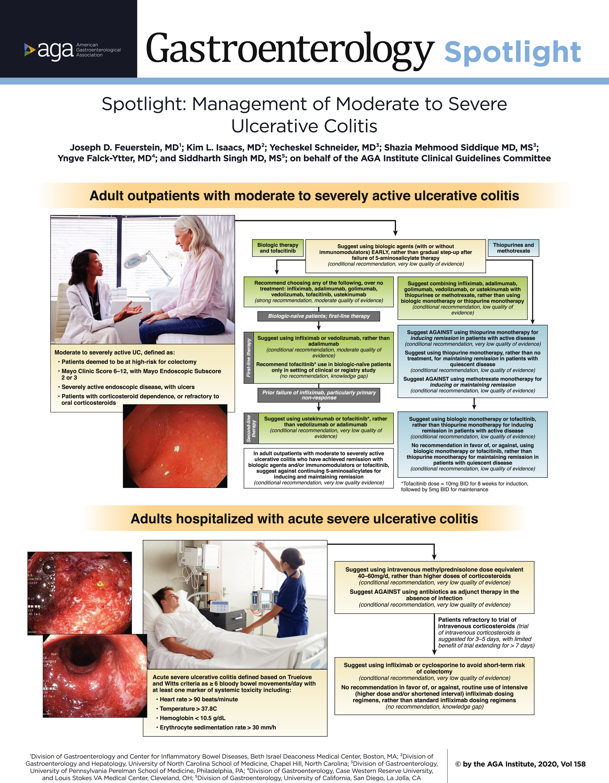

Slide 15
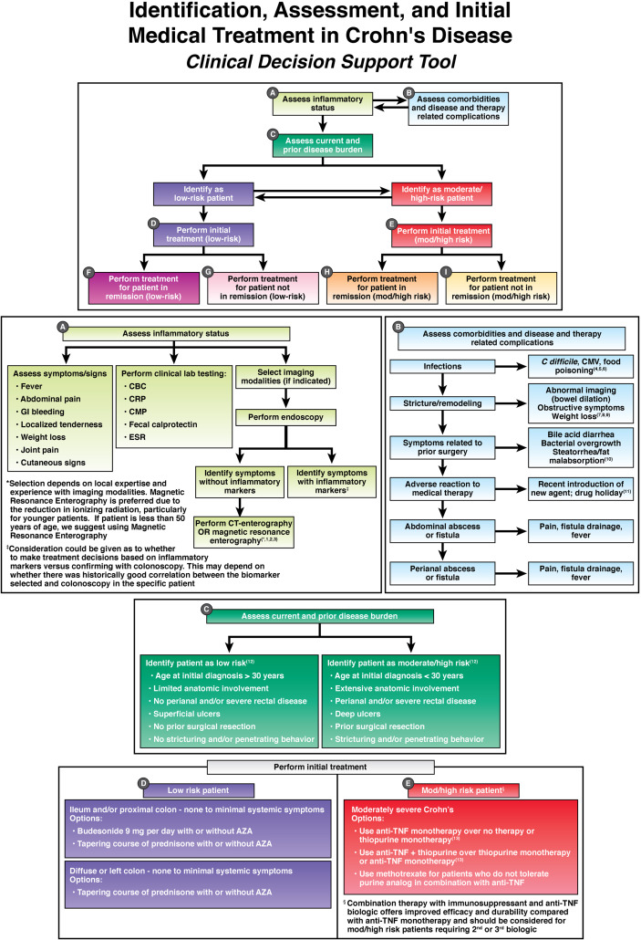
DOI:
https://doi.org/10.1053/j.gastro.2014.07.022

Slide 17
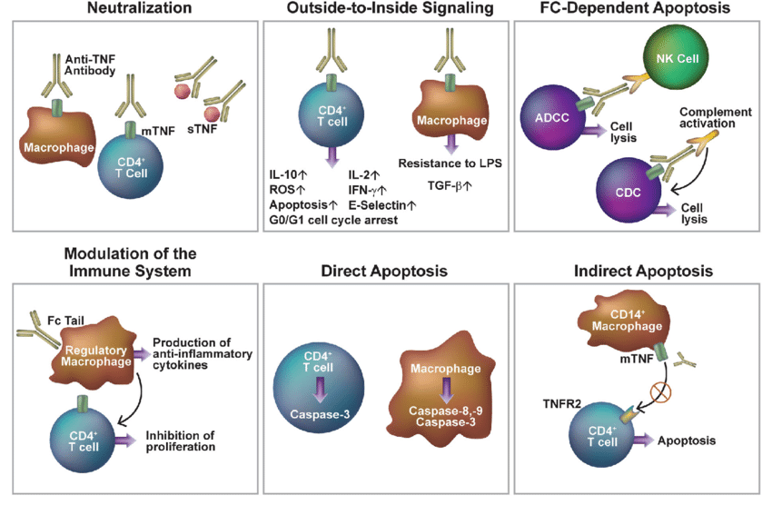
Mechanism of Anti-TNF alpha inhibitors

Slide 18
Non-responsiveness: Primary vs secondary
Primary : 13-40%
Secondary : 23-46%
patient-related factors,
microbiome-related factors
disease-related factors
treatment-related factors
The possible factors contributing can be classified into four categories,

Slide 19
Proposed mechanisms underlying PNR
Pharmacokinetic failure
Proteolytic catabolism (FCGR)
Degradation that occurs in lysosomes
Pharmacodynamic failure
presence of adequate circulating drug and absence of Antidrug antibodies (ADAs)
most favorable alternative avenue would be to switch to an
out-of-class medication,
Immunogenicity failure
low circulating serum TNF-α antagonists and high levels of ADAs
switch to an alternative anti-TNF
or to incorporate the use of an immunomodulator.
Ulcerated mucosa that leads to clearance
recommends steady-state trough levels between 3 and 8 μg/mL for IFX and between 5 and 12 μg/mL for ADA
Notes:
Pharmacokinetic failure
Proteolytic catabolism that occurs in the reticuloendothelial system due to the
ability of monoclonal antibodies to bind to Fc gamma receptors
Degradation that occurs in lysosomes as a result of interaction with membranebound TNF
Ulcerated mucosa that leads to clearance and drug loss through the mucosalmembrane as a result of non-immune clearance, ultimately resulting in considerable loss of protein and electrolytes in addition to loss of drug
Pharmacodynamic failure
This type of failure occurs when no improvement in clinical symptoms occurs despite
the presence of adequate circulating drug and absence of Antidrug antibodies (ADAs)
(Ainsworth et al., 2008). The most favorable alternative avenue would be to switch to an
out-of-class medication,
Immunogenicity failure
This scenario is characterized by a lack of improvement in symptoms in the presence
of low circulating serum TNF-α antagonists and high levels of ADAs.
Neutralizing and non-neutralizing antibodies and low drug concentrations have been
reported in up to 83% of PNRs (Echarri et al., 2014). Additionally, the effective induction
of remission in PNRs by using a second TNF-α antagonist occurs in only 50% of IBD
patients (Gisbert et al., 2015). The perfect option is to switch to an alternative anti-TNF
or to incorporate the use of an immunomodulator.

Slide 20
TDM
Proactive
Reactive
Proactive TDM is applied during remission. to modify the dose of IFX to avoid sub-therapeutic dosing and the risk of failure or to minimize the intensity of the therapy to reduce the financial costs associated with supra-therapeutic dosing.
In contrast, reactive TDM is applied as a result of treatment failure despite the previous use of IFX therapy to achieve a successful outcome.

Slide 21
PREDICTORS of non-responsiveness
Clinical history
Age
Gender
PK/PD
Concentration of the drug
Auto-antibody level
Biological markers
Smoking
Surgery history
Disease duration
Weight
Albumin
Genetics
Cytokines
CRP
HLADQ1*05
Microbiome
IL8,16,17A,1B
Dysbiosis index
Bacteriotoid, Fermicuts
Fecal calprotectin
ANCA, pANCA
TNFR
PK dashboard ?!

Slide 22
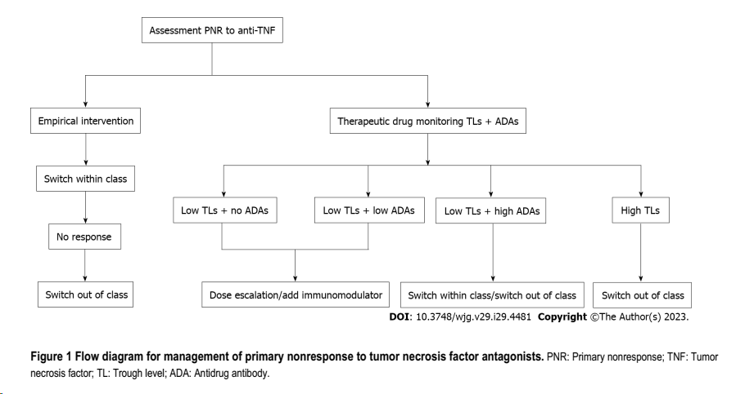
However, several studies have demonstrated that the treatment outcome following a switch to a second anti-TNF antagonist in PNR patients is still poor with a response rate of approximately 50–65% .
Switching to an out-of-class medication that acts through different mechanisms may provide a worthwhile resolution to this problem

Slide 23
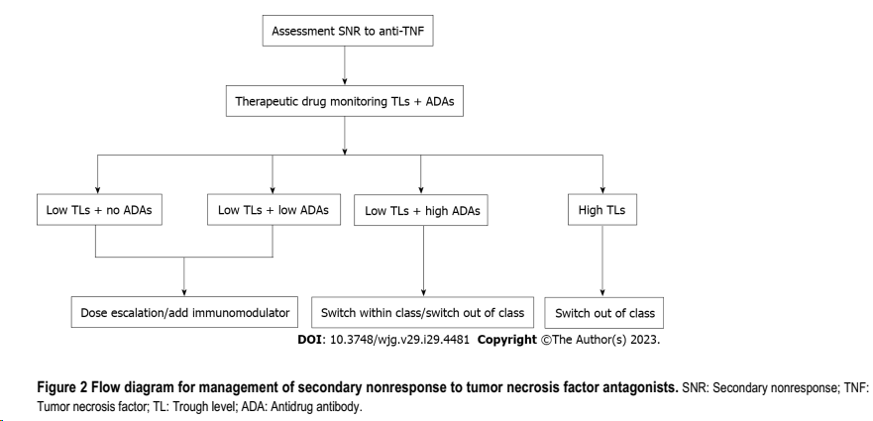
Among the anti-TNF patients,
(25.8% of UC) and (19.2% of CD) patients required dose-escalation.

Slide 24
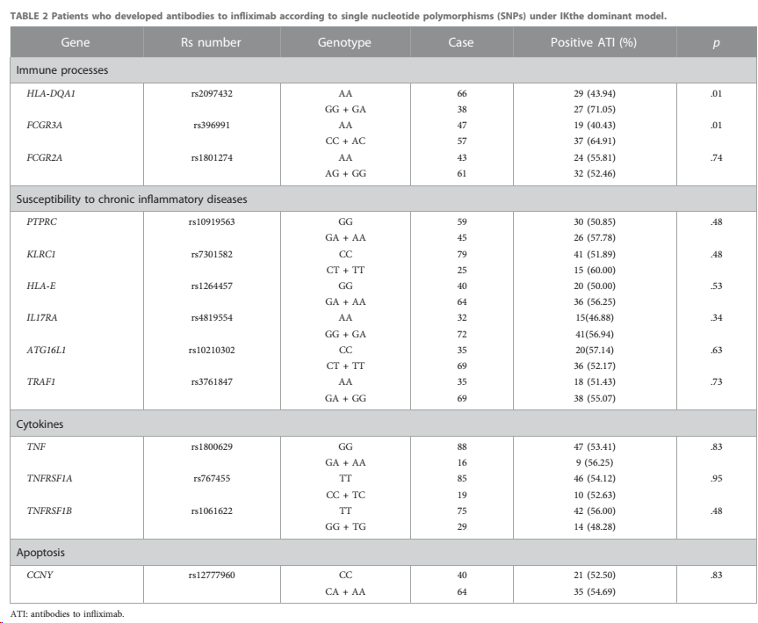
Genetic study
HLA-DQA1
FCGR3A

Slide 25
Fcγ receptor type IIIA ( V158F)
Fcγ receptor type IIIA: A Spanish team found higher serum concentration levels of both infliximab and adalimumab in FCGR3A FF carriers than in FCGR3A VV carriers during maintenance therapy in IBD and found that the proportion of VV patients who developed ADAs was significantly higher than that of FF patients diagnosed with IBD
HLADQA1*05 ,Human leukocyte antigen:
A genome-wide analysis of 1240 subjects in the PANTS cohort
revealed that approximately 40% of Europeans carried HLA-DQA1*05 and significantly increased rates of ADAs production, using genotypic analysis, showed that HLADQA1*05 was independently associated with LOR to infliximab and increased ADAs in IBD.

Slide 26
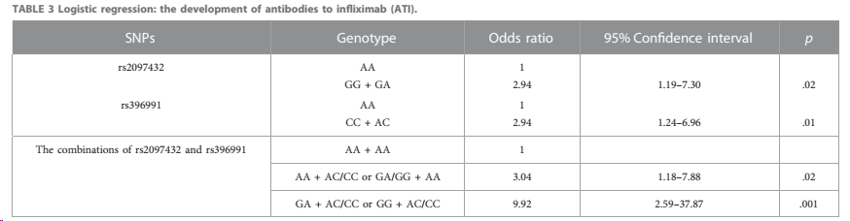

Slide 27
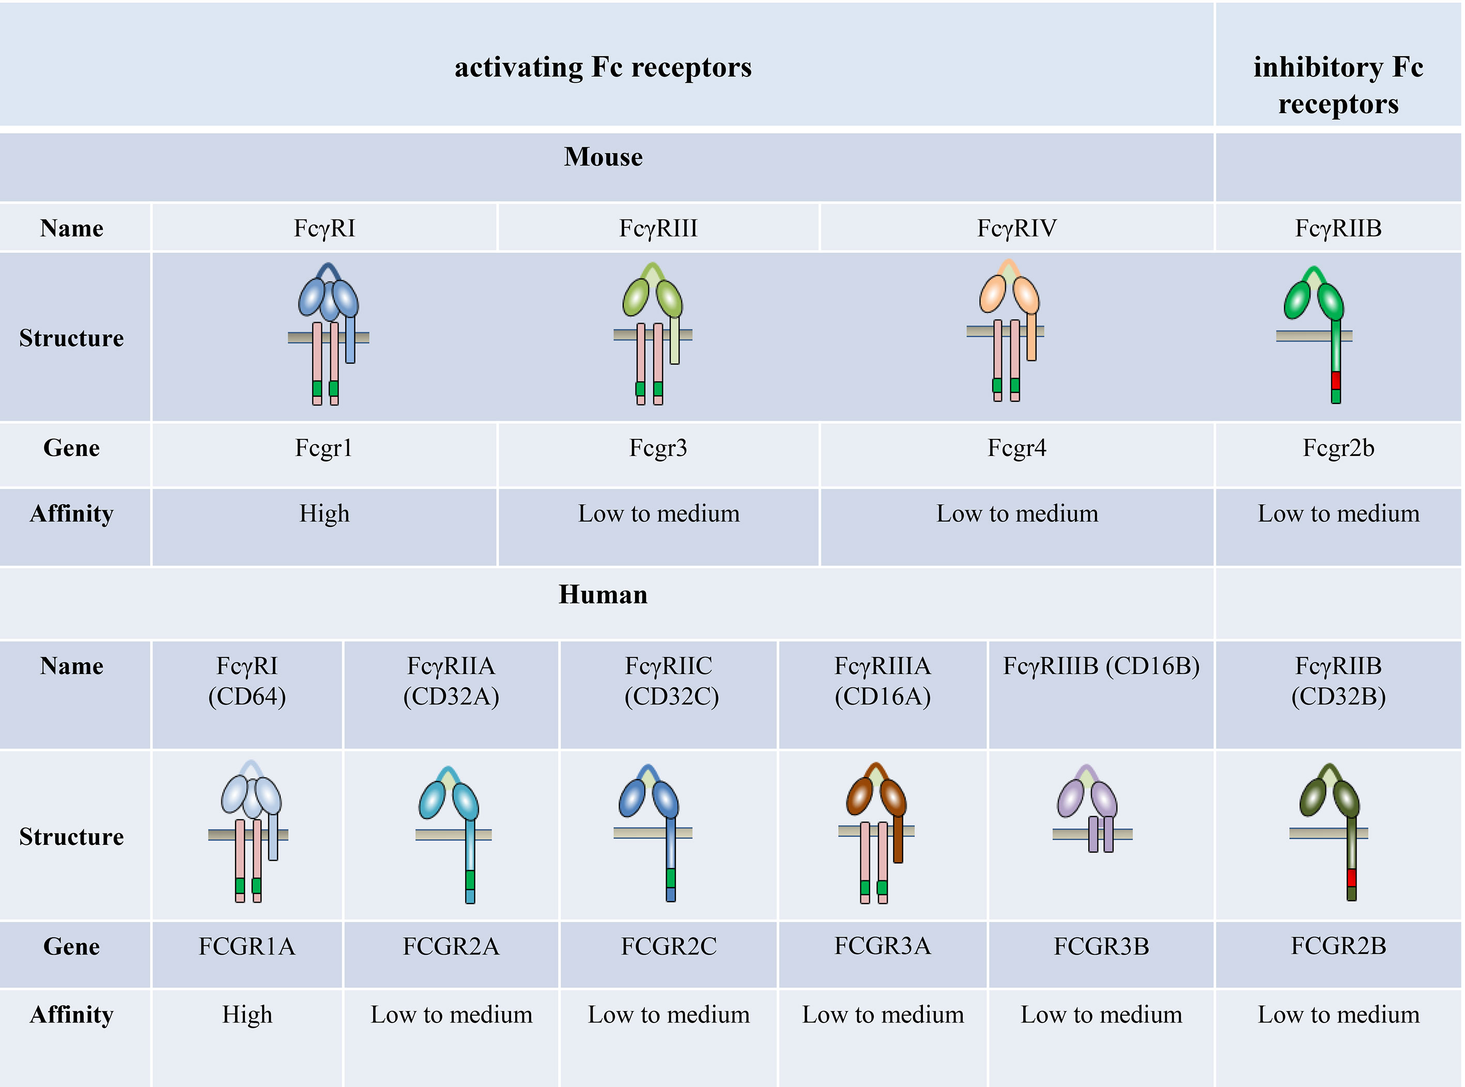

Slide 28
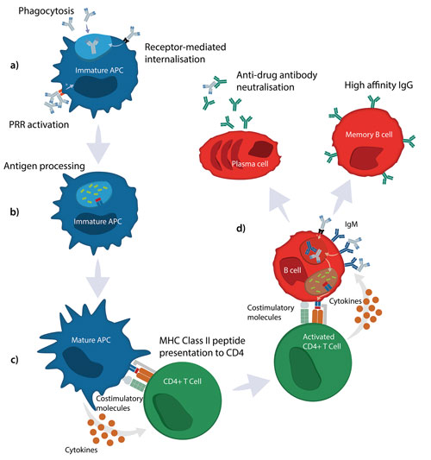
Summary of the adaptive humoral immune response for T-dependent antigens

Slide 29
Thank you

Slide 30
Differences (CD Vs UC)
Crohn disease and ulcerative colitis
 | Crohn disease | Ulcerative colitis
Pathophysiology | Mediated by dysfunctional IL-23-Th17 signaling | Mediated by Th2 cells
Frequency/type of defecation | Increased Typically nonbloody, watery diarrhea May be bloody in more severe cases | Greatly increased Bloody diarrhea with mucus Tenesmus Urgency
Nutritional status | Poor or malnourished | Mostly normal, but weight loss and malnutrition may occur in severe disease ^{[41]}
Physical examination | Mostly constant pain in RLQ Palpable abdominal mass Low-grade fever | Painful defecation, pain located in LLQ Abdominal cramps and tenderness Tachycardia Orthostatic hypotension
Extraintestinal manifestations | Nephrolithiasis (e.g., calcium oxalate) Cholelithiasis | Primary sclerosing cholangitis
 | Skin Pyoderma gangrenosum Erythema nodosum Eyes Uveitis Episcleritis Mouth: aphthous stomatitis Joints Peripheral arthritis Spondylitis
Fistulas | Common (to skin, bladder, or in between loops) May cause pneumaturia and/or recurrent UTIs | Rare
Other complications | Abscess Strictures (obstructions) Perianal fissures | Fulminant colitis Toxic megacolon Perforation
Cancer risk | Increased due to underlying pathology Increased secondary to immunosuppression
 | Small intestine Colon Non-Hodgkin lymphoma | Cholangiocarcinoma Colorectal cancer ^{[42]}
Antibodies | ASCA | p-ANCA
Endoscopy and imaging
Location | Typical location: terminal ileum and colon with rectal sparing May affect the entire GI tract | Colon and rectum (exception: backwash ileitis)
Pattern of inflammation | Discontinuous (skip lesions ) | Continuous
Typical diagnostic findings | Cobblestone sign Linear and/or serpiginous ulcerations Small aphthous ulcerations Creeping fat String sign | Friable mucosa Mucosal ulcerations can be deep or superficial Crypt abscesses Loss of haustra (lead pipe sign )
Histology | Transmural inflammation Noncaseating granulomas Giant cells Lymphoid aggregates | Confined to mucosa and submucosa No granulomas
 | Neutrophilic inflammation of the crypts
Treatment
Medication | Corticosteroids Thiopurine analogs (azathioprine , 6-mercaptopurine ) Anti-p40 antibodies (e.g., ustekinumab ) Alpha 4 integrase inhibitors (e.g., natalizumab , vedolizumab ) Possibly antibiotics outside of an acute episode (e.g., ciprofloxacin , metronidazole ) | 5-aminosalicylic acid (e.g., mesalamine ) 6-mercaptopurine Calcineurin inhibitors (e.g., cyclosporine , tacrolimus )
 | Biologics (e.g., infliximab , adalimumab )
Surgery | Noncurative surgery may become necessary to alleviate symptoms | Curative surgery possible (proctocolectomy )

Slide 31
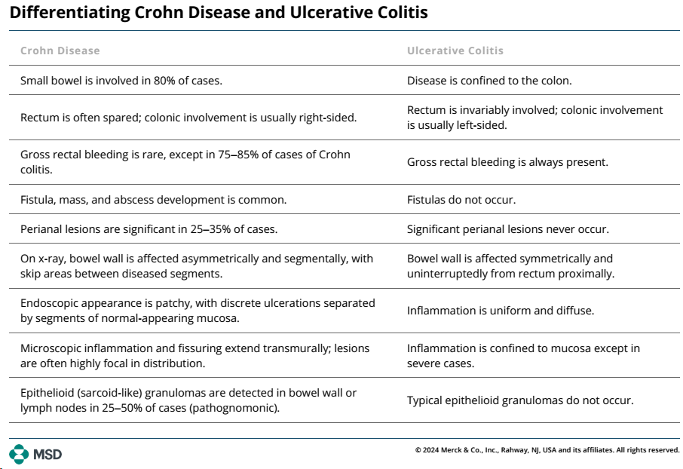

Slide 32
Health Maintenance in Inflammatory Bowel Disease
Immunizations
Patients with IBD should receive the yearly influenza vaccination and the pneumococcal vaccination. Those ≥ 19 years of age should receive the recombinant herpes zoster vaccine (1). This vaccine should be given before starting immunosuppressive therapy when possible.
Routine vaccinations such as tetanus-diphtheria, hepatitis A, hepatitis B, and human papillomavirus should be given as per the Advisory Committee on Immunization Practices (ACIP) guidelines.
The Centers for Disease Control and Prevention (CDC) and the Canadian Association of Gastroenterology recommend patients with IBD, including those on immunosuppressive therapy, receive an mRNA COVID-19 vaccine.
Screening tests
Female patients who are not receiving immunosuppressive therapy should be screened for cervical cancer every 3 years. Patients who are receiving immunosuppressive therapy should be screened for cervical cancer yearly.
All patients who are taking or plan to take immunomodulating drugs or biologic agents should be evaluated for skin cancer annually.
Patients at risk of osteoporosis should have a dual-energy x-ray absorptiometry (DXA) scan.

Slide 33

Management of moderate to severe ulcerative colitis
Recommendations
1. In adult outpatients with moderate to severe ulcerative colitis (UC), AGA recommends using infliximab, adalimumab, golimumab, vedolizumab, tofacitinib or ustekinumab over no treatment. (Medications are ordered based on year of approval by the U.S. FDA.)
2a. In adult outpatients with moderate to severe UC who are naïve to biologic agents, AGA suggests using infliximab or vedolizumab rather than adalimumab, for induction of remission.
2b. In adult outpatients with moderate to severe UC who are naïve to biologic agents, AGA recommends that tofacitinib only be used in the setting of a clinical or registry study.
2c. In adult outpatients with moderate to severe UC who have previously been exposed to infliximab, particularly those with primary nonresponse, AGA suggests using ustekinumab or tofacitinib rather than vedolizumab or adalimumab for induction of remission.
3a. In adult outpatients with active moderate to severe UC, AGA suggests against using thiopurine monotherapy for induction of remission.
3b. In adult outpatients with moderate to severe UC in remission, AGA suggests using thiopurine monotherapy rather than no treatment for maintenance of remission.
3c. In adult outpatients with moderate to severe UC, AGA suggests against using methotrexate monotherapy for induction or maintenance of remission.
4a. In adult outpatients with active moderate to severe UC, AGA suggests using biologic monotherapy (tumor necrosis factor (TNF)-α antagonists, vedolizumab or ustekinumab) or tofacitinib rather than thiopurine monotherapy for induction of remission.

Slide 34
4b. In adult outpatients with moderate to severe UC in remission, AGA makes no recommendation in favor of or against using biologic monotherapy or tofacitinib rather than thiopurine monotherapy for maintenance of remission.
5a. In adult outpatients with moderate to severe UC, AGA suggests combining TNF-α antagonists, vedolizumab or ustekinumab with thiopurines or methotrexate rather than biologic monotherapy.
5b. In adult outpatients with moderate to severe UC, AGA suggests combining TNF-α antagonists, vedolizumab or ustekinumab with thiopurines or methotrexate rather than thiopurine monotherapy.
6. In adult outpatients with moderate to severe UC, AGA suggests early use of biologic agents with or without immunomodulator therapy rather than gradual step up after failure of 5-aminosalicylate (5-ASA).
7. In adult outpatients with moderate to severe UC who have achieved remission with biologic agents and/or immunomodulators or tofacitinib, AGA suggests against continuing 5-ASA for induction and maintenance of remission.
8. In hospitalized adult patients with acute severe ulcerative colitis (ASUC), AGA suggests using intravenous methylprednisolone dose equivalent of 40–60 mg/d rather than higher doses of intravenous corticosteroids.
9. In hospitalized adult patients with acute severe UC without infection, AGA suggests against adjunctive antibiotics.
10. In hospitalized adult patients with ASUC refractory to intravenous corticosteroids, AGA suggests using infliximab or cyclosporine.
11. In hospitalized adult patients with acute severe UC being treated with infliximab, AGA makes no recommendation on routine use of intensive vs. standard infliximab dosing.

Slide 35
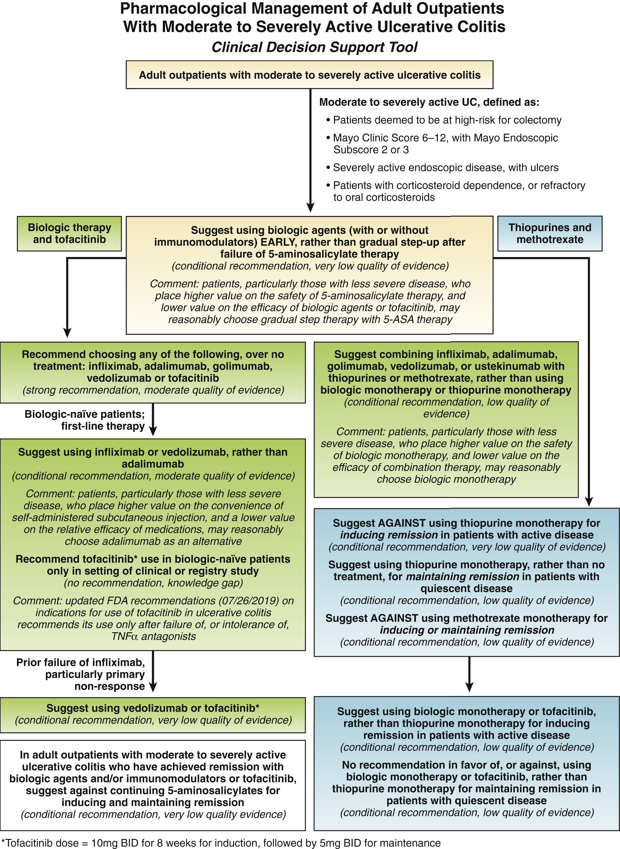

Slide 36
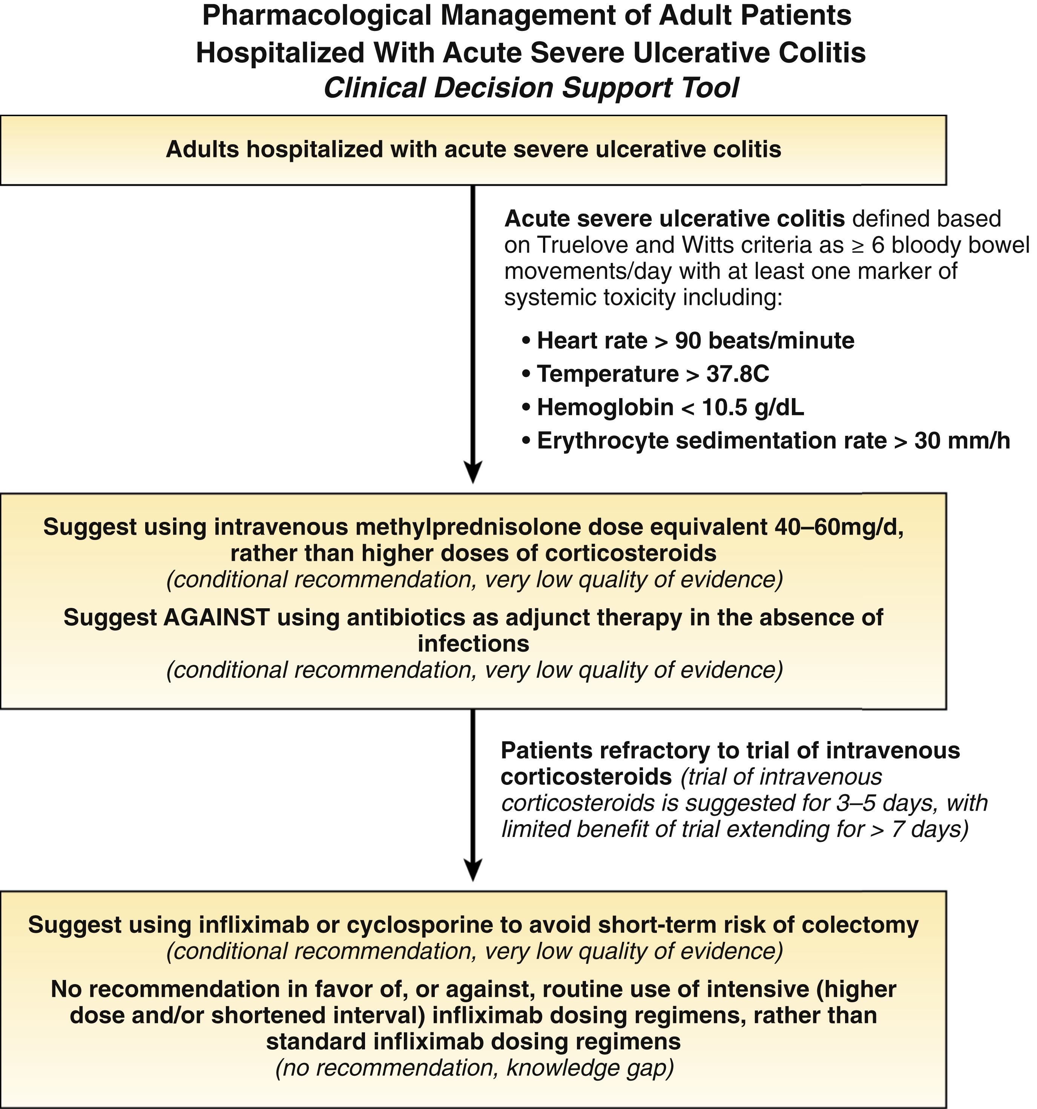


Copyright © 2020 AGA Institute

