Slide 1
Collagen matrices versus connective tissue graft in the treatment of gingival recession
Prof. Basima Gh ALI

Slide 2
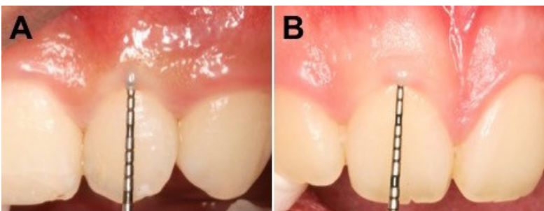
The term “periodontal biotype” was first introduced by Seibert and Lindhe in 1989. Unlike the term “gingival biotype,” it includes several related morphologic characteristics of the bone, teeth, and periodontium, as well as gingival thickness.
These biotypes are thought to influence the outcomes of periodontal therapy, prosthodontic work, implant therapy, and root coverage procedures.

Slide 3
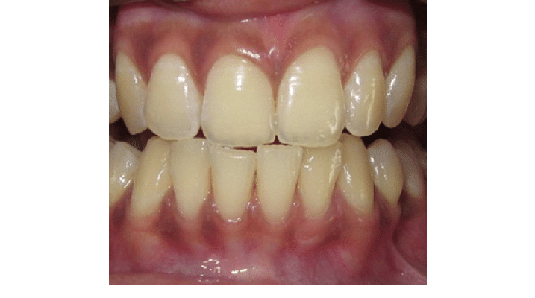
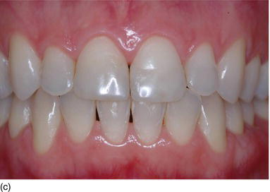
A higher risk of gingival recession was reported after the same periodontal therapy or implant therapy in patients with the thin periodontal biotype than in those with the thick biotype . Most clinicians who scrutinize patients' periodontal areas will agree that a large portion of gingival recession patients have a thin periodontal biotype. Therefore, the ability to change this delicate and thin biotype into a more durable biotype would be of paramount importance, not only for the outcomes of exposed root coverage procedures, but also for long-term stability and the prevention of recurrence.

Slide 4
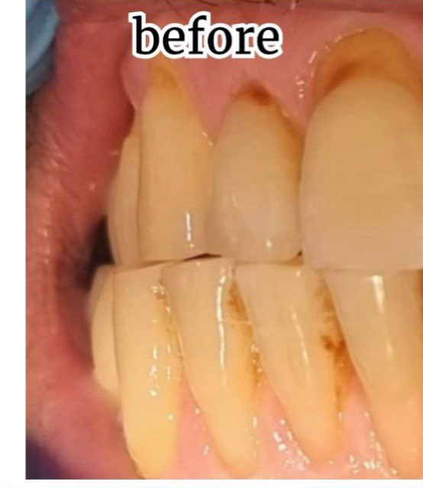
One of the main goals of periodontal plastic surgery is the
resolution of gingival recessions, which affects populations
with both high and poor oral hygiene
Gingival recession, defined as the apical displacement
of the gingival margin with the concomitant exposure of
a portion of the root surface, often results in esthetic
and hypersensitivity concerns for the patient becoming
a relevant therapeutic issue.

Slide 5
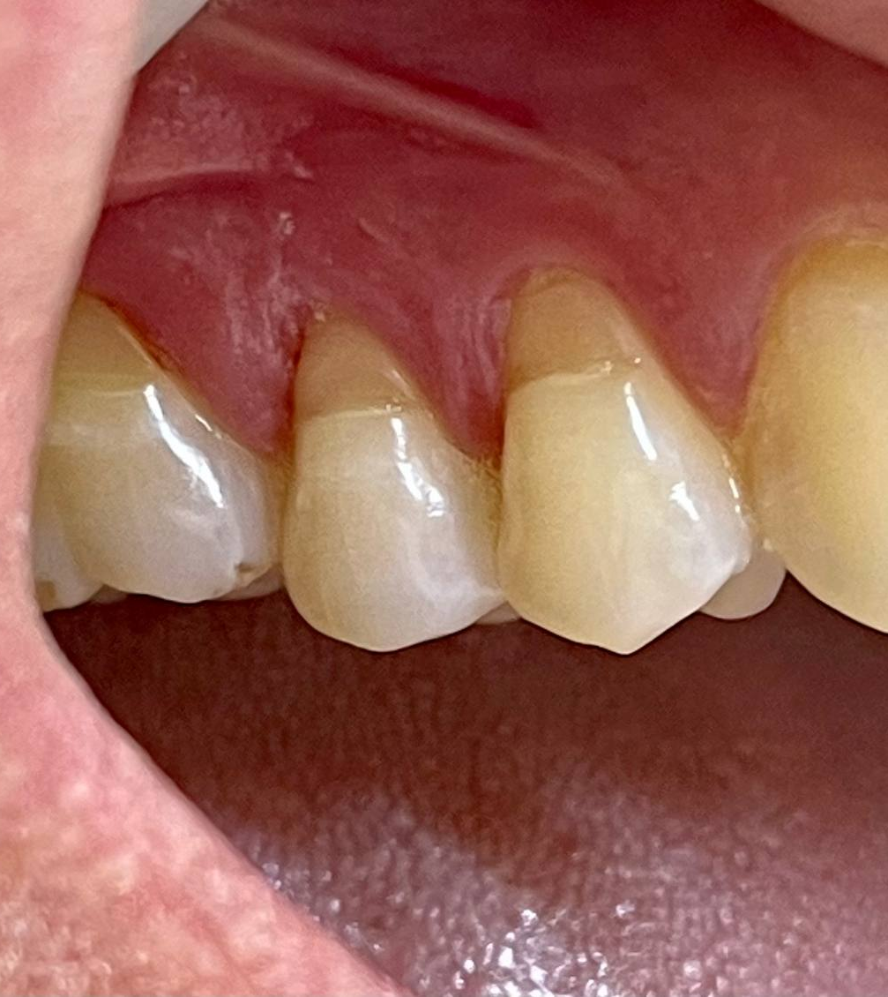
Over the years, several clinical procedures have been proposed with the specific aim of achieving complete root coverage,
recession reduction, and keratinized tissue increase
considering both the scientific evidence and “patient-centered” outcomes.
Extensive evidence suggests that coronally advance flap (CAF) in conjunction with connective tissue graft (CTG) is the best surgical technique to treat single gingival recessions .
The adjunctive use of CTG resulted in better mean and complete root coverage as well as long-term stability in clinical situations with deep gingival recessions, small or absent keratinized tissue and flap thickness of < 0.8 mm.

Slide 6
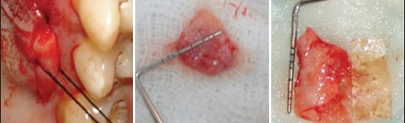
the use of CTG requires a second surgical site (the palate) for
graft harvesting and this is frequently associated with aprolonged surgical time, increased patient morbidity, greater
chance of postoperative complications such as bleeding, sensibility changes in the donor area, and limited supply of donor tissue .
The latter limit is even more important in the case of multiple recessions when more than one defect site requires the adjunction of CTG .

Slide 7
In the last few years, in order to overcome this kind
of drawbacks, researchers have been focused on developing
new alternatives to CTG such as acellular dermal
matrix (ADM)), xenogeneic collagen matrix (XCM),
enamel matrix derivative (EMD), and platelet-rich fibrin
(PRF) in combination with coronally advanced flap
(CAF

Slide 8
Unlike the membranes for Guided Bone Regeneration whose function is occlusive and space maintenance, for the purpose of soft tissue augmentation, a suitable material needs to fulfill two main criteria
—stability of volume over time and favorable biological behavior
—allowing modeling and remodeling processes. Biodegradation and subsequent reorganization of the collagen matrix have important implications in terms of cell proliferation and organization with the creation of a suitable functioning tissue structure. The rapid biodegradation by the enzymatic activity of periodontopathic bacteria, macrophages, and polymorphonuclear leucocytes of native collagen is still a concern.

Slide 9
Xenogeneic porcine collagen matrices, processed to remove antigenic cellular components, have been described as an unlimited alternative to acellular dermal matrix and connective tissue grafts, with comparable results to autogenous soft tissue constructs .
These substitute biomaterials act as a three-dimensional scaffold to allow, at the same time, continuous production of new connective tissue and degradation of the original matrix. The process causes the material to gradually be replaced by host tissues.

Slide 10
Matrices with a higher collagen content and thickness should degrade more slowly. In addition, in order to decelerate resorption and, thus, prolong the barrier function of collagen matrices, several cross-linking methods, such as ultraviolet radiation, glutaraldehyde, diphenyl-phosphoryl azide or hexamethylene diisocyanate, have been used.

Slide 11
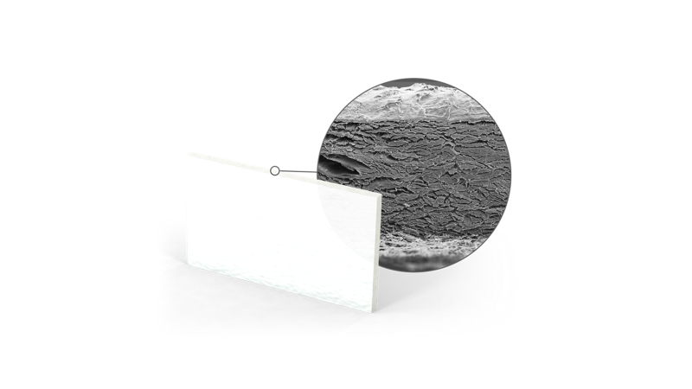
Focusing on xenogeneic devices, in 2009 a new collagen
matrix (Geistlich Mucograft®) has been introduced showing
successful outcomes for promoting regeneration of
keratinized tissue around implants and improvement of
early mucosal wound healing .

Slide 12
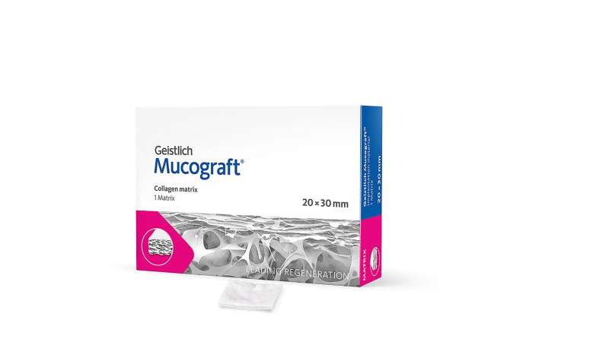
Geistlich Mucograft is a fully resorbable collagen matrix made of porcine collagen without further cross-linking.
Geistlich Mucograft is approximately 2.5–5.0 mm thick. No prior hydration is required.

Slide 13
Geistlich Mucograft® collagen matrix has been
adopted in several clinical trials showing superiority in
root coverage outcomes compared to CAF alone, both
short and long term. In fact, root coverage and
gingival thickness outcomes following CAF + collagen
matrix (CM) remained stable in treated gingival recessions
over 1 and 3 years of follow-up with similar
patient-reported outcomes with respect to CAF alone
However, when CAF + CM has been tested in
comparison with CAF + CTG the latter reported
greater results of root coverage and recession reduction.
Nonetheless, the use of the collagen matrix revealed
good results in terms of patient discomfort and postoperative
pain, as the surgical donor site is avoided .

Slide 14
XCM is a newly developed porcine-derived MUCODERM
bioresorbable product. This 3D-matrix is a bilayered composite of pure Type I and III collagen without cross-linking. The outer layer is compact, intended to hold sutures and protect the defect in open healing situations while the inner layer is porous, designed to promote blood clot stabilization and rapid vascularization and to allow the ingrowth of tissue .

Slide 15
Mucoderm is a resorbable matrix of 1.2 to 1.7 mm thickness, which is made of pure porcine collagen without any artificial/chemical cross-linking. The elastic properties of the matrix change with hydration, and the flexibility of the Mucoderm graft increases with hydration time, so a sufficiently long hydration, 5 to 20 min, is required before application.

Slide 16
Mucoderm is a 3D collagen tissue matrix derived from porcine dermis containing collagen and elastin . The collagen fibers are disposed as a loose mesh, forming an open-porous collagen structure that guides soft tissue cells and blood vessels .

Slide 17
High tensile strengthDue to the structural stability, mucoderm® can be:
– sutured, pinned or screwed
– easily cut to the required size and shape
– easily applied by the tunnel technique without risk of tearing the matrix apart.
Structure similar to human tissuemucoderm® is a viable alternative to the patient’s own tissue in certain indications:
– Remodels completely into patient’s own tissue within 6 – 9 months.
– Reduces the patients’ discomfort and donor site morbidity.

Slide 18
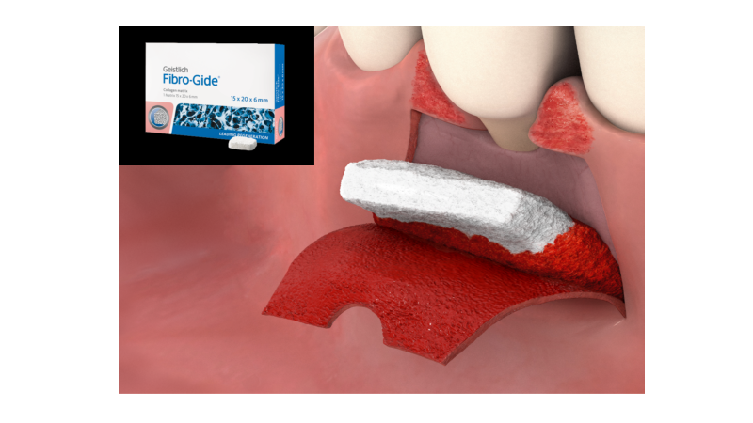
Recently, a new volume stable porcine-derived collagen matrix (Geistlich Fibro-Gide®, VCMX) with modified mechanical properties has been developed with the ultimate goal of maintaining a stable threedimensionality even after flap suturing. Thus, this new connective tissue alternative should improve the space making effect and stabilization of the blood clot providing sufficient space for the ingrowth of host cells during wound healing.
The VCMX has been tested in several preclinical and clinical trials and has shown:
to serve as a scaffold for fibroblasts and to promote tissue remodeling .
to be safe for use in clinical studies and
to favor tissue integration into surrounding soft and hard tissues (murine and rabbit model)

Slide 19
Fibro-Gide has only one porous layer consisting of 60–96% (w/w) porcine collagen and 4–40% (w/w) elastin. The biomaterial has 93% volume porosity, and cross-linked collagen displays a trabecular structure that forms large honeycomb-like interconnected pores, consisting of an amorphous, sheet-like matrix of collagen .

Slide 20
Geistlich Fibro-Gide is a porous, resorbable and volume-stable matrix, made of reconstituted collagen, which undergoes smart chemical cross-linking. The matrix is provided in 6 mm thickness, and it can be applied in either a dry or wet state according to individual preference, but swelling upon wetting must be taken into account when determining final dimensions, as the matrix will gain approximately 25% in volume.

Slide 21
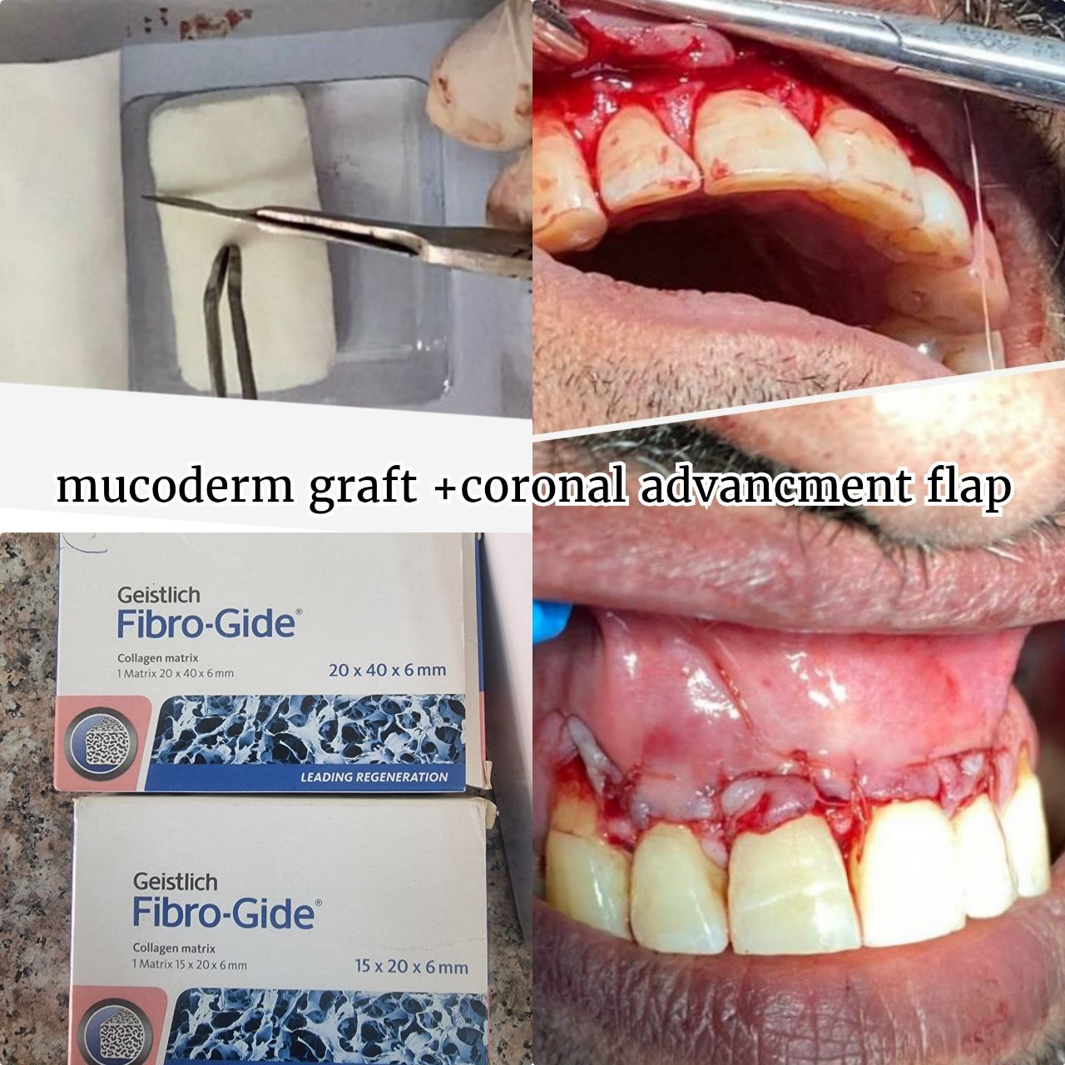
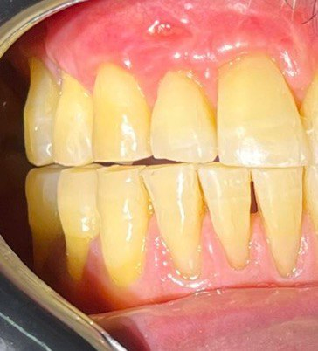

Slide 22
It is commonly known that increasing the number of links between collagen molecules will
induces the formation of stable intra- or intermolecular chemical bonds,
strengthens collagen matrices, and
slows down enzymatic degradation.
However, these cross-linked collagen matrices are not usually employed clinically, because it has been shown that
cross-linking using glutaraldehyde decreased biocompatibility,
whereas enzymatic cross-linking reduced the tissue integration and biodegradation pattern.
In addition, increased cross-linking diminishes water absorption and increases membrane stiffness, which may affect clinical manageability.
usually employed crosslinking methods, are frequently related to severe inflammatory responses.

Slide 23
Matrix | Collagen | Origin | Cross-Link | Structure | Thickness (mm) | Exposed to the Oral Environment
Fibro-Gide | Type I and III | Porcine | Yes | 3D matrix | 6 | No Submerged healing
Mucograft | Type I and III | Porcine | No | 2 layers: compact and spongious scaffold | 2.5–5.0 | No/Yes Submerged healing recommended
Mucoderm | Type I and III | Porcine | No | 1 layer | 1.2–1.7 | Yes Open healing is feasible in the case of a vestibuloplasty.

Slide 24
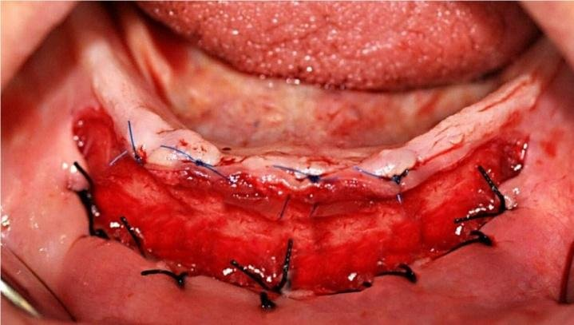
Differently from Fibro-Gide, Mucograft and Mucoderm could be exposed to the oral cavity . Therefore, a greater resistance to degradation than Fibro-Gide was expected. Mucograft, a bilayered collagen matrix, presents two layers: a smooth, occlusive and compact layer of dense collagen that allows possible open healing , and another porous layer to promote cell adhesion. Exposure of Mucoderm, according to recommendations, should always be avoided when used for recession coverage, and open healing is feasible only in the case of a vestibuloplasty .

Slide 25
It is indispensable that the collagen matrices to be incorporated and accepted in the recipient tissue, and present adequate volumetric stability, in order to allow enough time for cell and blood vessel infiltration . Migration, activation and proliferation of endothelial cells from existing vessels is required .
studies demonstrated in an in vivo animal model that a single-layer acellular human dermis membrane was revascularized quickly, with this process being completed by the second postoperative week. It was considered that 14 days was sufficient time for the cell invasion and revascularization.

Slide 26
However, it has been demonstrated that the integration of collagen membranes of human and porcine origin is different, despite the similarity in morphology and behavior of porcine and human skin .
In the case of porcine collagen matrices, it has been shown that this time is significantly longer, and the vascularization of the central zone of the matrix occurs between 30 days and 60 days . This is the reason why the matrix must remain intact for at least 4 weeks in order to allow the incorporation and regeneration of oral tissues.

Slide 27
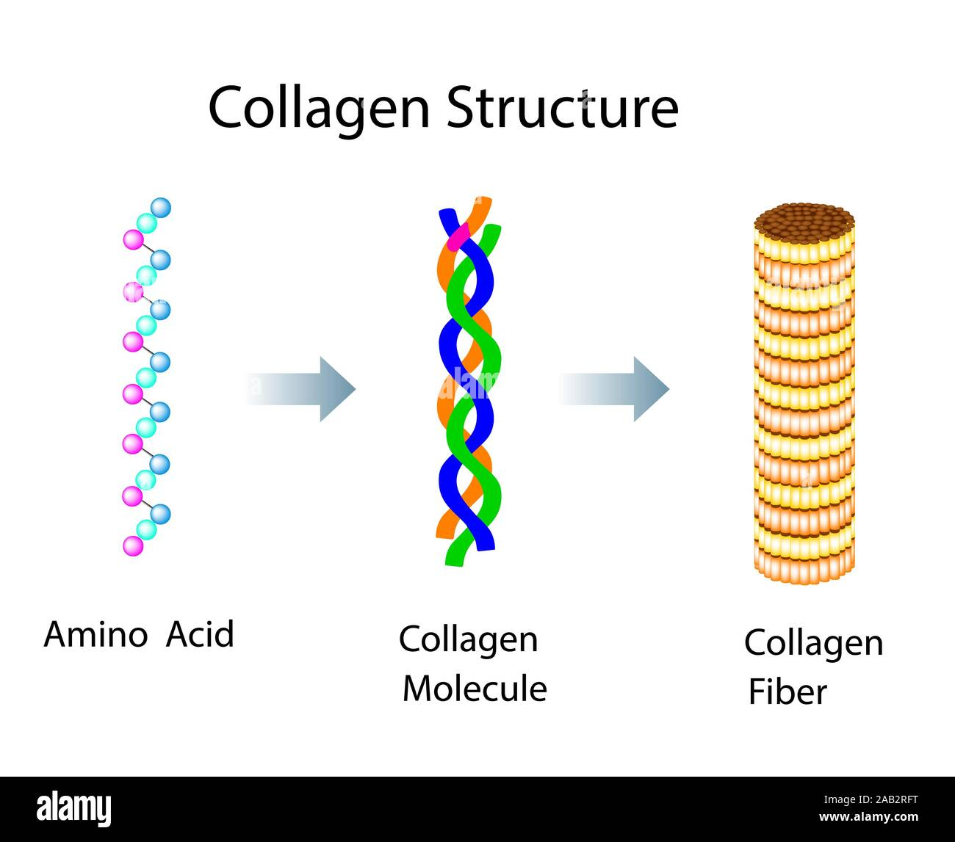
Several studies have demonstrated the affinity and adhesion of bacteria to collagen . Bacterial adhesion to collagen plays critical roles in the pathogenesis and persistence of infections caused by numerous bacteria . Each collagen molecule is formed through the interactions of three protein polypeptides known as α-strands and recognized as a triple helix structure . Many bacteria have evolved to produce collagen adhesins to interact with this group of proteins , which favor the binding to collagen.

Slide 28
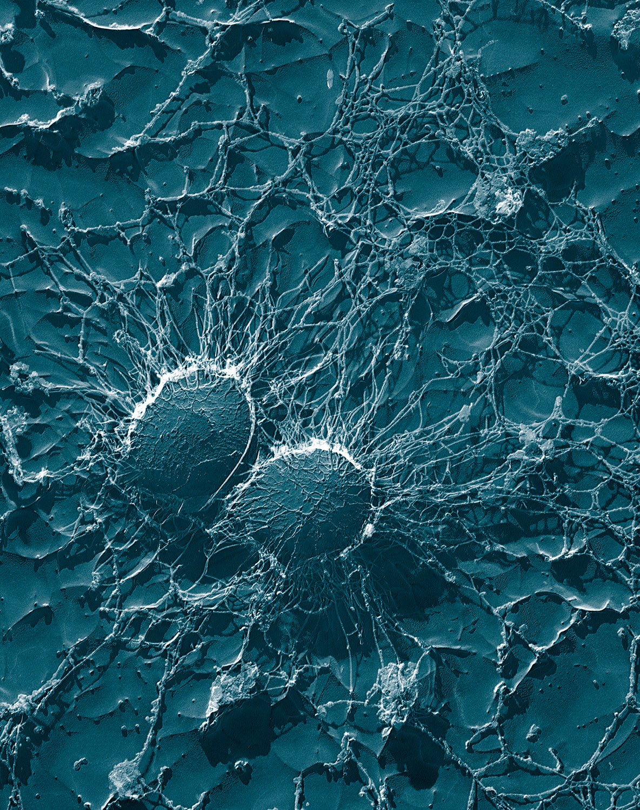
This suggests that in the presence of bacteria, such as those of the genera Staphylococcus, Streptococcus, Enterococcus, and Bacillus, an immediate contamination of the collagen matrix would occur, which implies its rapid degradation.
Collagen cross-linking has been shown to strengthen the matrices against collagenase degradation for up to 7 days.
However, this time is considered insufficient to achieve a complete conversion and regeneration of the soft oral tissue . Therefore, doping of the matrices with an antibacterial agent should be considered in order to partially overcome the problem of rapid degradation, which is caused by bacterial contamination in those cases in which membrane exposure may occur.

Slide 29
