Slide 1
Cephalometric analysis using different methods

Slide 2
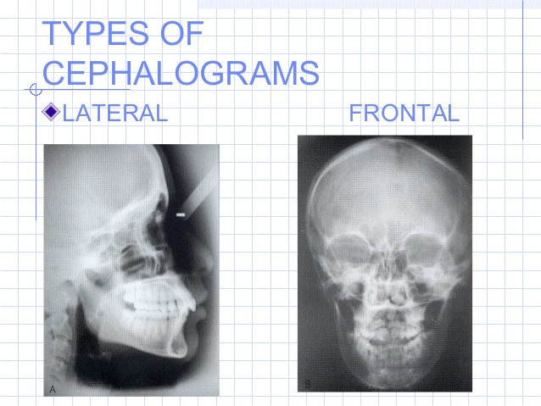
Two views can be used with this type of radiographic method:

Slide 3
Uses of Cephalometrics
  The LCR is used primarily in orthodontic diagnosis and treatment planning, particularly when considering orthognathic surgery.
  It is a useful record prior to treatment and can be used during treatment to assess progress. It is used to assess the aetiology of malocclusion; to determine whether the malocclusion is due to skeletal relationship, dental relationship or both.
  These radiographs can also be used for research purposes, although the radiographs must be clinically justified.
  Once taken, the LCR should be traced; either by hand or digitally and analysed to help with treatment planning and diagnosis.

Slide 4
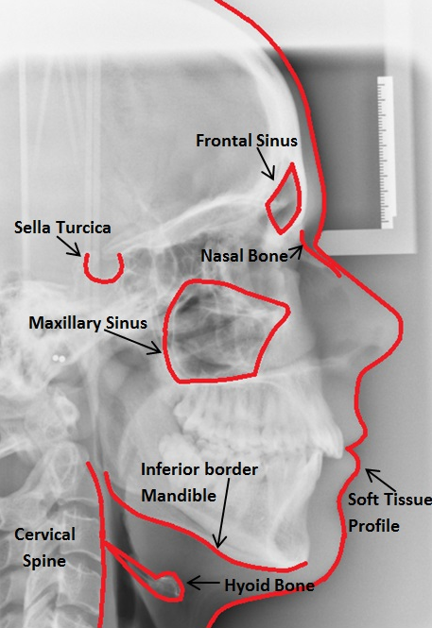
Anatomy
It is very important that prior to tracing the radiograph, it is examined for any pathology. Some of the basic anatomy seen on an LCR is detailed below.

Slide 5
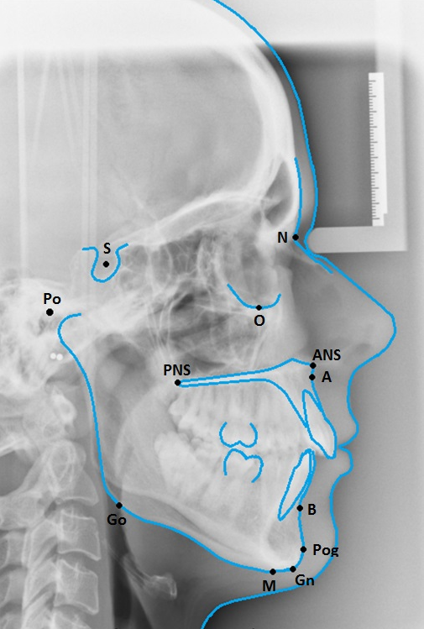
Cephalometric Points
A point (A)
B point (B)
Sella (S)
Nasion (N)
Orbitale (Or)
Porion (Po)
Anterior Nasal Spine (ANS)
Posterior Nasal Spine (PNS)
Gonion (Go)
Gnathion (Gn)
Menton (Me)
Pogonion (Pog)

Slide 6
Soft Tissue
Upper Lip Point (UL) –
Lower Lip Point (LL) –
Soft Tissue Pogonion (Pog’)
tip of the nose

Slide 7
There are 3 planes which are usually assessed;
Anteroposterior, Vertical Using the LCR
Transverse relationships by posteroanterior views of the skull, although this is rarely done in practice.

Slide 8
a. Anteroposterior Relationship
SN line
Frankfort Plane
Mandibular Plane (MnPl)
Maxillary Plane (MxPl)
“Esthetic Plane”“E” plane

Slide 9
a. Anteroposterior Relationship
SN line The plane demonstrated by a line through the nasion and sella
Frankfort Plane The plane demonstrated by a line through the orbitale and porion
Mandibular Plane (MnPl) The plane demonstrated by a line through the gonion and menton. The definition varies slightly, but the plane is used to show the plane of the lower border of the mandible
Maxillary Plane (MxPl) The plane demonstrated by a line through the anterior and posterior nasal spines
“Esthetic Plane”“E” plane is simply a line drawn from the tip of the nose to the tip of the chin. His key assessment was to look at how the upper and lower lip related to that line.

Slide 10
SNA This angle represents the relative anterioposterior position of the maxilla to the cranial base

Slide 11
SNB This angle represents the relative anterioposterior position of the mandible to the cranial base

Slide 12
ANB This angle represents the relative anterioposterior position of the maxilla to the mandible and can be used to determine skeletal class.

Slide 13
Inter-Incisal Angle The angle between the long axis of the maxillary incisors and the long axis of the mandibular incisors

Slide 14
Maxillary-mandibular plane angle (MMPA) The angle formed between the Maxillary Plane and Mandibular Plane

Slide 15
Maxillary Incisal Inclination (UInc to MxPl) The angle between the maxillary plane and the axis of the maxillary incisors (UInc)

Slide 16
Mandibular Incisal Inclination (LInc to MnPl) The angle between the mandibular plane and the axis of the mandibular incisors (LInc)

Slide 17
Upper Lip‐EL

Slide 18
Lower Lip‐EL

Slide 19
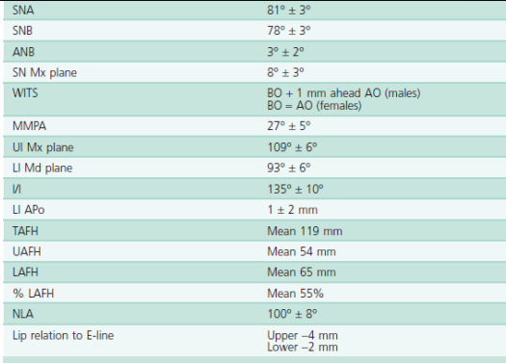

Slide 20
b. Vertical Relationship
SN‐Mxpl:

Slide 21
Facial Proportion (FP)
Lower facial height
Upper facial height

Slide 22
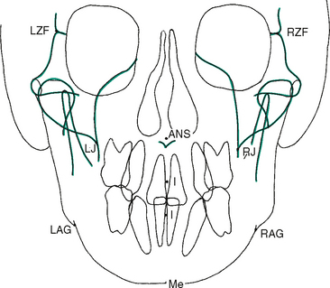
c. Horizontal Relationship

Slide 23
References
Mitchell L, Littlewood SJ, Nelson-Moon ZL, Dyer F. Introduction to Orthodontics (4th Ed). Oxford University Press; 2013
Whaites E, Drage N. Essentials of Dental Radiography and Radiology. Churchill Livingstone; 2013
Heasman P. Master Dentistry Volume 2. Churchhill Livingstone; 2009
British Standards Institute. Glossary of Dental Terms (BS 4492), BSI, London; 1983
Profitt, WR, Fields, HW and Sarver, DM. Contemporary Orthodontics. Fourth edition, Mosby, Inc., St. Louis, 2006.
Thilander, B and Ronning, O. Introduction to Orthodontics. Fifth edition, Minab/Gotab, Stockholm, 1985.
Walther, DP and Houston, WJ. Orthodontic Notes. Fifth edition, Butterworth‐Heinemann Ltd., Oxford 1994.
Wisth, P. Introduction to the Edgewise Technique: A Technical Manual. University of Bergen, Norway, 1985.
American Board of Orthodontics. Specific Instructions for Candidates. American Board of Orthodontics, St. Louis, 1990.

Slide 24
THANK YOU

