Slide 1
Soft tissue substitutes of porcine origin in periodontal plastic surgery
Prof. Basima Gh ALI

Slide 2
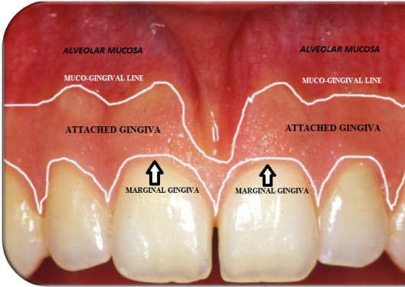
The oral mucosa comprises both masticatory and alveolar mucosa. The nonattached alveolar mucosa is thin and is mostly composed of loosely affiliated collagen fibers while the attached mucosa is fixed, thick, keratinized, and is composed of well-organized, dense, collagen fibers . An adequate amount of attached keratinized mucosa is essential for the maintenance of teeth and dental implants .

Slide 3
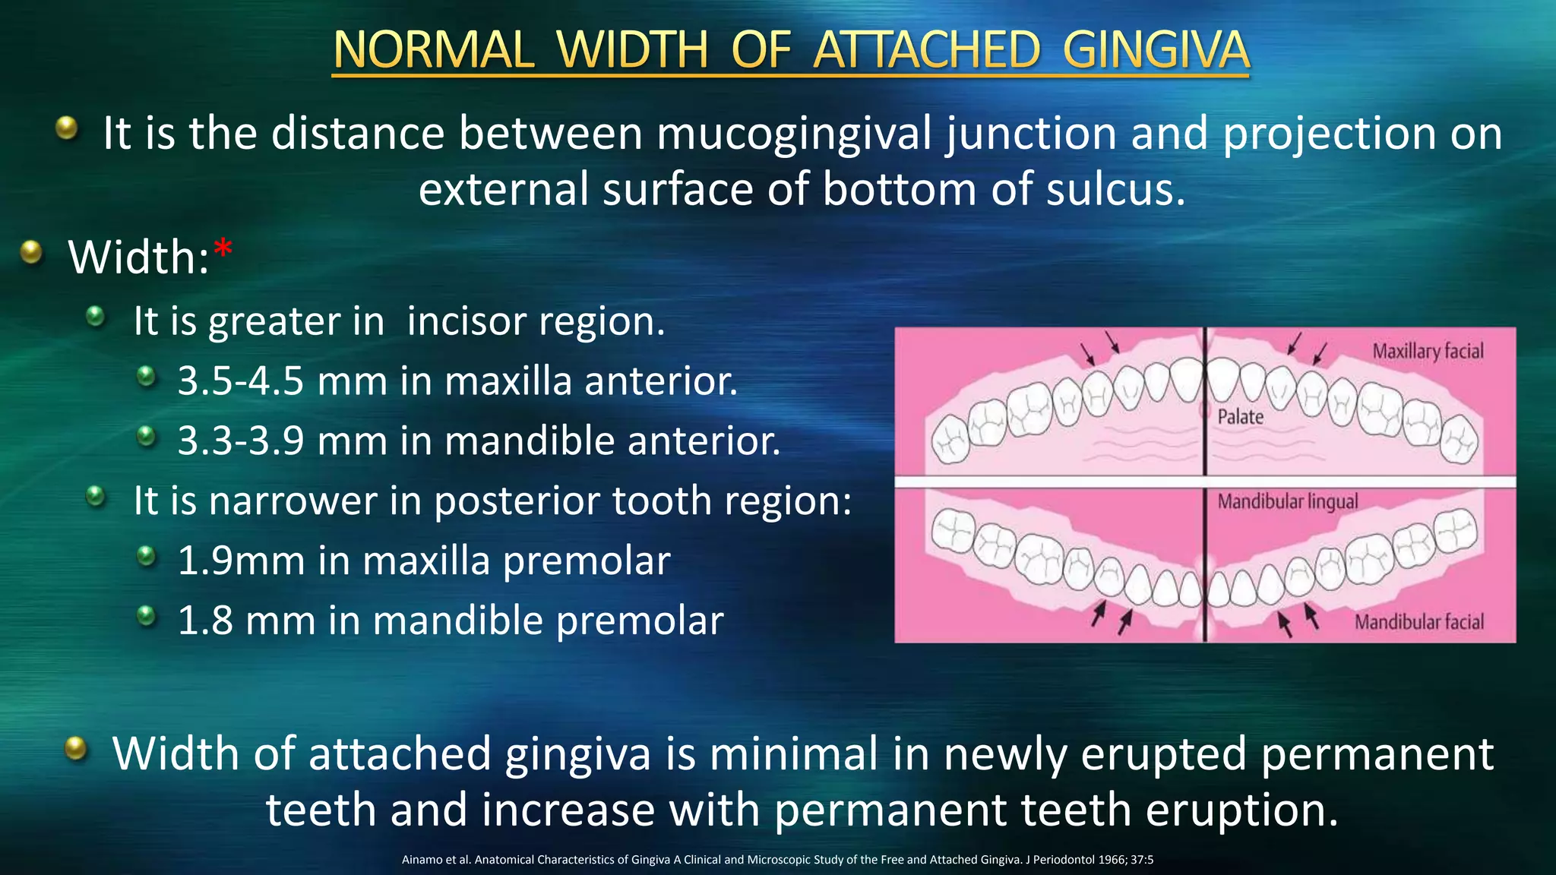
Notwithstanding the recognized value of a sufficient amount of keratinized mucosa, scientific evidence reports controversial data about the thickness and amount required. Previous findings have stated that a keratinized mucosa width of less than 2 mm more frequently exhibits clinical signs of inflammation, whereas sites showing ≥2 mm of keratinized mucosa remained healthy . It was established that an adequate width of keratinized mucosa (≥2 mm) may be necessary in order to maintain periodontal health.

Slide 4
ON THE OTHER HAND
clinical signs of inflammation can be detected regardless of keratinized mucosa width. As with teeth, the effect of adequate width of a keratinized mucosa around dental implants on the stability of peri-implant tissues is still a matter of debate.
However, it is clear that the lack of keratinized mucosa is not always associated with increased bone loss or peri-implant disease, but an adequate amount of it may be more favorable for the long-term maintenance of dental implants.
The presence of keratinized mucosa helps to preserve soft and hard tissues, favoring oral hygiene and preventing recession over time.
In addition, the absence of a sufficient width and thickness of periodontal or peri-implant soft tissues can compromise the aesthetics or function.

Slide 5
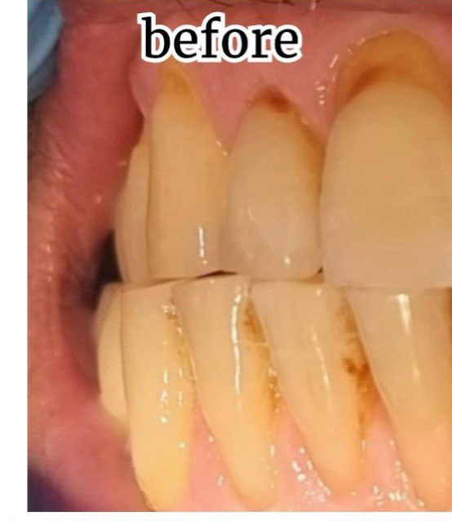
One of the main goals of periodontal plastic surgery is the
resolution of gingival recessions, which affects populations
with both high and poor oral hygiene
Gingival recession, defined as the apical displacement
of the gingival margin with the concomitant exposure of
a portion of the root surface, often results in esthetic
and hypersensitivity concerns for the patient becoming
a relevant therapeutic issue.

Slide 6
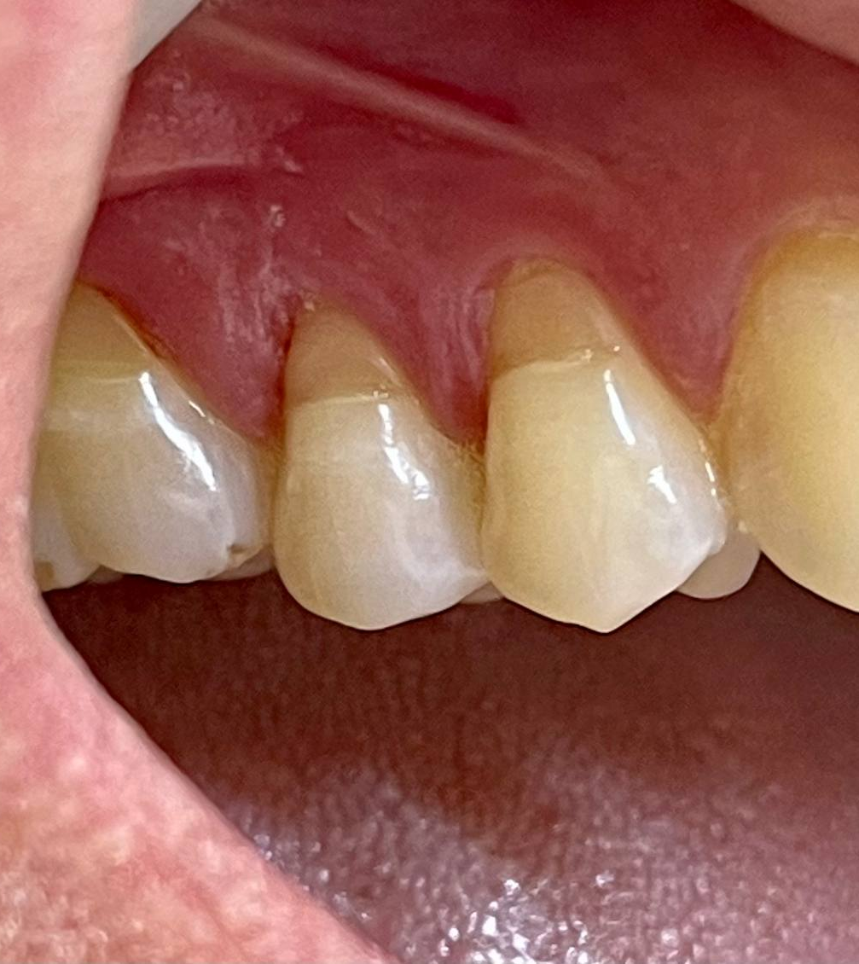
Over the years, several clinical procedures have been proposed
with the specific aims of achieving complete root coverage,
recession reduction, and keratinized tissue increase
considering both the scientific evidence and “patient-centered”
outcomes.
Extensive evidence suggests that coronally advance
flap (CAF) in conjunction with connective tissue graft
(CTG) is the best surgical technique to treat single gingival
recessions .
The adjunctive use of CTG resulted in better mean and
complete root coverage as well as long-term stability in clinical
situations with deep gingival recessions, small or absent
keratinized tissue and flap thickness of < 0.8 mm.

Slide 7
Soft tissue augmentation procedures have been proposed to treat mucogingival deformities and achieve both
aesthetic and functional results,
increasing the survival rates of teeth and dental implants.
Many surgical techniques have been performed to augment the gingival tissue dimension. These procedures are categorized into two main groups:
methods involved in keratinized mucosa generation and/or widening, and
those causing increases in the volume/thickness of soft tissue.
Regardless of the technique used, autogenous connective tissue grafts are the gold standard.

Slide 8
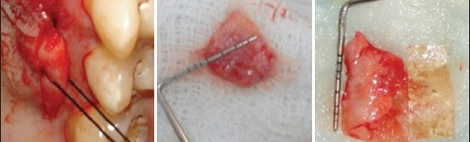
the use of CTG requires a second surgical site (the palate) for
graft harvesting and this is frequently associated with aprolonged surgical time, increased patient morbidity, greater
chance of postoperative complications such as bleeding, sensibility changes in the donor area, and limited supply of donor tissue .
The latter limit is even more important in the case of multiple recessions when more than one defect site requires the adjunction of CTG .

Slide 9
In the last few years, in order to overcome this kind
of drawbacks, researchers have been focused on developing
new alternatives to CTG such as acellular dermal
matrix (ADM)), xenogeneic collagen matrix (XCM),
enamel matrix derivative (EMD), and platelet-rich fibrin
(PRF) in combination with coronally advanced flap
(CAF

Slide 10
Unlike the membranes for Guided Bone Regeneration whose function is occlusive and space maintenance, for the purpose of soft tissue augmentation, a suitable material needs to fulfill two main criteria—stability of volume over time and favorable biological behavior—allowing modeling and remodeling processes. Biodegradation and subsequent reorganization of the collagen matrix have important implications in terms of cell proliferation and organization with the creation of a suitable functioning tissue structure. The rapid biodegradation by the enzymatic activity of periodontopathic bacteria, macrophages, and polymorphonuclear leucocytes of native collagen is still a concern.

Slide 11
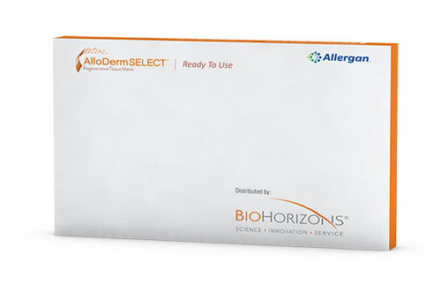
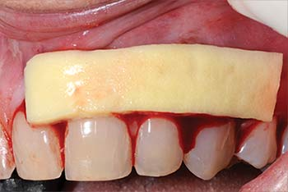
Acellular dermal matrix allograft obtained from human cadaveric skin may be associated with ethical concerns and potential risk of disease transmission . Xenogeneic porcine collagen matrices, processed to remove antigenic cellular components, have been described as an unlimited alternative to acellular dermal matrix and connective tissue grafts, with comparable results to autogenous soft tissue constructs . These substitute biomaterials act as a three-dimensional scaffold to allow, at the same time, continuous production of new connective tissue and degradation of the original matrix . The process causes the material to gradually be replaced by host tissues.

Slide 12
Furthermore, the degradation of collagen-based biomaterials is accentuated when the substitute is exposed to the oral environment . The fiber strength and degradation rate can be influenced by combining collagen with other materials, by synthetically induced crosslinking, or by adding more thickness of collagen . Various studies have been carried out to investigate the influence of membrane thickness on durability with the addition of a second membrane layer . Although the rate of collagen degradation is similar in both configurations, the application of an additional layer results in a significantly higher amount of residual collagen .

Slide 13
This suggests that matrices with a higher collagen content and thickness should degrade more slowly. In addition, in order to decelerate resorption and, thus, prolong the barrier function of collagen matrices, several cross-linking methods, such as ultraviolet radiation, glutaraldehyde, diphenyl-phosphoryl azide or hexamethylene diisocyanate, have been used.

Slide 14
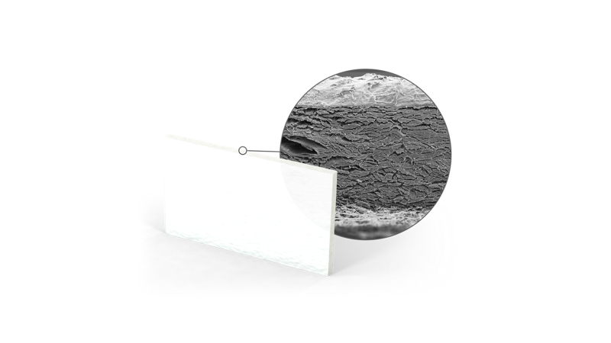
Focusing on xenogeneic devices, in 2009 a new collagen
matrix (Geistlich Mucograft®) has been introduced showing
successful outcomes for promoting regeneration of
keratinized tissue around implants and improvement of
early mucosal wound healing .

Slide 15
Mucoderm is a resorbable matrix of 1.2 to 1.7 mm thickness, which is made of pure porcine collagen without any artificial/chemical cross-linking. The elastic properties of the matrix change with hydration, and the flexibility of the Mucoderm graft increases with hydration time, so a sufficiently long hydration, 5 to 20 min, is required before application.

Slide 16
Mucoderm is a 3D collagen tissue matrix derived from porcine dermis containing collagen and elastin . The collagen fibers are disposed as a loose mesh, forming an open-porous collagen structure that guides soft tissue cells and blood vessels .

Slide 17
XCM is a newly developed porcine-derived MUCODERM
bioresorbable product. This 3D-matrix is a bilayered composite of pure Type I and III collagen without cross-linking. The outer layer is compact, intended to hold sutures and protect the defect in open healing situations while the inner layer is porous, designed to promote blood clot stabilization and rapid vascularization and to allow the ingrowth of tissue .

Slide 18
High tensile strengthDue to the structural stability, mucoderm® can be: – sutured, pinned or screwed – easily cut to the required size and shape – easily applied by the tunnel technique without risk of tearing the matrix apart.
Structure similar to human tissuemucoderm® is a viable alternative to the patient’s own tissue in certain indications: – Remodels completely into patient’s own tissue within 6 – 9 months. – Reduces the patients’ discomfort and donor site morbidity.

Slide 19
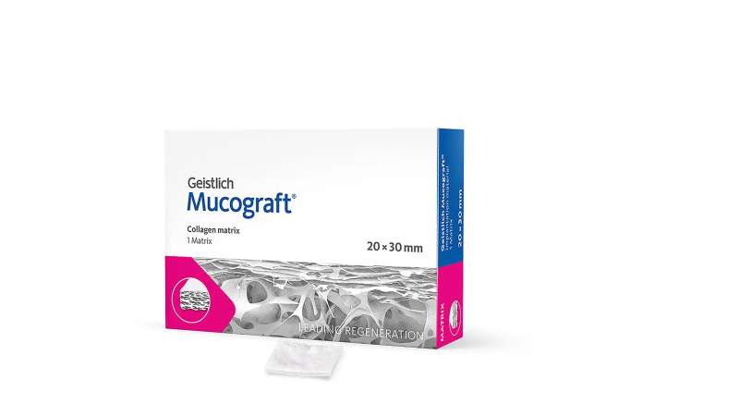
Geistlich Mucograft is a fully resorbable collagen matrix made of porcine collagen without further cross-linking. As indicated by the provider, Geistlich Mucograft is approximately 2.5–5.0 mm thick. No prior hydration is required.

Slide 20
Mucograft is composed of a porcine collagen bilayer structure that presents two surfaces. The compact layer consists of condensed collagen fibers with occlusive cellular properties, allowing tissue adherence as a prerequisite for favorable wound healing. This layer is expected to protect against bacterial infiltration during open healing conditions and offers elastic properties to accommodate suturing. The second layer consists of a thick, porous, spongy collagen structure, which is placed next to the host tissues to facilitate organization of the blood clot, promoting both neoangiogenesis and tissue integration .

Slide 21
Geistlich Mucograft® collagen matrix has been
adopted in several clinical trials showing superiority in
root coverage outcomes compared to CAF alone, both
short and long term. In fact, root coverage and
gingival thickness outcomes following CAF + collagen
matrix (CM) remained stable in treated gingival recessions
over 1 and 3 years of follow-up with similar
patient-reported outcomes with respect to CAF alone
However, when CAF + CM has been tested in
comparison with CAF + CTG the latter reported
greater results of root coverage and recession reduction.
Nonetheless, the use of the collagen matrix revealed
good results in terms of patient discomfort and postoperative
pain, as the surgical donor site is avoided .

Slide 22
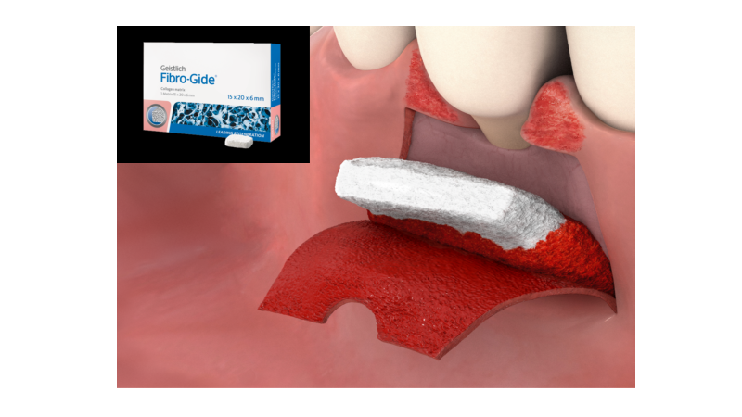
Recently, a new volume stable porcine-derived collagen matrix (Geistlich Fibro-Gide®, VCMX) with modified mechanical properties has been developed with the ultimate goal of maintaining a stable threedimensionality even after flap suturing. Thus, this new connective tissue alternative should improve the space making effect and stabilization of the blood clot providing sufficient space for the ingrowth of host cells during wound healing.
The VCMX has been tested in several preclinical and clinical trials and has shown:
to serve as a scaffold for fibroblasts and to promote tissue remodeling .
to be safe for use in clinical studies and
to favor tissue integration into surrounding soft and hard tissues (murine and rabbit model)

Slide 24
Fibro-Gide has only one porous layer consisting of 60–96% (w/w) porcine collagen and 4–40% (w/w) elastin . The biomaterial has 93% volume porosity, and cross-linked collagen displays a trabecular structure that forms large honeycomb-like interconnected pores, consisting of an amorphous, sheet-like matrix . A study concluded that the sheet-like matrix was collagen, and the small fibers were elastin

Slide 25
Geistlich Fibro-Gide is a porous, resorbable and volume-stable matrix, made of reconstituted collagen, which undergoes smart chemical cross-linking. The matrix is provided in 6 mm thickness, and it can be applied in either a dry or wet state according to individual preference, but swelling upon wetting must be taken into account when determining final dimensions, as the matrix will gain approximately 25% in volume.

Slide 26
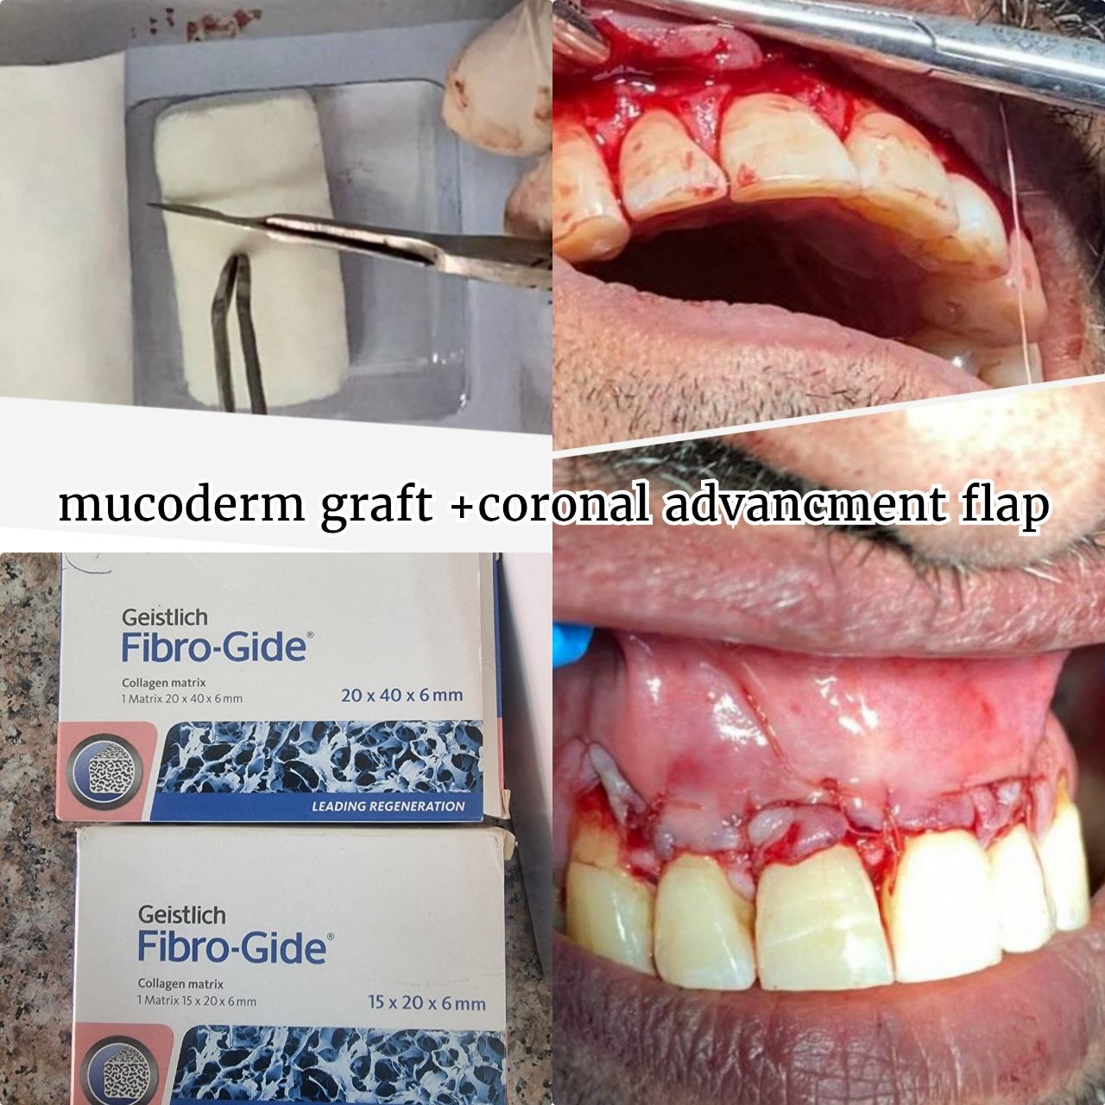
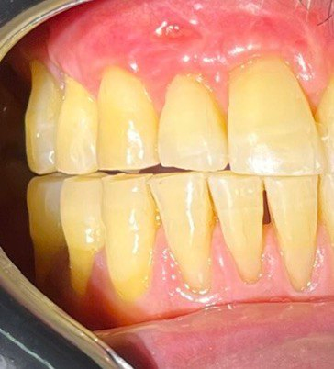

Slide 27
It is commonly known that these processes increase the number of links between collagen molecules . This procedure induces the formation of stable intra- or intermolecular chemical bonds, strengthens collagen matrices, and slows down enzymatic degradation . The reinforcement of matrix materials through the cross-linking of collagen treated by different physical/chemical methods has been previously demonstrated . However, these cross-linked collagen matrices are not usually employed clinically, because it has been shown that cross-linking using glutaraldehyde decreased biocompatibility, whereas enzymatic cross-linking reduced the tissue integration and biodegradation pattern . In addition, increased cross-linking diminishes water absorption and increases membrane stiffness, which may affect clinical manageability .

Slide 28
The exposed matrices are expected to be submitted to more aggressive environments than those in submerged healing. Several studies have assessed the degradation of guided bone regeneration membranes ; however there is no research that elucidates the potential in vitro degradability associated with the collagen matrix for soft tissue augmentation procedures.

Slide 29
Matrix | Collagen | Origin | Cross-Link | Structure | Thickness (mm) | Exposed to the Oral Environment
Fibro-Gide | Type I and III | Porcine | Yes | 3D matrix | 6 | No Submerged healing
Mucograft | Type I and III | Porcine | No | 2 layers: compact and spongious scaffold | 2.5–5.0 | No/Yes Submerged healing recommended
Mucoderm | Type I and III | Porcine | No | 1 layer | 1.2–1.7 | Yes Open healing is feasible in the case of a vestibuloplasty.

Slide 30
the presence of cross-linked collagen fibers in the composition of a matrix causes greater stability and resistance against degradation tests.
Predicting matrices’ behavior and their degradation in different scenarios is essential for the collagen matrices used in soft tissue augmentation.

Slide 31
It is indispensable that the collagen matrices to be incorporated and accepted in the recipient tissue, and present adequate volumetric stability, in order to allow enough time for cell and blood vessel infiltration . Migration, activation and proliferation of endothelial cells from existing vessels is required . Eppley et al. demonstrated in an in vivo animal model that a single-layer acellular human dermis membrane was revascularized quickly, with this process being completed by the second postoperative week. It was considered that 14 days was sufficient time for the cell invasion and revascularization.

Slide 32
However, it has been demonstrated that the integration of collagen membranes of human and porcine origin is different, despite the similarity in morphology and behavior of porcine and human skin . In the case of porcine collagen matrices, it has been shown that this time is significantly longer, and the vascularization of the central zone of the matrix occurs between 30 days and 60 days . This is the reason why the matrix must remain intact for at least 4 weeks in order to allow the incorporation and regeneration of oral tissues . Rothamel et al. stated that, after four weeks of implantation, matrices were vascularized and the degradation was practically completed.

Slide 33
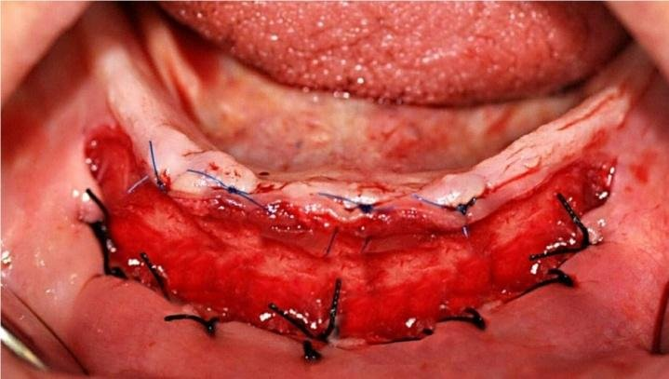
Differently from Fibro-Gide, Mucograft and Mucoderm could be exposed to the oral cavity . Therefore, a greater resistance to degradation than Fibro-Gide was expected. Mucograft, a bilayered collagen matrix, presents two layers: a smooth, occlusive and compact layer of dense collagen that allows possible open healing , and another porous layer to promote cell adhesion. Exposure of Mucoderm, according to recommendations, should always be avoided when used for recession coverage, and open healing is feasible only in the case of a vestibuloplasty .

Slide 34
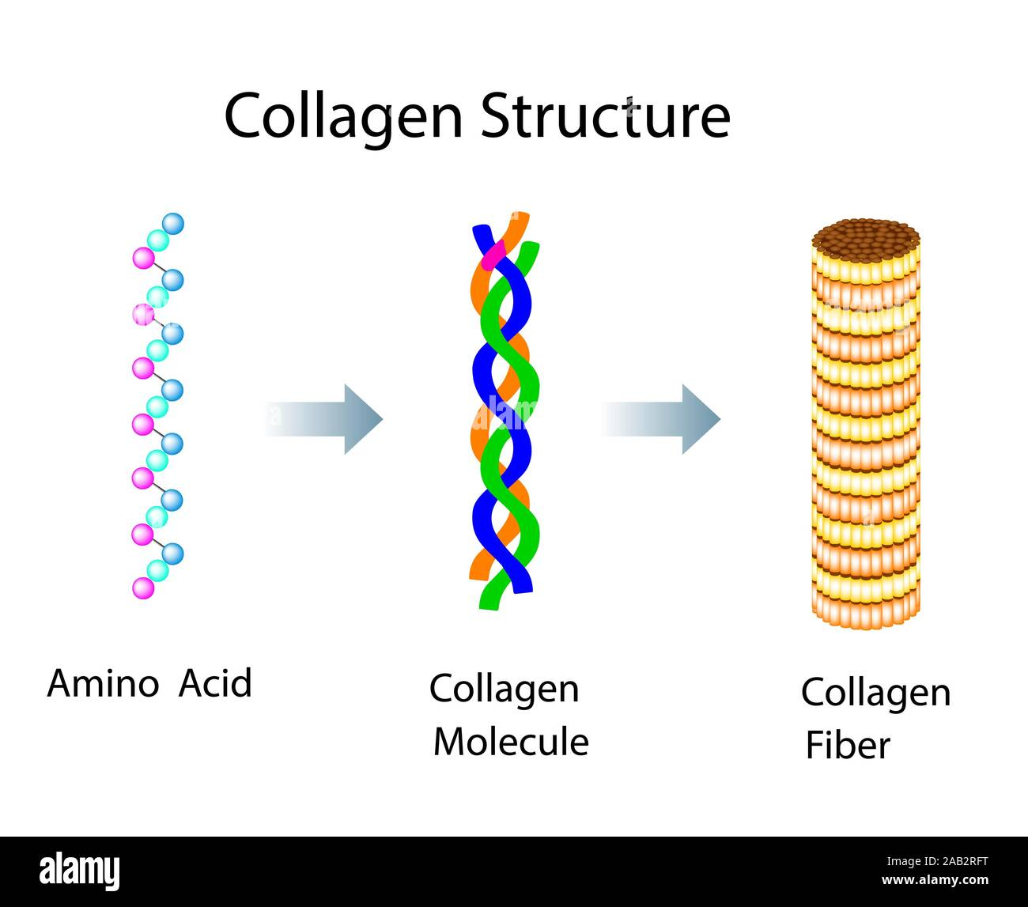
Several studies have demonstrated the affinity and adhesion of bacteria to collagen . Bacterial adhesion to collagen plays critical roles in the pathogenesis and persistence of infections caused by numerous bacteria . Each collagen molecule is formed through the interactions of three protein polypeptides known as α-strands and recognized as a triple helix structure . Many bacteria have evolved to produce collagen adhesins to interact with this group of proteins , which favor the binding to collagen. This suggests that in the presence of bacteria, such as those of the

Slide 35
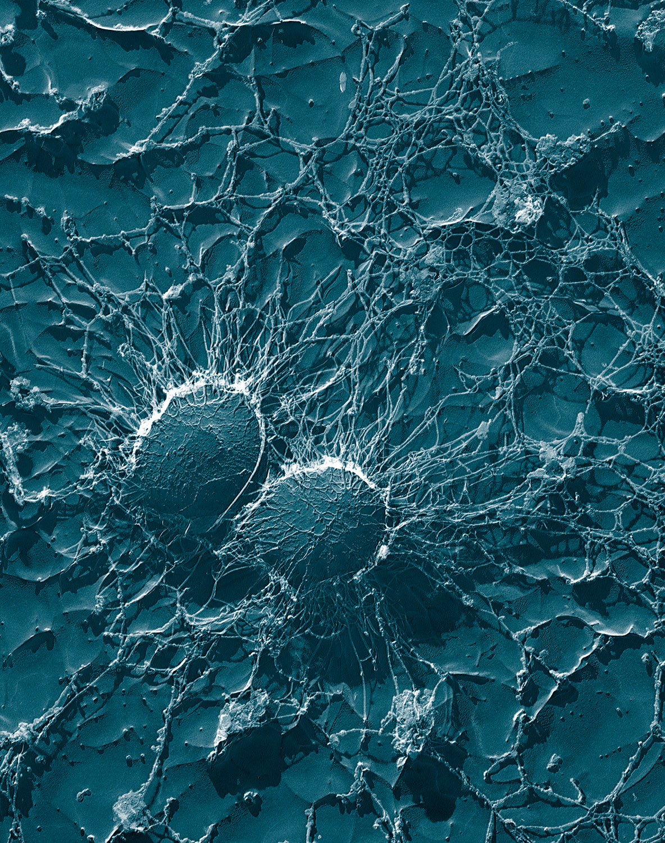
]. Many bacteria have evolved to produce collagen adhesins to interact with this group of proteins , which favor the binding to collagen. This suggests that in the presence of bacteria, such as those of the genera Staphylococcus, Streptococcus, Enterococcus, and Bacillus, an immediate contamination of the collagen matrix would occur, which implies its rapid degradation. Collagen cross-linking has been shown to strengthen the matrices against collagenase degradation for up to 7 days. However, this time is considered insufficient to achieve a complete conversion and regeneration of the soft oral tissue . Therefore, doping of the matrices with an antibacterial agent should be considered in order to partially overcome the problem of rapid degradation, which is caused by bacterial contamination in those cases in which membrane exposure may occur.

Slide 36
This study suggests that the presence of cross-linked collagen fibers in the matrix represents the most important aspect in terms of increasing resistance to degradation. At this point, a balance needs to be achieved between the increasing of resistance to degradation and the avoidance of the drawbacks of many of the usually employed crosslinking methods, which are frequently related to severe inflammatory responses .

Slide 37
REFERENCES
1-Definition and Objectives of Periodontal Plastic Surgery-Practical Periodontal Plastic Surgery-Wiley Online Library. [(accessed on 27 December 2020)]; Available online: https://onlinelibrary.wiley.com/doi/abs/10.1002/9781119014775.ch1
2-Thoma D.S., Zeltner M., Hilbe M., Hämmerle C.H.F., Hüsler J., Jung R.E. Randomized Controlled Clinical Study Evaluating Effectiveness and Safety of a Volume-Stable Collagen Matrix Compared to Autogenous Connective Tissue Grafts for Soft Tissue Augmentation at Implant Sites. J. Clin. Periodontol. 2016;43:874–885. doi: 10.1111/jcpe.12588.
3-Cristina Vallecillo, Manuel Toledano-Osorio,* Marta Vallecillo-Rivas, Manuel Toledano, Raquel Osorio.In Vitro Biodegradation Pattern of Collagen Matrices for Soft Tissue Augmentation
Polymers (Basel). 2021 Aug; 13(16): 2633.
Published online 2021 Aug7. doi: 10.3390/polym13162633

Slide 38
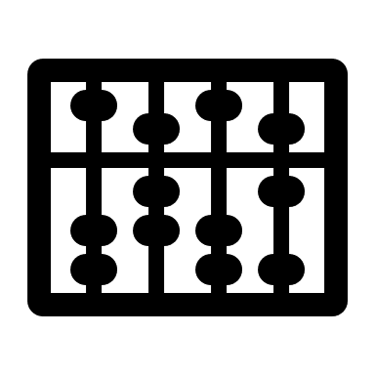


Slide 39
The observed morphological changes of collagen matrixes after degradation mainly include the disarrangement of the collagen web and the widening of the interfibrillar spaces, which are consistent with previously described alterations found after scanning and transmission electron microscopy analyses of water degradation of human collagen .

Slide 40
Membranes that are commercially available for soft tissue augmentation have been clinically shown to report favorable results, including the recent stable volume collagen matrix with cross-linked collagen . However, due to the frequency of exposure of the membranes to the oral environment during the healing period, it would be interesting to observe the behavior of these matrices against media that represent similar conditions as exposure to the oral environment. Collagen matrices with different cross-linked structures exhibit significant differences in biodegradation pattern, resorption time, and extent of inflammatory cell invasion . Therefore, it can be assumed that the reaction behavior of matrices with and without collagen cross-linking to immersion media will be different

Slide 41
The term “periodontal biotype” was first introduced by Seibert and Lindhe in 1989. Unlike the term “gingival biotype,” it includes several related morphologic characteristics of the bone, teeth, and periodontium, as well as gingival thickness . These biotypes are thought to influence the outcomes of periodontal therapy, prosthodontic work, implant therapy, and root coverage procedures . A higher risk of gingival recession was reported after the same periodontal therapy or implant therapy in patients with the thin periodontal biotype than in those with the thick biotype . Most clinicians who scrutinize patients' periodontal areas will agree that a large portion of gingival recession patients have a thin periodontal biotype. Therefore, the ability to change this delicate and thin biotype into a more durable biotype would be of paramount importance, not only for the outcomes of exposed root coverage procedures, but also for long-term stability and the prevention of recurrence.

Slide 42
The safety and efficacy of XCM in the treatment of GRs were reported in a histological study in minipigs (Vignoletti, et al., 2011). Published studies (Cardaropoli et al., 2012; McGuire & Scheyer, 2010) have reported that the outcomes of XCM are comparable to those of CTG in terms of recession reduction (RecRed) and mean root coverage (MRC). Nevertheless, it was indicated that the combination of XCM did not provide superior results in a short-term follow-up in treating gingival recessions in some trials (Aroca et al., 2013; Moreira, et al., 2016). Hence, there is not clear evidence on the efficacy of XCM for the treatment of gingival recessions. It is the purpose of this systematic review to answer the following focused questions: In patients with single or multiple gingival recessions, what is the efficacy of XCM in terms of clinical parameters and patient-related outcomes?

Slide 43
This autogenous graft requires a donor area, increasing morbidity in terms of post-operative discomfort and procedure time . Taking an autograft harvested from the palatal implies possible complications such as bleeding due to damage of the branches of the palatine artery, necrosis of the mucosa and hypo- or anaesthesia . In order to avoid these complications related to the second surgical site, biomaterials are being used as replacements. Such alternative products can be broadly divided into different groups according to their origin: allogeneic, xenogeneic, and synthetic (alloplastic) materials .

Slide 44
Although the adsorbed water is probed to be similar for the wetting and drying processes, indicating that the collagen is at a close equilibrium of water adsorption/desorption [45], the initial water absorption is integrated into collagen by different states, i.e., bound and free water. Bound water, where water molecules form bridges between neighboring polypeptide chains, acts as a receptor for CH–O hydrogen bonds [46]. Free water is water that is fixed by one hydrogen bond between polypeptide chains or fixed in the hole zones at the end of the polypeptide chain [47]. Bound water needs specific methods to be removed from the collagen once it has been incorporated. Therefore, thicker matrices with higher collagen content absorb more water from the medium, with a part of it being incorporated into their structure as bound water [43].

