Slide 1


Slide 2
Importance of CBCT in endodontic treatment
Asst.prof Zainab H. AL-Ghurabi

Slide 3
Role of Imaging in Endodontics
Radiography is essential to successful diagnosis of odontogenic and nonodontogenic pathoses, treatment of the pulp chamber and canals system in a compromised tooth, biomechanical instrumentation, obturation, and healing assessment

Slide 4
Intraoral periapical radiographs during endodontic procedures are still the most commonly used treatment adjuncts.
They provide useful information for the presence and location of periradicular lesions, root canal anatomy and the proximity of adjacent anatomical structures.

Slide 5
Despite many applications in endodontics, there are still many shortcomings that can be named for periapical X-ray imaging.
As a result of superimposition, periapical radiographs reveal limited aspects of the 3D anatomy thus the amount of information gained from conventional film and digitally captured periapical radiographs is limited
Several factors can result in solving the reduced diagnostic ability of conventional radiography, one of these factors was using of Cone-Beam Computed Tomography (CBCT)

Slide 6
Cone-beam computed tomography (CBCT)
CBCT is an advanced imaging modality that has high clinical applications in the field of dentistry.
CBCT proved to be a successful investigative modality that has been used for dental and maxillofacial imaging.

Slide 7
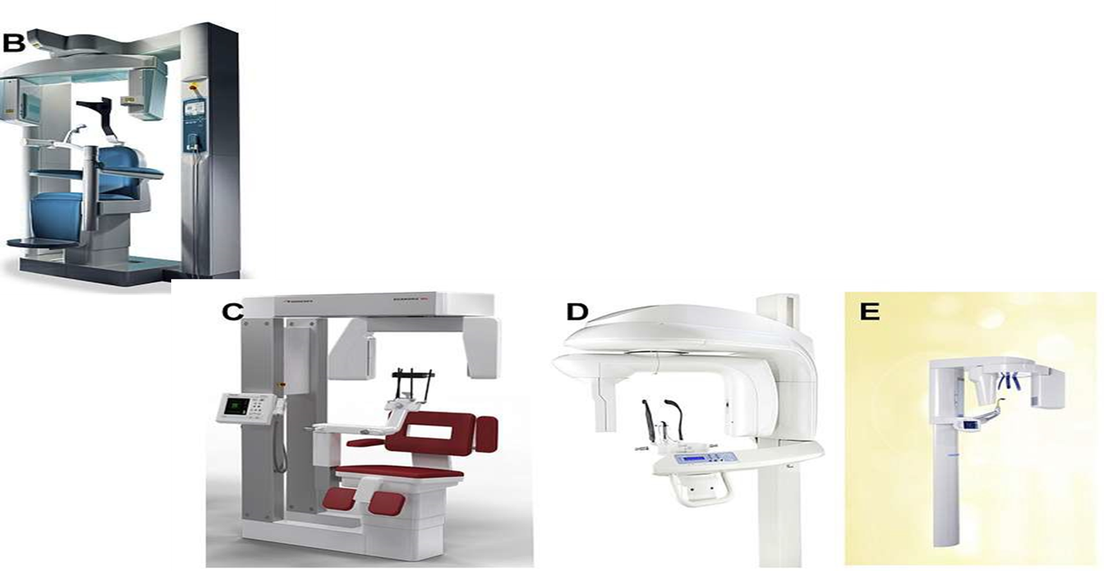
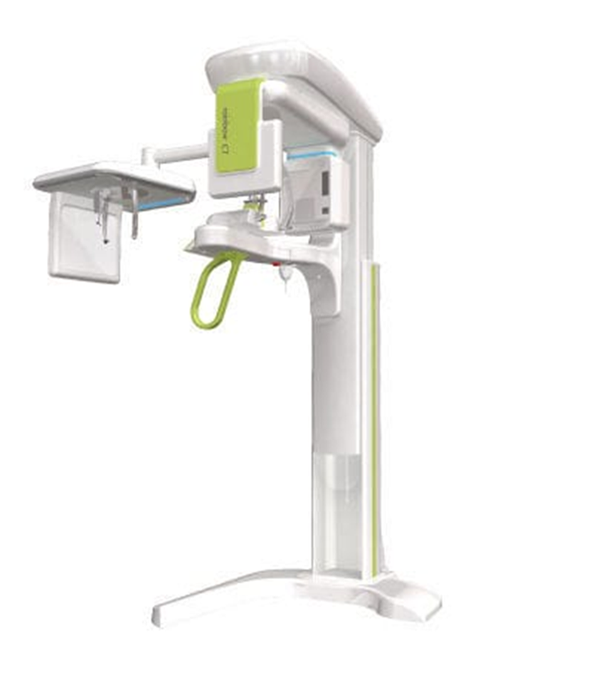

Slide 8
Furthermore, CBCT is highly accurate and can provide a three-dimensional volumetric data in axial, sagittal and coronal planes with one rotation
This imaging technique is based on a cone shaped X-ray beam, 2D detector that performs one rotation around the object, producing a series of 2D images.
CBCT generates 3D images at a lower cost and absorbed dose compared with conventional CT.

Slide 9
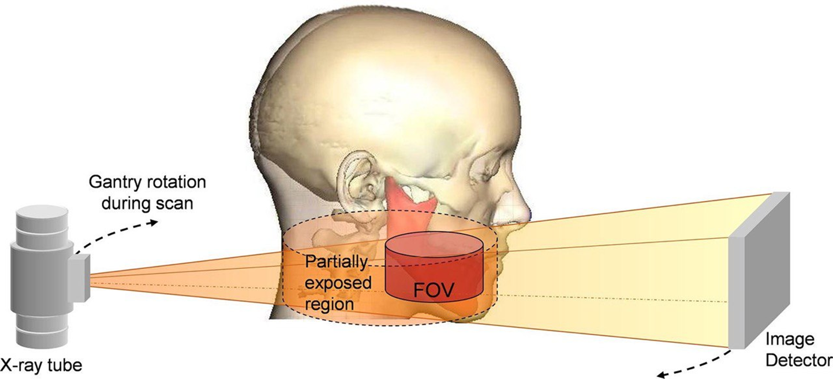

Slide 10
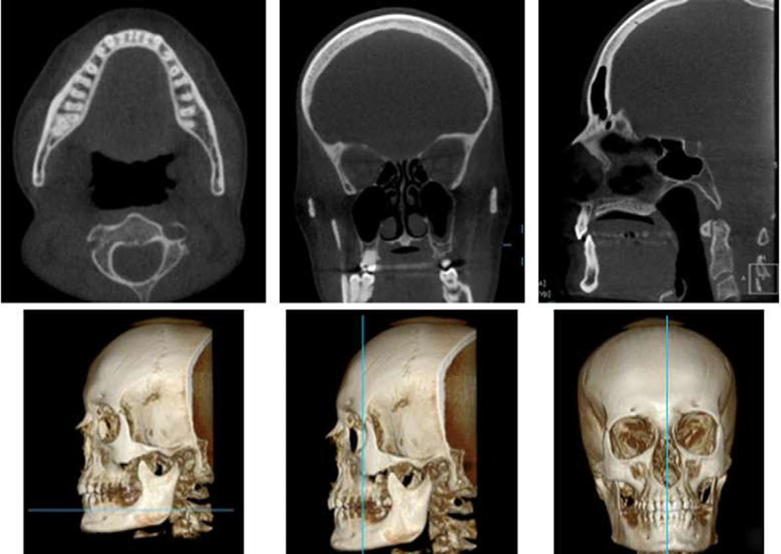

Slide 11
Applications of CBCT in endodontics
CBCT systems are available that provide small field of view images at low dose with sufficient spatial resolution for applications in endodontic diagnosis, treatment guidance, and post treatment evaluation
The potential benefits of CBCT in endodontics are vast especially where the anatomy being assessed is complex.
However, the higher effective dose of ionizing radiation in comparison with conventional two-dimensional radiographs is not justifiable in every case.
Generally, the application of CBCT in endodontics should be limited to the evaluation and management of complex endodontic conditions which will be named here

Slide 12
1) Detection of apical periodontitis
In this regard CBCT is significantly more accurate and sensitive than conventional radiography in the identification of apical periodontitis in humans, periapical bone destruction associated with endodontic infection can be identified using CBCT before the evidence of their existence becomes identifiable on conventional radiographs.

Slide 13
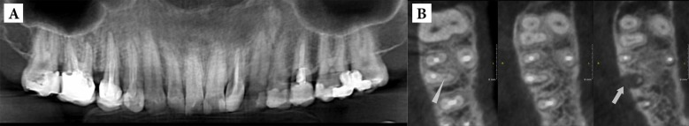
A panoramic image of a patient complaining of dull pain two years after root canal therapy of the right maxillary first molar. The apical periodontitis around the apex of the MB root.
Axial CBCT scanning of the maxillary right quadrant showing the undetected and untreated second mesiobuccal canal

Slide 14
2) Assessment of Potential surgical sites
CBCT is an extremely useful tool in the planning of surgical endodontic treatment.
The spatial relationship of the specific tooth root(s) undergoing the surgical procedure (and the associated bony destruction) to adjacent anatomical structures such as the maxillary sinuses, the inferior dental nerve canal and the mental foramen can be precisely assessed.
The presence or absence of the maxillary sinus between the roots could be presented, and the distance between the cortical plate and the palatal root apex could be measured (Figure 2).

Slide 15
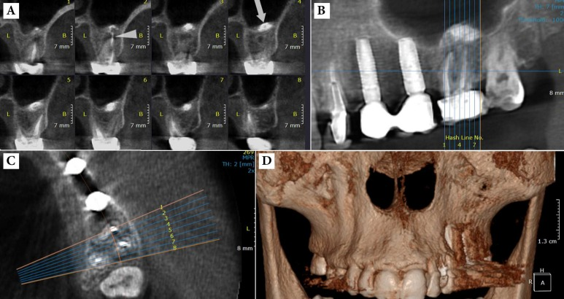
A) Cross-sectional CBCT view showing the extrusion of sealer after root canal therapy (RCT) of the left maxillary first molar. This image also represents the anatomical relation of roots and maxillary sinus. B) Note the extrusion of the sealer through the periapical lesion into the maxillary sinus. C) Anatomical relation of roots and buccal/palatal cortical plates. D) Three-dimensional reconstruction

Slide 16
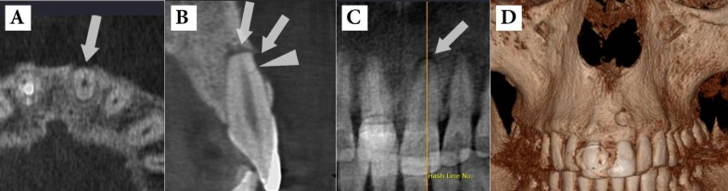
C)Assessment of traumatic dental injuries
CBCT provides valuable information regarding the detection of type and severity of traumatic dental injuries
CBCT view shows a tiny horizontal root fracture on the buccal surface of the maxillary left central incisor caused by impact trauma
B and C) Note the two separate periradicular lesions in the apical area (arrow) and adjacent to the fracture line (arrow head) due to tooth necrosis;
D) Three-dimensional reconstruction of the lesion in the periradicular buccal area

Slide 17
D) Diagnosis of different types of root resorption
After dental luxation and avulsion injuries, external root resorption (ERR) is a common complication. The sensitivity of conventional radiography is considerably poorer than CBCT in the detection of this resorptio in its early stages, and before the resorption becomes evident on conventional radiographs, significant hard tissue damage may have potentially occurred to the affected tooth.

Slide 18
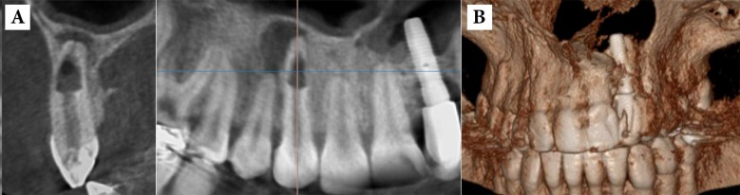
A) Internal root resorption in the maxillary right canine: note the extensive bone resorption adjacent to the perforated root site and apical periodontitis around the apical foramen; B) Three-dimensional reconstruction of the region

Slide 19
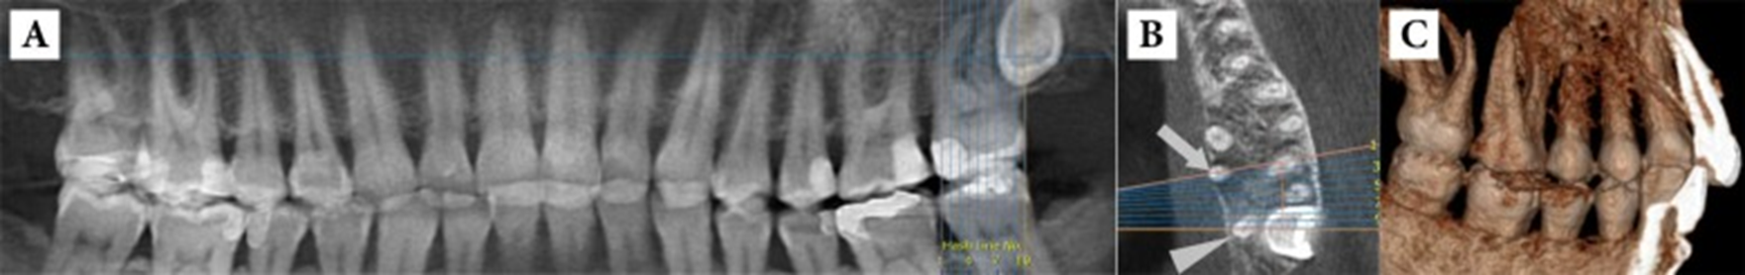
E)Assessment of Root canal anatomy and morphology
The success of endodontic treatment depends on identification, cleaning, shaping and obturation of all accessible areas of root canal systemAs a result, failure to distinguish and treat all canals can negatively affect treatment
.
A) Panoramic view of a patient complaining of pain in the upper left quadrant: the second molar has a normal appearance. B) The axial view showing the abnormal anatomy of the second molar with four roots. C) Three dimensional reconstruction of the alveoli showing the two separate palatal roots of maxillary left second molar

Slide 20
FOV & voxel size
The FOV or the region of interest ….selected can be small, medium and large.
Small FOV(5*5 cm) endodontic diagnosis, periapical conditions, root fracture and implant planning
Single arch, FOV is 5–7 cm
Interarch, 7–10 cm
maxillofacial, 10–15 cm
craniofacial, greater than 15 cm.

Slide 21
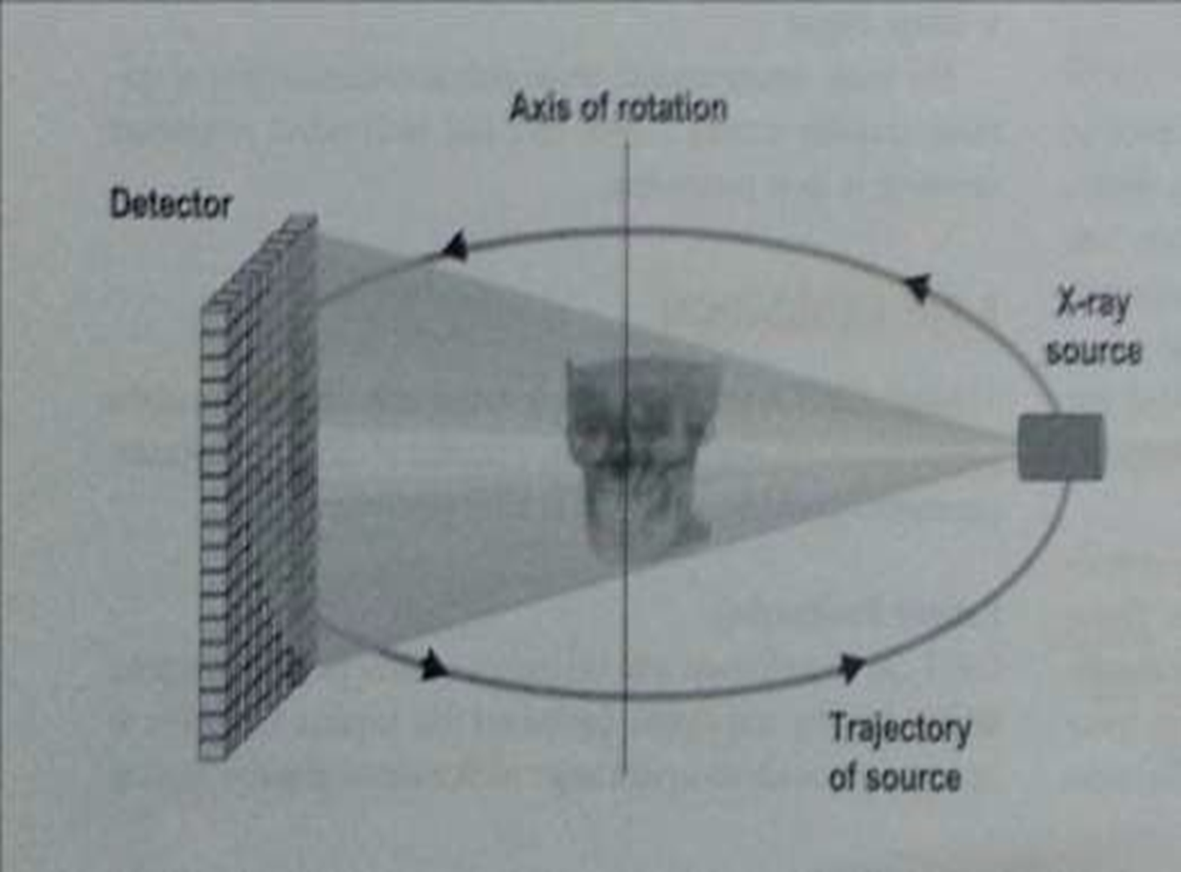
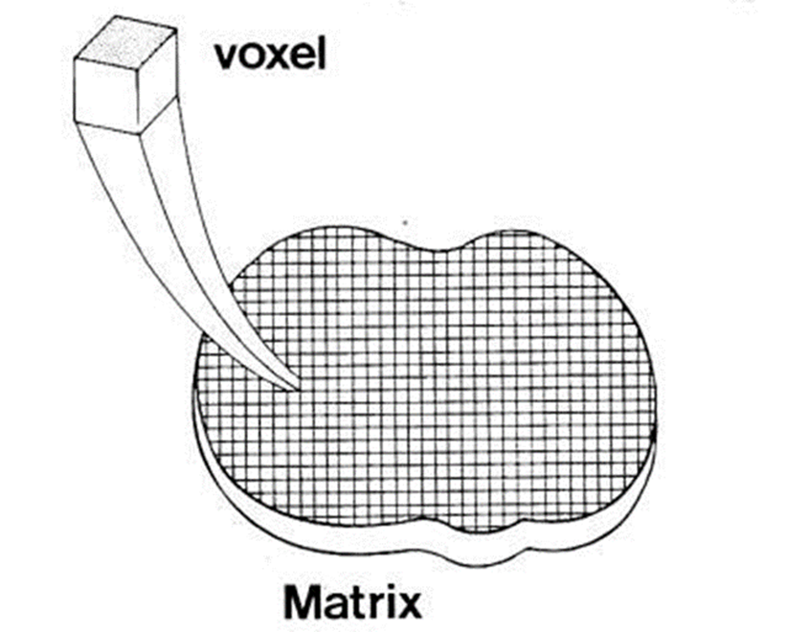
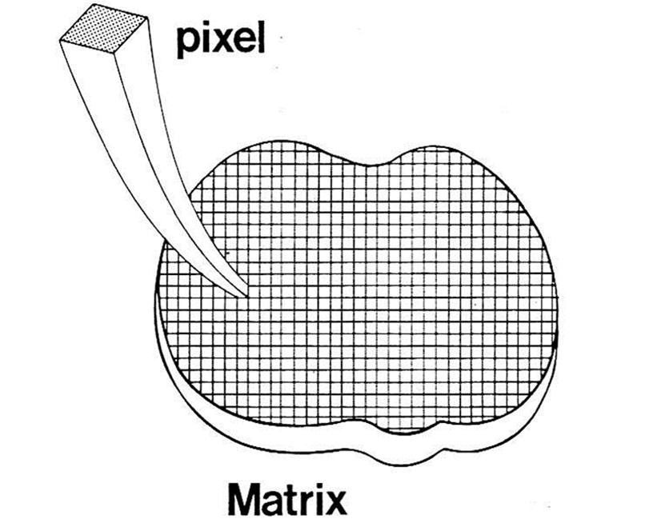
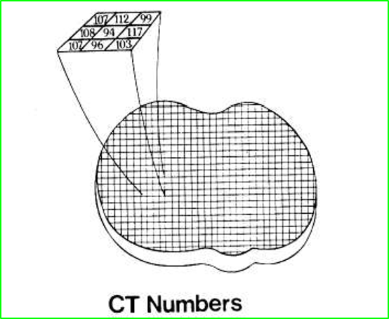

Slide 22
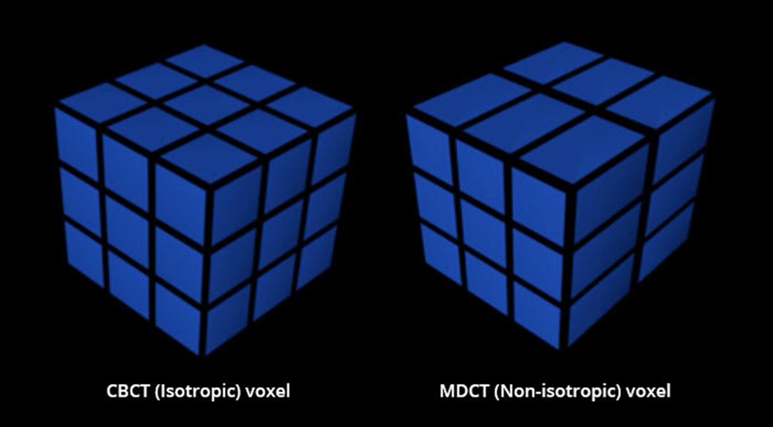
The voxel on CBCT images is isotropic, which means that all the sides are the same dimension with uniform resolution in all directions.
In contrast, an MDCT voxel is in general nonisotropic meaning that one side of the voxel is different in dimension

Slide 23
The small field of view units may use a small voxel size of 0.076 mm, which enables visualization of very small changes to structures.
Other voxel sizes available for CBCT units are variable, such as 0.2 mm, 0.3 mm, and 0.4 mm.
It is important to note that the larger the voxel size, the less resolution the image will have and less capability to differentiate between small structures

Slide 24
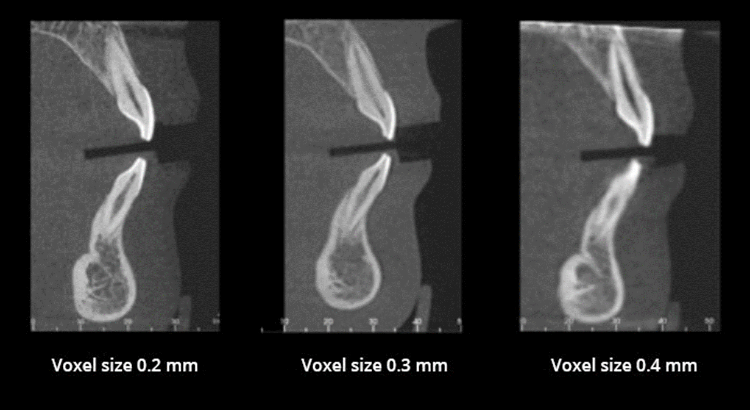

Slide 25
Effective dose of CBCT
Comparing the radiation dose of different CBCT scanners with medical CT scanners may be confusing due to different units of radiation dose that can be used .
Therefore, radiation exposures are converted to effective dose which is measured in Sieverts (Sv), for a meaningful comparison of radiation risk. The Sv is a large unit, so in maxillofacial imaging milliSieverts (mSv) [10-3] or microSieverts (μSv) [10-6] are presented.
The radiation dose to specific tissues is measured and adjusted for the amount of that tissue in the FOV, or weighted in accordance with radiation sensitivity of the tissue.
Then the weighted tissue/organ doses are summed to compute effective dose.
Comparisons can be performed according to natural background radiation in the United States of about 3,000 Sv (3.0 mSv).

Slide 26
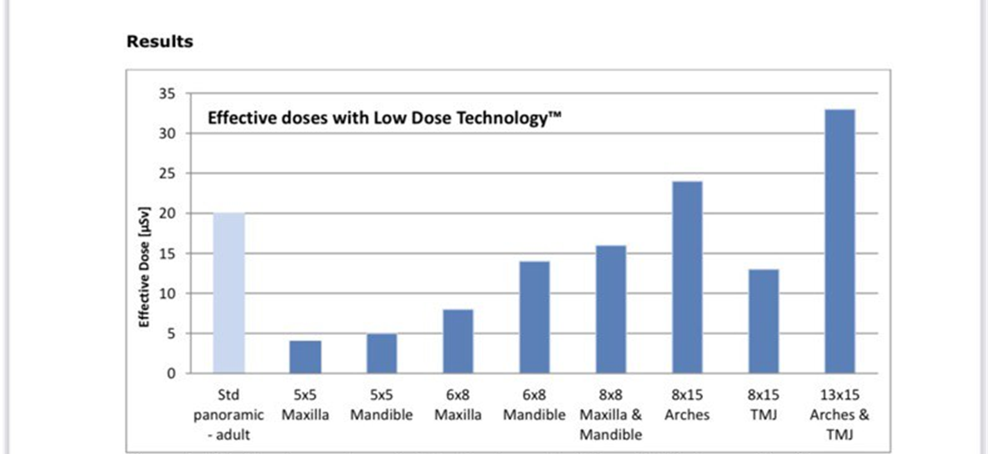

Slide 27
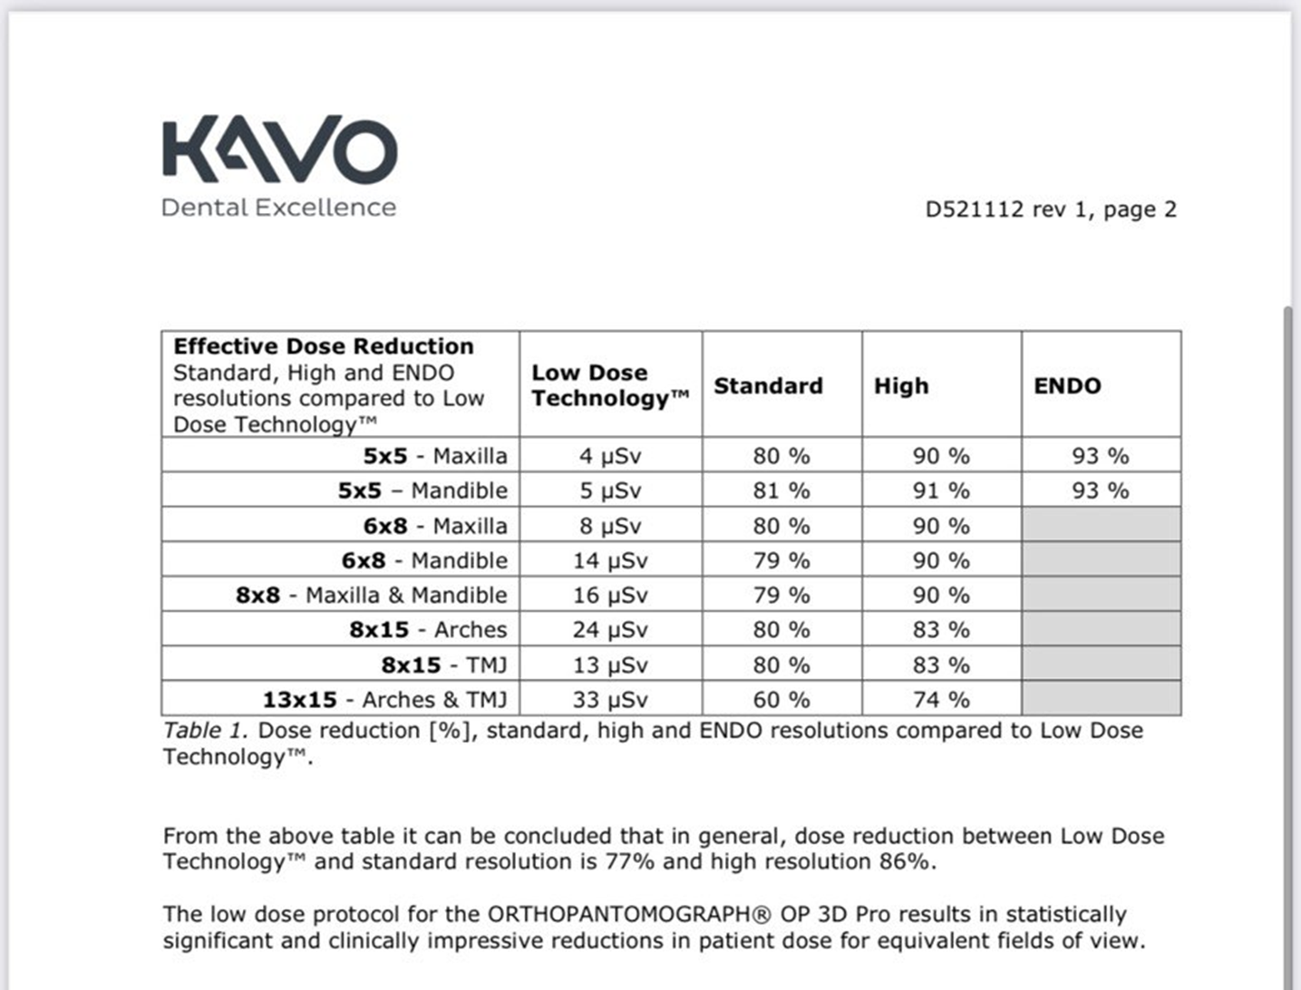

Slide 28


