Slide 1
Dental Ankylosis: Prevalence, Etiology and Guidelines for Clinical Management
Rusul Jaffar Hadi

Slide 2
Contents
Definition of dental ankylosis
Prevalence
Causes and the mechanism of formation
Management and treatment

Slide 3
Aims of the study
Definition of dental ankylosis
Prevalence
Causes and the mechanism of formation
Management and treatment

Slide 4
Aims of the study
Definition of dental ankylosis
Prevalence
Causes and the mechanism of formation
Management and treatment

Slide 5
Aims of the study
Definition of dental ankylosis
Prevalence
Causes and the mechanism of formation
Management and treatment

Slide 6
Aims of the study
Definition of dental ankylosis
Prevalence
Causes and the mechanism of formation
Management and treatment

Slide 7
Dental Ankylosis
is a serious condition deﬁned as the process that causes the fusion between the dentin or the cementum of the root and the alveolar bone, with the obliteration of the periodontal ligament (PDL) becoming progressively replaced by bone tissue

Slide 8
Dental Ankylosis
is a serious condition deﬁned as the process that causes the fusion between the dentin or the cementum of the root and the alveolar bone, with the obliteration of the periodontal ligament (PDL) becoming progressively replaced by bone tissue

Slide 9
Dental Ankylosis
is a serious condition deﬁned as the process that causes the fusion between the dentin or the cementum of the root and the alveolar bone, with the obliteration of the periodontal ligament (PDL) becoming progressively replaced by bone tissue

Slide 10
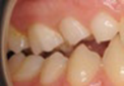
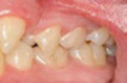
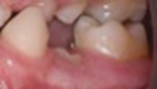
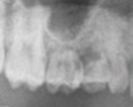
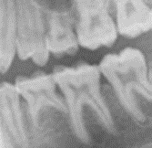
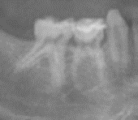
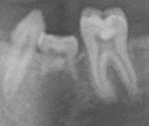
Classification
According To Severity
None
Mild
Moderate
Sever

Slide 11
Classification
According To Severity
None
Mild
Moderate
Sever
No IO present between the occlusal level and the interproximal contact point of the adjacent teeth

Slide 12
Classification
According To Severity
None
Mild
Moderate
Sever
IO between the occlusal level and the interproximal contact point of the adjacent teeth

Slide 13
Classification
According To Severity
None
Mild
Moderate
Sever
IO at the interproximal contact point of the adjacent teeth

Slide 14
Classification
According To Severity
None
Mild
Moderate
Sever
IO below the interproximal contact point of the adjacent teeth

Slide 15
Classification
According To Severity
None
Mild
Moderate
Sever

Slide 16
ETIOLOGY
There are three theories
Trauma
Genetic
Eruption

Slide 17
ETIOLOGY
There are three theories
Trauma
Genetic
Eruption

Slide 18
ETIOLOGY
There are three theories
Any disruption in the continuity of the PDL caused by trauma can lead to the onset of the degenerative processes that will result in the fusion between tooth and bone.
Trauma
Genetic
Eruption

Slide 19
ETIOLOGY
There are three theories
Genetic
The second theory focuses on genetic factors; however, so far, no responsible genes have been identiﬁed.
Trauma
Eruption

Slide 20
ETIOLOGY
There are three theories
Disturbed local metabolism: If the roots of a deciduous tooth have been resorbed and the crown exfoliated, no trace of the periodontal membrane remains.
Eruption
Trauma
Genetic

Slide 21
ETIOLOGY
There are three theories
Trauma
Genetic
Eruption

Slide 22
Prevalence
According to

Slide 23
Prevalence
According to
GENDER
SEVERITY
there are no statistically signiﬁcant differences between genders for the prevalence of ankylosis, but there was higher incidence in girls than boys, so accordingly female to male ratio is 6:5.
A higher percentage of cases with ankylosis had mild to moderate IO more than cases with severe IO .
AGE
TEETH
higher prevalence in the early stage of mixed dentition in children aged 6 to 9 years. The prevalence of this condition is ten times higher in decidual dentition than in permanent dentition.
The lower primary molars are ten times more affected compared to the upper molars, the ﬁrst lower primary molar was the most frequently affected . This was followed by the second lower primary molar iand then the ﬁrst and second upper molars.

Slide 24
Diagnosis

Slide 25
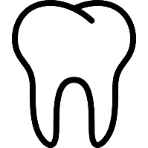
Diagnosis
Clinical Examination
Radiographical Examination

Slide 26
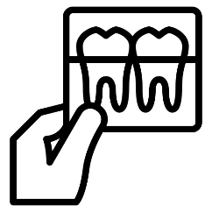
Diagnosis
Clinical Examination
Vertical percussion is a physical examination technique that aids greatly in the diagnosis of DA; it is positive when a hollow sound is detected.
Radiographical Examination

Slide 27
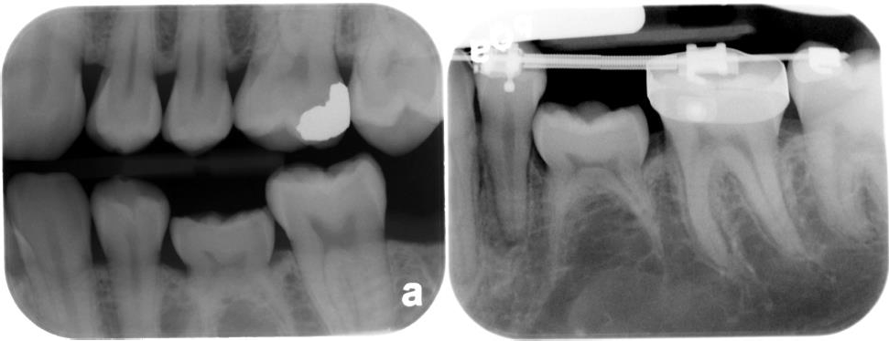
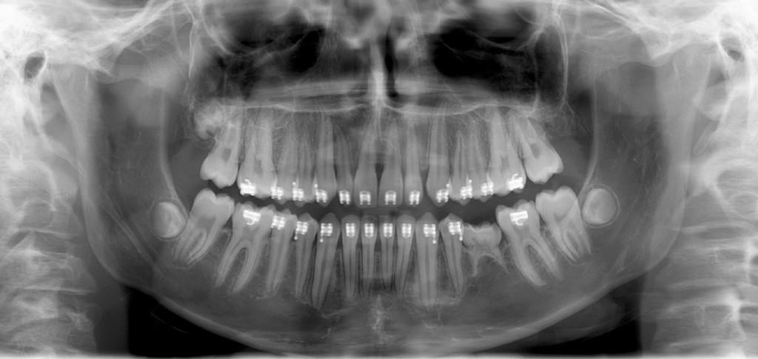
Diagnosis
Radiographical Examination
Radiological images will show the fusion between the bone and the root surface as well as the absence of periodontal space. Additionally, the roots lose their opacity and, in cases of severe ankylosis, there is no clear delimitation from the surrounding bone
Clinical Examination

Slide 28
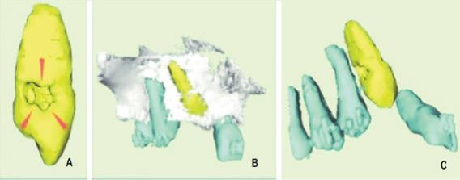
Diagnosis
Radiographical Examination
In these cases, the investigator can use CT, an imaging examination that allows multiplanar reconstruction of the scanned volume, i.e., the visualization of axial, coronal, sagittal, and oblique images, as well as 3D reconstruction. Traditional CT and CBCT are available.
Clinical Examination

Slide 29
Consequences

Slide 30
Consequences
Affects the surrounding teeth
Dental asymmetry and midline deviation and malocclusion.
Complicate the eruption of succedaneous
Caries and periodontal disease
Submerged

Slide 31
Consequences
Affects the surrounding teeth
Dental asymmetry and midline deviation and malocclusion.
Complicate the eruption of succedaneous
Caries and periodontal disease
Submerged

Slide 32
Ankylosis In Permanent Teeth

Slide 33
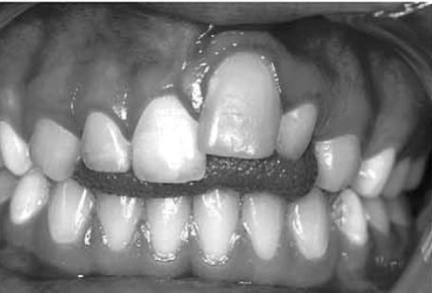
Ankylosis In Permanent Teeth
Ankylosis of tooth root to alveolar bone is the most commonly reported PDL complication following replantation of avulsed permanent teeth.
When teeth are replanted after being avulsed, the repair process sometimes results in ankylosis because the cementum of the root and the alveolar bone have fused together.
It has also been shown to develop in approximately 70% of incisors that had been intruded greater than one-half of the clinical crown.

Slide 34
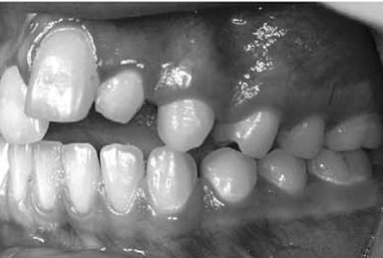
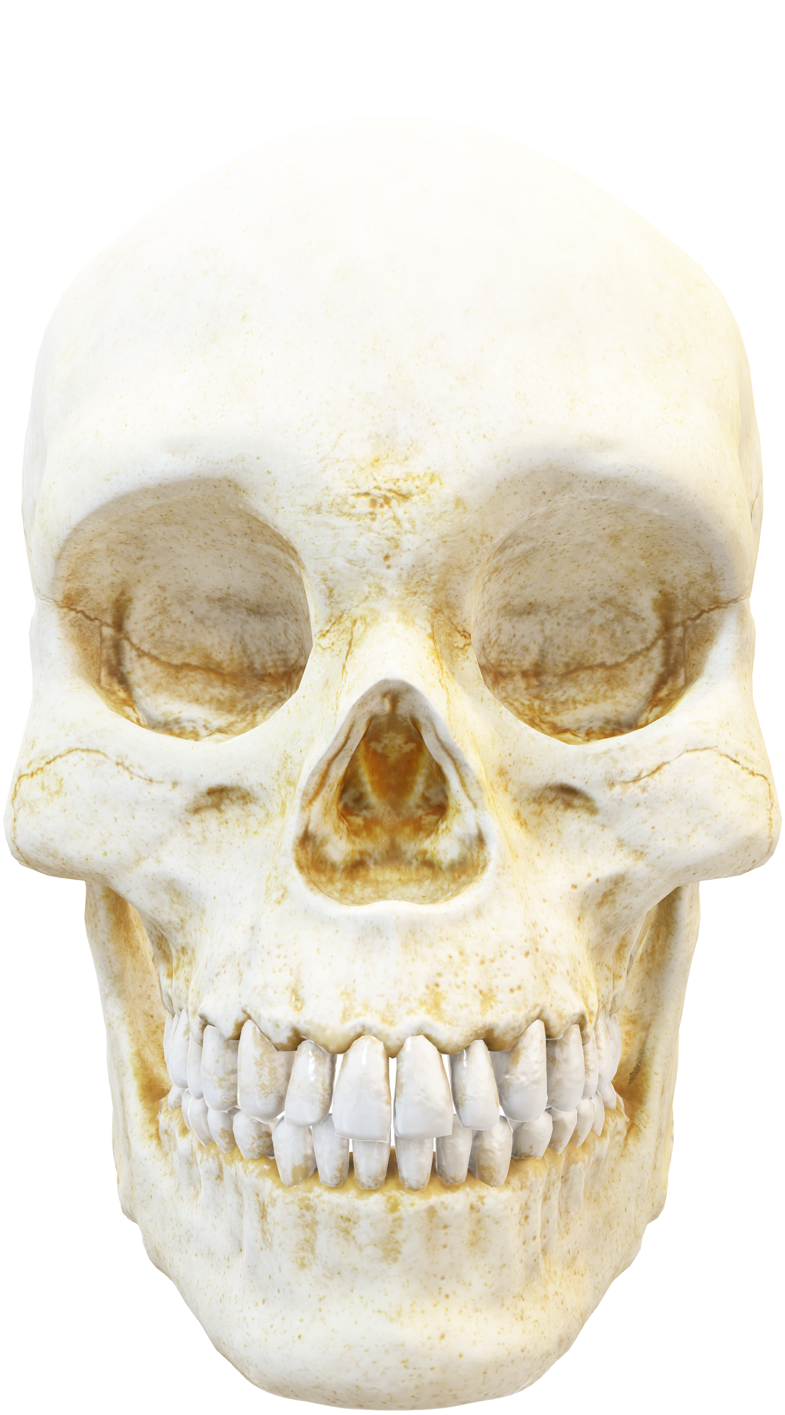
Ankylosis In Permanent Teeth

Slide 35
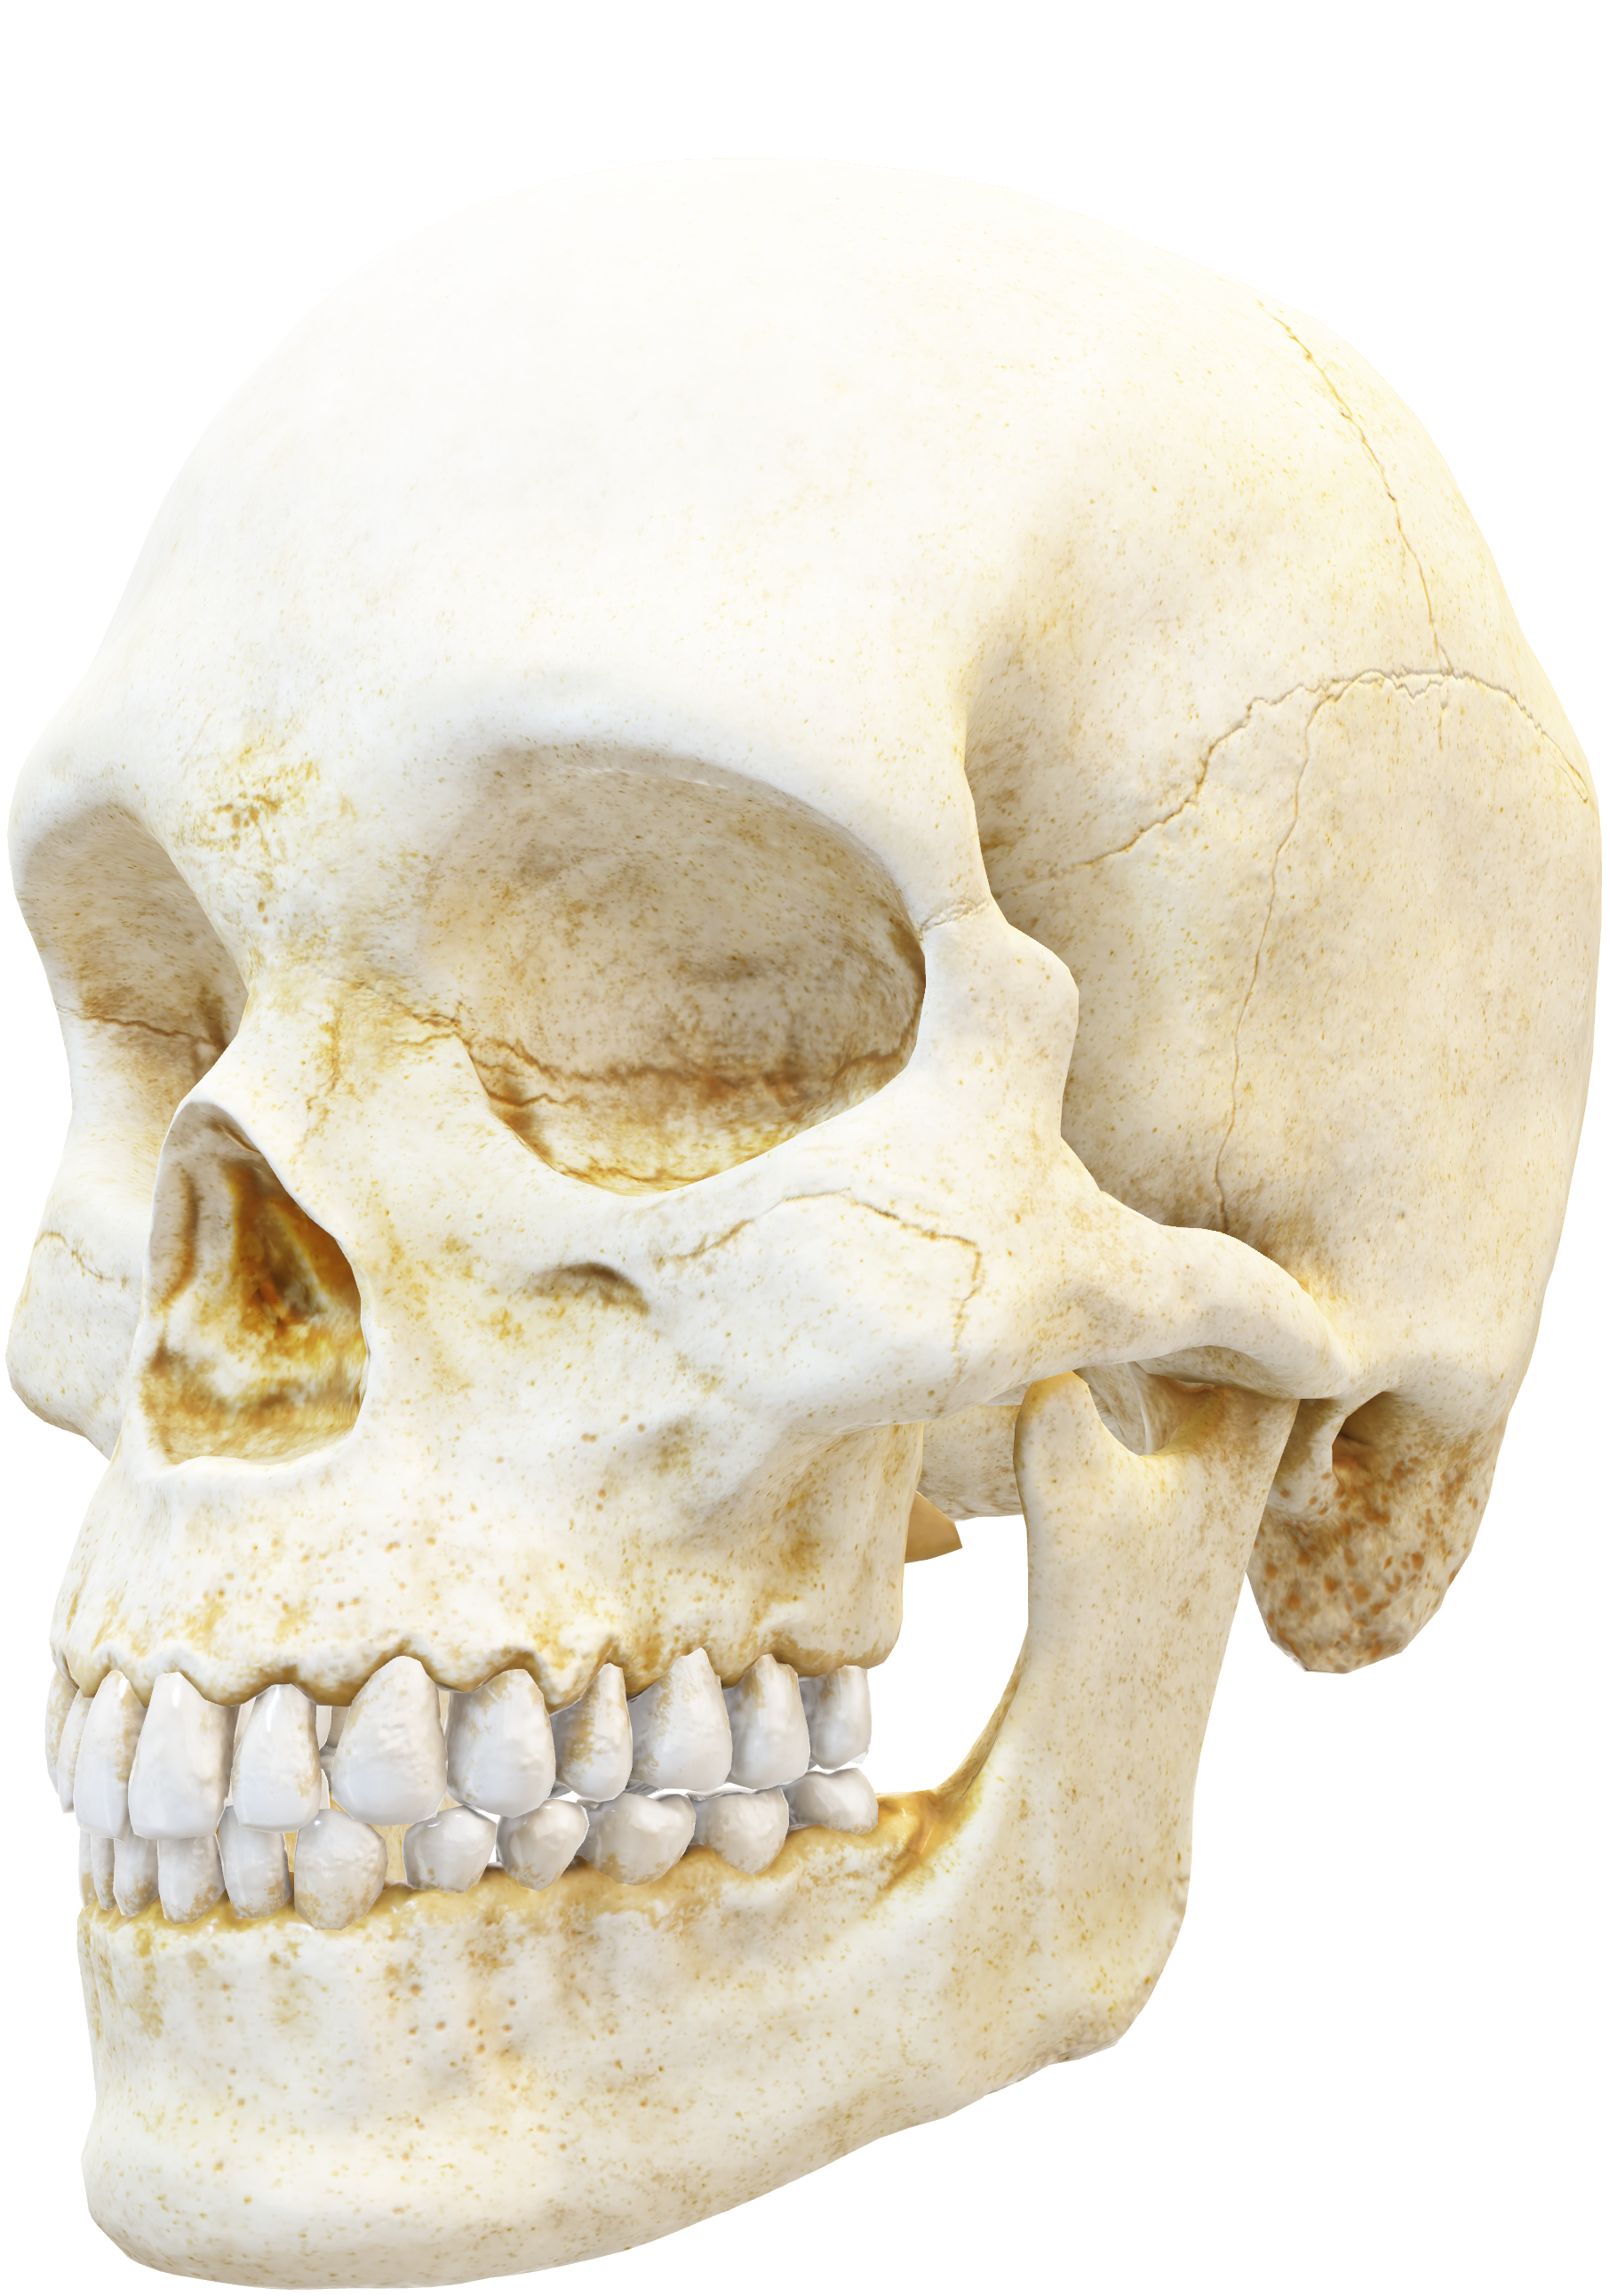
Ankylosis In Permanent Teeth

Slide 36
Ankylosis in permanent teeth
Treatment options

Slide 37
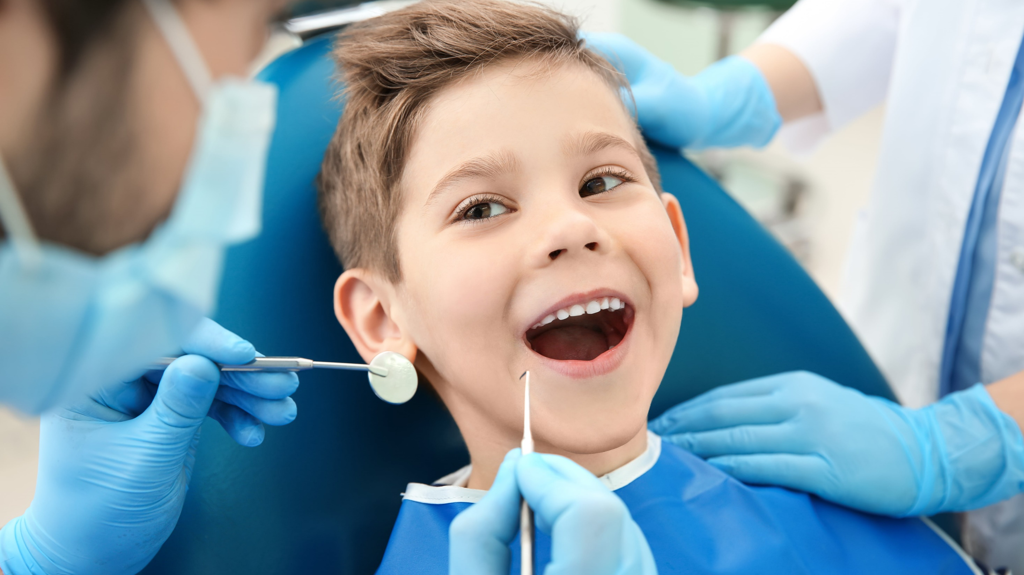
Periodical follow-up of the ankylosed teeth with possible composite build-up for any minor IO.
Periodical follow up

Slide 38
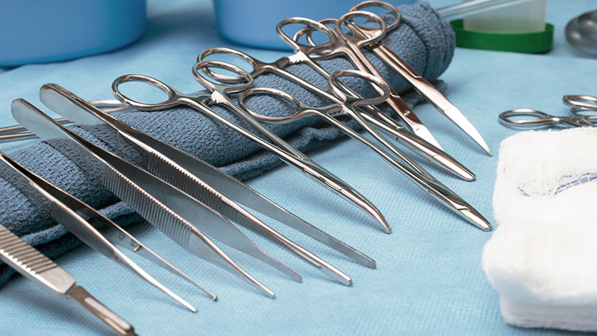
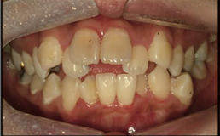
Repositioning of the ankylosed teeth.

Slide 39
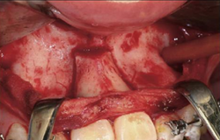
Pre-treatment intraoral photographs.
Repositioning of the ankylosed teeth.

Slide 40
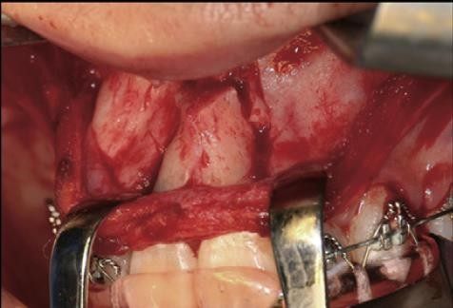
Vertical and occlusally diverging osteotomy
Repositioning of the ankylosed teeth.

Slide 41
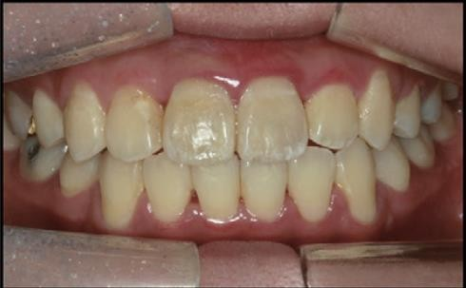
Post-treatment intraoral photographs
Repositioning of the ankylosed teeth.

Slide 42
Conventional prosthodontics and dental implants

Slide 43
Conventional prosthodontics and dental implants

Slide 44
Conventional prosthodontics and dental implants

Slide 45
Conventional prosthodontics and dental implants

Slide 46
Conventional prosthodontics and dental implants

Slide 47
Conventional prosthodontics and dental implants

Slide 48
Conventional prosthodontics and dental implants

Slide 49
Conventional prosthodontics and dental implants

Slide 50
Conventional prosthodontics and dental implants

Slide 51
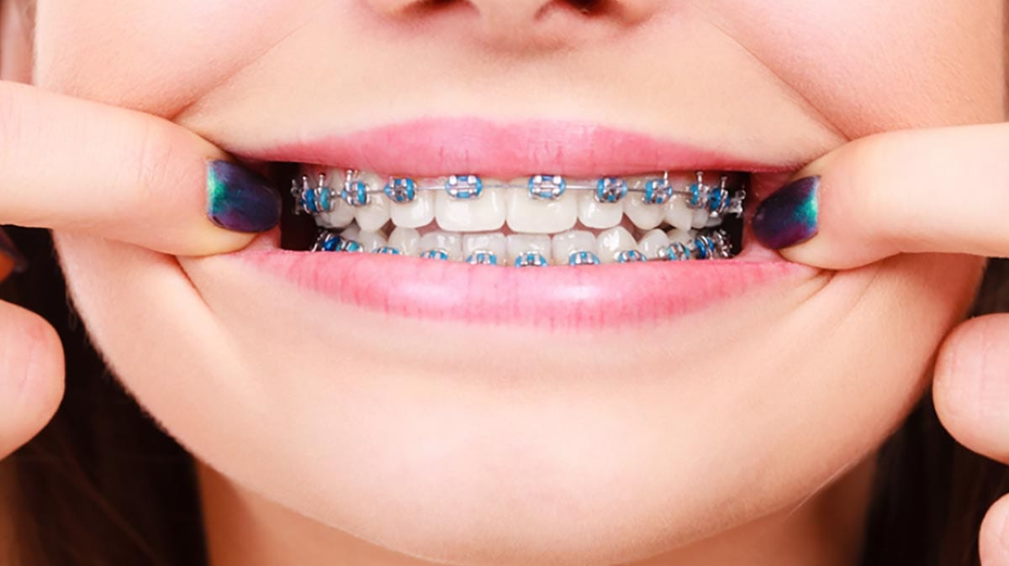
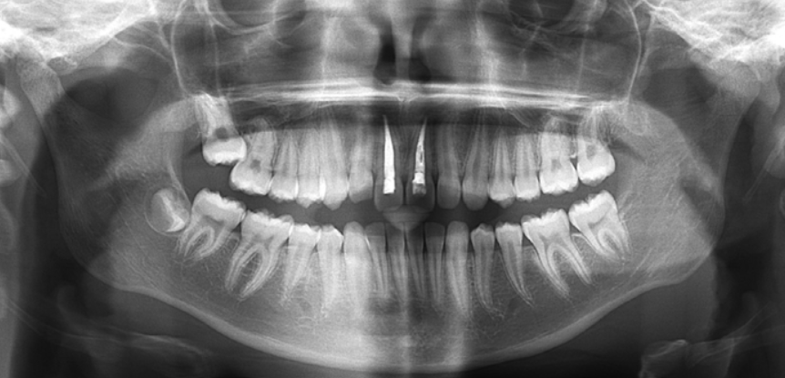
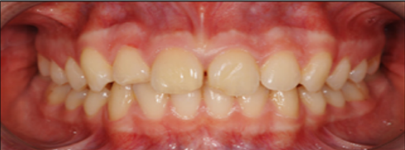
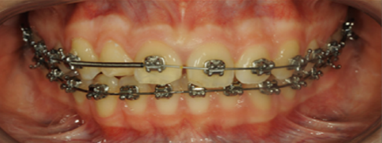
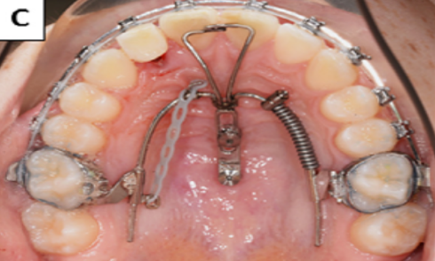
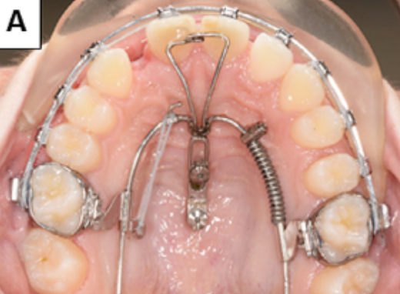
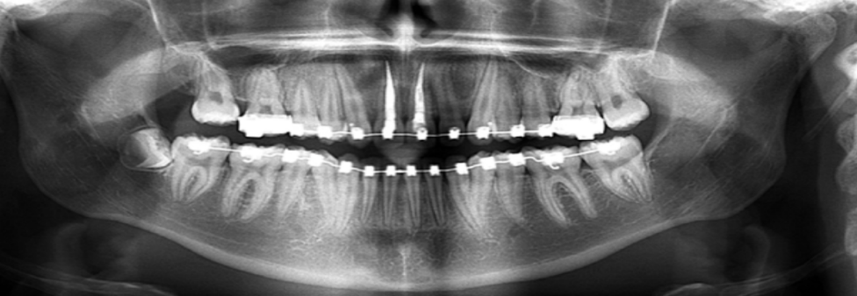
Extraction and orthodontic space closure
A
B
C
D
E
F

Slide 52
Thank you

