Slide 1

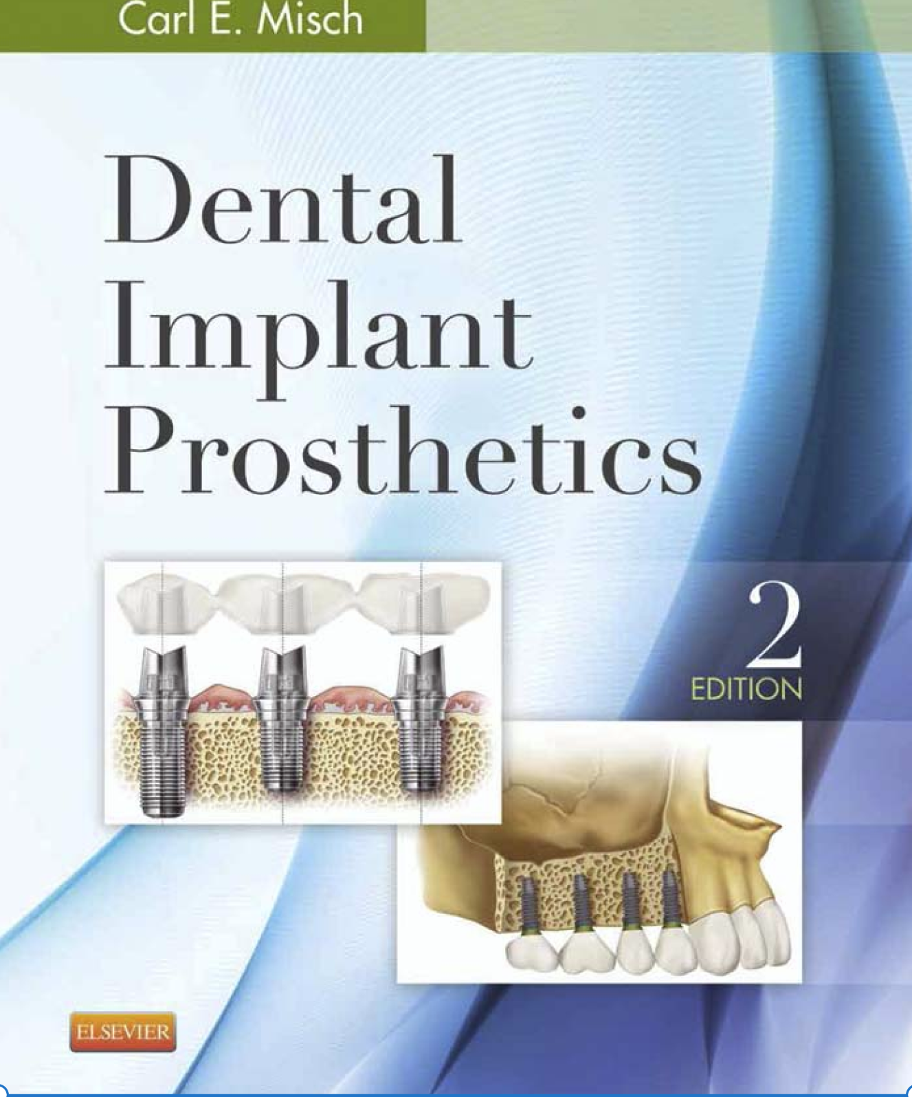
Treatment Plans in Implant Dentistry
Dental Implant Prosthetics, 2 edition, Carl E. Misch, Chapter 19
Assist. Lec. Mustafa Shakir Mahmood

Slide 2
Treatment Plans in Implant Dentistry
Completely Edentulous Arches

Slide 3
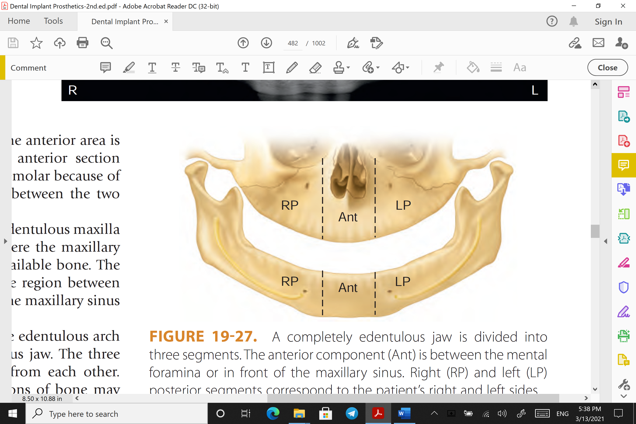
Type 1
In a type 1 edentulous arch, the division of bone is similar in all three anatomical segments. Therefore, four different categories of type 1 edentulous arches are present. In a type 1, division A ridge, with abundant bone in all three sections, as many root forms as needed may be inserted (and the locations of implants are not limited) to support the final prosthesis. As a general rule, the range of 5-9 implants may be used in the mandible and 7 to 10 implants in the maxilla for a fixed prosthesis.

Slide 4
Type 1
The type 1, division B edentulous ridge presents adequate bone in all three sections in which to place narrow-diameter root form implants. It is common practice to modify the anterior section of bone in the mandible by osteoplasty to a division A and to place full-size root form implants in this region.

Slide 5
Type 1
It is more unusual to have sufficient height in either the posterior maxilla or mandible to permit osteoplasty to improve the division. Therefore, several narrower implants are often indicated in the mandible if posterior implants are inserted without grafting. One implant is used for every tooth root to compensate for the decrease in surface area of implant support.

Slide 6
Type 1
Augmentation by bone spreading may be indicated in the maxilla if the patient desires a fixed prosthesis, especially when opposing natural teeth.
If stress factors are great, then lateral augmentation may also be necessary in the posterior regions to increase implant diameter.

Slide 7
Type 1
Type 1, division C–w edentulous arches present adequate height of available bone but have inadequate width. If the patient desires an implant-supported removable prosthesis, then an osteoplasty may be used to convert the ridge to C–h in the mandible. The treatment plan then follows a type 1, division C–h formula.
When a fixed restoration is desired, an autogenous onlay graft in the C–w arch is usually warranted to restore the ridge to division A before implant insertion.
In the maxilla, osteoplasty is less effective to increase width and augmentation is more usual to convert the ridge to division A or B.

Slide 8
Type 1
Type 1, division C–h edentulous arches often do not present all of the essential requirements for predictable long-term implant support for fixed prostheses. An implant-supported RP-4 or RP-5 removable prosthesis is often indicated to reduce occlusal loads.

Slide 9
Type 1
The mandibular arch may be treated with a complete subperiosteal implant or root form implants in the anterior section. The prosthesis should be completely implant supported (RP-4) to halt the continued bone loss in the posterior regions of the mouth.
When only division C anterior root form implants are inserted, posterior soft tissue support (RP-5) may be required.

Slide 10
Type 1
The edentulous maxilla is often treated with a conventional removable prosthesis until the mandible is completely restored. If this denture needs additional retention or stability, then HA can be used to augment the premaxilla. This squares the ridge shape and provides resistance to occlusal excursions during function.

Slide 11
Type 1
The C–h maxilla should often consider subnasal augmentation combined with root form implants in the canine eminence region and sinus graft with root form implants with an RP-4 prosthesis.
Additional surgical training is required for these last two alternatives, and they have a greater incidence of complication.

Slide 12
Type 1
Fixed prostheses in either arch may need autogenous iliac crest grafts to change the anterior division of bone and improve long-term success and esthetics.
Sinus grafts are also indicated in the maxilla in these situations.

Slide 13
Type 1
The edentulous arches classified as type 1, division D are the most challenging to traditional and implant dentistry. If an implant fails in a type 1, division D patient, then pathologic fractures or almost unrestorable conditions may result, yet these are the patients who need the most help for support of their prostheses.
The benefits versus risks must be weighed carefully for each patient.
Endosteal implants may be placed in the anterior mandible. However, the unfavorable crown height of greater than 20 mm and mandibular fracture during implant placement or after implant failure may result in significant complications.

Slide 14
Type 1
Often the best solution is to change the division with autogenous grafts and then reevaluate the improved conditions and appropriately alter the treatment plan.
The type 1, division D ridges most often use autogenous iliac crest grafts. After 6 months, the arch is reevaluated. It may be converted to a C–h or a division A bone volume, depending on a list of patient host factors. A total of 5-9 implants may then be placed in the anterior and posterior regions.

Slide 15
Thank you

