Slide 1
AI Tools for Advancing Academic Research
Subtitle: Strategies for Finding Recent Topics, Literature Review, and Identifying Research Gaps.
By
Dr. Omar Al-Janabi
Dr. Taghreed Al-sudani

Slide 2
Meaning of Research
“a careful investigation or inquiry specially through search for new facts in any branch of knowledge.”
“a movement from the known to the unknown.”
Notes:
What is the branch of knowledge?

Slide 3
Agenda
Overview of the presentation's flow:
Research Process
AI for Discovering Recent Topics.
AI for Comprehensive Literature Review.
Identifying Research Gaps Using No AI.

Slide 4
Research Process
Formulating the research problem
Extensive literature survey
Identifying research gaps

Slide 6
Define Research Problem
States of Nature: These research problems are descriptive in nature. They often seek to describe a circumstance, phenomenon, or condition. For example, "What is the level of job satisfaction among employees in the tech industry?" These questions are designed to capture the current state or condition of the subject being studied.
Relationships Between Variables: These are explanatory research problems. They seek to explore the relationships among variables and ascertain cause and effect. For example, "Does an increase in exercise lead to a decrease in stress levels?" Here, the goal is to identify whether or not a relationship exists and, if so, the nature of that relationship.
Notes:
Two types of research problem

Slide 7
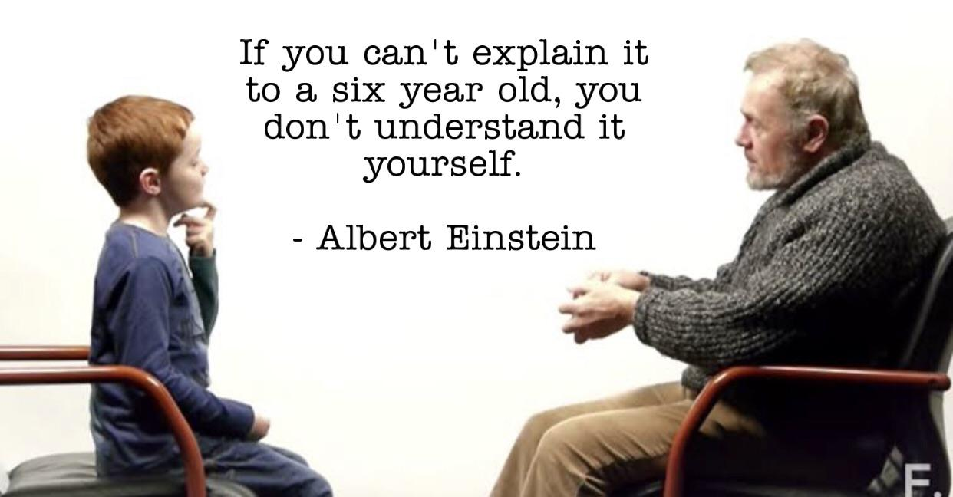
Notes:
Your problem is easy to understand it does not mean to be naïve!

Slide 8
Steps for Formulating the Research Problem
Identifying the Area/Topic of Interest: Before diving into specific questions, a researcher should broadly identify the field or topic they are interested in. This sets the scope and context for the research.
Narrowing Down the Topic: Once a general area of interest has been selected, the next step is to narrow this down. This involves conducting a literature review, considering the feasibility of the study, and identifying gaps in existing research or areas that require further investigation.
Statement of the Research Problem: After the topic has been refined, the researcher needs to articulate the research problem explicitly. This should be a clear, unambiguous statement that outlines the research question or hypothesis.

Slide 9
Steps for Formulating the Research Problem
Identifying the Area/Topic of Interest: Before diving into specific questions, a researcher should broadly identify the field or topic they are interested in. This sets the scope and context for the research.
- But what questions??
By formulating specific questions, a researcher can:
Define the focus of their study more narrowly.
Identify the appropriate methods and tools required for data collection and analysis.
Set clear objectives and outcomes for their research.
Facilitate a more structured and systematic approach to their investigation.

Slide 10
AI for Discovering Recent Topics

Slide 11
Introduction to AI-powered topic discovery
General AI tools:
ChatGPT
Bard
Microsoft Bing (Edge)
Poe

Slide 12
ChatGPT

Slide 16
Example Tool - "ArXiv Sanity Preserver”.
How it filters and recommends the most recent and relevant papers.
Notes:
Bias in Emotion Recognition with ChatGPT

Slide 17
Steps for Formulating the Research Problem
Identifying the Area/Topic of Interest: Before diving into specific questions, a researcher should broadly identify the field or topic they are interested in. This sets the scope and context for the research.
Narrowing Down the Topic: Once a general area of interest has been selected, the next step is to narrow this down. This involves conducting a literature review, considering the feasibility of the study, and identifying gaps in existing research or areas that require further investigation.
Statement of the Research Problem: After the topic has been refined, the researcher needs to articulate the research problem explicitly. This should be a clear, unambiguous statement that outlines the research question or hypothesis.
Notes:
What is your topic of interest ? Nano-technology ? What is specifically in Nano-technology? What are the recent papers addresses nano-technology ? Which paper shall I read? Is it research paper ? Review paper ? Report ? Abstract ? What journal shall I target ? Is it about the journal ? Or is it about the author ?
How to select the best journal ? How to read the selected article within the journal ?

Slide 18
AI for Comprehensive Literature Review

Slide 19
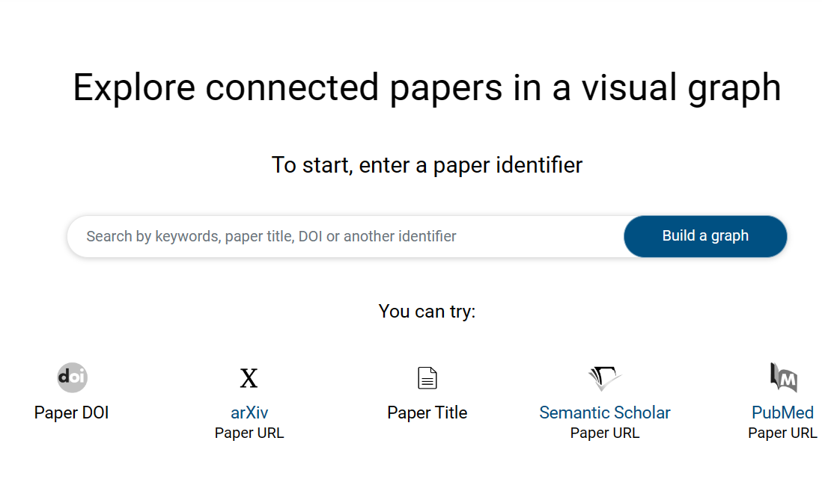
Tool - "Connected Papers."
Visual exploration of academic papers and their interconnections.

Slide 20
Tool - "Semantic Scholar."
AI-driven content recommendation, paper summarization, and citation tracking.

Slide 22
Tool - "RAx (Research Assistant powered by AI)."
Assists in identifying research trends, gaps, and provides summarizations.

Slide 24
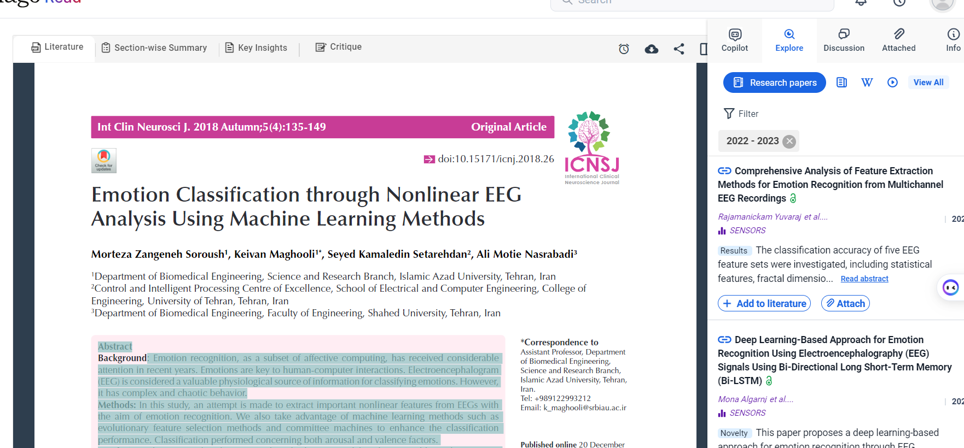

Slide 25
Tool - “Elicit"

Slide 26
Tool - “SCISPACE"

Slide 27
Other noteworthy tools.
Google Scholar
Scopus
ScienceDirect
Mendeley

Slide 28
Steps for Formulating the Research Problem
Identifying the Area/Topic of Interest: Before diving into specific questions, a researcher should broadly identify the field or topic they are interested in. This sets the scope and context for the research.
Narrowing Down the Topic: Once a general area of interest has been selected, the next step is to narrow this down. This involves conducting a literature review, considering the feasibility of the study, and identifying gaps in existing research or areas that require further investigation.
Statement of the Research Problem: After the topic has been refined, the researcher needs to articulate the research problem explicitly. This should be a clear, unambiguous statement that outlines the research question or hypothesis.

Slide 29
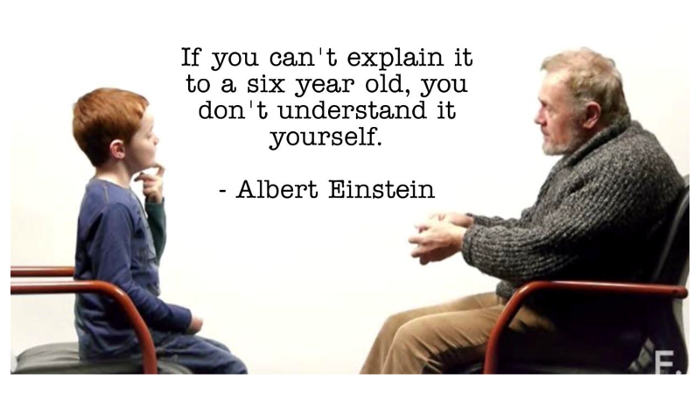
Steps for Formulating the Research Problem
3. Statement of the Research Problem: After the topic has been refined, the researcher needs to articulate the research problem explicitly. This should be a clear, unambiguous statement that outlines the research question or hypothesis.
Statement ??

Slide 30
Identifying Research Gaps Using No AI
Notes:
Research gap can’t be identified using AI, because it is a critical thing to be explored !!

Slide 31
Ex: What is the research gap in the EEGs topic ?

Slide 32
Conclusion
Integrating AI Tools for Seamless Research
Topic of Interest
Comprehensive Literature Review
Problem Statement
Approaching the Problem
New methodology

Slide 33
Tool – “scolary”

Slide 34
Thank you
Email me on: omar.m@comed.uobaghdad.edu.iq

