Slide 2
Scenario-Based Learning
Scenarios are designed to engage learners in processes of problem-solving, decision-making, critical thinking, generating perspectives, and acting creatively in relation to assumed roles, responsibilities, dilemmas and challenges of the professional culture (Errington, 2010).
Unlike traditional eLearning courses, a scenario-based eLearning approach shifts the delivery of a lesson from passive, information-based learning to active, performance-based learning.

Slide 3
What are the benefits of scenario-based learning
Improves Knowledge Retention
Allows Learners To Learn From Mistakes
Improves ROI
Promotes Critical Thinking
Engages Learners Emotions

Slide 4
SBL Types
Skills-based scenarios
Problem-based scenarios
Issues-based scenarios
Speculative scenarios

Slide 5
Learning scenarios is thinking tools Think about learners
Who they are?
What they know?
How they think?
How to reach them effectively so they get the most out of their educational experience?
Which learning type would be most benefitted using technology in your own course?

Slide 7
Acquisition (Read watch listen)
Learning through acquisition is what learners are doing when they are listening to a lecture or podcast, reading from books or websites, and watching demos or videos (the teacher controls the narrative of learning)

Slide 8
Inquiry (investigate)
Allowing learners to control their learning and skills development. The essence of it is that the learner develops their knowledge and understanding through activities close to the discipline’s authentic practice. Learners explore, compare and critique concept and ideas being taught or included in the training resources.

Slide 9
Discussion
Socially situated learning that happens through conversation. Learners need to articulate their ideas and questions. They also need to respond to and critically reflect on others’ questions and ideas. You can combine this with follow up tasks such as reflection.

Slide 10
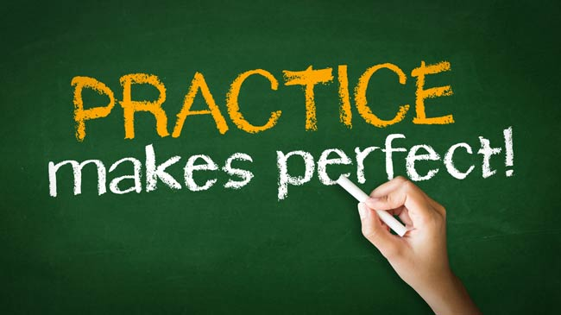
Practice
Learners perform a practical task to practice the skill or knowledge and use the feedback to improve their next action. You can combine and follow this with providing feedback, embedding peer feedback or self-reflection to help learners improve their following activity or future performance.

Slide 11
Collaboration
Learners build knowledge by working together on a project or a task. They try to find meaning, a solution to a problem or demonstrate what they learn by creating something .
Collaboration builds on investigations and acquisition and happens during the online or offline discussion, practice and production. When designing the collaborative task, consider groups’ size and whether it will be a synchronous or an asynchronous task.

Slide 12
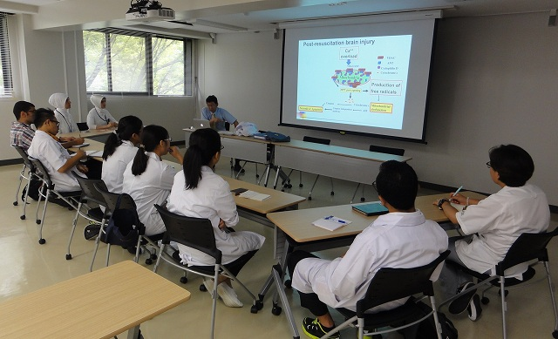
Production
Learners apply knowledge in practice. They consolidate their learning by creating actual artefacts or articulating their current understanding and how they use it in practice.

Slide 14
Learning Types

