Slide 1
برعايه السيد رئيس فرع التعويضات الاصطناعيه
د.غسان عبد الحميد المحترم
يقيم فرع التعويضات الاصطناعيه دورة تريبيه للعاملين بالمختبر
تحت عنوان
survey and block out
-

Slide 2
منهاج الدورة التدريبيه
1st day theoritcal lecture/ suerey م م دزينب عبد المنعم
2nd day theoritcal lecture/relief and block outم ديقظان حيدر
3rd day practical demonstrationم م مصطفى شاكر

Slide 3
introduction

Slide 4
when a dental prosthesis was fabricated , the necessity for appropriately planned and executed tooth preparation, followed by verification of a well-fitting prosthesis that engages the teeth as planned, is very important step

Slide 5
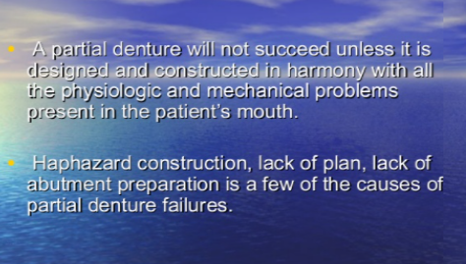

Slide 6
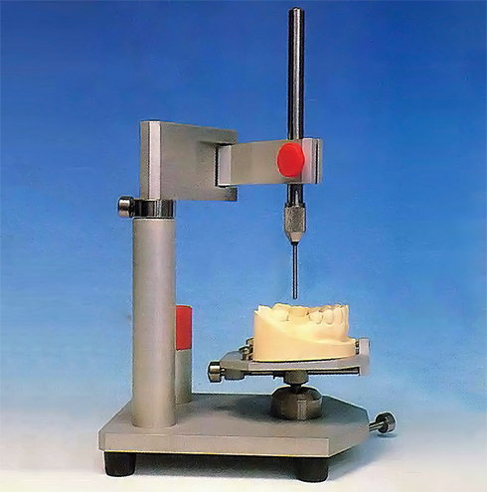
How we overcome such problem??
By the use of dental surveyor

Slide 7
WHAT IS DENTAL SURVEYING?
Dental surveying is an analysis and comparison of the prominence of intraoral contours associated with fabrication of a dental prosthesis with an instrument called the surveyor.
A dental surveyor is an paralleling instrument used in the construction of a dental prosthesis to locate & delineate the contours & relative positions of abutment teeth & associated structures. Also, to determine the relative parallelism of two or more surfaces of the teeth or other parts of the cast of a dental arch.

Slide 8
Therefore surveying;
is to identify the modifications of oral structures that are necessary to fabricate a removable partial denture that will have a successful prognosis. It is the modification of tooth surfaces to accommodate placement of the component parts of the partial denture in their designated ideal positions on abutment teeth that facilitates this prognosis.

Slide 9
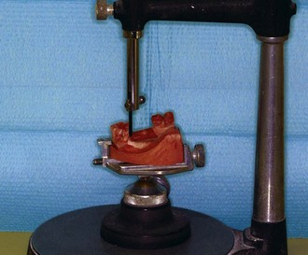
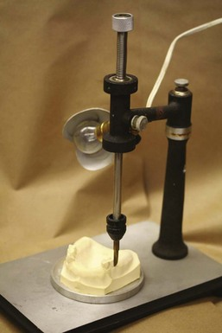
Types of dental surveyor
the most widely used surveyors are the Ney (Figure 1) and the Jelenko (Figure 2). They differ principally in that the Jelenko arm swivels, whereas the Ney arm is fixed. The technique for surveying and trimming blockout is therefore somewhat different
Figure -1 Figure -2

Slide 10
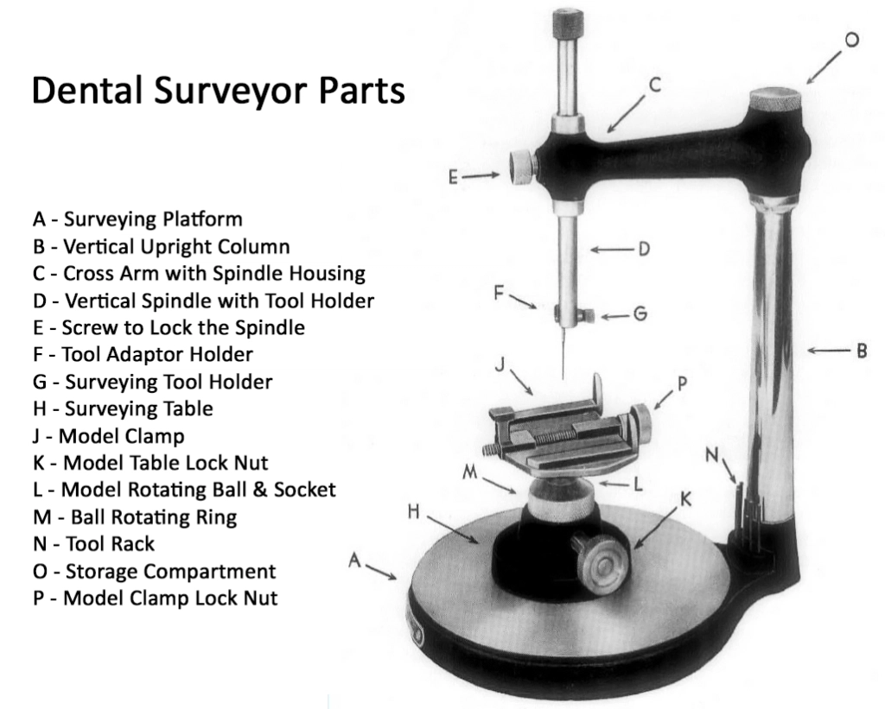
Parts of Dental Surveyor

Slide 11
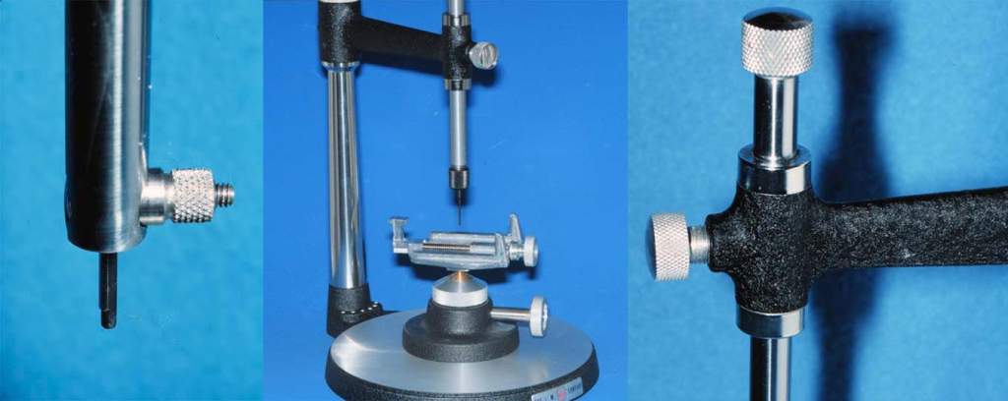
Surveying Arm

Slide 12
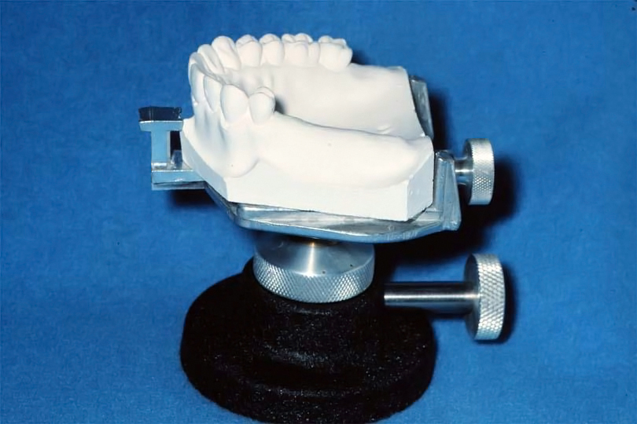
Surveying Table

Slide 13
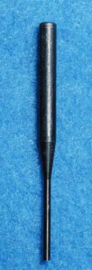
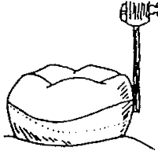
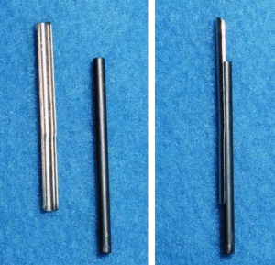
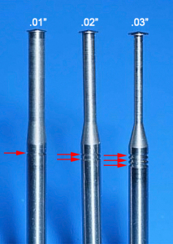
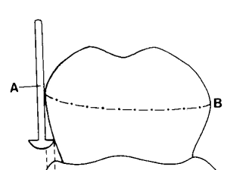
Surveying Tools
Analyzing rods Carbon marker Undercut gauge gauge

Slide 14
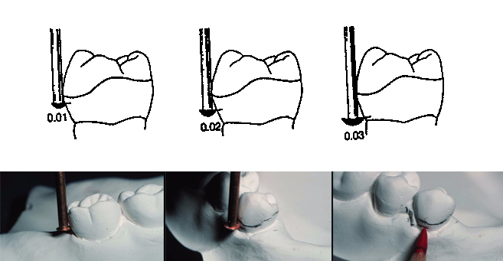

Slide 15
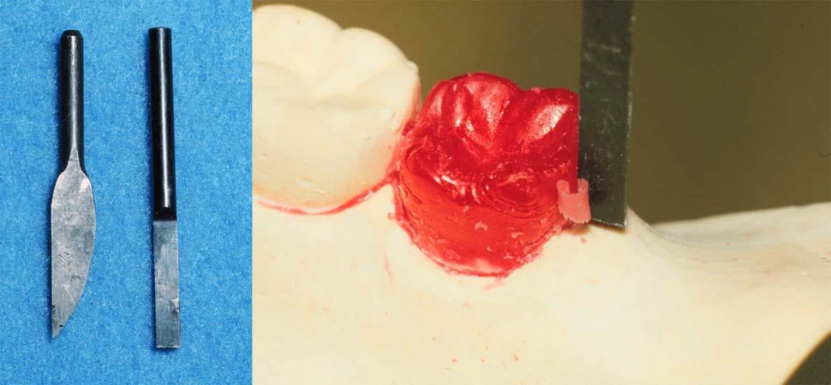
Wax trimmer

Slide 16
Purposes of Surveyor:
1. To determine the most desirable path of placement that will eliminate or minimize interference to placement and removal.
2. To identify proximal tooth surfaces that are, or need to be, made parallel so that they act as guiding planes during placement and removal.
3. To locate and measure areas of the teeth that may be used for retention.
4. To determine whether tooth and bony areas of interference will need to be eliminated surgically or by selecting a different path of placement.
5. To determine the most suitable path of placemen that will permit locating retainers and artificial teeth to the best esthetic advantage.
6. To permit an accurate charting of the mouth preparation to be made.
7. To delineate the height of contour on abutment teeth and to locate areas of undesirable tooth undercut that are to be avoided, eliminated, or blocked out.
8. To record the cast position in relation to the selected path of placement for future reference.

Slide 17
Objectives of Surveying:
This is to ensure that the prosthesis can be easily inserted & removed by the patient.
Will contribute optimally to appearance.
Will resist unseating forces to a reasonable degree.
Will create no undesirable food traps when in place in the mouth.

Slide 18
Phases of surveying:
Preliminary visual assessment of study cast (eyeballing of the cast)
Initial survey
Analysis
Final survey

Slide 19
Important Terminologies in Surveying
Guiding planes:
Vertically parallel surfaces on abutment teeth or/and dental implant abutments oriented so as to contribute to the direction of path of placement and removal of a removable dental prosthesis.

Slide 20

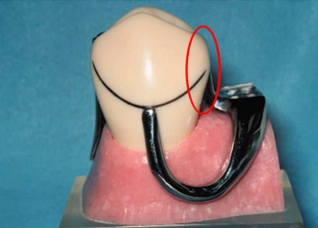

Slide 21
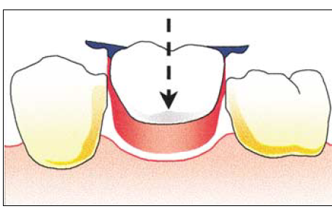
Path of Insertion & Removal
Path that the prosthesis is placed or removed and usually a single path.
Path of insertion:The direction in which a restoration moves from the point of initial contactof its rigid part with the supporting teeth, to its terminal resting position, with rests seated & denture base in contact with the tissues.
It is determined by tilt of cast.
It is not a single entity.

Slide 22
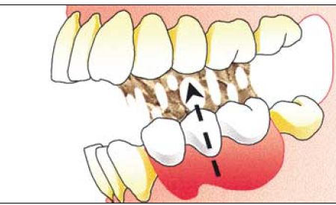
Path of displacement: Reverse of Path of Insertion

Slide 23
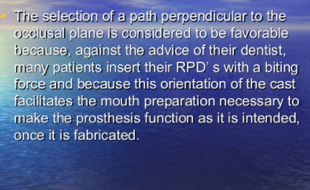

Slide 24
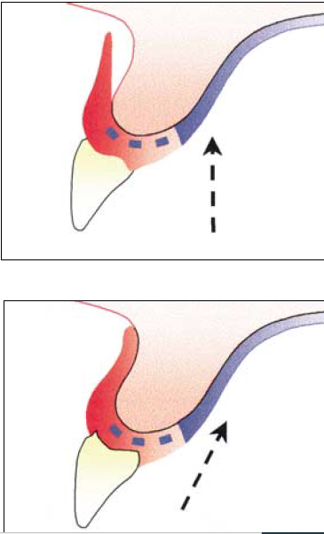
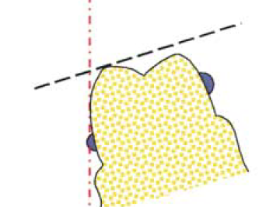
Factors Determining Path of Insertion & Removal
a) Guiding planes
b) Retentive areas
c) Interference
d) Esthetics

Slide 25
Advantages of a Single Path of Insertion:
Equalizes retention
Bracing and Cross-arch Stabilization
Minimizes torque on abutments
Allows removal without encountering interferences
Directs forces along long axes of teeth
Provides frictional retention

Slide 26
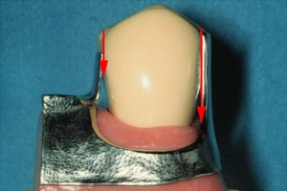
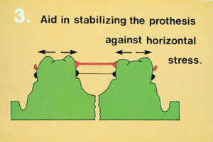
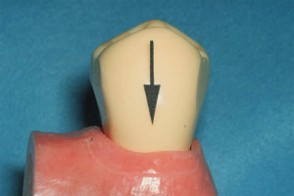

Slide 27
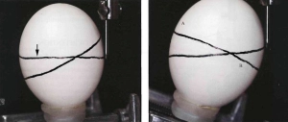
Survey line/ Height of Contour (HOC)
A line encircling a tooth produced on a cast by a surveyor, marking the greatest prominence of contour in relation to the planned path of placement of the restoration.

Slide 28
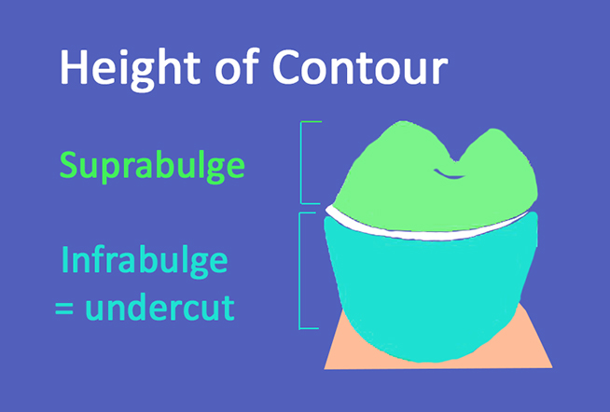
Any areas cervical to HOC used for placement of retentive clasp components
Areas occlusal to the HOC used for the placement of nonretentive, stabilizing, or reciprocating components.

Slide 29
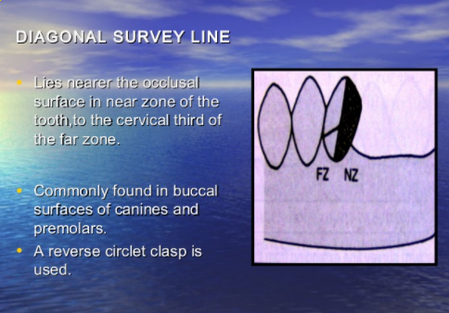
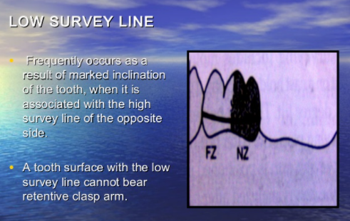
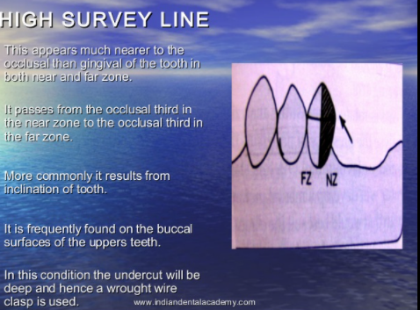
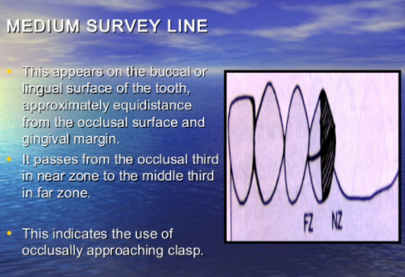

Slide 30
Significance of Survey Lines:
All rigid components of the partial denture must be kept occlusal to it.
Normally only the terminal third of the retentive clasp is placed gingival to the survey line.
The survey line also helps locate areas of undesirable tooth undercuts that must be avoided or eliminated by contouring or placing restoration on the teeth.

Slide 31
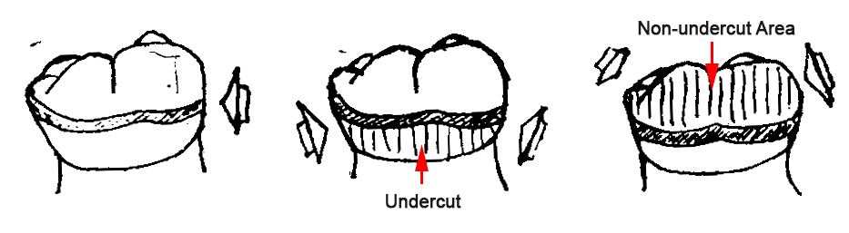
Undercut

Slide 32
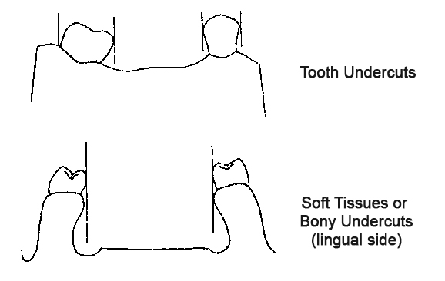

Slide 33
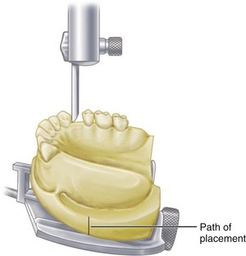
Survey Procedure
Diagnostic cast survey
Identifying the most favorable tilt
Path of insertion
Tripoding the cast
Placing survey lines

Slide 34
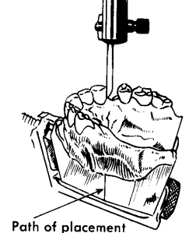
Tilting :is simply changing the position of the cast survey lines.
Factors determining most favorable tilt of a cast:
Presence of suitable undercuts (retention)
Elimination of hard & soft tissue interferences
Creation of desirable esthetics
Establishment of appropriate guiding planes

Slide 35
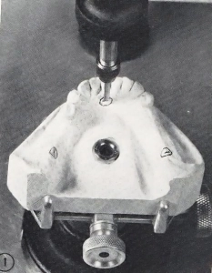
Tripoding the Cast
Tripoding is a method of indexing the cast while it is on the surveyor so that it can be removed and returned to its original position whenever desirable.

Slide 36
Master cast survey
Most suitable path of placement
Measurement of retentive areas and clasp location
Locate undesirable undercut
Trim blockout material

Slide 37
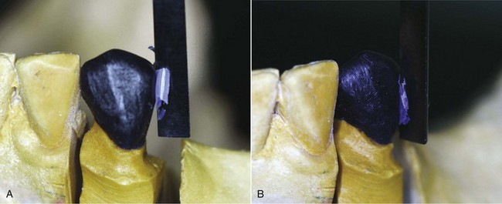
Surveying Ceramic Veneer Crowns
Ceramic veneer crowns are often used to restore abutment teeth on which extracoronal direct retainers will be placed. The surveyor is used to contour all areas of the wax pattern for the veneer crown except the buccal or labial surface. It must be remembered that one of the principal goals in using a porcelain veneer restoration is to develop an esthetic replica of a natural tooth

Slide 38
Placement of Intracoronal Retainers (Internal Attachments
1. To select a path of placement in relation to the long axes of the abutment teeth that will avoid areas of interference elsewhere in the arch
2. To cut recesses in the stone teeth on the diagnostic cast for estimating the proximity of the recess to the pulp (used in conjunction with roentgenographic information to estimate pulp size and location) and to facilitate the fabrication of metal or resin jigs to guide preparations of the recesses in the mouth
3. To carve recesses in wax patterns, to place internal attachment trays in wax patterns, or to cut recesses in castings with the handpiece holder (whichever method is preferred)
4. To place the keyway portion of the attachment in the casting before investing and soldering; each keyway must be located parallel to the other keyways elsewhere in the arch

Slide 39
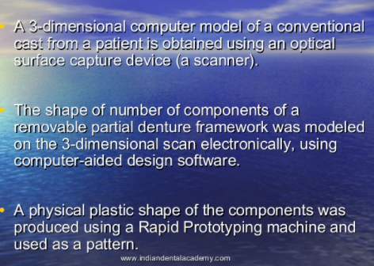
Advancing in surveying

Slide 40
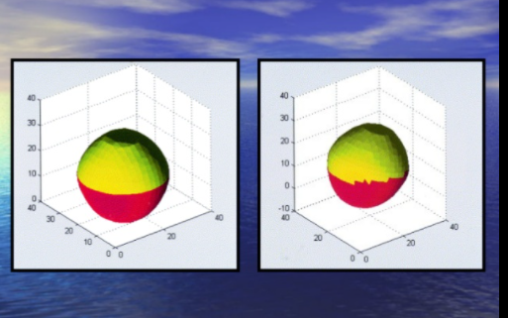
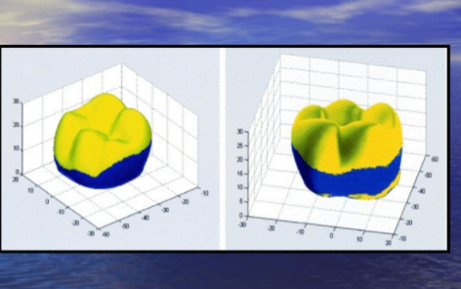

Slide 41
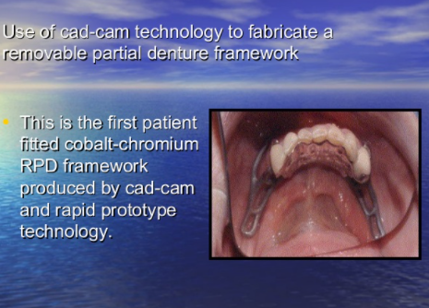
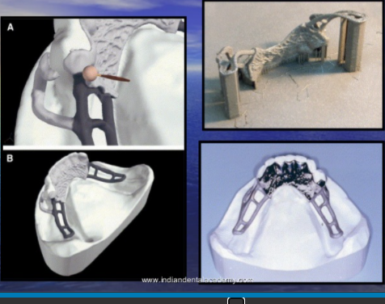
Cad cam

Slide 42
Conclusion
Partially removable dentures should be properly designed so that there be no pressure on the supporting teeth beyond the physiological tolerance, which can easily be placed and discharged by the patient and should be maintained against reasonable amount of forces, in order to avoid an unfavorable appearance.

Slide 43
References:
Textbook of clinical removable partial prosthodontics by Stewart, Rudd, Kuebker 2 edition.
McCracken’s removable partial prosthodontics, ninth edition.
Removable partial prosthodontics by Joseph E Grasso and Ernest L Miller.
Partial denture by John Osborne/ Atkinson (Pg 145-147).

