Slide 1



Lecturer: Yagthan M. Haider
Ass. Lec.mustafa shakir

Slide 2
Blockout
Blocking out is the act of placing wax and other materials into undesirable undercuts on the master cast. Since the framework is waxed and cast on a duplicate of the master cast, undercuts that would prohibit the framework from going into place must be eliminated.

Slide 3
Cast preparation
Before the addition of the blockout wax, a maxillary cast is beaded. Beading is the act of scraping the outline of the major connector into the master cast. The bead line is approximately 0.5 mm deep and becomes less distinct as it approaches the gingival margins.
The bead line produces a raised edge at the border of the major connector and ensures positive contact of the major connector with the palatal tissues. This feature reduces packing of food beneath the major connector.

Slide 5
Bead lines are not used in conjunction with mandibular major connectors because these connectors rest on thin gingival tissues that cannot tolerate the associated pressures.

Slide 6
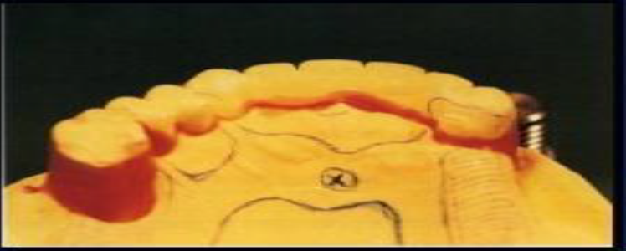
Types of blockout of master cast
1-parallel blockout:
Parallel blockout is necessary for areas that will be used as guiding plane surfaces and over all undercut areas that will be crossed by major or minor connectors. Hard inlay wax may be used satisfactorily as a blockout material. It is easily applied and is easily trimmed with the surveyor blade.

Slide 7
Trimming is facilitated by slightly warming the surveyor blade with an alcohol torch:
Proximal tooth surfaces to be used as guiding planes.

Slide 8
Beneath all minor connectors.

Slide 9
Tissue undercuts to be crossed by rigid connectors.

Slide 10
-Tissue undercuts to be crossed by origin of bar clasps.

Slide 11
Deep interproximal spaces to be covered by minor connectors or linguoplates.

Slide 12
Beneath bar clasp arms to gingival crevice.

Slide 13
-All guiding plane areas must be parallel to path of placement, and all other areas that will be contacted by rigid parts of denture framework must be made free of undercut by parallel block out.

Slide 14
2-shaped blockout
Wax ledge for reciprocal clasp arm as cervical as possible also ledge for location of retentive clasp arm, ledge is applied below the survey line around the abutment teeth. Situated on buccal and lingual surfaces, to locate the wax patterns for clasp arms.

Slide 15
3- ARBITRARY BLOCKOUT:
Such areas are the labial surfaces and labial undercuts not involved in the denture design and the sublingual and distolingual areas beyond the limits of the denture design. These are blocked out arbitrarily with hard baseplate wax, but because they have no relation to the path of placement, they do not require the use of the surveyor.

Slide 16
Arbitrary block out is done to:
- Facilitate the removal of the cast from the impression during duplication.
- Prevent distortion of duplicating mold when the master cast is removed arbitrary blockout.
- All gingival crevices.
- Gross tissue undercuts situated below areas involved in design of denture framework.
- Tissue undercuts distal to cast framework.
- Labial and buccal tooth and tissue undercuts not involved in denture design.

Slide 17
RELIEVING THE MASTER CAST
-Relief is the procedure of placing wax in certain areas on the master cast before duplication, to create a raised area on the refractory cast.
-Purpose of relief:
-To prevent tissue impingement resulting from rotation of the denture framework.

Slide 18
-To create space for the acrylic resin (beneath the retentive ladder).

Slide 19
Sites
- Areas in which major connectors will contact thin tissue, such as hard areas so frequently found on lingual or mandibular ridges and elevated palatal raphes and tori.
Beneath the ladder minor connectors for attachment of resin bases.

Slide 20

Mandibular major connectors often warrant relief between the rigid metal surfaces and the underlying soft tissues.

Slide 21


