Slide 1

Traveling to Rio Olympics

Slide 2
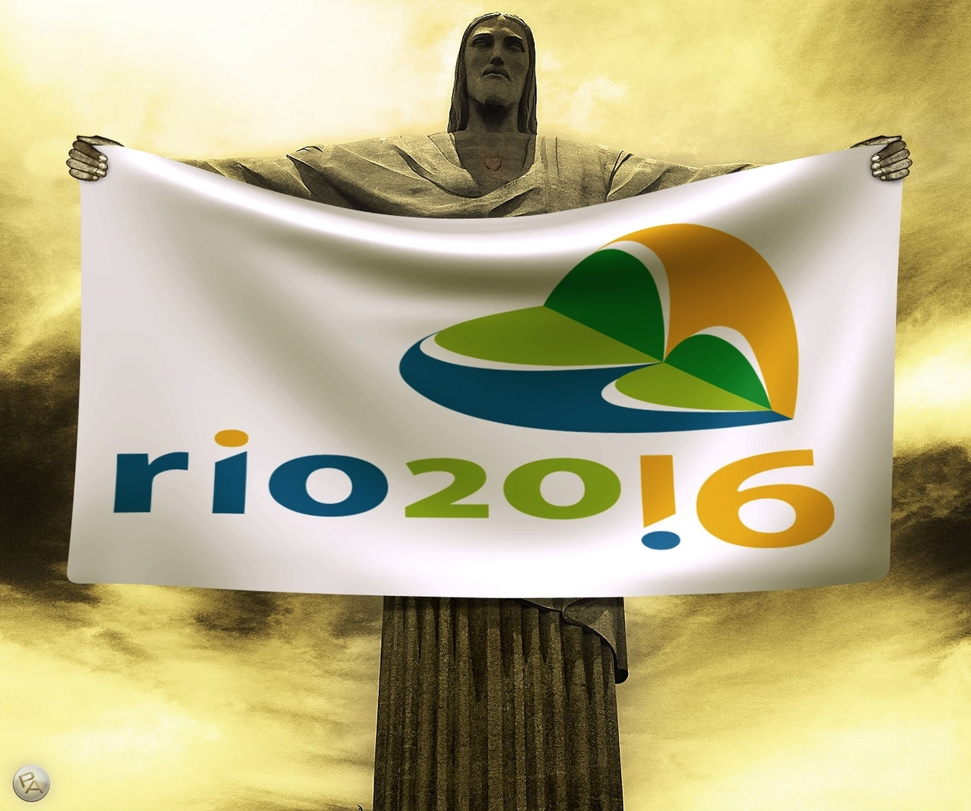

Slide 3
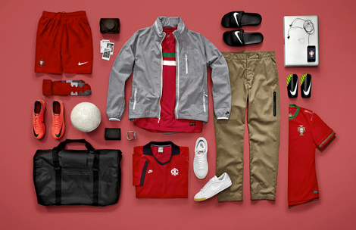
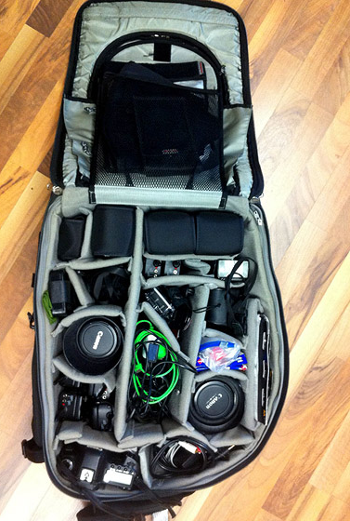
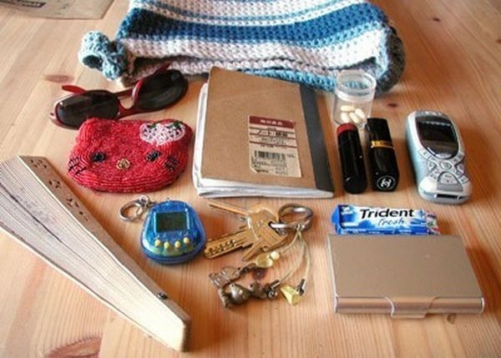
Packing our Luggage

Slide 4
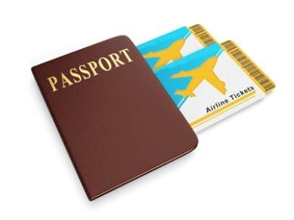
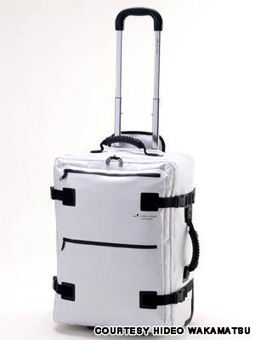
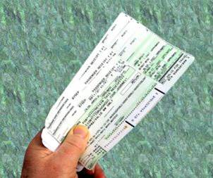
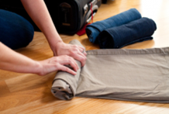
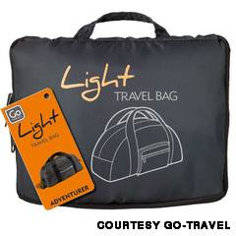
.
.
.
.
.

Slide 5
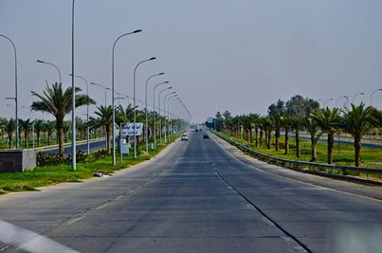

Slide 6
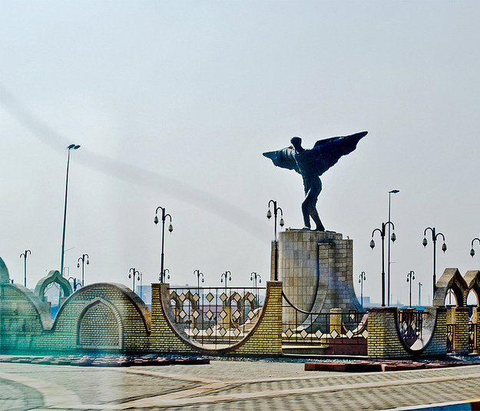

Slide 7
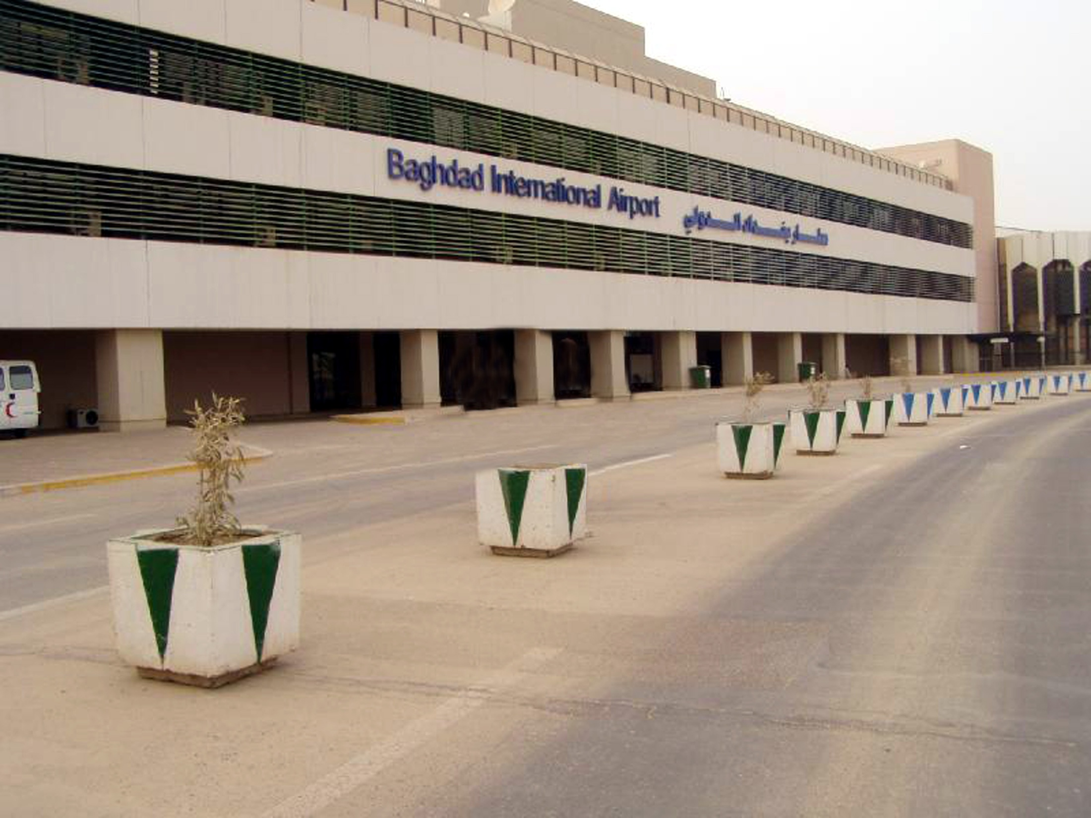
Arrival to Baghdad airport

Slide 8
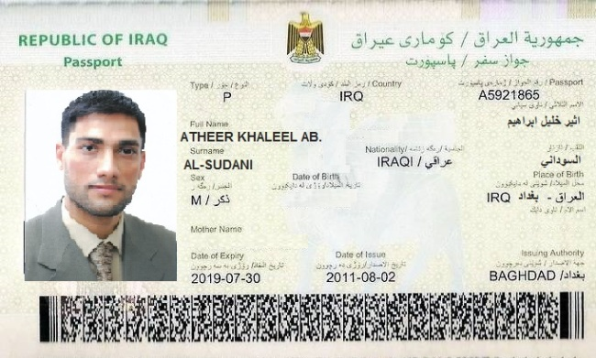
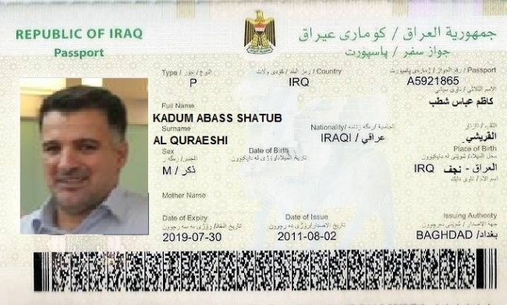
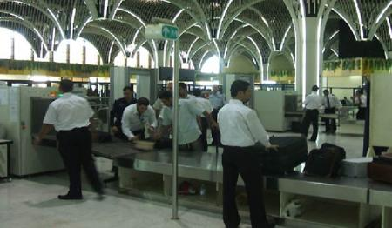
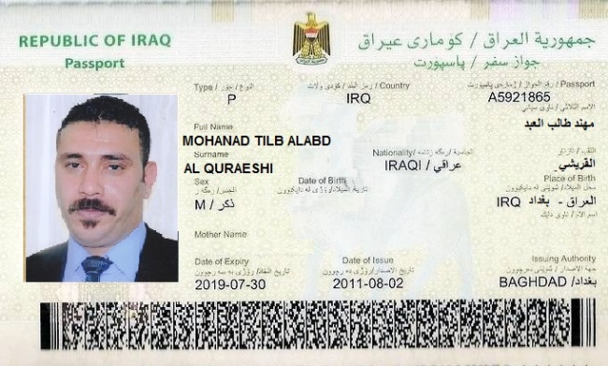
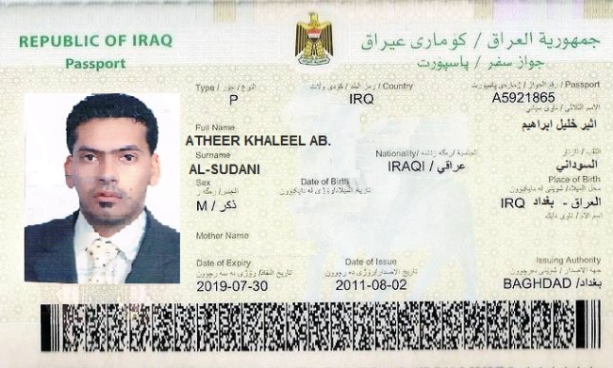

Slide 9
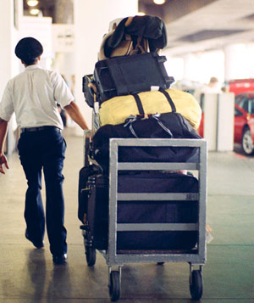
Skycap take our luggage
Into the airport

Slide 10
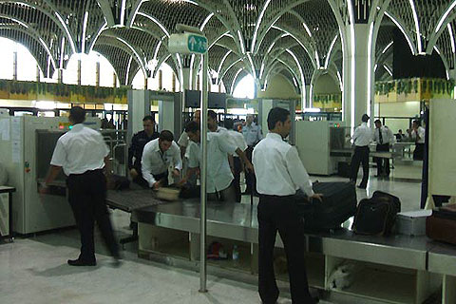
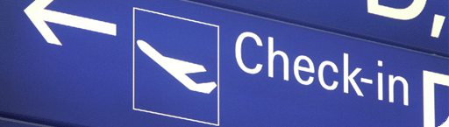
Check –in and the TSA. Agent for check up by security screener

Slide 11
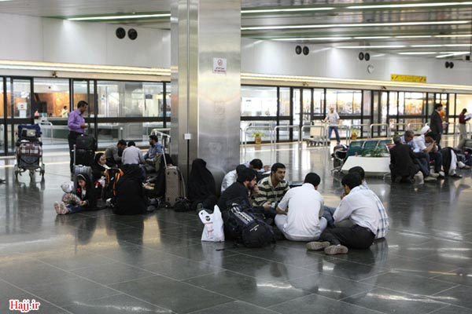
Waiting in the airport for three hours …… before check in electronically

Slide 12
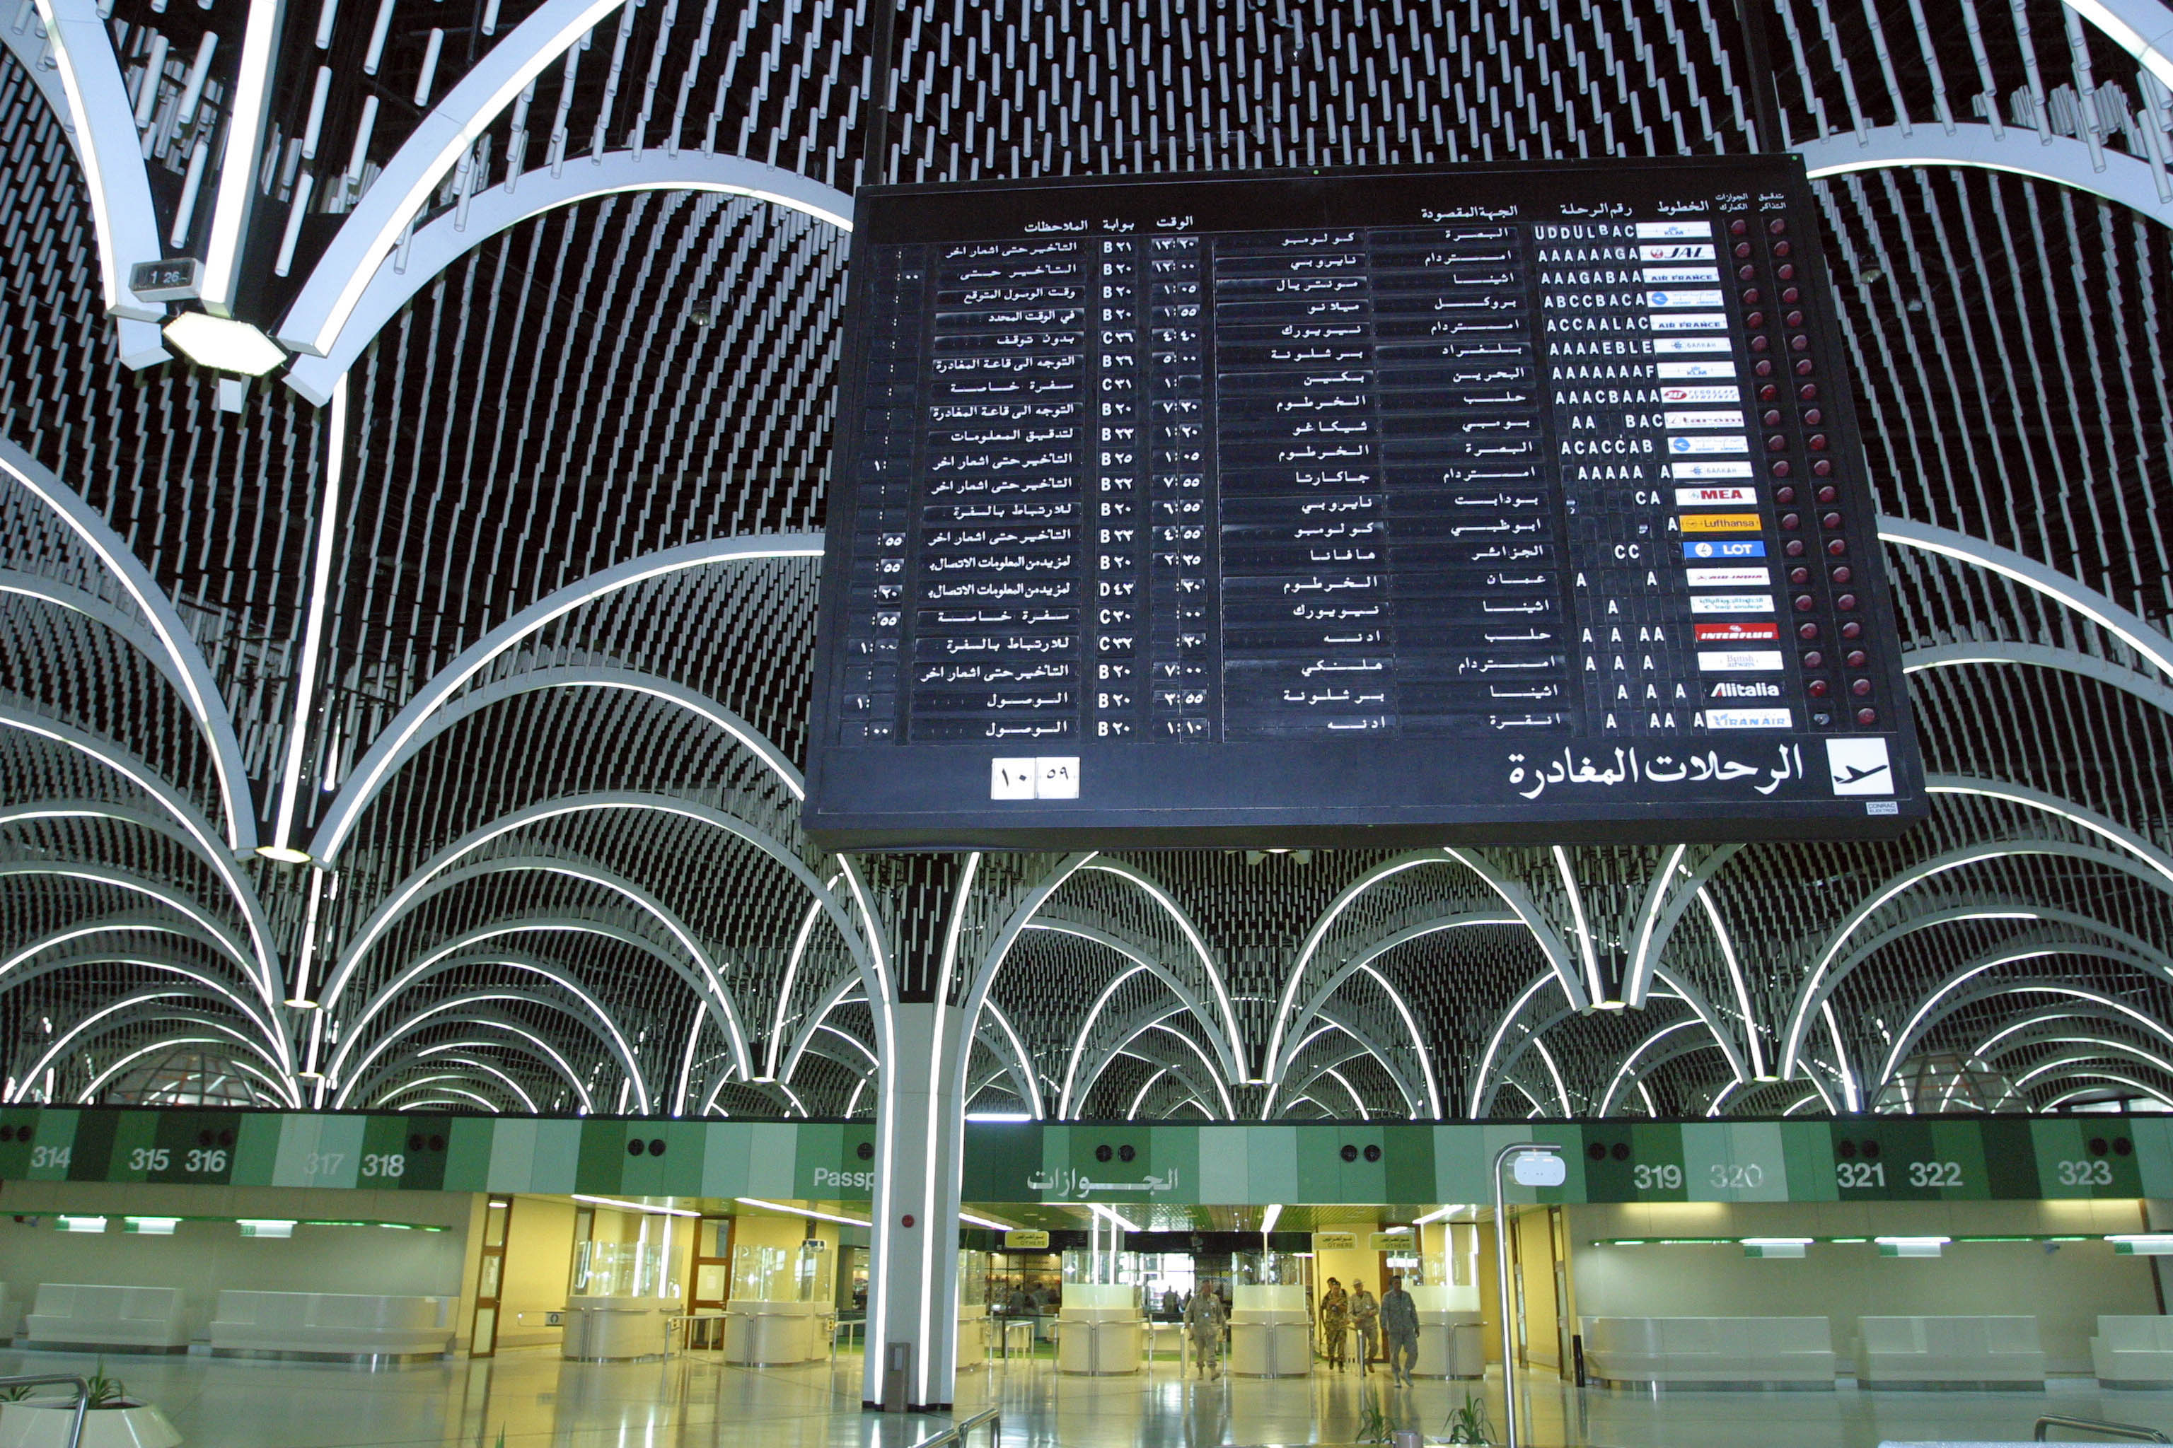
After that we check the flight schedule board to ensure from our flight

Slide 13
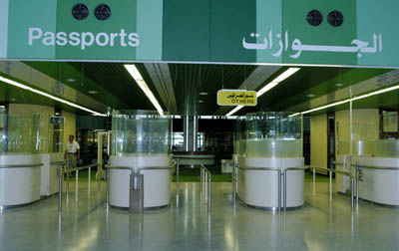
Then we go to the passports to show the tickets and the ID

Slide 14
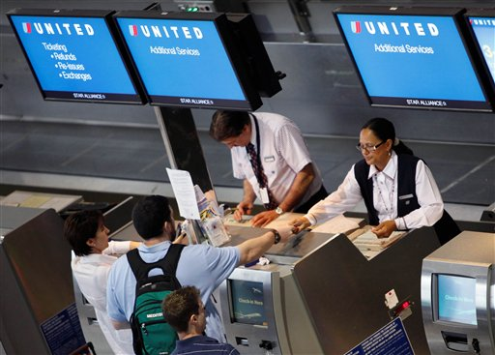
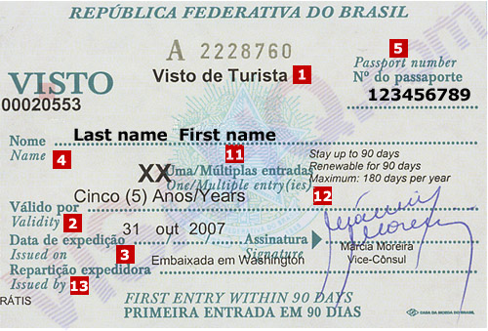
Check in electronically

Slide 15
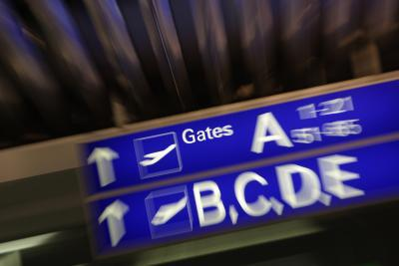
After checking our ID and the visa we go straight to the gate

Slide 16
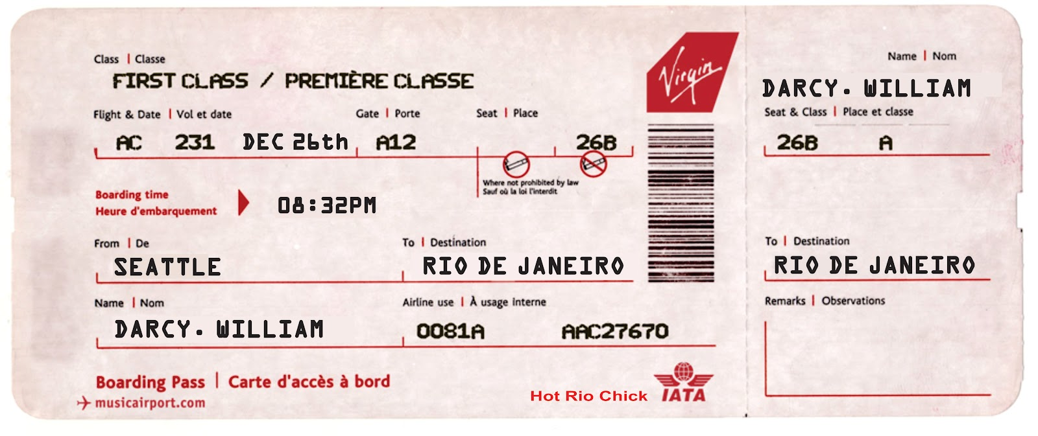
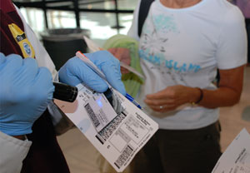
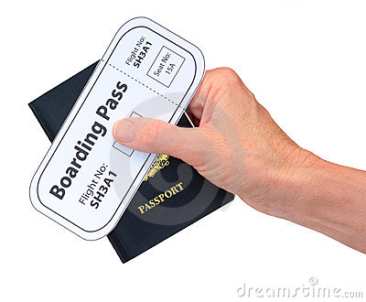
IRAQ

Slide 17
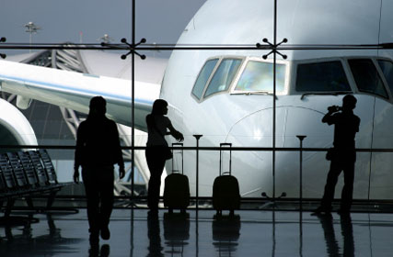
Now we are in the terminal waiting for aboard the plane

Slide 18
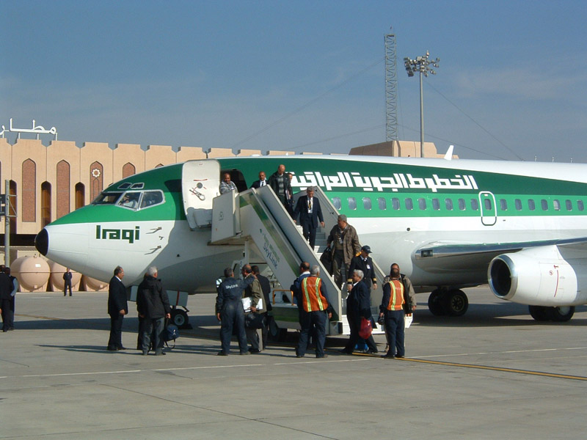
At last….final stage in Baghdad airport BOARD THE PLANE

Slide 19
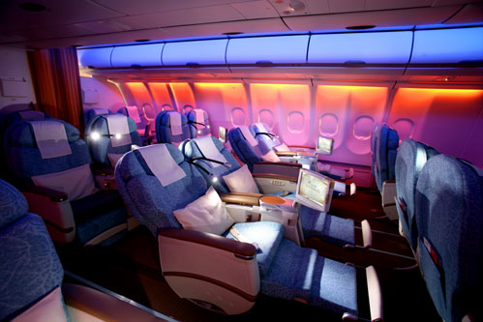
The plane was beautiful from inside……every one was looking for his seat

Slide 20
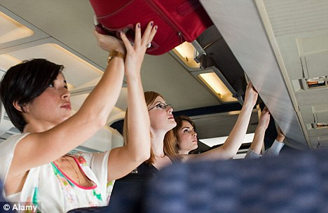
As soon as we board the plane we began to stow our carry – on bags

Slide 21
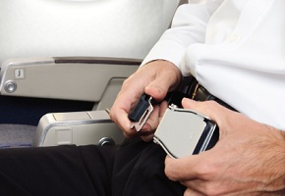
We fasten our seat belts

Slide 22
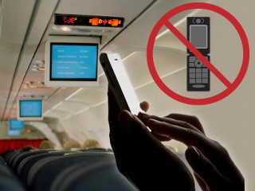
Turn our cell phone - off

Slide 23
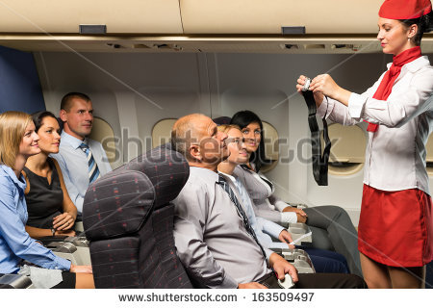
The fly attendant became give us some instruction
to survive just in case……you know!!

Slide 24
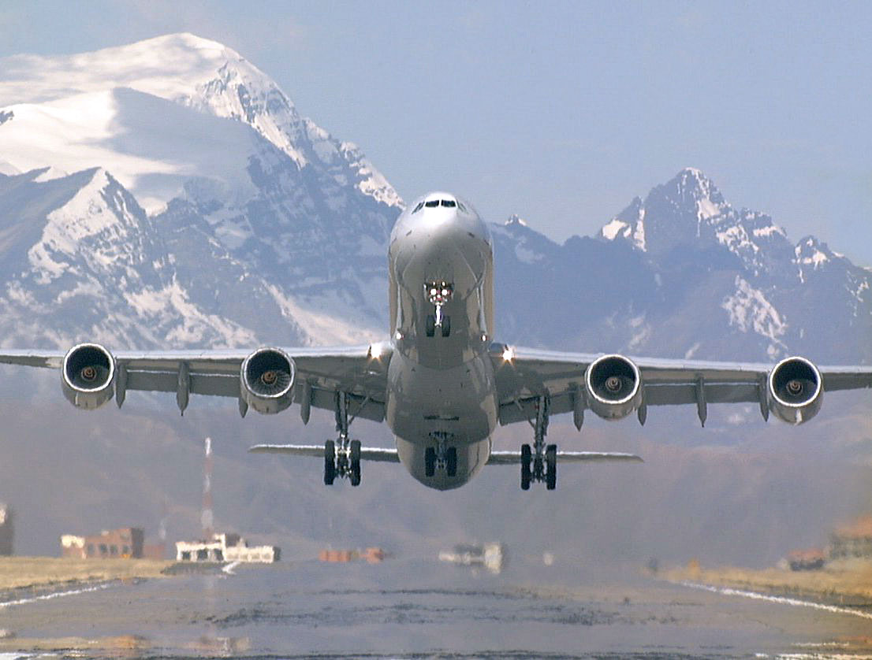
Now the plane taking off
See you Baghdad after one month

Slide 25
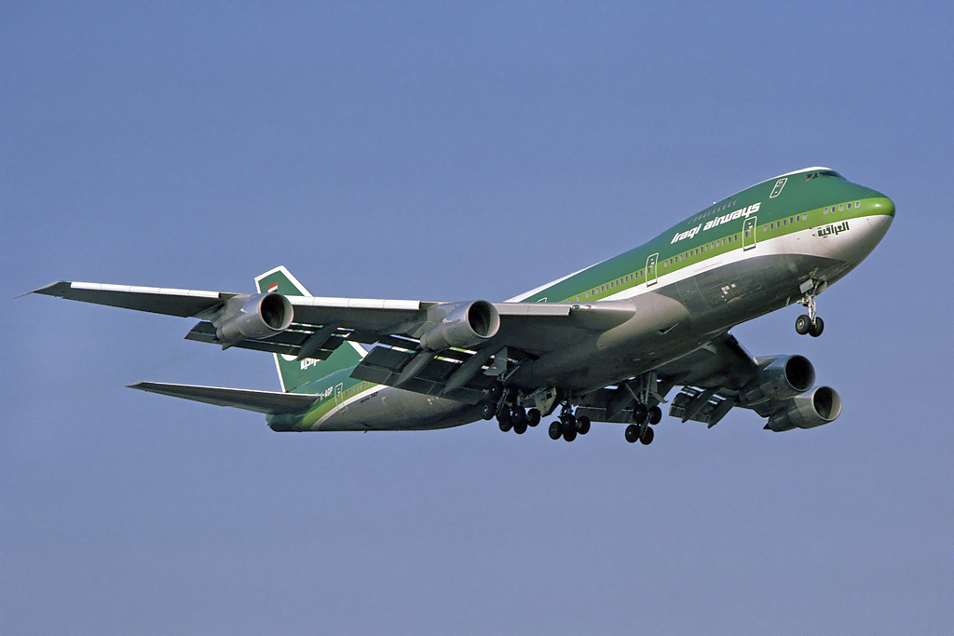
Our destination to brazil

Slide 26
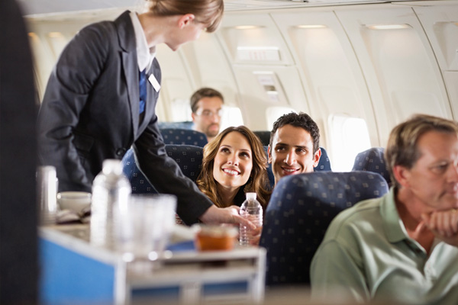
Haitham and sura was really cheerful because of the meal of the first class!

Slide 27
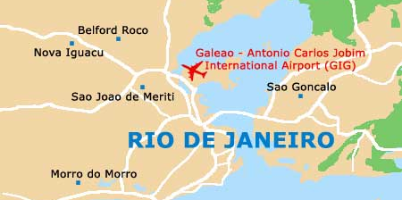
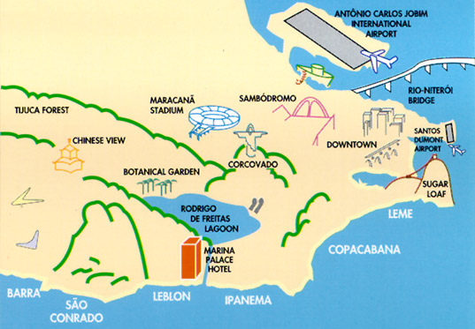

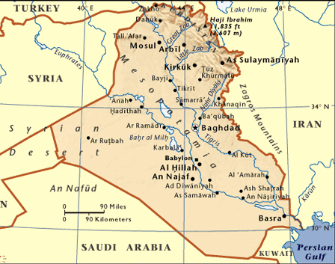
We spend 10 hours in the plane
to get RIO

Slide 28
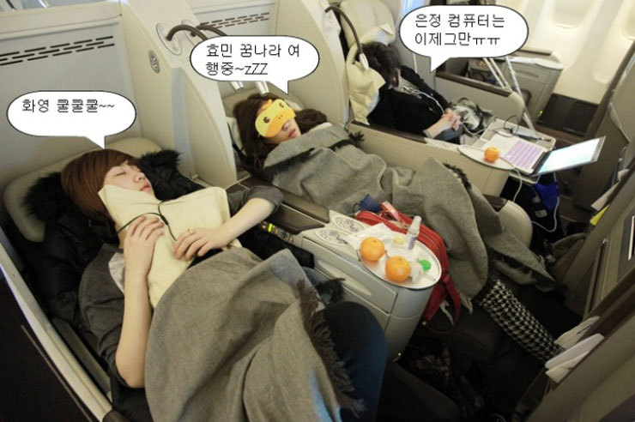
The flight taking so long… thus we sleep deeply!

Slide 29
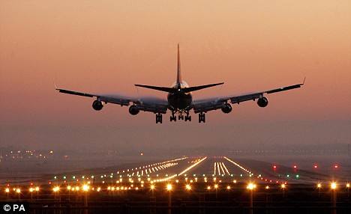
The plane landing in Rio

Slide 30
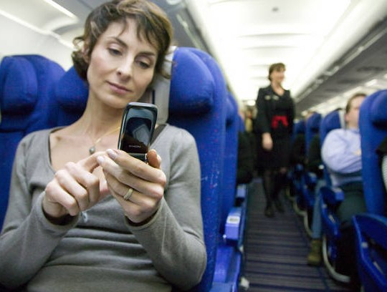
We turn our cell phones - on

Slide 31
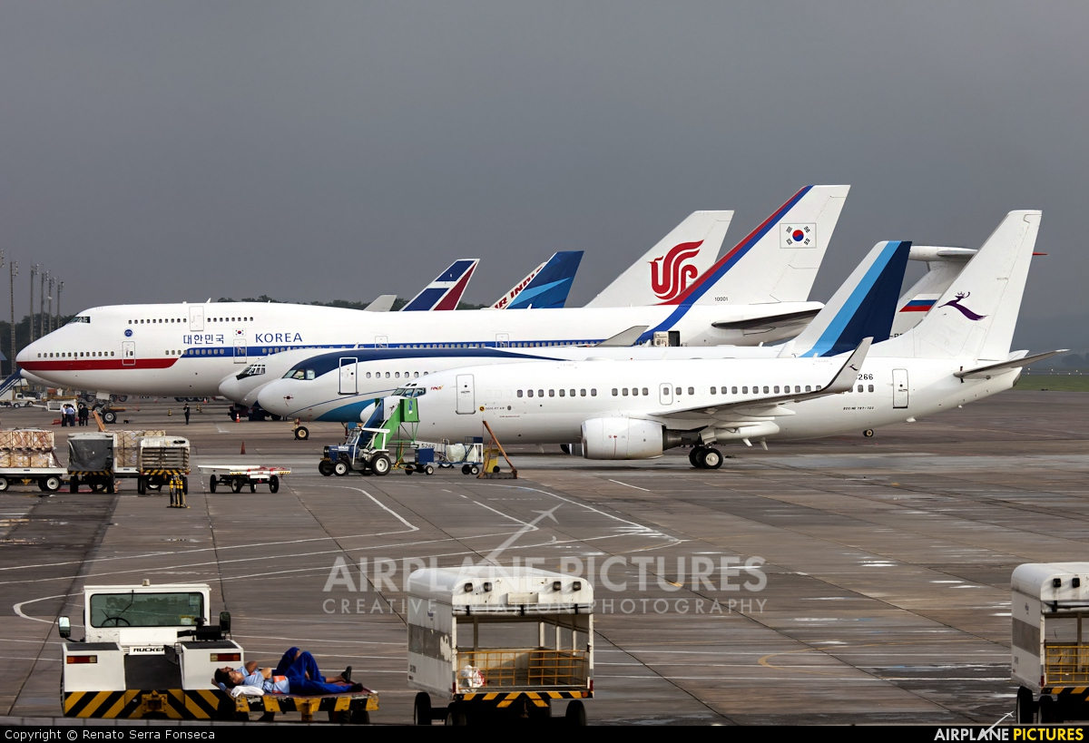
Rio De Janiero airport

Slide 32
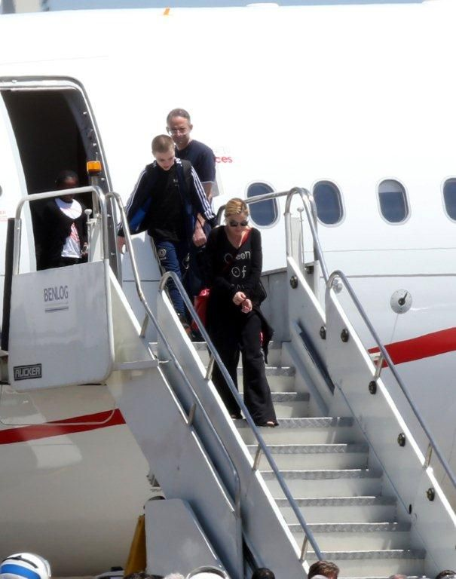
When we arrived the whether was nice in rio de janiero

Slide 33
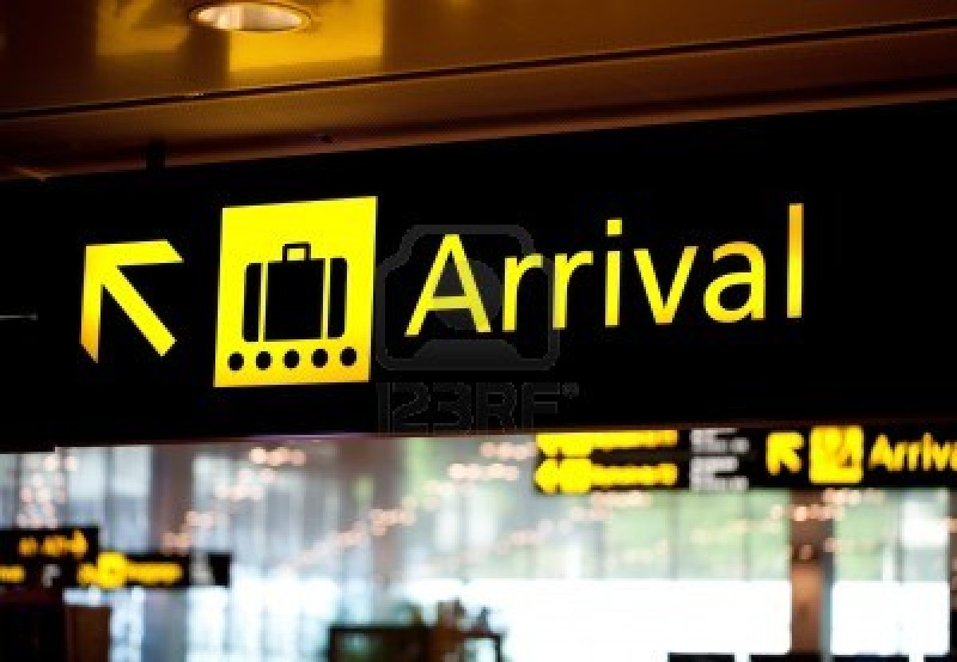

Slide 34
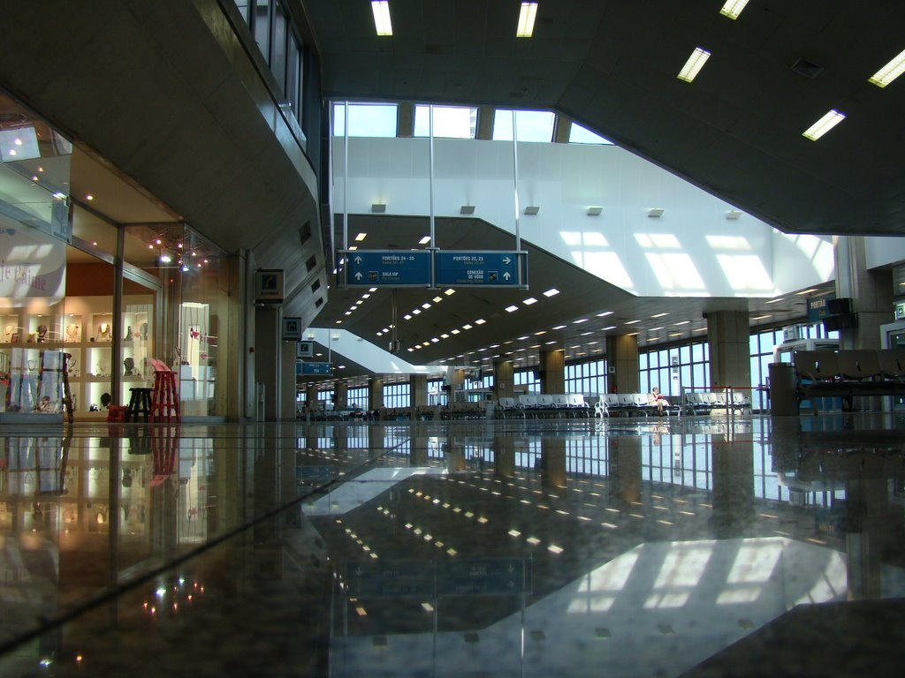

Slide 35
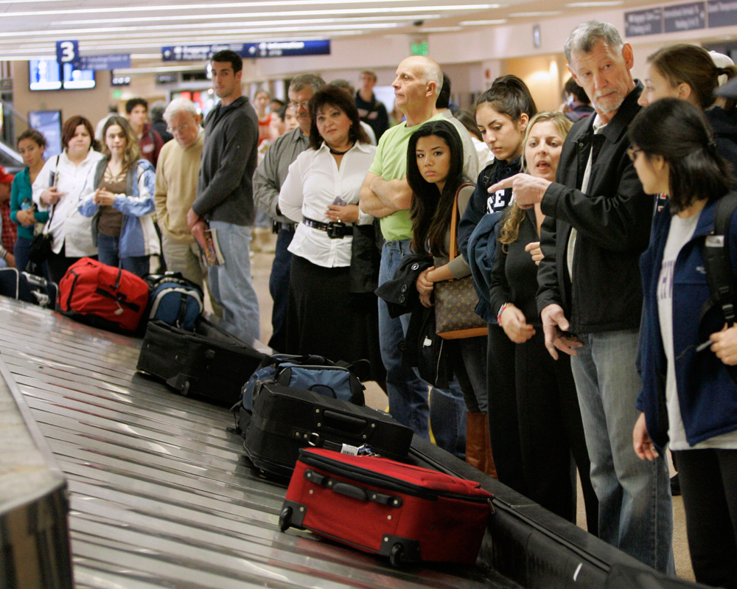
We claim our baggage

Slide 36


Slide 37




We finish filling the declaration form and pass the customs officer

Slide 38

Welcome to Rio De Janiero

Slide 39

We take taxi from the airport to
one of the most famous hotels in Rio

Slide 40

Which is the Copacabana palace

Slide 41

Our apartment was good and there are three beds

Slide 42

The living room was big & the view from the window was charmed

Slide 43



After taking rest we order a limousine and driver
to take us for a ride showing us the town

Slide 44


And its unbelievable experiment

Slide 45



We faced some culture shock
And we were making stereotypes ……….!

Slide 46

We choose a restaurant with open buffet so we have a larger collection of food.

Slide 47

Our program in
Rio 2016

Slide 48

In the next day on morning the bus take us to the stadium to look at the place that we
Going to train in it!!!

Slide 49

The structure of Rio De Janiero stadium was circle
in beautiful way of architecture

Slide 50


Slide 51

We start to train for the Olympics

Slide 52

We visit many places in the city like Sugarloaf mountain and Corcovado. Corcovado meaning "hunchback" in Portuguese. is a mountain in central Rio de Janeiro, Brazil. The 710-metre is located in the Tijuca Forest, a national park. It is sometimes confused with nearby Sugarloaf Mountain.

Slide 53

We visit Praia Vermelha beach for swimming and other activities

Slide 54


