Slide 1
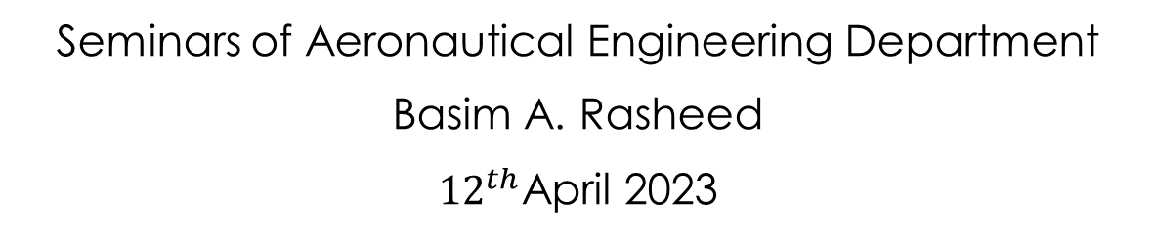
Coriolis effect mass flowmeaters performance and applications
Seminars of Aeronautical Engineering Department
Basim A. Rasheed
${12}^{th}$April 2023

Slide 2
Contents
Flowmeters definition.
Type of flowmeters.
Coriolis effect flowmeters.
Construction of coriolis effect flowmeters.
Operation of coriolis effect flowmeters.
Application of coriolis effect flowmeters.

Slide 3
Flowmeter definition
The flowmeter is an instrument for measuring the rate of flow of a fluid especially through a pipe.

Slide 4
2 . Type of flowmeters
Volume-displacement flowmeters.
Coriolis effect flowmeters.
Turbine flowmeters.
Orifices-flow nozzles and venture tubes.
Rotameters .
Thermal mass flowmeters.
Vortex-shedding flowmeters.
Pitot-static flowmeters.
Drag-force flowmeters.
Ultrasonic flowmeters.

Slide 5
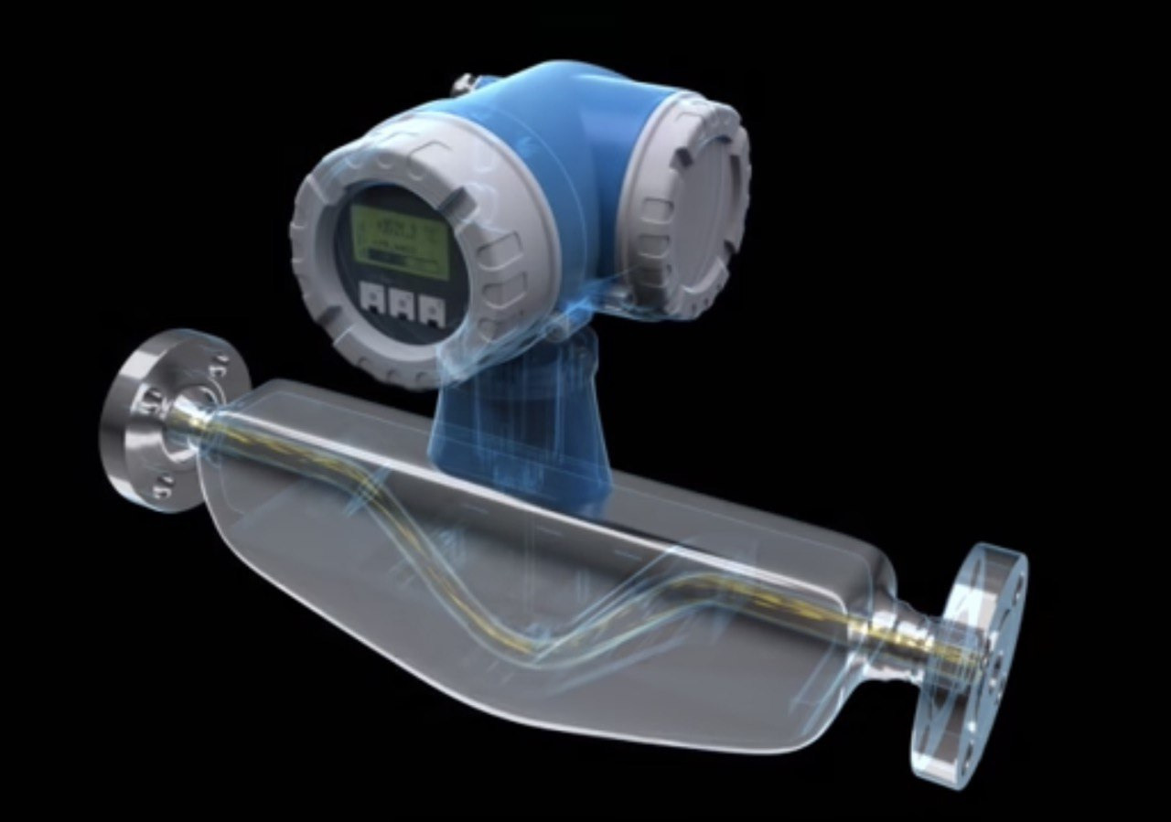
3 . Coriolis effect flowmeters.
Coriolis flowmeters are among the most accurate gaseous or liquid refrigerant mass flow measuring devices.
Accuracy ± 0.1% for liquids.
Accuracy ±0.5% for gases.

Slide 6
4 . Construction of coriolis effect flowmeterS
The meter consisted of two items:-
The sensor.
Indicator.
The sensor is fixed in the refrigerant loop and connected to the indicator with a data cable

Slide 7
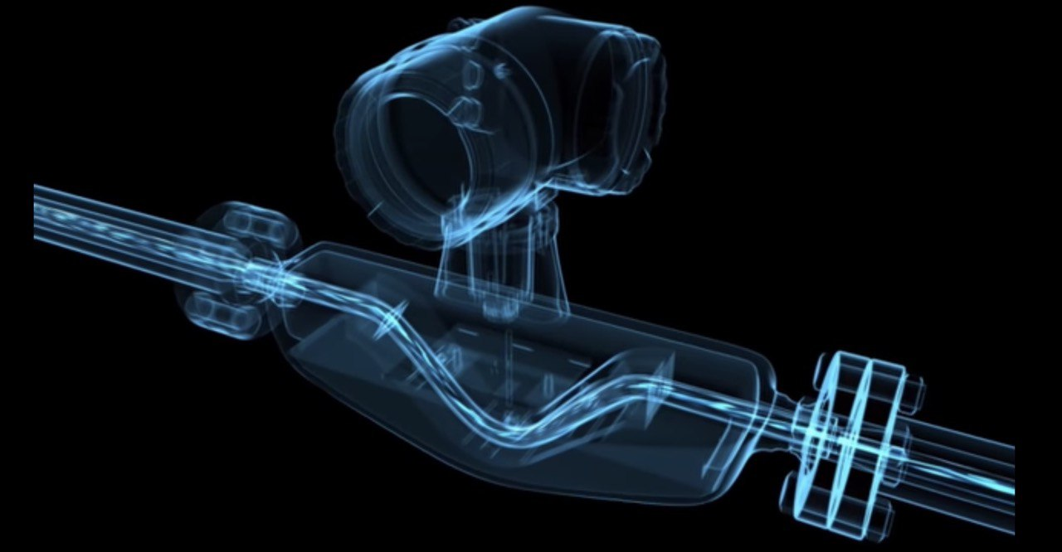
5 . Operation of coriolis effect flowmeters
These meters are based on the relationship of the creolise component of acceleration to mass and velocity.
Refrigerant flows through a vibrating sensor tube within the meter. This vibration is according to a defined frequency so, the oscillating angle is initially known. When the refrigerant flows in this tube causes the tube to disturb with oscillating.

Slide 8
6 . Application of coriolis effect flowmeters
Coriolis mass flowmeters can detect the flow of all liquids including Newtonian and non-Newtonian as well as all gases and all refrigerant.

