Slide 1
Teaching English without teaching English
Dr bushra naima

Slide 2
Minimal pairs are pairs of words in a language that differ by only one sound (Koch & Oesterreicher, 2011). These pairs can be particularly challenging for non-native speakers to distinguish and produce correctly in English. For instance, "sheep" and "ship" are minimal pairs that share a similar sound but carry different meanings. Similarly, "cot" and "caught" can be difficult for non-native speakers to differentiate.
However, practicing minimal pairs can help learners to improve their ability to perceive and produce these sounds accurately (Derwing & Munro, 2015). By engaging in exercises such as identifying the spoken word or repeating the words themselves, learners can focus on the differences in pronunciation, which can ultimately improve their overall pronunciation and communication skills in English.
Therefore, minimal pairs are a useful tool for language learners seeking to enhance their ability to distinguish between similar sounds in English and improve their overall fluency and accuracy when speaking the language.

Slide 3
Here are some additional examples of minimal pairs in English:
Bat / Bet: The only difference between these two words is the vowel sound, with "bat" pronounced with a short 'a' sound and "bet" pronounced with a short 'e' sound.
Coat / Goat: These two words differ only in the initial consonant sound, with "coat" pronounced with a 'k' sound and "goat" pronounced with a 'g' sound.
Feet / Seat: The only difference between these two words is the initial consonant sound, with "feet" pronounced with an 'f' sound and "seat" pronounced with an 's' sound.
Light / Right: These two words differ only in the initial consonant sound, with "light" pronounced with an 'l' sound and "right" pronounced with an 'r' sound.
Thin / Sin: These two words differ only in the initial consonant sound, with "thin" pronounced with a 'th' sound and "sin" pronounced with an 's' sound.

Slide 4
Minimal pairs:
Students practice distinguishing between words that sound similar but have different meanings, such as "ship" and "sheep.“
Ship /sheep
Pen / pin
Bit / bet
Cat / cut
Fat / vat
Sit / set

Slide 6
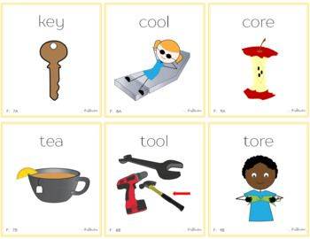
minimal pairs

Slide 8
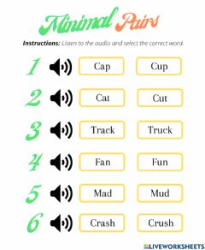

Slide 9
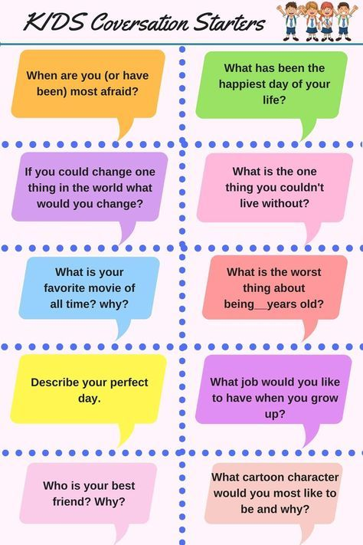

Slide 10
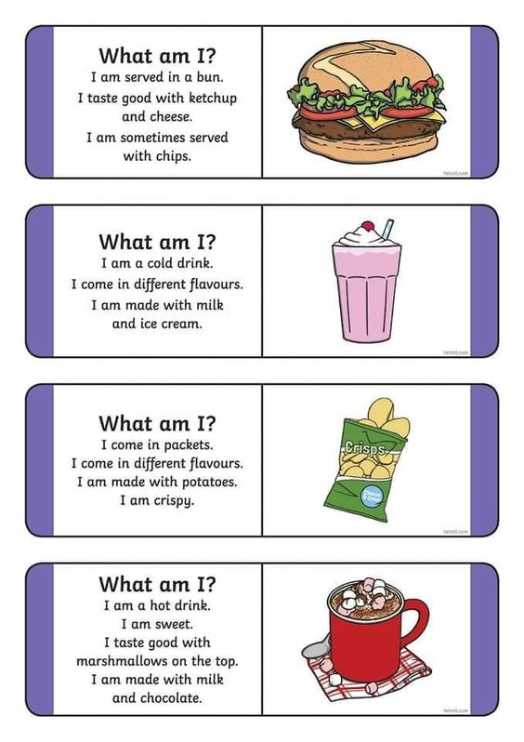

Slide 11
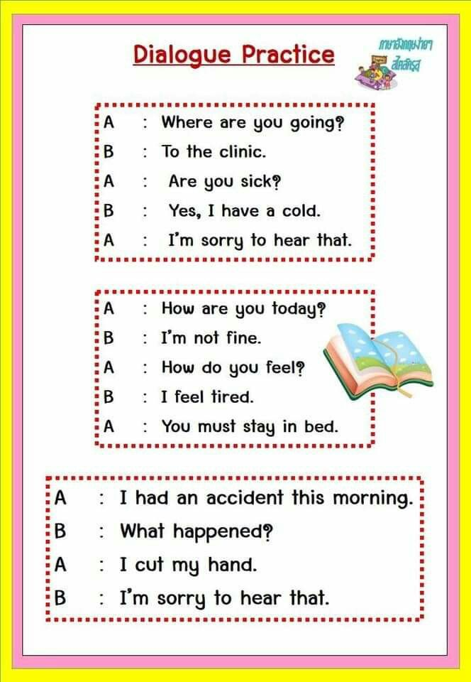

Slide 12
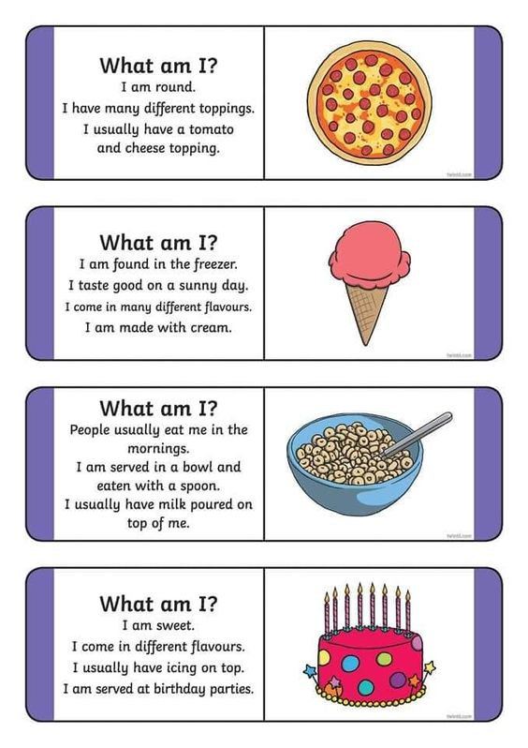

Slide 14
