Slide 1

Imaging of mandibular fractures
استثمار الطاقة النظيفة طريقنا نحو التنمية المستدامة
Oral Diagnosis Department
Asst. prof.
Zainab AL-Bahrani

Slide 2
Aims
Describe the epidemiological pattern of mandibular fractures
Fractures classification
Imaging modality
Showing the main goal of imaging techniques that identify:
The Presence
Number
Exact Localization
Extension Of Fracture
As Well as to analyze the complications in the
adjacent anatomical structures.

Slide 3
Key points
Mandibular fractures are among the most common maxillofacial fractures observed in emergency rooms and are mainly caused by road accidents.
The main clinical features of mandibular fractures are malocclusion and loss of mandibular function.
Knowledge of the action of masticatory muscles is crucial for recognizing bone fragment displacements
Panoramic radiography is usually limited to isolated fracture, whereas computed tomography is the tool of choice for any other facial traumatic events.

Slide 4

Treatment options include:
- a conservative approach
- or surgical treatment
based on the anatomic area and the severity of fracture.

Slide 5
Mandibular fractures are among the most common (60– 70%) maxillofacial fractures observed in emergency
rooms.
The epidemiology of Mandibular fractures varies according to geographical areas and socio-economic factors. The most common causes of Mandibular fractures are road traffic accidents (40–42%), falls, assaults, sports, and work injuries.
The average age of patients with mandibular fracture
occur in the 18- to 54-year age group. Men are mainly involved (male-to-female ratio 5:1)
Mandibular fractures are more likely to occur on weekend days than on other days of the week

Slide 6
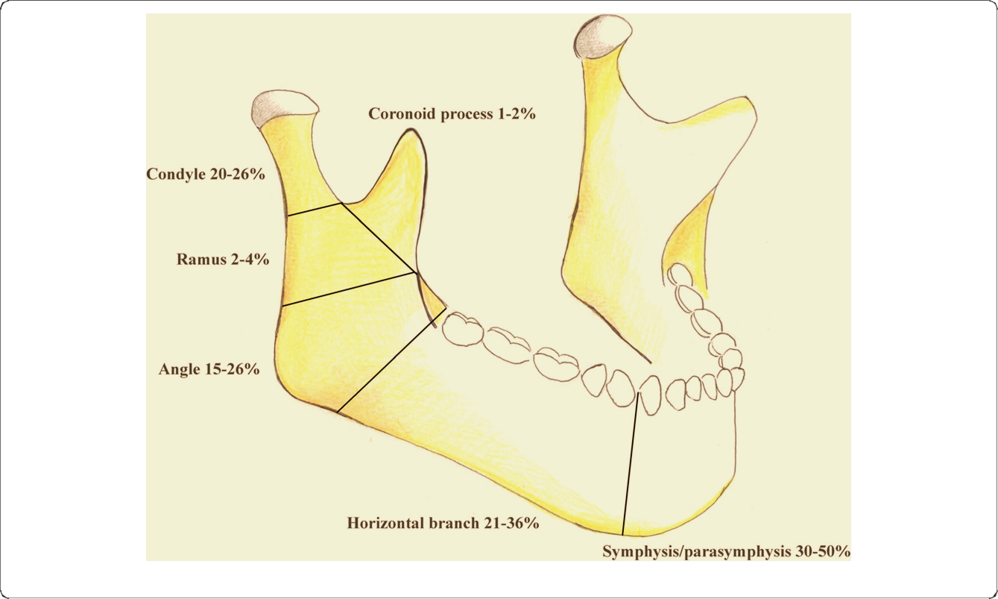
classification
Mandibular fractures can be classified in relation to their anatomic localization as follows: symphysis/ parasymphysis (30–50%), horizontal branch (21–36%), angle (15–26%), ramus (2–4%), condyle (20–26%), and coronoid process (1–2%).

Slide 7
another classification based on pattern of fracture:
Simple fractures consist of single fracture planes that do not communicate with the external environment.
- compound fractures communicate with the exterior, either via the periodontal ligament space or lacerations of the oral mucosa or facial skin.
-Comminuted fractures involve multiple bone fragments at one fracture site

Slide 8
Greenstick fractures are incomplete fractures that involve only one cortical plate
- The term complex fracture or complicated fracture is used to describe fractures with damage to adjacent major vessels and nerves
(e.g., the inferior alveolar neurovascular bundle).
- indirect fractures that arise distant to the site of direct trauma.

Slide 9
Imaging techniques
Radiography represents the first level of diagnosis
in patients with traumatic injury of the mandible
because Proper treatment of fractured mandible is dependent on proper diagnosis.
.
Different X-ray views can be performed for mandibular fractures:

Slide 10
Intra-oral views
If the patient is cooperative and conscious, intraoral periapical, and occlusal images may be beneficial, given their higher resolution, especially when dentoalveolar fractures are suspected

Slide 11
The periapical view can be useful to identify specific dental trauma or abscesses at fracture site.
Occlusal views are very useful when used intraoperatively on patients with symphyseal and parasymphyseal fractures to avoid displaying of the lingual cortex, and widening of the mandibular width.

Slide 12
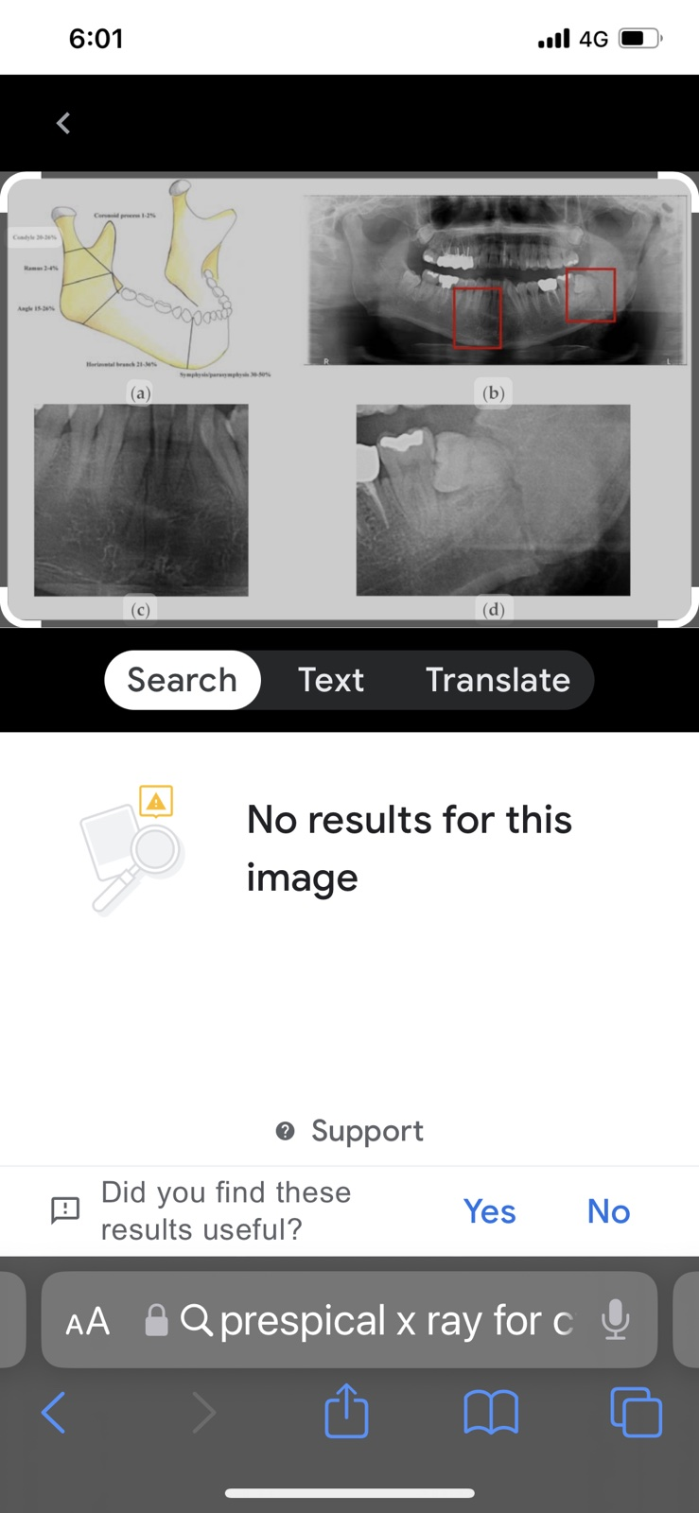
periapical view

Slide 13
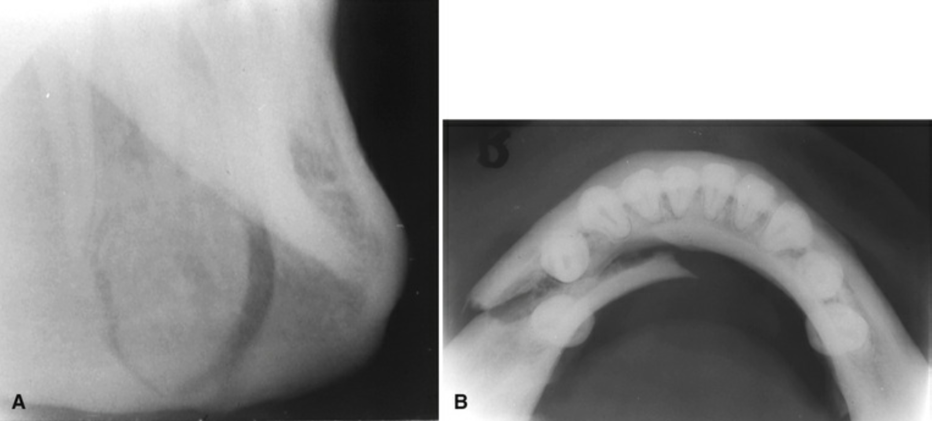
True occlusal image

Slide 14
Extra-oral views
a postero-anterior view, generally used for angle and ramus fractures;
reverse Towne, useful in case of displacement of condylar fragments;
bilateral oblique view, used to analyse the angle and horizontal branch of the mandible.

Slide 15
Panoramic radiography
Panoramic radiography has become the standard of care for the evaluation of mandibular fractures in many institutions. It has much higher sensitivity
The ability to obtain these views while the patient is in the supine position is a great problem in trauma centers where the patient may be unstable, and in patients for whom the cervical spine (C-spine) has traumatized.

Slide 16
Proper Patients positioning with their backs and spines as erect as possible and their necks extended may be the most important part of the radiologic workup in the evaluation of mandibular trauma since it influences the options for evaluation of the mandible.
Panoramic views with posteroanterior or reverse Towne's views
are likely to give a higher yield than the panoramic view alone.

Slide 17
Lateral oblique image of the right mandible in the
premolar region

Slide 18
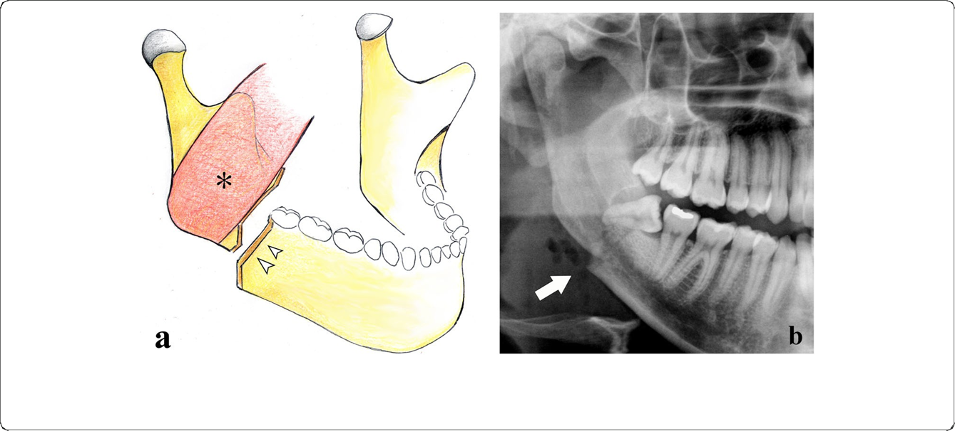
Cropped panoramic radiograph. Mandibular angle fracture involving an impacted third molar (arrow)

Slide 19
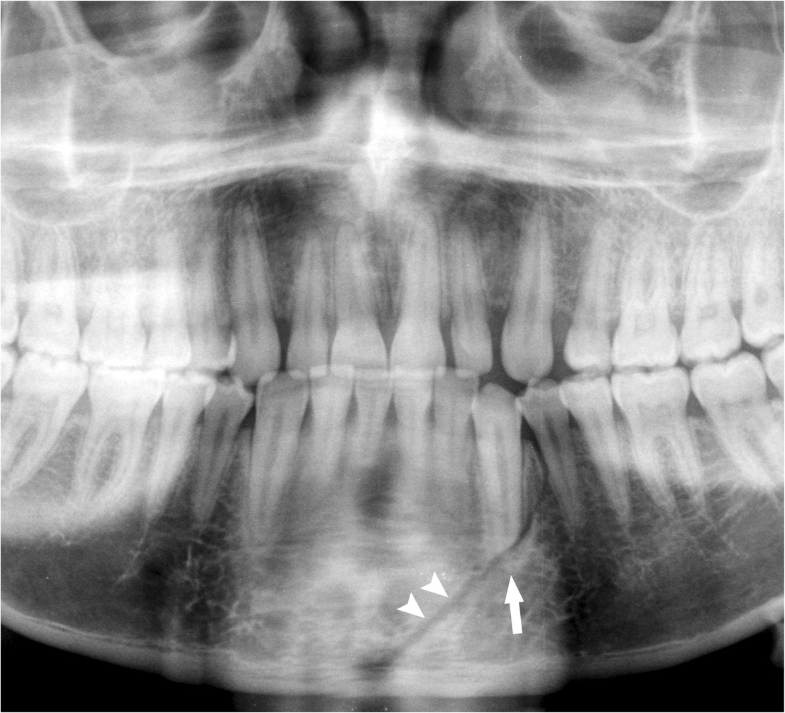
Nardi et al. Insights into Imaging
(2020) 11:30
Page 2 of 15
panoramic radiograph
Fig. 2 Symphysis fracture. Cropped panoramic radiograph. The fracture rhyme (arrowheads) runs from the base of the mandibular symphysis to the alveolar process of the lower left first premolar. The root apex of the canine is fractured (arrow)

Slide 20
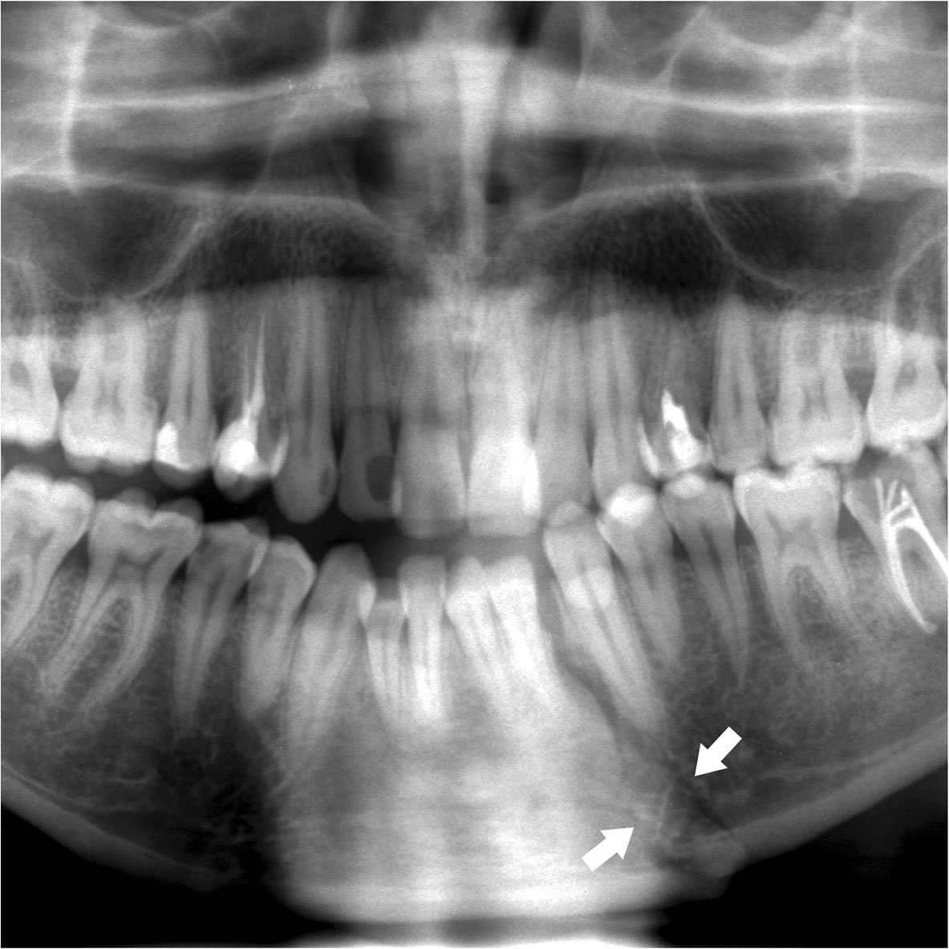
Nardi et al. Insights into Imaging
(2020) 11:30
Page 3 of 15
panoramic radiograph

Slide 21
Advanced radiography
Multislice spiral computed tomography (MSCT)
Represents the reference in complex fractures because it benefits from:
- thin-layer thicknesses (0.5–1.0 mm),
-native images, and three-dimensional
- multiplanar reconstructions
- with no overlap between the different anatomic structures.
- MSCT has sensitivity around 100% in the detection of mandibular fractures

Slide 22
More recent studies performed with improved, higher resolution CT suggest that CT is superior to panoramic radiography, in both:
-sensitivity
-and offering the surgeon a better understanding of the nature of the fractures.
Three-dimensional CT may have an important role in the future for evaluating pre- and postreduction techniques, particularly of subcondylar fractures.
New multislice CT technology will further improve the resolution and speed of CT imaging and reconstructions.

Slide 23
Computed tomography images of bilateral condylar neck fractures showing medial displacement of the condylar heads in line with the lateral pterygoid muscles

Slide 24
Computed tomography examination showing fractures of the left condylar neck and the right mandibular body.

Slide 25
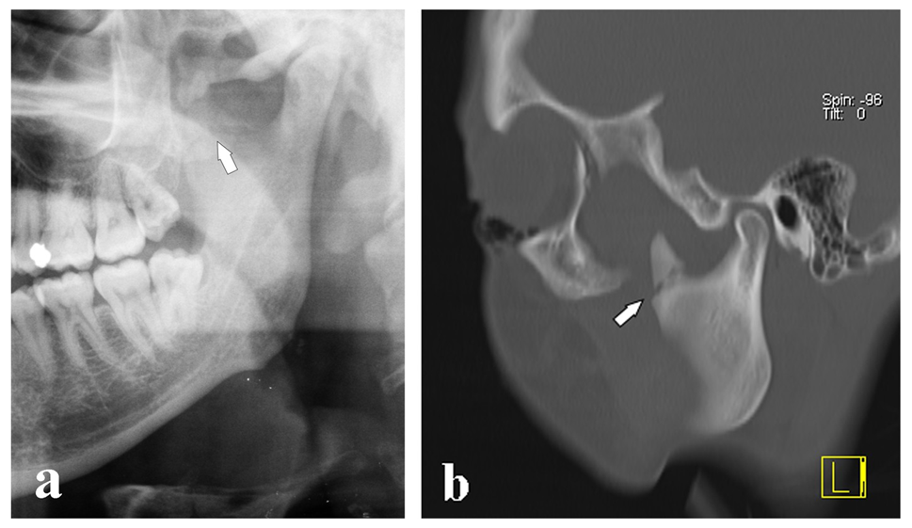
Coronoid process apex fracture. a Cropped panoramic radiograph. b Computed tomography 5-mm oblique reconstruction of the same patient

Slide 26
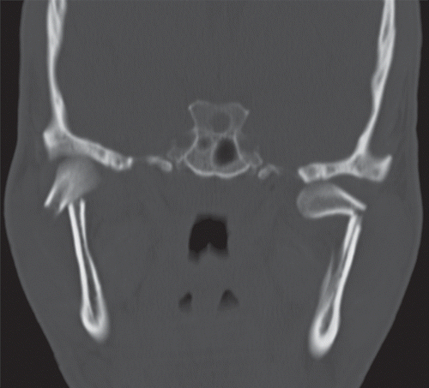
Multidetector CT of Mandibular Fractures,

Slide 27
Cone beam computed tomography (CBCT)
The more recent three-dimensional imaging technique cone beam computed tomography (CBCT) has proved to supply an excellent volumetric study of maxillofacial bone structures and satisfactorily recognise mandibular fractures Moreover,
it has a high spatial resolution (0.075–0.4 mm isotropic voxel)
delivers relatively low radiation doses compared to MSCT
and is only slightly affected by metal artefacts, which often occur in patients stabilised by immobilisation techniques that use metallic materials

Slide 28
Also it used during post-treatment in patients who experience pain and have functional disability for the increased risk of motion
MSCT must be recommended only in multiple traumatized patients.

Slide 29
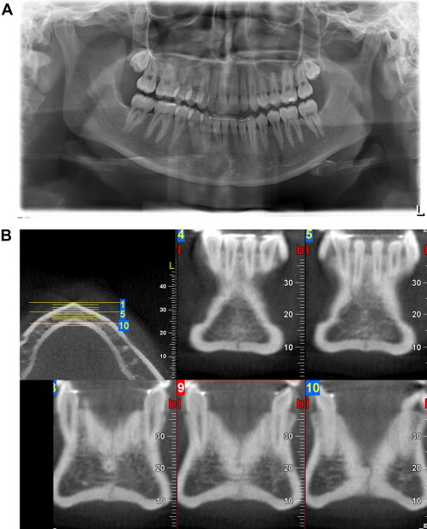
(A) Fracture of the mandibular symphysis not seen before on the panoramic radiograph. (B) Coronal view (CBCT) and topogram taken in the area of the lower incisors.

Slide 30
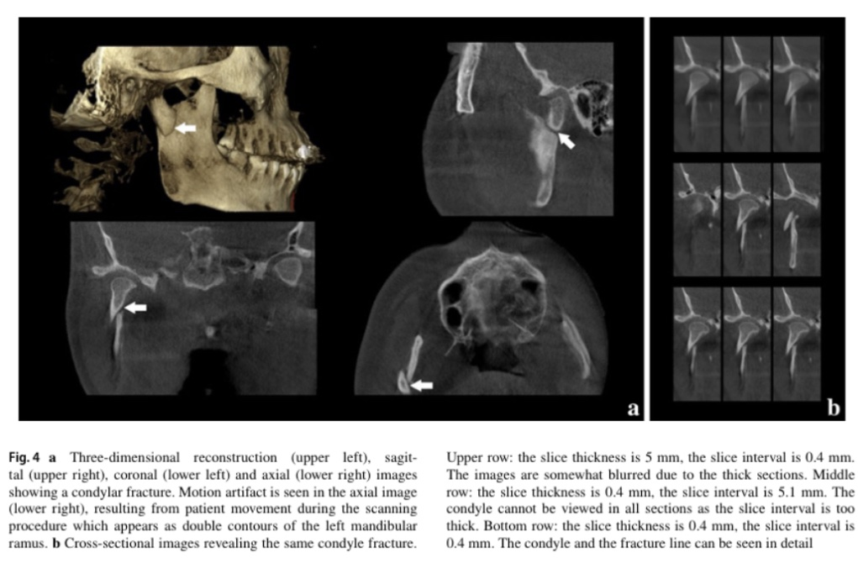
CBCT

Slide 31
Magnetic resonance imaging (MRI)
Is considered to be the best technique for soft tissue evaluation in
condylar fractures since it can accurately identify any
post-traumatic alteration of the structures that make
up the temporomandibular joint, especially the displacement
of mandibular condyles.
Furthermore, MRI is ideal for determining the increase in the amount of extracellular water in bone marrow oedema, whereas MSCT allows high-quality study of the cortical bone.

Slide 32
Magnetic resonance T2w coronal image and T1w
sagittal image of the same patient. The condylar head is in the horizontal position and completely outside the glenoid fossa (arrows)

Slide 33
Interpretation
The margins of fracture planes
usually appear as:
sharply defined radiolucent lines of separation that are confined to the structure of the mandible.
Displacement of the fragments results in a cortical
discontinuity or “step-type defect,” or an irregularity in the occlusal plane.
Occasionally the margins of the adjacent fracture fragments overlap over each other , resulting in an area of increased radiopacity at the fracture site.

Slide 34
Nardi et al. Insights into Imaging
(2020) 11:30
Page 4 of 15
Nondisplaced mandibular
fractures may involve one or both buccal and
lingual cortical plates.
When the x-ray beam is not directed through the fracture plane, the fracture lines in the buccal and lingual plates are not superimposed and may appear as two lines that converge at the periphery

Slide 35
Unfortunately, both PAN and conventional
X-ray views are affected by the typical disadvantages of two-dimensional imaging difficulty in:
the patient’s positioning,
anatomic noise,
superimposition,
geometric distortion,
X-ray angulations,
radiographic contrast
slight movements of the mandible, resulting in artefacts.

Slide 36

Could the panoramic X-ray not detect a displaced fracture of the mandible?

Slide 37
Case 1
A 24-year-old male falling from a height
With 2-cm irregular skin wound has deviated, very painful and limited mandibular movement and mouth opening. mild gingival bleeding, grade II to III mobility, and displacement. After a full clinical evaluation, neurologists ordered a computed tomography (CT) scan , while a panoramic X-ray was requested by the maxillofacial surgeons to assess the jaws’ condition.
It was very surprising when we compared the two images, The panoramic radiograph showed normal findings except for a fracture of the right condylar neck.
While CT scan shows Unusual additional double-splitting fracture of the mandible in the right parasymphysis it was displaced and involving both lingual and labial cortical plates.

Slide 38
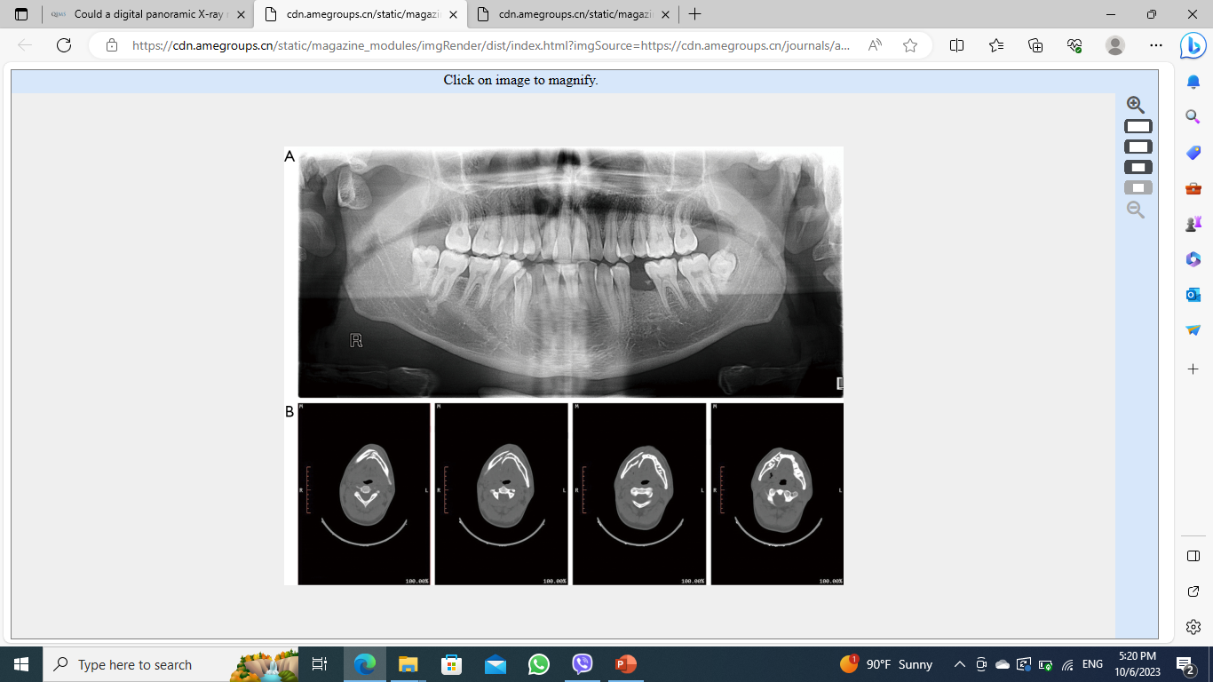

Slide 39
only two similar cases were reported case 2 by Sever et al. [2011] in a 26-year-old female patient presented with split mandibular fracture. case 3 Ersan et al. [2015] presented a 33-year-old male with lingual-cortex splitting fracture.
Both cases could not be detected on the panoramic X-ray
Displaced mandible fractures can be missed when only panoramic radiography is considered as a diagnostic tool. An additional CT or CBCT scan may be required to confirm the diagnosis when there is clinical signs of fracture.

Slide 40
Automatic Detection of Mandibular Fractures in Panoramic Radiographs Using Deep Learning system
An automatic diagnosis method of mandibular fractures in a panoramic radiograph without the intervention of radiologists.
Nowadays, the deep learning system has been applied in many medical fields using
- Convolution neural network (CNN) is one of the most popular methods performed by the association between pixels and the surrounding pixels in the image so Multiple images are obtained from convolution calculation using special filter

Slide 41
- Recently, another deep learning method, you only look once (YOLO), has also been applied for the detection and classification of cyst and tumor of the jaw in panoramic radiographs, breast masses, skin lesion.
This method suggests applying tone mapping to input panoramic radiographs. First, adapt image processing to panoramic radiographs, by enhance the local contrast, desaturation in bright areas, and the balance between each tone for better visibility at the bone border. The enhanced panoramic radiographs are increase the accuracy of the detection of mandibular fractures. convert the original panoramic radiographs with overall dark and irregular background brightness into images with even brightness.

Slide 42
As a conclusion
Assessment of mandibular fractures by imaging techniques is crucial for directing the patient towards surgical or conservative treatments.
It is hoped that a careful radioghrafical assessments with detailed history, and clinical examination will be valuable to health care professionals involved in planning future programs for trauma prevention and treatment methods.

Slide 43


