Slide 1
Evaluation of Parabolic Trough Solar Collector Performance Provided with Metal Foam Inserts and PCM Heat Storage
Supervised by
Asst. Prof. Dr. Mohammed A. Nima

Slide 2
INTRODUCTION
Solar energy is the most abundantly available form of energy on earth.
It is free, clean, and renewable and can be converted into more useful forms of energy, such as electricity, by using appropriate technologies.
Parabolic trough-based solar energy conversion systems have shown promising results when integrated with steam power plants.
A single PTC consists of a parabolic shaped reflecting concentrator, which collects incoming direct solar radiation via its large aperture, as shown in Figure 1.

Slide 3
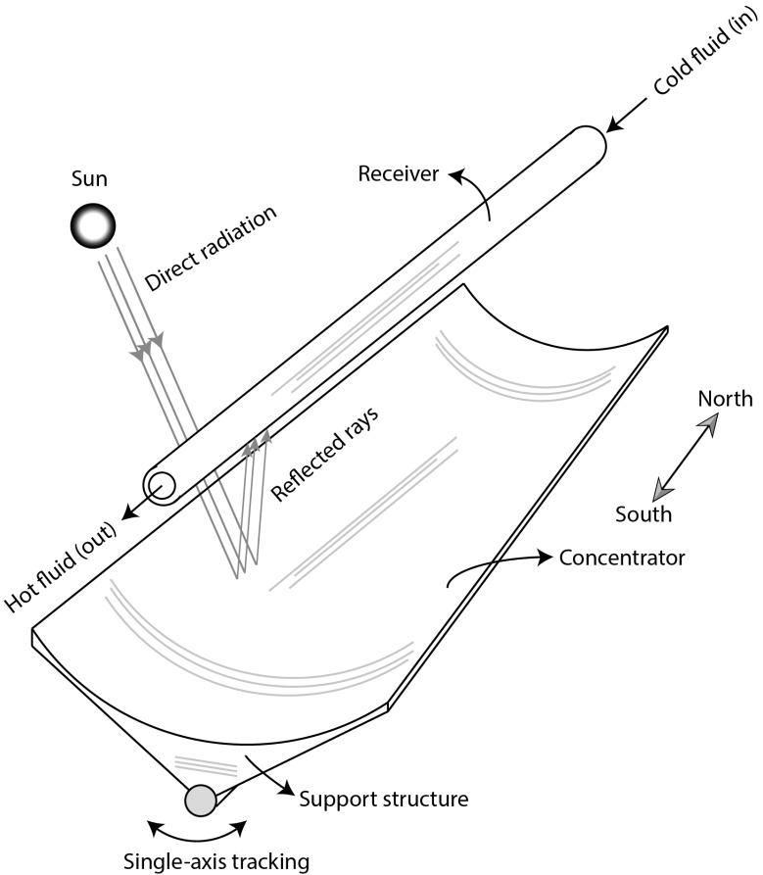
INTRODUCTION
Figure 1: A typical parabolic trough collector (PTC)

Slide 4
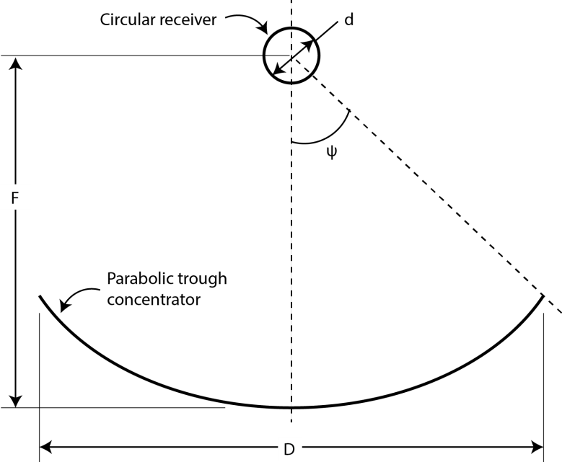

In general, the geometric design of a PTC is characterized by three dimensions as shown in Figure 2. Given these parameters,
The aperture width of the concentrator ($D$),
the diameter of the receiver ($d$)
and the rim angle ($ψ$),
Figure 2: The characteristic dimensions of a PTC

Slide 5
INTRODUCTION
As of 2014, the largest solar thermal power systems using parabolic trough technology include the
354 MW SEGS plants in California,
the 280 MW Solana Generating Station with molten salt heat storage,
the 250 MW Genesis Solar Energy Project,
the Spanish 200 MW Solaben Solar Power Station,
and the Andasol 1 solar power station.

Slide 6
Literature Review
(H. Peng et al. 2021) investigated experimentally and numerically the effect of a semi-annular and fin-shaped metal foam (SAFM) in a parabolic trough collector (PTC).
Monte Carlo Ray-Trace Method is used to determine the non-uniform heat flux on the absorber tube wall.
The results show that the insertion of SAFM improves the thermohydraulic and thermodynamic performance of the absorber tube; compared with a smooth tube,

Slide 7
Literature Review
(Guerraiche, et al. 2020), The present work presents numerical and experimental investigations to study a thermal energy storage system.
The results showed that the use of a PTC with PCM in the receiver periphery can improve the thermal performance of the presented system in the absence of intense radiation.
The maximum outlet water temperature achieved using phase change material in the receiver tube is about 16.80% and 14.86% higher than the simple tube for July 21 and October 21, respectively.

Slide 8
CFD modeling
A computational fluid dynamics (CFD) software tool was used to study the thermal performance of the concentric receiver with a metal foam & PCM.
The computational domain is discretized using hexahedral and quadrilateral elements. Dense grids were generated near the bellows where a large temperature gradient exists as Figure below.
The SIMPLE algorithm was used for coupling pressure and velocity. The complete receiver of the PTC was modeled.
The energy equation solves the heat transfer equation in conjunction with the standard k-ε turbulence model with the solidification and melting model.

Slide 9
CFD modeling
The boundary conditions for the geometry are defined for inlet, outlet, and outer wall of. The boundary conditions of the non-uniform heat flux on the absorber tube's outer wall was obtained using the Monte Carlo ray tracing in Sol Trace.
The solution of the ray tracing is coupled to the CFD model by means of interpreted user defined functions.
To guarantee that the computed results were accurate and reliable, a grid independence study was conducted. Simulations with three grids (500,000, 800,000, 1,000,000 elements) were performed in Fluent™ to determine the frictional pressure drop and temperature increase within one PTR. A comparison of the results showed that there are less than 2% differences in pressure drop and temperature.

Slide 10
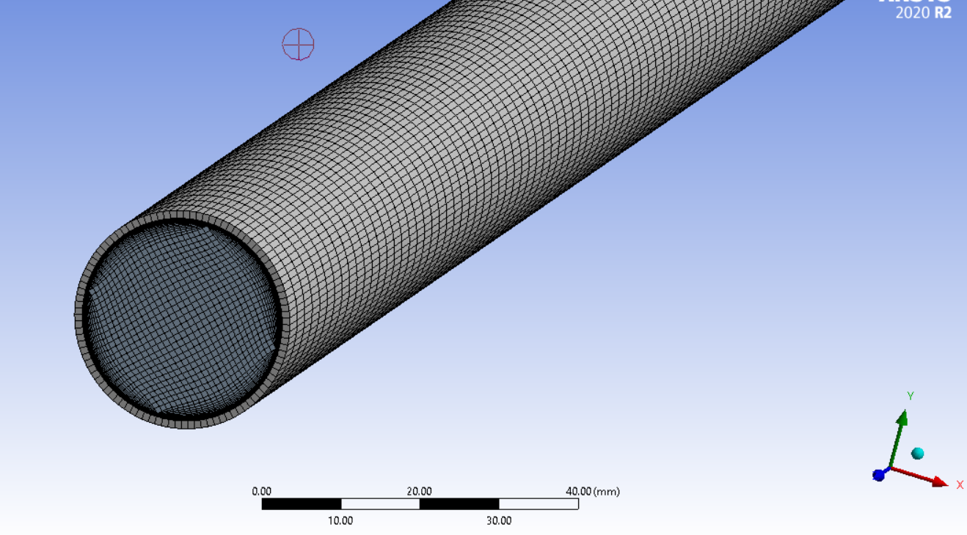

Slide 11
CFD modeling
Thus we will use a 800,000 elements for this study and were used all over this study.
The governing equations are formulated as below, which are composed of the continuity, momentum, and energy equations.
(1) Continuity equation
(2) Momentum equation
(3) Energy equation

Slide 12
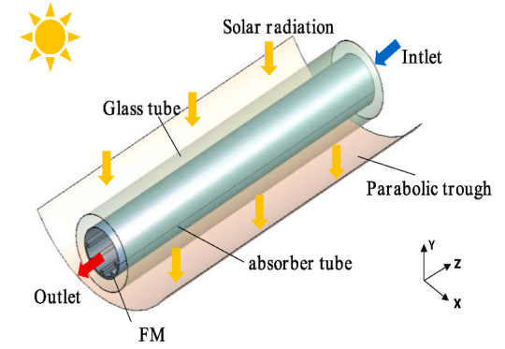
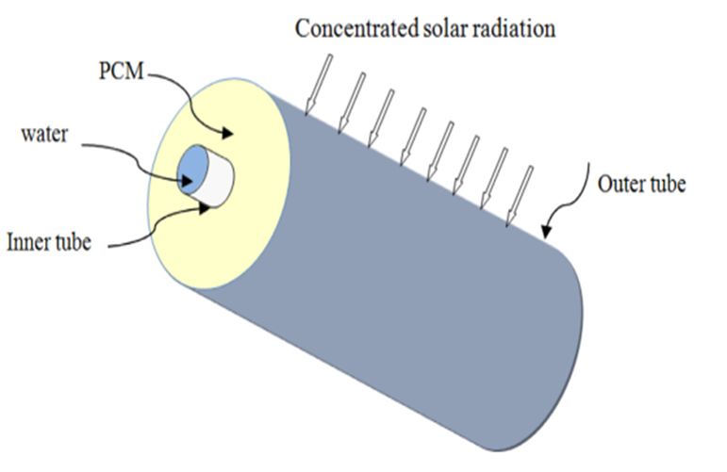

Slide 13
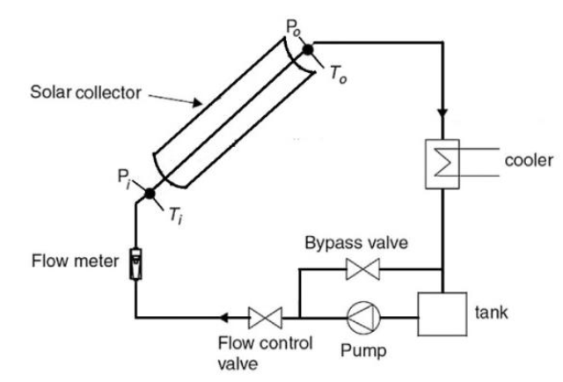
PTC performance analysis

Slide 14
PTC performance analysis
A solar-powered PTC consists of a parabolic reflector plate, a working fluid chamber (absorber or receiver), and a concentric, transparent cover.
The absorber material should be selected with a low emittance for the temperature range and high absorption for solar radiation, such as copper and stainless steel materials.
The vacuum in the heat collection element (receiver tube) should be located to reduce convection losses within the receiver.
The parabolic collector is attached to a structure by a solar tracking mechanism, which rotates the parabolic concentrator with the movement of the sun.

Slide 15
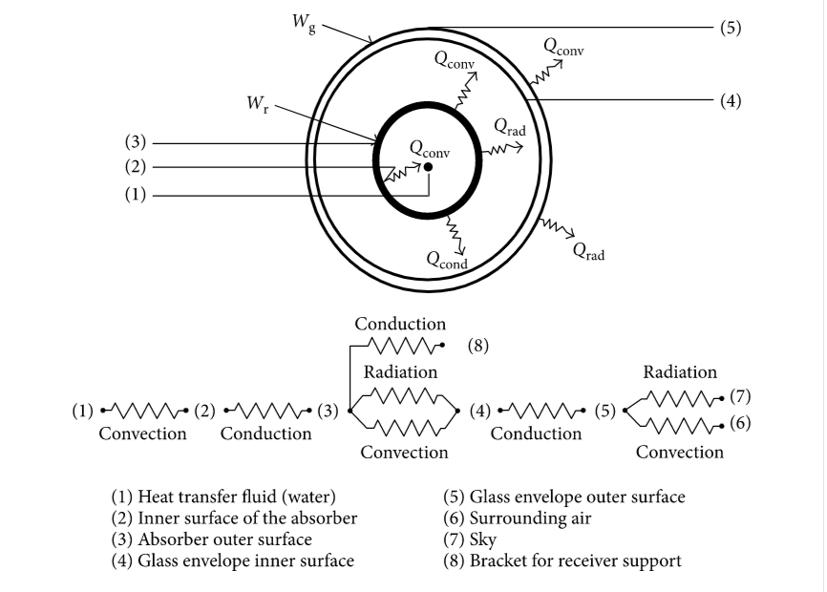
PTC performance analysis

Slide 16
Numerical model and mathematical formulation
Optical modeling
The solar heat flux density calculation by Sol Trace is done to obtain the heat flux distribution profile considering a direct normal irradiation of 1000 W/m².
Figures below show the solar heat flux distribution along the receiver tube outer wall.
The flow is concentrated on the lower part, which is facing the PTC's mirror.
For the upper part, the heat flux density is very low.
For each continuous segment of the data polynomial functions were created using the built-in curve fitting functions in Microsoft Excel.

Slide 17
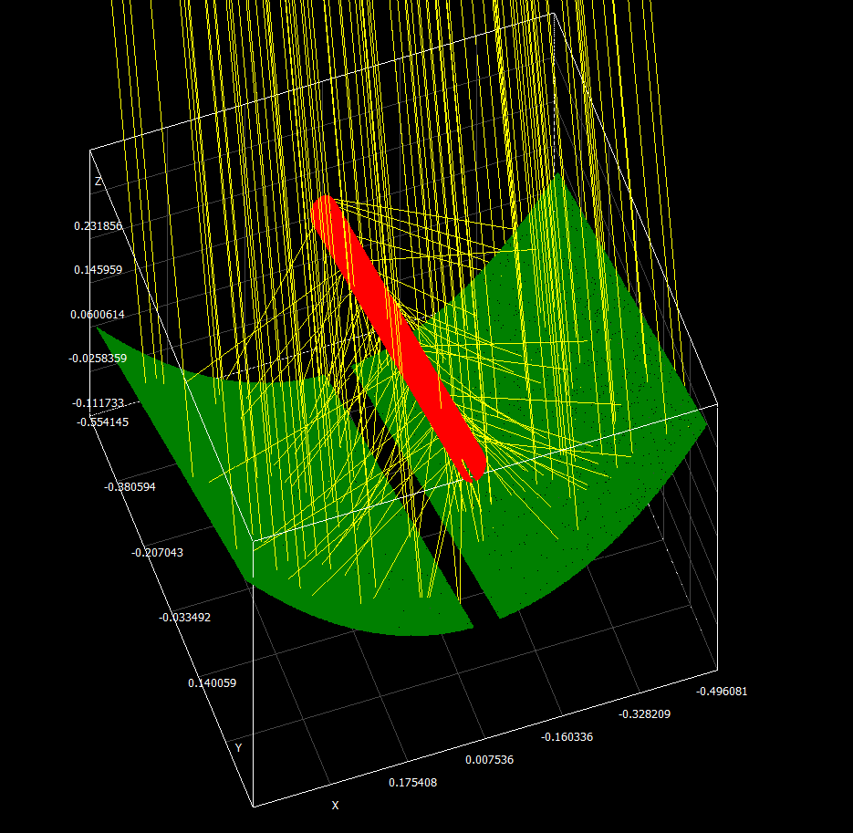
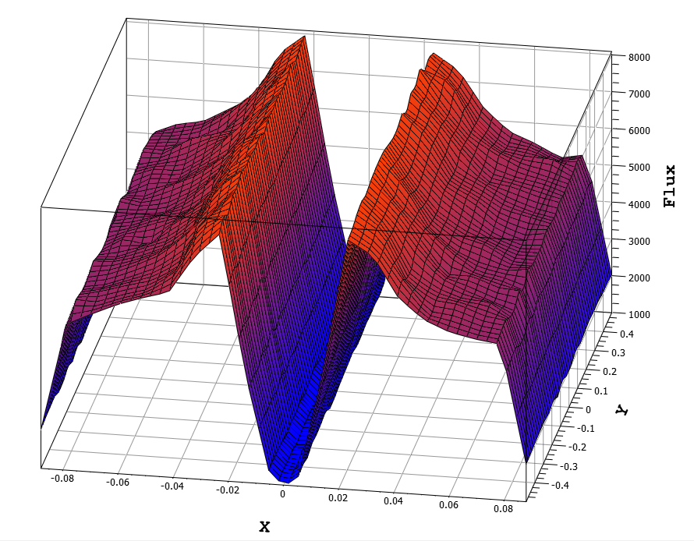
Numerical model and mathematical formulation

Slide 18
Numerical model and mathematical formulation
Temperature Distribution
The numerical study to simulate the heat transfer and fluid flow characteristics in the smooth pipe.
The problem of convection heat transfer through the pipe that subjected to variable heat flux is solved based on the thermal equilibrium model.
Figure below show the temperature contours along the pipe for flow rate 0.5 Lpm.
The inlet temperature is 25ºC and constant according to ASHREA 93 standard.

Slide 19
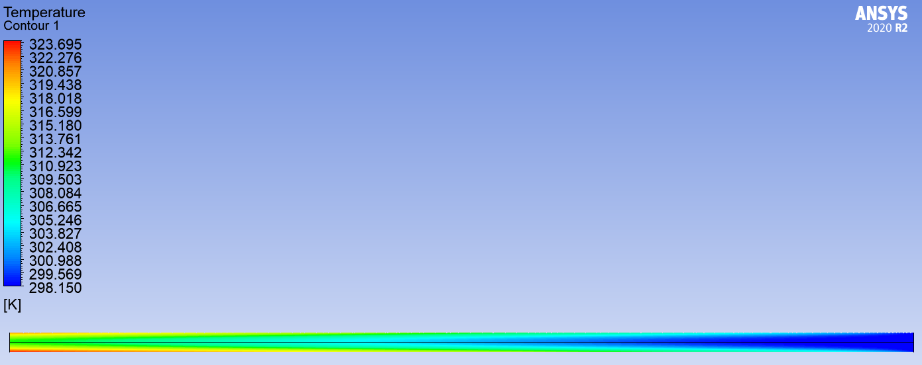
Temp contour with foam @ 0.5 Lpm

Slide 20
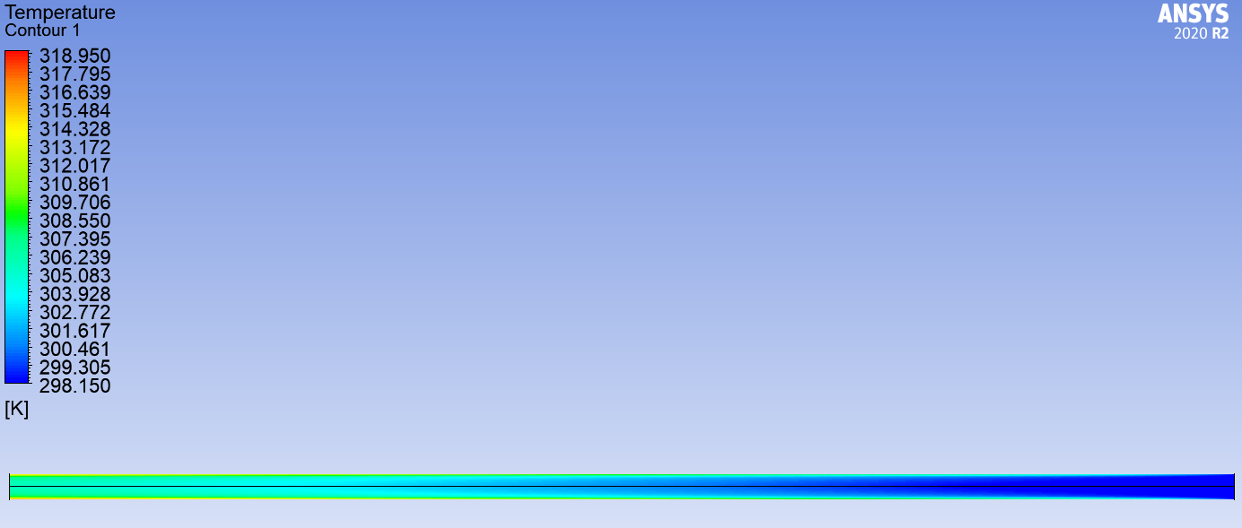
Temp contour without foam @ 0.5 Lpm

Slide 21
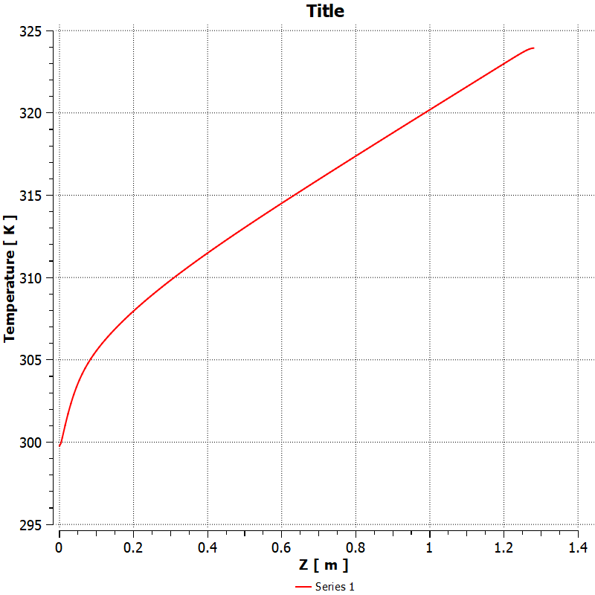
Temp distribution along the pipe – 0.5 lpm with foam

Slide 22
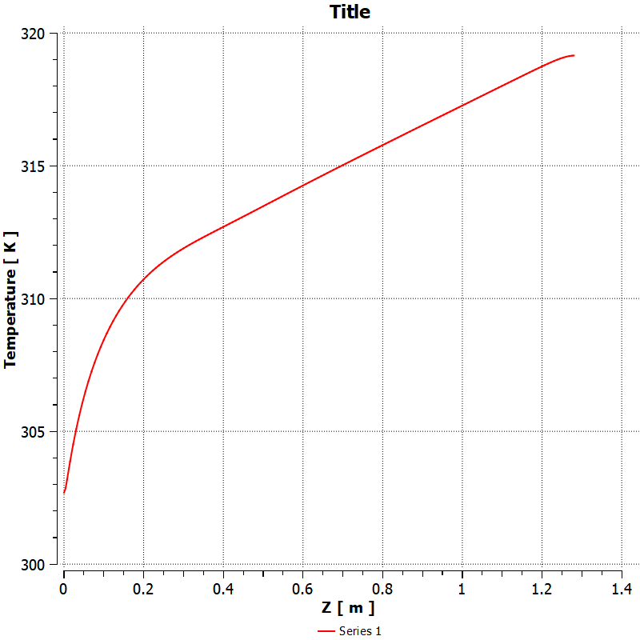
Temp distribution along the pipe – 0.5 lpm without foam

Slide 23
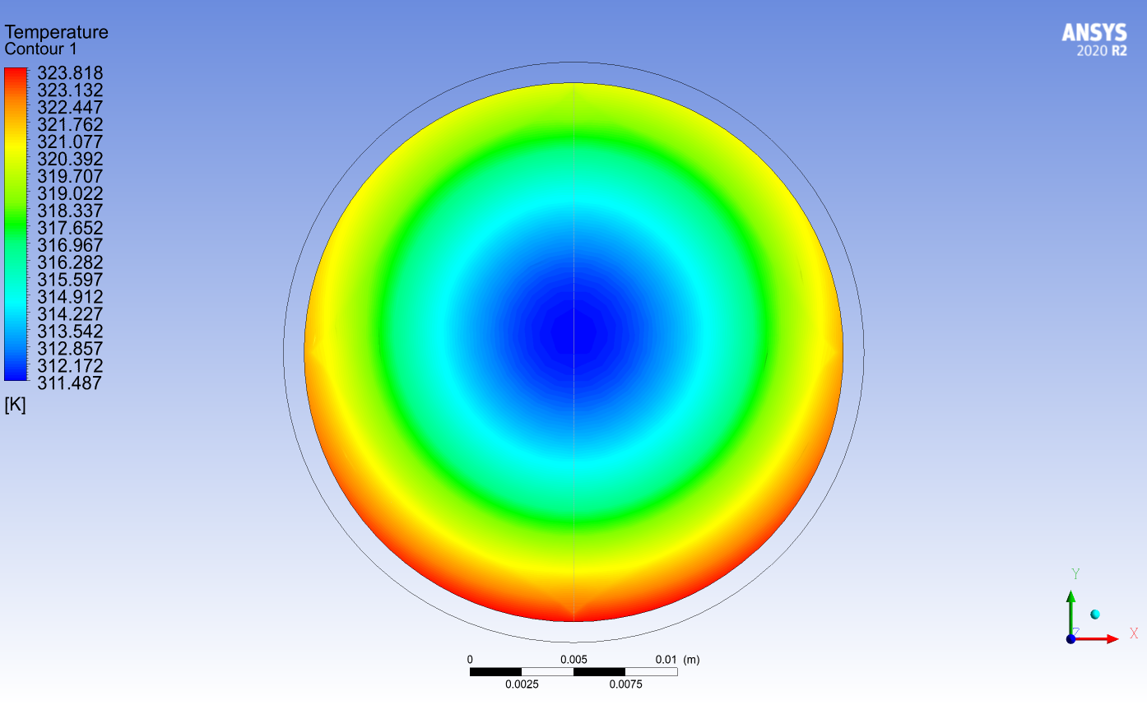
Temp. contour at the outlet - 0.5 lpm with foam

Slide 24
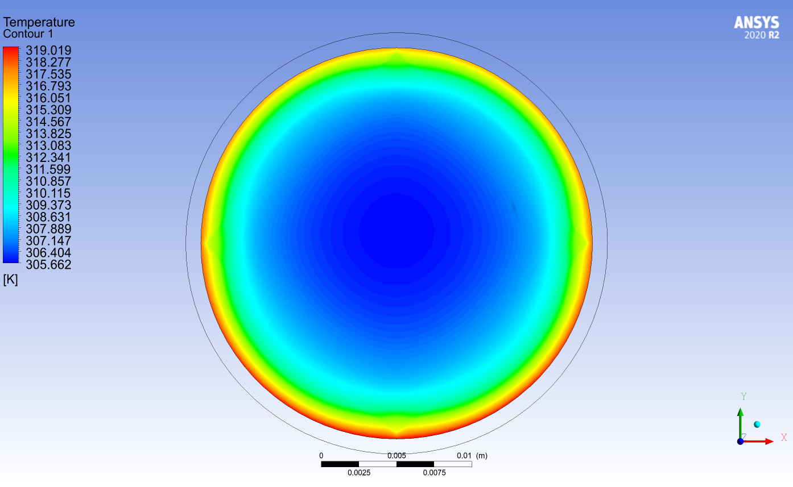
Temp. contour at the outlet - 0.5 lpm without foam

Slide 25
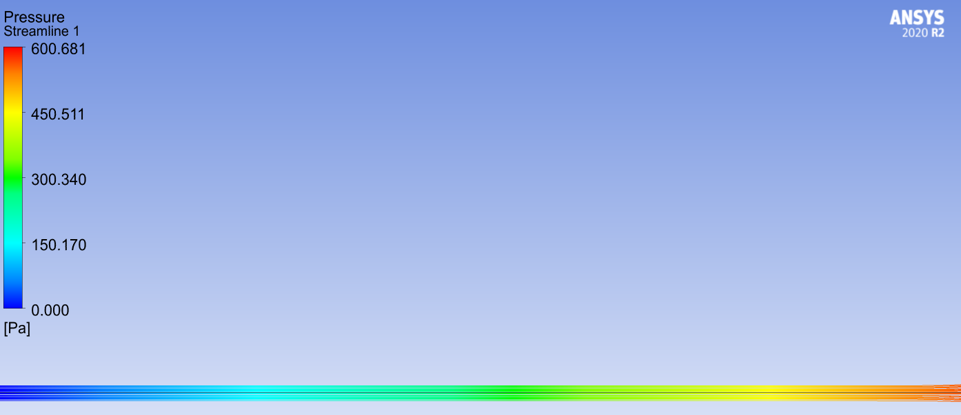
Pressure stream line – 0.5 lpm with foam

Slide 26
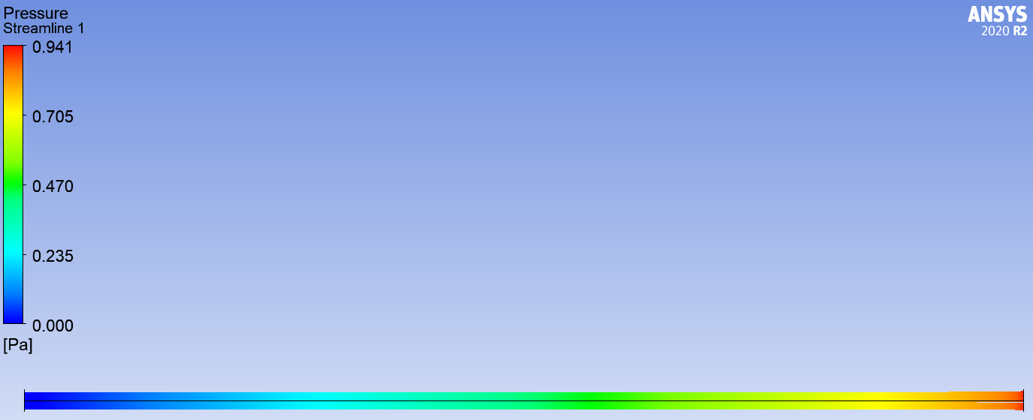
Pressure stream line – 0.5 lpm without foam

Slide 28
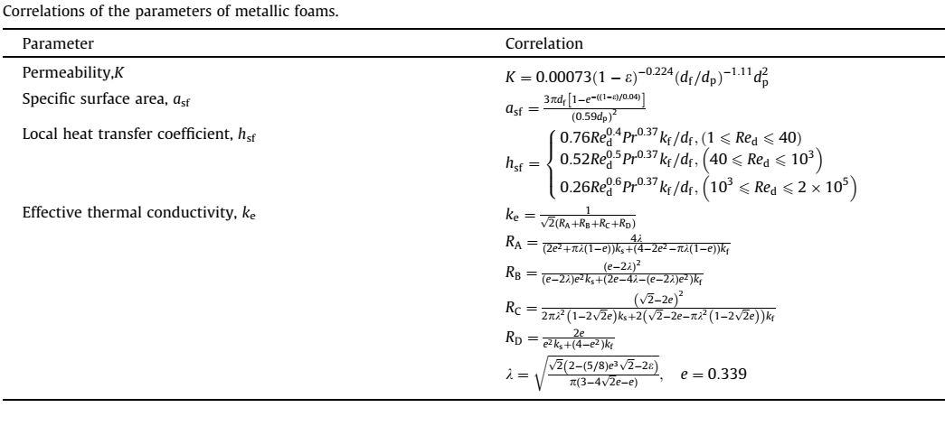
Metal Foam
In the present work, copper foam is used as a porous medium. A copper foam of 10 PPI and a fixed porosity of 0.903 will be used. The parameters of these copper foams are computed as explained below.

Slide 29
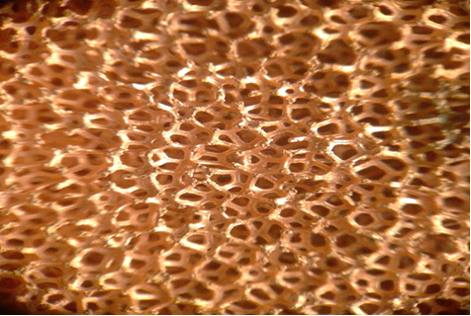
We're still running numerical solutions on the shape of the metal foam inside the pipe to determine the best shape configuration to use in the experiments.
10 PPI Copper Foam

Slide 30
Phase-change materials (PCMs)
An appropriate type will be used as a phase change material, depending on the melting temperature of the material to suit the application according to the theoretical results that we are still working on to reach the best material from PCMs.
Choice of a PCM depends on several basic parameters such as:
melting temperature,
specific heat capacity,
thermal conductivity,
fusion heat,
density,
volume change,
chemical stability, and compatibility with construction materials

Slide 31
Thanks for listening

