Slide 1
Manufacturing and Evaluation of a Robotic Knee Prosthesis for Trans Femoral Amputees
Supervised by
Dr. Ahmed Abdul Hussein
PhD. Student
Marwa Qassim Ibraheem

Slide 2
Research goal
The purpose of this work is to boost the passive prosthesis to a microcontroller-based prosthesis to provide a rotational speed that suits the function for which it is used with characteristics that facilitate turning, walking on irregular grounds, and reducing secondary injuries on above knee amputees.
The boost focuses on providing a knee mechanism design by using Maxon EC motor, a socket and foot that can be obtained from previous designs.
The study required to be achieved some of the basic criteria, as the proposed knee joint must have sufficient strength to bear up the weight of the amputee’s body and also have the ability to flex the knee to 115⁰

Slide 3
Introduction
Thousands of people lose their lower limbs due to circulatory and vascular problems, diabetes complications, cancer, or trauma every year. Among them, some people lost part or all of their lower limbs and the ability to walk need to be restored by lower limb many physical and psychological challenges face patients with lower limb amputations which harm their health and mobility, modern prosthetic designs aim to retrieve a natural and effective gait by optimizing active and passive components to resemble the properties of the healthy limb
Types of knee prosthetic's
the passive knee prosthesis
the semi-active knee prosthesis
the active knee prosthesis
Prosthetic knees can be divided into Mechanical or Computerized
Single-Axis Knees
Polycentric Knees
Pneumatic or Hydraulic Knees
Computerized Knees

Slide 4
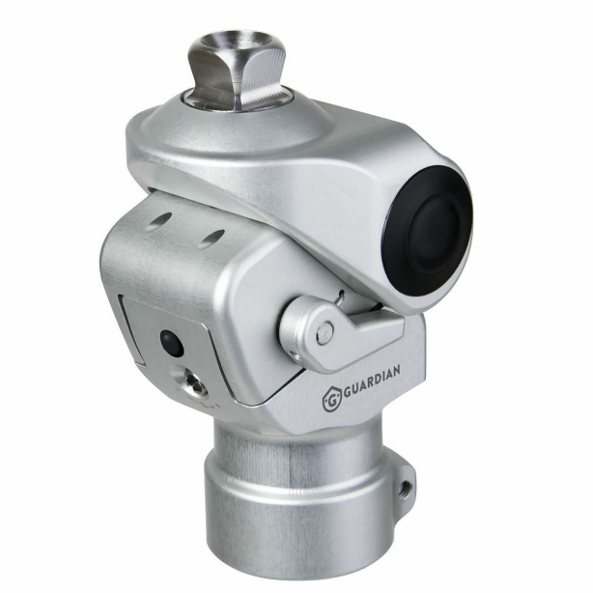
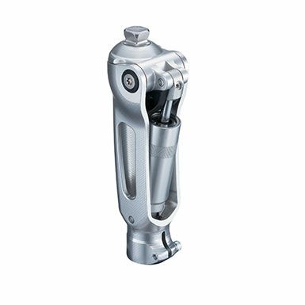
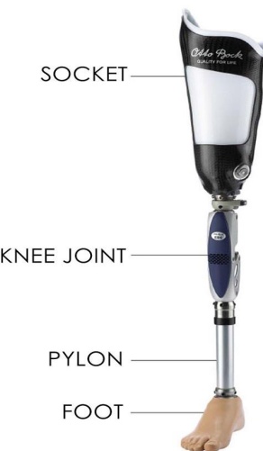
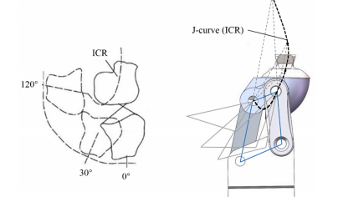
Types of knee prosthetic's

Slide 5
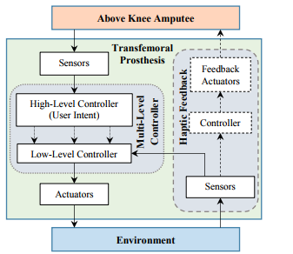
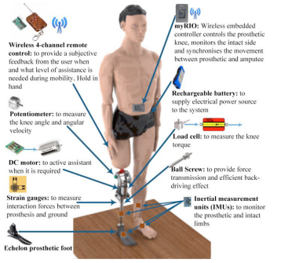
Types of knee prosthetic's

Slide 6
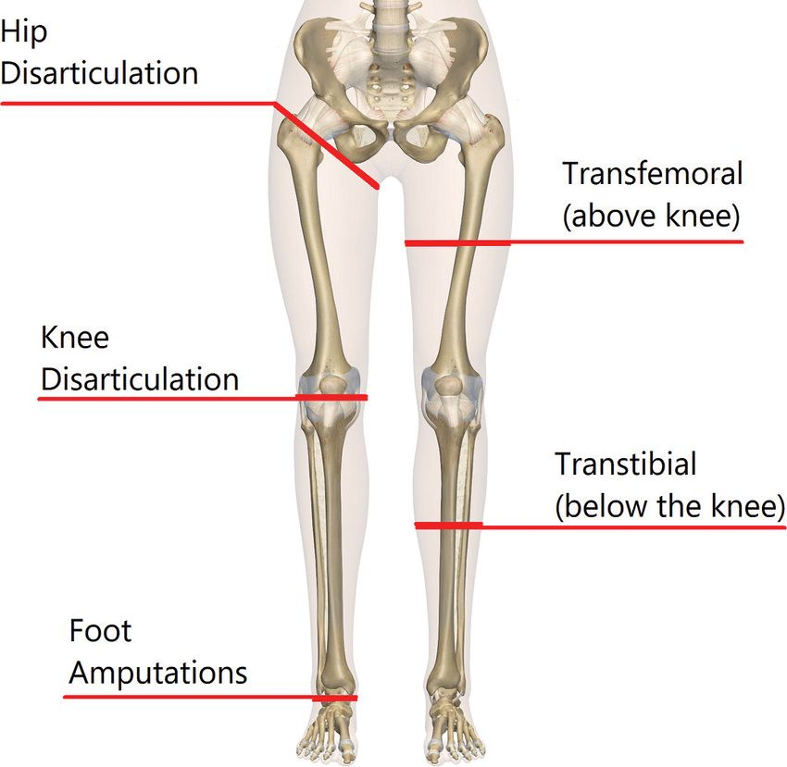
level of amputations

Slide 7
Literature Survey
Jan Andrysek Compared kinematic gait parameters for two common types of friction-based swing-phase controlled prosthetic knee joints. Two-dimensional optical gait analysis was conducted as part of a cross-over study design involving 17 individuals with unilateral trans femoral amputations. Two prosthetic knee joints were compared. One utilized constant-friction (CF) and the other a variable cadence controller (VCC) for swing-phase control. Gait was analyzed at normal and fast walking speeds. Primary gait parameters included swing-phase time, step length, and knee flexion. Swing-phase time and peak knee flexion angles, as well as their related symmetry indices, were lower for the VCC compared to the CF (p < 0.01), The VCC resulted in faster walking speeds by approximately 15% compared to the CF (p = 0.002)
Lucas Galey Compare three knee joint (a simple passive knee M3, the prototype E-Knee, and a high-end knee C-leg). Use a microprocessor locking test to evaluate the prototype’s ability to prevent falls, the E-Knee added sensing, computing, and controlling. Initial data from two types (E-Knee ,C-Leg )found that it improved gait by providing more stability than the M3. Patients reported no perceived differences in stability between the E-Knee and the C-Leg. Patient trials supported that the E-Knee prototype behaved more naturally than M3.

Slide 8
Literature Survey
Mai Murabayashi Develop a passive prosthetic knee for a trans femoral amputee to prevent prosthetic knee flexion during the stance phase. Proposed mechanism restricts only flexion during the prosthetic stance phase with a load on the prosthetic knee regardless of the joint angle of the prosthetic knee. The load on the prosthetic knee required to maintain locked flexion was analyzed. The results of level walking showed that the proposed mechanism limits knee flexion ,as designed.
Zhang, propose semi-active model with ball-screw driven by the motor and the passive hydraulic damping cylinder. The mathematical models of hydraulic cylinder damping and active torque were established to simulate the knee torque and angle. The results show that the knee torque is smaller than 10% in the whole gait. The knee angle value is 34.7% in stance phase and 11.5% in swing phase. The angle in swing phase is closer to the intact knee. The semi-active prosthetic knee could provide similar torque and angle of the biological knee.

Slide 9
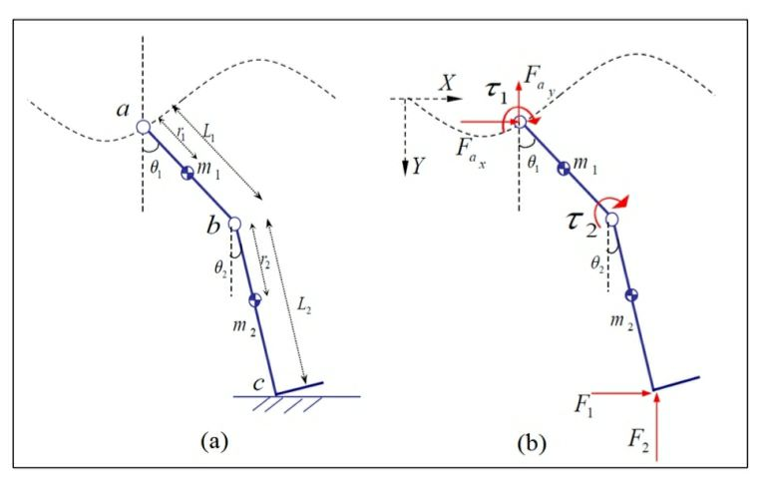
Mathematical Model

Slide 10
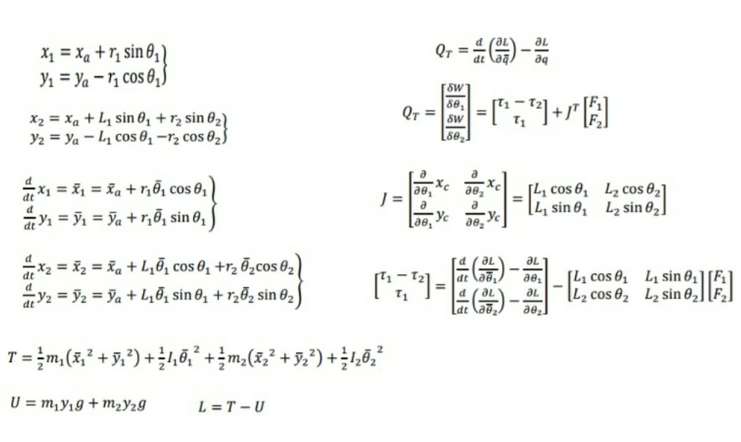
Mathematical Model

Slide 11
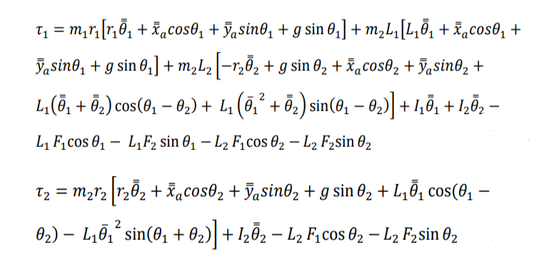
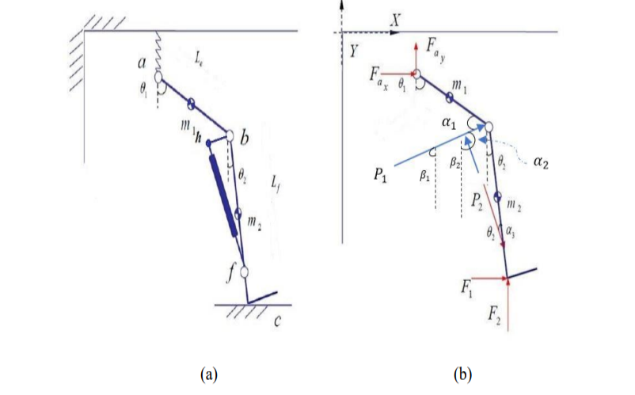
Mathematical Model

Slide 12
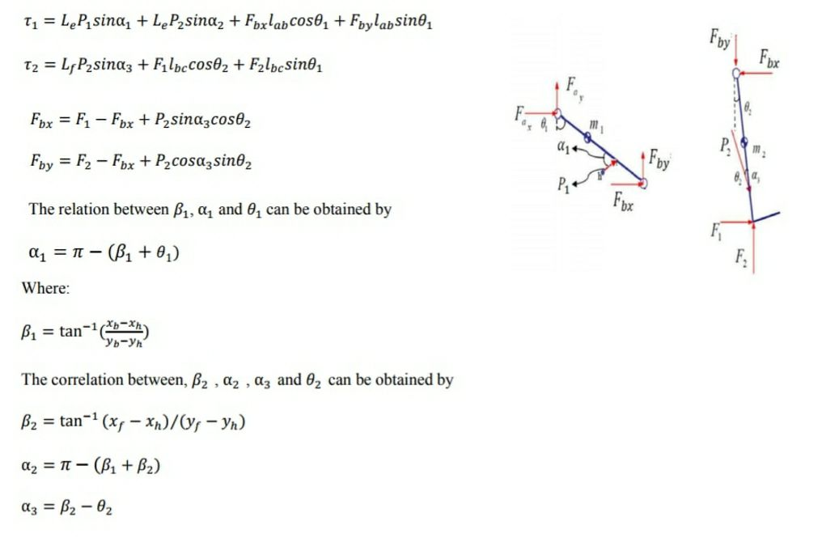
Mathematical Model

Slide 13
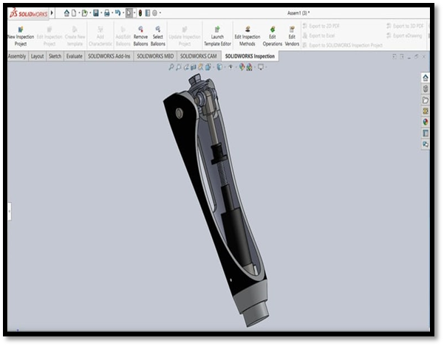
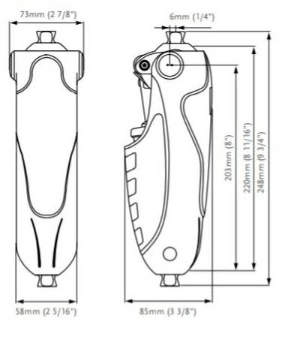
Proposed design for prosthetic knee joint

Slide 14
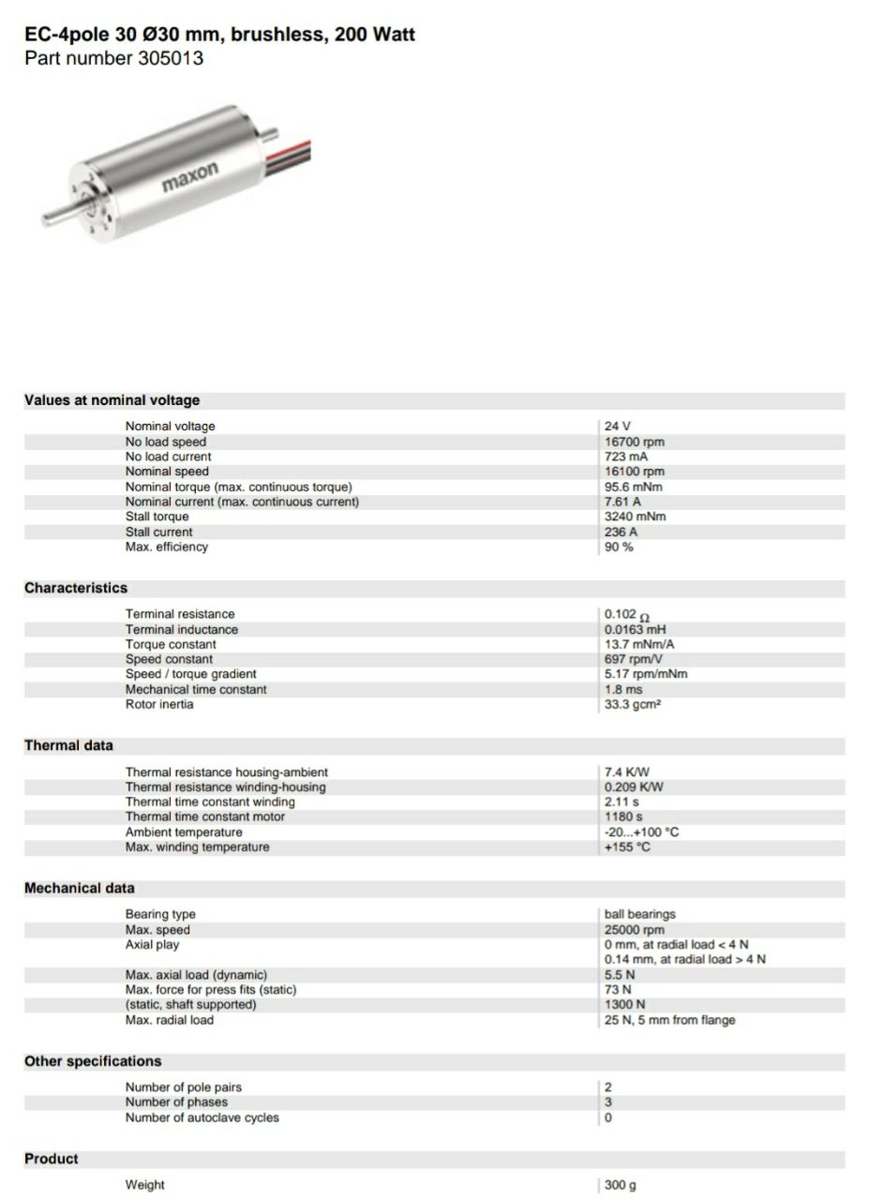

Slide 15
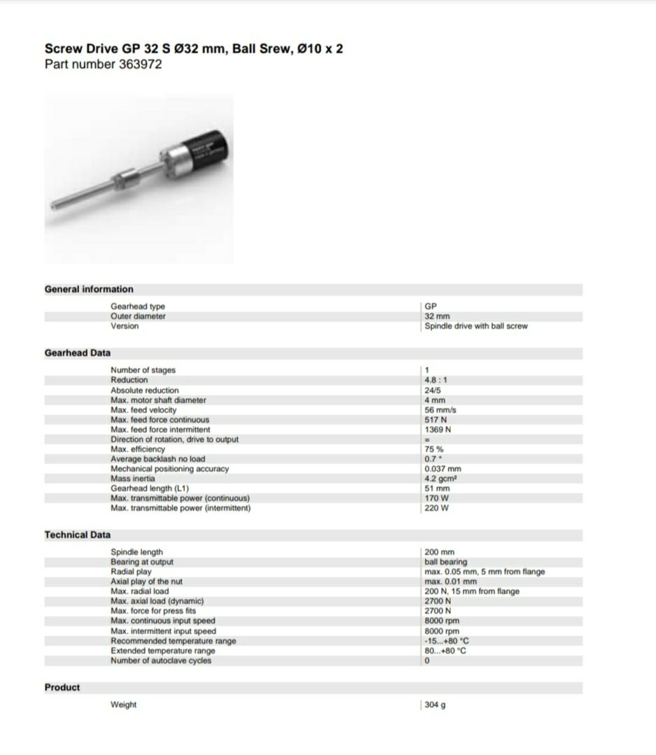

Slide 16
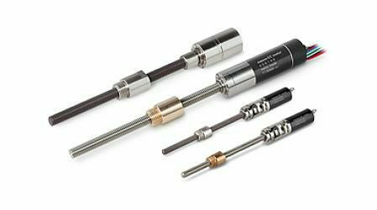
Boundary Condition and Finite Element Analysis
Boundary condition for knee joint model analysis The analysis evaluation for knee joint model of von mises stress and deformation with safety factor done by applying load 1200N at position (A ) tip of upper part of the hinged and fixed support at position (B) on the surface of the lower part .
Finite Element Analysis In this work selected three kinds of materials. They are Aluminum Alloy 6061 T6 , Aluminum alloy 2024 and AISI4130 Stainless Steel. The simulation executed by using ANSYS2020R2 program, and according to the results, one material was selected.Three kinds of analyses were performed.Von mises stress, displacement and safety factor analysis that display in next figures Synopsis of this results was tabulated in Table 1.

Slide 17
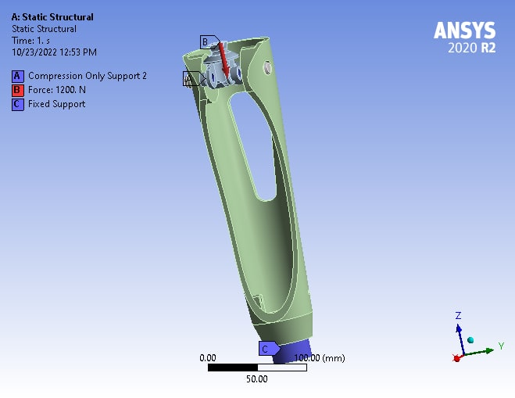
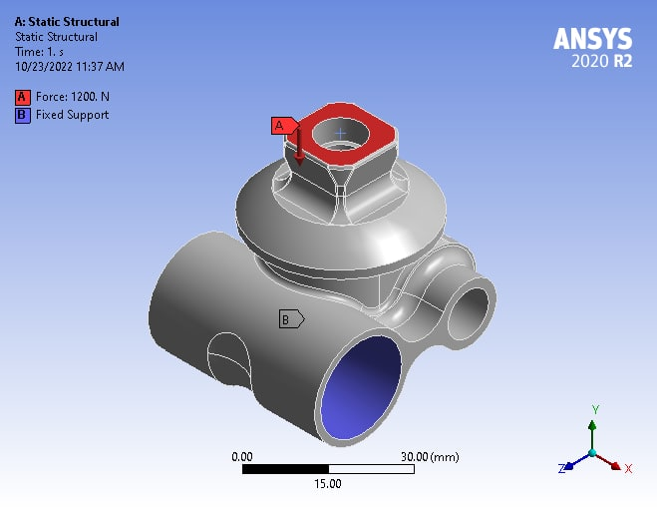
Boundary Condition and Finite Element Analysis

Slide 18
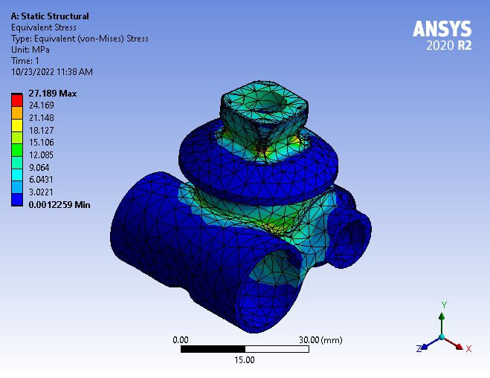
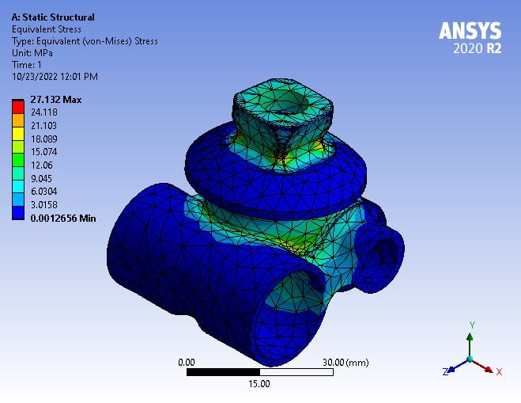
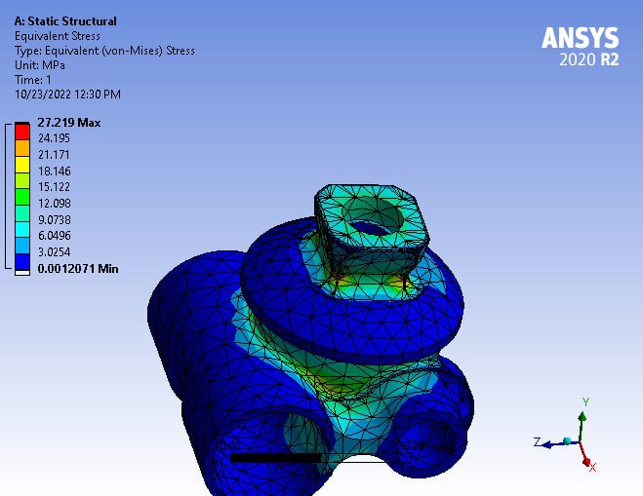
Von Mises Stress Analysis

Slide 19
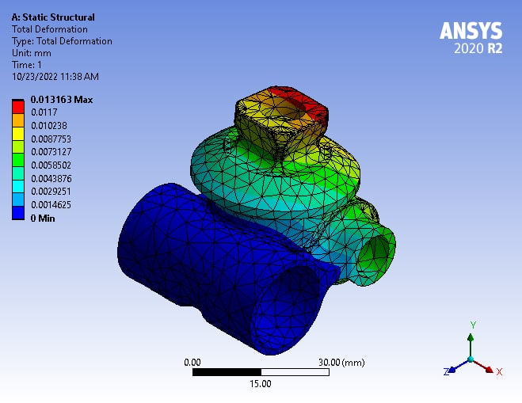
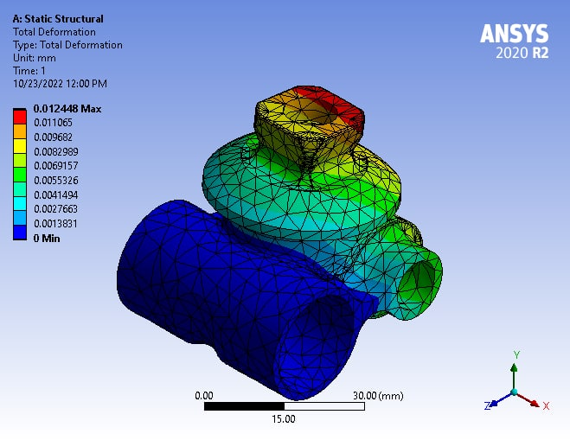
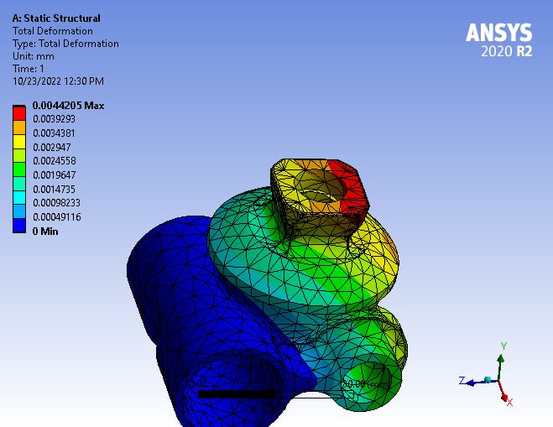
Displacement Analysis

Slide 20
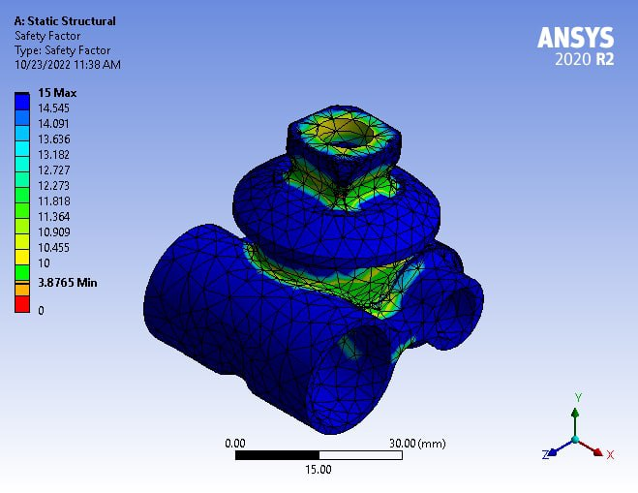
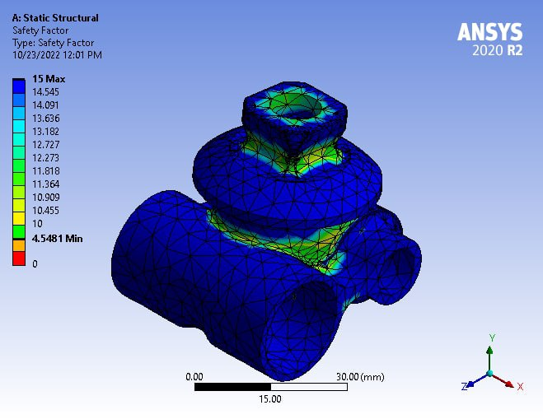
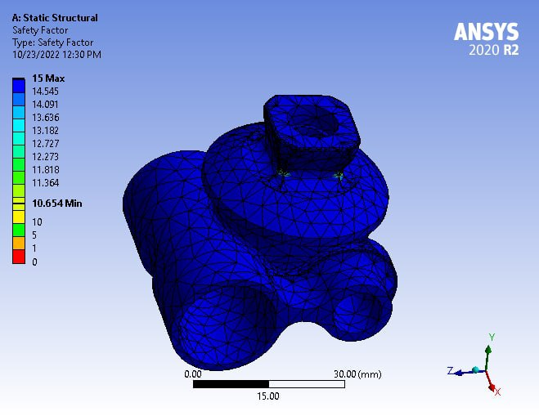
Safety Factor Analysis

Slide 21
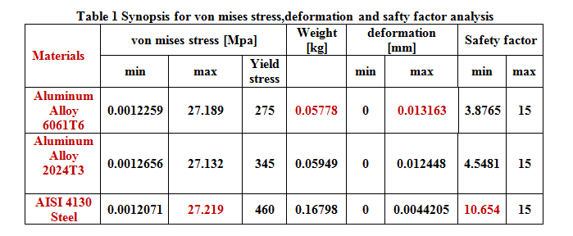
RESULT

Slide 22
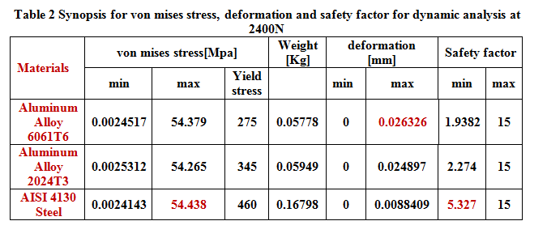
Dynamic Analysis
Dynamic loads are taken into account during the ascending and descending of stairs, assuming that the applied force becomes double since impact load rises the effect of load to twice its static effect in a sense similar to the effect of a step function on a dynamic system. In order to further understand its impact on the outcomes, a 2400N force was applied

Slide 23

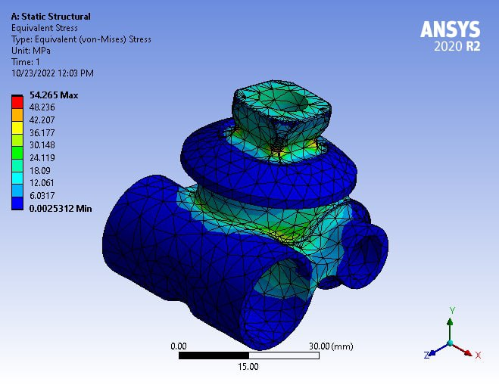
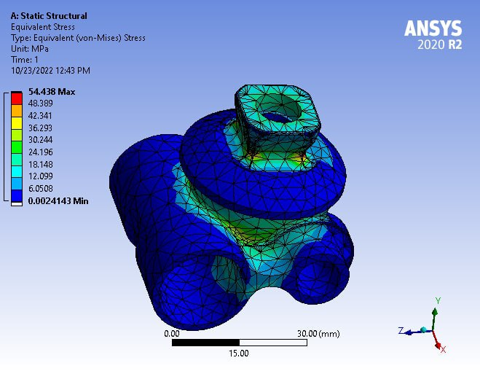
Von Mises Stress Analysis

Slide 24

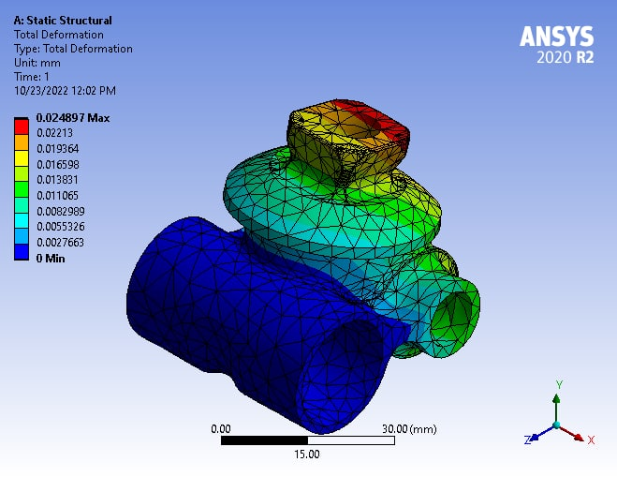
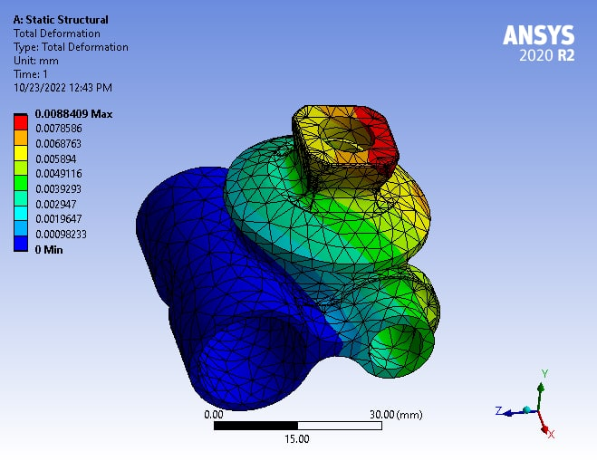
Displacement Analysis

Slide 25
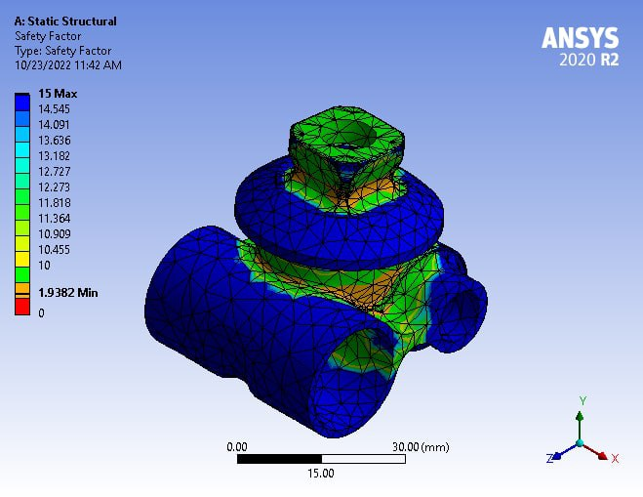
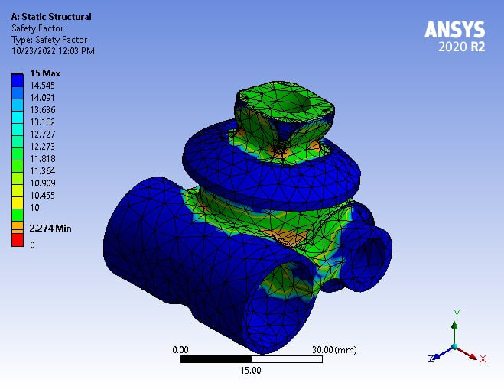
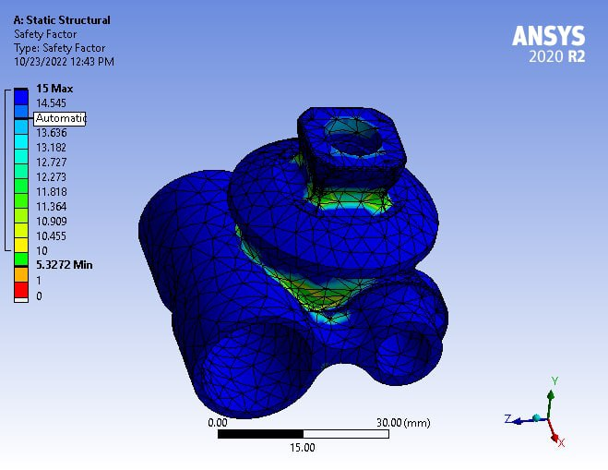
Safety Factor Analysis

Slide 26
Conclusions
Due to the Aluminum Alloy 6061 light weight, acceptable safety and low cost, it has been selected and considered the best for use in prosthetic knee joints, which gives more comfort and stability for amputees.
AISI 4130 Steel showed highest von mises stress value which was (27.219 Map)
All three materials recorded the highest value for the safety factor, with value of (15)
Aluminum Alloy 6061 recorded the highest value of deformation which was (0.013163mm) with lightest weight at a value (0.05778 Kg), and it represented the most appropriate choice for the design

Slide 27
References
[1] Gailey R S, Roach K E, Applegate E B, Cho B., Cunniffe B, Licht S, Maguire M and Nash M S., 2002 The Amputee Mobility Predictor: An instrument to assess determinants of the lower-limb amputee’s ability to ambulate, Arch. Phys. Med. Rehabil. vol .83(5), pp. 613– 627.
[2] Pitkin, M. R., 2010 Biomechanics of Lower Limb Prosthetics, Springer Berlin Heidelberg, Berlin, Heidelberg DOI:10.1007/978-3-642-03016-1 ISBN: 978-3-642-03015-4.
[3] Roozbeh Borjian, (2008) Design, Modeling, and Control of an Active Prosthetic Knee University of Waterloo, degree of Master of Applied Science in Mechanical Engineering. http://hdl.handle.net/10012/4082 .
[4] Lambrecht, B. G. A, 2008, Design of a hydbrid passive-active prosthesis for above knee amputees" University of California, Berkeley, Unpublished doctoral dissertation.
[5]https://shop.ottobock.us/Prosthetics/Lower-Limb-Prosthetics/Knees---Mechanical/c/1300 .

Slide 28
References
[6] https://www.physio-pedia.com/Prosthetic_Knees
[7] Andrysek, J.; Michelini, A.; Eshraghi, A.; Kheng, S.; Heang, T.; Thor, P. Gait Performance of Friction-Based Prosthetic Knee Joint Swing-Phase Controllers in Under-Resourced Settings. Prosthesis 2022, 4, 125–135. https://doi.org/ 10.3390/prosthesis4010013
[8] Galey, L.; Gonzalez, R.V. Design and Initial Evaluation of a Low-Cost Microprocessor-Controlled Above-Knee Prosthesis: A Case Report of 2 Patients. Prosthesis 2022, 4, 60–72. https://doi.org/10.3390/ prosthesis4010007
[9] Murabayashi, M.; Mitani, T.; Inoue, K. Development and Evaluation of a Passive Mechanism for a Transfemoral Prosthetic Knee That Prevents Falls during Running Stance. Prosthesis 2022, 4, 172–183. https://doi.org/10.3390/ prosthesis4020018
[10] Zhang, Z.; Yu, H.; Cao, W.; Wang, X.; Meng, Q.; Chen, C. Design of a Semi-Active Prosthetic Knee for Transfemoral Amputees: Gait Symmetry Research by Simulation. Appl. Sci. 2021, 11, 5328. https://doi.org/10.3390/app11125328

Slide 29
Thanks

