Slide 1

University of Baghdad
College of Engineering
Mechanical Engineering Department
Dynamic crack propagation for composite thin plates reinforced with carbon nanotubes under multi axial cycling loading
By
Hayder Sami Abdulameer
By Supervisor Prof.Dr.Fathi Abdulsaheeb Alshamaa

Slide 2


THE PLAN OF STUDY
Material
Type of Crack
Multi Axial Fatigue
AL-Carbon nano tubes
Edge Crack
Mixed Crack
Central Crack
Proportional Load
Non-Proportional load
Single Wall Carbon Nano Tubes
Multi Wall Carbon Nano Tubes
$\frac{σ_{1}}{σ_{2}}$= constant
$\frac{σ_{1}}{σ_{2}}$not constant

Slide 3
The Flow Chart of the Study:
Dynamic crack propagation for composite thin plates reinforced with carbon nanotubes under multi axial cycling loading.
Nano-composite fabrication
Aluminum+CNTs
Preparing Samples
Doing fatigue test
Designing a new apparatus for multi axial fatigue
Find the Stress Intensity Factors for Mode I and Mode II
Conduct the microstructure analysis FESEM &XRD& EDXRF
Find the Mechanical Properties
Determination of life estimation
Modification of the analytical formulas
Numerical simulation using ABAQUS
End

Slide 4
Research originality
In our research work, the originality is in the study of multi axial fatigue analysis in a thin plate made of aluminium alloy 2024 T3 heat treated and coated with more than one coating method, Also the study of the crack propagation of the central crack in the specimen under the effect of boundary conditions (constant tension mode I and cyclic in plane shear mode II). Also study the speed of crack growth under the effect of these loads.
The study here is theoretically by deriving equations and using MATLAP and experimentally by manufacturing a new apparatus that works on applying this type of loads and knowing the crack propagation and its speed in all types of manufactured specimens and numerically by using the ABAQUS program.

Slide 5
Previous studies
There are several researches in this field:
[1] Omer Ali. Dynamic crack propagation in nano-composite thin plates under multi-axial cyclic loading has studied the new procedure of The material (homogenous and isotropic) of plates are pure Copper and reinforced with two types of CNTs with 6 vol %, Single Wall Carbon Nano Tubes Carboxylic (SWCNTs-COOH) and Multi-Wall Carbon Nano Tubes Carboxylic MWCNTs-COOH. It was used an efficient way for producing a Nano-composite material, with perfect dispersions of CNTs, to enhance the mechanical properties of copper and getting a homogeneous mixture of Copper and CNTs. Also he studied the effect of multi-axial cyclic loading on the thin composite plate(Cu + CNTs) with central crack with crack length (2a) and the boundary conditions are (constant tension mode I with cyclic out of plane shear mode III) .

Slide 6
Previous studies
[2] Mustafa M. Kadhim, He studying the case with that structures and components in automobiles, aviation, and other practical applications suffer often from non-proportional multi-axial fatigue loading. One of the important materials that are used in the manufacture of these structures is FML fiber metal laminated. The fatigue crack propagation was also studied in a sample made of glass laminate aluminium reinforced-epoxy GLARE under the influence of a special case of multi-axial fatigue loading (constant shear with repeated tensile stresses),analytical, numerical and experimental.. During this research work, a multi-axial fatigue device was manufactured, including the manufacture of the mechanical system, the hydraulic system, and the control systems, to investigate and follow up the crack growth. Theoretically, the Paris relation was used to predict the crack growth through the aluminium layers of GLARE specimen. The ABAQUS 2021 program was used to simulate cracking and delamination growth in GLARE specimen with the fatigue loading mentioned above.

Slide 7
In our study we will use the Aluminum 2024 T3/ Multi wall carbon nanotube (MWCNT) for manufacturing the composite thin plate (150*50*2.5)mm central crack (5mm) under multi axial cycling loading (cyclic in plane shear) with constant tension stress. Also, we will design a new apparatus to applied the multi-axial fatigue loading. Also we will use numerical programming ABOQUS to find the results and compare with experimental and analytical.
Aluminum/carbon nanotubes composite is a promising candidate material for aerospace applications owing to its high strength-to-weight ratio. Because of the low density of carbon nanotubes (CNTs), their dispersion is difficult in molten metal. We investigated induction melting, a fairly distinct approach to facilitate the dispersion of CNTs in molten aluminium.

Slide 8
Objectives:
In this research the main aims are:
1-Manufacturing a Nano composite material of Aluminum 2024 T3 reinforced by pure MWCNTs.
2-Seeing the effects of two types of plating (electroplating and electroless plating) on the mechanical proprieties, microstructure and velocity of crack propagation of the thin plate subjected to the cycling in plane shear with constant tension.
3- Doing two type of Fatigue test with a new apparatus.( uniaxial fatigue test and multiaxial fatigue test).
4-To understand the dynamic crack propagation in Nano composite material by applying Multi axial cyclic loading.
5-Finding a Theoretical and Analytical phenomenon to solve this problem with minimum error percentage.
6-Calculation of crack speed theoretically and experimentally.

Slide 9
MATERIAL: Carbon Nano Tubes (CNTs):
is an attractive material with wonderful properties have excited the scientists, engineers and technologists for large area of applications. easy, effective and cheap. Important work has been executed in this area and many procedures have been studied to make CNTs via a lot of investigators. There are three types of CNTs, Single Wall Carbon Nanotubes (SWCNTs), Double Wall Carbon Nano Tubes (DWCNTs) and Multi-Wall Carbon Nano Tubes (MWCNTs). The strength of Carbon-Carbon bonds gives a great advantage in the mechanical properties of Carbon Nano Tubes. In theory, these must be stronger than any other known material. Modulus of Elasticity for Single-Walled Carbon nanotubes (SWCNTs) can be higher than (2,8 - 3,6) TPa and (1,7 - 2,4) TPa for multiwall Carbon Nanotubes (MWCNTs) which is about (10) times more than steel the most strong metal alloy

Slide 10
MATERIAL: Al 2024T3:
In our work, an American-made 2024 T3 aluminium alloy was used after purchasing it from the global markets, and a chemical composition test was conducted for it to verify its type. In addition, a tensile test was performed and compared with the standard to know its grade. This type of aluminium was chosen because it is the most widely used in the manufacture of aircraft parts and because the practical application of my thesis is to study the effect of multi axial fatigue on the aircraft wing.
Two coating processes were carried out on a thin aluminium plate by add 2 g\l pure (MWCNT) on the Ni-CNT ) Electroplating &Electroless plating) and compare the results with the specimen heat treated only to show the effect of CNT on the properties of aluminium alloy.

Slide 11
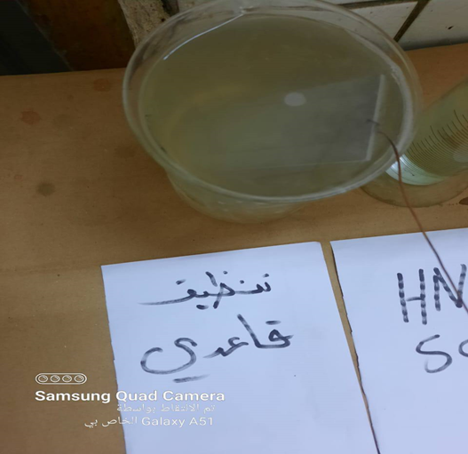
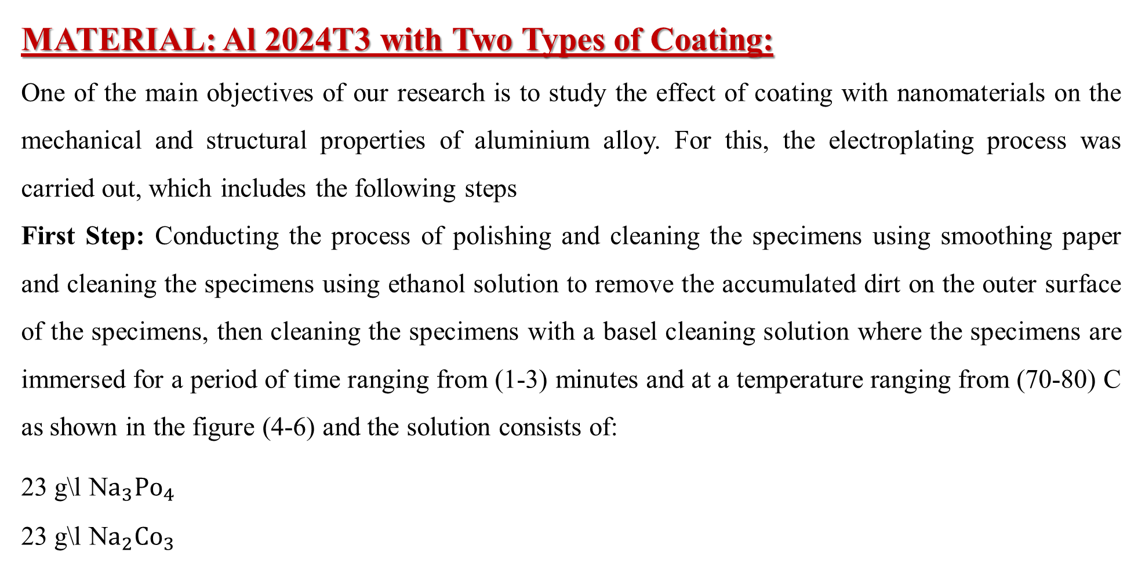
MATERIAL: Al 2024T3 with Two Types of Coating:
One of the main objectives of our research is to study the effect of coating with nanomaterials on the mechanical and structural properties of aluminium alloy. For this, the electroplating process was carried out, which includes the following steps
First Step: Conducting the process of polishing and cleaning the specimens using smoothing paper and cleaning the specimens using ethanol solution to remove the accumulated dirt on the outer surface of the specimens, then cleaning the specimens with a basel cleaning solution where the specimens are immersed for a period of time ranging from (1-3) minutes and at a temperature ranging from (70-80) C as shown in the figure (4-6) and the solution consists of:
23 g\l N$a_{3}Po_{4}$
23 g\l N$a_{2}Co_{3}$

Slide 12
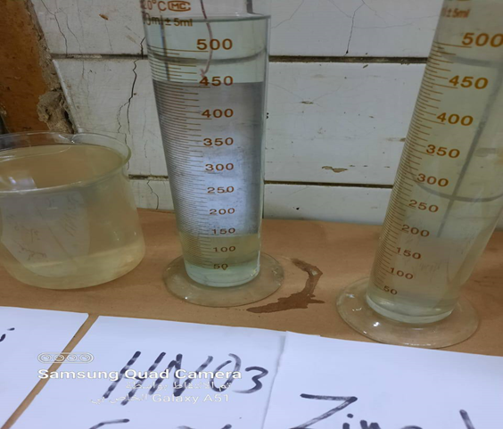
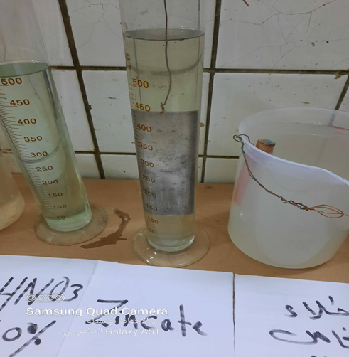
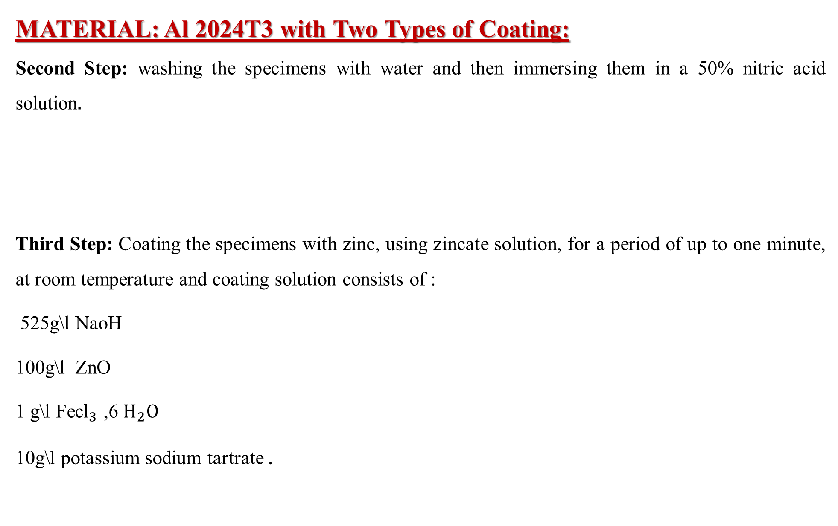
MATERIAL: Al 2024T3 with Two Types of Coating:
Second Step: washing the specimens with water and then immersing them in a 50% nitric acid solution.
Third Step: Coating the specimens with zinc, using zincate solution, for a period of up to one minute, at room temperature and coating solution consists of :
525 g\l NaoH
100g\l ZnO
1 g\l Fec$l_{3}$ ,6 $H_{2}O$
10g\l potassium sodium tartrate .

Slide 13
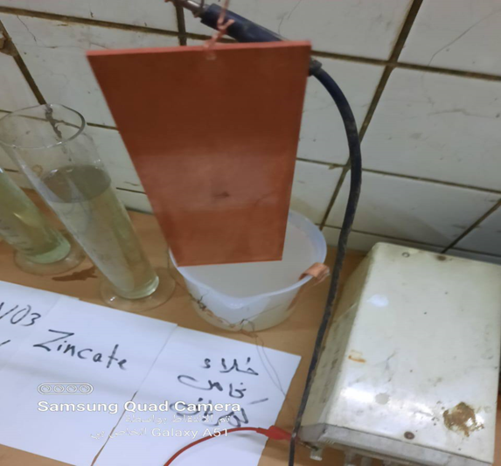
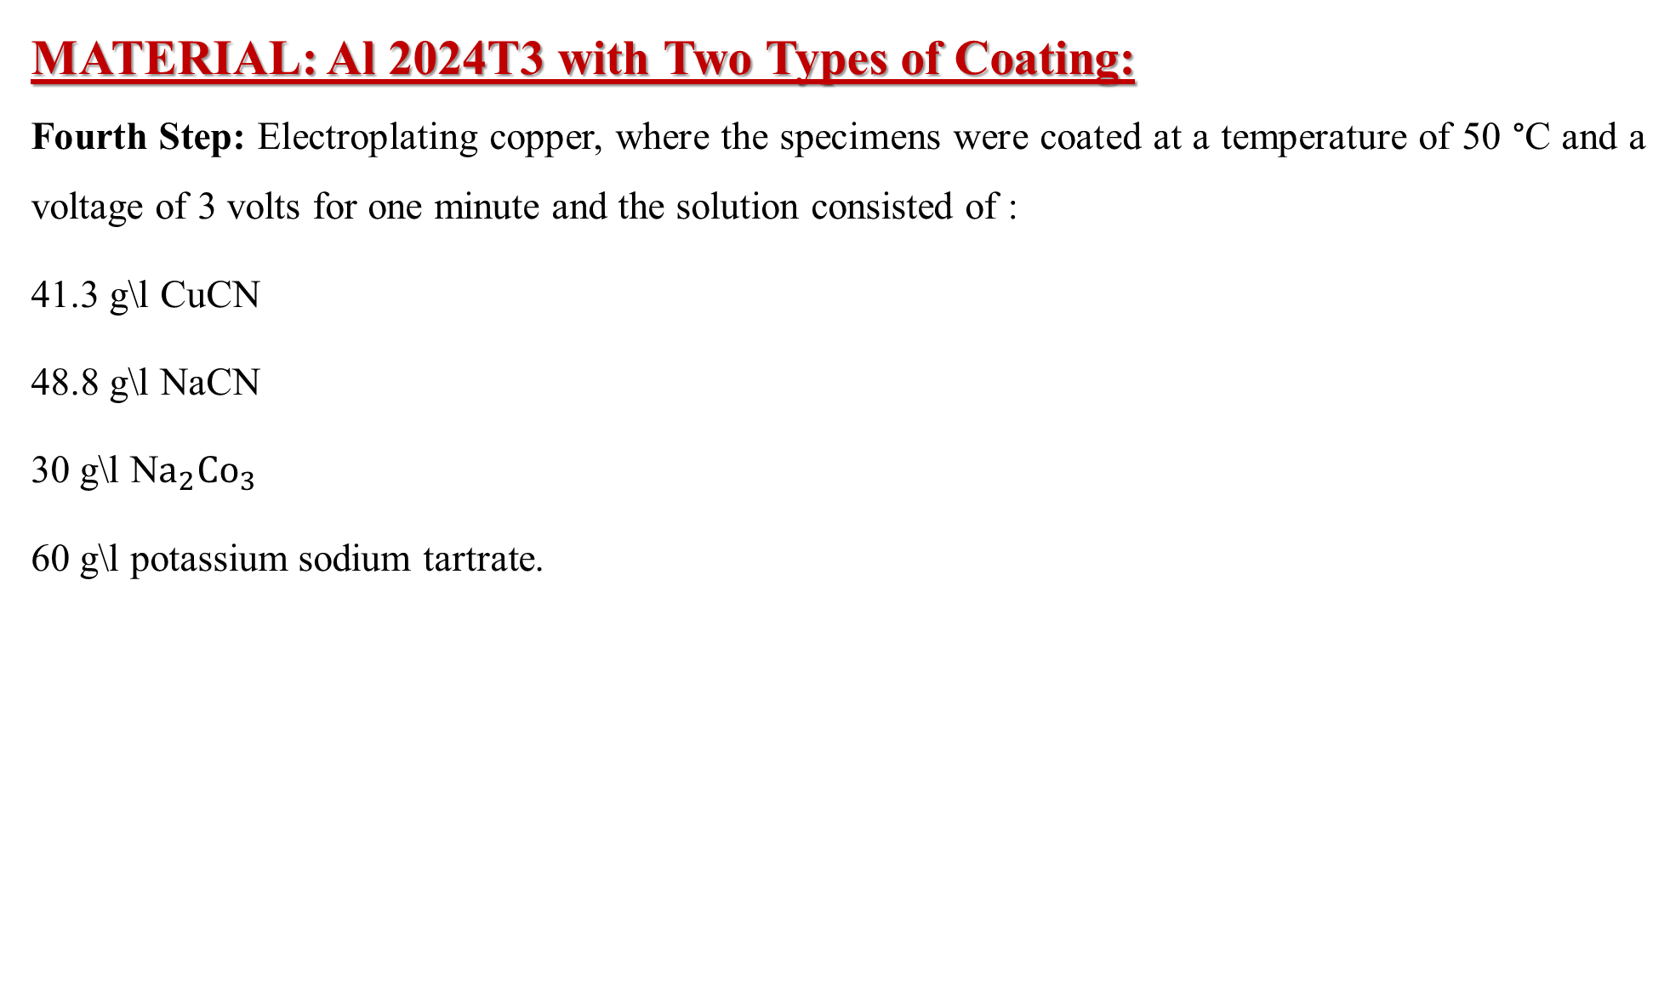
MATERIAL: Al 2024T3 with Two Types of Coating:
Fourth Step: Electroplating copper, where the specimens were coated at a temperature of 50 °C and a voltage of 3 volts for one minute and the solution consisted of :
41.3 g\l CuCN
48.8 g\l NaCN
30 g\l N$a_{2}Co_{3}$
60 g\l potassium sodium tartrate.

Slide 14
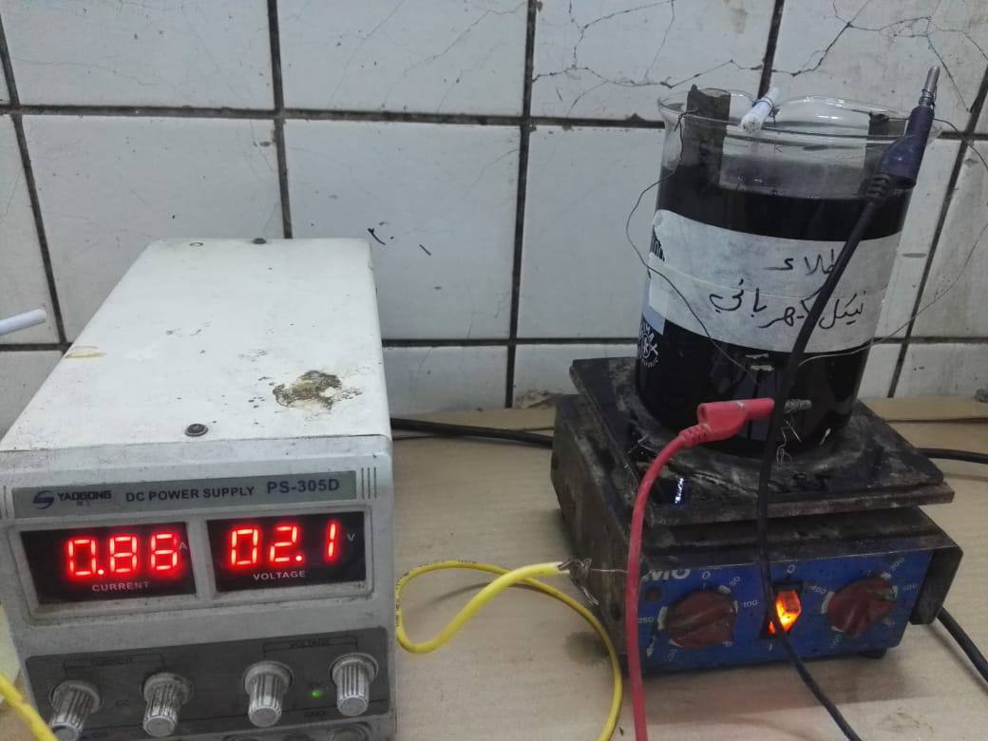
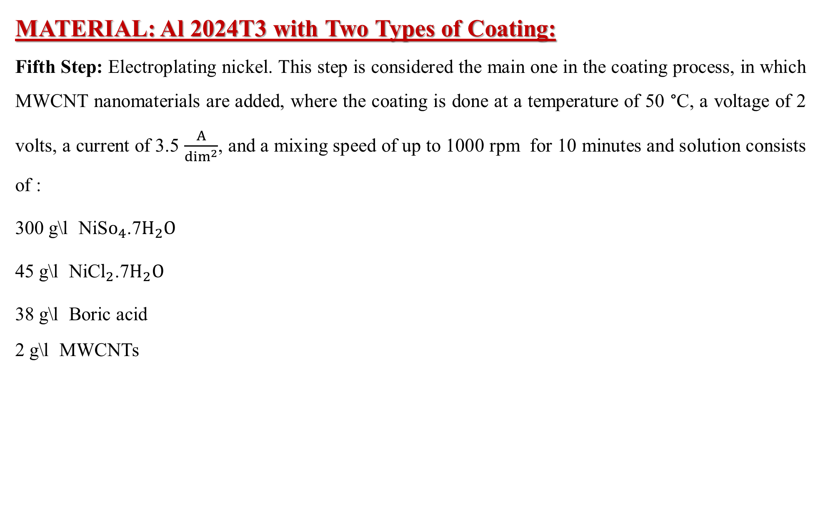
MATERIAL: Al 2024T3 with Two Types of Coating:
Fifth Step: Electroplating nickel. This step is considered the main one in the coating process, in which MWCNT nanomaterials are added, where the coating is done at a temperature of 50 °C, a voltage of 2 volts, a current of 3.5 $\frac{A}{\dim^{2}}$, and a mixing speed of up to 1000 rpm for 10 minutes and solution consists of :
300 g\l NiS$o_{4}$.7$H_{2}O$
45 g\l NiC$l_{2}$.7$H_{2}O$
38 g\l Boric acid
2 g\l MWCNTs

Slide 15
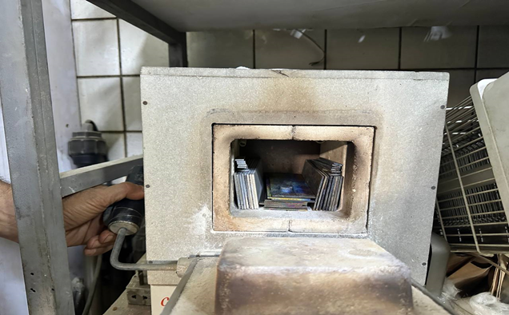
MATERIAL: Al 2024T3 with Two Types of Coating:
Sixth Step: Annealing heat treatment process, in this process will placing the specimens in the oven after its temperature becomes 420 °C for three hours and leaving the samples to cool inside the oven without coming out

Slide 16
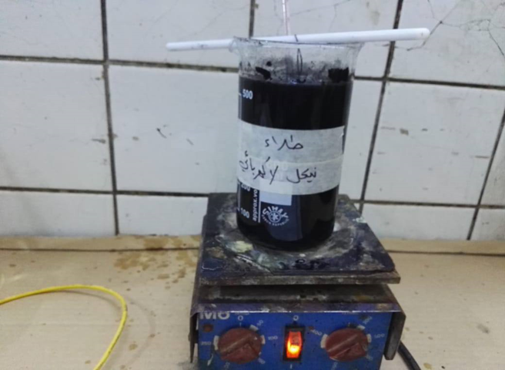
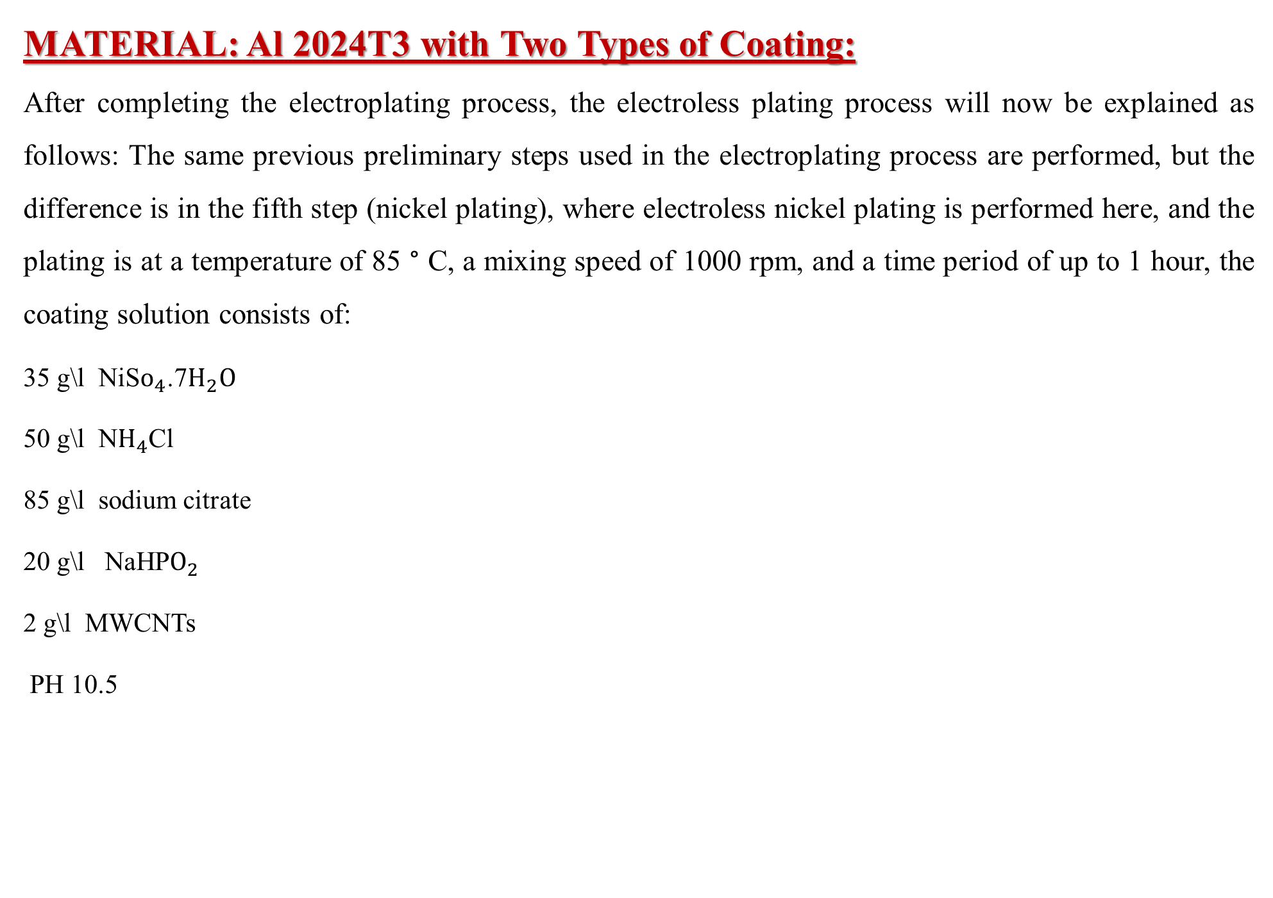
MATERIAL: Al 2024T3 with Two Types of Coating:
After completing the electroplating process, the electroless plating process will now be explained as follows: The same previous preliminary steps used in the electroplating process are performed, but the difference is in the fifth step (nickel plating), where electroless nickel plating is performed here, and the plating is at a temperature of 85 ° C, a mixing speed of 1000 rpm, and a time period of up to 1 hour, the coating solution consists of:
35 g\l NiS$o_{4}$.7$H_{2}O$
50 g\l N$H_{4}$Cl
85 g\l sodium citrate
20 g\l NaHP$O_{2}$
2 g\l MWCNTs
PH 10.5

Slide 17
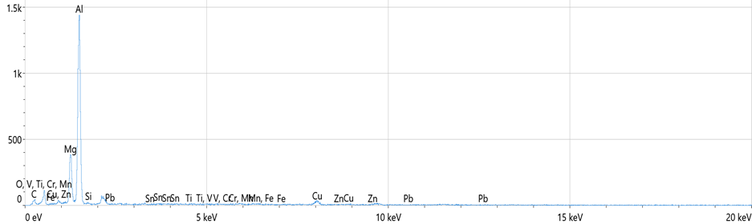
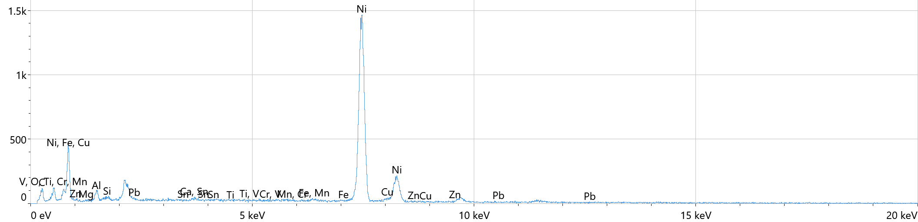
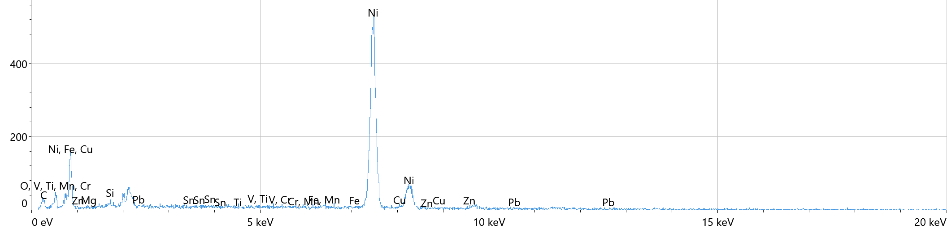
MATERIAL: Al 2024T3 with Two Types of Coating:
After completing the coating process with all its steps for both types of coatings that were used, an EDXRF analysis was conducted for the resulting specimens to know the quality of the coating and the distribution of the coating on the surface of the coated specimens,
Map data for only H.T
Map data for electroplated
Map data for electroless plated

Slide 18
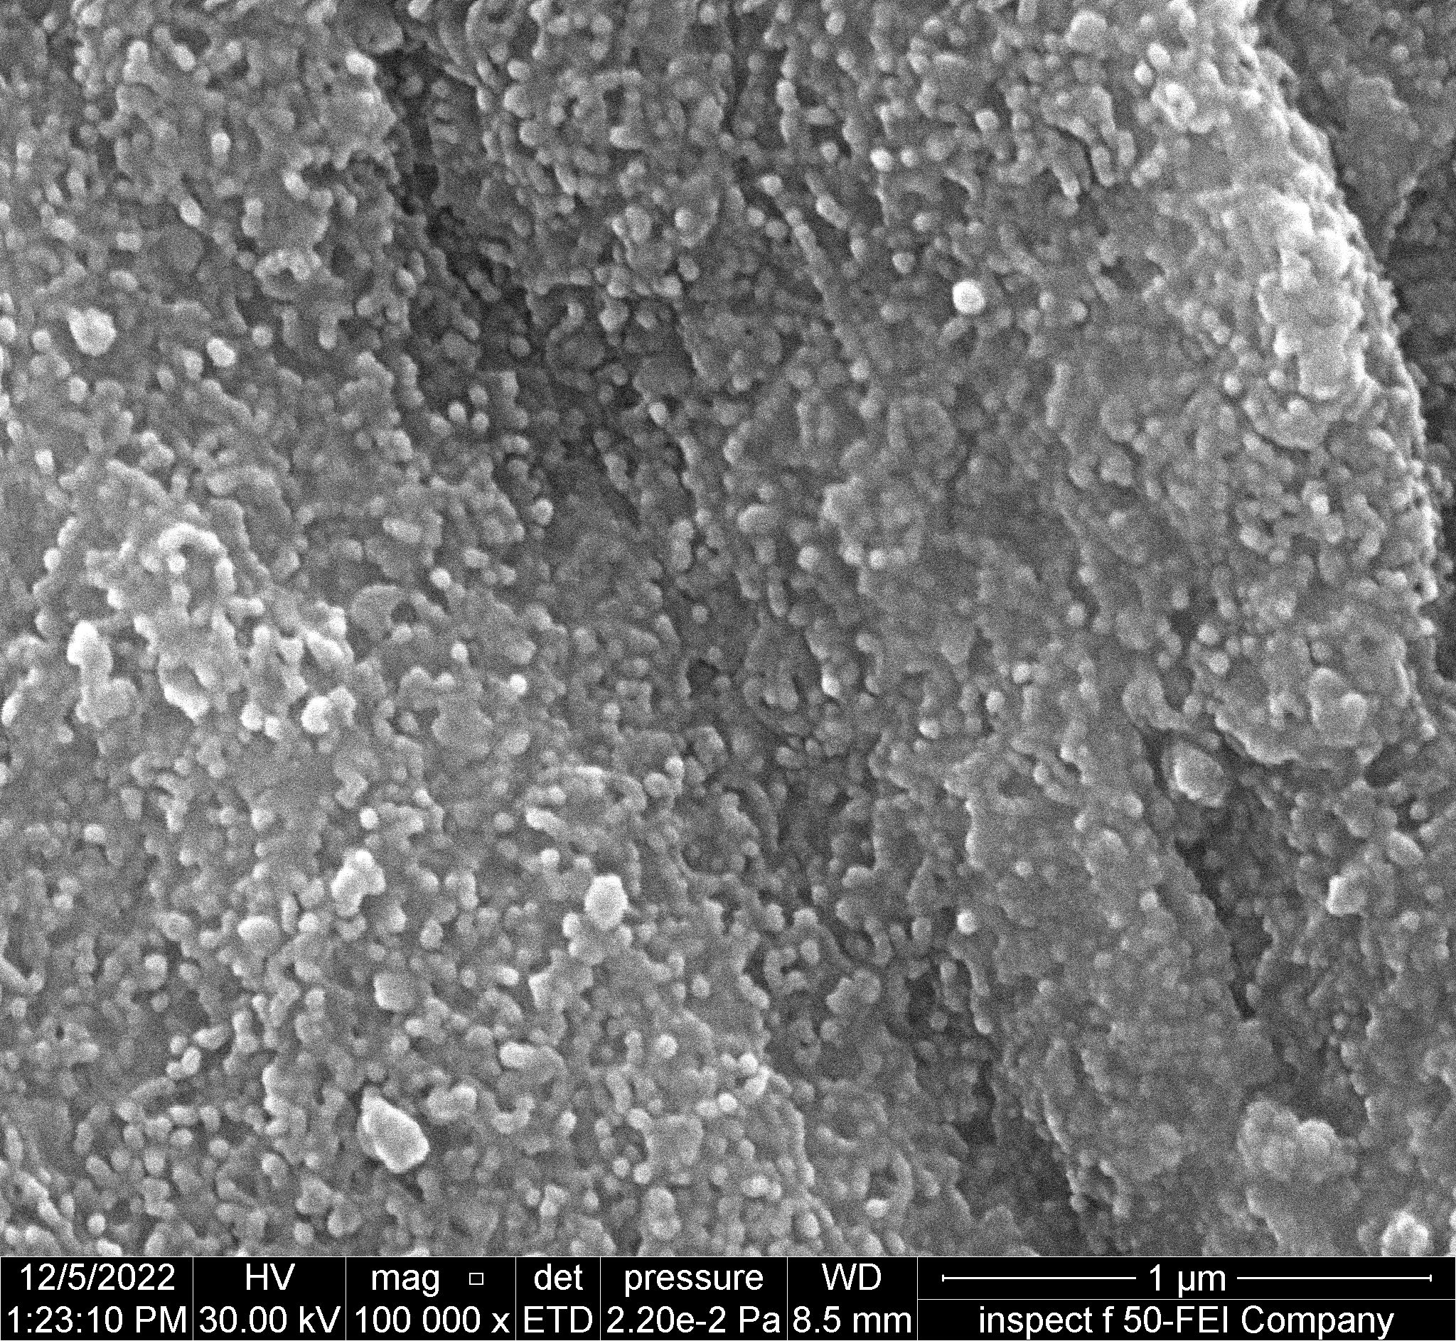
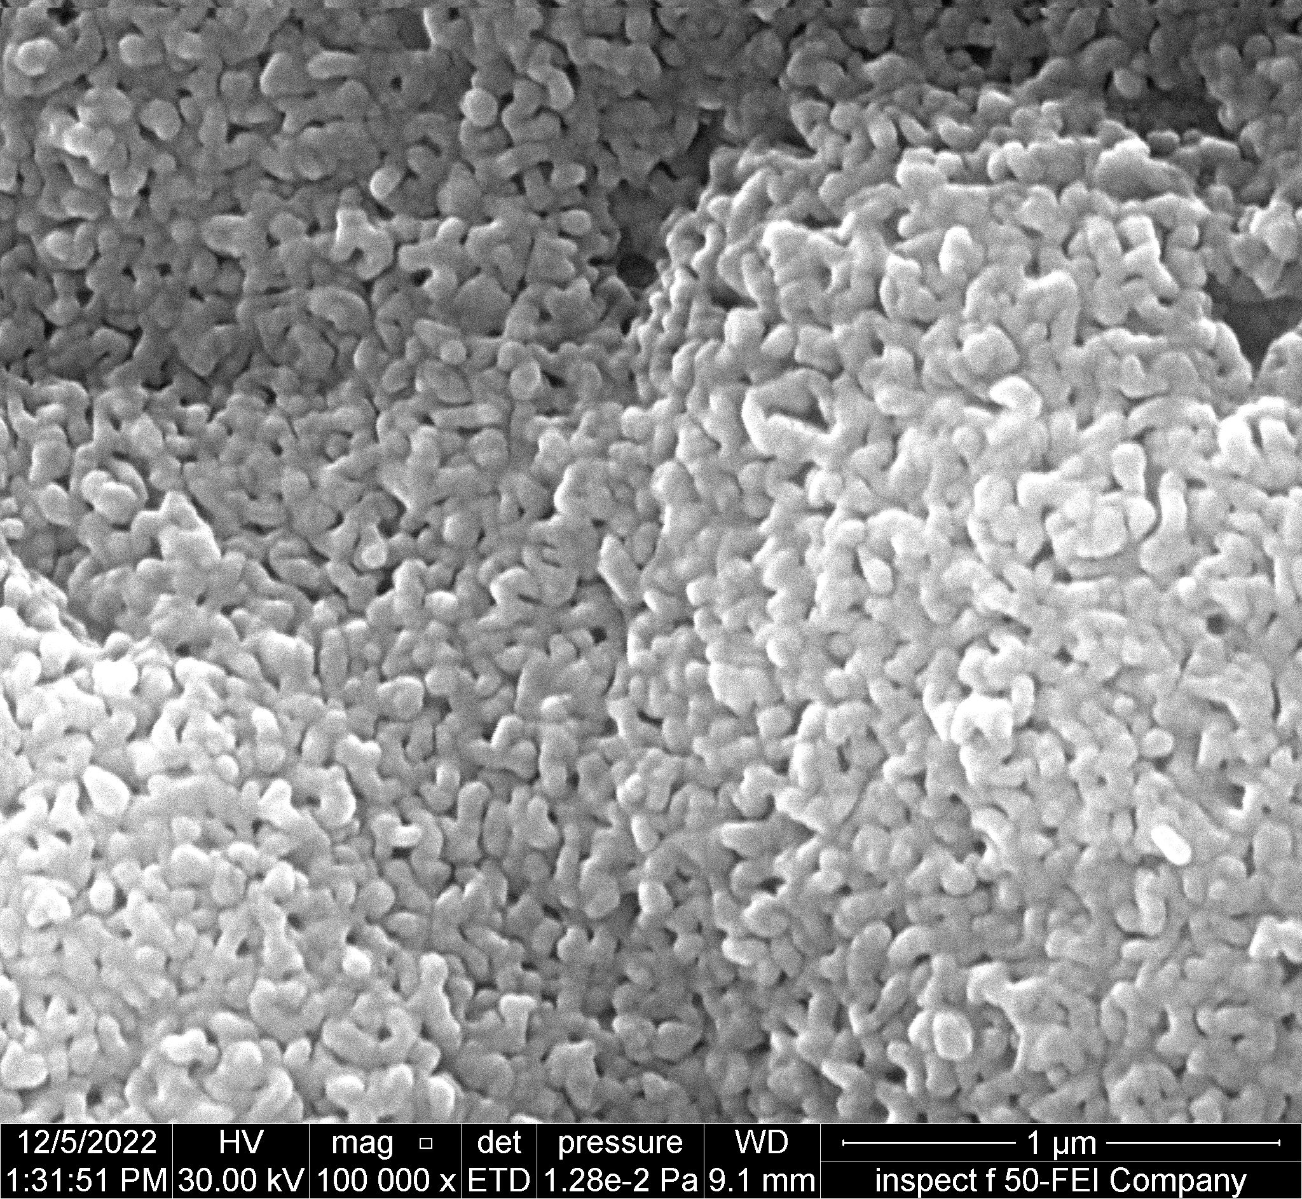
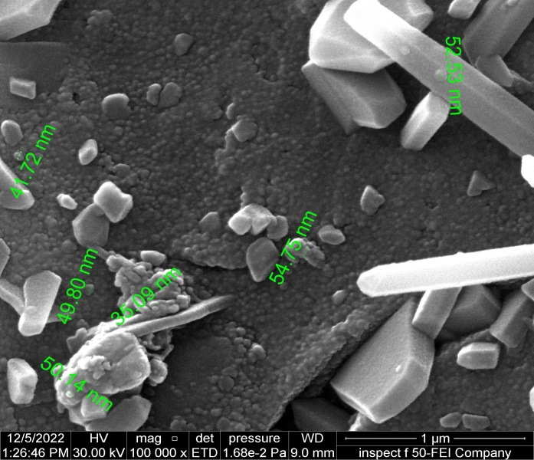
MATERIAL: Al 2024T3 with Two Types of Coating:
The FESEM image showed the distribution of both types of coatings containing carbon nano tubes MWCNTs on the surface of aluminium alloy 2024 T3 with a high imaging resolution of 100000 x. The distribution of MWCNTs on the surface of the alloy was uniform and good, and the thickness of the coating layer reached (625.8 nm) in the electroplating and in the electroless plating to (49.88 nm) and the results were compared with a photograph of the original sample without coating with heat treatment only

Slide 19
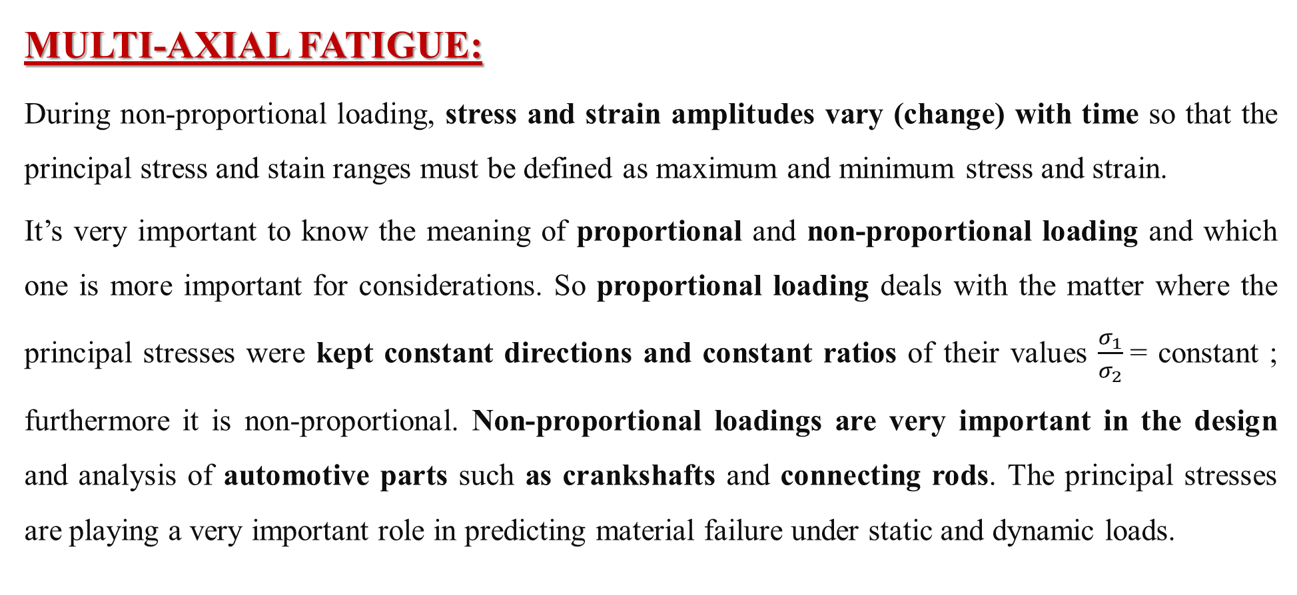
MULTI-AXIAL FATIGUE:
During non-proportional loading, stress and strain amplitudes vary (change) with time so that the principal stress and stain ranges must be defined as maximum and minimum stress and strain.
It’s very important to know the meaning of proportional and non-proportional loading and which one is more important for considerations. So proportional loading deals with the matter where the principal stresses were kept constant directions and constant ratios of their values $\frac{σ_{1}}{σ_{2}}$= constant ; furthermore it is non-proportional. Non-proportional loadings are very important in the design and analysis of automotive parts such as crankshafts and connecting rods. The principal stresses are playing a very important role in predicting material failure under static and dynamic loads.

Slide 20
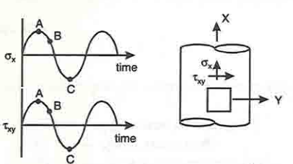
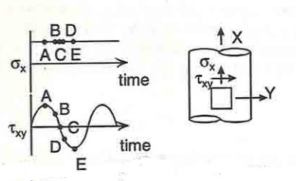
Mohr’s circle is an invaluable tool in its ability to determine the principal stresses and the associated principal directions.
In our study we will use rectangular thin plate subjected to multi-axial cyclic load (non-proportional).
Proportional malti-axial loading Non-Proportional malti-axial loading

Slide 21
Experimentally:
The expected new mechanism will contain a three phase motor with the power and number of specific cycles (r.p.m) with AC drive to control the speed of the motor and its input is Single Phase and its output power is three phase, the motor was connected to the crank shaft by belt (V) type then the crank joined with slot link that connected to shear’s gripper that connected with slot slide from the down to make the movement on one direction only and connected to a dial gauge at its end , the other side gripper is fixed. For constant tension load was used a manual hydraulic pressing machine that press the oil into a hydraulic Jack, the piston of the jack is connected to the tension’s Gripper and the other gripper is fixed on the sliding base.

Slide 22
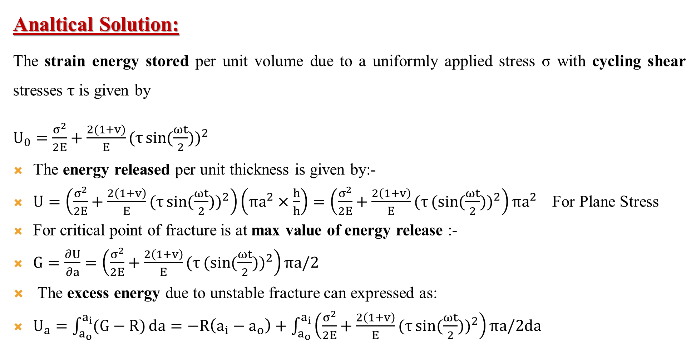
Analtical Solution:
The strain energy stored per unit volume due to a uniformly applied stress σ with cycling shear stresses $τ$ is given by
$U_{0}=\frac{σ^{2}}{2E}+\frac{2(1+v)}{E}{(τ\sin{(\frac{ωt}{2}))}}^{2}$
The energy released per unit thickness is given by:-
$U=\left(\frac{σ^{2}}{2E}+\frac{2\left(1+v\right)}{E}{(τ\sin{(\frac{ωt}{2}))}}^{2}\right)\left(πa^{2}×\frac{h}{h}\right)=\left(\frac{σ^{2}}{2E}+\frac{2\left(1+v\right)}{E}{(τ(sin{(\frac{ωt}{2}))}}^{2}\right)πa^{2}$ For Plane Stress
For critical point of fracture is at max value of energy release :-
$G=\frac{∂U}{∂a}=\left(\frac{σ^{2}}{2E}+\frac{2\left(1+v\right)}{E}{(τ(sin{(\frac{ωt}{2}))}}^{2}\right)πa/2$
The excess energy due to unstable fracture can expressed as:
$U_{a}=\int_{a_{o}}^{a_{i}}{(G−R)}da=−R\left(a_{i}−a_{o}\right)+\int_{a_{o}}^{a_{i}}{\left(\frac{σ^{2}}{2E}+\frac{2\left(1+v\right)}{E}{(τ\sin{(\frac{ωt}{2}))}}^{2}\right)πa/2da}$

Slide 23
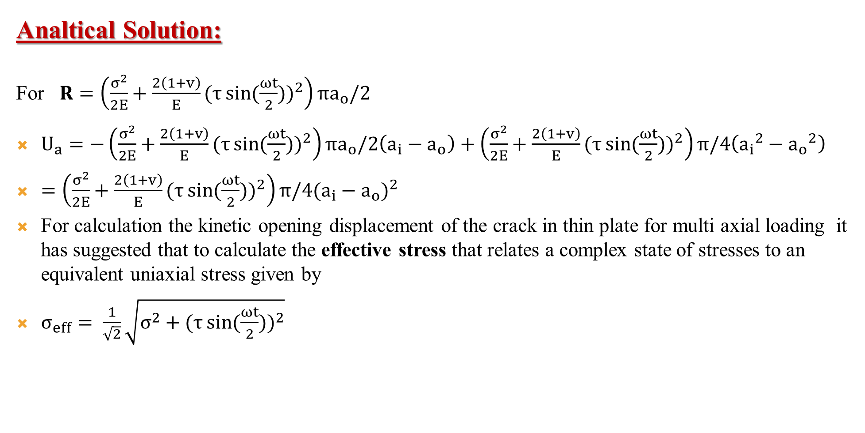
Analtical Solution:
For $R=\left(\frac{σ^{2}}{2E}+\frac{2\left(1+v\right)}{E}{(τ\sin{(\frac{ωt}{2}))}}^{2}\right){πa}_{o}/2$
$U_{a}=−\left(\frac{σ^{2}}{2E}+\frac{2\left(1+v\right)}{E}{(τ\sin{(\frac{ωt}{2}))}}^{2}\right){πa}_{o}/2\left(a_{i}−a_{o}\right)+\left(\frac{σ^{2}}{2E}+\frac{2\left(1+v\right)}{E}{(τ\sin{(\frac{ωt}{2}))}}^{2}\right)π/4\left({a_{i}}^{2}−{a_{o}}^{2}\right)$
$=\left(\frac{σ^{2}}{2E}+\frac{2\left(1+v\right)}{E}{(τ\sin{(\frac{ωt}{2}))}}^{2}\right)π/4{(a_{i}−a_{o})}^{2}$
For calculation the kinetic opening displacement of the crack in thin plate for multi axial loading it has suggested that to calculate the effective stress that relates a complex state of stresses to an equivalent uniaxial stress given by
$σ_{eff}= \frac{1}{\sqrt{2}}\sqrt{σ^{2}+{(τ\sin{(\frac{ωt}{2}))}}^{2}}$

Slide 24
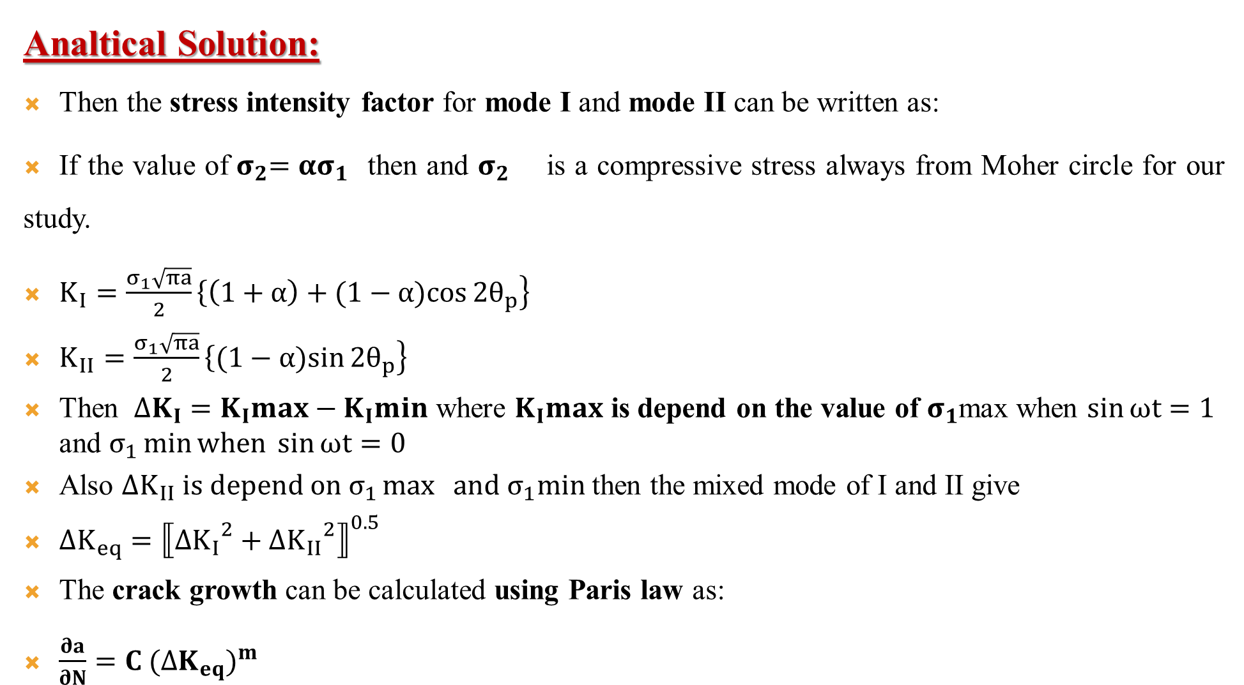
Analtical Solution:
Then the stress intensity factor for mode I and mode II can be written as:
If the value of${ σ}_{2}=ασ_{1}$ then and $σ_{2}$ is a compressive stress always from Moher circle for our study.
$K_{I}=\frac{σ_{1}\sqrt{πa}}{2}\left\{\left(1+α\right)+(1−α)\right.\left.\cos{2θ_{p}}\right\}$
$K_{II}=\frac{σ_{1}\sqrt{πa}}{2}\left\{(1−α)\right.\left.\sin{2θ_{p}}\right\}$
Then $∆K_{I}=K_{I}max−K_{I}min$ where $K_{I}max$ is depend on the value of $σ_{1}$max when $\sin{ωt=1}$ and $σ_{1}\min{when \sin{ωt}=0}$
Also $∆K_{II} is depend on σ_{1}\max{ and σ_{1}min}$ then the mixed mode of I and II give
$∆K_{eq}={⟦{∆K_{I}}^{2}+{∆K_{II}}^{2}⟧}^{0.5}$
The crack growth can be calculated using Paris law as:
$\frac{∂a}{∂N}=C {(∆K_{eq})}^{m}$

Slide 25
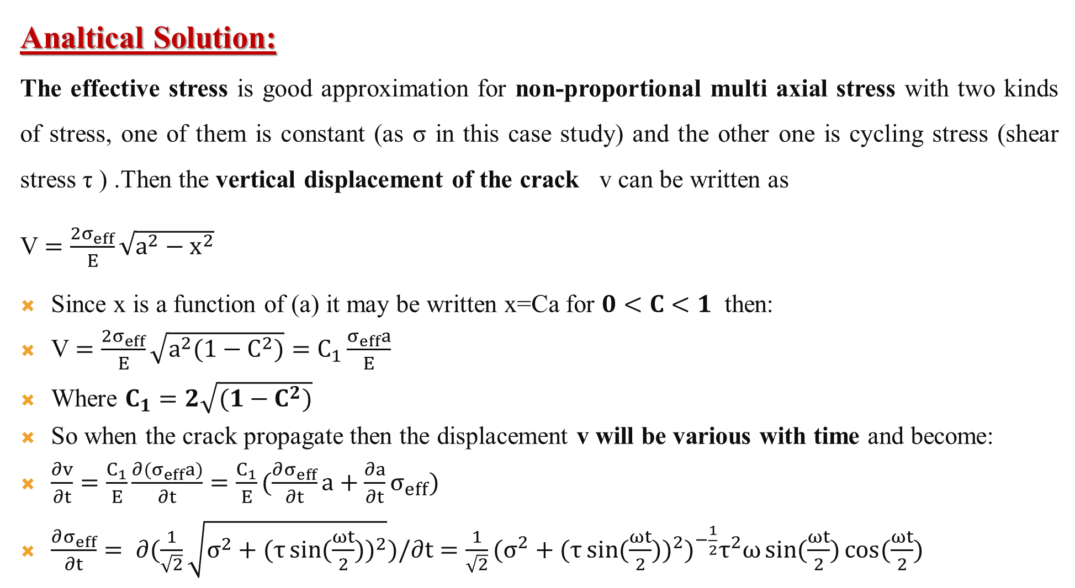
Analtical Solution:
The effective stress is good approximation for non-proportional multi axial stress with two kinds of stress, one of them is constant (as σ in this case study) and the other one is cycling stress (shear stress τ ) .Then the vertical displacement of the crack v can be written as
V $=\frac{2σ_{eff}}{E}\sqrt{a^{2}−x^{2}}$
Since x is a function of (a) it may be written x=Ca for $0<C<1$ then:
V $=\frac{2σ_{eff}}{E}\sqrt{a^{2}(1−C^{2})}=C_{1}\frac{σ_{eff}a}{E}$
Where $C_{1}=2\sqrt{(1−C^{2})}$
So when the crack propagate then the displacement v will be various with time and become:
$\frac{∂v}{∂t}=\frac{C_{1}}{E}\frac{∂{(σ}_{eff}a)}{∂t}=\frac{C_{1}}{E}(\frac{∂σ_{eff}}{∂t}a+\frac{∂a}{∂t}σ_{eff})$
$\frac{∂σ_{eff}}{∂t}= ∂(\frac{1}{\sqrt{2}}\sqrt{σ^{2}+{(τ\sin{(\frac{ωt}{2}))}}^{2}})/∂t=\frac{1}{\sqrt{2}}{(σ^{2}+{(τ\sin{(\frac{ωt}{2}))}}^{2})}^{−\frac{1}{2}}τ^{2}ω\sin{(\frac{ωt}{2})}\cos{(\frac{ωt}{2})}$

Slide 26
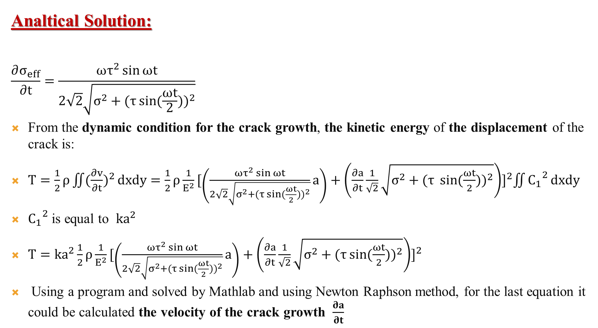
Analtical Solution:
$$\frac{∂σ_{eff}}{∂t}=\frac{ωτ^{2}\sin{ωt}}{2\sqrt{2}\sqrt{σ^{2}+{(τ\sin{(\frac{ωt}{2}))}}^{2}}}$$
From the dynamic condition for the crack growth, the kinetic energy of the displacement of the crack is:
$T=\frac{1}{2}ρ\iint{({\frac{∂v}{∂t})}^{2}}dxdy=\frac{1}{2}ρ\frac{1}{E^{2}}{[\left(\frac{ωτ^{2}\sin{ωt}}{2\sqrt{2}\sqrt{σ^{2}+{(τ\sin{(\frac{ωt}{2}))}}^{2}}}a\right)+\left(\frac{∂a}{∂t}\frac{1}{\sqrt{2}}\sqrt{σ^{2}+{(τ \sin{(\frac{ωt}{2}))}}^{2}}\right)]}^{2}\iint{{C_{1}}^{2}}dxdy$
${C_{1}}^{2}$ is equal to $ka^{2}$
$T=ka^{2}\frac{1}{2}ρ\frac{1}{E^{2}}{[\left(\frac{ωτ^{2}\sin{ωt}}{2\sqrt{2}\sqrt{σ^{2}+{(τ\sin{(\frac{ωt}{2}))}}^{2}}}a\right)+\left(\frac{∂a}{∂t}\frac{1}{\sqrt{2}}\sqrt{σ^{2}+{(τ\sin{(\frac{ωt}{2}))}}^{2}}\right)]}^{2}$
Using a program and solved by Mathlab and using Newton Raphson method, for the last equation it could be calculated the velocity of the crack growth $\frac{∂a}{∂t}$

Slide 27
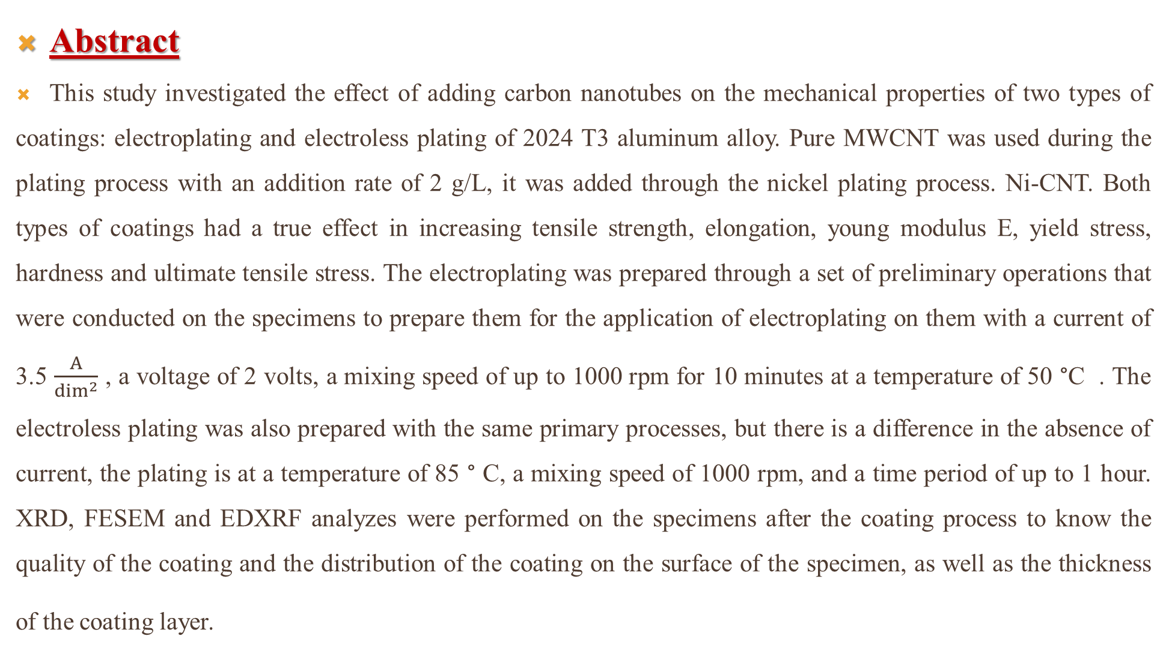
Abstract
This study investigated the effect of adding carbon nanotubes on the mechanical properties of two types of coatings: electroplating and electroless plating of 2024 T3 aluminum alloy. Pure MWCNT was used during the plating process with an addition rate of 2 g/L, it was added through the nickel plating process. Ni-CNT. Both types of coatings had a true effect in increasing tensile strength, elongation, young modulus E, yield stress, hardness and ultimate tensile stress. The electroplating was prepared through a set of preliminary operations that were conducted on the specimens to prepare them for the application of electroplating on them with a current of 3.5 $\frac{A}{\dim^{2}}$ , a voltage of 2 volts, a mixing speed of up to 1000 rpm for 10 minutes at a temperature of 50 °C . The electroless plating was also prepared with the same primary processes, but there is a difference in the absence of current, the plating is at a temperature of 85 ° C, a mixing speed of 1000 rpm, and a time period of up to 1 hour. XRD, FESEM and EDXRF analyzes were performed on the specimens after the coating process to know the quality of the coating and the distribution of the coating on the surface of the specimen, as well as the thickness of the coating layer.

Slide 28
The hardness tests showed a 57% increase in the hardness of the specimens that were electroplated, and also there was an increase of 72% in the amount of hardness of the specimens that were electroless plated. Also with regard to the Young modulus, there was an increase of 37.5% for the electroplated specimens and by 50% for the electroless plated specimens compared to the heat treated specimens only.
Work has been done to manufacture a apparatus to conduct (Uni axial and Multi axial fatigue test) according to the boundary conditions (constant tension with cyclic in plane shear).

Slide 29
Thanks For Listening

