Slide 1

بسم الله الرحمن الرحيم

Slide 2
Thermal Performance Evaluation of Flat Plate Solar Dryer Provided with Porous Absorber Plate and PCM Heat Storage
By: Hussein Khalaf Jobair
Supervisor: Asst. Prof. Dr. Mohammed A. Nima

Slide 3
Introduction
Drying is one of the oldest techniques for the preservation of food and agricultural products. The main objective of drying is to reduce the moisture content to a safe storage level, at which the products can be stored for a longer period without any deterioration. The low moisture content prevents the growth of microorganisms such as molds, bacteria, and yeasts in agricultural products and reduces the chemical reactions deteriorating the quality of the products. It also reduces the mass and volume of the products resulting in minimum packaging, storage, and transportation costs.

Slide 4
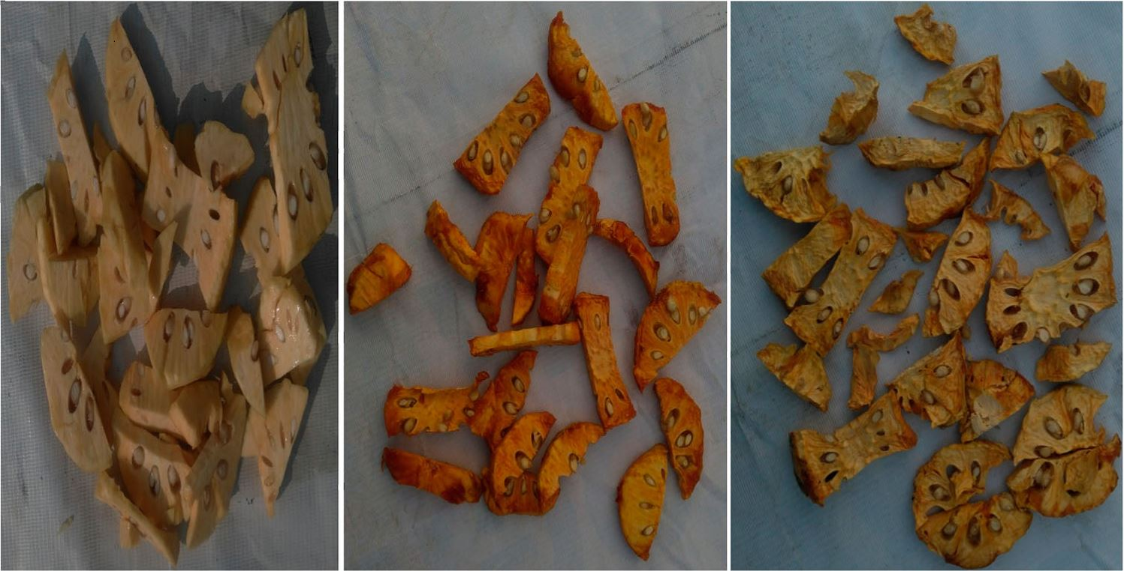
Fig. 1. Dried sample of the product

Slide 5
In the solar dryer, the product is dried in an enclosed space or a drying cabinet at an elevated temperature by the hot air produced in a device known as the solar air heater. It is an efﬁcient drying process. The product is dried at high temperatures and low relative humidity in the solar dryer
The product can be dried in the solar dryer in a drying air temperature varying between 45 ºC and 60 ºC which is a more suitable drying air temperature range for many agricultural products.

Slide 6
However, the intermittent nature and the uncertainty in the availability of solar radiation are still the concerns associated with the solar dryer. These concerns affect the reliability of the solar dryer and thus limit its application To overcome these challenges, auxiliary heat sources are generally incorporated into the solar dryer. In the present work, the phase change material (PCM) is used as an auxiliary heat source. parafﬁn wax is stored The thermal energy by the transition of the phase from solid to liquid.

Slide 7
2. Literature Survey
Enibe (2002) designed, constructed and evaluated the performance of a natural convention solar air heater with heat storage using the PCM. Parafﬁn is used as the PCM and encapsulated in Modules. These modules are made of rectangular channels whose tops are welded to the absorber plate and bottoms rest on the bottom insulation of the collector and are welded to the solar collector. The underside of the absorber plate, together with the vertical sides of the PCM modules, serves as an air-heating chamber.

Slide 8
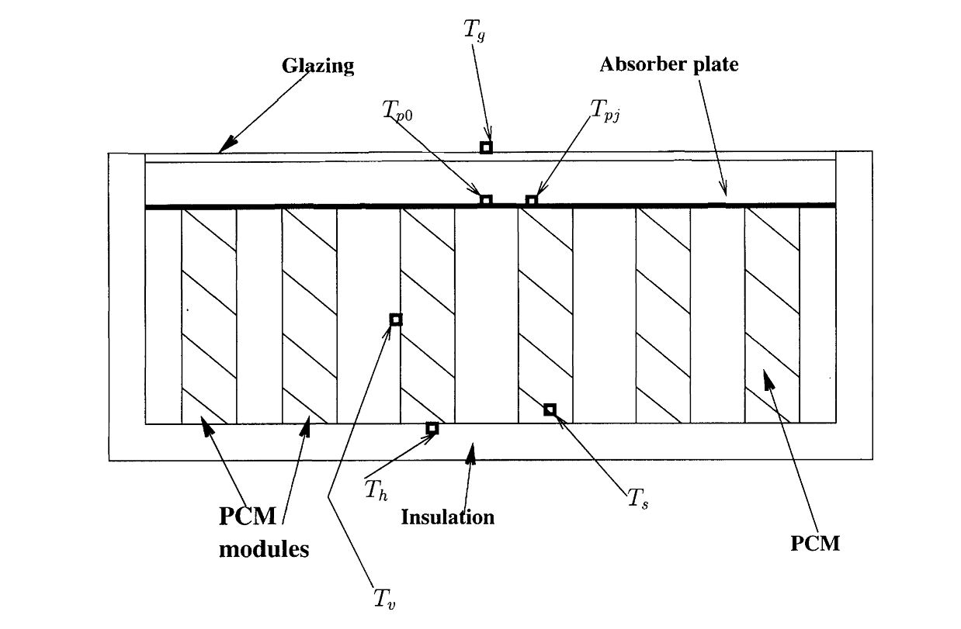
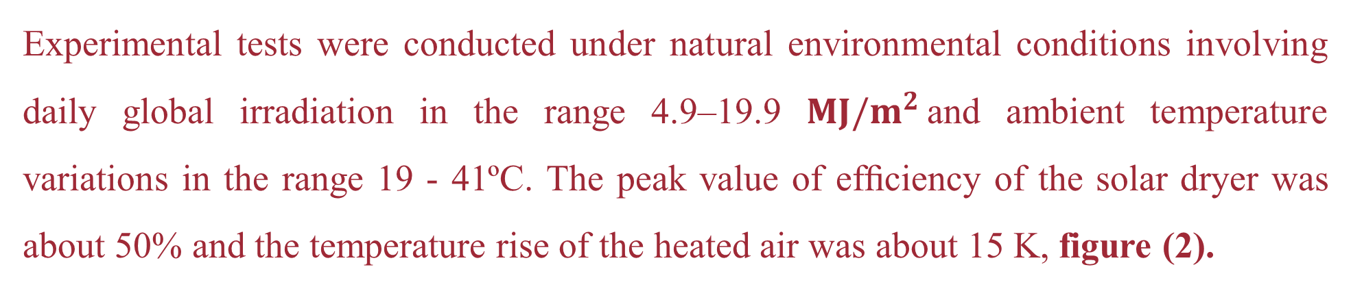
Experimental tests were conducted under natural environmental conditions involving daily global irradiation in the range 4.9–19.9 $MJ/m^{2}$and ambient temperature variations in the range 19 - 41ºC. The peak value of efﬁciency of the solar dryer was about 50% and the temperature rise of the heated air was about 15 K, figure (2).
Fig. 2. Cross-sectional view of the collector assembly. The heated air ﬂows perpendicular to the page,
and the little boxes indicate the approximate locations of thermocouples

Slide 9
Devahastin and Pitaksuriyarat (2005) investigated the feasibility of using a parafﬁn wax-based LHS unit in the solar dryer. The melting temperature of the wax employed in the storage was in the range of 35-54ºC. The authors studied the effect of the air velocity and the temperature on the charging and discharging characteristics of the PCM and reported that the charging time decreased with an increase in the air temperature and the velocity. The drying rate of the sweet potato increased with a decrease in the air velocity through the storage. This was due to the higher drying air temperature. At lower velocities, the air could extract more energy from the storage resulting in high temperatures. They reported that the incorporation of the LHS helped in saving 34% – 40% of energy during drying.

Slide 10
Shalaby and Bek (2014) designed an indirect-type forced convection solar dryer integrated with an LHS unit and tested the dryer with and without thermal storage for drying medicinal plants. Two vertical cylindrical containers ﬁlled with the parafﬁn wax having a melting temperature of 49 ºC and thirty - two copper tubes embedded uniformly (through which air is supplied) in the wax were used as the storage unit. The investigators reported that the accumulated heat released from the storage during the discharge period maintained the drying air temperature higher than the ambient temperature by 2.5-7.5 ºC for 5 h after the sunset.

Slide 11
3. The present work
a. The numerical investigation
Numerical solution for the problem of the three-dimensional forced convection heat transfer, and turbulent airflow by utilizing (a copper flat plate, 10 PPI, and 40 PPI) absorber plate has been presented. ANSYS FLUENT software package has been utilized for simulating the problem.
Examine the effect of airflow rates (0.0076, 0.011773869, and 0.013595293 kg/s) on the outlet temperature, thermal efficiency, and drying rate for (a flat plat, 10PPI, and 40PPI) absorber plate.

Slide 12
Examine the effect of the inclination angle (25°, 33.3°, and 50° kg/s) on the outlet temperature and thermal efficiency for (a flat plat, 10PPI, and 40PPI) absorber plate.
Examine the effect of solar radiation (wide range) on the outlet temperature and thermal efficiency for (a flat plat, 10PPI, and 40PPI) absorber plate.
Examine the effect of the air gap (1, 2, 3, 4, and 5cm) for flat plate absorber and (0, 1, 2, 3, 4, and 5) for (10PPI, and 40PPI) absorber plate, on the outlet temperature and thermal efficiency.

Slide 13
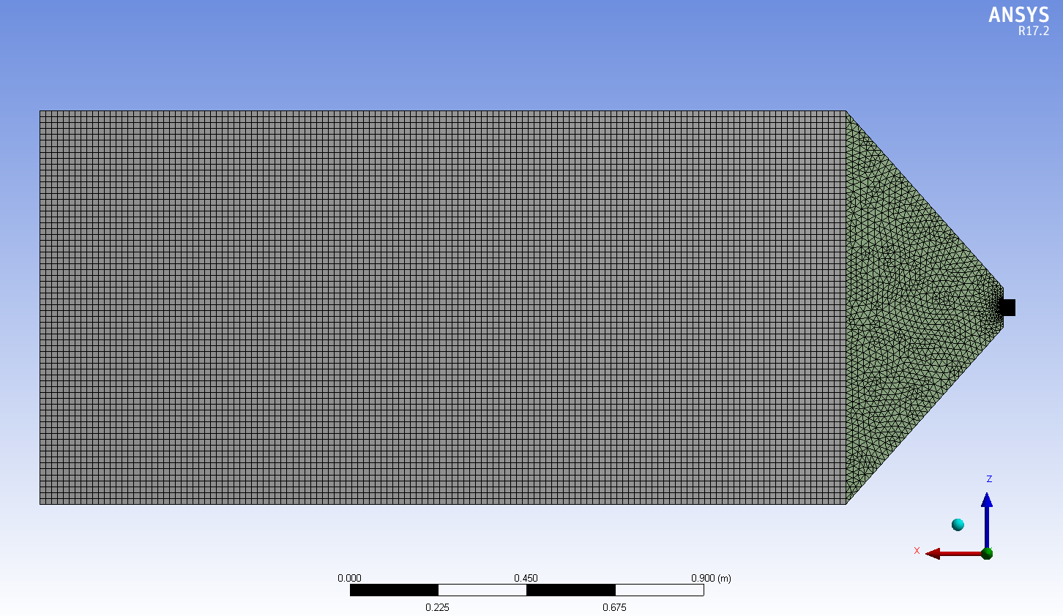
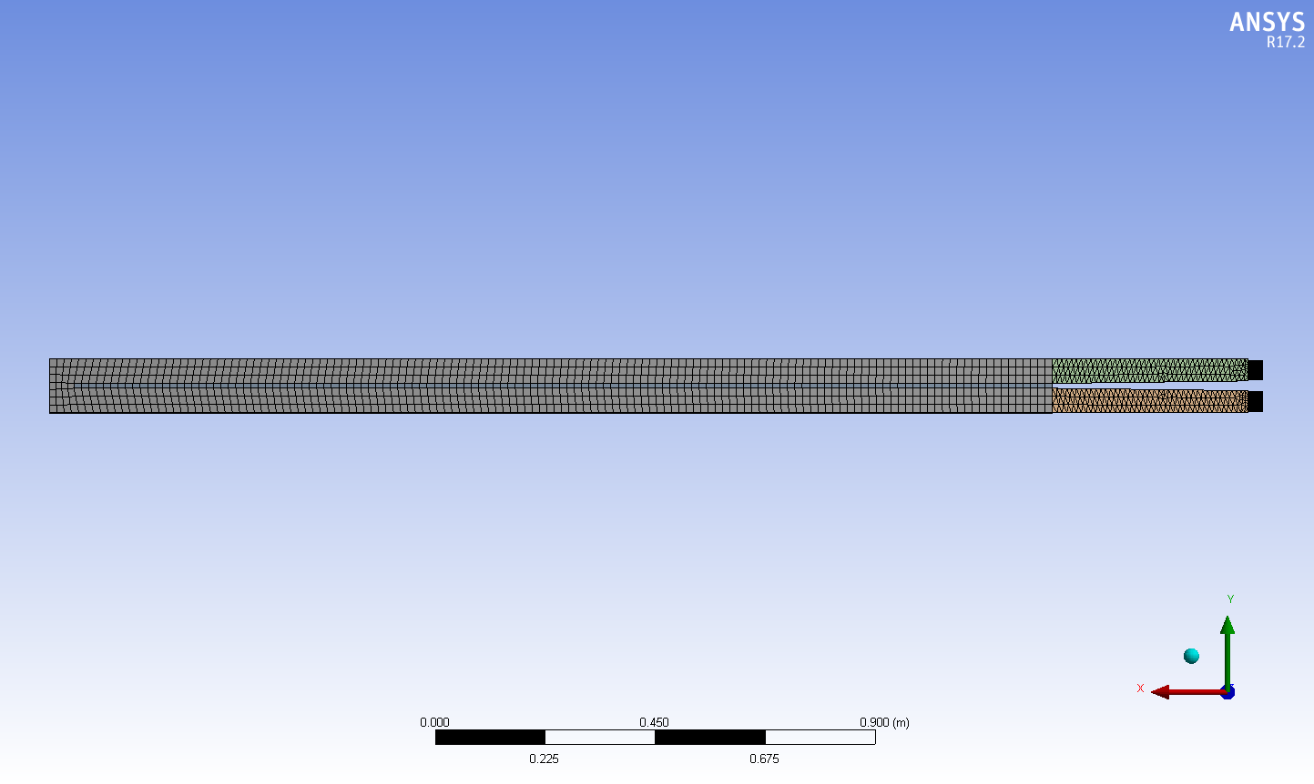
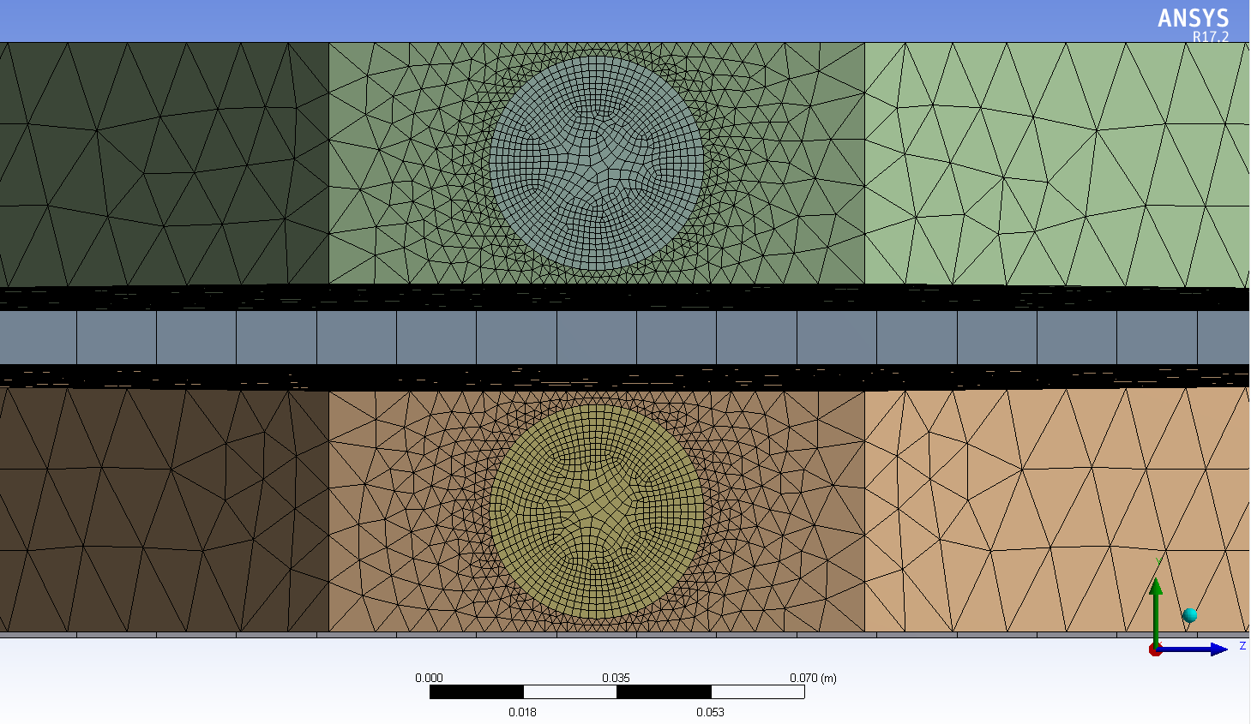
Fig. 3. Collector Mesh Generation

Slide 14
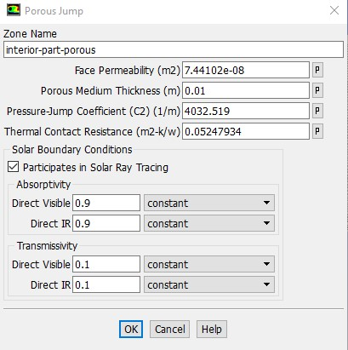
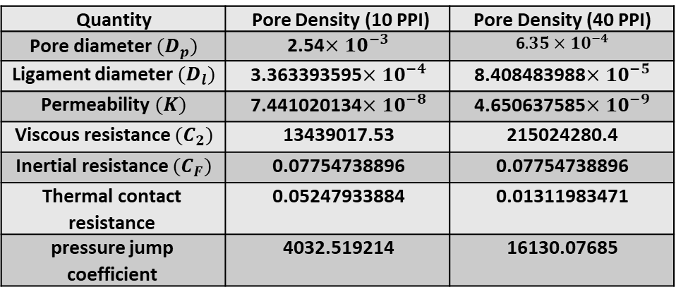
Table 1. Parameters and coefficients of the metal foam (10PPI and 40PPI)
Quantity | Pore Density (10 PPI) | Pore Density (40 PPI)
Pore diameter $(D_{p})$ | 2.54$×{10}^{−3}$ | 6$.35×{10}^{−4}$
Ligament diameter $(D_{l})$ | 3.363393595$×{10}^{−4}$ | 8.408483988$×{10}^{−5}$
Permeability $(K)$ | 7.441020134$×{10}^{−8}$ | 4.650637585$×{10}^{−9}$
Viscous resistance $(C_{2})$ | 13439017.53 | 215024280.4
Inertial resistance $(C_{F})$ | 0.07754738896 | 0.07754738896
Thermal contact resistance | 0.05247933884 | 0.01311983471
pressure jump coefficient | 4032.519214 | 16130.07685
Fig. 4. The Boundary Conditions of the Porous Jump (10PPI)

Slide 15
b. Experimental Investigation
According to the most recent literature review, there is no existing experimental investigation on the performance evaluation of solar dryer systems provided with porous metal foam as an absorber plate and PCM heat storage, particularly in Iraq (33.34º latitude, 44.42º longitude). As a result, this investigation is proposed to address this gap in understanding the performance of the indirect solar drying system.
The effect of air mass flow rates on the thermal performance of solar dryers was investigated for (flat plate, 10 PPI, and 40 PPI) absorber plates.

Slide 16
Investigate the effect of the air gap of the solar dryer system for (flat plate, 10 PPI, and 40 PPI) absorber plate to evaluate and compare the thermal performance of the mentioned dryer systems.
Investigate the effect of mass flow rate and air gap of the solar dryer system for (flat plate, 10 PPI, and 40 PPI) absorber plate on the drying kinetics, drying time, drying rate, and the reduction in moisture content of the product.
Validate the results obtained experimentally with previous studies.

Slide 17
Air blower
Manual valves
Drying chamber
Orifice meter
Anemometer
Solar meter
Solar Collector
Transmission pipes
Manometer
Stand frame
Heat Exchanger
PCM
Data logger
Thermocouples
Fig. 5. Schematic diagram of the solar drying system

Slide 18
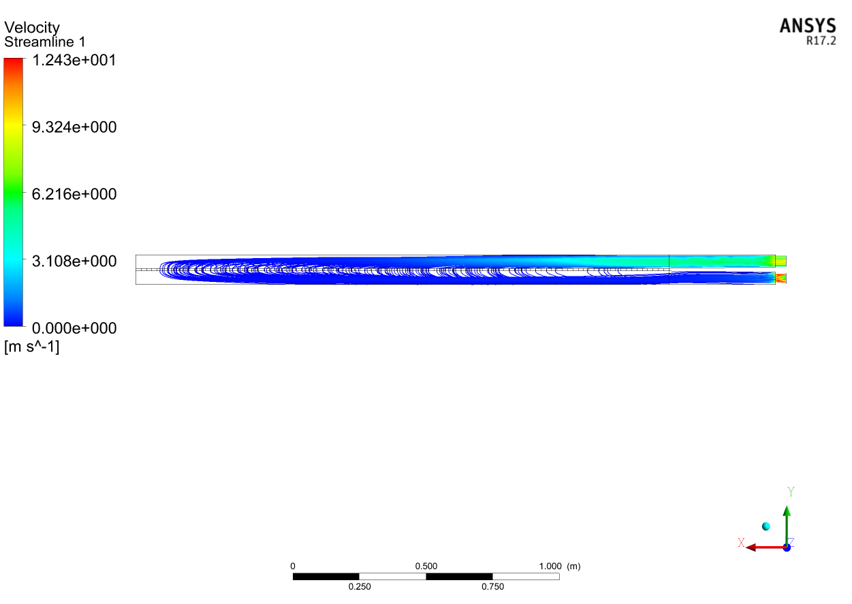
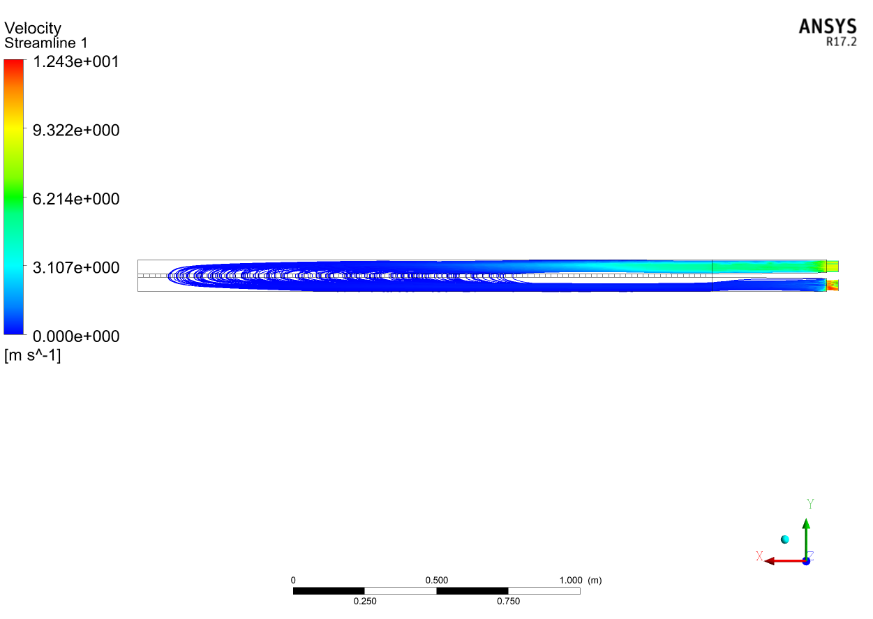
4. Results
Fig.6a. Streamlines (10 PPI, Gap= 0cm, Max flow, Side View)
Fig.6b. Streamlines (40 PPI, Gap= 0cm, Max flow, Side View)

Slide 19
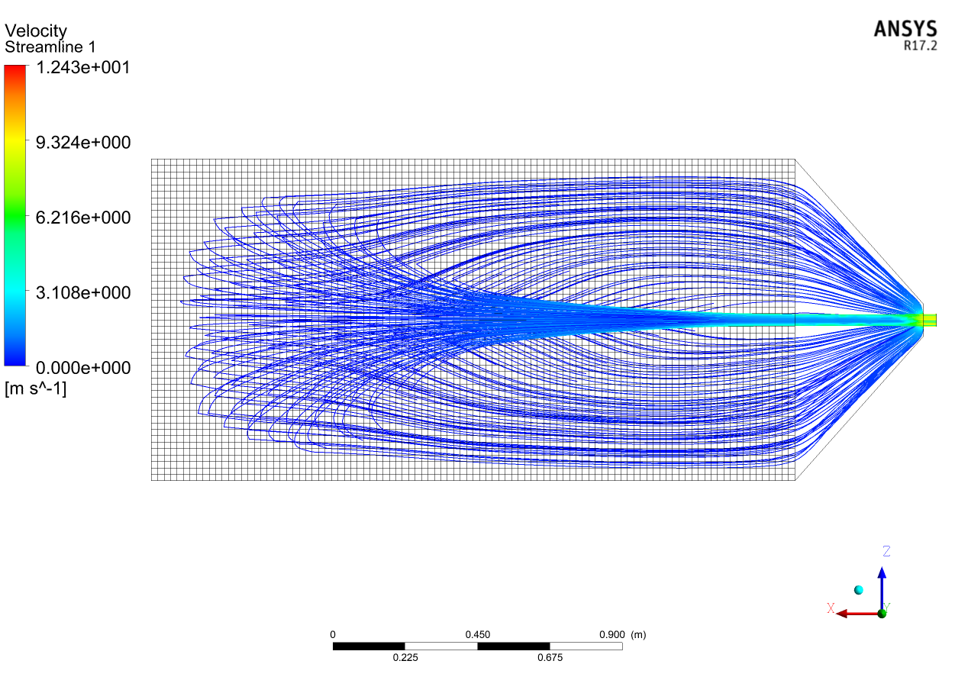
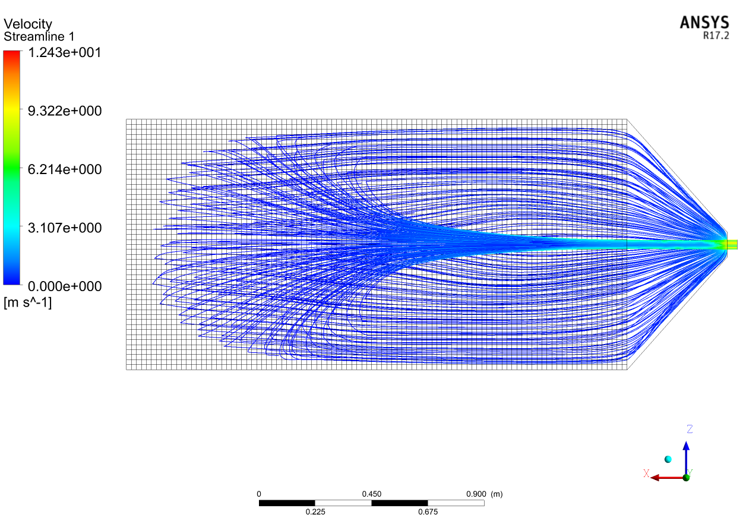
Fig.7a. Streamlines (10 PPI, Gap= 0cm, Max flow, Top View)
Fig.7b. Streamlines (40 PPI, Gap= 0cm, Max flow, Top View)

Slide 20
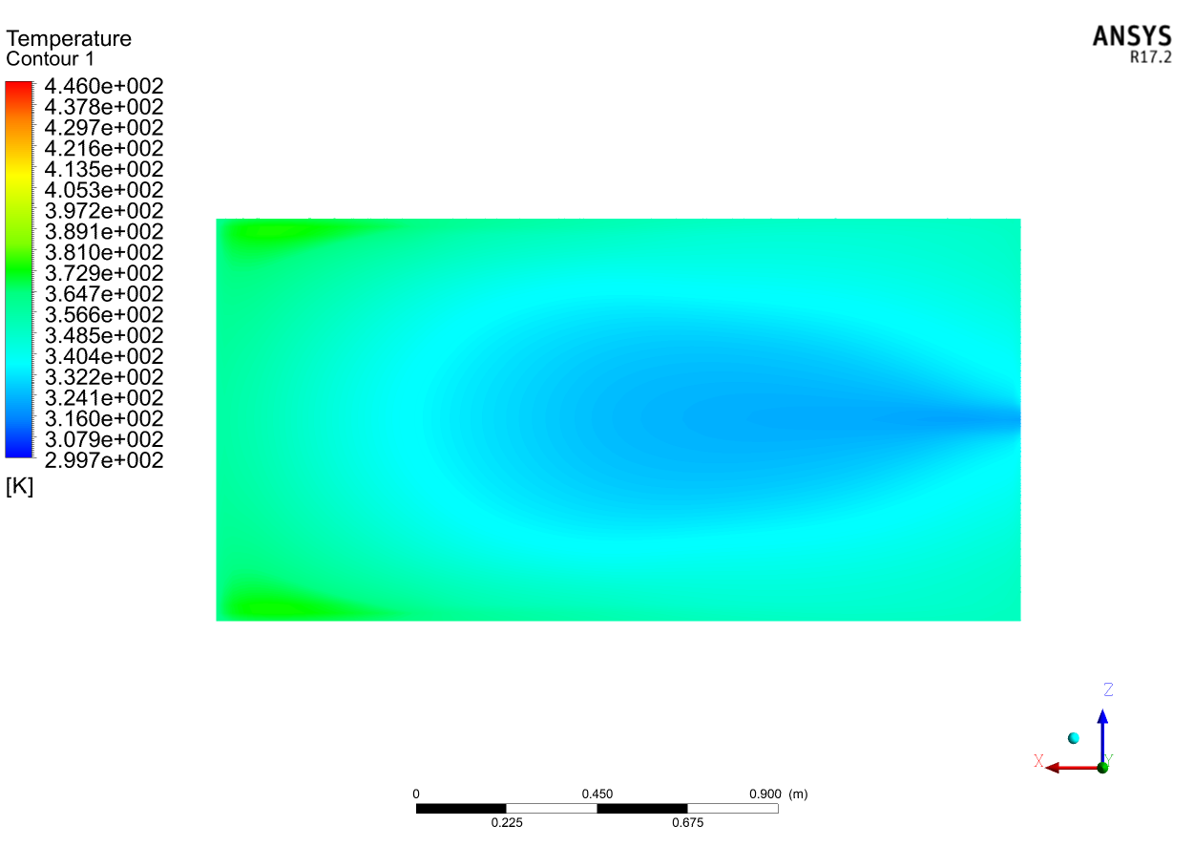
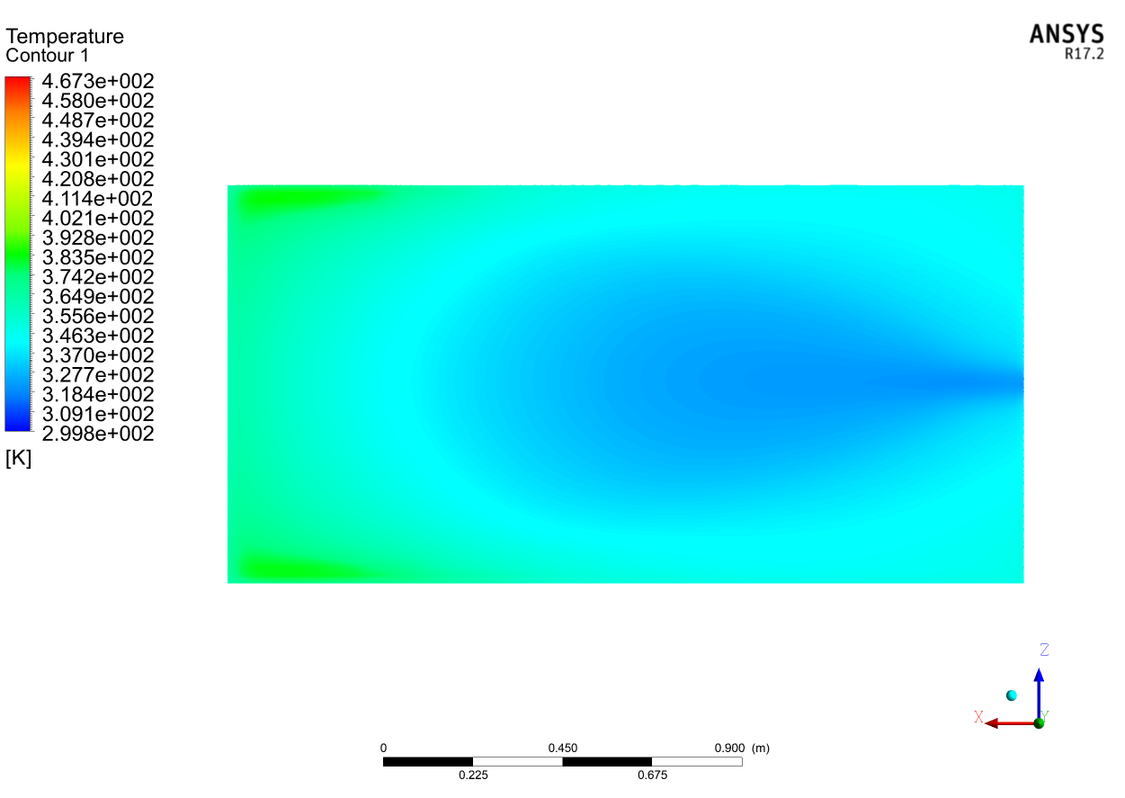
Fig.8a. Porous absorber contour (10 PPI, Gap= 5cm, Max flow)
Fig.8a. Porous absorber contour (10 PPI, Gap= 5cm, Max flow)

Slide 21
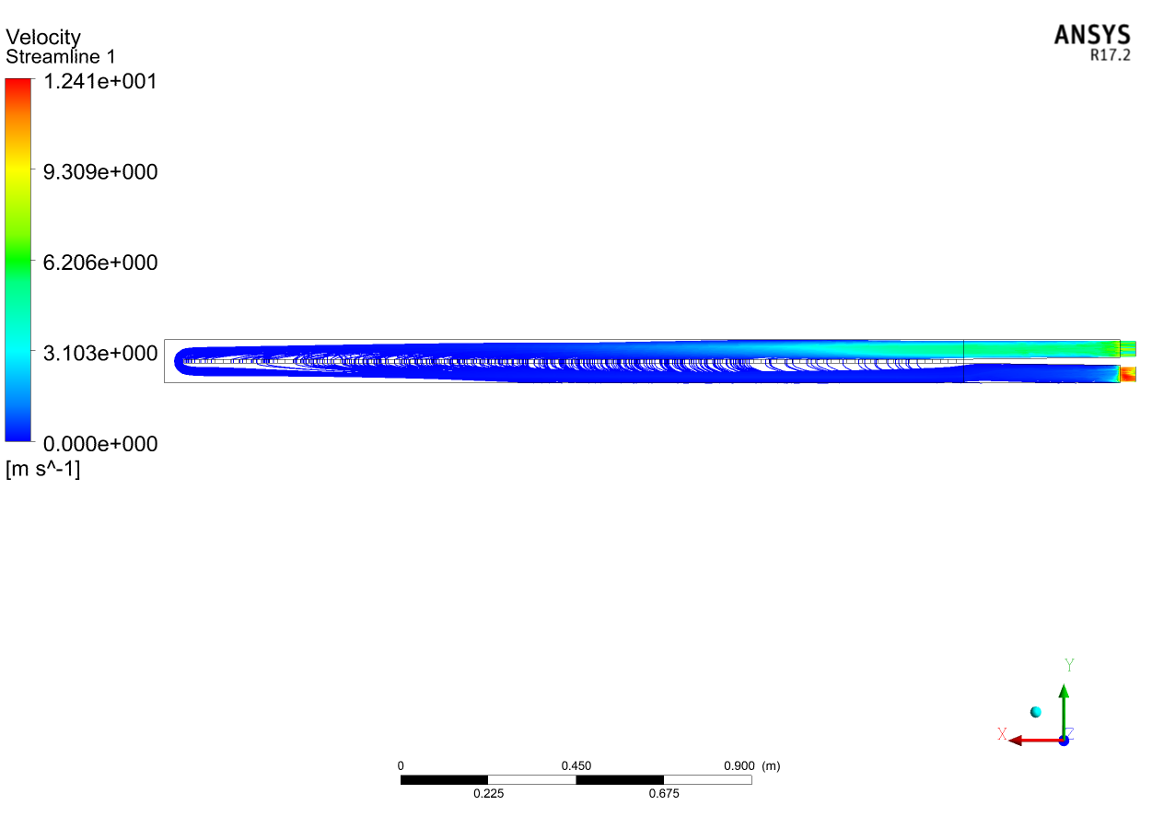
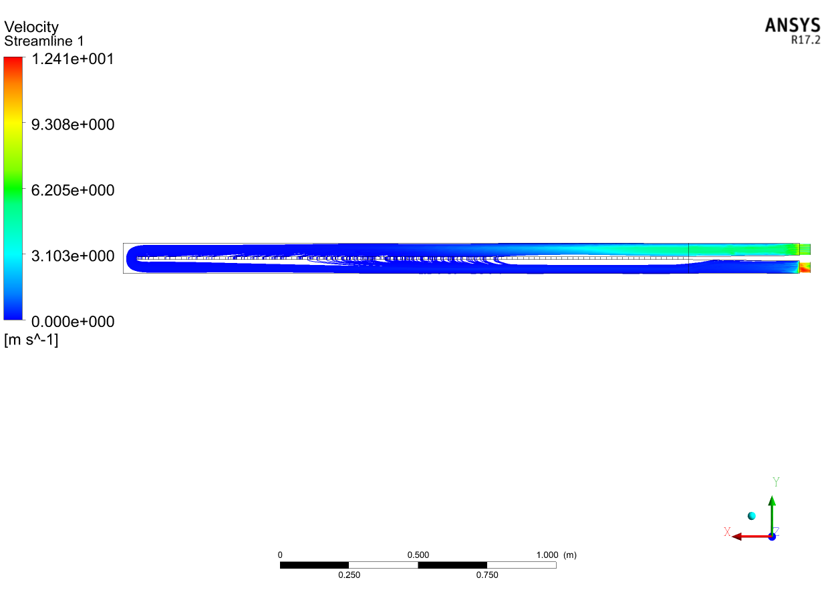
Fig.9a. Streamlines (10 PPI, Gap= 5cm, Max flow, Side View)
Fig.9b. Streamlines (40 PPI, Gap= 5cm, Max flow, Side View)

Slide 22
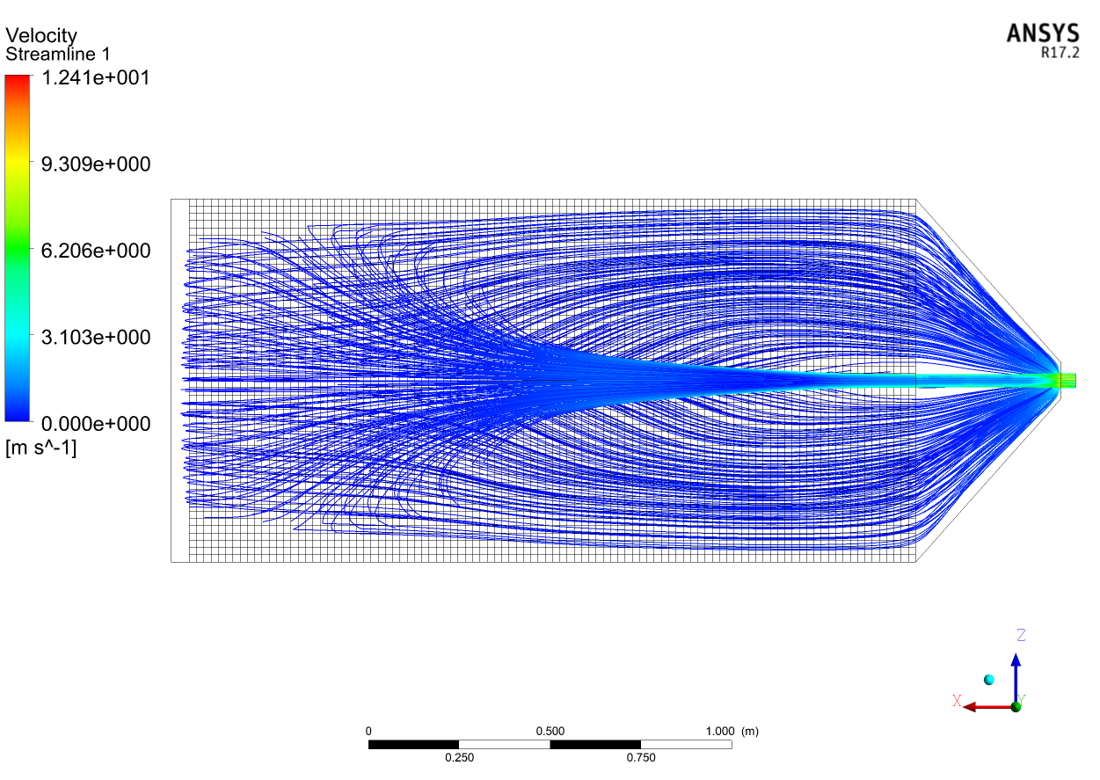
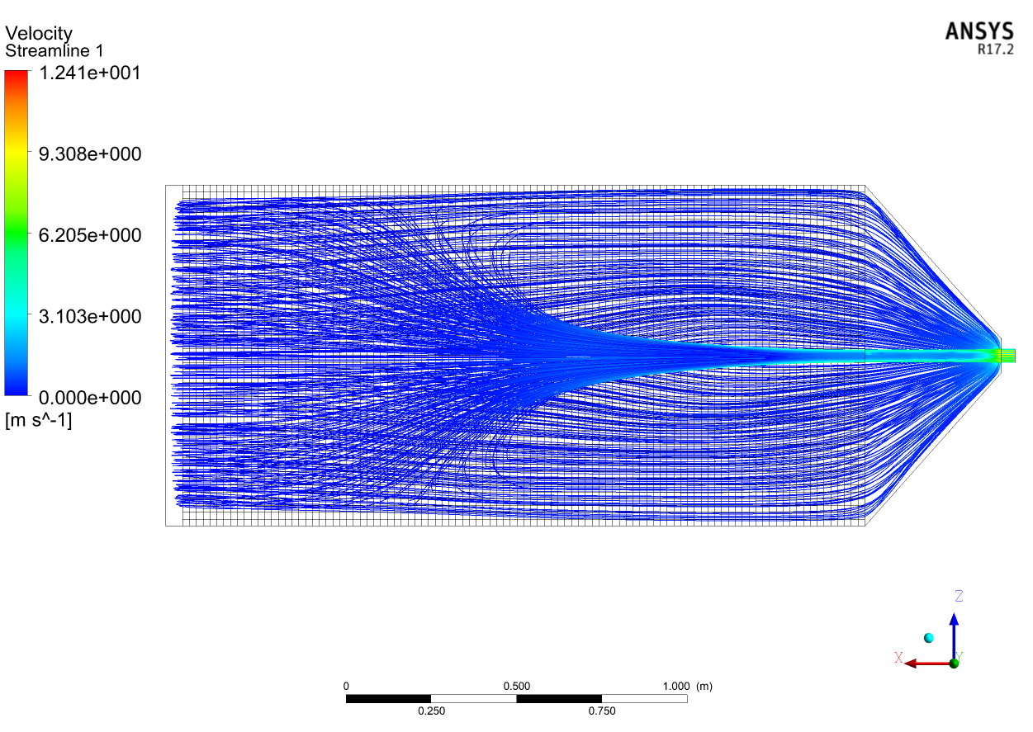
Fig.10a. Streamlines (10 PPI, Gap= 5cm, Max flow, Top View)
Fig.10b. Streamlines (40 PPI, Gap= 5cm, Max flow, Top View)

Slide 23
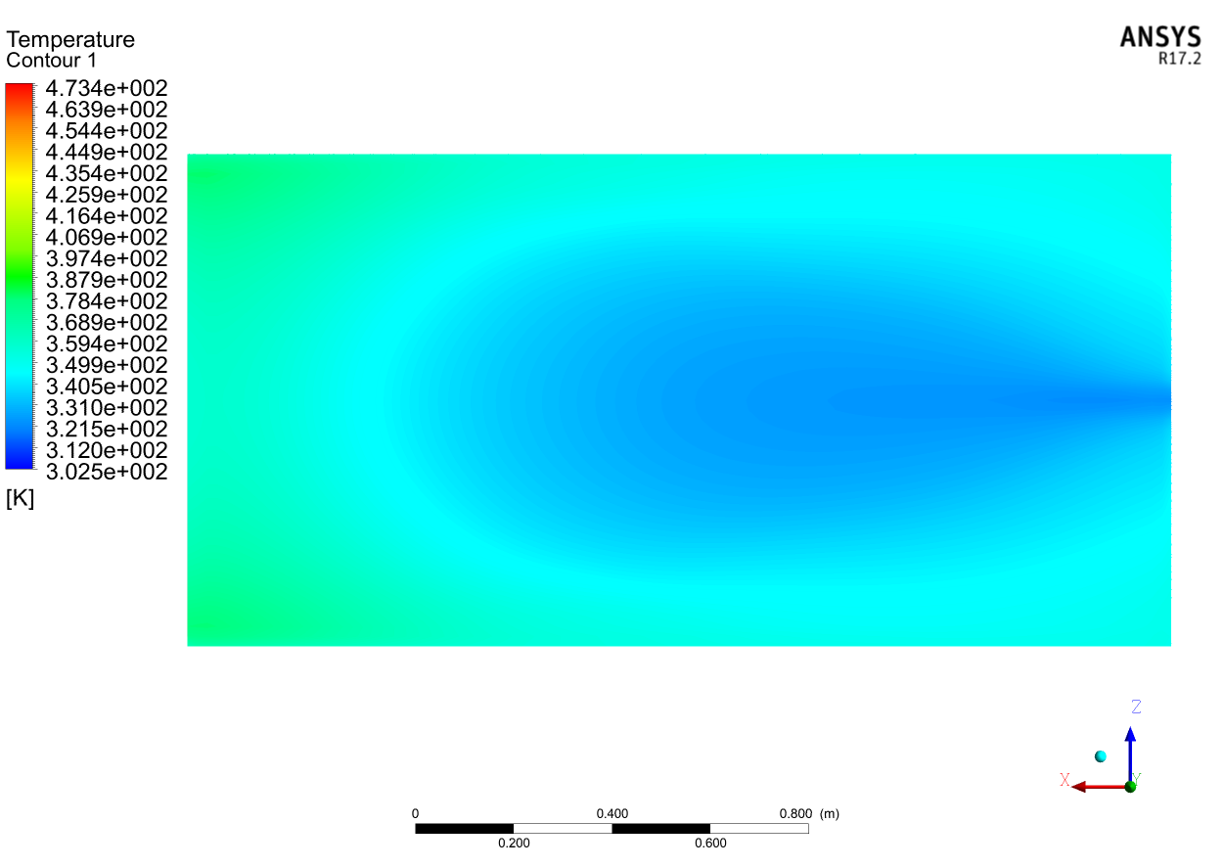
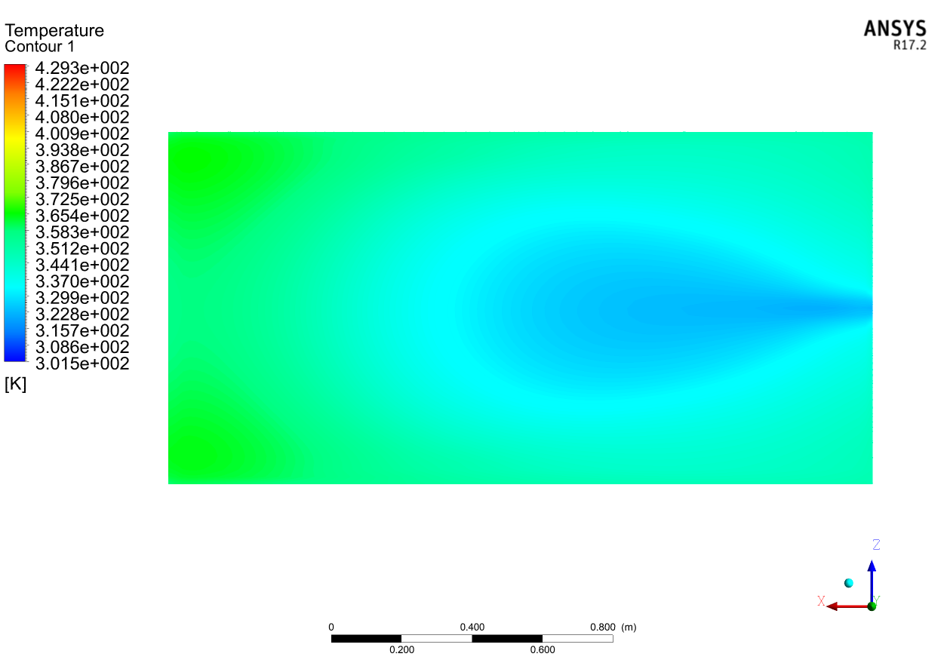
Fig.11a. Porous absorber contour (10 PPI, Gap= 5cm, Max flow)
Fig.11b. Porous absorber contour (40 PPI, Gap= 5cm, Max flow)

Slide 24
Fig.12a. Efficiency Versus Time (10PPI,40PPI, Gap=0cm Max flow)
Fig.12b. Efficiency Versus Time (10PPI,40PPI, Gap=1cm Max flow)

Slide 25
Fig.13a. Efficiency Versus Time (10PPI,40PPI, Gap=2cm Max flow)
Fig.13b. Efficiency Versus Time (10PPI,40PPI, Gap=3cm Max flow)

Slide 26
Fig.14a. Efficiency Versus Time (10PPI,40PPI, Gap=4cm Max flow)
Fig.14b. Efficiency Versus Time (10PPI,40PPI, Gap=5cm Max flow)

Slide 27
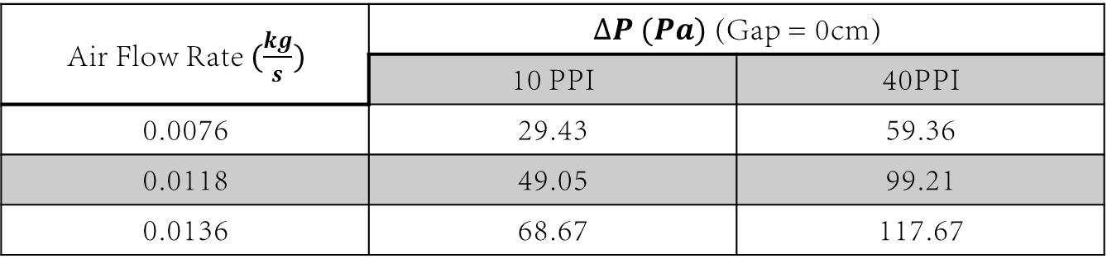
Table 2. Pressure Drop Versus Mass flow rates (gap = 0cm)
$∆P (Pa)$ (Gap = 0cm) |  | Air Flow Rate $(\frac{kg}{s})$
40PPI | 10 PPI
59.36 | 29.43 | 0.0076
99.21 | 49.05 | 0.0118
117.67 | 68.67 | 0.0136

Slide 28
Fig. 16a. efficiency versus time for 10 PPI (5cm gap), mass flow rates (0.0076, 0.0118, and 0.0136 kg/s)
Fig. 16b. efficiency versus time for 10 PPI (5cm gap), mass flow rates (0.0076, 0.0118, and 0.0136 kg/s)

Slide 29
5. References
Enibe, S. O. (2002). Performance of a natural circulation solar air heating system with phase change material energy storage. Renewable Energy, 27(1), 69-86.‏
Devahastin, S., & Pitaksuriyarat, S. (2006). Use of latent heat storage to conserve energy during drying and its effect on drying kinetics of a food product. Applied thermal engineering, 26(14-15), 1705-1713.‏
Shalaby, S. M., & Bek, M. A. (2014). Experimental investigation of a novel indirect solar dryer implementing PCM as energy storage medium. Energy conversion and management, 83, 1-8.‏

Slide 30


Thank
you

