Slide 1



University of Baghdad
College of Engineering
Mechanical Engineering Department
ANALYSIS, DESIGN AND MANUFACTURING OF A POWERED KNEE JOINT PROSTHESES FOR AN ABOVE KNEE AMPUTATION
By
Ahmed Khaleel Abdul Ameer
By Supervisor
Prof. Dr . Mohsin AL-Shammari

Slide 2
The Outlines of Dissertation
Significance of Dissertation
Problem Statement
The Scientific Originality
Plan of the dissertation
Methodology
Design of Knee Prosthesis
1. Functional anatomy & biomechanics of the knee joint
2. Mathematical Modelling
3. Mechanical Design

Slide 3
Significance of Dissertation
Iraq has witnessed during the eighties and nineties of the last century from wars and what’s happened after 2003 from a deterioration in security, resulting in the bombing and killing in addition to the accidents and some of the diseases such as diabetes that leads sometimes to amputation limbs, thus show the importance of this study where we will study designing the most important part of above knee prosthesis that is knee joint where a good prosthetic knee should mimic the behavior of the biological knee

Slide 4
problem statement
The problem is the lack of a lightweight, durable, and precise powered prosthetic knee joint for above knee amputation patients. Current prosthetic knee joints either lack the precision of control or the durability required for daily use.

Slide 5
The Scientific Originality
Design and manufacture a novel prosthetic knee joint capable of mimicking the human knee joint as closely as possible so that the amputee feels comfortable

Slide 6
The PLAN OF the dissertation
Analysis of the biomechanics of the human knee
Selection of suitable actuators
Design and modeling of the prosthesis
Control system design
Manufacturing
Testing and Evaluation
Modifying and Improving
Future Works

Slide 7


Review of Computerized Prosthetic Knee Joint in Terms of Mechanical and Control Design
Methodology
Methodology
1
2
3
Searching
collecting information related to smart knee prosthesis by studying many research papers (210 including scientific papers, thesis, and dissertations)
Classification
Category the research papers in terms of active prosthesis and semi-active prosthesis
Disassembly
Disassembly of previous types of knee prostheses that exist in local markets to know all their components
Classify
According Mechanical Design
Classify
According Control Design
Classify
Control Algorithms
Mechanical Design of Semi-Active Prosthesis
Mechanical Design of Active Prosthesis
Control System
Type of Actuator
[Variable Damping Actuator]
Type of Actuator [Electromechanical Actuator or Pneumatic Artificial Muscles Actuator (PAM)]
The Used Material
The Used Material
Numerical Analysis
Numerical Analysis

Slide 8
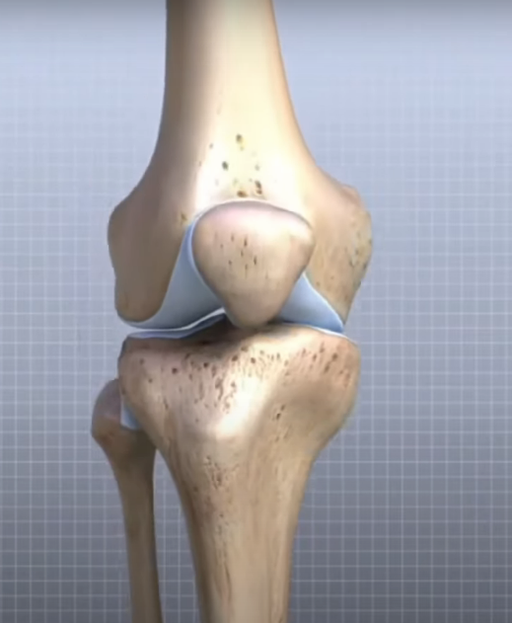
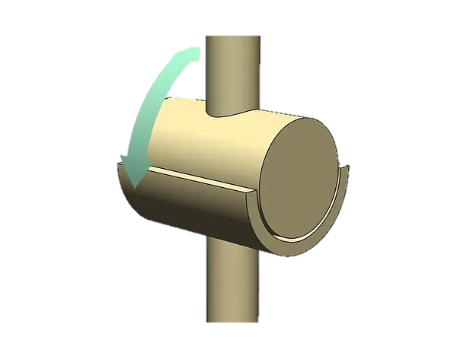











Design of Knee Prosthesis
Functional anatomy & biomechanics of the knee joint
The knee is one of the largest and most complex joints in the body. It joins the thigh bone (femur) to the shin bone (tibia). The smaller bone that runs alongside the tibia (fibula) and the kneecap (patella) are the other bones that make the knee joint.
Femur
Patella
Fibula
Tibia

Slide 9
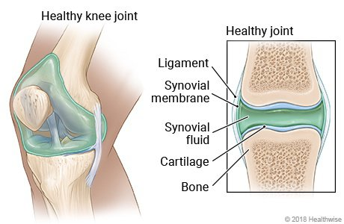








Design of Knee Prosthesis
Functional anatomy & biomechanics of the knee joint
Synovial fluid or generally known as joint fluid has thick and sticky consistency, act as a lubricant in the knee joint to reduce frictions and as a shock absorber, which helps the movement of our body. Getting up, sitting, or standing could be done effortlessly.
Zoom
Variable Damping Actuator

Slide 10


Design of Knee Prosthesis
Functional anatomy & biomechanics of the knee joint
Degrees of Freedom for Knee Joint
2 DOF
Flexion- Extension Movements
Rotation
Movements
Lateral Rotation
Medial Rotation
Flexion
Extension

Slide 11
Design of Knee Prosthesis
Functional anatomy & biomechanics of the knee joint
The biomechanical functions of knee joint are:
Locomotion with:
As little energy requirements from the muscles as possible.
Stability while performing activity on different terrains.
To transmit, absorb and redistribute forces caused during the activities of daily life:
Support during weight-bearing
Mobility during non-weight bearing.

Slide 12


Design of Knee Prosthesis
Functional anatomy & biomechanics of the knee joint
The Forces & Moments that Acting on Knee Joint
The magnitude of the forces and moments on a joint produced by:-
Body weight
Muscle action
Soft tissue resistance
Externally applied loads
After Amputation
Variable – Damping Actuator

Slide 13



Design of Knee Prosthesis
Functional anatomy & biomechanics of the knee joint
The Forces & Moments that Acting on Knee Joint
F_{Ky}
X
1. The largest compressive force occurs at
F_{Kx}
M_{K}
The Terminal Stance Phase (Approximately 81% of Stance Phase)
Knee
Mass = 100 Kg
F_{GR} = 100 * 1.2 * 9.81 = 1177.2 N
F_{GRy} = 1177.2 × Sin(81.6) = 1164.6 N
Y
F_{GRx} = 1091.4 × Cos(81.6) = 172 N
∑ M_{knee}= 0
Ankle
h
-(172× 0.5)+ (1164.6× 0.0637)+ M_{k}= 0
M_{k} ≈ 11.81 N.m
81.6°
F_{GR}

Slide 14

Design of Knee Prosthesis
Functional anatomy & biomechanics of the knee joint
The Forces & Moments that Acting on Knee Joint
F_{Ky}
2. The largest compressive force occurs at
X
The Terminal Stance Phase (Approximately 13% of Gait Cycle)
M_{K}
F_{Kx}
Mass = 100 Kg
F_{GR} = 100 * 1.2 * 9.81 = 1177.2 N
F_{GRy} = 1177.2 × Sin(79.2) = 1156.35 N
Y
F_{GRx} = 1177.2 × Cos(79.2) = 220.6 N
∑ M_{knee}= 0
(220.6× 0.5)- (1156.35× 0.125) +M_{k} = 0
79.2°
F_{GR}
M_{k} ≈ 34.2 N.m

Slide 15

Design of Knee Prosthesis
Functional anatomy & biomechanics of the knee joint
The Range of Motion
No. | Activity | Range of Motion from Knee Extension to Knee Flexion (Degrees)
1 | Walking | 0 – 67°
2 | Climbing Stairs | 0 – 83°
3 | Descending Stairs | 0 – 90°
4 | Sitting Down | 0 – 90°
Range of Motion
(0 – 90°)

Slide 16



Design of Knee Prosthesis
F_{a-y}
2. Mathematical Modelling
Y
𝞽₁
Pelvis motion
X
(x_{a},y_{a})
a
r₁
L₁
F_{a-x}
a
Knee Joint
m₁
𝞽₂
m₁
(x₁,y₁)
θ₁
(x_{b},y_{b})
b
b
Hip Joint
r₂
m₂
L₂
Thigh
m₂
(x₂,y₂)
(x_{c},y_{c})
θ₂
c
Leg
c
F₁
F₂
The Simplified Model of Lower Limb
Free Body Diagram

Slide 17
Design of Knee Prosthesis
2. Mathematical Modelling
Assumptions:-
Fixed Position Point Represents the Joint Rotation Center
Fixed Mass Center for Each Segment
Rigid Bodies as Segments
Neglected Trunk Mass
Fixed Ankle

Slide 18
Design of Knee Prosthesis
2. Mathematical Modelling of the Human Lower Limb
We will use Euler-Lagrange’s Equation to find the equation of
Motion for fixed ankle lower limb
(x_{a},y_{a})
a
r₁
L₁
(x_{b},y_{b})
are known
(x_{a},y_{a})
(x_{c},y_{c})
m₁
(x₁,y₁)
θ₁
x₁ = x_{a} + r₁sin (θ₁)
(x_{b},y_{b})
b
r₂
y₁ = y_{a} - r₁cos (θ₁)
L₂
Eq. (1)
m₂
x₂ = x_{a} + L₁sin (θ₁) + r₂sin (θ₂)
(x₂,y₂)
θ₂
y₂ = y_{a} - L₁cos (θ₁) - r₂cos (θ₂)
(x_{c},y_{c})
c
The Simplified Model of Lower Limb

Slide 19
Design of Knee Prosthesis
2. Mathematical Modelling of the Human Lower Limb
To derive the displacements in Eq. (1) with respect to time, the components of velocity are obtained
x˙₁ = x˙_{a} + r₁ θ˙₁ cos (θ₁)
y˙₁ = y˙_{a} + r₁θ˙₁ sin (θ₁)
Eq. (2)
x˙₂ = x˙_{a} + L₁θ˙₁ cos (θ₁) + r₂ θ˙₂ cos(θ₂)
y˙₂ = y˙_{a} + L₁ θ˙₁ sin (θ₁) + r₂ θ˙₂ sin(θ₂)

Slide 20
Design of Knee Prosthesis
2. Mathematical Modelling of the Human Lower Limb
Langragian’s equation is used in this analysis to determine the equation of motion, the mathematical formula to Langragian’s Formula can be written as follows:-
L = K.E – P.E
K.E = 0.5 × m× V²
P.E =m× g× h
K.E = (0.5 × m₁× (x˙₁² +y˙₁² )) + (0.5 × I₁× θ˙₁²)+ (0.5 × m₂× (x˙₂² +y˙₂² ))
+ (0.5 × I₂× θ˙₂²)
P.E =(-m₁× g× y₁) + (-m₂ × g× y₂)

Slide 21
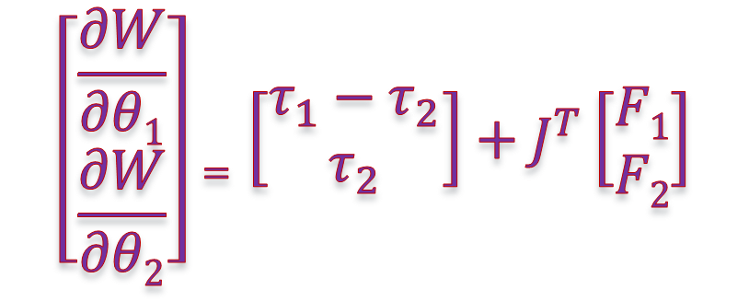

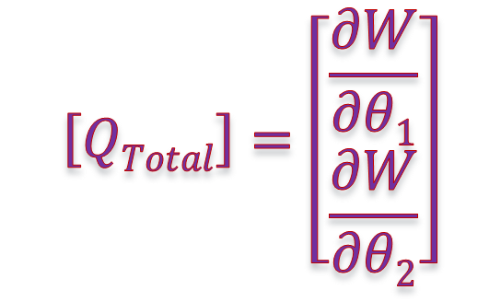
Design of Knee Prosthesis
2. Mathematical Modelling of the Human Lower Limb
L = (0.5 × m₁× (x˙₁² +y˙₁² )) + (0.5 × I₁× θ˙₁²)+ (0.5 × m₂× (x˙₂² +y˙₂² )) + (0.5 × I₂× θ˙₂²) + m₁× g× y₁ + m₂ × g× y₂
Langragian’s equation is :-
$\frac{∂}{∂t}\left(\frac{∂L}{∂q˙}\right)−\frac{∂L}{∂q}=Q$_{Total}
Two generalized coordinates:
θ₁ and θ₂
$$\left[QTotal\right]=\left[\begin{matrix}\frac{∂W}{∂θ1} \\ \frac{∂W}{∂θ2}\end{matrix}\right]$$
Virtual Work Theory
$$\left[\begin{matrix}\frac{∂W}{∂θ1} \\ \frac{∂W}{∂θ2}\end{matrix}\right]=\left[\begin{matrix}τ_{1}−τ_{2} \\ τ_{2}\end{matrix}\right]+J^{T}\left[\begin{matrix}F1 \\ F2\end{matrix}\right]$$

Slide 22



Design of Knee Prosthesis
2. Mathematical Modelling of the Human Lower Limb
2. Mathematical Modelling
$$\left[QTotal\right]=\left[\begin{matrix}τ_{1}−τ_{2} \\ τ_{2}\end{matrix}\right]+J^{T}\left[\begin{matrix}F1 \\ F2\end{matrix}\right]$$
The serial-system Jacobian matrix can be determined as following:-
$$\left[ J \right]=\left[\begin{matrix}\frac{∂}{∂θ1}xc \frac{∂}{∂θ2}yc \\ \frac{∂}{∂θ1}xc \frac{∂}{∂θ2}yc\end{matrix} \right]$$
$xc$ = 𝑥_{a} + L₁ sin(𝜃₁) + L₂ sin(𝜃₂)
$yc$ = 𝑦_{a} - L₁ cos(𝜃₁) - L₂ cos(𝜃₂)

Slide 23
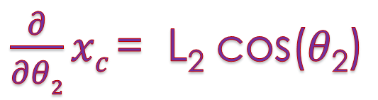
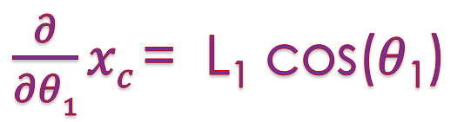
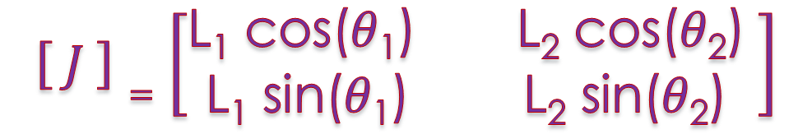
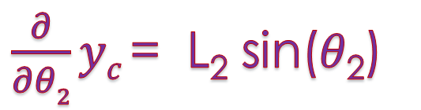
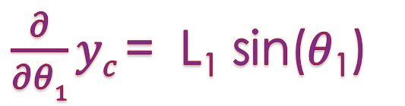
Design of Knee Prosthesis
2. Mathematical Modelling of the Human Lower Limb
2. Mathematical Modelling
$\frac{∂}{∂θ1}xc$= L₁ cos(𝜃₁)
$\frac{∂}{∂θ2}xc$= L₂ cos(𝜃₂)
$\frac{∂}{∂θ1}yc$= L₁ sin(𝜃₁)
$\frac{∂}{∂θ2}yc$= L₂ sin(𝜃₂)
$$\left[ J \right]=\left[\begin{matrix}\text{L}\text{1} \text{cos}\text{(}\text{θ}\text{1}\text{)} \text{L}\text{2} \text{cos}\text{(}\text{θ}\text{2}\text{)} \\ \text{L}\text{1} \text{sin}\text{(}\text{θ}\text{1}\text{)} \text{L}\text{2} \text{sin}\text{(}\text{θ}\text{2}\text{)}\end{matrix} \right]$$

Slide 24
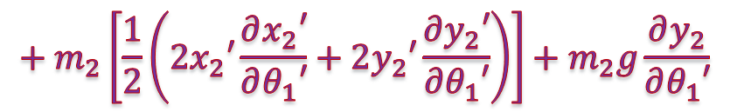

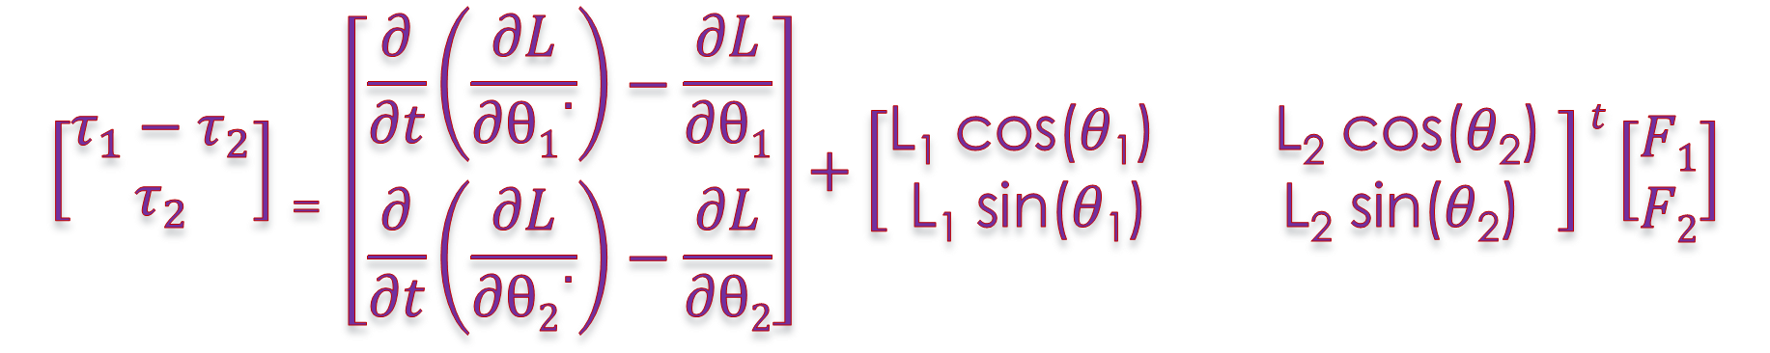
Design of Knee Prosthesis
2. Mathematical Modelling of the Human Lower Limb
$$\left[\begin{matrix}τ_{1}−τ_{2} \\ τ_{2}\end{matrix}\right]= \left[\begin{matrix}\frac{∂}{∂t}\left(\frac{∂L}{∂θ1˙}\right)−\frac{∂L}{∂θ1} \\ \frac{∂}{∂t}\left(\frac{∂L}{∂θ2˙}\right)−\frac{∂L}{∂θ2}\end{matrix}\right]+\left[\begin{matrix}\text{L}\text{1} \text{cos}\text{(}\text{θ}\text{1}\text{) }\text{L}\text{2} \text{cos}\text{(}\text{θ}\text{2}\text{)} \\ \text{L}\text{1} \text{sin}\text{(}\text{θ}\text{1}\text{) }\text{L}\text{2} \text{sin}\text{(}\text{θ}\text{2}\text{)}\end{matrix} \right]t\left[\begin{matrix}F1 \\ F2\end{matrix}\right]$$
$$\frac{∂L}{∂{θ˙}_{1}}=\frac{∂}{∂{θ˙}_{1}}\left[\frac{1}{2}m_{1}\left({x^{˙}}_{1}^{2}+{y^{˙}}_{1}^{2}\right)+\frac{1}{2}I_{1}{θ^{˙}}_{1}^{2}+\frac{1}{2}m_{2}\left({x^{˙}}_{2}^{2}+{y^{˙}}_{2}^{2}\right)+\frac{1}{2}I_{2}{θ^{˙}}_{2}^{2}+m_{1}y_{1}g+m_{2}y_{2}g\right]$$
= $m_{1}\left[\frac{1}{2}\left(2x_{1}′\frac{∂x_{1}′}{∂θ_{1}′}+2y_{1}′\frac{∂y_{1}′}{∂θ_{1}′}\right)\right]+I_{1}{θ^{′}}_{1}+m_{1}g\frac{∂y_{1}}{∂θ_{1}′}$
$$+ m_{2}\left[\frac{1}{2}\left(2x_{2}′\frac{∂x_{2}′}{∂θ_{1}′}+2y_{2}′\frac{∂y_{2}′}{∂θ_{1}′}\right)\right]+m_{2}g\frac{∂y_{2}}{∂θ_{1}′}$$

Slide 25
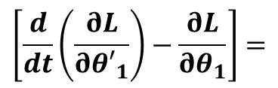
Design of Knee Prosthesis
2. Mathematical Modelling of the Human Lower Limb
$$\left[\frac{d}{dt}\left(\frac{∂L}{∂{θ′}_{1}}\right)−\frac{∂L}{∂θ_{1}}\right]=$$
$m_{1}\left[x_{a}^{"}r_{1}cosθ_{1}+y_{a}^{′′}r_{1}sinθ_{1}+r_{1}^{2}θ_{1}^{"}+gr_{1}sinθ_{1}\right]{+m}_{2}\left[x_{a}^{"}L_{1}cosθ_{1}+y_{a}^{′′}L_{1}sinθ_{1}+L_{1}r_{2}θ_{2}^{′′}\cos\left(θ_{1}−θ_{2}\right)+L_{1}r_{2}{θ_{2}^{′}}^{2}\sin\left(θ_{1}−θ_{2}\right)+gL_{1}sinθ_{1}\right.$ + $L_{1}^{2}{θ^{′}}_{1}^{′}]$ ${ \text{+} I}_{1}{{θ′}^{′}}_{1}$

Slide 26
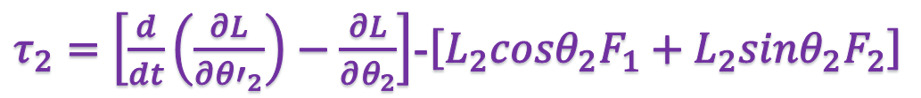


Design of Knee Prosthesis
2. Mathematical Modelling of the Human Lower Limb
$τ_{2}=\left[\frac{d}{dt}\left(\frac{∂L}{∂{θ′}_{2}}\right)−\frac{∂L}{∂θ_{2}}\right]$-$\left[L_{2}cosθ_{2}F_{1}+L_{2}sinθ_{2}F_{2}\right]$
$τ_{2} {=m}_{2}r_{2}\left[x_{a}^{"}cosθ_{2}+y_{a}^{"}sinθ_{2}+L_{1}θ_{1}^{"}\cos\left(θ_{1}−θ_{2}\right)+L_{1}{θ_{1}^{′}}^{2}sin{(θ_{2}−θ}_{1})+r_{2}θ_{2}^{"}+gsinθ_{2}\right]$ $+I_{2}{θ^{"}}_{2}$
-$\left[L_{2}cosθ_{2}F_{1}+L_{2}sinθ_{2}F_{2}\right]$
$τ_{2} {= m}_{2}r_{2}\left[x_{a}^{"}cosθ_{2}+y_{a}^{"}sinθ_{2}+L_{1}θ_{1}^{"}\cos\left(θ_{1}−θ_{2}\right)+L_{1}{θ_{1}^{′}}^{2}sin{(θ_{2}−θ}_{1})+r_{2}θ_{2}^{"}+gsinθ_{2}\right]$ $+I_{2}{θ^{"}}_{2}$
- $\left[L_{2}cosθ_{2}F_{1}+L_{2}sinθ_{2}F_{2}\right]$

Slide 27
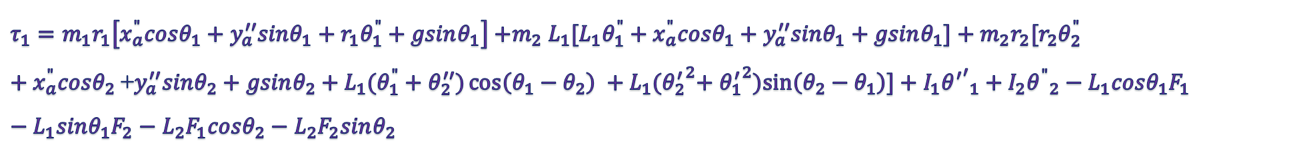

Design of Knee Prosthesis
2. Mathematical Modelling of the Human Lower Limb
$τ_{1}=\left[\frac{d}{dt}\left(\frac{∂L}{∂{θ˙}_{1}}\right)−\frac{∂L}{∂θ_{1}}\right]$-$\left[L_{1}cosθ_{1}F_{1}+L_{1}sinθ_{1}F_{2}\right]$ $+\left[\frac{d}{dt}\left(\frac{∂L}{∂{θ′}_{2}}\right)−\frac{∂L}{∂θ_{2}}\right]\text{−}\left[L_{2}cosθ_{2}F_{1}+L_{2}sinθ_{2}F_{2}\right]$
$=m_{1}\left[x_{a}^{"}r_{1}cosθ_{1}+y_{a}^{′′}r_{1}sinθ_{1}+r_{1}^{2}θ_{1}^{"}+gr_{1}sinθ_{1}\right]{+I_{1}{{θ′}^{′}}_{1}+m}_{2}[x_{a}^{"}L_{1}cosθ_{1}+y_{a}^{′′}L_{1}sinθ_{1}+L_{1}r_{2}θ_{2}^{′′}\cos\left(θ_{1}−θ_{2}\right)+L_{1}r_{2}{θ_{2}^{′}}^{2}\sin\left(θ_{1}−θ_{2}\right)+gL_{1}sinθ_{1}+L_{1}^{2}{θ^{′}}_{1}^{′}]+ m_{2}r_{2}\left[x_{a}^{"}cosθ_{2}+y_{a}^{"}sinθ_{2}+r_{2}θ_{2}^{"}+L_{1}θ_{1}^{"}\cos\left(θ_{1}−θ_{2}\right)+L_{1}{θ_{1}^{′}}^{2}sin\left(θ_{2}−θ_{1}\right)+gsinθ_{2}\right]+I_{2}{θ^{"}}_{2}−L_{2}F_{1}cosθ_{2}−L_{2}F_{2}sinθ_{2}$ -$\left[L_{1}cosθ_{1}F_{1}+L_{1}sinθ_{1}F_{2}\right]$
- $\sin\left(θ_{1}−θ_{2}\right)=sin\left(θ_{2}−θ_{1}\right)$
$τ_{1}=m_{1}r_{1}\left[x_{a}^{"}cosθ_{1}+y_{a}^{′′}sinθ_{1}+r_{1}θ_{1}^{"}+gsinθ_{1}\right]{+m}_{2}L_{1}[{L_{1}θ_{1}^{"}+x}_{a}^{"}cosθ_{1}+y_{a}^{′′}sinθ_{1}+gsinθ_{1}]+m_{2}r_{2}[r_{2}θ_{2}^{"}+x_{a}^{"}cosθ_{2}$+$y_{a}^{′′}sinθ_{2}+gsinθ_{2}+L_{1}{(θ_{1}^{"}+θ}_{2}^{′′})\cos\left(θ_{1}−θ_{2}\right) +L_{1}{{(θ}_{2}^{′}}^{2}+ {θ_{1}^{′}}^{2})sin\left(θ_{2}−θ_{1}\right)]+I_{1}{{θ^{′}}^{′}}_{1}+I_{2}{θ^{"}}_{2}−L_{1}cosθ_{1}F_{1}−L_{1}sinθ_{1}F_{2}−L_{2}F_{1}cosθ_{2}−L_{2}F_{2}sinθ_{2}$

Slide 28

Design of Knee Prosthesis
2. Mathematical Modelling of the Human Lower Limb
M(θ)Ӫ + C(θ,$\dot{θ}$) $\dot{θ}$+ G(θ) = τ
𝞽-₁𝞽₂ = M₁₁ Ӫ₁ + M₁₂ Ӫ₂ + C₁ + G₁
𝞽₂ = M₂₁ Ӫ₁ + M₂₂ Ӫ₂ + C₂ + G₂
M11, M12, M21 and M22 are the moments of inertia matrix components respectively
C1 and C2 represent the centripetal force and Coriolis force at thigh and leg respectively
G1 and G2 express the gravity of thigh and leg respectively

Slide 29
Design of Knee Prosthesis
Kinetic Modeling of Microprocessor Prosthetic Knee Joint
Before starting to study the kinetic analysis of a prosthetic knee joint, it is very necessary to ask ourselves the following questions:
Do we use a single axis or polycentric mechanism in designing a smart prosthetic knee joint?
Which suitable type of actuators can be used in the designing? Do we choose a fully powered actuator or a variable-damping actuator?
If we choose a powered actuator, do we use electro-mechanical actuator or Pneumatic Artificial muscles? and why?
In the case of choosing a variable damping actuator, which is better (hydraulic actuator or magnetorheological actuator)?

Slide 30
Design of Knee Prosthesis
We use a single-axis mechanism in the design of smart prosthetic knee joints because:
The single-axis mechanism is common and can offer a stable pace and speed.
Its low cost
Its reliability
Its simplicity
Its low maintenance

Slide 31
Design of Knee Prosthesis
The choosing criteria of the suitable actuator in the design:
Safety
Its weight must be light
affordable cost
must simulate the performance of the amputated part
must provide stability and required amount of torque
Can be controlled and has a fast response
Low energy consumption
No Noise

Slide 32
Design of Knee Prosthesis
Not applicable
No | Design Criteria | EM Actuator | SE Actuator | PAM Actuator
1 | Safety
2 | Its weight must be light
3 | affordable cost
4 | simulate of the amputated part
5 | Stability
6 | Can be controlled
7 | Low energy consumption
8 | Noise
EM: Electro-mechanic actuator
SE : Series elastic actuator
PMA: Pneumatic artificial muscles actuator

Slide 33
Design of Knee Prosthesis
Which suitable type of actuators can be used in the designing? Do we choose a Active actuator or a variable-damping actuator?
The Active prosthetic knee can control the knee joint angle effectively because of mechanical actuator and microprocessor. The actuator should generate large force to support the weight of human body. But, generating the large torque using small actuator is difficult.
To solve this problem, a variable-damping actuator prosthetic knee has been researched.

Slide 34
Design of Knee Prosthesis
No | Design Criteria | Hydraulic Actuator | MR Actuator
1 | Safety
2 | Its weight must be light
3 | affordable cost
4 | simulate of the amputated part
5 | Stability
6 | Can be controlled
7 | Low energy consumption
8 | Noise
Suitable Actuator

Slide 35
Design of Knee Prosthesis
No | Design Criteria | Hydraulic Actuator | MR Actuator
1 | Safety
2 | Its weight must be light
3 | affordable cost
4 | simulate of the amputated part
5 | Stability
6 | Can be controlled
7 | Low energy consumption
8 | Noise
1. A Clinical Comparison of Variable-Damping and Mechanically Passive Prosthetic Knee Devices
2. Design and Evaluation of Swing Phase Controllers for Single-axis Knee

Slide 36






Design of Knee Prosthesis
Kinetic Modeling of Microprocessor Prosthetic Knee Joint
L_{ac}
𝞽₁
r₁
L₁
0 ≤ β ≤ 90°
c
a
β
θ₁
𝞽₂
d
$$δ$$
L_{ab}
r₂
L₂
L_{MR}
L_{MR}
b
Zoom
θ₂
$\cos\left(90−β\right)$ = sin$\left(β\right)$

Slide 37



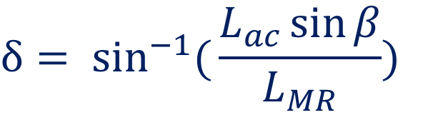
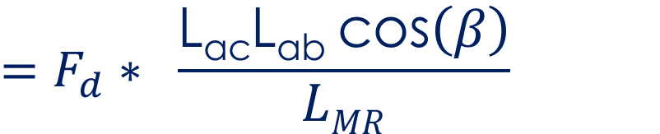


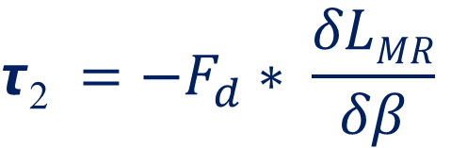

Design of Knee Prosthesis
Kinetic Modeling of Microprocessor Prosthetic Knee Joint
$$=F_{d}∗ \frac{\text{L}\text{ac}\text{L}\text{ab} \text{cos}\left(β\right)}{LMR}$$
F_{d}
$$\text{τ}\text{2} =−F_{d}∗ \frac{δLMR}{δβ}$$
L_{ac}
𝞽₂
c
a
$$δ= \sin^{−1}({\frac{L_{ac}\sin{β}}{L_{MR}})}$$
$$δβ$$
β
$$δLMR$$
d
The damping force of MR damper can be calculated:-
$$δ$$
L_{ab}
L_{MR}
$$Fd= ∆P∗A$$
b
The cross sectional area of the piston
Pressure drop between upper and lower chamber

Slide 38


Design of Knee Prosthesis
Kinetic Modeling of Microprocessor Prosthetic Knee Joint
The pressure drop (ΔP) is consists of viscous component (ΔP_{η}) induced from fluid friction force and yield stress component (ΔP_{𝞽}) The pressure drop as follow is :-
$$∆P=\text{Δ}\text{P}\text{η}\text{+}\text{Δ}\text{P}\text{τ}$$
And the cross sectional area of the piston (A) can be calculated by :-
$$A=\text{π}r_{p}^{2}$$
The radius of piston

Slide 39
Design of Knee Prosthesis
Mechanical Design a prosthetic knee :
Design Criteria according to Priorities:
Cost
Durability
Repairability/maintenance
Stability and Weight Limit
Weight of Component
Range of Motion
Cosmetics/appearance
Decreasing prosthesis mass to 25% of physiological leg mass can reduce absolute hip work by 22%
Dimensioning
Type of actuator
The used Material

Slide 40


Design of Knee Prosthesis
Mechanical Design a prosthetic knee :
NO | Design Criterion | Specification
1 | Cost | Cost less than 1000 $
2 | Stability and Weight Limit | Provide mechanism to arrest flexion Support patient of 100 kg
3 | Weight of Component | Weigh less than 2.5 kg
4 | Range of Motion | 90° of flexion
5 | appearance | The length and the width of the prosthetic knee should not be around 250 mm and 70 mm respectively

Slide 41
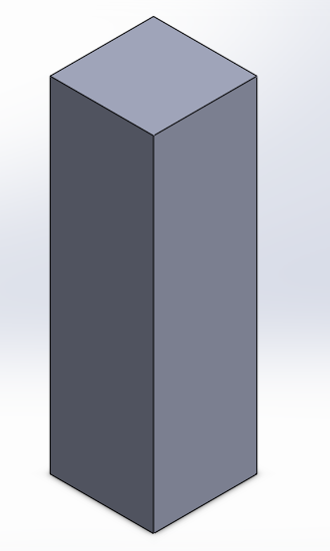
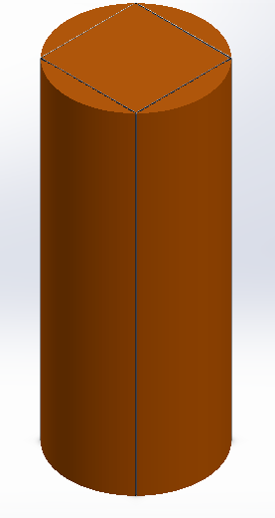
Design of Knee Prosthesis
Mechanical Design of a prosthetic knee :
2. Selection of Materials:
Aluminum alloy is suitable for the structure of my design of a prosthetic knee joint because of its lightweight, good mechanical properties, and availability in the local markets.
Availability in the local markets:
Al 6061
Al 2024 T3
Al 7075 T6
The Diameter = 101 mm at least
According to our dimensions
& manufacture method
The length = 72 mm at least
or

Slide 42
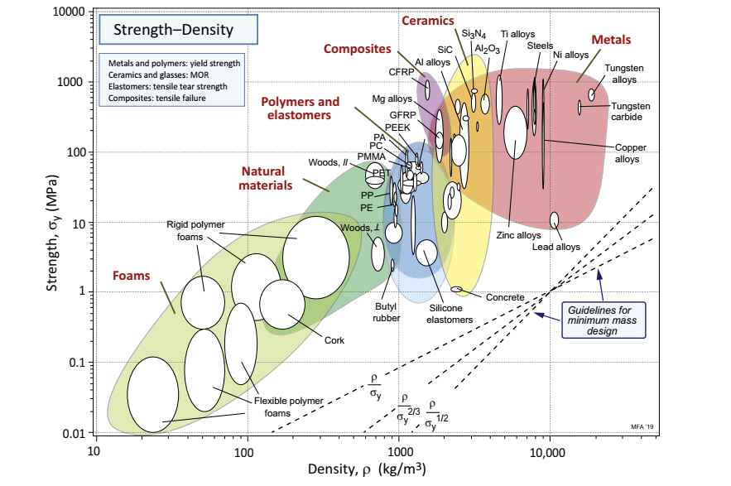

Design of Knee Prosthesis
Mechanical Design of a prosthetic knee :
2. Selection of Materials:
Selected Materials:-
Mg alloys
CFRP
Al alloys
Ti alloys
Steel

Slide 43










Design of Knee Prosthesis
Selected Materials:-
$\frac{σ_{y}}{ρ})Min=323$ for CFRP
$\frac{σ_{y}}{ρ})Max=588.2$ for CFRP
$\frac{σ_{y}}{ρ})Min=94$ for Ti
$\frac{σ_{y}}{ρ})Max=281.7$ for Ti
$\frac{σ_{y}}{ρ})Min=115$ for Mg
$\frac{σ_{y}}{ρ})Max=230$ for Mg
$\frac{σ_{y}}{ρ})Min=107.1$ for Al
$\frac{σ_{y}}{ρ})Max=160.7$ for Al
$\frac{σ_{y}}{ρ})Min=115.4$ for Steel
$\frac{σ_{y}}{ρ})Max=141$ for Steel

Slide 44
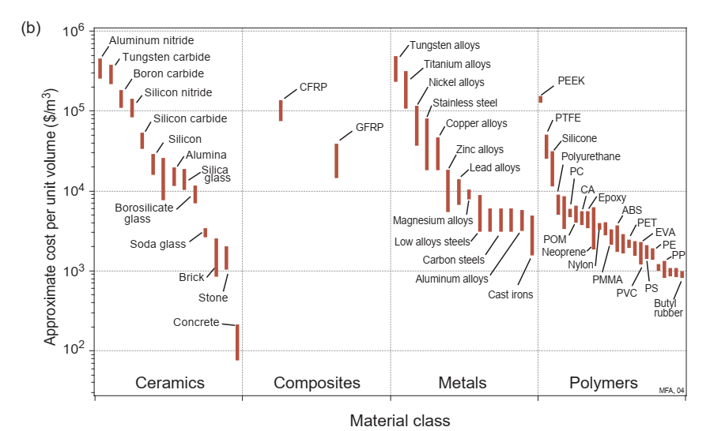

Design of Knee Prosthesis
Lowest Price
The Selected Metal:-
Aluminum alloys

Slide 45
Design of Knee Prosthesis
The Selected aluminum alloys:-
Al 2014-T6,T651
Al 2024-T3
Al 2024-T4,T351
Al 2024-T6,T651
Al 2024-T81,T851
Al 2024-T861
Al 2124-T851
Al 2219-T81,T851
Al 4032-T6
10) Al 6262-T9
11) Al 7075-T6,T651
13) Al 7075-T73,T7351
14) Al 7178-T6,T651
15) Al 7178-T76,T7651

Slide 46

Design of Knee Prosthesis
3. The Segment Dimensions:-
Height (H)
Leg Height = 0.246 H
Foot Height = 0.039 H
Foot Width = 0.055 H
Foot Length = 0.152 H
0.13 H
0.146 H
0.108 H
0.129 H
0.186 H
0.259 H
0.52 H
0.174 H
H
0.936 H
0.87 H
0.818 H
0.191 H
0.63 H
0.72 H
0.485 H
0.53 H
0.377 H
0.285 H
0.039 H
0.055H
0.152H
Foot Length

Slide 47
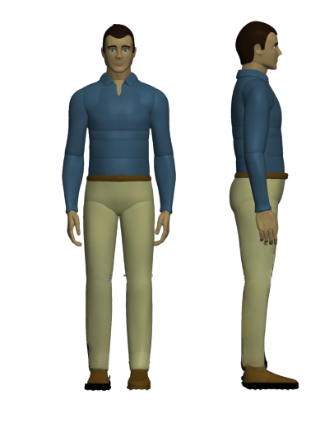
Design of Knee Prosthesis
Unit in mm
3. The Segment Dimensions:-
Anthropometric data:-
Height (H)= 1750 mm
2) Leg Height = 430.5 mm
3) Foot Height = 68.25 mm
1750
4) Foot Width = 96.25 mm
5) Foot Length = 266 mm
430.5
500
68.25
96.25
266

Slide 48
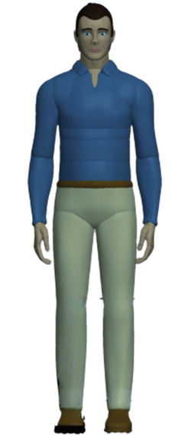
Design of Knee Prosthesis
Unit in Kg
4. Segment Mass:-
Mass (M)
2) Leg Mass = 0.0465 M
3) Foot Mass = 0.0145 M
4) Thigh Mass = 0.100 M
C.G
Anthropometric data:-
C.G
Mass (M) = 100 Kg
M_{Total}
2) Leg Mass = 4.65 Kg
M_{Thigh}
3) Foot Mass =1.45 Kg
C.G
4) Thigh Mass = 10 Kg
C.G
M_{Leg}
M_{Foot}

Slide 49
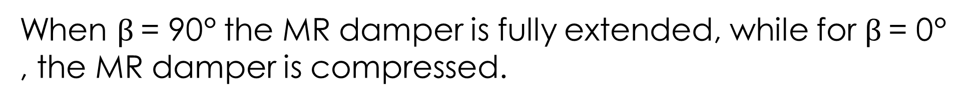



Design of Knee Prosthesis (Determination the Dimensions)
When $β$= 90° the MR damper is fully extended, while for $β$= 0° , the MR damper is compressed.
F
F_{m}
L_{ac}
$$L_{MR}=\sqrt[2]{(L_{ab}^{2})+(L_{ac}^{2})−[2∗L_{ab}∗L_{ac}∗\cos\left(β\right)]}$$
a
$$β=90−α$$
c
β
$$α$$
$${{179}^{2}= L}_{ab}^{2}+L_{ac}^{2}−(2∗L_{ac}L_{ab}\cos{90°)}$$
F_{d}
$$δ$$
L_{ab}
$${{150}^{2}= L}_{ab}^{2}+L_{ac}^{2}−(2∗L_{ac}L_{ab}\cos{0°)}$$
L_{MR}
R_{y}
We solve these two equations using MATLAB to find the values of (L_{ac}) and (L_{ab})
(L_{ac})= 27 mm and (Lab) = 177 mm
b
R_{x}

Slide 50
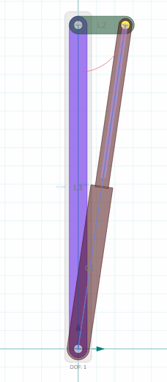
Design of Knee Prosthesis
Slider Crank Mechanism is drawn using MotionGen Pro
27 mm
Main Components of Prosthetic Knee Joint:
Frame
Knee Joint
MR damper
Knee Joint
177 mm
Frame
MR damper

Slide 51
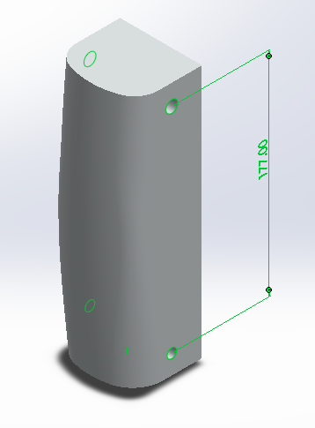
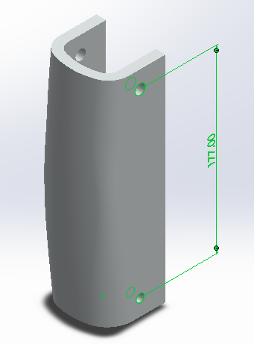
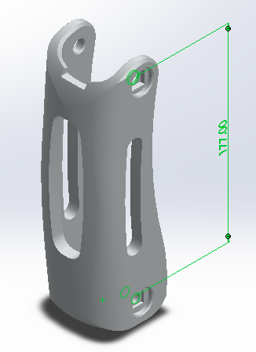
Design of Knee Prosthesis
1. Frame

Slide 52
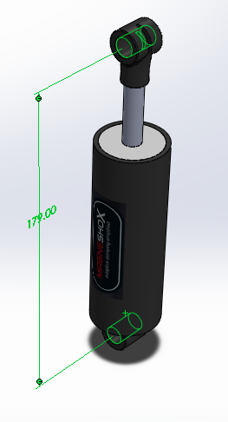
Design of Knee Prosthesis
2. MR damper

Slide 53

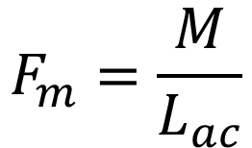







Design of Knee Prosthesis
F: Force exerted by the weight of the patient
F_{m}: Force required to generate moment
F
F_{m}
F_{mx}
F_{x}
L_{ac}
$$β$$
$$β$$
F_{my}
a
F_{y}
$$M=F_{m}× L_{ac}$$
c
β
$$α$$
$$F_{m}=\frac{M}{L_{ac}}$$
F_{d}
$$δ$$
L_{ab}
$$F=m_{body}×g$$
L_{MR}
R_{y}
The components of the force (F) directly depend on the angle of the knee joint(β).
R_{x}
b
$$F_{x}=F×\cos{β}$$
Free Body Diagram
$$F_{mx}=F×\cos{β}$$
$$F_{y}=F×\sin{β}$$
$$F_{my}=F×\sin{β}$$

Slide 54



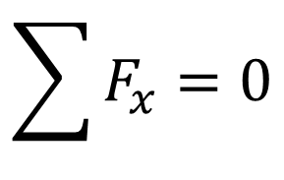
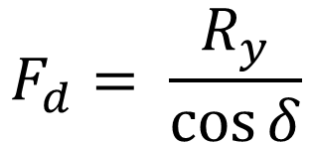





Design of Knee Prosthesis
F
F_{m}
F_{mx}
F_{x}
To find the value of the damping force (F_{d}) that necessary in actuator:-
L_{ac}
$$β$$
$$β$$
F_{my}
a
F_{y}
$$\sum{F_{x}}=0$$
c
β
$$α$$
F_{d}
$$F_{x}+ F_{mx} −R_{x}=0$$
$$δ$$
L_{ab}
$$Fcos⁡β+Fcos⁡β−R_{x}=0$$
L_{MR}
R_{y}
$$R_{x}=2Fcos⁡β$$
b
R_{x}
$$R_{y}=2F\sin{β}$$
$$F_{d}= \frac{R_{y}}{\cos{δ}}$$
Free Body Diagram

